Slide 1
The St. Louis Civic Tech and Data Collaborative NNIP Idea Showcase
February 16, 2017
John Cruz Data Management Coordinator, Rise Community Development

Slide 2
The Civic Tech and Data Collaborative
Created with grant from Living Cities
Funded by The MacArthur Foundation
Goal: to create a civic tech ecosystem to address a civic tech problem specific to St. Louis
Other cities received the grant and worked on issues specific to their area
St. Louis is focused on racial equity in the justice system and lowering the number of persons incarcerated over minor traffic fines in St.Louis County

Slide 3
Your STL Courts

Slide 4
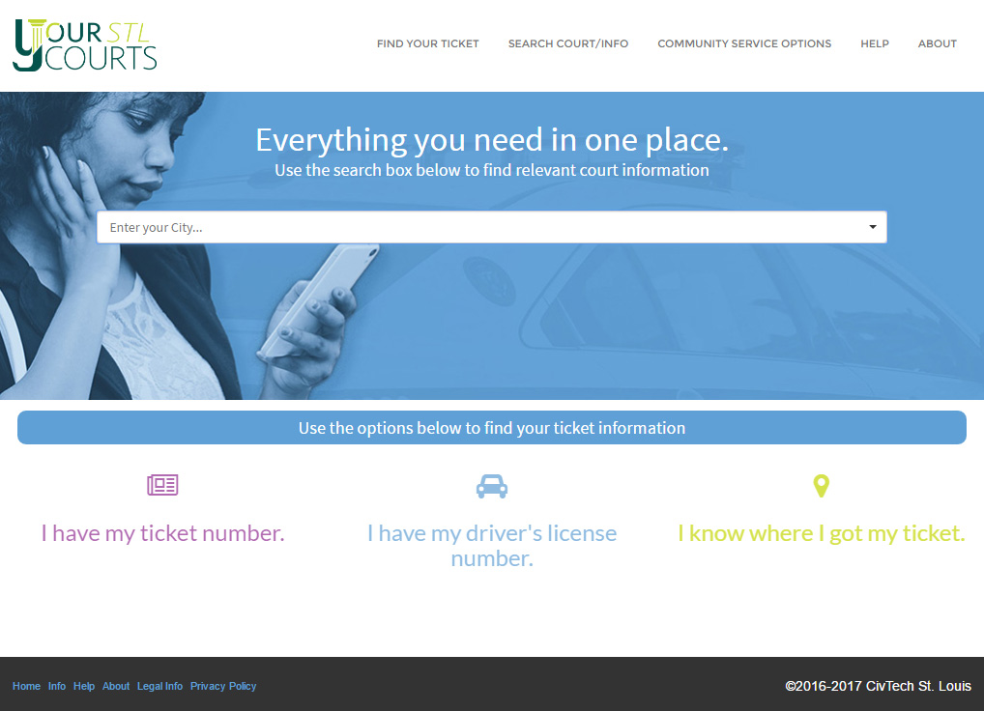

Slide 5
Program Architecture

Slide 6
Stakeholder Outreach
Public
Surveys outside court
Student focus group training
User testing
St. Louis County Library
Print materials
Police officer training
Judges and Clerks
Monthly newsletters/email blast (MailChimp)
Monthly steering committee meetings to gather input on outstanding questions and make decisions
Presentations at courts and monthly task force meetings
Distribution of marketing materials
Labor Day BBQ
E-survey
Coding Community
GlobalHack V
Hands Up United Tech Institute
LaunchCode
OpenDataSTL

Slide 7
Civic Tech St. Louis Ecosystem
St. Louis County
UMSL & other Unis
students
citizen focus groups
Racial Equity Activists
Arch City Defenders
MORE
MMACJA
MACA
Other STLCO munis
Other counties & munis
Apple Core Creative
Radio One
Newspapers
Missouri Supreme Court
REJIS, Tyler Tech, other vendors
OSCA
STL Tech Community
Blog
Newsletter/eblasts
Events
St. Louis County Public Library
Forward Through Ferguson
Living Cities
LaunchCode
OpenDataSTL
Venture Café/Cambridge Innovation Center
Hands Up United
Cohort Cities
Learning Partners
NNIP
Code for America

Slide 8
Challenges
Over 90 municipalities, multiple major court software vendors handing their database
Getting vendors and municipalities to agree to share their data
Staff turnover and change of roles, both internally and externally.
Software development time
Building political alliances

Slide 9
Thank you!
Follow-Ups:
Johnc@risestl.org
Civtechstl.com

