Slide 1
User-Centered Design of Property Dashboard
An update
Steve Saylor

Slide 2
Western Pennsylvania Regional Data Center
10 yrs of tech assistance.
12 property datasets over 2 publishers
We learned that people want
Linked data on property conditions.
To find investor owners
To make custom maps
www.wprdc.org | @wprdc | www.github.com/wprdc

Slide 3
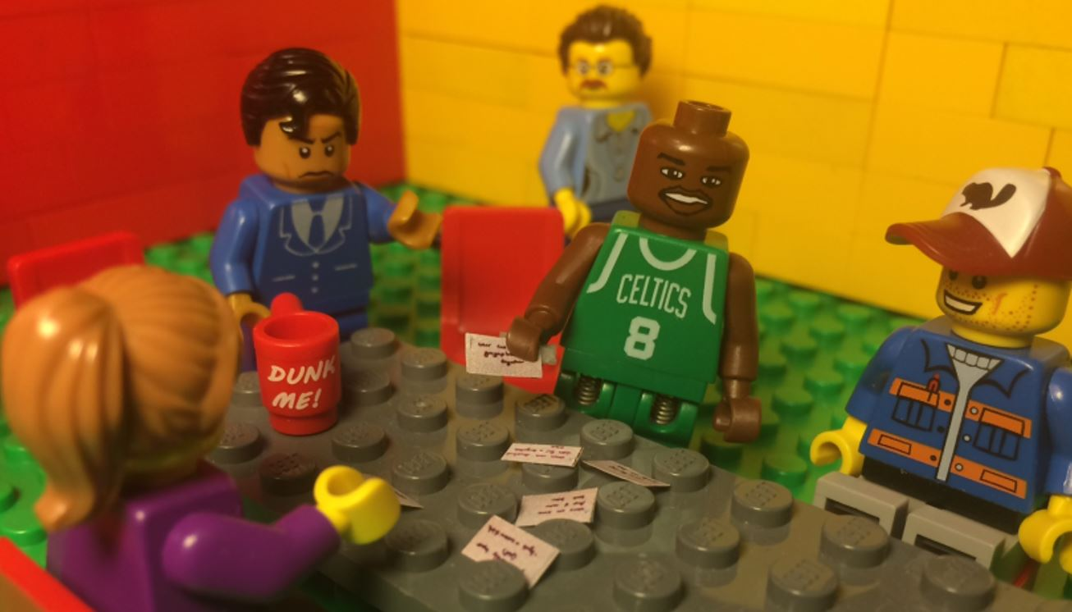
First User Group Meeting
What problems do users have with accessing the data?
What do they currently do to solve these problems?
Do current tools seem like they’d be useful?

Slide 4
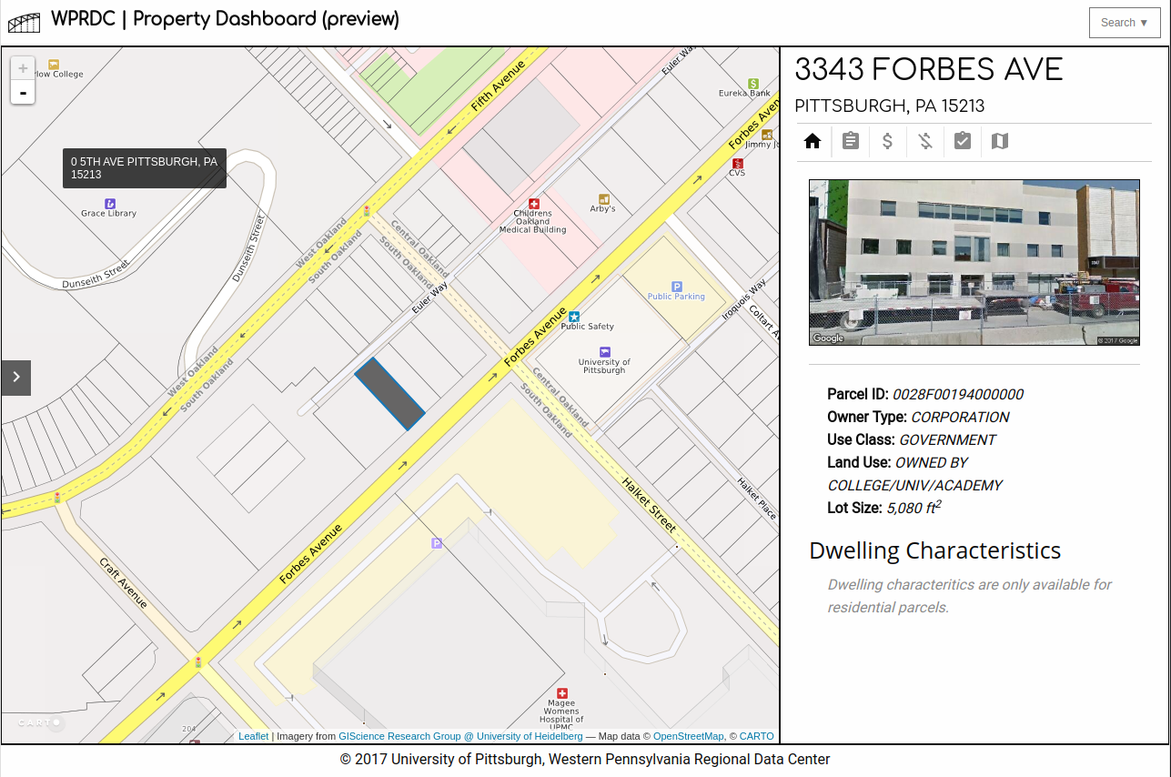
Developed Prototype

Slide 5
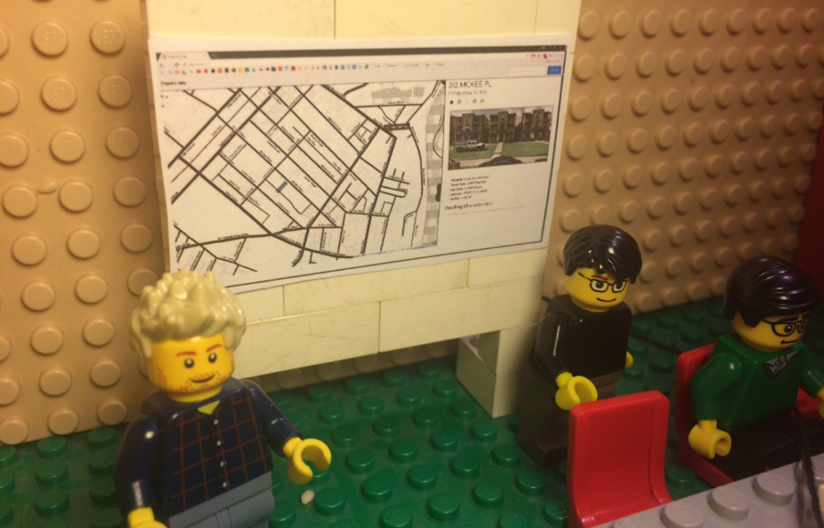
Second User Group Meeting
Preview of new tool.
Group discussion and feedback.
Card sorting exercise.

Slide 6
Personas
Archetypes of our real-life users.
Shows their motivations and constraints.
Used to inspire internal brainstorming
Notes:
Shown at Indy

Slide 7
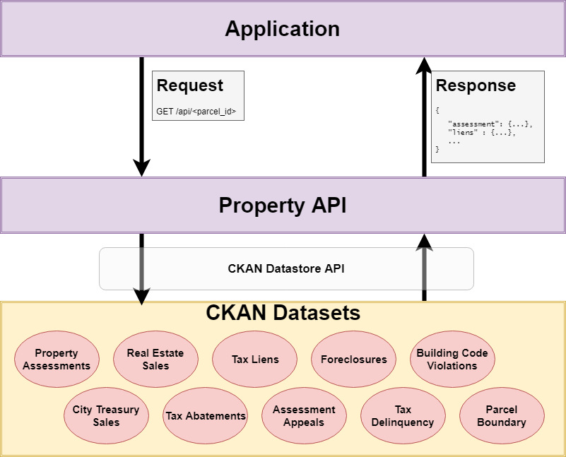
Current Features
Linked data on side
Style map using variables
Highlight common owners on map
Notes:
Add gif of highlight similar

Slide 8
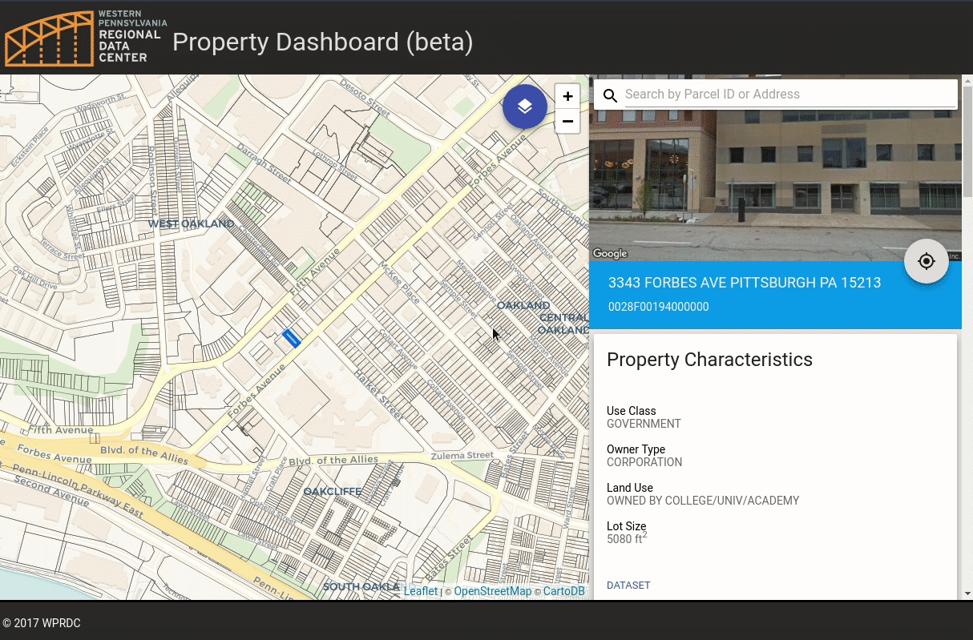
Current Features
Linked data on side
Style map using variables
Highlight common owners on map
Notes:
Add gif of highlight similar

Slide 9
Current Features
Linked data on side
Style map using variables
Highlight common owners on map
Notes:
Add gif of highlight similar

Slide 10
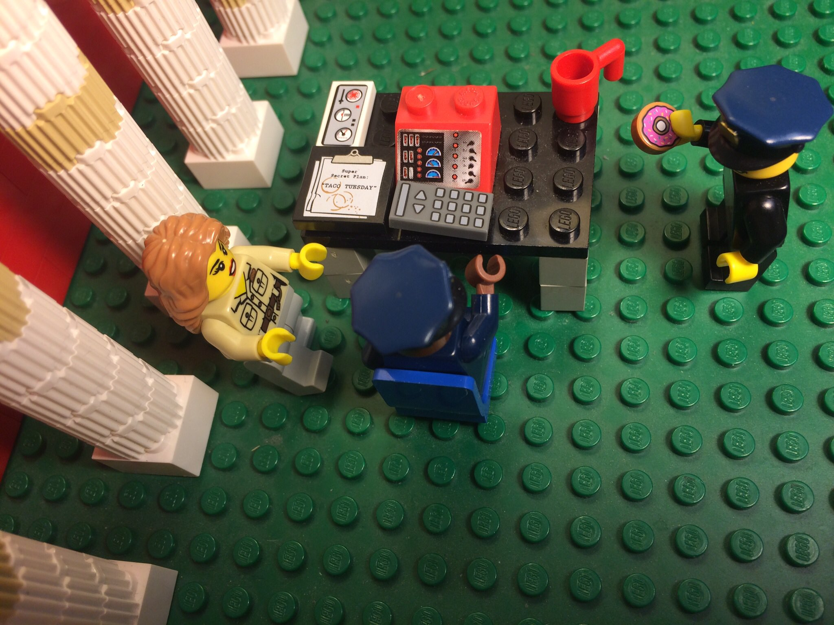
User Testing
At latest (3rd) User Group Meeting.
Following Chicago’s Civic User Test (CUT) method.
Tested users of various experience.
Observed users as they attempted a set of predefined tasks.

Slide 11
Takeaways
Planned Improvements
Users wanted more instructions and definitions.
We assumed users knew more mapping terms.
We assumed some components were more intuitive than they were.
Users found some bugs that I never noticed.
Provide user guide with definitions and tutorials.
Provide examples of different map styles in the guides.
Add tooltips for buttons that previously had only a symbol.
Moved bug fixes to front of roadmap.

Slide 12
Steve Saylor | steven.saylor@pitt.edu | @saylor_sd
Thank you!
📱 Hit me up! I’m always looking to collaborate.
Find all of our tools at: https://tools.wprdc.org
Persona examples: https://goo.gl/6Tq6Sv
Our user test worksheet: https://goo.gl/iu9ewB
Chicago’s NNIP CUT talk: https://goo.gl/fJ5rma
User Group/Test blog post: https://goo.gl/qZ9Fgs
Sunlight Foundation’s Tactical Data Engagement Playbook (User Groups): https://goo.gl/VnHbpf

