Slide 1
Bexar Data Dive
PLATFORM overview
Community Information Now (CI:NOW)

Slide 2
CI:Now
Community Information Now
Nonprofit local data intermediary
Our Mission: Improve lives & decrease disparities through democratized data.

Slide 3
Bexar Data Dive
Beginner friendly!
With the option to take a deeper dive into the data
Data sources: Census, ACS, local, state and national
Data is regularly added and updated
Office of Minority Health (OMH) grant
Notes:
Born out of this ‘data democratization movement’
The grant: OMH awarded us a grant to design and implement a data platform which will give users access to health and social determinants of health data.
Long term goal = Reduce health disparities by providing organizations, nonprofits, government entities, and businesses with an easy way to access health information and use it to inform decisions and policy
OMH (of the US Dept of HHS)
BDD general purpose: Offer data users access to multiple indicators and data sources in one place. We have designed it to be useful to beginner, intermediate, and advanced data users – and we hope that we can improve the health outcomes of Bexar County, especially those in marginalized populations.

Slide 4
SSAs
= Statistical Small Areas
Better reflect our real neighborhoods/barrios
Cluster analysis of demographic variables:
Race/ethnicity
Educational attainment
Mobility
Income
Housing
Age
Notes:
SSAs = “new geographic measure” = meaningful regions across Bexar County
As opposed to zip codes, census tracts, etc.
Cluster analysis – income, housing, educational attainment, mobility, race/ethnicity, age

Slide 5
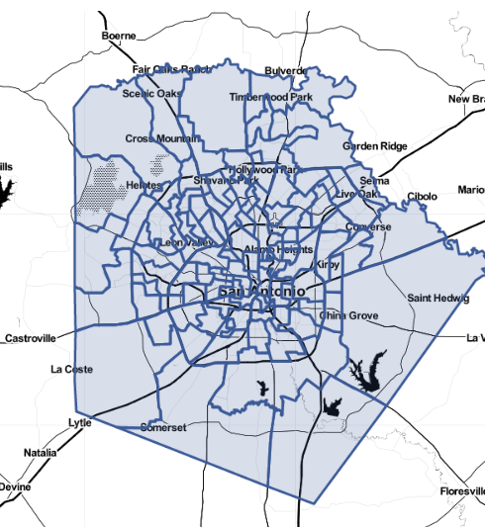
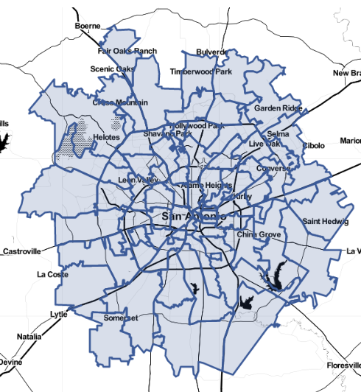
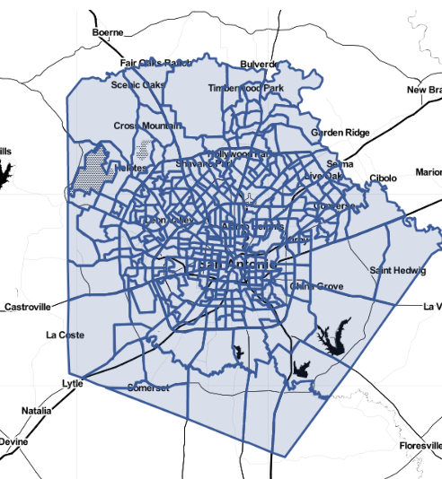
Community Types
SSAs
Zip codes
Census tracts
dive.cinow.info

Slide 6
dive.cinow.info

Slide 7
BDD: General Navigation
Notes:
3 cards (tools) + respective explanations (for 3 different ways to explore data)
My community = easiest and quickest way, ONLY TWO CLICKS!
Explore Data = deeper dive, will explore more later
Tables and Downloads = Access to downloadable data as a spreadsheet
Left menu (all 3 tools also accessible through there + additional navigation options)
SPANISH site is live!

Slide 8
BDD: Explore Data Example
Notes:
Basically: Deeper dive into data using “data visualization” and filtering
Featured indicators (Ranked by what’s popular on the site)
Top bar navigation (shows all available indicators by category, anything gray is in the works)
*search by key word also available (e.g. median household income)
Example: Household income (median) | 1307 | VS 1915.04
Title (indicator)
Filters (must click on “apply filter”)
Gets ‘bordered’ on the map
Color key
Now viewing (changes as you hover over the map)
Data visualized in 3 ways:
Maps (by geography)
Trends (by time)
Comparison (by variable)
Extra navigation options: (available for all 3 visualizations)
Labels, Downloads, Share the link (will preserve all information collected) & “About the indicator/tool”
*Available for each of the tools!!
Notes on comparison:
Just 16 miles apart, but income is 13X different
“High income segregation has been shown to harm whole cities, not just low-income areas”
Data tip: "median" household income is the cutpoint at which half of household incomes are higher and half are lower. That means half of households in 1915.04 have an income HIGHER than $217K, and half of households in 1307 have an income LOWER than $17K.

Slide 9
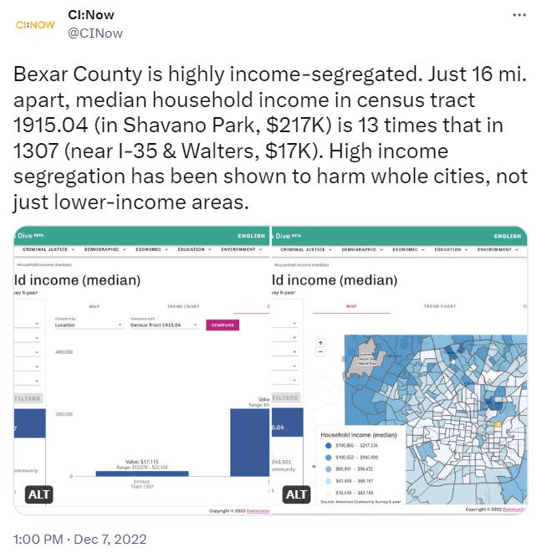
Follow us!
Twitter | @ CINow
Instagram
Facebook | Community Information Now
Linked In
Newsletter | cinow.info/newsletter-signup/

Slide 10
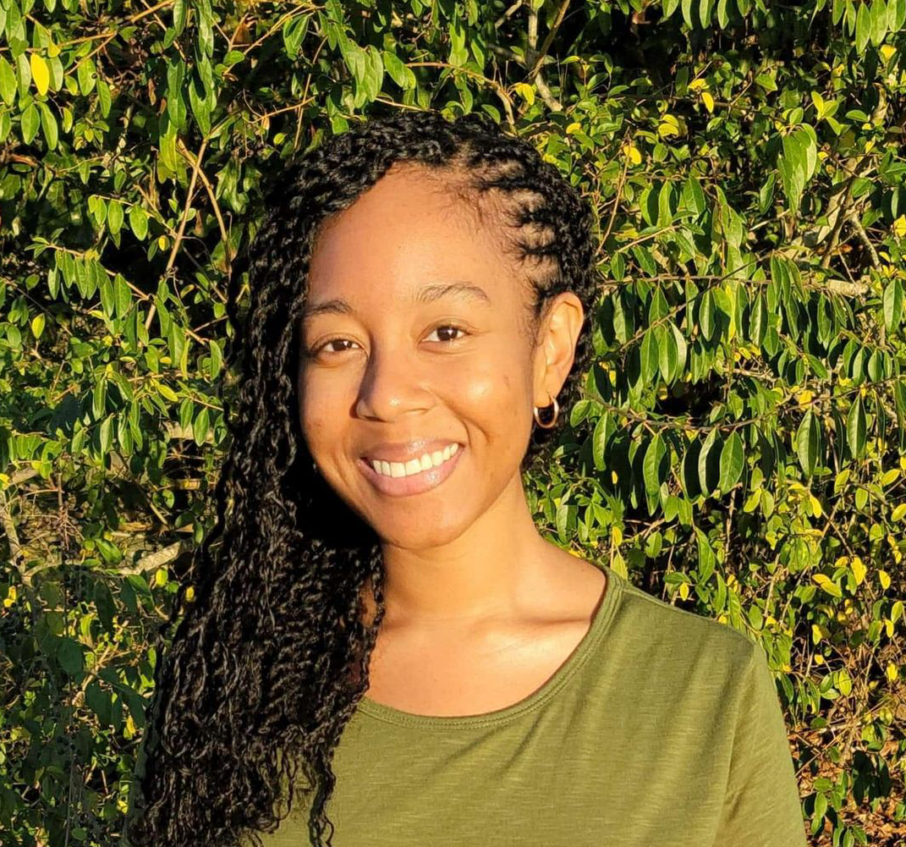
Meet the team!
Laura McKieran, DrPH
Executive Director
Laura.C.McKieran@uth.tmc.edu
Jeremy Pyne, MPA
Project Manager
Jeremy.D.Pyne@uth.tmc.edu
Danequa Forrest, PhD
Research Coordinator III
Daneque.Forrest@uth.tmc.edu
Cristina Martinez, MPH
Research Coordinator III
Cristina.E.Martinez@uth.tmc.edu
Natalia Rodriguez, MPH
Research Coordinator II
Natalia.D.Rodriguez@uth.tmc.edu
Jeanette Parra
Training Specialist II
Jeanette.Parra@uth.tmc.edu

