Slide 1
Using Data To Learn About Our Young Children: Mapping Early Development Instrument (EDI) Results in Miami-Dade County.
Zafreen Jaffery, Ed.D.

Slide 2

Use of Early Development Instrument (EDI) data to inform policy and practice
Notes:
What is EDI?
What does the EDI data tell us about our children?
How has EDI informed local action in Miami?

Slide 3

The Early Development Instrument (EDI)
Notes:
A population based tool used to collect data on children’s kindergarten readiness. Through a partnership with MDCPS, we collected 20, 656 EDIs from kindergartners, from 207 public schools here in the County.
The EDI measures the percentage of kindergartners in a school and a neighborhood who are on track or vulnerable in five developmental domains.
Results are mapped to illustrate children’s developmental status across specific geographic areas.
Five Domains of EDI are: Physical health and well-being; social competence; emotional maturity; language and cognitive development; communication skills and general knowledge.
Reports on 16 sub-domains.

Slide 4
Domain | Description | Question Examples
Social Competence | Child plays, gets along with others and shares, is self-confident | Follows rules and instructions Takes care of school materials Ability to get along with peer
Notes:
The EDI also reports on 16 subdomains so that communities can better understand the nature of the strengths and vulnerabilities of children in various neighborhoods
For instance within the Social competence domain there are four subdomains. These include:
Respect and responsibility
Independence and adjustment
Readiness to explore new things
Overall social competence with peers
An example of an item in the respect and responsibility domain is: Student respects the property of others with response options being often, sometimes, or never true.

Slide 5
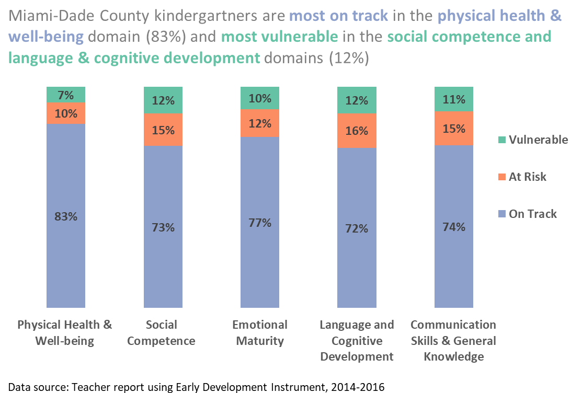
Notes:
What does the EDI data tell us about our children?
Kindergartners are most on track in physical health and well-being (83%)
Most vulnerable in social competence and language and cognitive domain (12%)

Slide 6

Where do children need the most help based on geographic region and developmental domain?

Slide 7
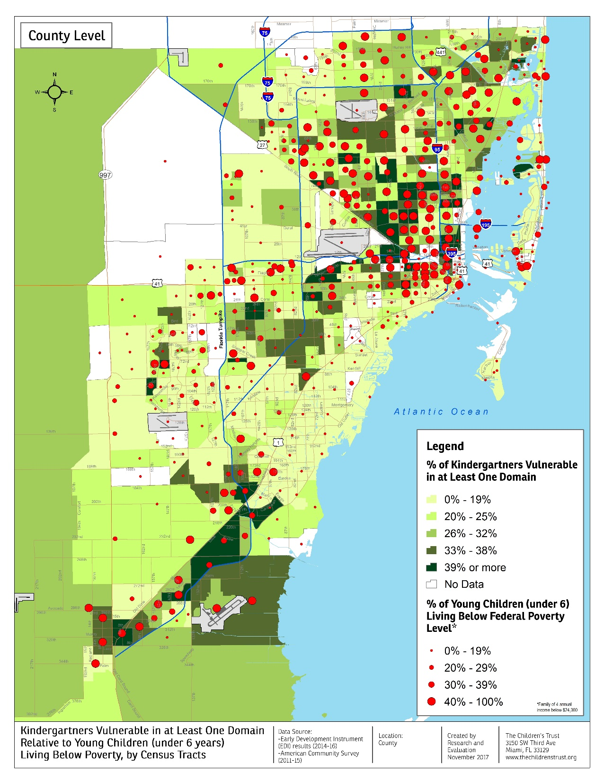
Notes:
What does the EDI data tell us about our children?
This map has a few layers:
The base of the map, rectangular and square shapes are census tracts,
The color indicates the % of children that are vulnerable in at least one of the five EDI domains
Lighter shade is 0-14% are vulnerable, darkest shade of green is 36-70% of children living in the neighborhood are vulnerable
The red circle indicate that % of young children under 6 living below federal poverty level
Each circle is housed in a census tract so indicative of children in poverty in that census tract
The smaller the circle the lesser the percentage of children living below poverty
The larger the circle the higher the percentage of children living in poverty
The largest red circle indicates that 40-100% of children in that census tract live below federal poverty level which is income below $24,300 for a family of four.
We see a lot of large red circle and a lot of dark green coexist on this map, meaning the higher the percentage of poverty and higher the percentage of children vulnerable in more than one domain

Slide 8
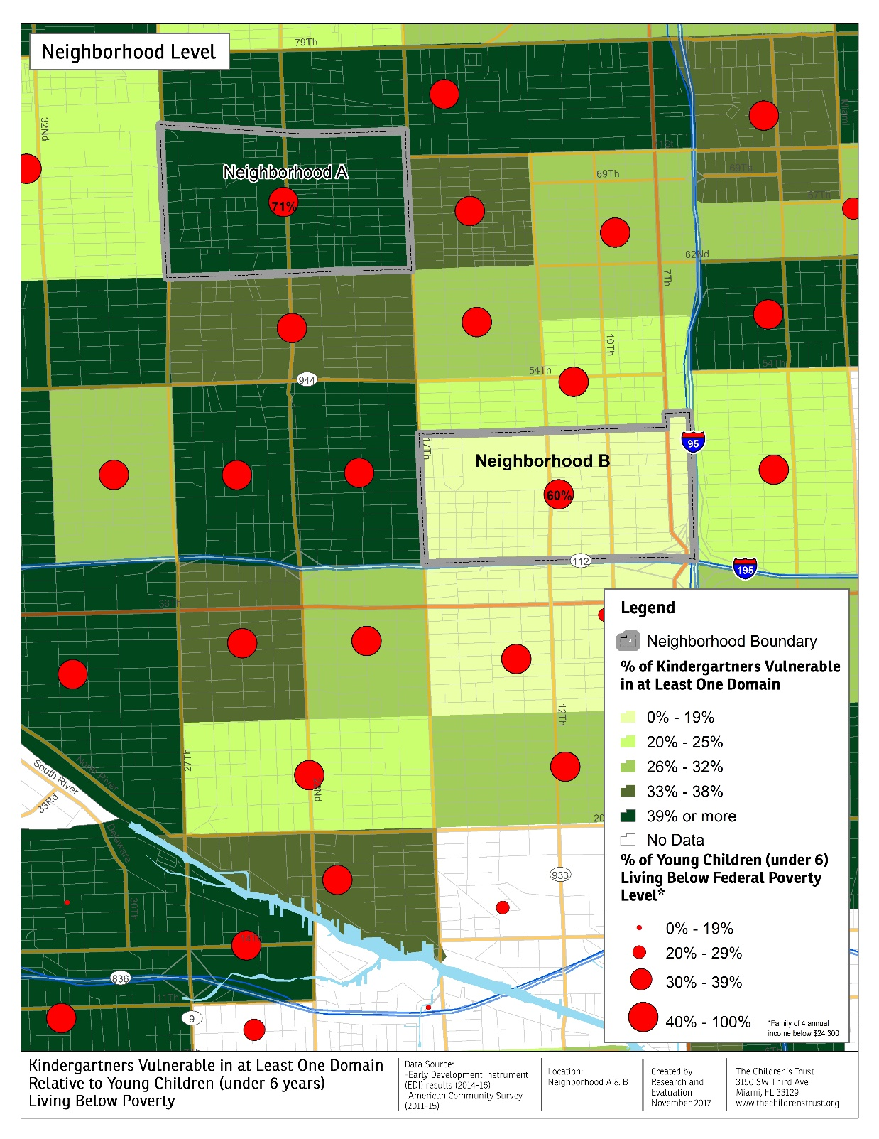
Notes:
Where do children need the most help? If we zoom in the northern part of the County, we see a relationship between poverty and vulnerability in more than one domain
We also see some anomalies where if you zoom in at neighborhood B, with 60% of children below federal poverty, there are 14% or less are vulnerable in more than one EDI domain.
We are interested in working with the communities to find out what are some protective factors that allow for lower % vulnerability in developmental domains where there is high poverty. What social services, programs or other factors contribute to that?
We are also beginning to look at some of this neighborhood data with other community indicators to see relationships such as % of children who read at 3rd grade reading levels.

Slide 9
Action steps from what we have learned
Mapping areas where there is need for more services and directing funding
Conducting further analysis to guide policy and funding decisions
Notes:
Need to conduct further analysis: what is the relationship of poverty and vulnerability
Perhaps correlate the EDI data with other vulnerability indexes
For now, we have specified a grant that is currently looking at improving children’s Birth -5 social emotional outcomes
Currently also applying to leverage funds to provide targeted language and literacy supports in some neighborhoods

Slide 10



Questions

