Slide 1
Addressing neighborhood public safety inequities through data-informed investment
Sharon Kandris, Associate Director, The Polis Center at IUPUI
May 4, 2021
IUPUI
Notes:
Sharon Kandris –
Polis mission, SAVI

Slide 2
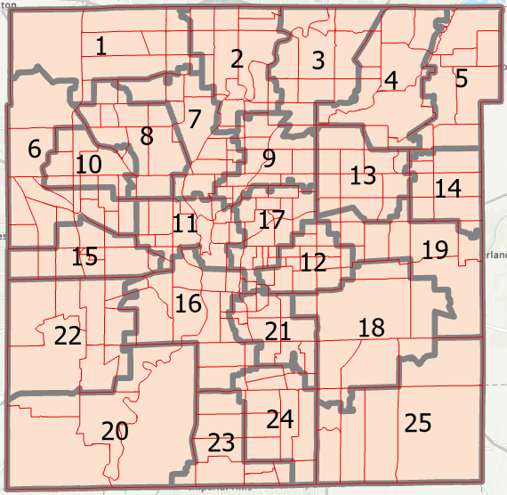
Indianapolis-Marion County 25 City-County Council Districts
Notes:
With a population of 965,000, the county is divided into 25 city-county council districts. The council historically distributed grant funds equally across districts. It wanted to change to an equitable allocation model – putting more funding where it is needed most.

Slide 3
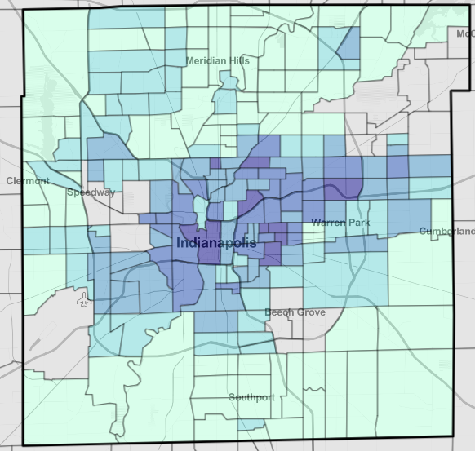
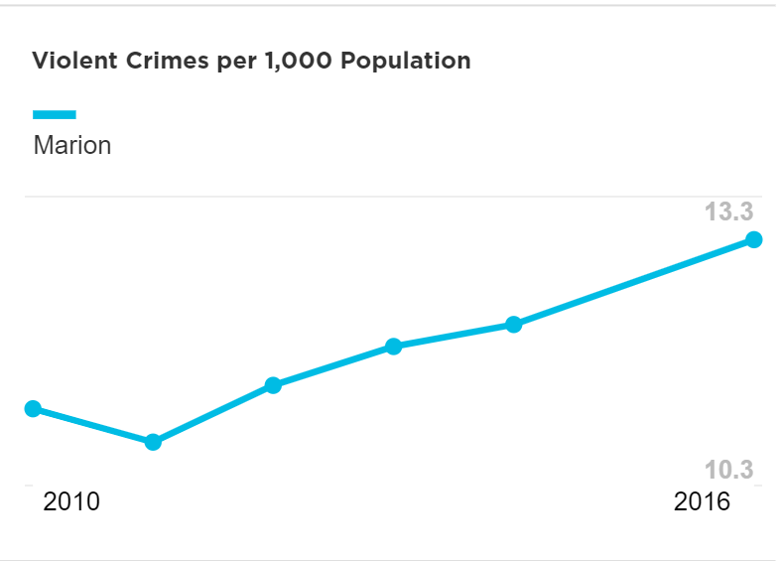
Violent Crimes per 1,000 Population
Notes:
With violent crimes increasing 22% in the past 5 years, and the recognition that some neighborhoods are more impacted than others, the council wanted to address these disparities by equitably investing $1.2 million in public safety grants. It wanted to focus on grass roots crime prevention and reduction efforts that will address factors relating to increasing violence. It sought our team’s expertise to help them make a data-informed decision.

Slide 4
Our Approach
Created a district-level model that takes into account social determinants of crime
Shared findings at council meetings and public safety committee meetings
Created district-specific reports
Helped district councilors dig into the data to establish district-specific priorities
Notes:
aimed to identify the council districts with greatest need and to develop a model for unbiased, equitable public safety funding. With input from committee members and stakeholders, Polis built an equity model and developed a new violent crime index using data from the SAVI Community Information System. Polis presented the results of the SAVI-based analysis to the council caucus and later at a public meeting of the council’s Public Safety and Criminal Justice Committee.

Slide 5
Violent Crime Index
1
Social Determinants of Violent Crime Score
2
Violent Crime Score
1b. Neighborhood Segregation
1a. Neighborhood Disadvantage
2a. Violent crime rate
Overall model design and analysis by The Polis Center. Original source data used in analysis of each component is cited.
Notes:
Measuring Need for Violence Reduction – where are those communities that have disproportionally more violent crimes intersected with those communities that are already socio-economically disadvantaged.
the research team selected these components based on what the literature suggests are predictors of violent crime (we provide several citations at the end)
So the model has two components – want to look beyond just the violent crime score to also take into account the layering effects of things like neighborhood disadvantage.
Neighborhoods that are disadvantaged are more likely to experience violent crime but also are less resilient to trauma such as violent crimes.
SDOV – based on predictors from the model

Slide 6
Social Determinants of Violence 1a. Neighborhood Disadvantage Variables
1
Social Determinants of Violent Crime Score
1a. Neighborhood Disadvantage
% unemployed (2014-18 average)
% below poverty
% receiving public assistance (TANF or SNAP)
% single-parent
% with no high school diploma
Data Source: ACS via SAVI
Notes:
To start out, I’ll talk about the variables we include in the model and how we define each component
Again – the research team selected these variables based on what the literature suggests about social determinants of violent crime (we provide several citations at the end)

Slide 7
Social Determinants of Violence 1b. Neighborhood Segregation
1
Social Determinants of Violent Crime Score
1b. Neighborhood Segregation
Racial Segregation
Black-white isolation is when these groups live in communities that are geographically separated, so have limited exposure to each other.
0=not isolated, 1= completely isolated
Economic Segregation
Worker earnings can be clustered in regions or spread evenly. This measure detects earnings clusters within tracts, compared to the spread in each district.
0= no clustering (spread evenly), 1= completely clustered
Data Source: ACS via SAVI
Notes:
Multiple studies have indicated that both income segregation and race segregation in large U.S. cities are predictive of violent crime rates, likely as
markers of generations of unremediated structural discrimination.
We look at spatial relationship to each other – isolation
The isolation measure we use only allows comparison of two groups at a time.
So our measure of racial segregation uses only two race groups: black and white
residents. A score of zero means each group is equally distributed across the
district and there is no segregation. A score of 100 means there is maximum
segregation.
The measure of income segregation compares the variation in the earnings
of full-time workers within the district to the variation in earnings in the
metropolitan area. A score of zero means there is no segregation. This district
has the same income mix as the region overall. A score of 100 means there
is total segregation. No households would have a neighbor with a different
income than its own.
Economic Segregation (see p9-10)
https://s4.ad.brown.edu/Projects/Diversity/data/report/report10162013.pdf
(from Census) Theil Index: “The entropy index (also called the information index) measures the (weighted) average deviation of each areal unit from the districts area's "entropy" or racial and ethnic diversity, which is greatest when each group is equally represented in the metropolitan area.”
Isolation/exposure Index example visualization
https://www.census.gov/hhes/www/housing/resseg/fig2-1b.html
(from Census) “The isolation index measures ‘the extent to which minority members are exposed only to one another,’ (Massey and Denton, p. 288) and is computed as the minority-weighted average of the minority proportion in each area.”

Slide 8
Scoring each Variable
District 13
 | District 1 | District 13
Unemployment Rate (2014-18 average) | 3.8% | 17.4%
Percentile Score | 12.5 | 100
District 1
Notes:
Once we have a district calculation for each variable, we then we have to standardize all of the variables in the model so that they can be compared and added together.
A score of 0 means you’re at the very bottom of all districts (District 25), a sore of 100 means you’re at the very top (District 13)
District 1 has a higher unemployment than 13% of other districts
District 13 has a rate higher than 100% of other districts

Slide 9
Neighborhood Disadvantage
District # | % un-employed Percent rank | % below poverty Percent rank | % public assistance Percent rank | % single-parent Percent rank | % w/o high school diploma Percent rank | N’hood Disadv SUM
1 | .13 | .33 | .29 | .38 | .17 | 1.3
13 | 1.00 | .92 | .96 | .96 | .79 | 4.63
1 = the district ranks highest for that variable
0 = the district ranks lowest for that variable

Slide 10
Social Determinants of Violence
District # | Neighborhood Disadvantage sum | Segregation sum | = Soc Detrm of Violence Sum | Soc Deter of Violence Score (percentile rank of sum)
1 | 1.3 | 1.04 | 2.34 | 33
13 | 4.63 | 1.79 | 6.42 | 100

Slide 11
Social Determinants Score
District 13
District 1: 33
District 13: 100
District 1
Notes:
This is a way of standardizing all of the variables in the model so that they can be compared and added together.
A score of 0 means you’re at the very bottom of all districts (District 2), a sore of 100 means you’re at the very top (District 13)
District 1 has a crime rate higher than 8% of other districts
District 13 has a rate higher than 100% of other districts

Slide 12
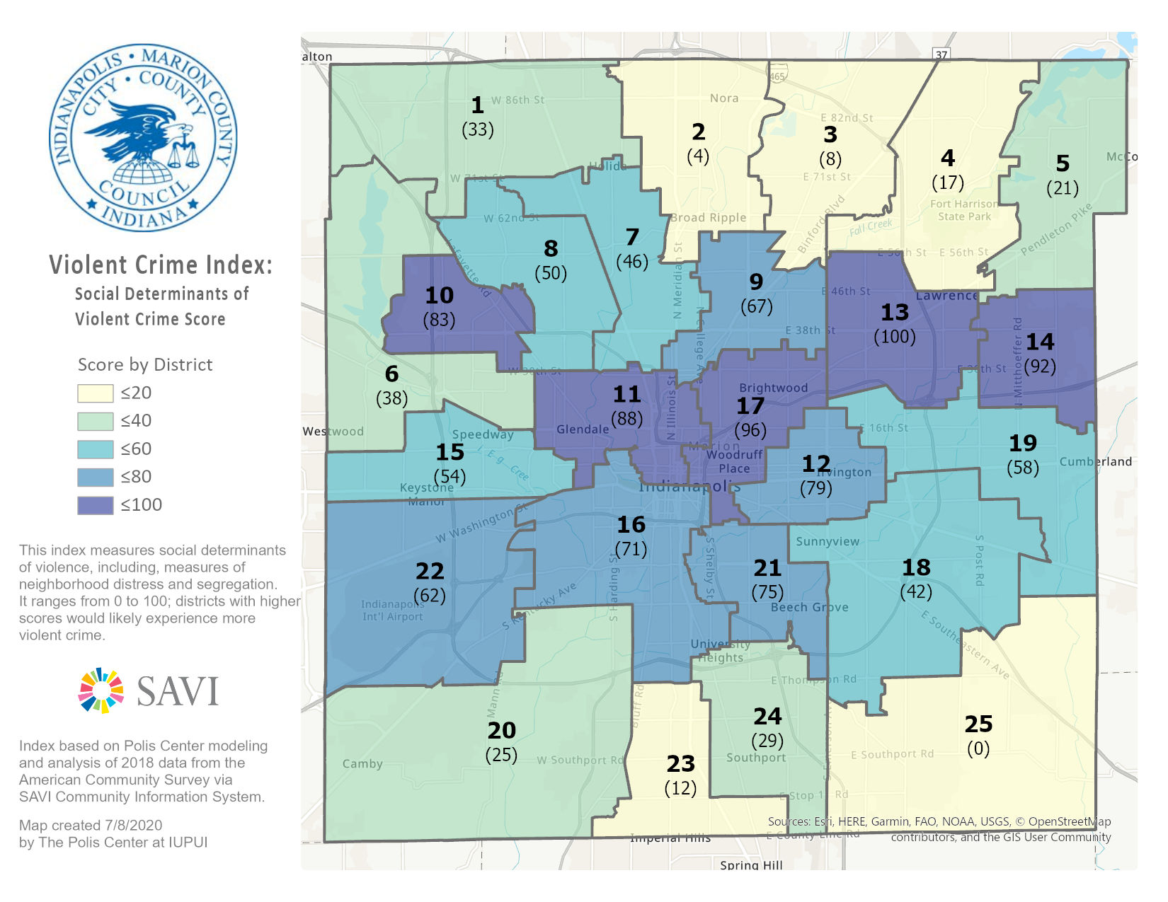

Slide 13
Violent Crime Score
2
Violent Crime Score
Percentile Rank of Violent Crime Rate
District 1: 42
District 13: 83
Data Source: IMPD via SAVI, FBI

Slide 14
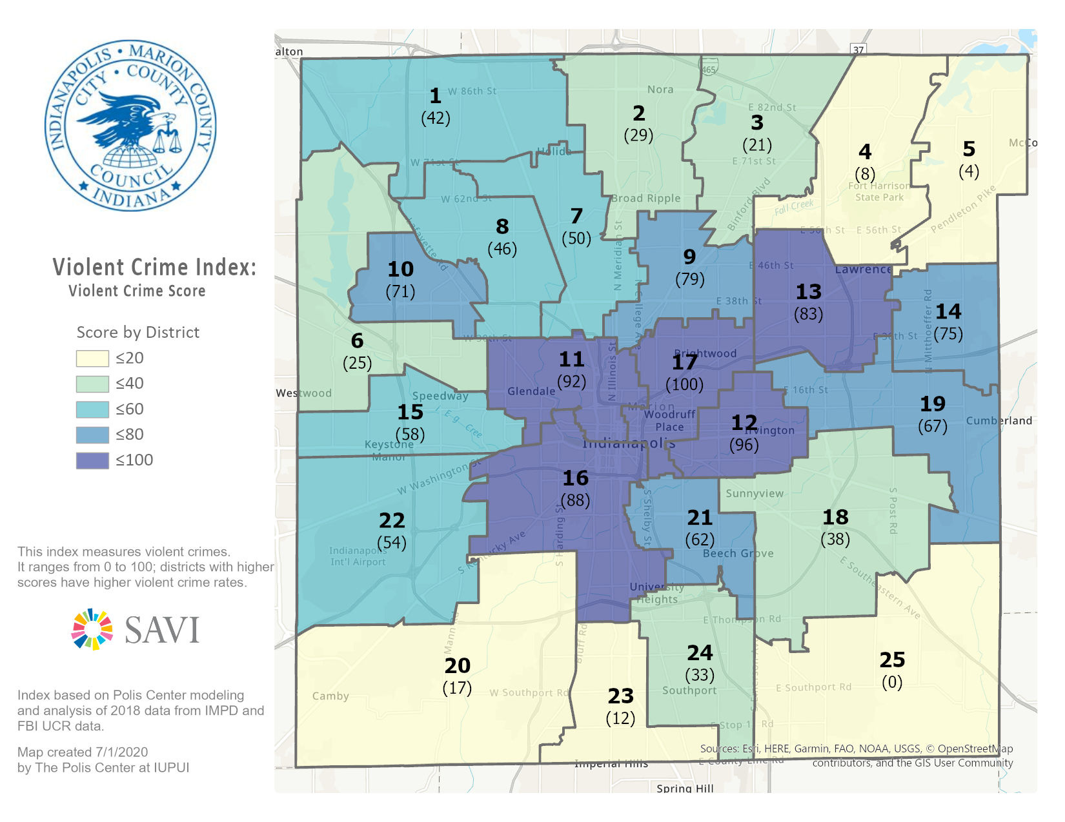
Index

Slide 15
Violent Crime Index
1
Social Determinants of Violence Score
2
Violence Crime Score
Percentile
Rank of
Sum =
Overall
Violence Crime
Index

Slide 16
Violent Crime Index
FINAL SCORE
District 1: 38
District 13: 96

Slide 17
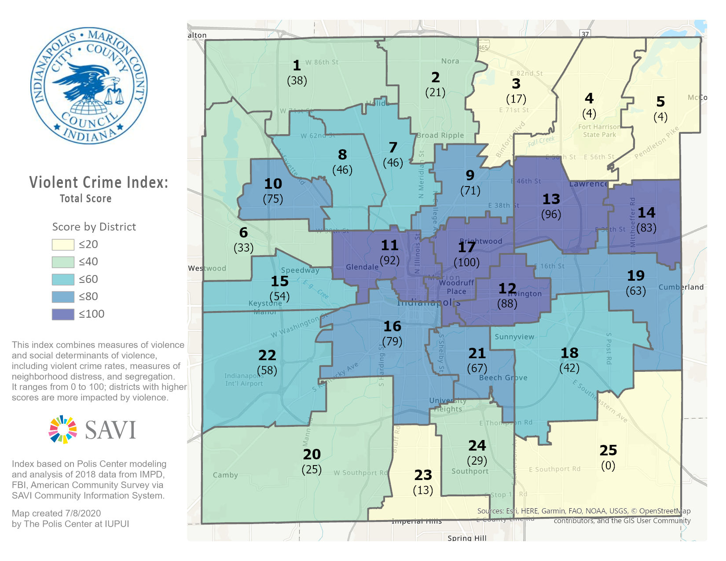

Slide 18
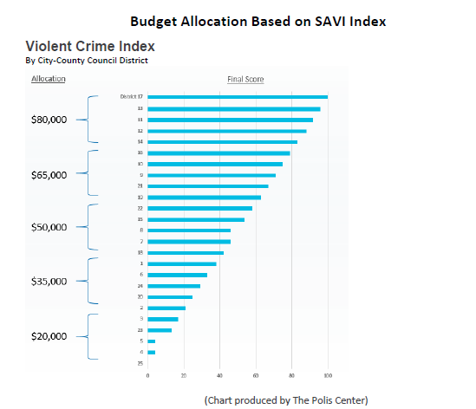

Slide 19
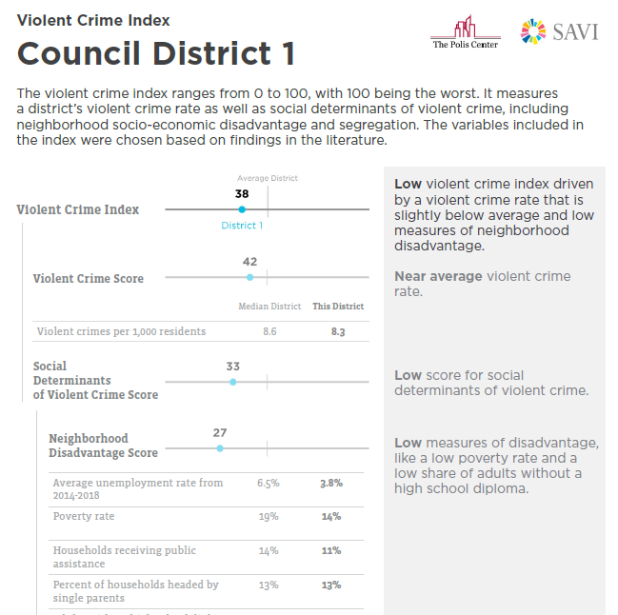
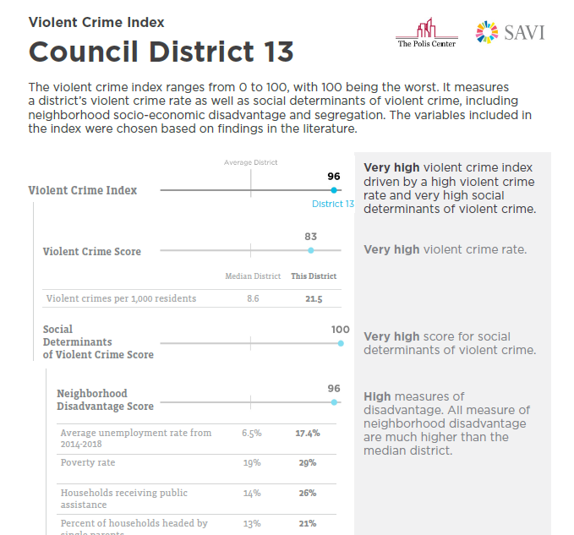
Notes:
Created report for each district (show example)
Provided tech support in interpreting and using the data in the details of the index and SAVI profiles (other factors and existing assets) to prioritize needs in their district
No district is the same in terms of its challenges and existing assets – and these data helped the councilors prioritize needs based on these data.

Slide 20
Results
Equity-driven policy
Equity-driven funding allocations
Community priorities informed by data
Increased awareness (public and across local government) of racial and geographic disparities in violence, social determinants, and other related factors
New grant program announced in April 2021 - Council District Crime Prevention Grants Program
City Office of Public Health and Safety, City-County Council, and Central Indiana Community Foundation
Based on the priorities established by councilors

