Slide 1
Etienne Laurent/EPA, Shutterstock
Climate Change and Environmental Justice: Opportunities for Local Data
Sara McTarnaghan
Anne N. Junod

Slide 2
Agenda
Environmental and Climate Justice 3
Role and Use of Data 4
Partner Spotlight: Data Driven Detroit 9
Self and Small Group Breakout 13

Slide 3
Environmental and Climate Justice

Slide 4
What’s at Stake
Climate and Environmental Justice
Climate change is a barrier to advancing equity and upward mobility
Impacts from climate change require a reimagining of physical, economic, and social infrastructure systems and investments
This presents an opportunity to redress past patterns of exclusion and disinvestment in many BIPOC, immigrant, and low income communities – considering both amenities and dis-amenities.
There is a huge role for local data!
Notes:
Anne

Slide 5
Key-Terms
Climate and Environmental Justice
Environmental Justice: the equitable exposure of all people to both environmental benefits and harms
Adaptation: taking action to prepare for and adjust to climate change
Mitigation: actions limiting the magnitude and rate of future climate change by reducing greenhouse gas emissions
Resilience: capacity of a system to maintain function in the face of stresses and shocks and to adapt the system to be better prepared
Notes:
Anne

Slide 6
Hazards are acute and chronic and cumulative impacts matter.
Climate and Environmental Justice
Disasters: punctuated and acute events, such as flooding, wildfire, severe heat or cold, hurricanes, derechos, etc.
Chronic exposure: air pollution, contaminated drinking water, heat , etc.

Slide 7
Climate change and EJ intersects with well-being across all domains.
Climate and Environmental Justice
Housing: disaster resilience, emissions reductions, indoor air quality, energy efficiency
Children: exposure to disasters and enviro stress can cause health, cognitive, social, and psychological impacts.
Job Markets and labor force: job and industry change and displacement, workforce safety, construction needs for recovery

Slide 8
The impacts are highly localized to neighborhood scale.
Climate and Environmental Justice
Environmental amenities and dis-amenities are often clustered in cities, following other patterns of segregation and exclusion.
Communities vary in capacity for recovery post-disaster.
Maladaptation may further aggravate these inequalities

Slide 9
The federal landscape is changing rapidly and input from local partners is urgently needed.
Climate and Environmental Justice
Agency climate plans
Justice40 Initiative
Inflation Reduction Act
EPA Office of Environmental Justice
New RFIs to shape design programs
Ex. HUD’s green and resilient housing program

Slide 10
Yet, much of the innovation and leadership continues to be local.
Policy influence via networks and advocacy such as c40 cities and Mayor’s Migration Council
Innovation in building regs and policy environment
New staffing to address challenges: heat and resilience officers

Slide 11
Role and Use of Data

Slide 12
Why is Data Important?
Role and USE Of data
Prioritizing investments, populations, programs, initiatives
Measuring harms and benefits
Accountability for plans, goals, and outcomes
Gauging impact

Slide 13
What and How to Measure?
Role and USE Of data
Indicator or Measure What you’re measuring | Metric How you measure it
Heat Air Quality Climate Change | Historical extreme heat days Number of extreme heat days per year above 90th percentile (NASA’s Land Data Assimilation System data) PM 2.5 levels in the air Annual average of particulate matter larger than 2.5 µg/m^3 (EPA’s Office of Air and Radiation data) Expected building loss, agricultural loss, and/or population loss from environmental hazards linked to climate change Building value, agricultural value, or rate of population injury or fatalities annually from avalanche, coastal flooding, cold wave, drought, hail, heat wave, hurricane, ice storm, landslide, riverine flooding, strong wind, tornado, wildfire, and winter weather (FEMA’s National Risk Index data)
Tradeoffs:
Metric choice, data scale and availability (rural/urban, neighborhood), data recency, data bias (e.g., race)

Slide 14
Data Sources
Role and USE Of data
Climate and Environmental Hazards
Air quality (indoor and outdoor), water quality, toxic exposure (industrial, air, point source), lead, asbestos, extreme heat, extreme precipitation, floodplain, wildfire, drought…
Social and Health Vulnerability
Low income status, BIPOC status, physical health risks (cardiopulmonary, cancer, asthma, diabetes, etc.), psychological health, language isolation, immigrant status, birth outcomes (mortality, birth weight), children under age 5…(CDC list)

Slide 15
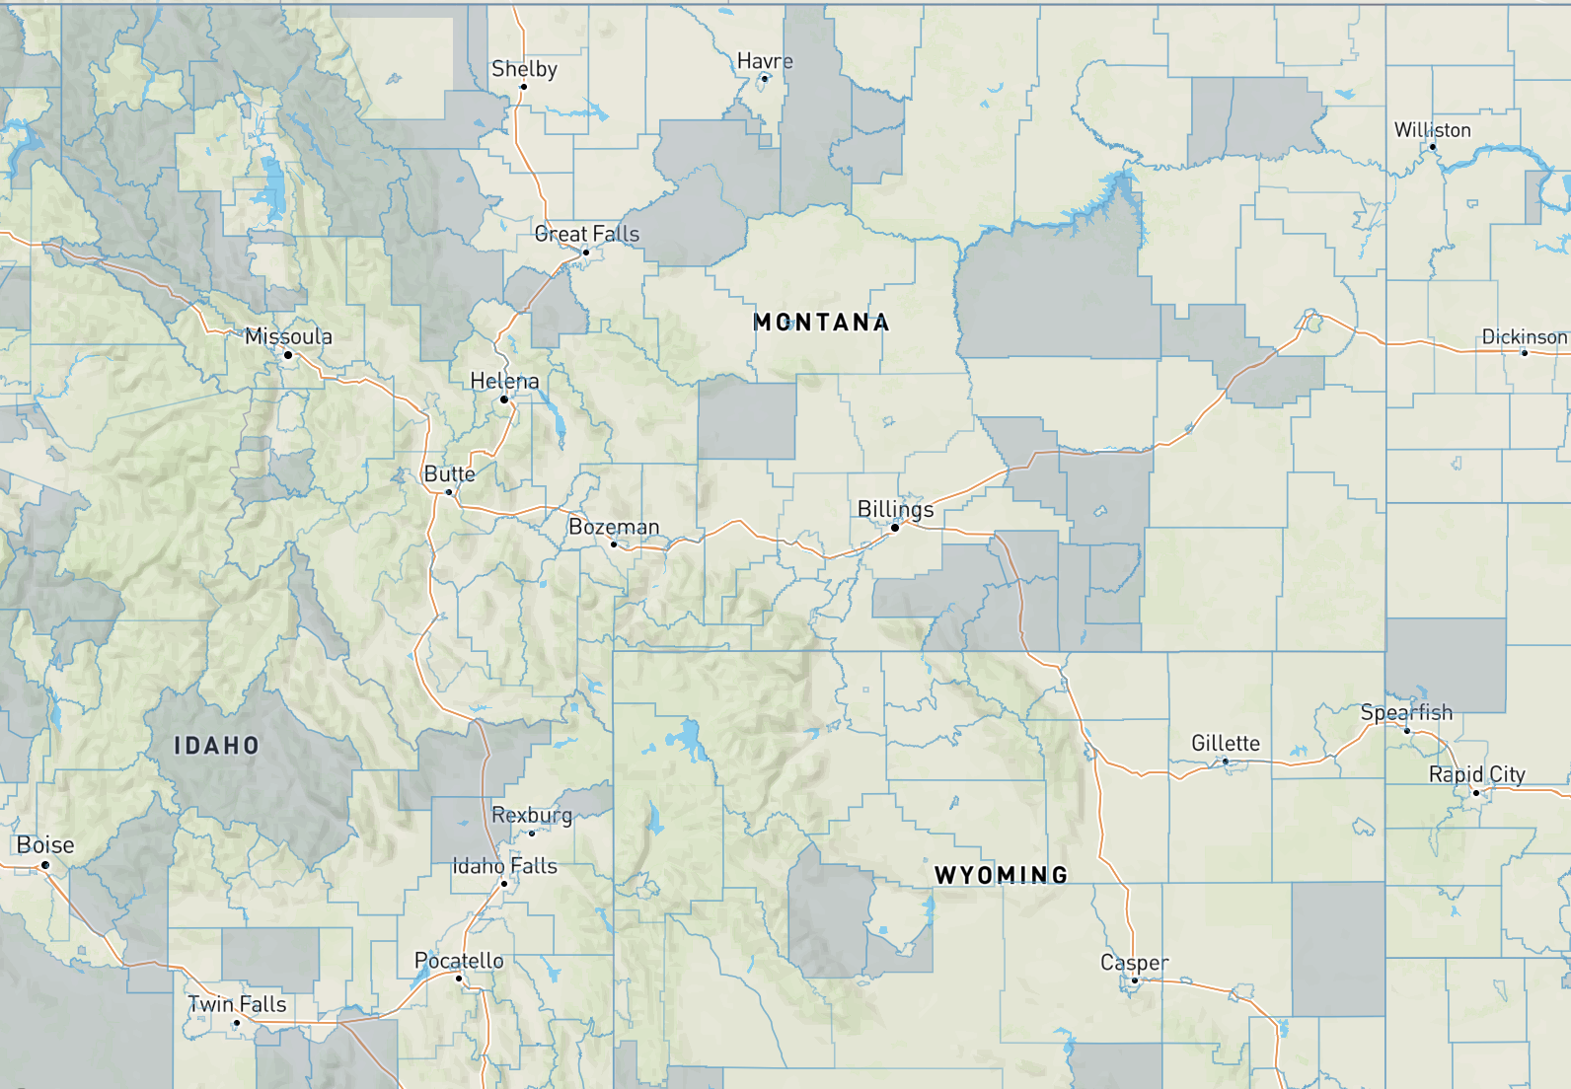
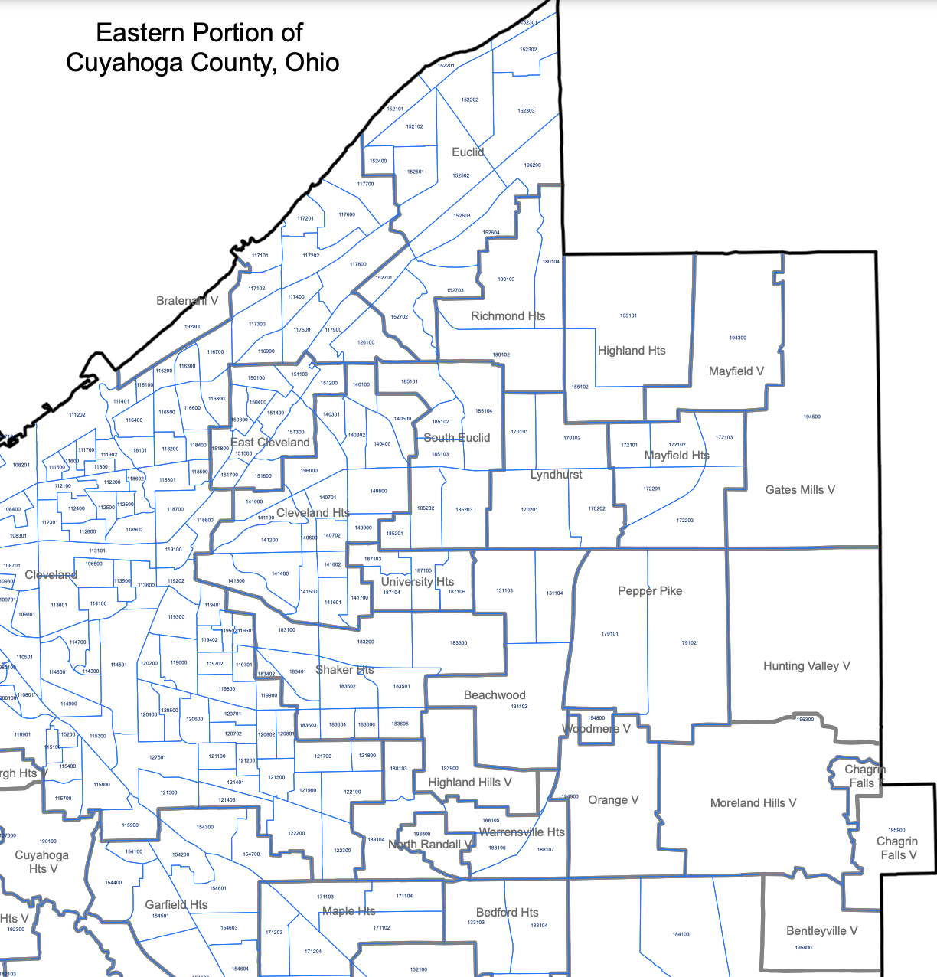
How Data Can Play Out at the Neighborhood Level
Role and USE Of data
Census Tract Level
Census Block Group Level

Slide 16
How Data Can Play Out at the Neighborhood Level
Role and USE Of data
Data scale: Examples
Measure/Indicator | Metric | Source | Smallest Geography Available
Air Quality | PM2.5 levels in air, µg/m3 annual avg. | EPA, Office of Air and Radiation (OAR) fusion of model and monitor data | Census block group
Ground-Level Ozone | Ozone summer seasonal avg. of daily maximum 8-hour concentration in air in parts per billion | EPA, OAR fusion of model and monitor data | Census block group
Diesel Particulate Matter | Diesel particulate matter level in air, µg/m3 | EPA Hazardous Air Pollutants | Census block group
Cancer Risk | Lifetime cancer risk from inhalation of air toxics | EPA Hazardous Air Pollutants | Census block group
Respiratory Hazard | Air toxics respiratory hazard index (ratio of exposure concentration to health-based reference concentration) | EPA Hazardous Air Pollutants | Census block group
Lead Paint | Percent of housing units built pre-1960, an indicator of potential lead paint exposure | Calculated based on ACS data | Census block group
Extreme Heat | Number of extreme heat days per year above 90th percentile | NASA’s North American Land Data Assimilation System (NLDAS) | Census tract
Extreme Precipitation | Number of extreme precipitation days per year above 90th percentile | NLDAS | Census tract

Slide 17
Data and Equity Considerations
Role and USE Of data
Measuring race
Low income populations
Children under 5
Older adults
Disability status
Language isolation
Immigrant status
Community physical health baselines
Community mental health baselines
Access to healthcare
Access to schools
Public transportation
Access to green spaces

Slide 18
Partner Spotlight: Data Driven Detroit

Slide 19
Discussion

Slide 20
Take 5 minutes to brainstorm individually…
Discussion
How might my work (e.g. in housing, health, or youth) intersect with climate change concerns and environmental justice?
How has our work already delved into this intersection?
What do we think we can do more of in the future? What additional capacity, resources or partnerships would we need?

Slide 21
Take 20 minutes to discuss with others…
Discussion
What are the similar challenges or opportunities our group has in thinking about our work and the intersection of climate change and EJ?
What data or lens mentioned in the presentation seems particularly attractive?
What existing or new partnerships would need to be invested in locally to increase focus in climate change and environmental justice in each of our cities?

