Slide 1
Population Estimates
Why They Are Important, How They Can Be Used, and What Can Be Done About Quality
Denice Ross
National Conference on Citizenship
Chris Dick
DA Advisors

Slide 2
Population Estimates: Why They Are Important, How They Can Be Used, and What Can Be Done About Quality

Slide 3
Count Question Resolution | Population Estimates Challenge Program | Special Censuses
Begins after delivery of Redistricting data ~Oct 2021 and goes through June 2023. Allows challenges to census counts for population or housing units based on a narrow criteria related to technical, data processing issues | Begins after release of 2021 population estimates in 2022, and every year thereafter ending with 2029 estimates. Jurisdictions have 90 days after release to submit Allows challenges to improve intercensal population estimates by correcting a processing error or the erroneous use of data or processes in calculating estimates | Under section 196 of Title 13, the Census Bureau can conduct a basic enumeration of an area through the Special Census program at the request of a governmental unit. Local officials might request this enumeration if there has been a significant population change in their community due to growth or annexation. The governmental unit requesting a special census is financially responsible for its cost.
Notes:
In 2017, the Census Bureau estimated a partial Special Census of the city of Washington, Illinois (population of 15,134 in the 2010 Census), would cost $113,570. Laws of states and localities dictate when and why governmental units request a special census. For instance, Iowa permits each city only one Special Census per decade while Illinois has no restriction, allowing towns to request as many as they deem necessary.

Slide 4
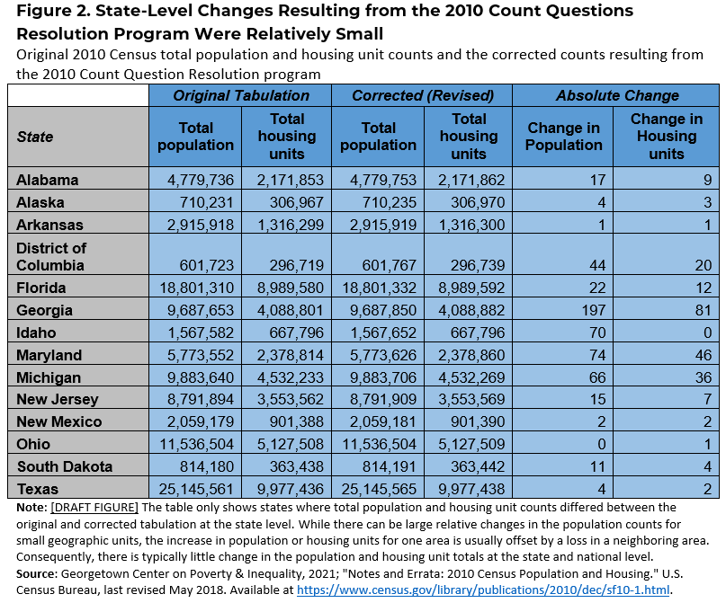

Slide 5
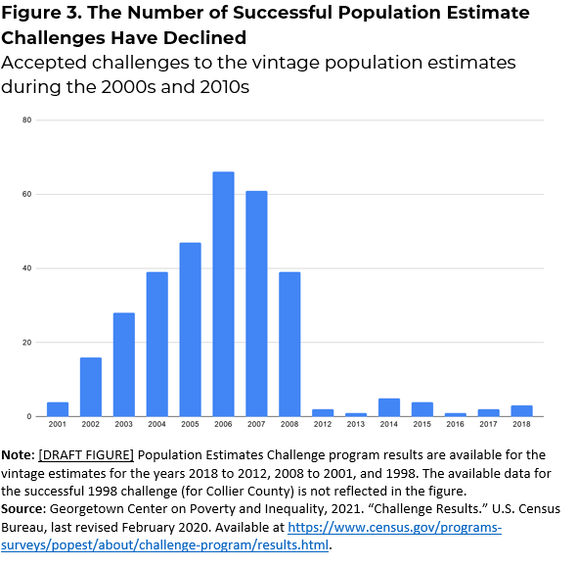
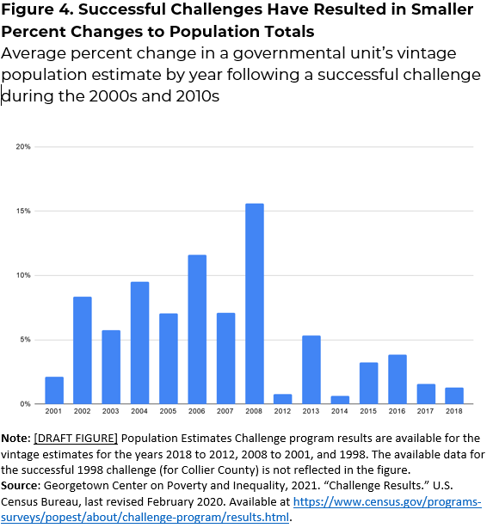

Slide 6
Population Estimates: Why Do We Care?

Slide 7
Population Estimates: The Year Doesn’t End in 0? These Data Have You Covered!
The Official measure of the population in all years that don’t end in zero
Key in weighting for the American Community Survey and so many other key surveys such as the CPS (unemployment estimates), AHS, and the SIPP.
The basis for school district, health insurance, and income and poverty estimates
Underlies many of the key data that are used for federal funding allocations $1.5 Trillion/year
Drives state bonding authority
Extremely cost effective to produce

Slide 8
Why Do We Care?
Comparison to the 2020 Census as (one of many) Quality Measures.
Downstream Impacts on Other Data Products
… To understand why, we first need to take a step back

Slide 9
Population Estimates: How They Are Developed

Slide 10
Population Estimates: How They are Developed.
Starting Population
2010 Census Data:
“The Base” updated annually by the Boundary and Annexation Survey (BAS) and Count Question Resolution Program (CQR)
April 1, 2010
Measures of Population Change
Administrative and Survey Data
Yearly Data (2010-2020)
Ending Population
Population Estimate!
July 1, 2020
Notes:
Link: https://www.census.gov/newsroom/press-releases/2021/2020-census-count-question-resolution.html
Fall 2021: Federal Register notice announces the beginning of a 30-day comment period for the public.
December 2021: The Census Bureau plans to officially notify tribal, state and local government officials eligible to file CQR cases.
January 2022: The Census Bureau begins accepting CQR cases for processing from eligible tribal, state and local governments.
June 30, 2023: Deadline for governments to send CQR cases to the Census Bureau.
September 30, 2023: Deadline for the Census Bureau to provide results to impacted governmental units.

Slide 11
Population Estimates: What Data Are Used?
County and Above
Birth Records
Death Records
IRS Filings
Medicare
American Community Survey (International Migration)
Other Country Census Data (International Migration)
Group Quarters Report
Below County Level (Including Cities and Towns)
Building Permits Survey (BPS)
Survey of Construction (Completes and Non-permitted Construction)
Manufactured Homes Survey
American Housing Survey (Loss)
Local Building Permits, MH Placement, Demolitions, Certificates of Occupancy
Group Quarters Report

Slide 12
Population Estimates: Where They Fit.
Decennial Census
Going out and counting the people… we obviously cannot do that every year.
Population Estimates
Thank goodness for administrative data!
All The Surveys
Those surveys need some weights to be representative of the population.

Slide 13
Population Estimates: A Measure of Census Quality?

Slide 14
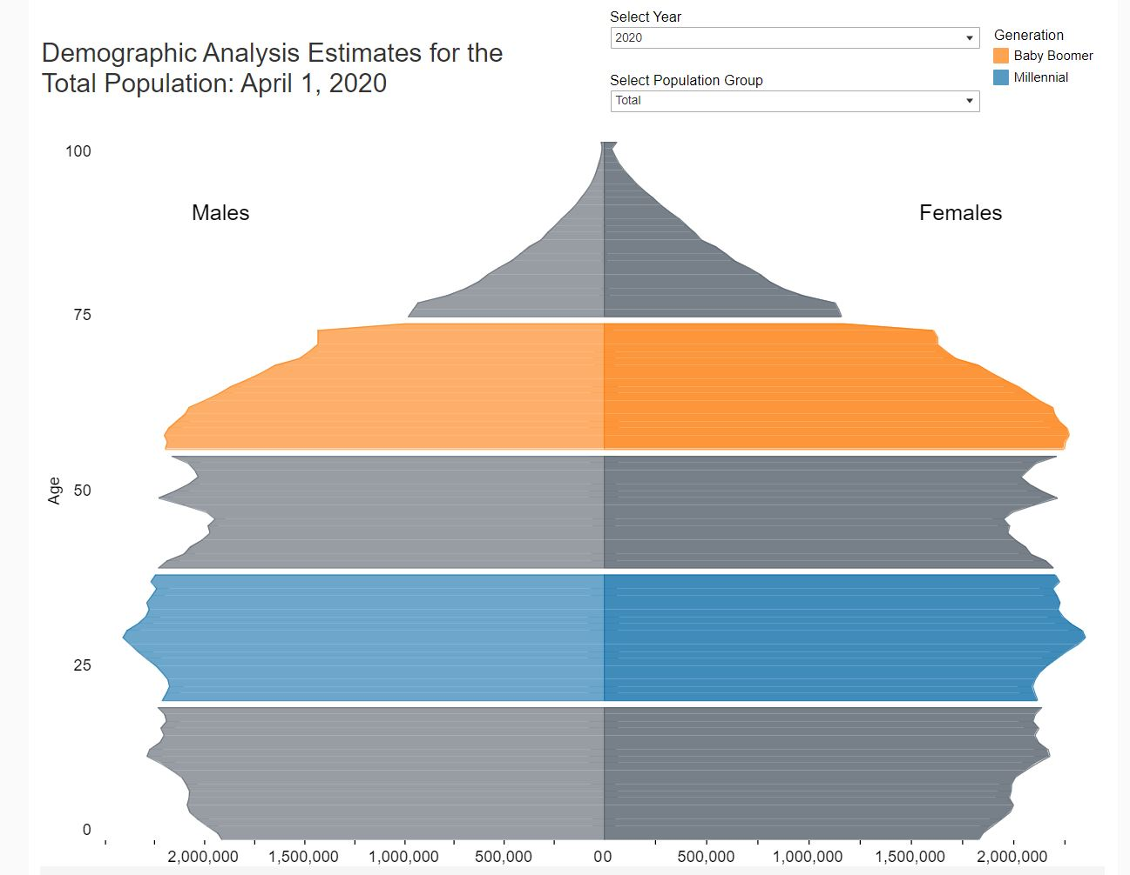
Traditional Measures of Census Quality
Key traditional measures of decennial census quality include:
Demographic Analysis
Post Enumeration Surveys
Operational Metrics and Data
What about Population Estimates and other data sources?

Slide 15
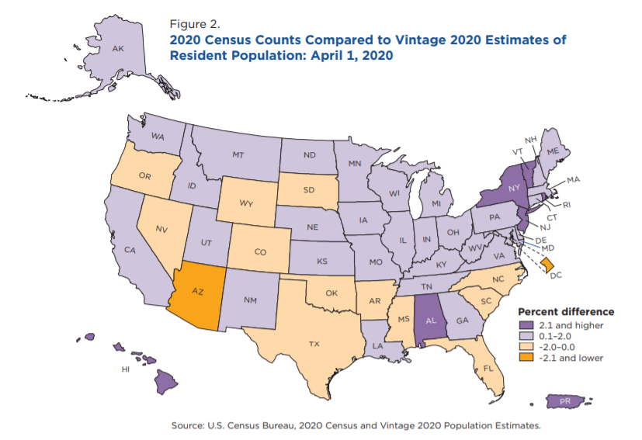
Population Estimates: Comparisons to 2020 Census
We can use the estimates to compare to the 2020 Census. Just remember, any differences between the two (the error of closure) can be caused by 3 issues:
Error in the 2020 Census
Error in the 2010 Census
Error in the estimation of components of change
https://www.census.gov/library/working-papers/2021/demo/POP-twps0104.html

Slide 16
Population Estimates: Vintage 2020 Release Dates
The Census Bureau is releasing “Evaluation Estimates” for July 1, 2020 on the following dates (Note: state and national totals were also released in December 2020)
May 4th: National, State, and County Totals and Components of Change
May 27th: City and Town Population / National, State, and County Housing Units
June 17th: National, State, and County Demographics
Since the data are “Evaluation Estimates,” they are not available in the same place you would usually find them. Data are available at:
https://www.census.gov/programs-surveys/popest/technical-documentation/research/evaluation-estimates.html

Slide 17
Population Estimates and the Challenge Process

Slide 18
What is the Challenge Process?
The Population Estimates Program has a mechanism for dealing with errors in their methodology or data called the “Challenge Process”*
It allows certain entities to officially challenge the population estimates for a given vintage (changes are then incorporated into future vintages as well), given certain criteria and rules.
The program is suspended and then restarted each decade, often with changes to the rules when it is restarted.
*What can be challenged can change.

Slide 19
What are the Rules?
As of the suspension of the program in the beginning of 2020, the challenge programs rules were as follows:
Who can challenge: Highest Elected Official for the impacted jurisdiction.
What can be challenged:
Methodology: The method by which the population estimates were calculated (Cohort-Component for the county and above, Distributive Housing Unit for estimates below the county level) are not challengable.
Data: Data sources and data errors are challengable. This includes limited ability to use alternative data sources as long as their quality and time stamp can be validated.
Timing: All challenges must be made within 90 days of data release.

Slide 20
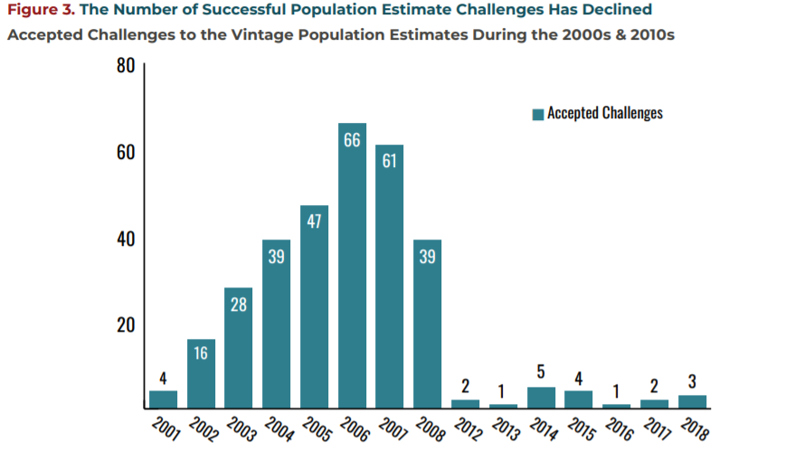
Changes from the 2000’s to the 2010’s
The rules changed substantially between the 2000’s and the 2010’s.
Specifically, challenges using alternative methodologies were accepted prior to 2010.
Why is this important?
Figure from: Lee, Jae June, Cara Brumfield, Sheila Naughton, "2020 Census Count Question Resolution & Population Estimates Challenge Programs: Opportunities for Improving Postcensal Population Estimates." Georgetown Center on Poverty and Inequality, 2021.

Slide 21
What is Different this decade?
The 2020 Census was different than any decennial census we have ever had:
Continued historical declines in trust and response.
Pandemic
Politicization
Natural Disasters
… the list goes on
This has caused cascading impacts on other programs, including the population estimates. One to note: the idea of a blended estimates base.

Slide 22
What Happens Next?
We are still learning about a couple of things:
Census Quality
Other programs such as CQR
As we learn more about these we can start helping to define what the population estimates challenge process should look like this decade.
A few things to think about:
Who can challenge?
What can be challenged?
What can be used to challenge?
How do we define “high quality” and “timeliness”?

Slide 23
What Can I Do Now? In the Future?

Slide 24
Potential roles for NNIP Partners
2021: Share information with local governments about opportunity to weigh in on ideas before the Census sets the guidelines
Winter/Spring 2022: Share information with local governments about new rules
Spring/Summer 2022: Depending on what can be challenged, share advice about methodology and data sources
Spring/Summer 2022: Help to acquire/process supplemental data that is allowed

Slide 25
Thank you!
Chris Dick
Principal, DA Advisors
chris@demoadvisors.com
Denice Ross
Senior Fellow, National Conference on Citizenship
denice@ncoc.org

