Slide 1
The Viz-a-lyzer: Explore, Map, & Analyze Data
Community Information Now
Norma I. Garza

Slide 2
What is the Viz-a-lyzer?
Interactive tool that allows individuals to explore and analyze Bexar County data
Viz-a-lyzer key features:
Maps key indicators by zip code and year
Provides county and state benchmark data where available
Shows the best and worst zip codes for a given indicator
Charts a five-year trend line where available
Filters by school district or county precinct
Saves and prints image

Slide 3
Who is the target audience?
Staff at nonprofits and public agencies
Those who need basic trustworthy data to inform their strategic plans or make the case in grant applications
Bexar County community members

Slide 4
Data available includes:
Total population
Educational attainment
Median income
Population below poverty
Housing affordability and vacancies
Uninsured population
Teen pregnancy
Hospitalizations

Slide 5
Viz-a-lyzer
Notes:
Every part of the Viz-a-lyzer is linked, so once you’ve chosen an indicator from the Data Chooser, every part of the screen is showing that indicator. And once you’ve clicked on a zip code in any part of the screen, that zip code is highlighted in every other part of the screen.

Slide 6
Data (Indicator) Chooser
Notes:
Data menu allows you to choose the indicator you want to see. By default the view will show total population. Many indicators include subcategories such as housing affordability by renter vs. owner occupied.

Slide 7
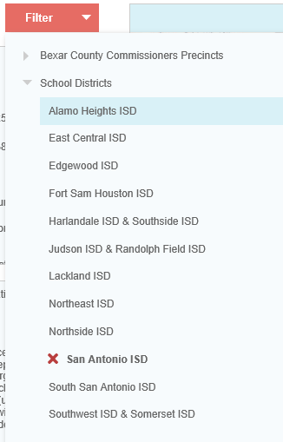
Filter (Geography) Chooser
Notes:
Allows you to simplify your view based on the geography/region you are interested in. For example, selecting SA ISD will only show you data for the zip codes within the district.

Slide 8
Year Chooser & Time Trend
Notes:
Allows you to select what year of data you want to see. If you press play the map series will animate and move continuously among all years.
The time trend line chart displays the data value, if available, for all five years for the selected indicator.

Slide 9
Legend, Boundaries, and Notes
Notes:
The legend is the key to interpreting the color-coding in all parts of the visualization.
Show/hide boundaries. The check boxes in the legend allow you to show or hide the boundary lines of Bexar County, local school districts, and county commissioner precincts. Unlike the filter, you’re just showing the boundaries of all the geopolitical units, like school districts, not restricting the data view to a single school district.
Notes. The notes box shows you the definition of the indicator you’ve selected, the data source, and other information to help you understand what you’re looking at.

Slide 10
Pie Chart
Notes:
The pie chart shows you at a glance roughly what proportion of zip codes fall into each category in the legend.

Slide 11
Histogram
Notes:
Each bar is a zip code sorted from lowest to highest value on the indicator selected. You can tell at a glance whether very many or very few zip codes fall into a particular color band in the legend.

Slide 12
Data Tables
Notes:
The data tables are where you’ll find the actual data value (or estimate, if the data comes from a survey) for each zip code, along with the values for Bexar County, Texas, and the United States if a true apples-to-apples comparison is available. The geography is in the left column and data values/estimates are in the right column.

Slide 13
Help, Print, and Share

Slide 14
Have an idea? Add it to the wish list

Slide 15
Upcoming
Three to four updates throughout the year
Jan 2018 update
City Council District boundaries
New indicators
2016 data update
April/May 2018 update
Prioritizing wish list items
New indicators
Improve features

