Slide 1

Democracy at Risk:
The State of the 2020 Census
November 10, 2018
Arturo Vargas
Chief Executive Officer
NALEO Educational Fund

Slide 2




2020 Census
Proposed Changes and New Approaches
Bureau was mandated to conduct the 2020 Census at a lower cost per household than 2010. Its plans have fallen short and may now be the most expensive Census in history.
Bureau is making final adjustments to changes and new approaches which all have important implications for the Latino community:
Internet response as primary response option
Redesign of questions on
Hispanic origin and race
Use of administrative records and other third-party data
for address canvassing and
non-response follow-up (NRFU)
Reduction in number of local census offices, field staff, field “presence”

Slide 3
The 2020 Census that is proceeding is NOT the operation the Bureau has been planning for the past decade
Years of underfunding have significantly altered the Bureau’s preparations and plans for the 2020 Census.
Rural communities hit hard: Update/Enumerate replaced by Update/Leave in most areas; no final tests in rural communities.
Plans for the Dress Rehearsal in three diverse sites replaced by a single, limited “End-to-End test” in an urban site.
Ban on hiring work-authorized non-U.S. citizens.
The 2020 Census questionnaire has been radically changed in the final months before the enumeration, including the abrupt, unexplained changes to the Bureau’s plans for data collection on Race and Ethnicity, and the last minute addition of a citizenship question.

Slide 4

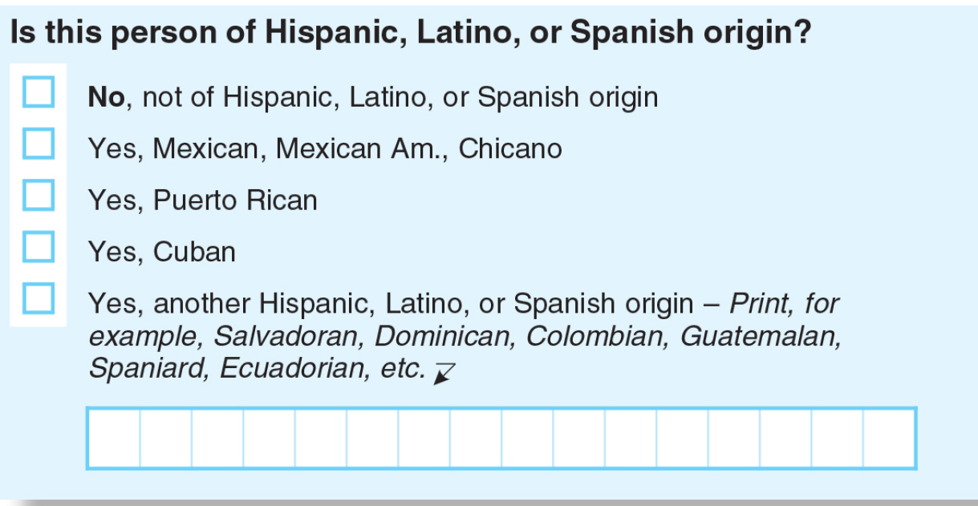
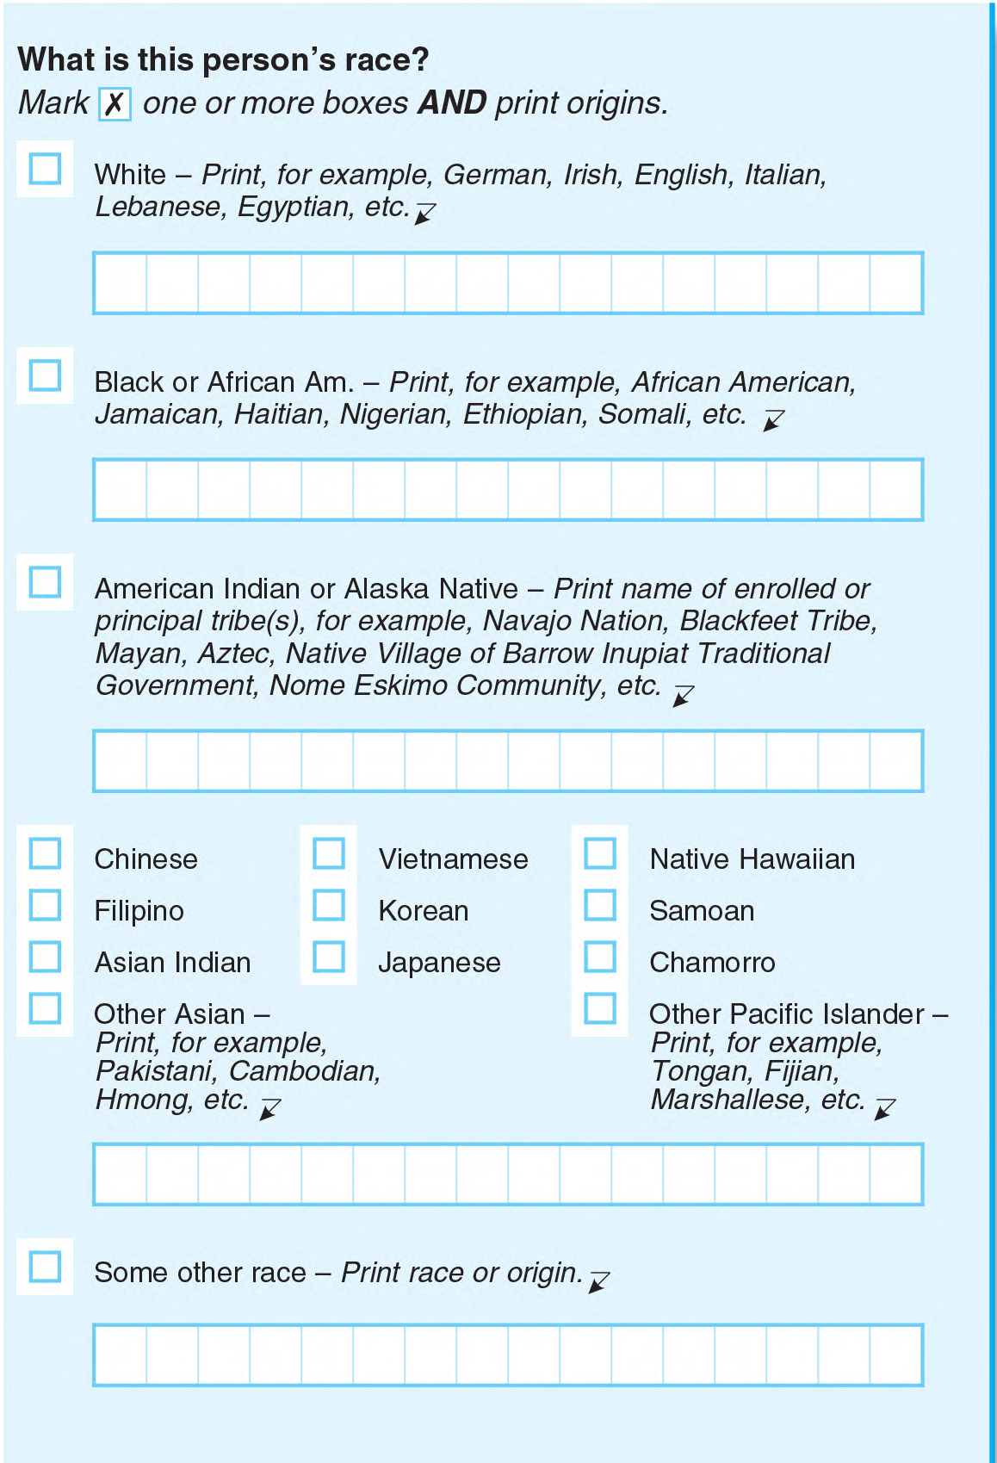
Two-question format on Race and Hispanic origin for
Census 2020 raises questions
Latino Voter Impact in 2008
Only one Latino national origin will be reported by Census Bureau regardless of how respondents answer.
Unclear how Latinos will be respond to detailed reporting of White and Black sub-group identifications; Afro-Caribbean examples not included in Black/African American question.
Census Bureau projects that with this approach, “Some other race” will become second largest racial group in the nation after Census 2020.

Slide 5
Other administration and legislative issues
No permanent Census Bureau Director since July 1, 2017. Dr. Stephen Dillingham has been nominated for the position; NALEO Educational Fund is evaluating the nomination
The GAO has designated Census 2020 as a “high risk” activity, citing new enumeration approaches and uncertain, and underfunded, IT systems
Erosion of public trust regarding the privacy of information given to the Census Bureau, including via the internet, and increased fear among immigrants in contact with the government
The Census Bureau’s financial situation has improved, but funding is still inadequate. FY 2019 appropriations projected to be $3.015 billion; advocates support $3.452 billion to adequately fund final preparations

Slide 6
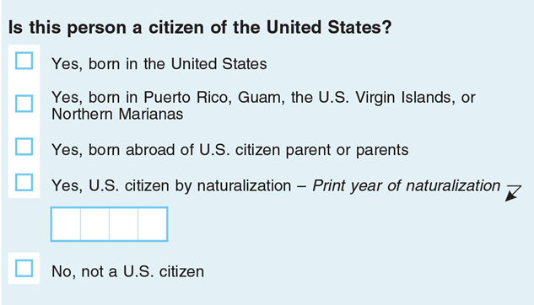
Administration’s last minute addition of a Citizenship Question puts Census 2020 at serious risk
On March 26, the Secretary Ross agreed to a DOJ request and ordered the addition of a citizenship question
Secretary Ross subsequently reported this was his idea all along, and that he asked DOJ to make the request
Census Bureau submitted Census 2020 questionnaire to Congress with this question, but not with the topics as required by March 2017

Slide 7
Eight lawsuits are pending
Two lawsuits in the Southern District of New York, which have been consolidated into one (State of New York, et. al.; ACLU and NYCLU); two lawsuits in the Northern District of California (State of California; LCCRUL), and the District of Maryland (MALDEF/AAAJC; National Redistricting Foundation) on the citizenship question.
  The New York case is proceeding most quickly. In July, Judge Jesse Furman granted additional discovery. Motions are now before the Supreme Court. Trial may start in November.
  Judges have rejected the Administration’s motions to dismiss the litigation, and the cases are moving forward.
  MALDEF/AAAJC lawsuit includes American Indians, conspiracy theory.
NAACP lawsuit alleges 2020 Census will undercount African Americans.
Alabama filed lawsuit to remove undocumented immigrants from the reapportionment count.

Slide 8
NALEO’s current position on the
Citizenship Question
Accurate and reliable information is not yet available about how the Census Bureau will handle the Citizenship Question; an internal working group will determine:
  What the Bureau will do if the question is left blank
  What will happen if the question is not answered accurately
  If it will use administrative records from DHS, Department of State, USCIS and other sources, to “impute” an answer
The Administration has nominated a new Census Bureau Director and it is unknown what policy agenda he may implement
Once these determinations are made, NALEO will be able to provide guidance on the Citizenship Question
Community leaders must work to avoid panic and misinformation

Slide 9

NALEO MESSAGING RESEARCH
GENERAL VIEWS ON CENSUS
Participants had a generally positive view of the Census.
Hesitation, fear, and cynicism arose among focus group participants when they saw a version of the actual questionnaire
  The citizenship question raised the most concerns, anxiety increased as participants considered the reality of providing their information to the current administration
There was lack of confidence that the data provided would be kept confidential.
“You know in Spanish the word, ‘desconfianza’? Ok that’s how I feel about it… …So, for me personally, this gives me that “desconfianza” feeling, asking about citizenship. I don’t think this Census is going to be very effective.”
Notes:
What concerns, if any do you have about participating in the 2020 Census?
I am concerned about….(percent agree they are concerned about statement)
56% Online security if I complete the Census online.
51% Giving the government personal information about me and my family.
50% Immigration enforcement using my information against me or my family.
40% Census workers coming to my home.

Slide 10
VIEWS ON RESPONSE MODES
Survey respondents overwhelmingly expressed a preference to complete the Census by mail on a paper form (75 percent)
Nearly 40 percent of respondents said it is not convenient to complete the form online
  “There's people that don't have internet service down here in the Valley [Texas], some areas just don’t have it.”
  “My mom is 61 years old and she’s not going to go on the computer. She’ll think it’s a trick, won’t like it, and won’t fill it out. If I go help her out, yes, she’ll do it. They are going to lose people who aren’t comfortable online.”
Over 64 percent of respondents said that sending a Census worker to their home was not convenient
Notes:
Which ways would be convenient for you to fill out your census form? Mark all that apply. (percent “yes” reported)
75% Mail the form to me, and I will fill it out and send it back in the mail.
61% Mail the online instructions to me, and I will fill it out online.
38% Mail dial-in information to me, and I will call in my information to Census.
36% Send Census worker to my home, and I will fill out the form with them.

Slide 11

2020 CENSUS MESSAGES
Any message is better than none: all four messages tested - Convenient, Safe, Required; Civic/Community Duty; Funding; Resistance/Defend Community - performed better than the control group which received no message
Messages about Census participation being “Convenient, Safe and Required” showed the most positive response in the survey
“Participating in the Census is safe and really easy, just a few clicks online. The Census protects your personal data and keeps your identity anonymous. By federal law, your response is required, and your information cannot be given out or shared”
Messages about the role of Census data in providing funding for local schools and community programs were the most effective in the focus groups
“The government relies on the Census population count to determine funding for state and local services, including education, police, fire, and health care. Our community schools, hospitals, and first responders are depending on us to do our part and participate in the Census”
Notes:
Survey Question - How likely is it that you will participate in the upcoming Census?
61% Definitely - Convenient, Safe, Required
59% Definitely – Civic/Community Duty
56% Definitely - Resistance
54% Definitely - Public Funding
Focus Group Messages
85% of all focus group respondents selected Funding as the most effective message
58% selected the undercount as an effective message
23% selected civic/community duty as the most effective
18% Resistance/Defend community as the most effective
18% Convenient, Safe, Required as the most effective

Slide 12
2020 CENSUS MESSAGES (continued)
Subgroup differences of note on the survey experiment
Immigrants were especially responsive to the convenience, safety, and required message with 75 percent saying they would definitely participate in response to the message. This is consistent with the serious privacy concerns voiced in the study
Women were most responsive to the civic and community duty message with 57 percent saying they would definitely participate in response to the message
Latinos under age 40 were most responsive to the resistance message, with 53 percent saying they would definitely participate in response to the message
Notes:
Survey Question - How likely is it that you will participate in the upcoming Census?
61% Definitely - Convenient, Safe, Required
59% Definitely – Civic/Community Duty
56% Definitely - Resistance
54% Definitely - Public Funding
Focus Group Messages
85% of all focus group respondents selected Funding as the most effective message
58% selected the undercount as an effective message
23% selected civic/community duty as the most effective
18% Resistance/Defend community as the most effective
18% Convenient, Safe, Required as the most effective

Slide 13
2020 CENSUS MESSENGERS
MESSENGERS
Consistent with previous NALEO voter engagement research, “Family Members” were the most trusted messengers
  Our previous voter engagement research also suggested that women in the household, in particular, were effective messengers
Nurses, doctors, health providers and Latino community organizations were also highly trusted as messengers
People who speak for “the children” or “the schools” – such as teachers -- were especially trusted and convincing (our previous research on voter engagement had comparable findings)
Elected officials were among the least trusted as a reliable source for information
Notes:
Survey Question - When you are looking for reliable information about important community matters, how often do you rely on or trust the following sources to give you useful tips or accurate information?
40% Very often (Very often/Sometimes 75%) - Family Members
28% Very often (Very often/Sometimes 68%) – Nurses, Doctors, other health providers
23% Very often (Very often/Sometimes 65%) – Teachers/local educators in community
22% Very often (Very often/Sometimes 60%) – Hispanic/Latino community organizations
11% Very often (Very often/Sometimes 45%) – Elected officials from your community

Slide 14
Prepare for Census 2020
  Review outreach and messaging approaches to determine strategies to adapt locally
  Use ROAM and CUNY mapping tools to identify “Hard to Count Census” tracts
  Identify partners and trusted messengers
  Work with state and local Complete Count Committees
  Advocate for state and local funding for Census outreach
  Urge Congress to provide the Census Bureau with adequate funding
  Push good candidates to apply for Census jobs – Census.gov/jobs
    Plan a “Get-Out-the Count” campaign
      Prepare and disseminate informational materials
      Provide questionnaire assistance
      Conduct community forums
      Work with traditional and social media on messaging campaign

Slide 15

TAKE ACTION!
#SaveTheCensus
Join our Census 2020 campaign!
Visit www.NALEO.org
Email to censusGOTC@naleo.org with “Subscribe” in the subject line to join our Census email list.
Text “CENSUS” to 97779 to join our SMS/Census Get Out the Count list.
(Standard messaging rates apply).

Slide 16
Thank you.
Arturo Vargas
Chief Executive Officer
avargas@naleo.org
Twitter: @ArturoNALEO
www.naleo.org

