Slide 1

The intersection of LGBTQIA+ identity, race and ethnicity in Connecticut
Results from the Household Pulse Survey
Presented by Shannon Carter, MPH

Slide 2
Data Sources
Census Bureau’s Household Pulse Survey
DataHaven’s Community Wellbeing Survey
CT Commission on Human Rights and Opportunities
Select qualitative interviews
Notes:
Context setting

Slide 3
Terminology
LGBTQIA+
Transgender & cisgender
Queer & straight
Latine

Slide 4
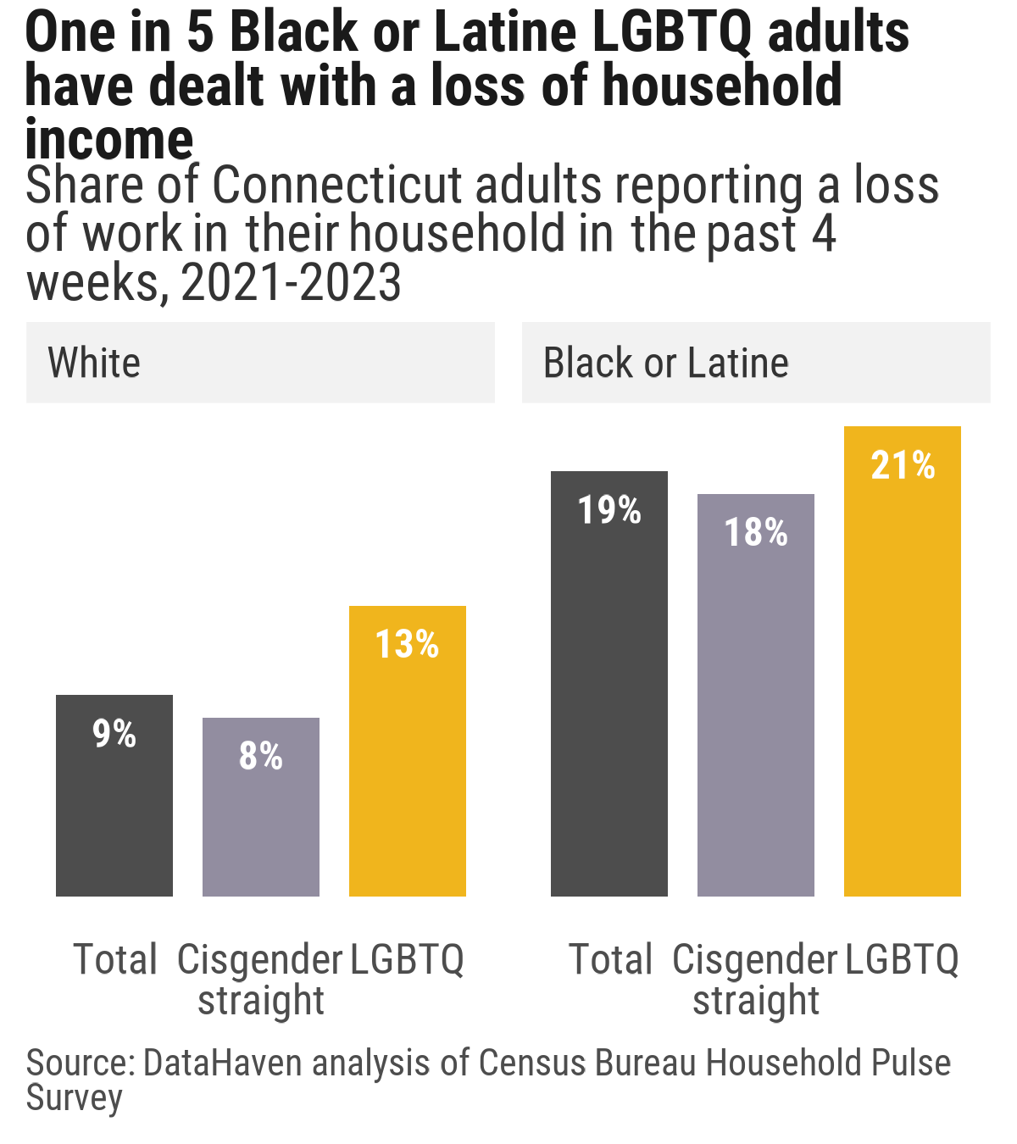
A markedly higher rate of loss of household income for Black and Latine-headed households in 2021-2023.

Slide 5
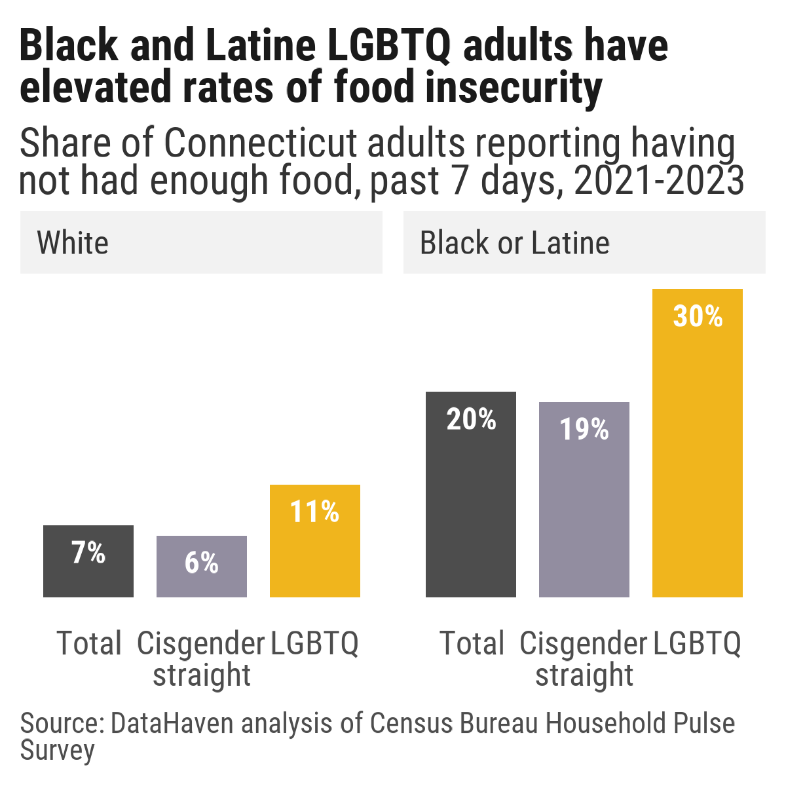
Food insecurity is especially stark for LGBTQIA+ Black and/or Latine adults during this time

Slide 6
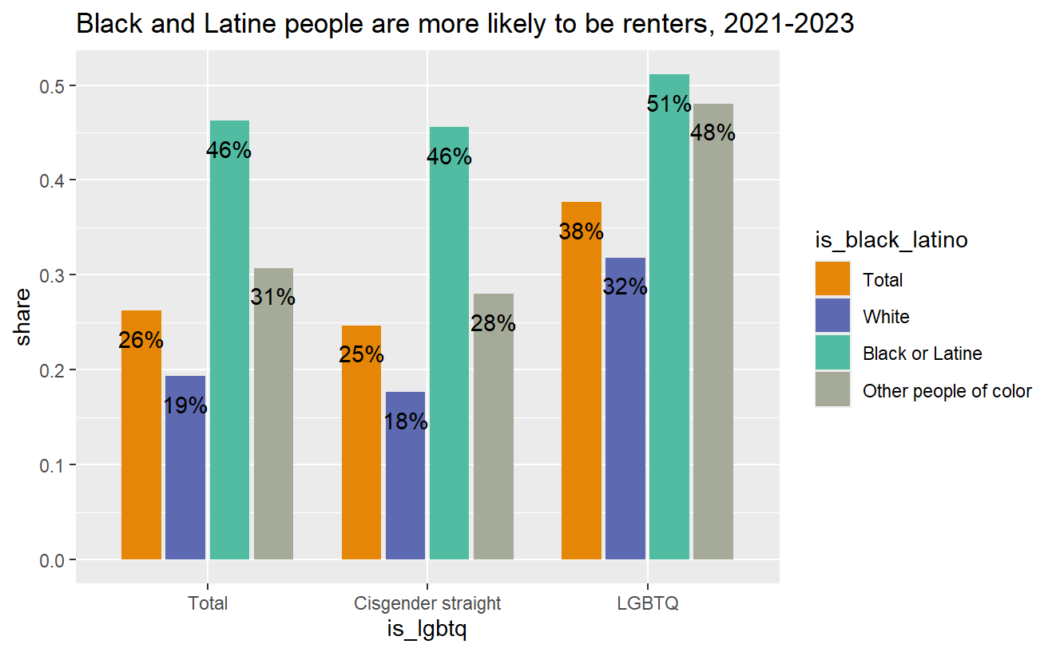

Slide 7
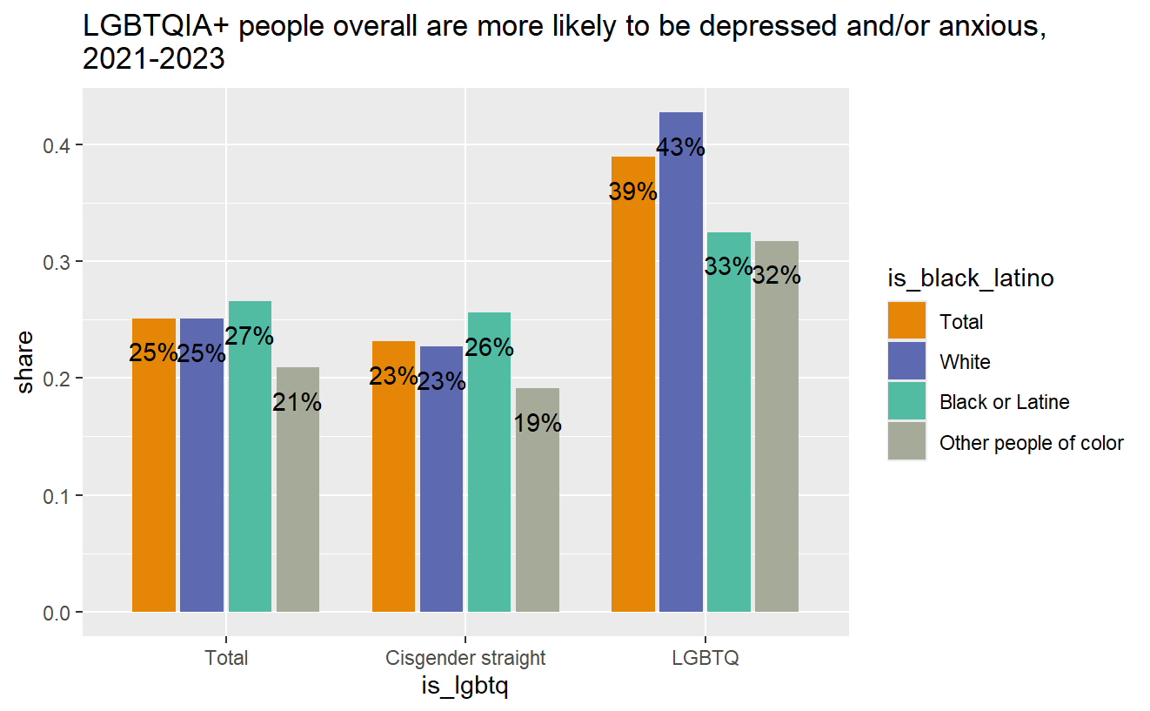

Slide 8
Frameworks
Historic and ongoing context of legal and social systems
Intersectionality
Stigma & Minority Stress Theory
Notes:
Discrimination, minority stress

Slide 9
Speaker 1: “Because you're not seen as a member of your BIPOC community, and you're not seeing oftentimes as a member of the queer community, and neither one is advocating for you.
Speaker 2: “…And at the same time, that you're, that you're being erased within the communities themselves, you're also at a heightened risk of violence from outside forces…”

Slide 10
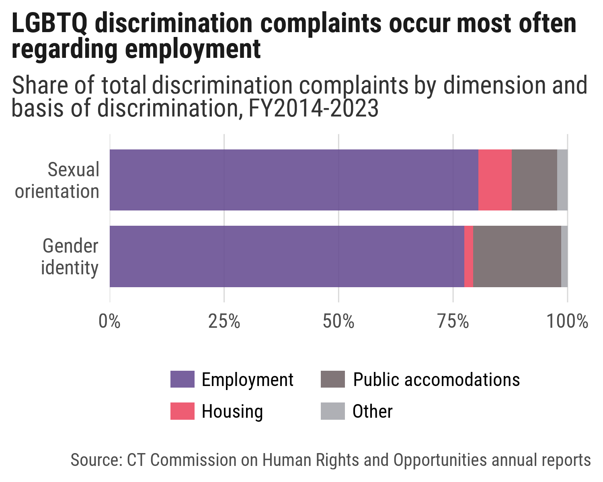

Slide 11
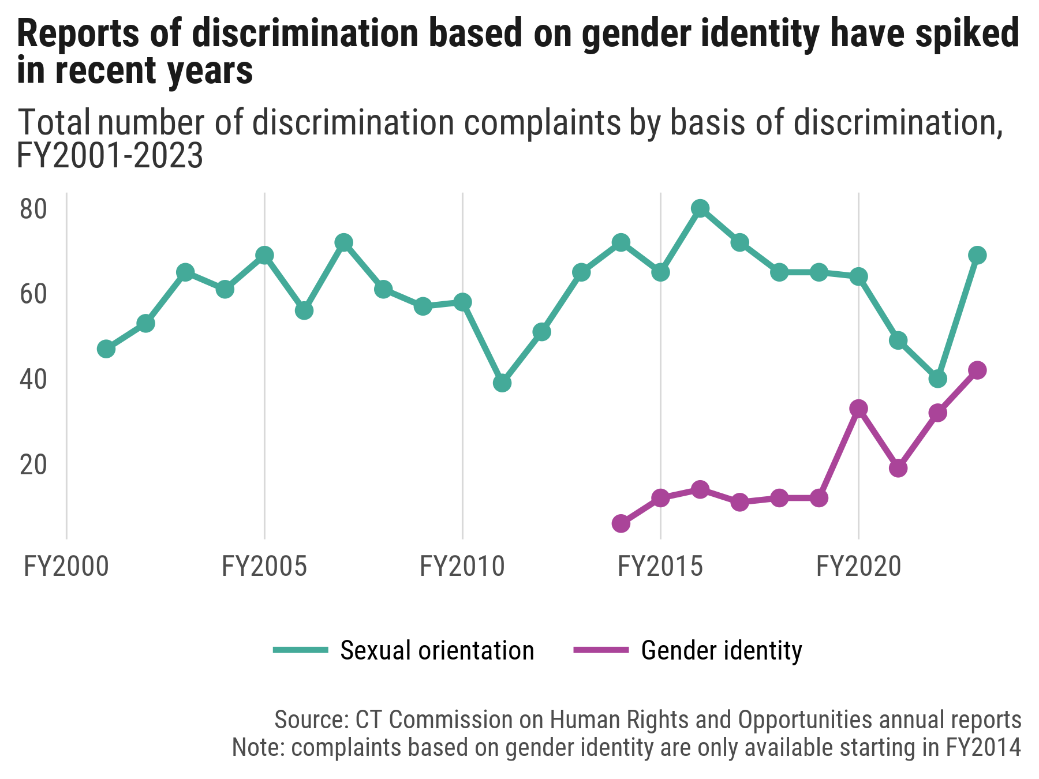
Discrimination DCWS

Slide 12
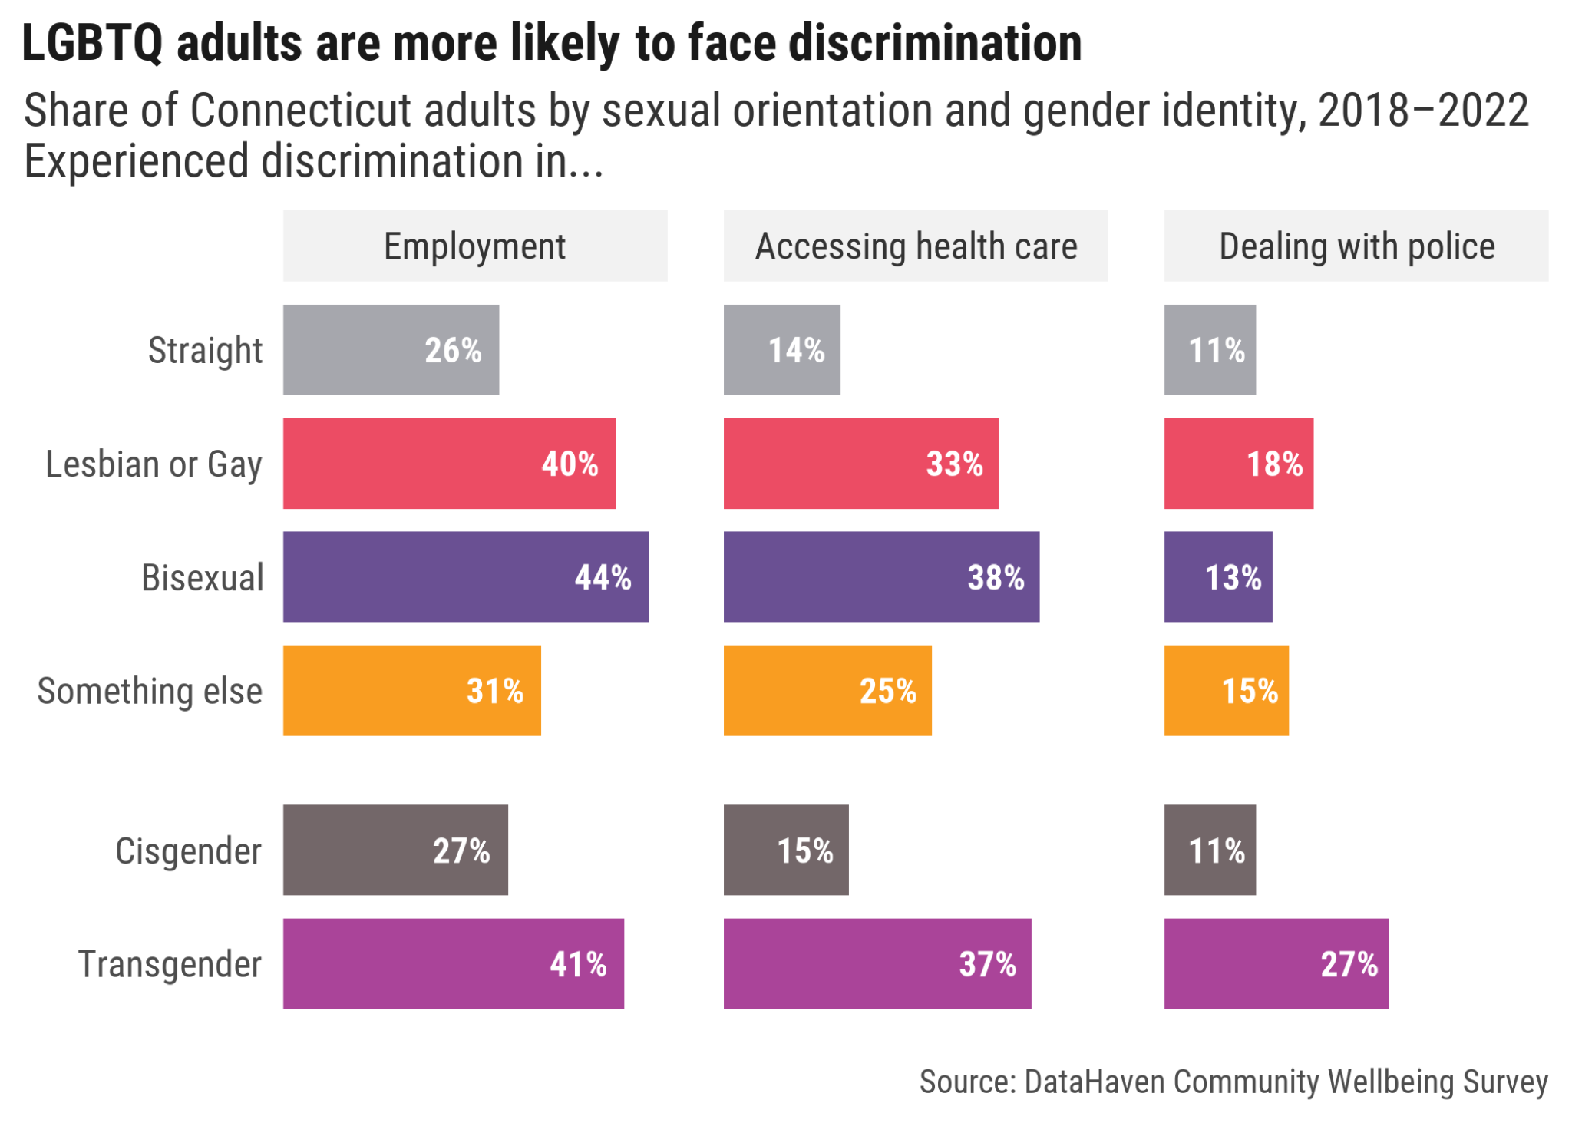
Discrimination - CHRO

Slide 13
“...And the broader systemic issues that queer people face like undocumented people, like queer people--And both queer people need to be acknowledged as present within those, like, spaces of oppression.”

Slide 14
What does this tell us?
Importance of understanding the whole person
Avoiding a “one-size-fits-all” approach
Gains for the LGBTQIA+ community are not distributed evenly

Slide 15
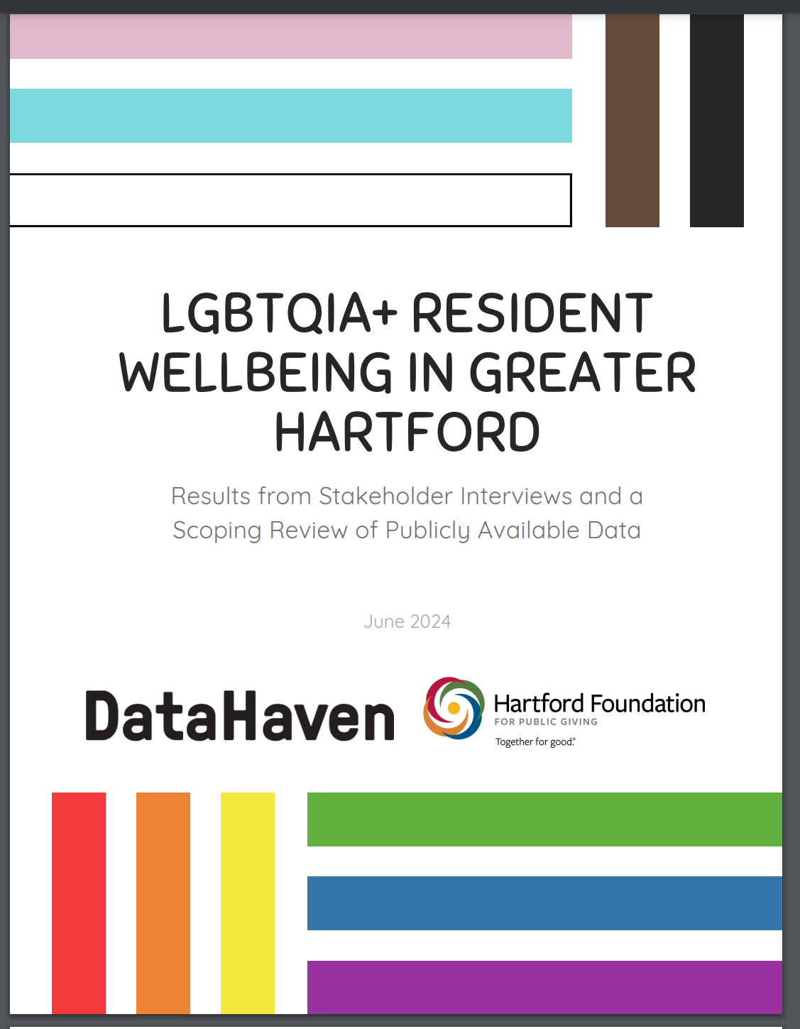
Report
Shannon Carter, MPH (they/them)
shannon@ctdatahven.org
https://www.ctdatahaven.org/

