Slide 1
A Brief Introduction to Detroit
Noah Urban, Co-Executive Director

Slide 2
Detroit Overview
Notes:
Founded in 2008
Converted to L3C in 2015
Working towards employee ownership

Slide 3
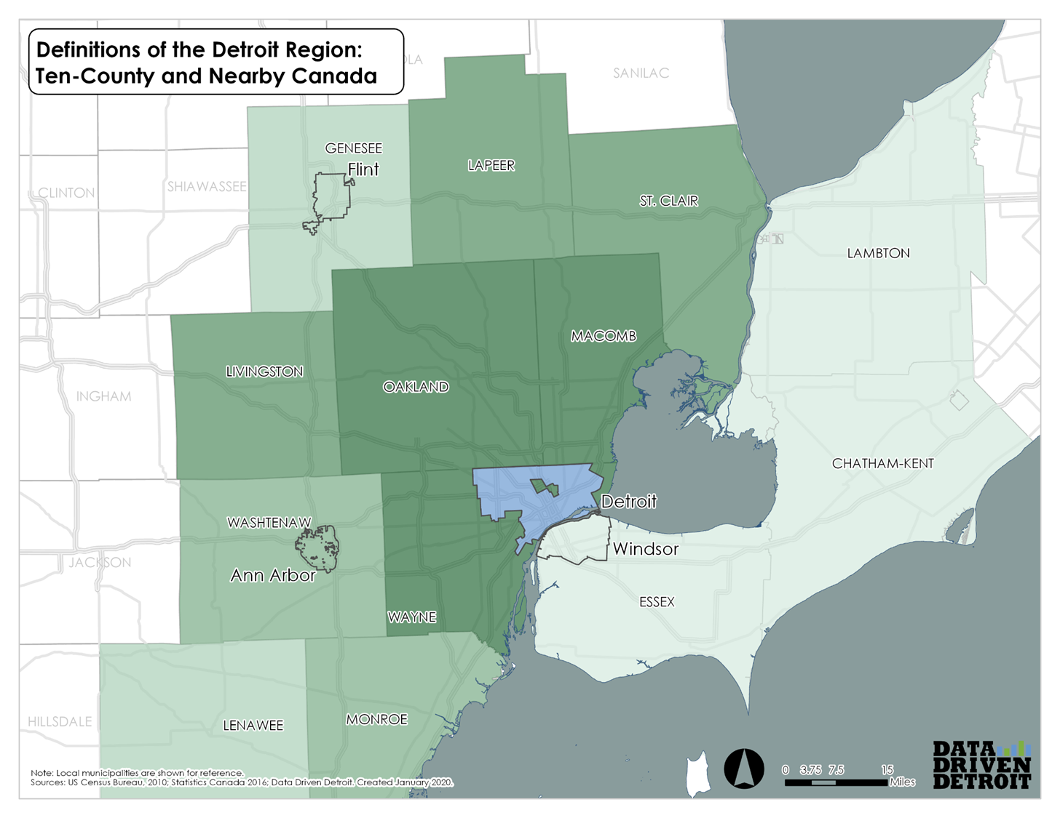
Defining the Region

Slide 4
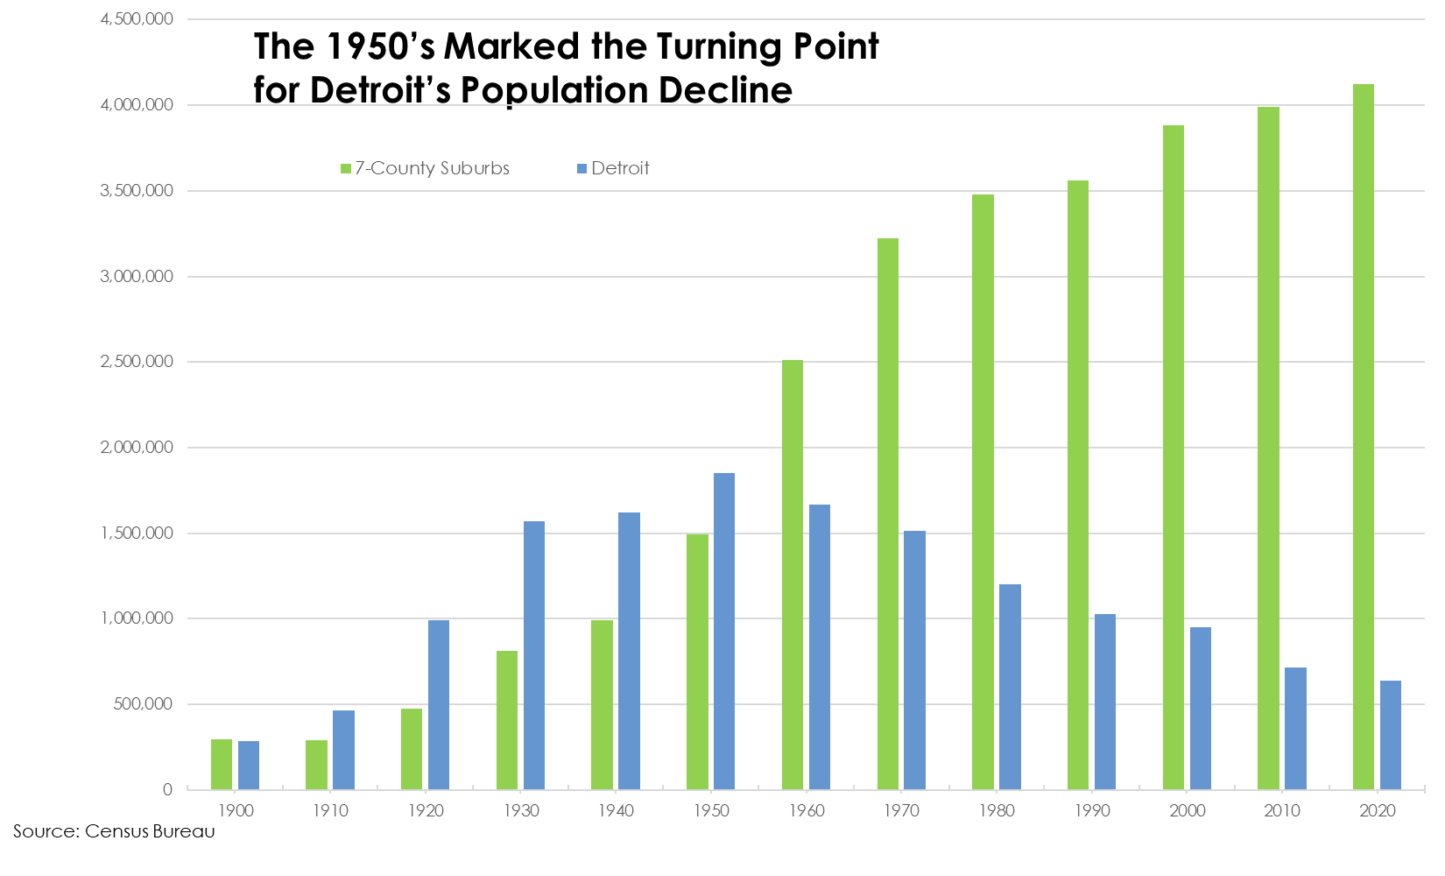
Detroit’s Growth and Decline

Slide 5
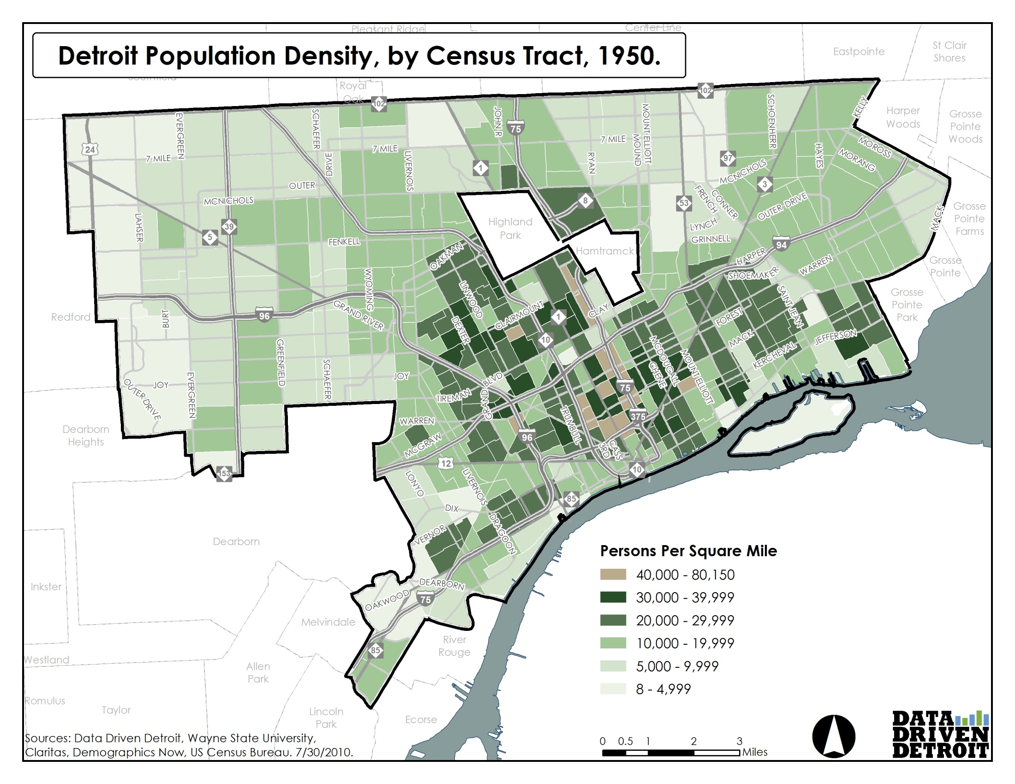
Detroit’s Growth and Decline
A Brief Introduction to Detroit

Slide 6
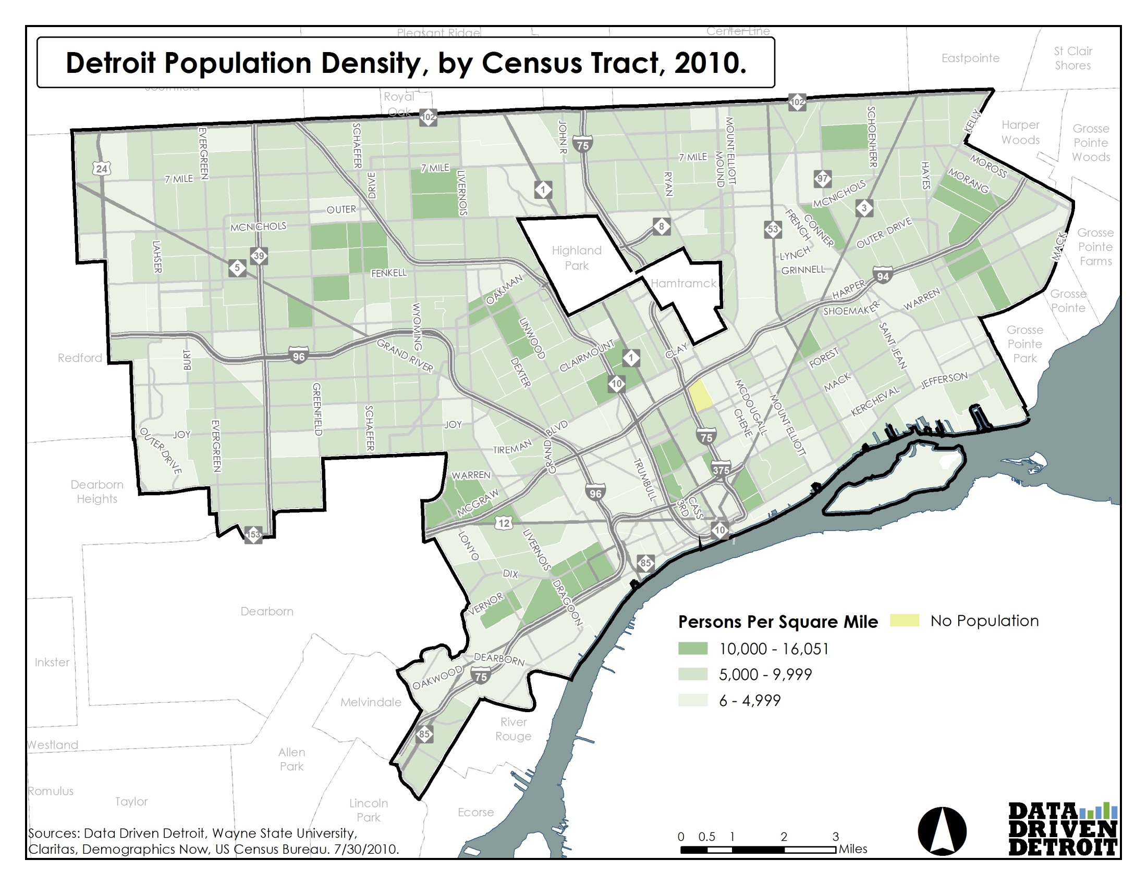
Detroit’s Growth and Decline
A Brief Introduction to Detroit
Notes:
Even after this dramatic decline in population density, Detroit is still a fairly densely populated place

Slide 7
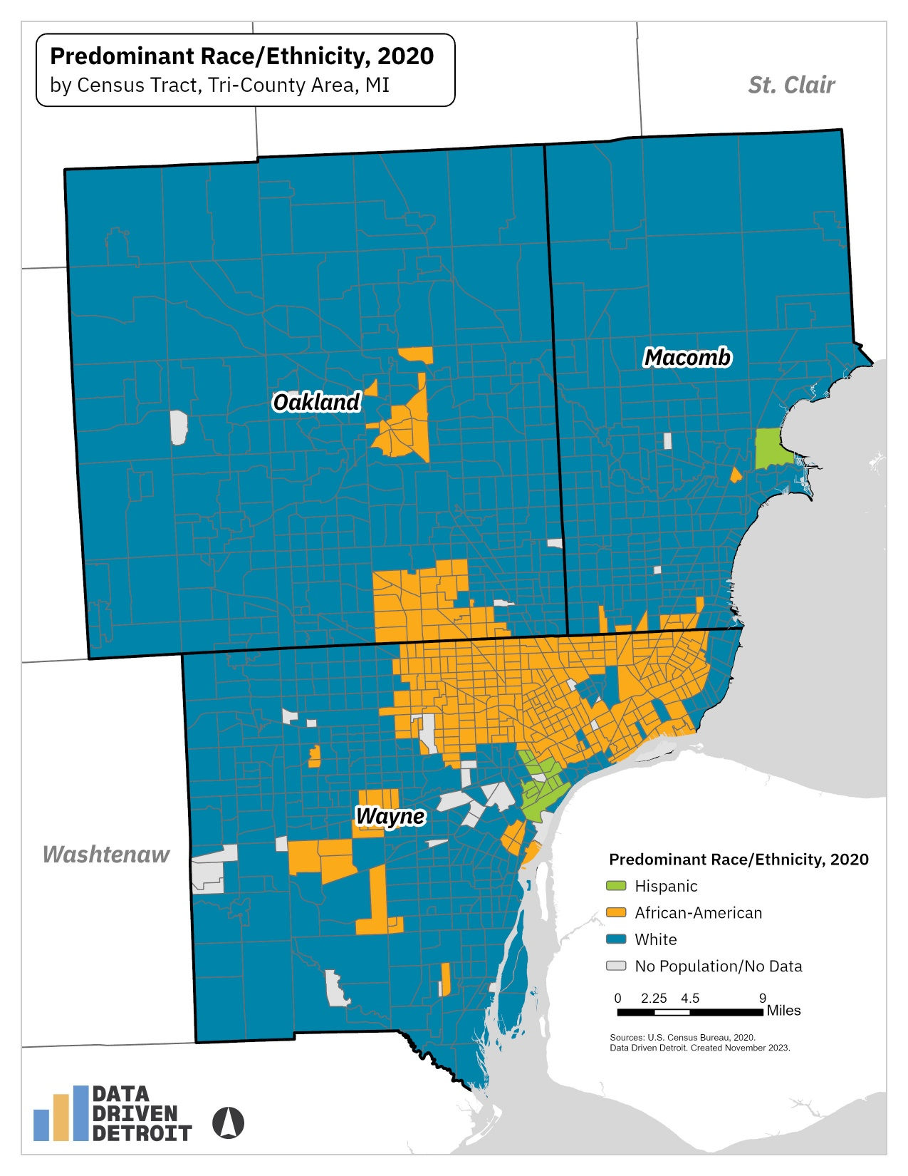
Detroit’s Growth and Decline
A Brief Introduction to Detroit

Slide 8
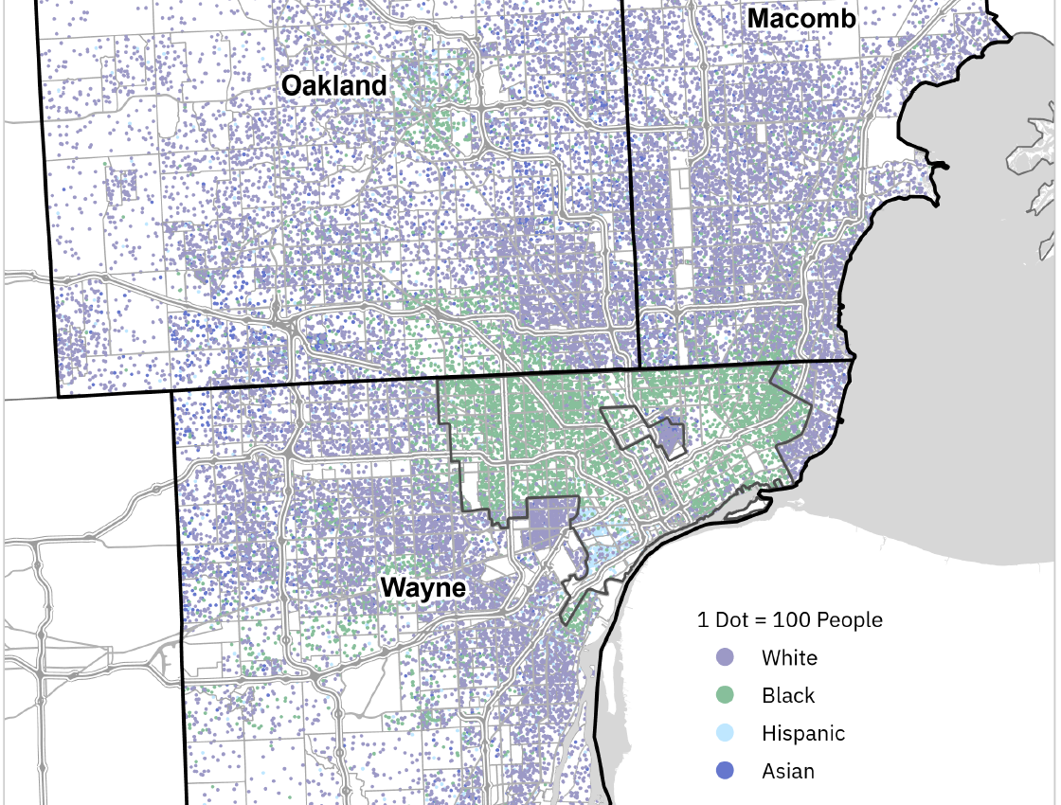
Detroit’s Growth and Decline

Slide 9
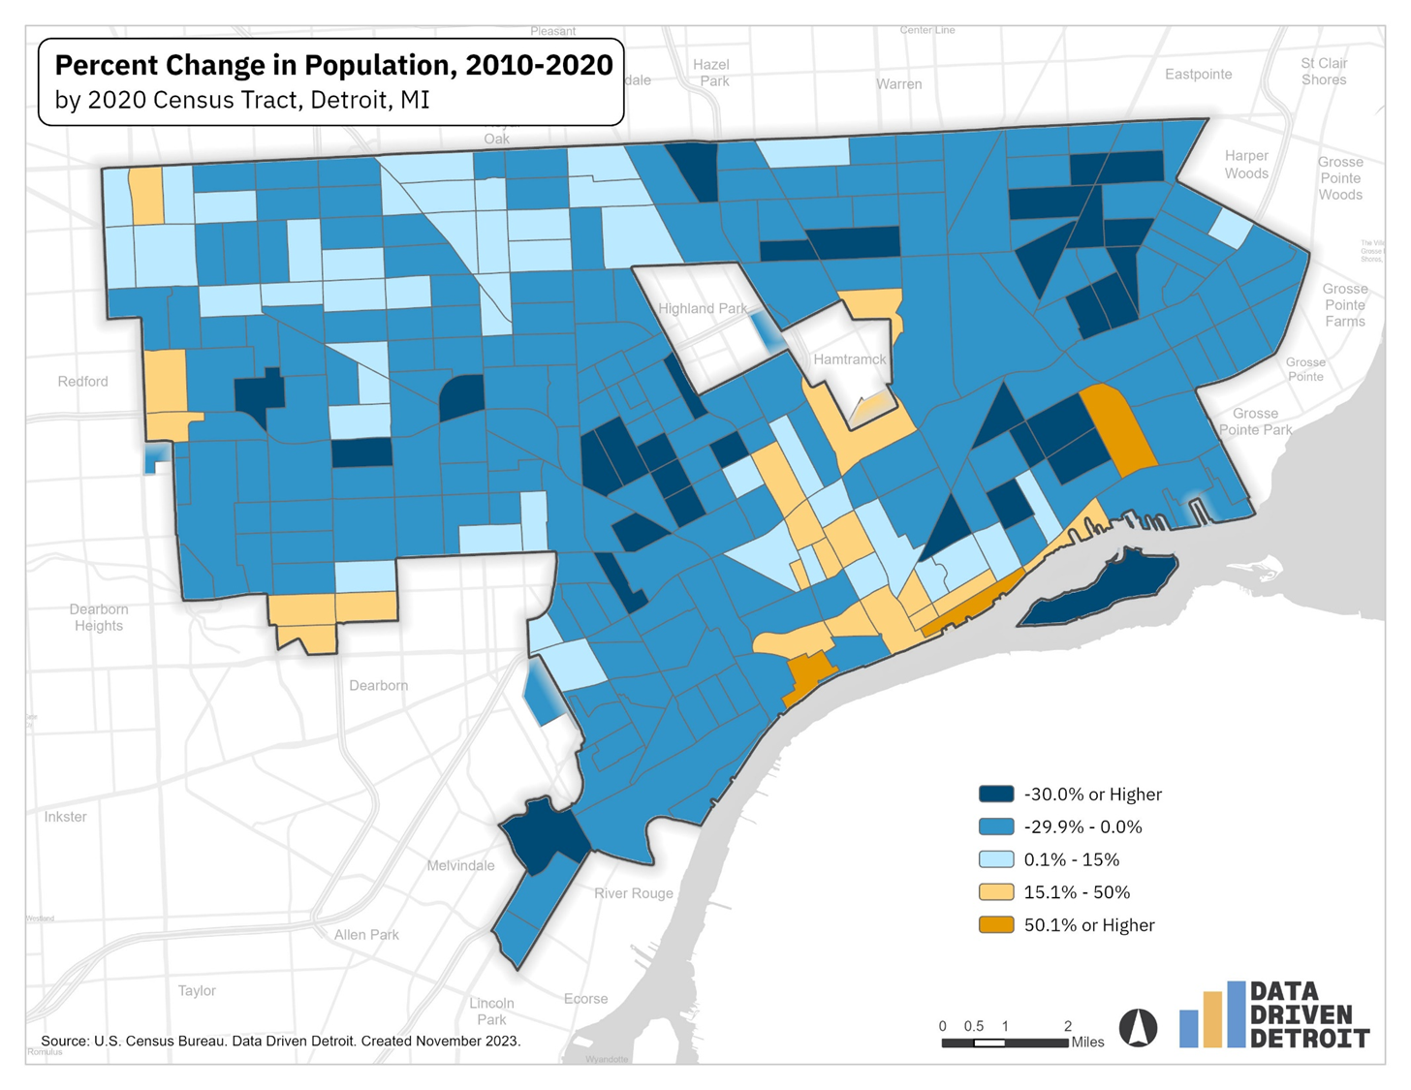
Positive Trends

Slide 10
Neighborhood Tours
Notes:
Founded in 2008
Converted to L3C in 2015
Working towards employee ownership

Slide 11
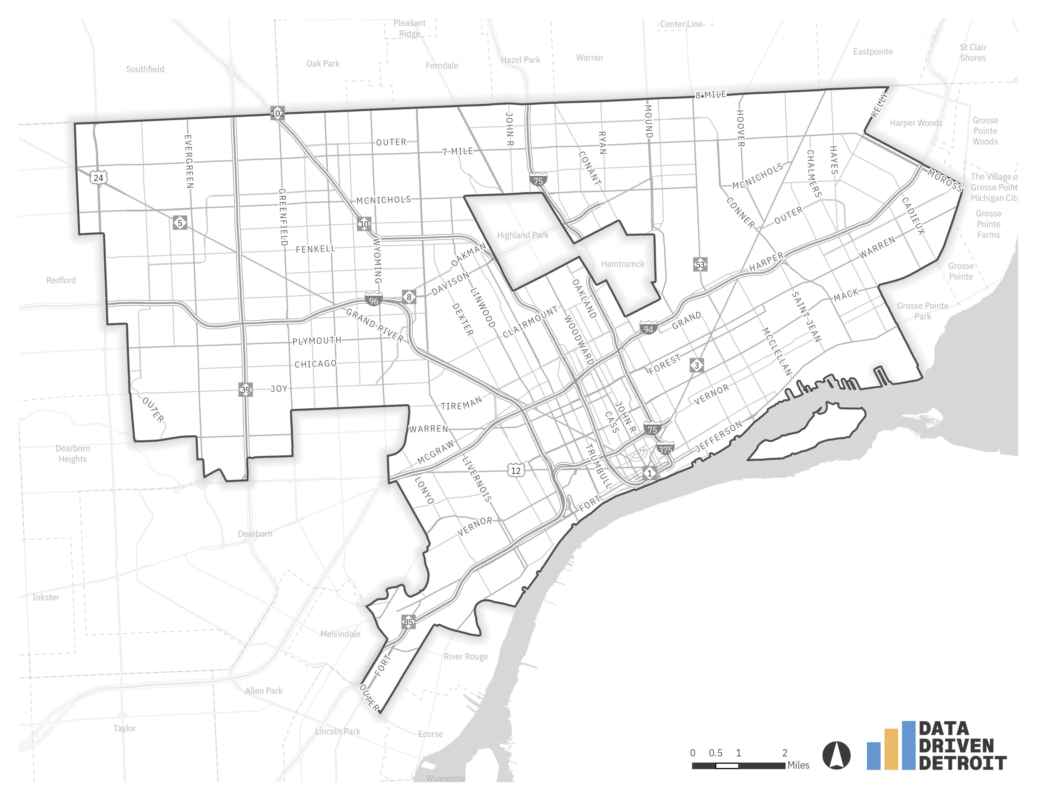
Hamtramck Walking Tour
The Donut Hole
Immigrant enclave, first Polish now Bengali, Bangladeshi, and Yemeni
Dense, walkable community despite changes in Detroit population

Slide 12
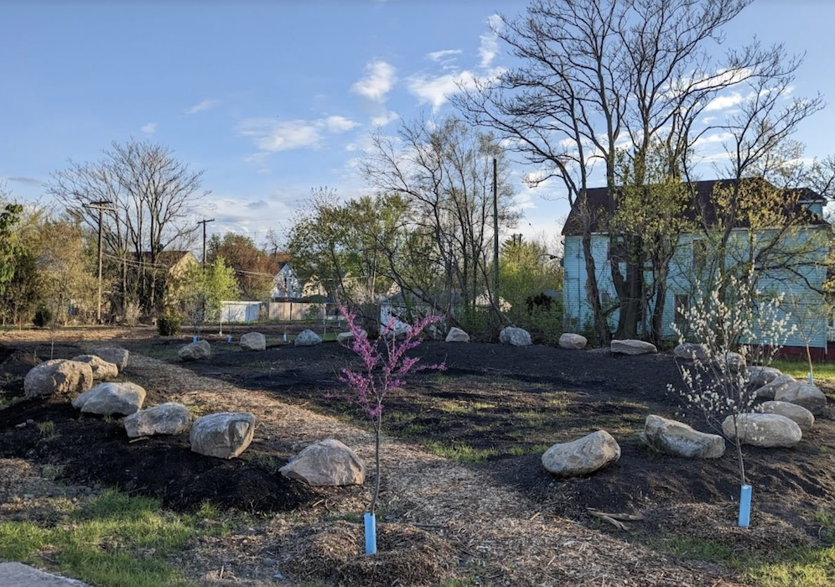
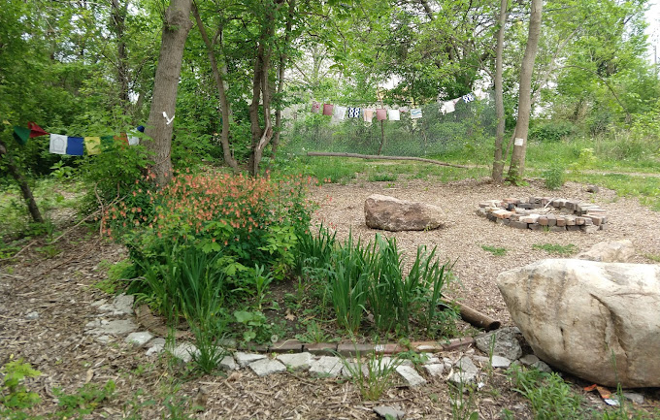
East Ferry Warren Greenway
Explore local green space and programs to transform abandoned lots
Experience a Buddhist tea ceremony

Slide 13


North End/Milwaukee Junction Walking Tour
Learn more about food access, land use and vacancy, and development
Visit local businesses
Learn more about the co-op movement

Slide 14
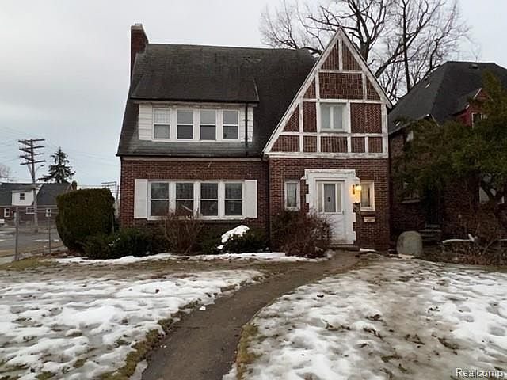
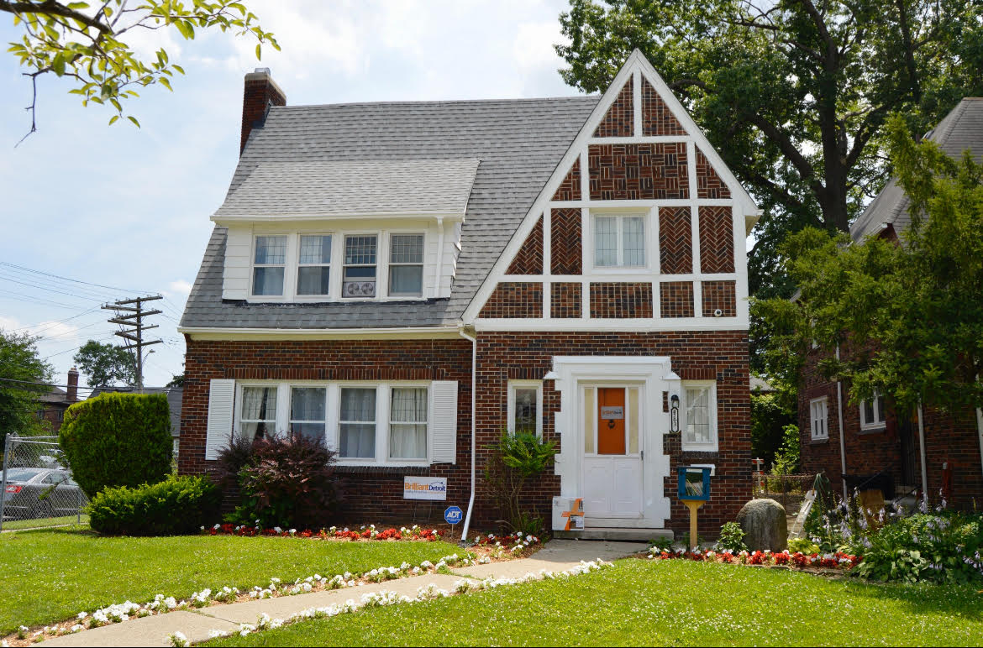

Brilliant Detroit
Learn more about a creative use of housing stock to build kid-focused kindergarten readiness programs
See how these homes are integrated into the surrounding community

Slide 15
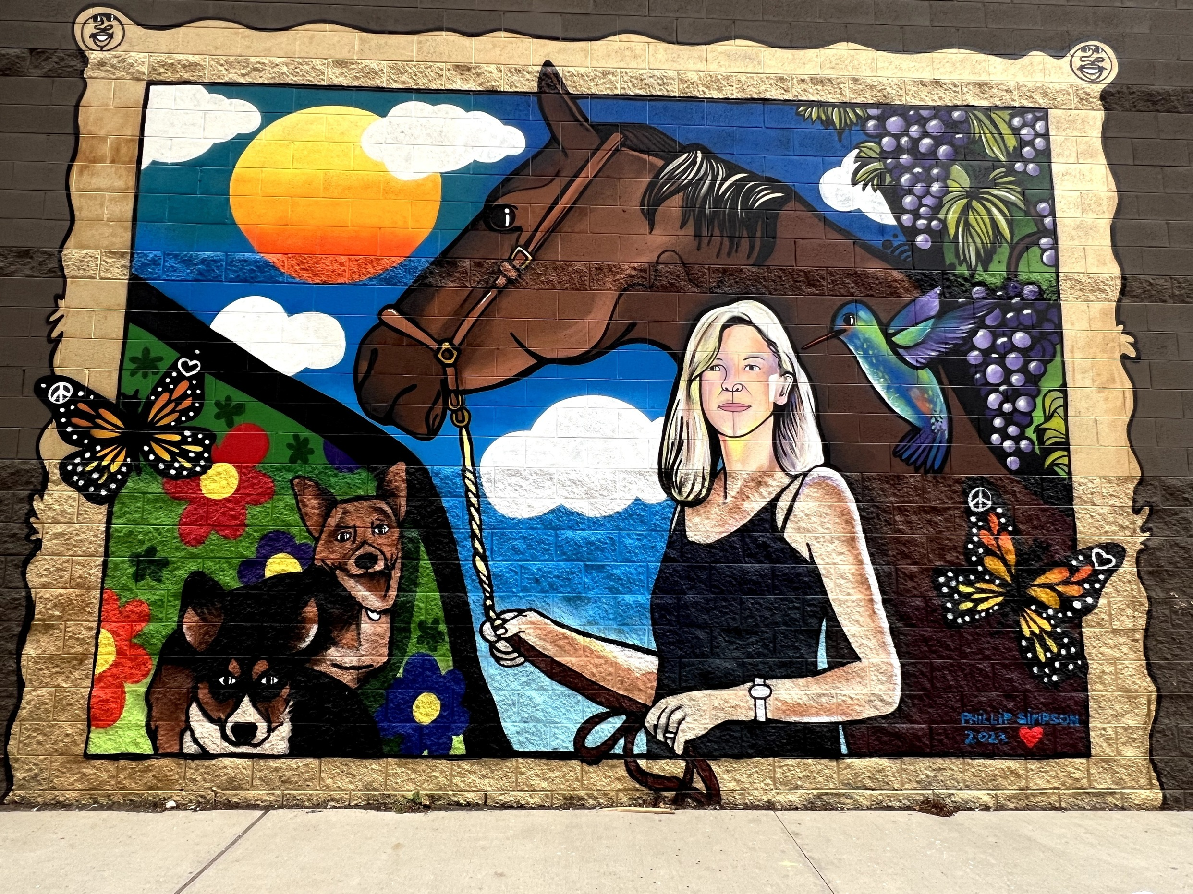
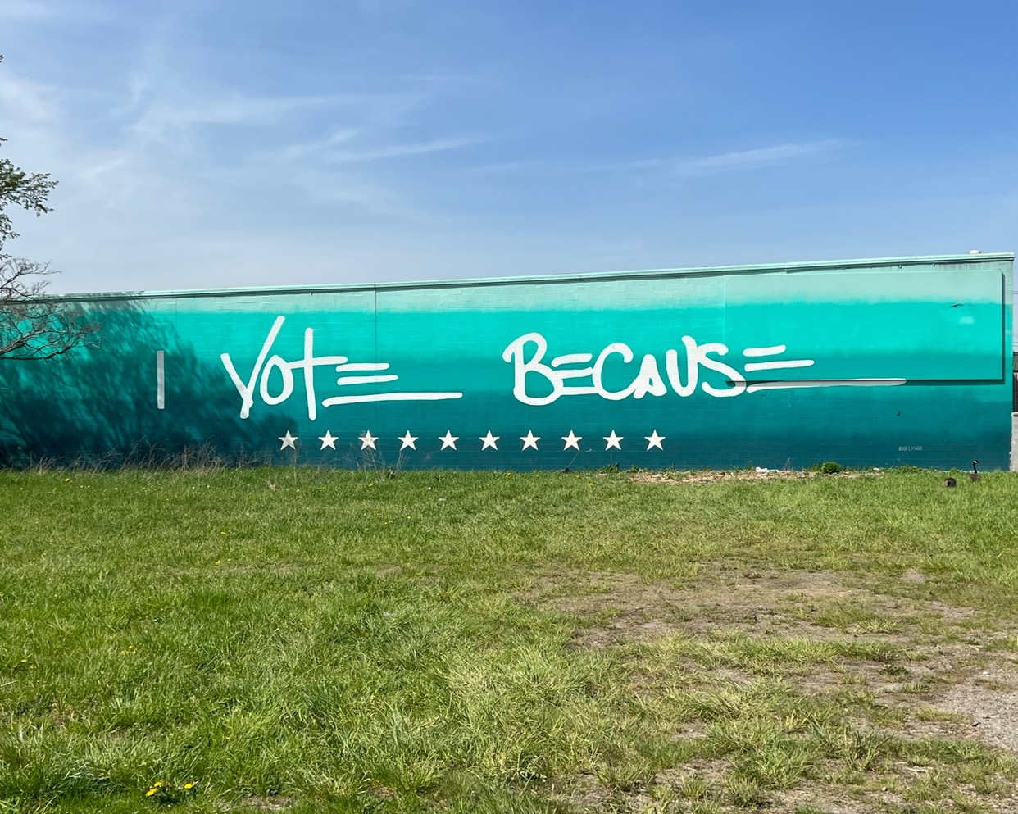

Eastern Market Tour
One of the oldest operating farmer’s markets
Revitalizing as energy from downtown revitalization spills over
Full of beautiful murals, part of UNESCO City of Design

