Slide 1
Using Community-Led Surveying
to Improve Data Equity:
Results from Kent County, MI
Dr. Jeff Williams

Slide 2
Community Health Improvement Cycle
CHNA + CHIP
3-year cycle in Kent County
KCHD leads and coordinates CHNA in partnership with 5 non-profit hospital systems
“The data you collect impacts the action you take.”

Slide 3
CHNA Survey Frustrations
Survey was too long
71 questions in 2020
16 (!) demographic questions
New year? New survey instrument
Extremely hard / impossible to track trends over time
Tension between representation and special populations
Could not shake the feeling that the same people were responding every year
Demographics did not match the county

Slide 4
Convenience Sample Results
Kent County Population¹
2020 CHNA Survey Respondents
18-34
35-54
55+
Female
Male
Asian
Black
Hispanic
White
< High School
HS Graduate
Some College
Bachelor’s Degree +
¹ U.S. Census Bureau, 5-year ACS estimates (2018-2022)

Slide 5
Three Key Factors
Multi-Mode Surveys and Samples
Leverage Existing Partnerships
Community-Led Outreach

Slide 6
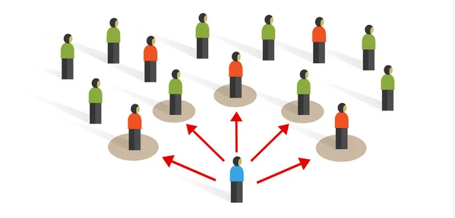
Multi-Mode Survey = Multiple Sampling Methods
 | Random | Convenience | Targeted
Pros | Representative (+/- 5%) | Cost-effective & quick | Produces bias in a way we want!
Cons | Cost & not quick | Produces bias / Non-representative | Relies heavily on trust
Method | Telephone & web panel | Paper & web | Paper & web

Slide 7
Leverage Existing Partnerships
Established in 2022
Evolved from community relationships built during COVID-19 pandemic
Had met in person for 18 months before the surveys were launched

Slide 8
Community-Led Outreach
Compensation
Priority populations were identified
Request made of HEC-Community Voice partners to support surveying efforts
Surveys in multiple languages
Social media toolkit
Unique URL
Flexibility in promotion

Slide 9
Compensation
$2,000 stipend
5-week survey period
Funding for up to 12 CBOs that serve priority populations
Surveys in multiple languages
Social media toolkit
Unique URL
Flexibility in promotion

Slide 10
Compensation
Surveys in multiple languages
Available in 6 languages
Online: English and Spanish
Paper: English, Spanish, Arabic, Kinyarwanda, Swahili, and Vietnamese
Social media toolkit
Unique URL
Flexibility in promotion

Slide 11
Compensation
Surveys in multiple languages
Social media toolkit
Unique URL
Flexibility in promotion

Slide 12
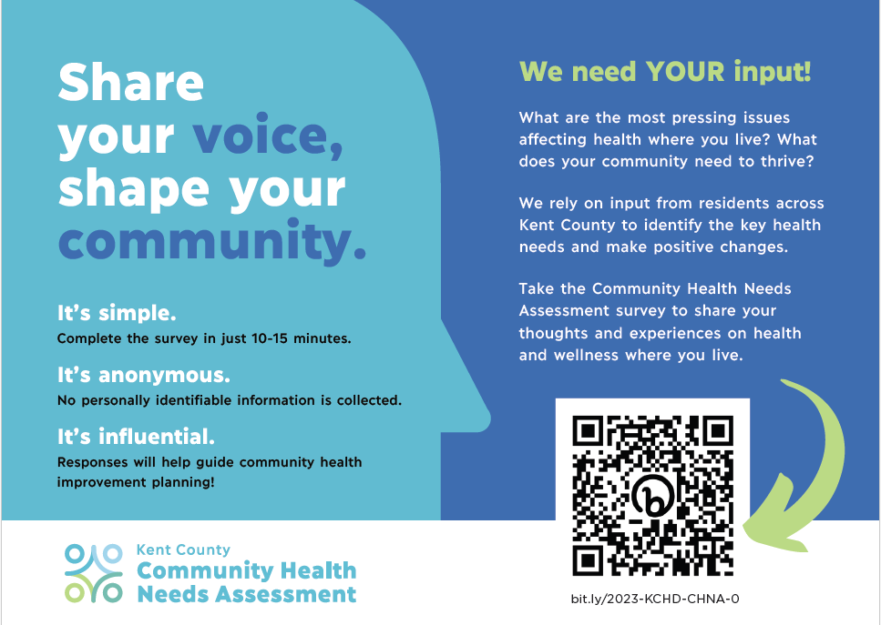
Compensation
Surveys in multiple languages
Social media toolkit
Unique URL
Flexibility in promotion

Slide 13
Compensation
Door-to-door
In-person events
Surveying in ESL classrooms as part of class activities
One-on-one for those with literacy or language barriers
Social media posts
E-mail
Handing out postcards with survey QR code
Networking with other organizations that serve similar populations
Surveys in multiple languages
Social media toolkit
Unique URL
Flexibility in promotion

Slide 14
Increase in Number of Survey Respondents
2023
2020
Responses more than doubled
from 2020 to 2023, despite the survey window being three weeks shorter

Slide 15
Improved Representativeness
Kent County Population¹
2020 Survey Respondents
2023 Survey Respondents
¹ U.S. Census Bureau, 5-year ACS estimates (2018-2022)

Slide 16
Thank you!

