Slide 1
NNIP Partners' Meeting
Detroit 2024
September 23, 2024

Slide 2

Imagine a world where all neighborhoods are places where people thrive.

Slide 3

NNIP Mission
NNIP helps local communities use data to shape strategies and investments so that all neighborhoods are places where people can thrive.

Slide 4

Thank you to Data Driven Detroit
Shout out especially to:
Jordan Graves
Stephanie Quesnelle
Erica Raleigh
Noah Urban
Notes:
Thank all the staff too - people doing panels, tour guides, etc

Slide 5

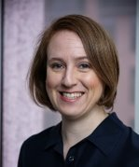
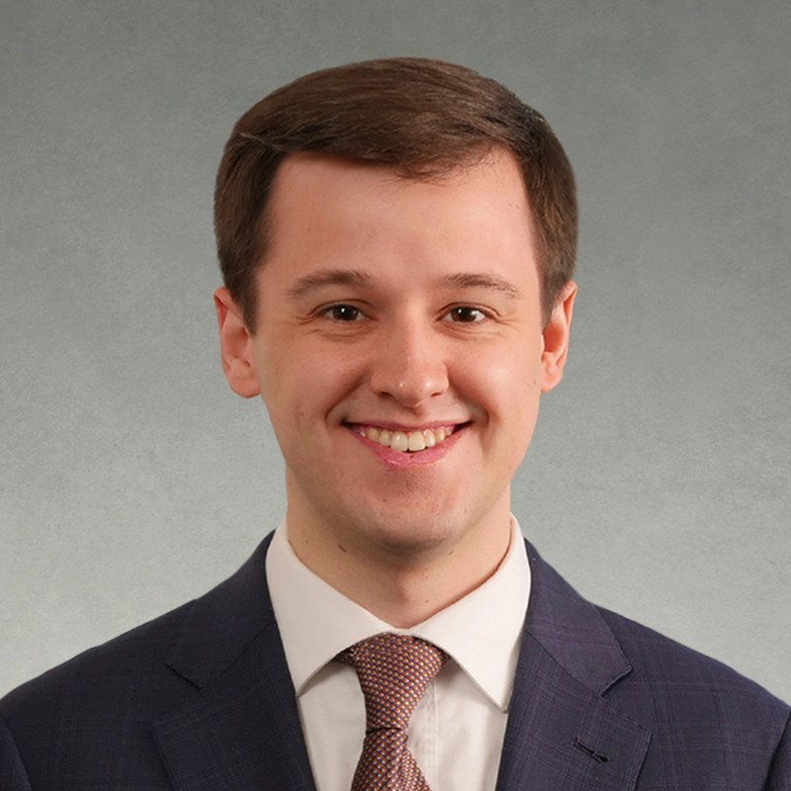
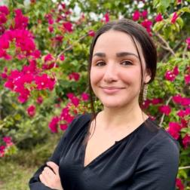
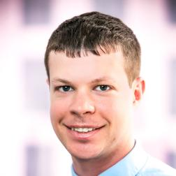
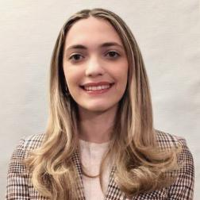
Urban Institute NNIP Staff
Kathy Pettit
Leah Hendey
Cole Campbell
Lizzy Ferrara
Rob Pitingolo
Sophia Ayaz
Notes:
Gabi is other team member – couldn't be here this week.

Slide 6
NNIP Leadership: Guiding the Agenda
Executive Committee 2024
Victor Amaya, Milwaukee
Amy Carroll-Scott, Philadelphia
Lamar Gardere, New Orleans
Elizabeth Monk, Pittsburgh
Amanda Phillips de Lucas, Baltimore
Elly Schoen, Los Angeles
Recent Members, 2022-2024
Noah Urban, Detroit
Geoff Smith, Chicago
Mariko Toyoji, Seattle
Altonio Smith, Memphis
Caroline Bhalla, Los Angeles
John Killeen, Durham
Notes:
Mention executive committee nominations/elections coming up

Slide 7

Welcome
Community Innovation Action Center from St. Louis!

Slide 8

Thank You to Partner and Alumni Speakers
29 staff speaking from 21 organizations

Slide 9
Welcome Alumni
Actionable Intelligence for Social Policy
City of Pleasant Ridge
Detroit Future City
Ohio Housing Finance Agency
Independent Consultants
Signal Cleveland
Walton Family Foundation

Slide 10




Welcome Guest Cities

Slide 11
Welcome National Guests
Atlanta Wealth Building Initiative
Black Wealth Data Center
Data-Smart Cities Solutions
Federal Reserve Bank of Chicago
National League of Cities
University of Toronto
Notes:
Also – local guests from Detroit Future City, KIDS Count network

Slide 12


NNIP Supporters

Slide 13
Strategic Framework: Goals for 2024-26
Data-informed local policy & practice
Inspiration
Replication
Innovation
Promotion & investment in local use of data
More focus on neighborhoods
Equitable data practices
Expanded community data capacity
Stronger, expanded NNIP network
Stronger, engaged partners
New partner cities
Engaged alumni
Improved Urban-NNIP exchange
Notes:
To achieve our vision where all neighborhoods are places where people thrive, as part of our recent strategic planning process we developed three goals for the network to work towards in the next three years, which I just wanted to touch on briefly.
The first is that Local actors adopt data-informed policies and practices to distribute resources more fairly and equitably across neighborhoods. We think this can happen by harnessing the collective insights and specific examples from NNIP to inspire other cities, replication within the network, and innovation through new cross-site projects.
The second goal is that National networks, organizations, and agencies actively promote and invest in the use of data influenced by NNIP values and examples. This means that these organizations place more focus on neighborhoods and their importance for equity, promote and use equitable data practices, and invest in expanding data capacity in NNIP cities and across the country.
And finally – as the power of NNIP is in the network – we want to work towards a stronger and expanded NNIP network to support influence and impact in NNIP cities
and nationally. This means having local partners be more engaged in the network, bringing in new partners cities, engaging more with the NNIP alumni, and improving the connection between Urban and NNIP.

Slide 14
Milestones 2023-2024
Launched NNIP Emerging Opportunities Fund
Elevated housing-related work & engagement
Developed cross-site concepts templates & materials
Piloted Impact Fellowship with 3 partners (and apply now!)
Added 2 partners and started research on other cities
Conducted Alumni survey & engagement
Initial outreach to other funders
Notes:
We will report out more this fall.
Plug for another set of impact fellowship

Slide 15
Agenda and Logistics

Slide 16

NNIP Meeting App
https://bit.ly/NNIPDetroit
Schedule
Chat
NNIPCamp
Restaurant google map
List of attendees
Notifications (which can be turned off)

Slide 17
Reception and Tours
Monday Reception from 6:00 – 7:30 pm
The Corner Ballpark, 1680 Michigan Ave, Detroit, MI 48216
5:40 pm and 6:10 pm – Meet for bus transportation. Buses leave at 5:45 and 6:15! Or a 20-minute walk.
Tuesday Tours: Meet at 3:20 to 3:35 to depart 3:30 to 3:45 (see handout and Yapp)
Thanks to Jordan for organizing and our tour guides!!
  Sign up for tours at the registration table today!

Slide 18
NNIP Code of Conduct & Meeting Norms
Relationships are the foundation of the NNIP Network!
Treat people with respect
Appreciate participants’ varied backgrounds
Assume good intentions
Be active listener & contributor
We are dedicated to providing an environment for all participants that is free from discrimination and harassment, regardless of gender, gender identity and expression, sexual orientation, disability, physical appearance, national origin, citizenship status, veteran status, race, age or religion.
Notes:
See handouts on your table.

Slide 19
Introductions: Pass the Mic

Slide 20
NNIP Camp Detroit
Rob Pitingolo

Slide 21
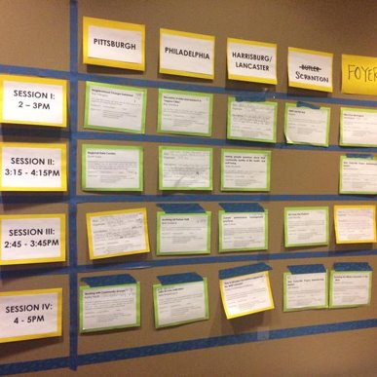
Together we build the agenda
Submit an idea
Vote on your favorites
Volunteer to lead if necessary
On Monday and Tuesday we build our agenda
Check the app for the schedule

Slide 22
Voting
Online votes helped with initial impressions, but votes on-site are critical so we can make final choices
Make sure to visit the boards today and vote early to help finalize camp sessions
Voting Deadlines:
  Monday, 1:00 pm
  Tuesday, 1:00 pm
  Wednesday, 8:00 am

Slide 23
NNIP Camp Rules
Set your own agenda.
Introduce yourself.
Assign a note-taker.
Avoid planned speeches & PPTs.
Contribute & allow other to contribute.
COME AND GO AS YOU PLEASE.

Slide 24
Mentimeter Questions

