Slide 1
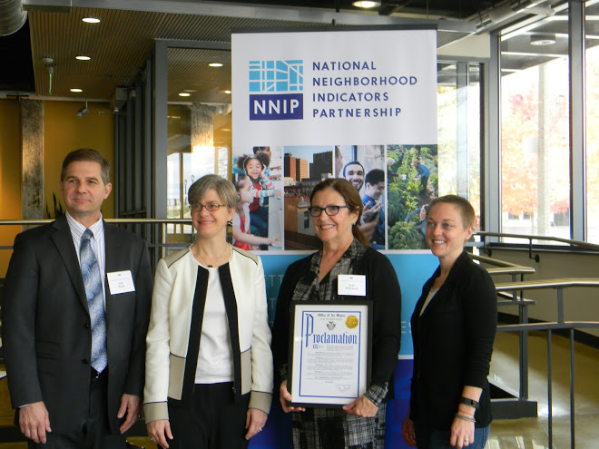
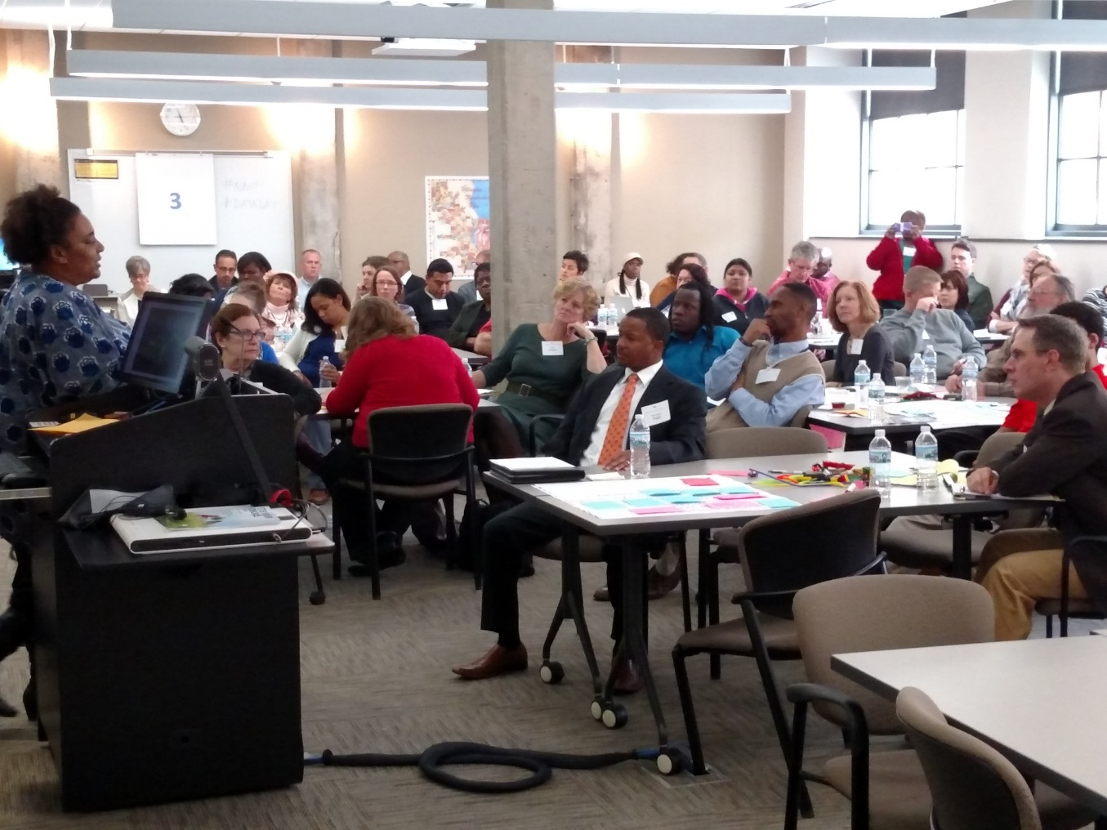
Milwaukee’s First Ever Data Day
Lessons Learned
Before, During and After
Katie Pritchard
IMPACT, Inc.

Slide 2
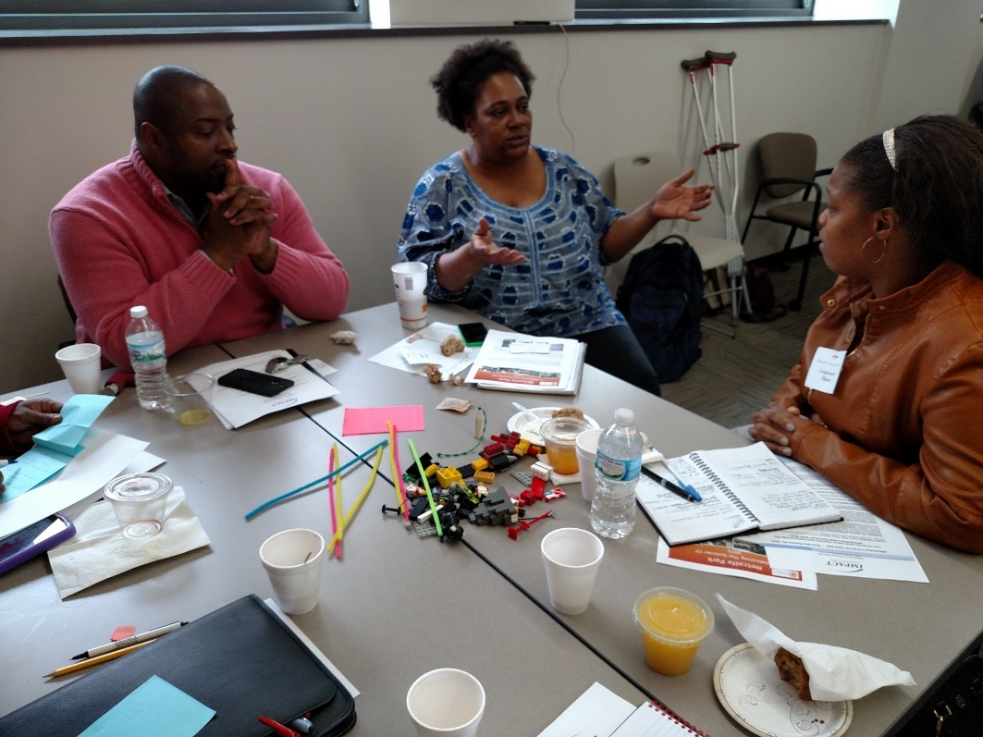
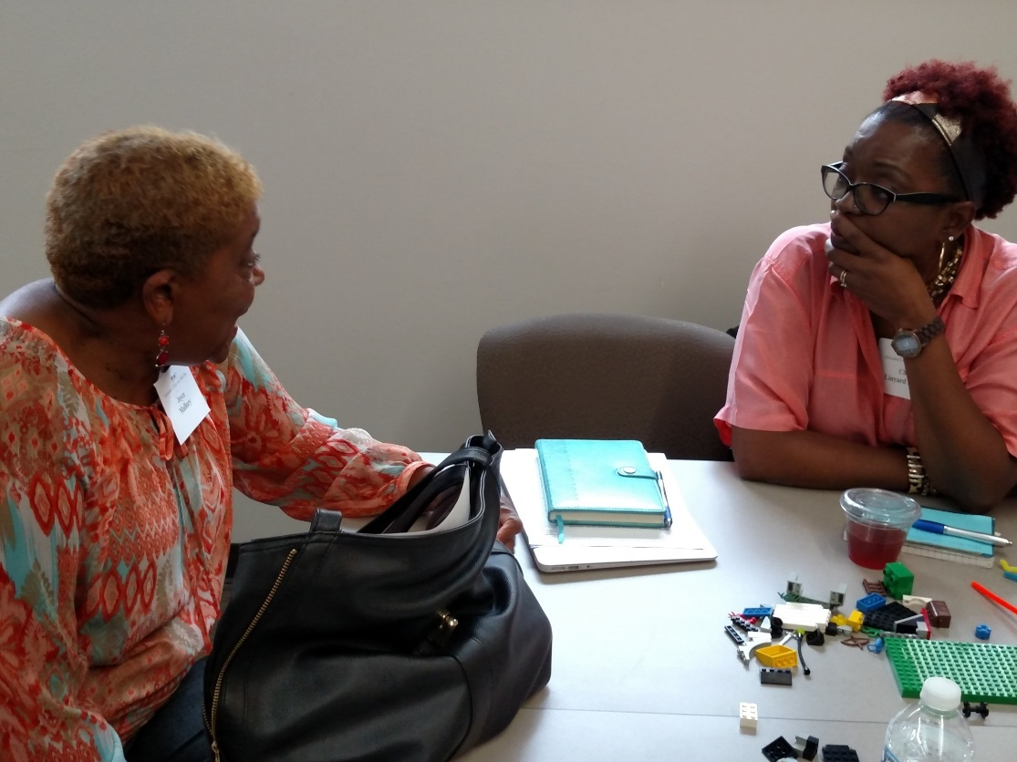
Before
Be intentional about the design
Strategically engage a Planning Committee
Gather support that will help with ownership
Notes:
Be Intentional about the Design
Translator—Design experience firm $1,500 for a design session
What do you want to get out of it? Design the experience to reinforce the goals.
Mark our entry, feature NNIP HQ and Data Driven Detroit
Connect, reflect, select
size, venue, attendees, invited guests, name
Intentionally Modest – have to start somewhere
Strategically engage a Planning Committee –funders that work in neighborhoods, school of public health, United Way, Children’s Hospital, Nonprofit Center, resident, data keepers
They controlled invite list and contributed
Gather Support that will help with ownership
from $500 to $10,000, food, space, venue, proclamation

Slide 3
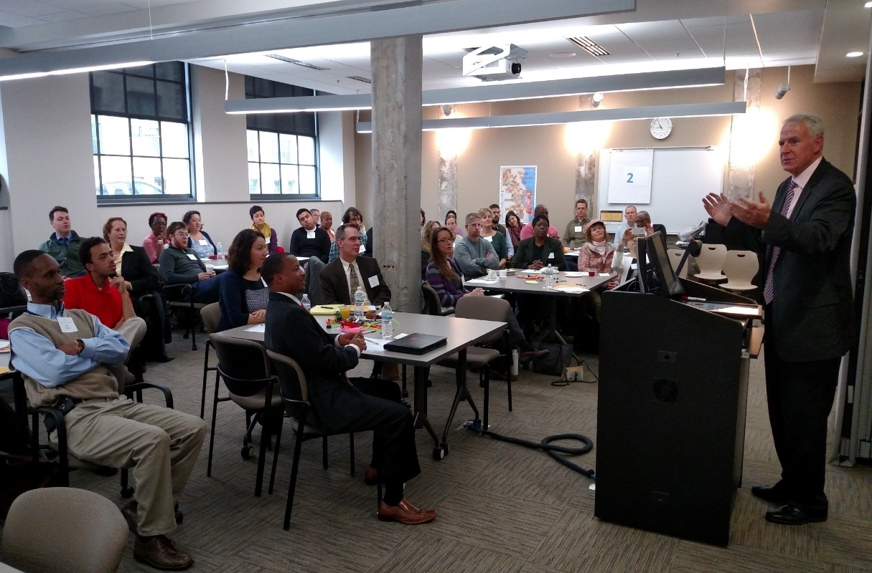
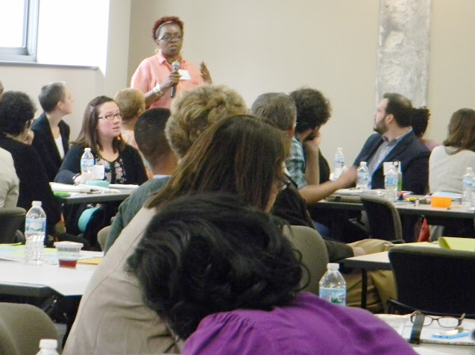
During
Set the stage
Mayor, NNIP HQ, Federal Reserve Bank
Data Driven Detroit
Neighborhood agencies and residents
Community Conversations (Harwood)
Funders- give them a role
Recruit Data Keepers to help
Engage the group in identifying next steps
Notes:
Set the stage Food from the neighborhoods, Based in a redevelopment area
Neighborhood agencies and residents
Certificates and stipends for neighborhood residents
Photo releases for all, contact infor for all
Funders- give them a role, they picked neighborhoods, and recruited res
Agenda
Welcome– Mayor, NNIP HQ, Federal Reserve
Community conversation around neighborhoods
Assets, problems, strategies
What’s the evidence?
Lunch Keynote—Data Driven Detroit
Data Keepers contribute to strategy
Groups make pitch presentations re project(s)
Data people responded (fell short)
Select project where data could be useful

Slide 4
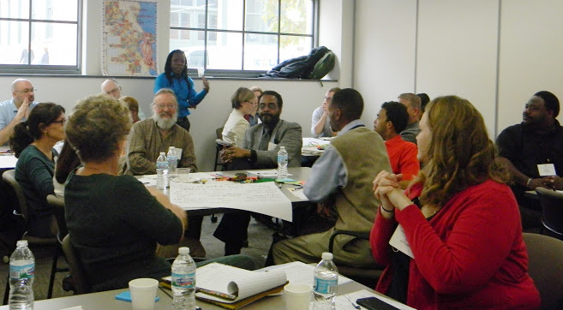
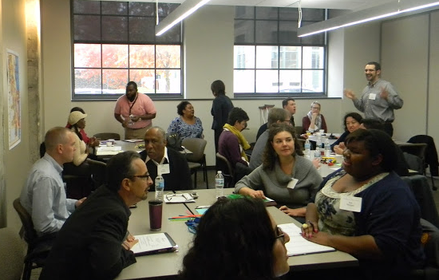
Facilitated Community Conversation
Greatest neighborhood Assets
How are they documented? What’s the evidence?
Greatest neighborhood Problems
How are they documented? What’s the evidence?
What is our most promising change strategy?
How are they documented? What’s the evidence?

Slide 5
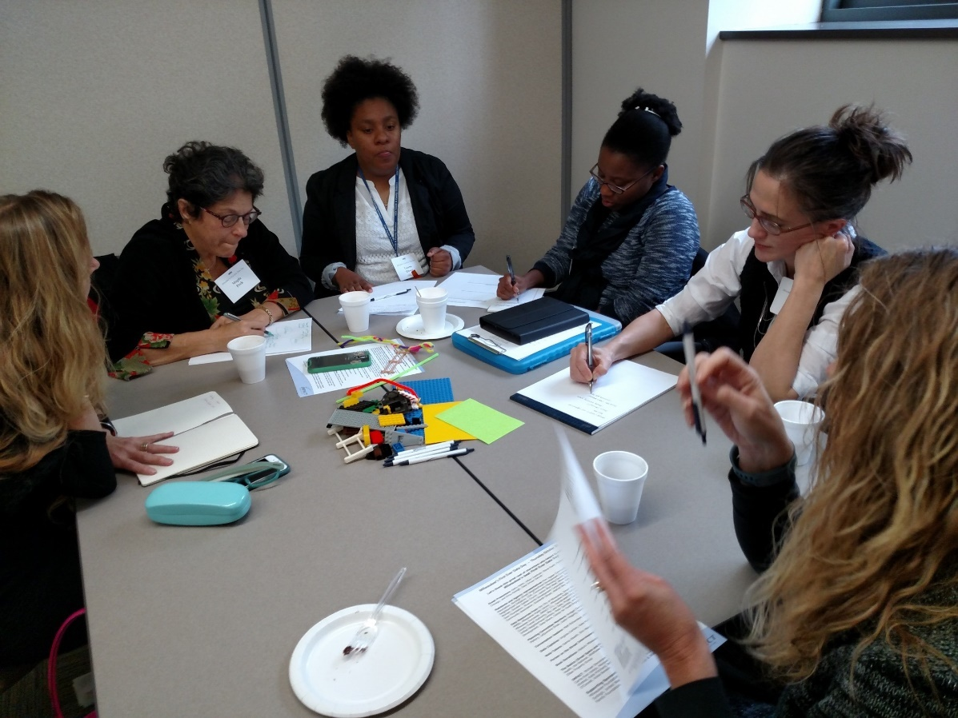
After
Two projects: swings, parks, maps, voting
Telling the story
City – Mayor’s Office & Common Council
University- GIS project- parks and crime, registered voters
Two foundations committed for next year
Notes:
Certificates for neighborhood residents
Photo releases
Parks in two neighborhoods….
Action research
What kind of data do you need to make the case
GIS/ Criminal justice/ community organizing
“Heard good things about data day” exposure
Engagment , action and support

Slide 6
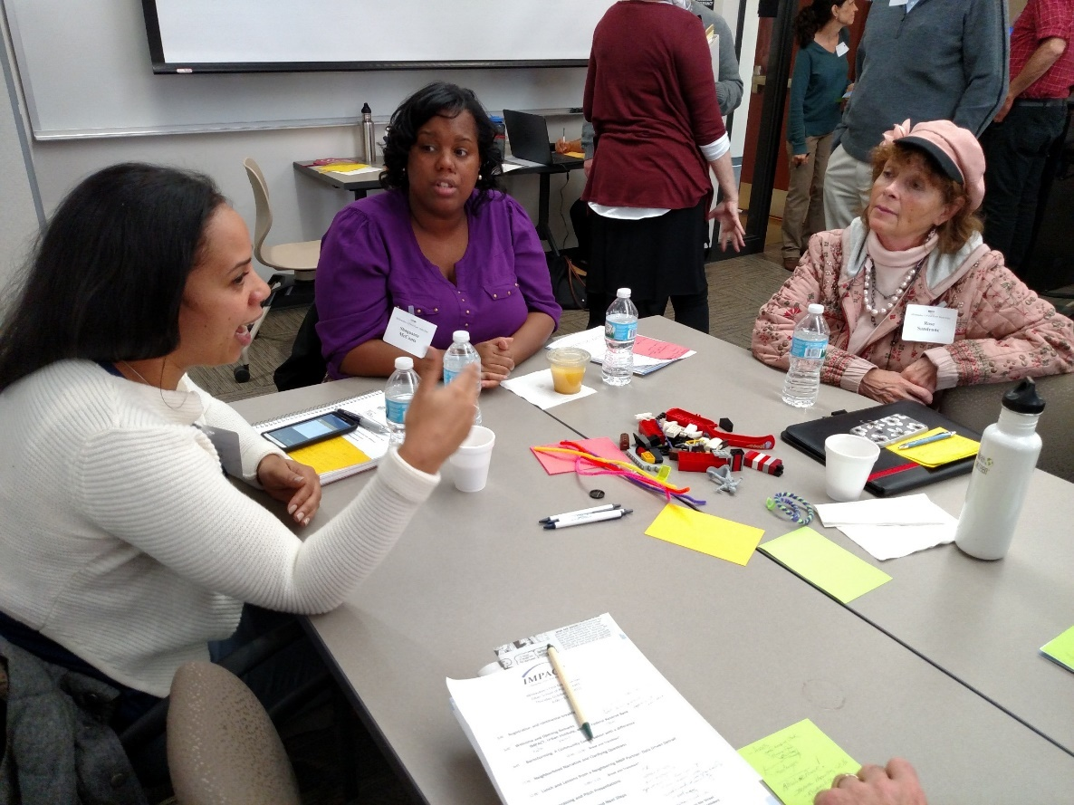
Milwaukee’s Second Ever Data Day?

