Slide 2
Recap: Mile High Data Day
Denver Metro Region Feb 2016
Mingming Zhang
The Piton Foundation

Slide 3
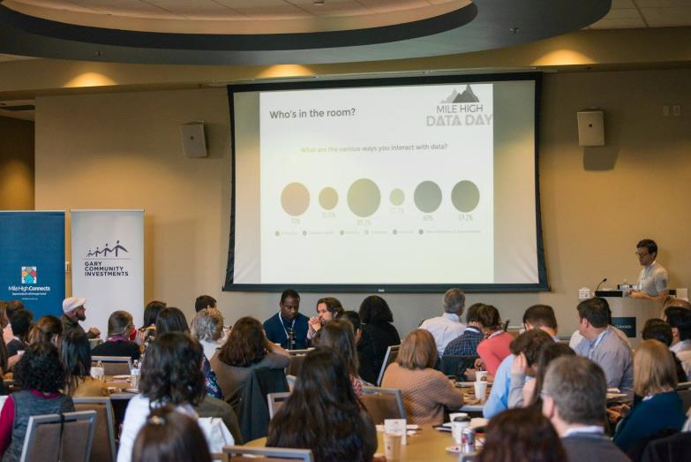
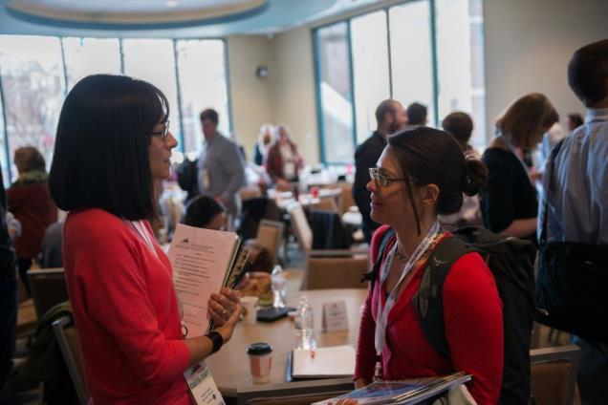
Driving Social Change through Data
To create a network focused on using open data to support Community change

Slide 4
Partners
The Data Initiative at The Piton Foundation
UCD College of Architecture and Design
Denver Regional Council of Governments
OpenColorado
Mile High Connects

Slide 5
Overview of the day
Keynote Presentation
Steve Spiker
Director of Research & Technology, Urban Strategies Council
Panel of Data Practitioners & Users
Lunch Round Table Discussion
Two Rounds workshops
7 workshops + unconference session
Networking Game
Over 50% attendees finished the game

Slide 6
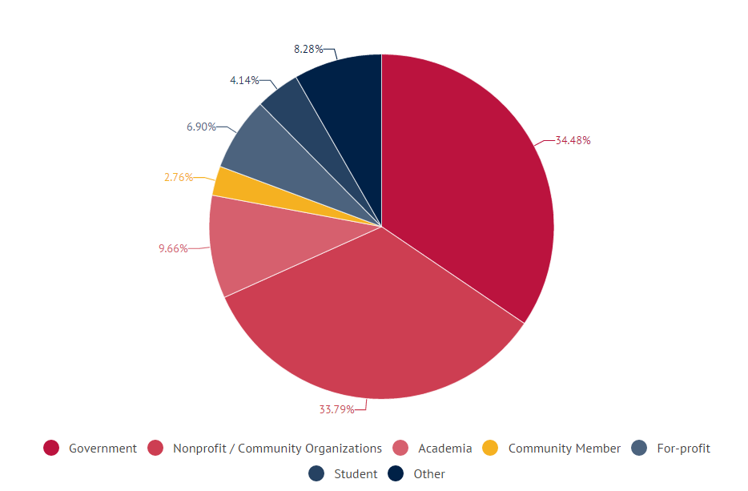
Who’s in the room

Slide 7
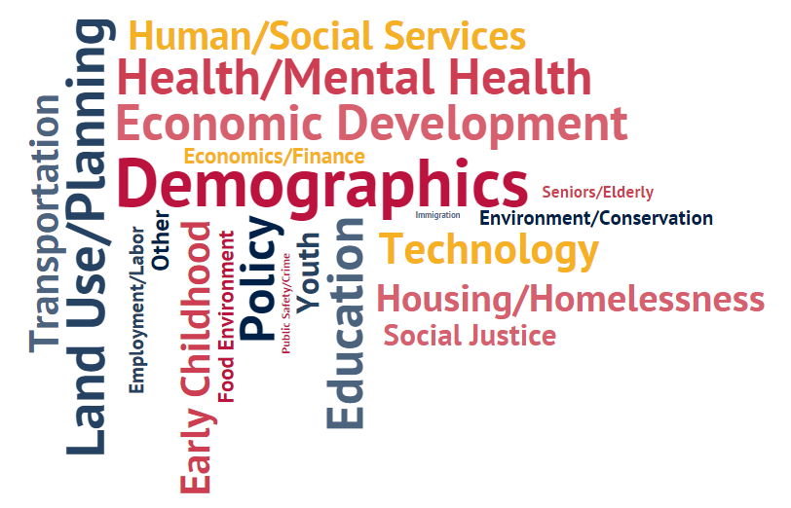
Who’s in the room

Slide 8
Who’s in the room
Various ways interact with data

Slide 9
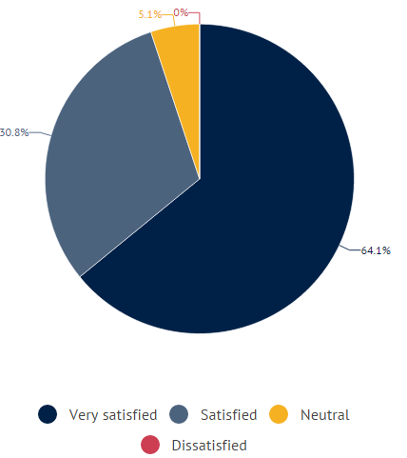
Data Day Overview: Post-Survey
Feedback Survey: 80/120 responses
Overall, how satisfied?
Do you plan on attending next year?

Slide 10
Data Day Overview: Post-Survey
Please tell us how much you agree with the following statement
The content of the conference sessions was appropriate and informative
The conference and registration process were well organized

Slide 11
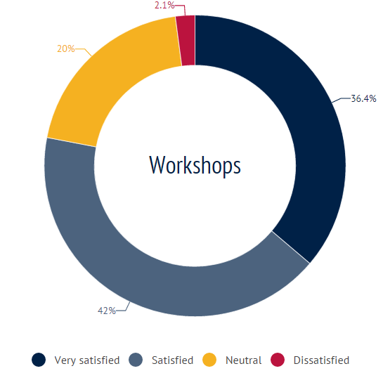
Data Day Overview: Post-Survey
Workshops

Slide 12
Data Day Resources
#MileHighDataDay was trending on Twitter throughout the day. Check out the Twitter dialogue on our Storify page.
Visit Piton’s Facebook page to view photos from the event.
Read our blog post on Reflections on planning Mile High Data Day
Get more resources of our event
Contact
Mingming Zhang
Data and Research Analyst
The Data Initiative
mzhang@garycommunity.org
303.454.3765
Kelly Nelson
Research Analyst
The Data Initiative
knelson@garycommunity.org
303.454.3754

