Slide 1
MicroCider: MICROSITE GENERATOR FOR DATA-DRIVEN REPORTS
Maxwell Austensen
Data Analyst
NYU Furman Center
NNIP Idea Showcase
June 9, 2016
1

Slide 2
Microsites and MicroCider
Microsite:
Separate website, with different design and structure
Not dynamic, so no upkeep required
Concise, and shareable at different levels
Perfect solution, between PDF and full website
MicroCider developed by Brian Karfunkel
NNIP Ideas Showcase presentation:
July 2015 Presentation (starts @ 25:00)

Slide 3
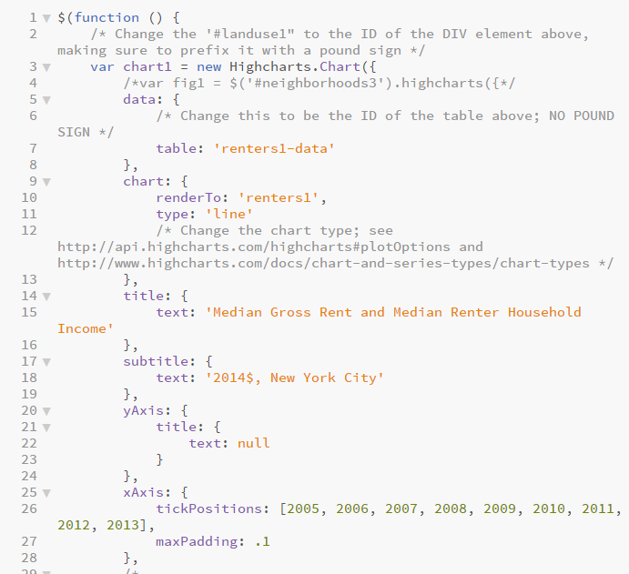
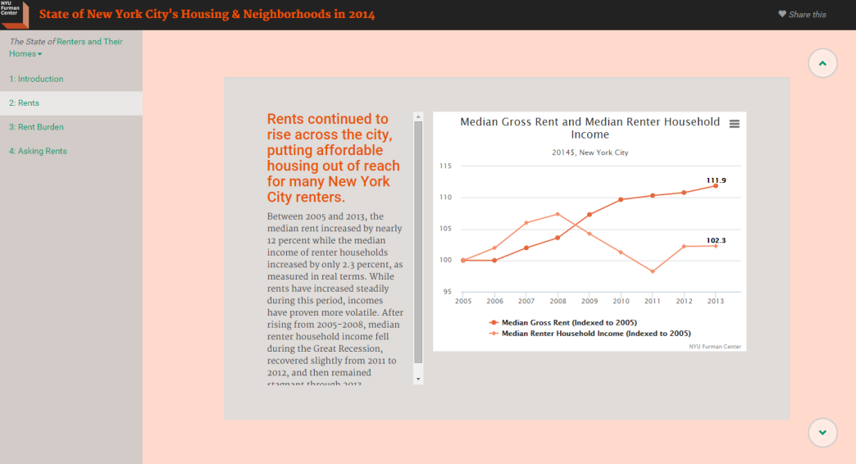
Generating microsites
Text file with content
Javascript file specifying interactive figure
title: In the past eight years, rent increases have far surpassed income growth.
figure: figure1.js
Between 2005 and 2013, median rent increased by nearly 12%, while median income of renter households increased by only 2.3% as measured in real terms.
Formatted Website
Run MicroCider…

Slide 4
Limited Technical Knowledge Required
You’ll need someone who:
Can install and run programs from the command line
Is familiar with Python, HTML, and CSS
Knows basic Javascript for interactive figures
Can upload files to a web server (and create subdomains if necessary)
File organization separates more technical backend files from content components

Slide 5
Links
NYU Furman Center’s Microsite example:
furmancenter.org/soc2014
MicoCider’s Github repository:
github.com/FurmanCenter/MicroCider
NYU Furman Center’s CodePen profile:
codepen.io/FurmanCenterNYU
Documentation for MicroCider in repo:
microsite\docs\build\html

Slide 6
Need help getting started? Get in touch!
Maxwell Austensen
Data Analyst
NYU Furman Center
Maxwell.austensen@nyu.edu

