Slide 1
Open Government Budget Data in Equity Analysis
Jeff Matson
jmatson@umn.edu
CIC Impact Summit
11/16/17
Notes:
First of two presentations: 20 min + questions

Slide 2
Outline
Two projects examining city budgets
St. Paul’s Capitol Improvement Budget (CIB)
Minneapolis’ Capitol Long-range Improvement Committee (CLIC)
Data Availability
Equity questions

Slide 3
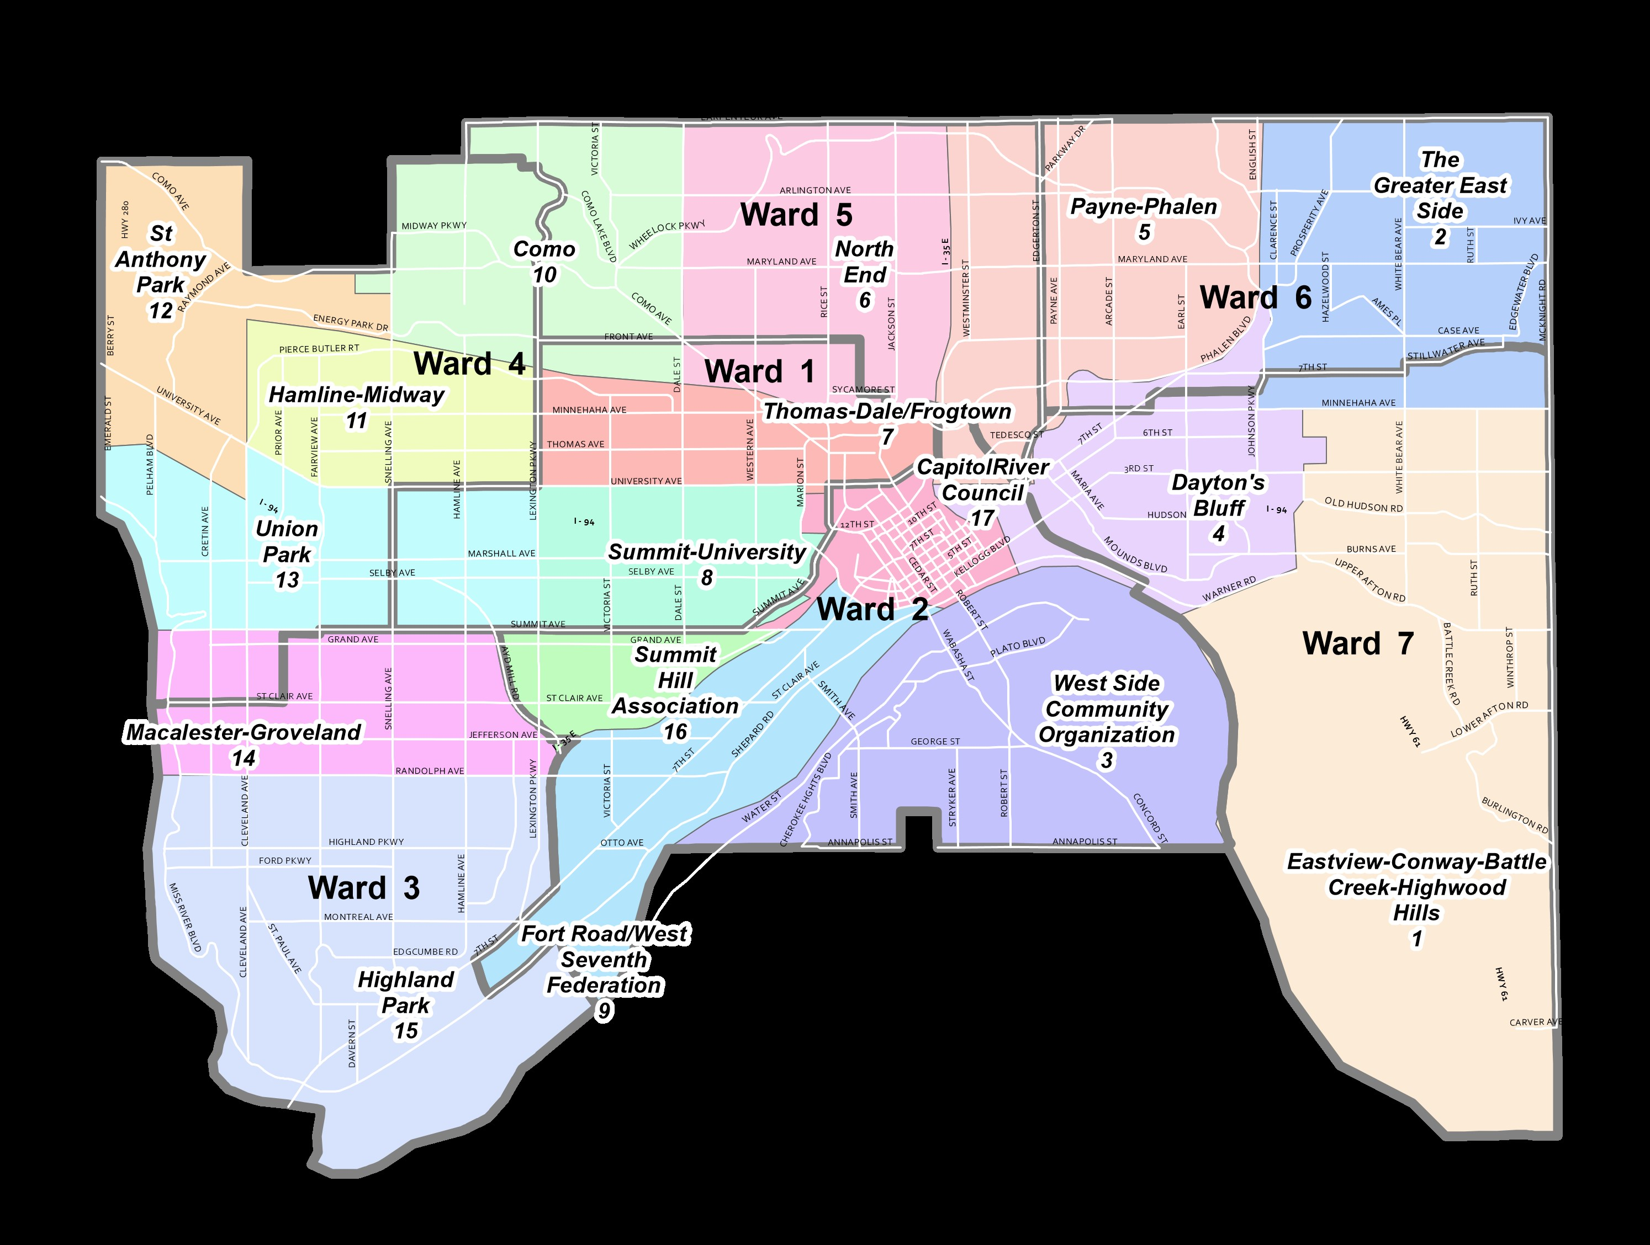
St. Paul’s Eastside
ESNDC
DBNHS

Slide 4
Funding Programs
CIB
Complicated Review Process
Neighborhoods, City Departments, Individuals
STAR
Competitive Grants and Loans
Neighborhood-based
Funded through City Sales Tax
$2-3M per year ($10,000 - $150,000)
15-20 projects
One-to-one match on funding

Slide 5
Three Questions
Who gets funding?
Is the Eastside getting its fare share?
Has the process changed?

Slide 6
CIB Process Overview

Slide 7
Our Role
Sort through budget docs
Geocode projects
Assign projects to one or more planning districts
Population based equity analysis
Look at the process and rankings

Slide 8
CIB Tracking Spreadsheet
Project Submission
Committee Recommendation
Mayor Proposed
Council Approved
Track Rankings
Ratio of submission to approved $

Slide 9
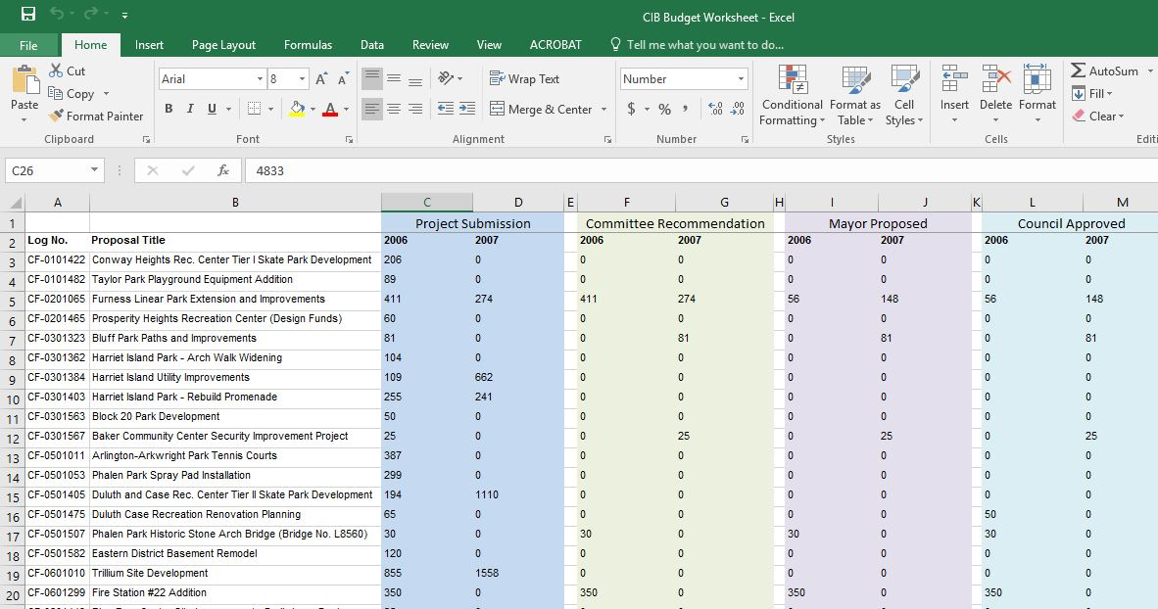
CIB Tracking Spreadsheet

Slide 10
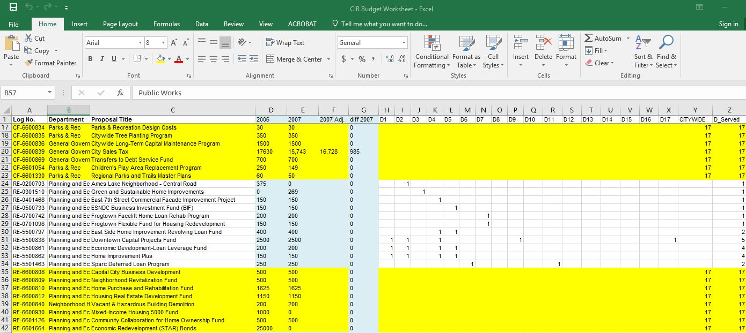
CIB Tracking Spreadsheet

Slide 11
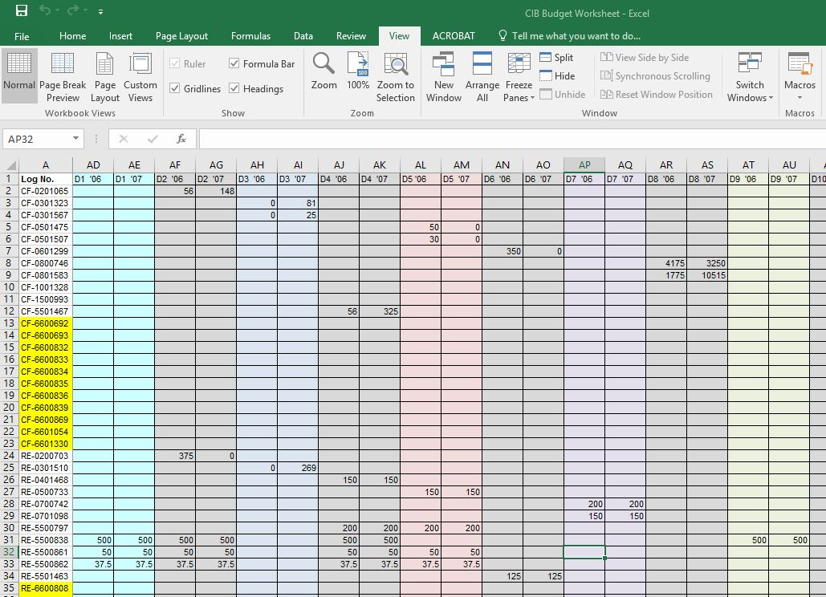
CIB Tracking Spreadsheet

Slide 12
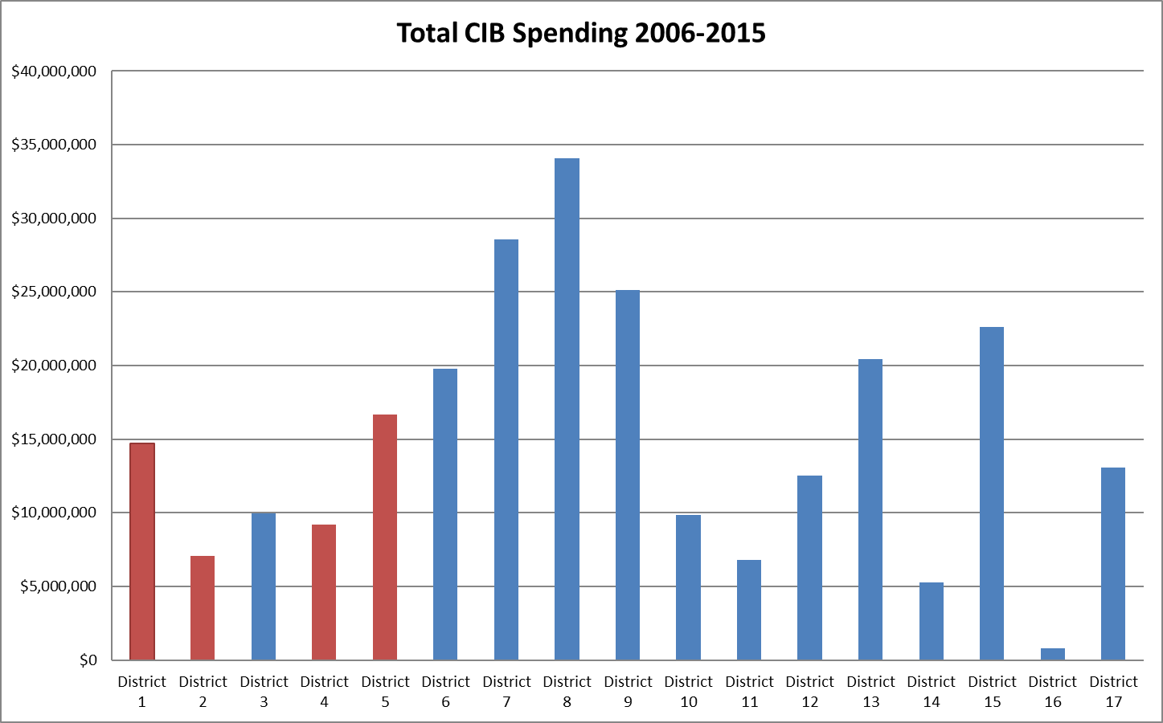

Slide 13
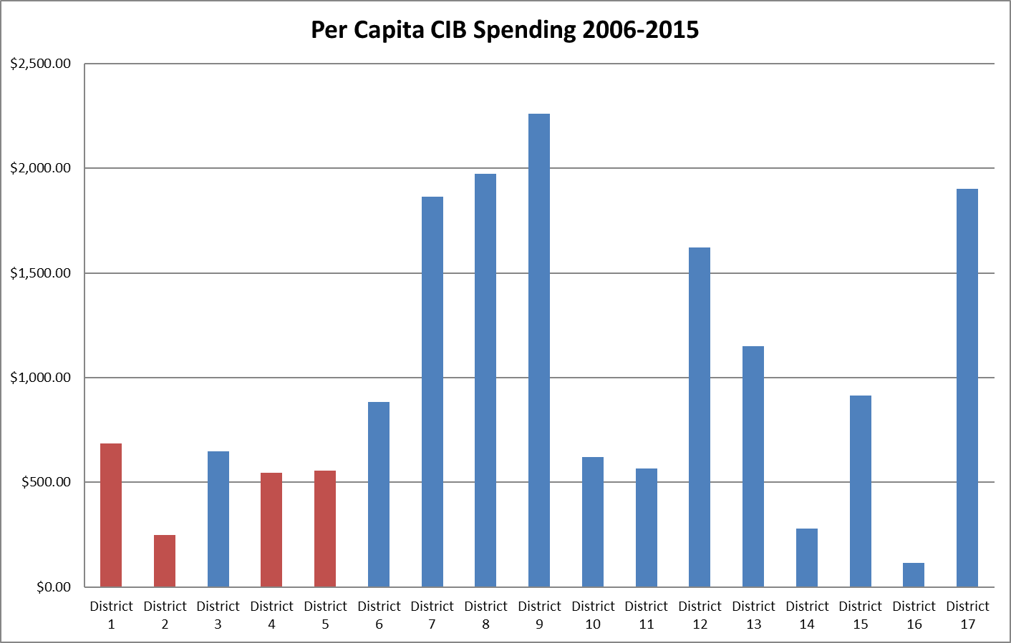

Slide 14
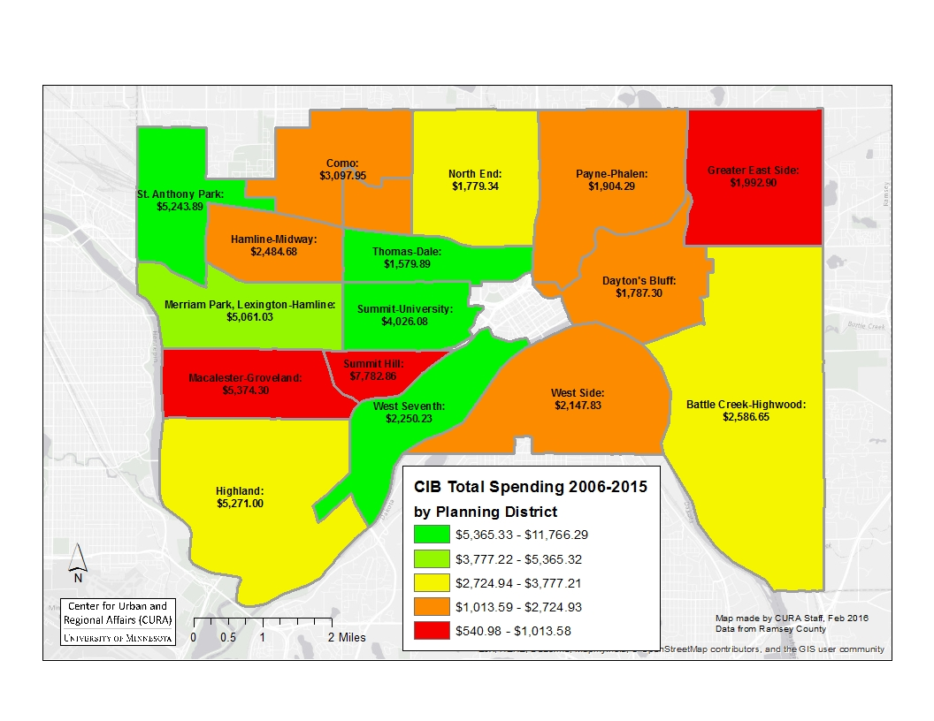
Total Spending 2006-2015

Slide 15
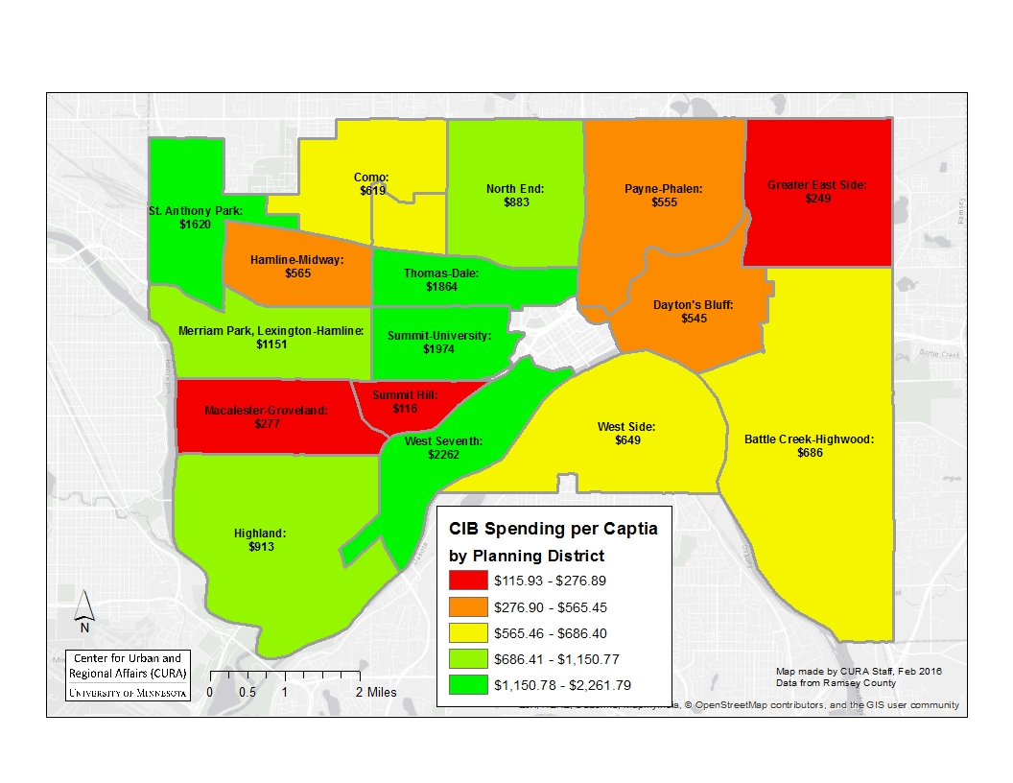
Per Capita Spending 2006-2015

Slide 16
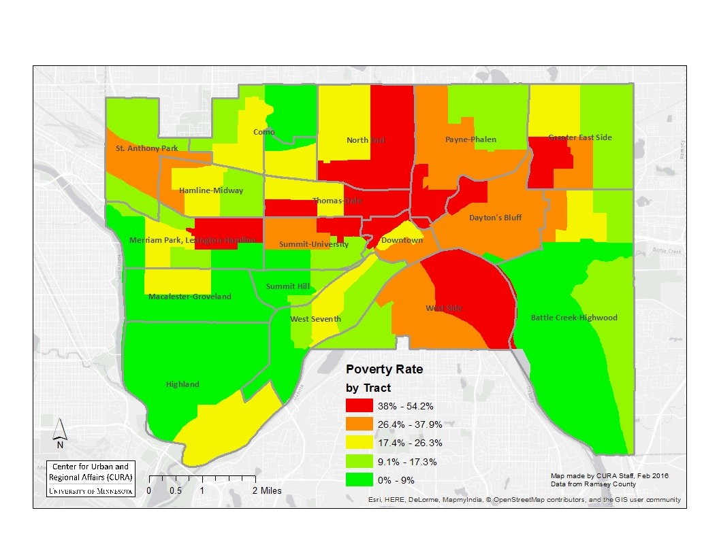
Poverty Rate 2011-2015 ACS

Slide 17
Other Related Projects
Minneapolis Promise Zone
Phase II St. Paul
Brooklyn Park Immigrant Organizations
Police Budgets v. capital improvements
Ordinances adversely affecting immigrant communities
Phillips Community Park Equity

Slide 18
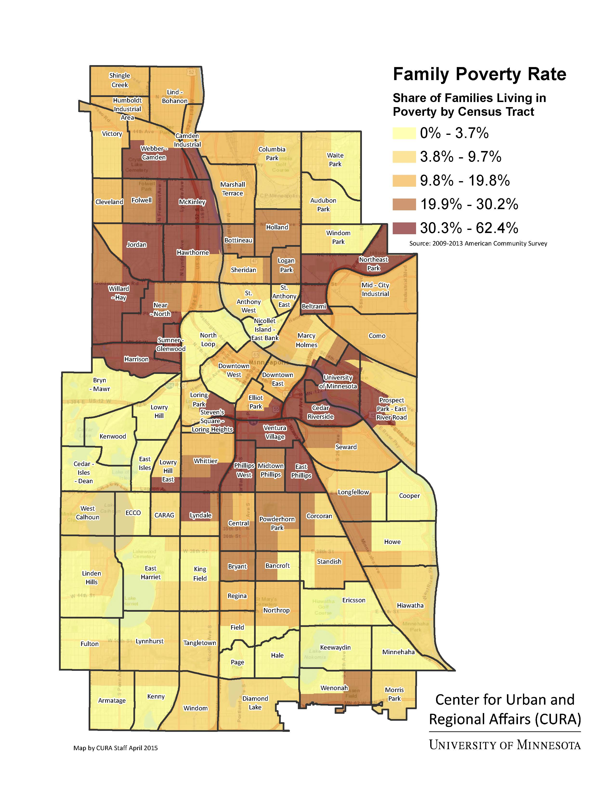
Minneapolis Promise Zone
Notes:
PZs are federally designated, high poverty communities where Federal Government agencies partner with local organizations and leaders to increase economic activity, improve educational opportunities, and leverage private investment. There are a total of twenty-two urban, rural and tribal PZs across the nation. More information
The Minneapolis Promise Zone (MPZ) supports a comprehensive, community-driven revitalization strategy that builds on and aligns numerous initiatives to address the persistent unemployment, crime, housing blight, and poor educational outcomes that affect the area.
Promise Zone Boundaries
West to East: Queen Avenue North to the Mississippi River
North to South: 45th Avenue North/Victory Memorial Drive to Basset Creek Valley

Slide 19
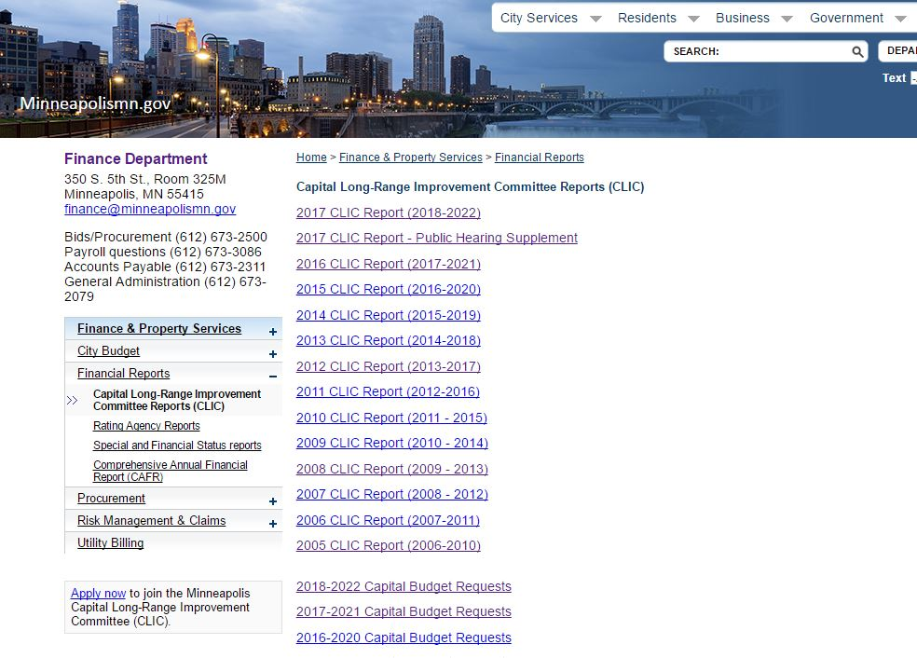

Slide 20
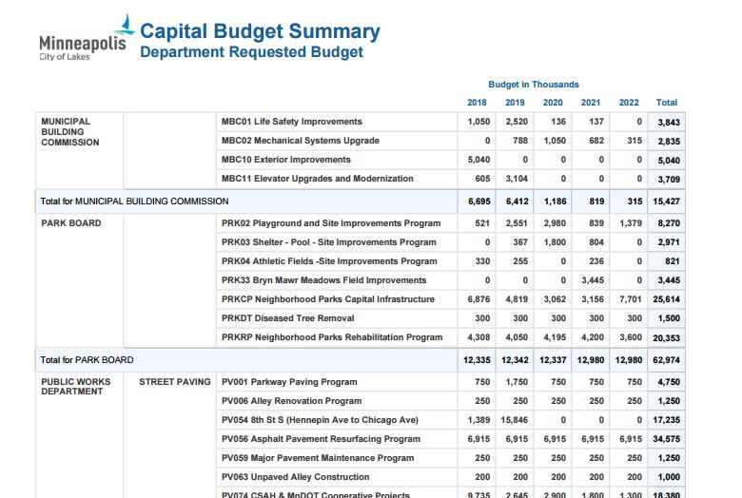

Slide 21
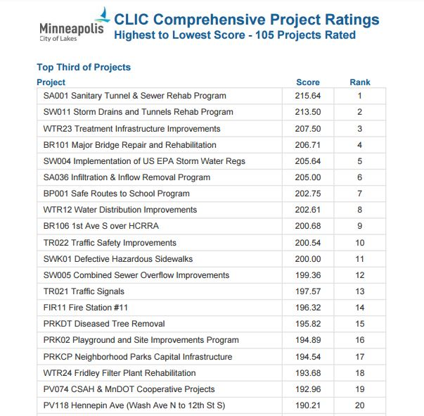

Slide 22
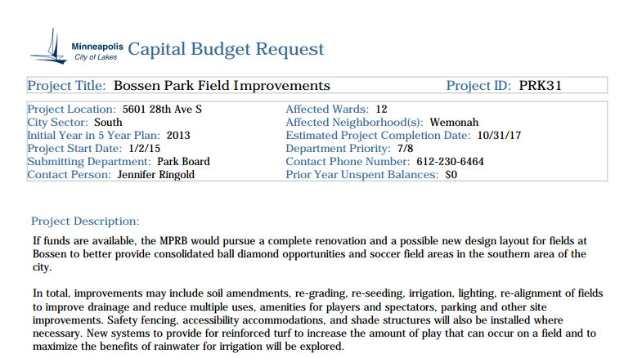

Slide 23
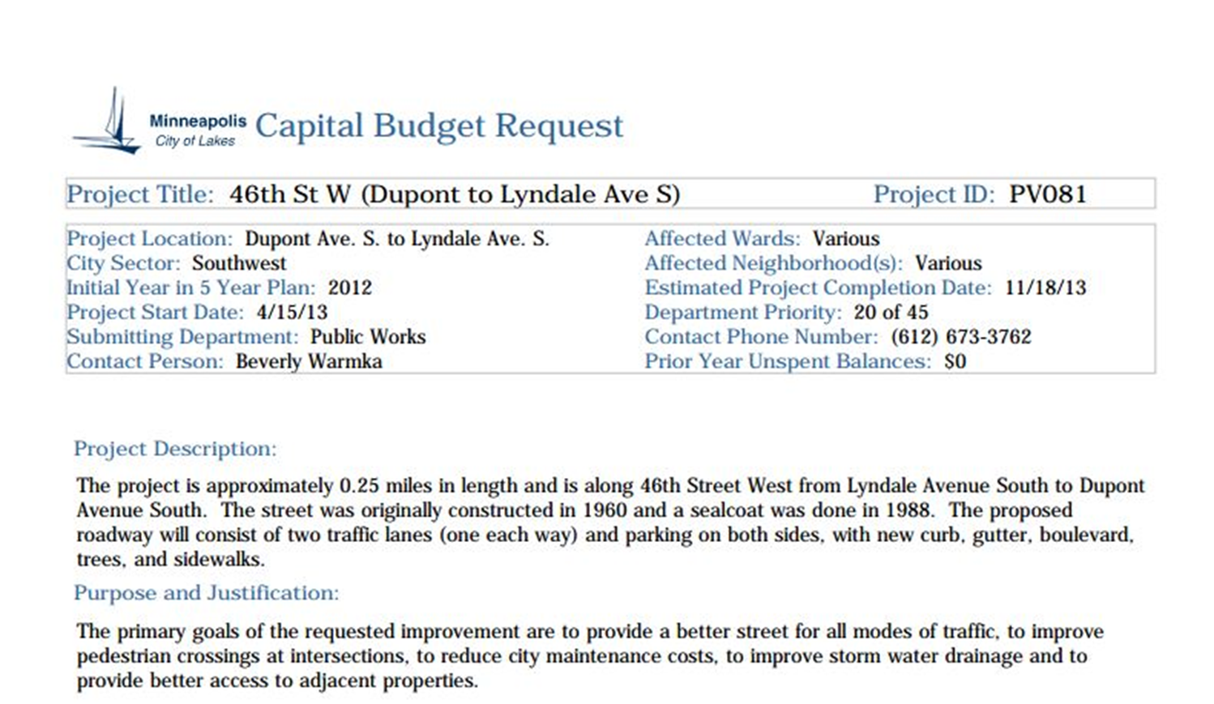

Slide 24
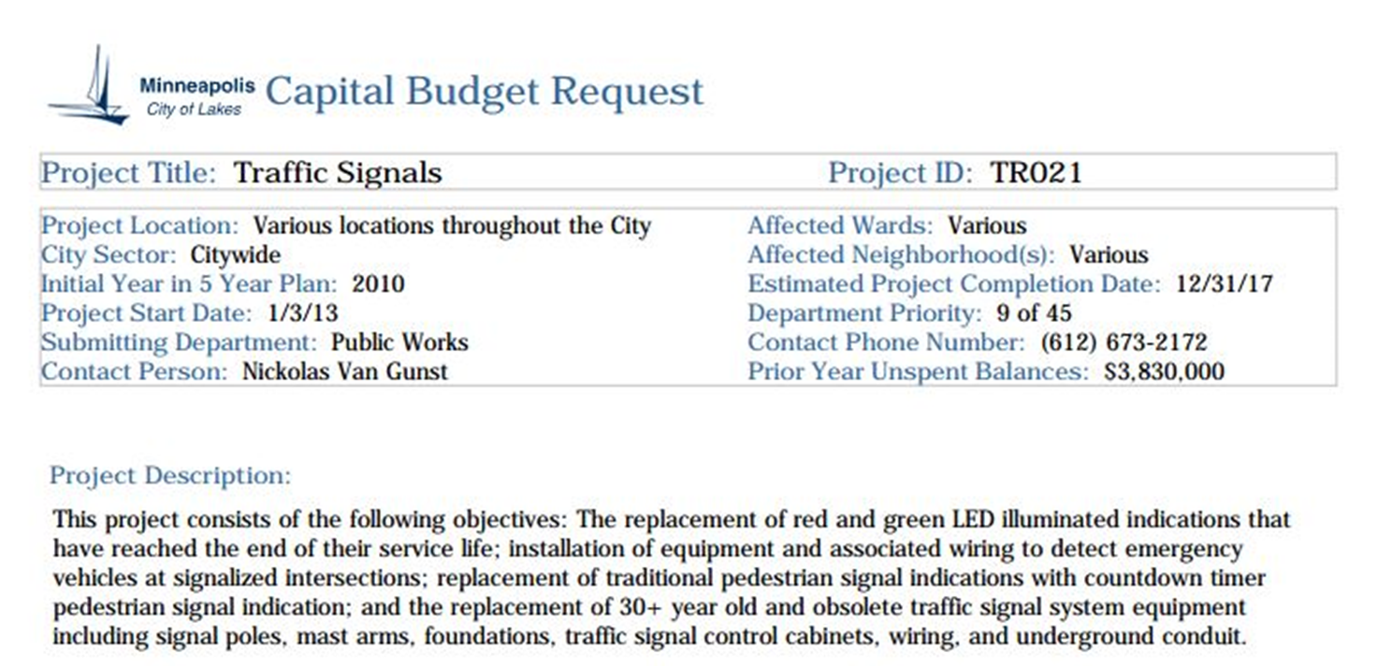

Slide 25
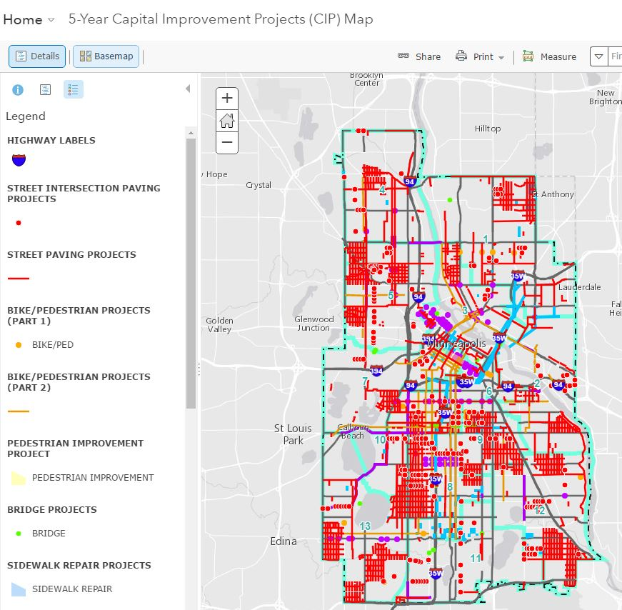

Slide 26
Summary / Conclusion
What are cities providing
What SHOULD they provide?
Is the data in a useful format?
How are these decisions being made
Who, where, why
Need for historical data
What can we learn from it?

Slide 27
Thank you!
Jeff Matson
jmatson@umn.edu

