Slide 1
Employee Ownership as a Model for Building Community Wealth
CIC Impact Summit
November 16th, 2017

Slide 2
Outline
The “Silver Tsunami”
Regional and Neighborhood Impacts
Using data to address the problem

Slide 7
Industry Selection
Data Source: MN Department of Employment and Economic Development

Slide 8
Industry Selection
Industry | NAICS Code | Median Wage | Projected Growth
Retail | 44-45 | $14.37 | 4.3%
Health Care and Social Assistance | 62 | $14.60 | 20.6%
Accommodation and Food Services | 72 | $9.48 | 6.8%
Home Care | 812 | $11.42 | 23.9%
Janitorial | 5617 | $12.55 | 9.2%

Slide 9
Business Identification
Data Source: Mergent Intellect, 2016
Notes:
Using a business database (Dunn & Bradstreet) available to us through the University library system we were able to identify individual business
Estabilshed > 10 years ago gets around the ‘age of business owner’ problem. That data isn’t available (publicly) at firm-level

Slide 10
Total Impact
3,351 Businesses
62 owned by people of color
92,466 Employees
23,990 people of color
$6.8 Billion in Annual Revenue
$517 Million in Sales Tax
Notes:
2% PoC Owned
25% PoC employed

Slide 11
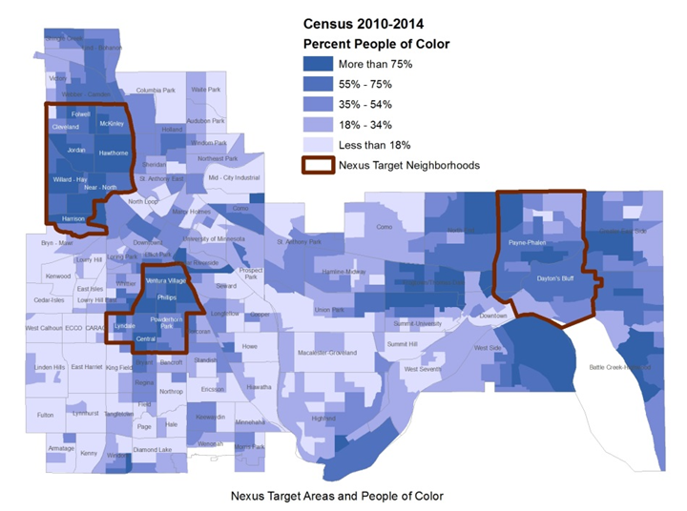
Local Impact
Notes:
Why it matters/context for results
Population about the same size: 15,330 // 15,794 // 18,352

Slide 12
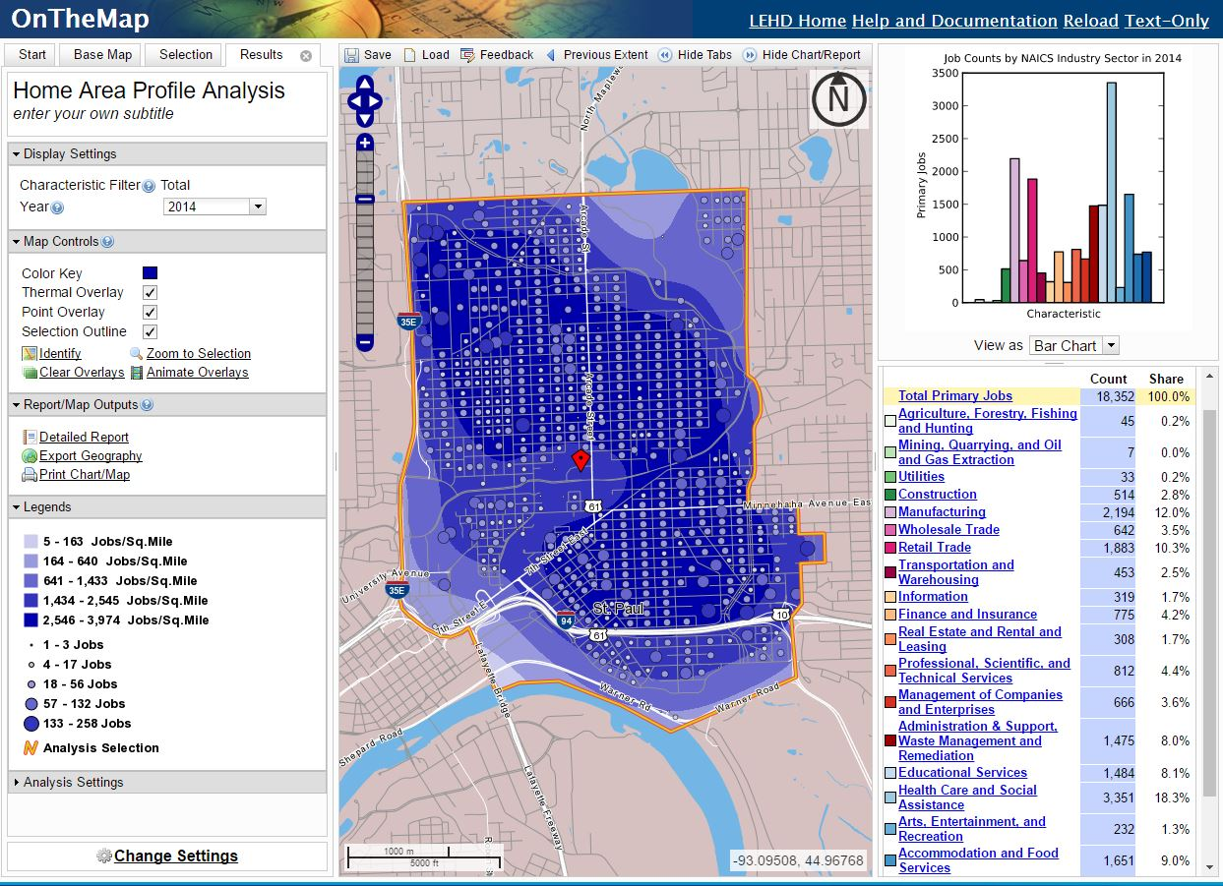
Local Impact
Notes:
Why it matters/context for results
Population about the same size: 15,330 // 15,794 // 18,352

Slide 13
Impact on Nexus Communities
38% 39% 41%
Data Source: Local Employment Dynamics, U.S. Census Bureau
Notes:
Health Care also fastest growing of these three, second only to Home Care
68% total residents make <40k

Slide 14
Impact on Nexus Communities
Data Source: Local Employment Dynamics, U.S. Census Bureau
Notes:
Health Care also fastest growing of these three, second only to Home Care
68% total residents make <40k

Slide 15
Notes:
At the level of the entire US we disaggregated the number of businesses by age and industry. We captured the percentage ownership by age for each industry at the national level. We excluded businesses that are publicly traded and non-employer businesses.
We made the following assumption: The national patterns of age of ownership within industries are assumed to be same at the disaggregate level of county. The assumption is necessary because the data at the county level is not disaggregated by age.
We then used county-specific ownership data by industry to get the number of privately-held businesses with employees per industry. We applied the national industry-level percentage of businesses with owners over the age of 55 to arrive at an estimate of the number of businesses, employees, receipts and payroll.
We consolidated industries without significant regional representation into Other Industries and included the industries of Real Estate, Educational Services, Finance & Insurance and Information & Technology in Professional Services. The 2012 Survey of Business Owners did not publish data for some industries in counties with a small sample size; these fields will show up blank.
Source: US Census 2012 Survey of Business Owners
Acknowledgements: Thanks to Gouri Shankar Mishra, a data scientist and PhD candidate at UC Davis and a former researcher at Stanford University, for his guidance and assistance in compiling this data.

