Slide 1
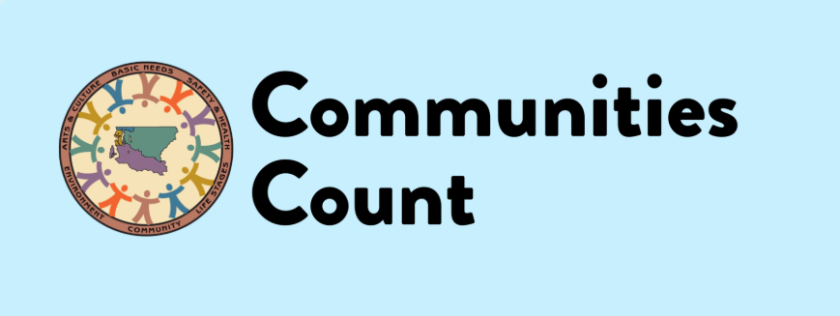
Renovating our online home: A user-centered approach to redesigning a local data website
Mariko Toyoji, MPH
Communities Count, Public Health Seattle and King County
June 14, 2019

Slide 2
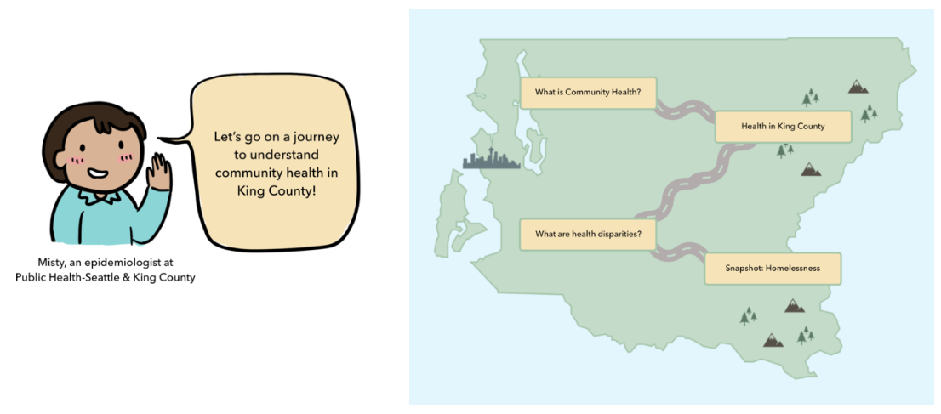
About Communities Count
A private-public partnership between:
Public Health Seattle & King County’s Assessment Policy Development and Evaluation Unit
The Seattle Foundation
Started over 20 years ago as a community informed population based survey on health and social well being in King County, WA
Transitioned to an online data platform in 2011, with a curated set of over 60 health and social indicators with interpretative narrative
Provides data trainings and technical assistance in using population data to further equity work in King County.

Slide 3
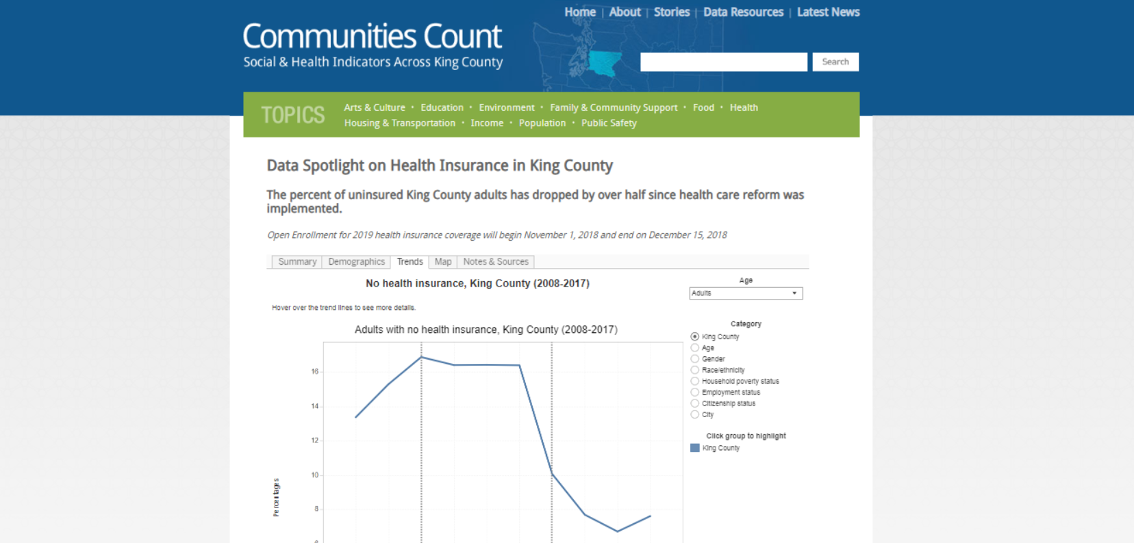
Taking the Plunge: Committing to redesign
Website was built in 2011, we were seeking a more modern look/functionality
Growing challenges with navigation, search and customization
Opportunity for a fresh start and to update to new technology

Slide 4
Internal Assessment
Collected feedback from staff
Google Analytics Performance Assessment
Leveraged previous user research
Comparative Analysis of other data intermediary/indicator websites (Thank you NNIP partners!)

Slide 5
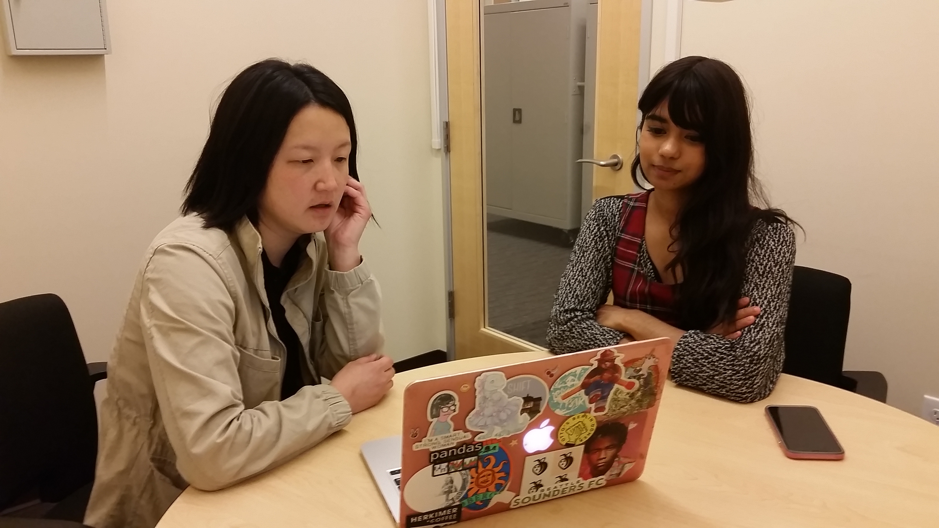
Usability Testing
Hosted 5 usability testing sessions with different users
(Experienced, novel, government, non-profit, community partners and students)
Sessions included:
Background interview
Impression test, first-click testing
Cognitive-walkthrough with concurrent think aloud exercise
Wrap-up interview questionnaires.

Slide 6
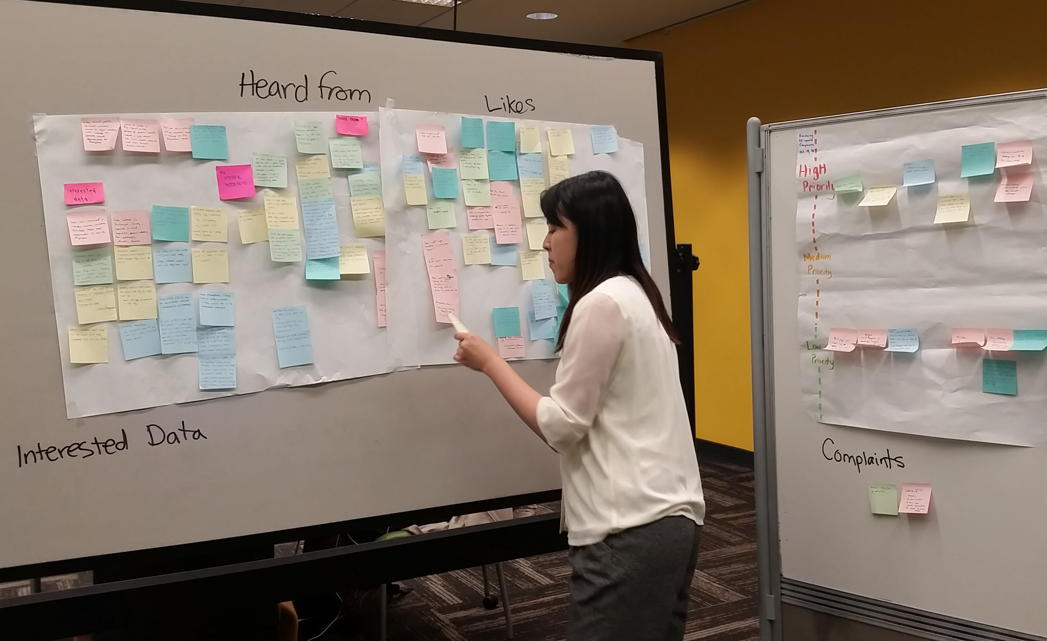
Analysis/ Findings
Key areas to be improved upon in the new website:
Navigation
Search-ability
Appropriate context for the website
Accessing and using our data dashboards
The overarching goal: a modern-looking website with intuitive navigation, efficient search function, and story-telling layout capabilities.

Slide 7
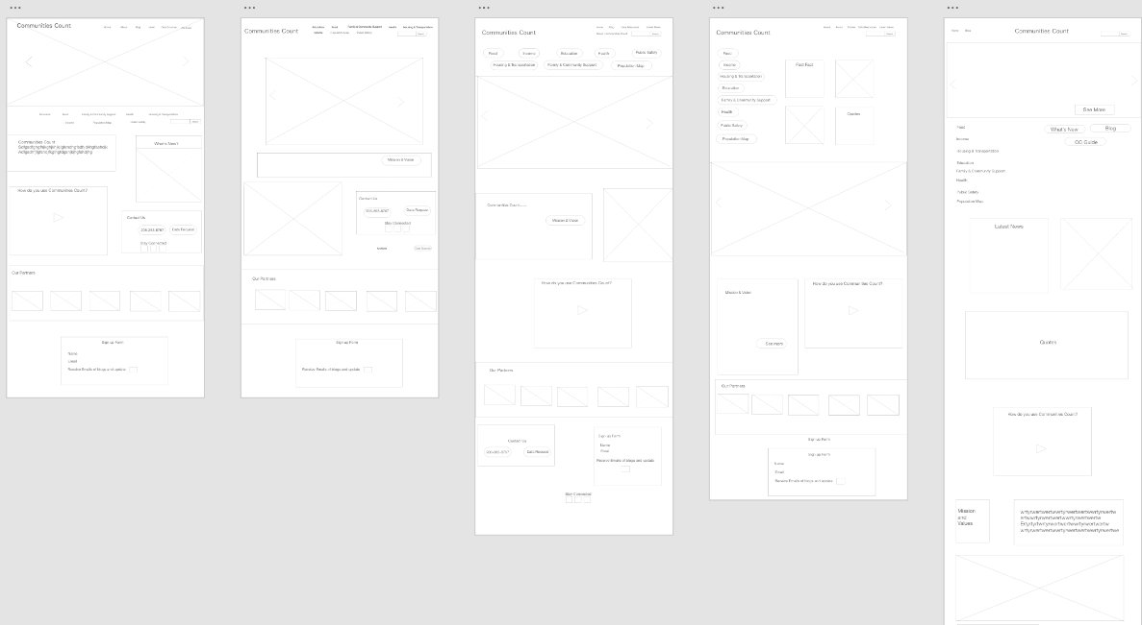
Wire framing

Slide 8
Prototyping …and more testing and feedback

Slide 9
Final design

Slide 10
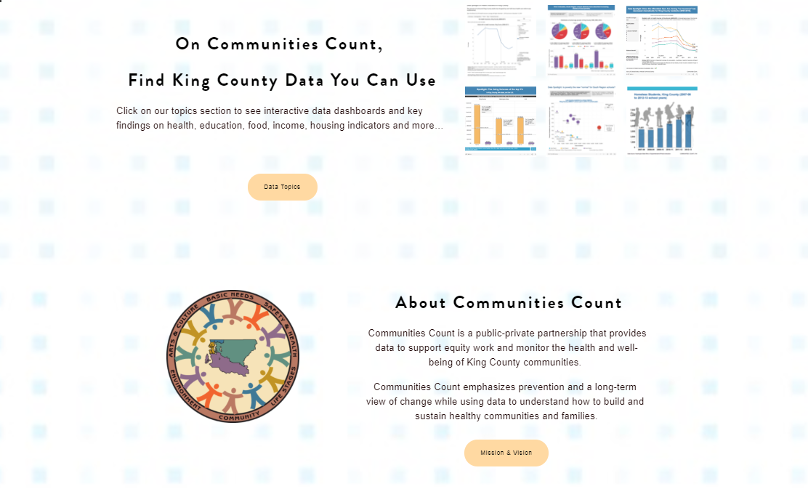
Homepage: More context more highlights

Slide 11
Customized Navigation

Slide 12
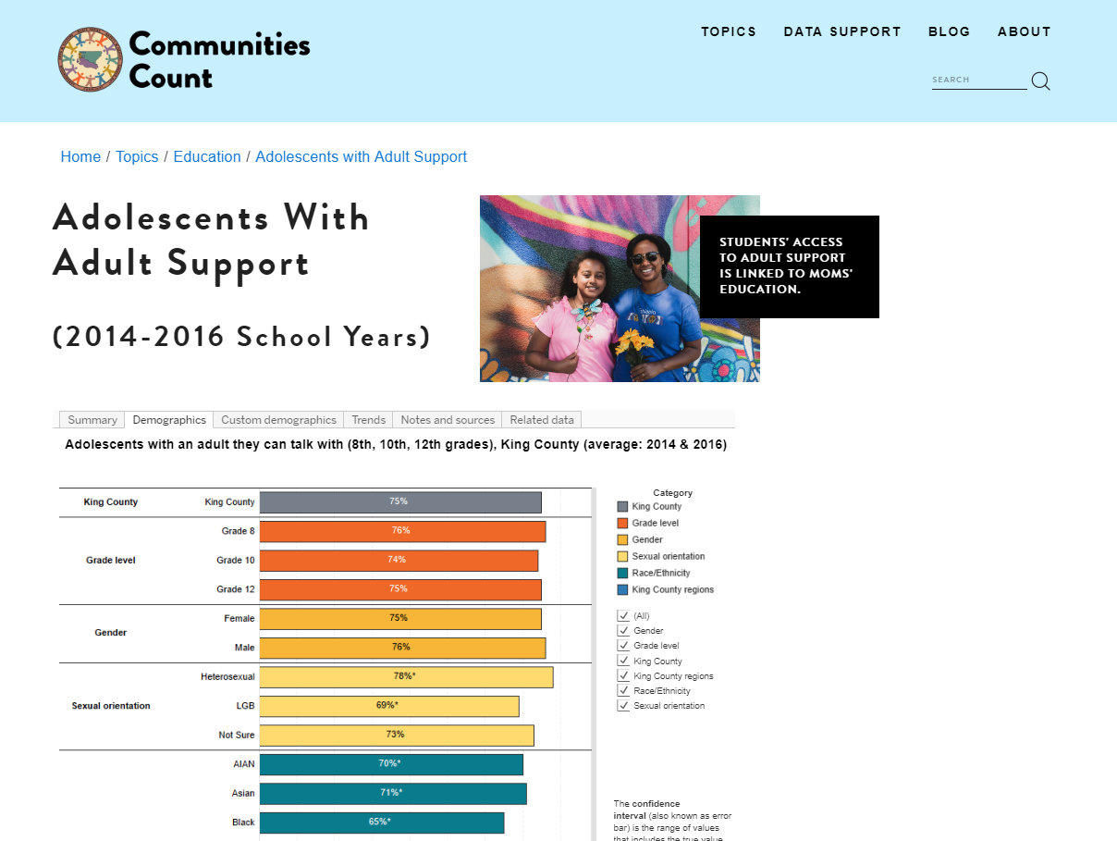
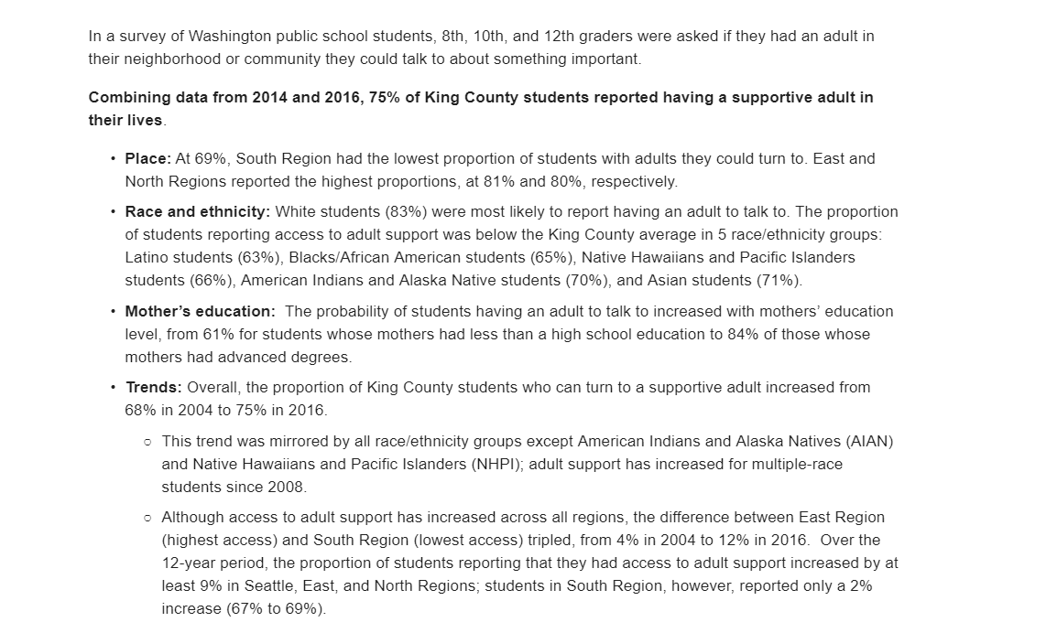
Redesigned indicator pages

Slide 13
Revamped Data Resources and Support Pages

Slide 14
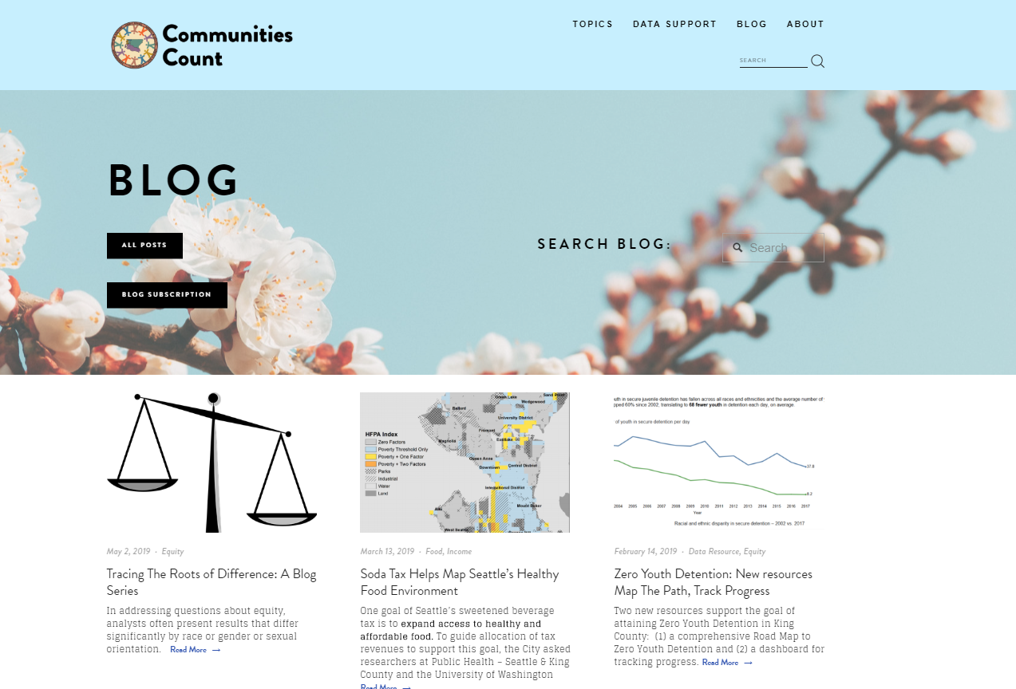
Redesigned Blog

Slide 15
Archive and access to older content

Slide 16
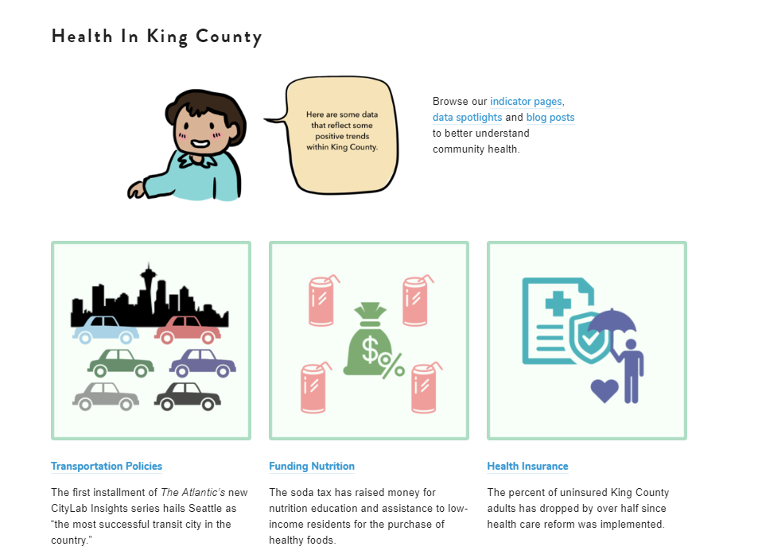
Outreach and Engagement
Announcement through our blog and newsletter
Requests for cross promotion from partners
Planned webinars and lunch and learns
Summer Presentation Tour with Partners
Ongoing trainings and opportunities to collect feedback

Slide 17
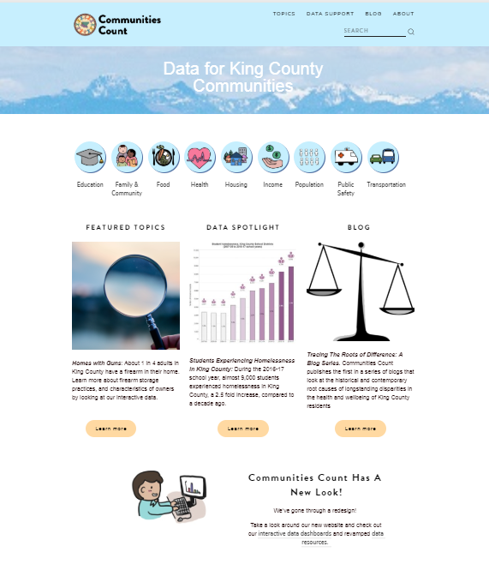
Before and After

Slide 18
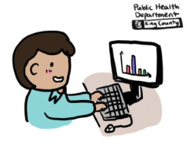
Lessons Learned
Plan for more time than you think need
Seek out and find new expertise and talents
Re/engage with partners old and new
Use a platform/content management system that meets your needs
Documentation, documentation, documentation…
Consider rolling out features in stages

Slide 19
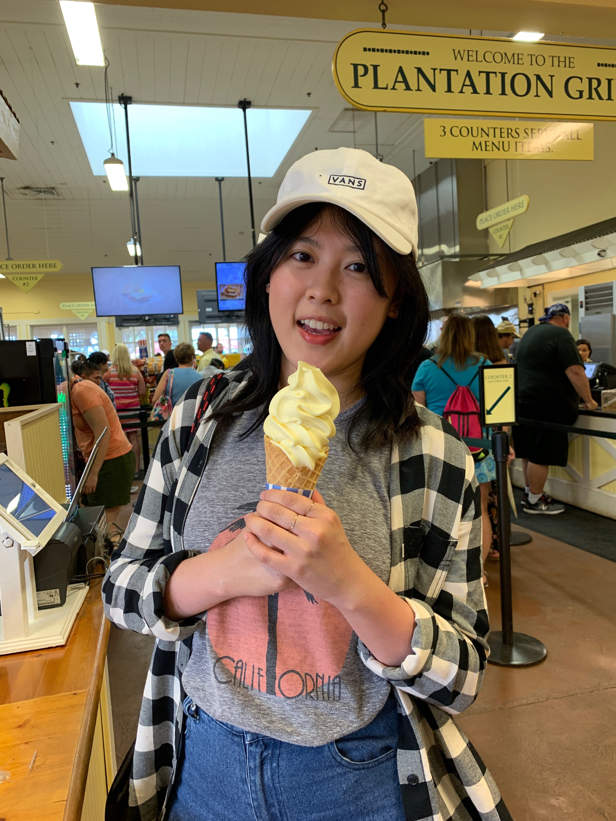
Thank you to our great team!
Many thanks our team of staff, partners and especially our University of Washington student interns Navi Midathada and Melody (Ching Ting) Yu.

Slide 20
Questions? Keep in Touch!
Visit us at: communitiescount.org
Contact: Mariko Toyoji
mtoyoji@kingcounty.gov
Communities Count, Public Health Seattle and King County

