Slide 1
Turning the lens on ourselves: what should a local data intermediary measure?
NNIP Idea Showcase
February 21, 2019
Laura C. McKieran, DrPH
Executive Director, CI:Now
Associate Professor, UTHealth Houston School of Public Health in San Antonio

Slide 2
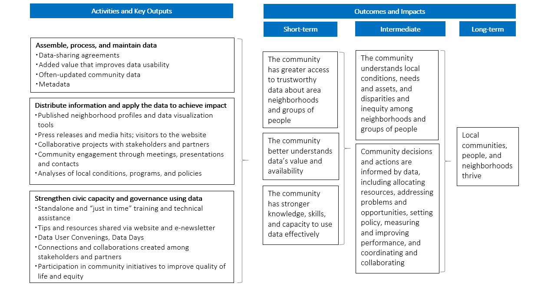
draft

Slide 3
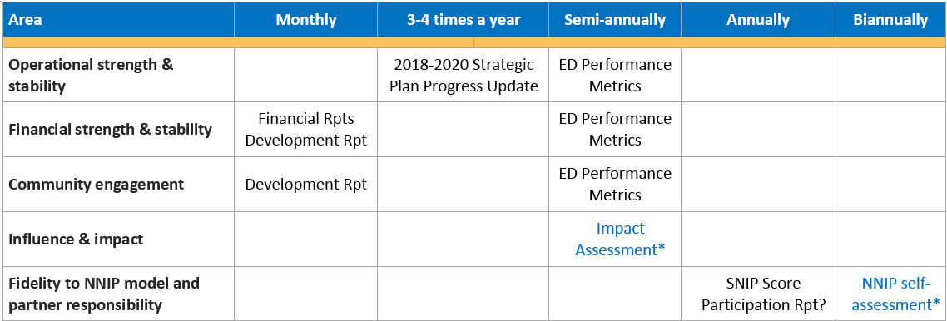
What we measure and when
*Developmental

Slide 4
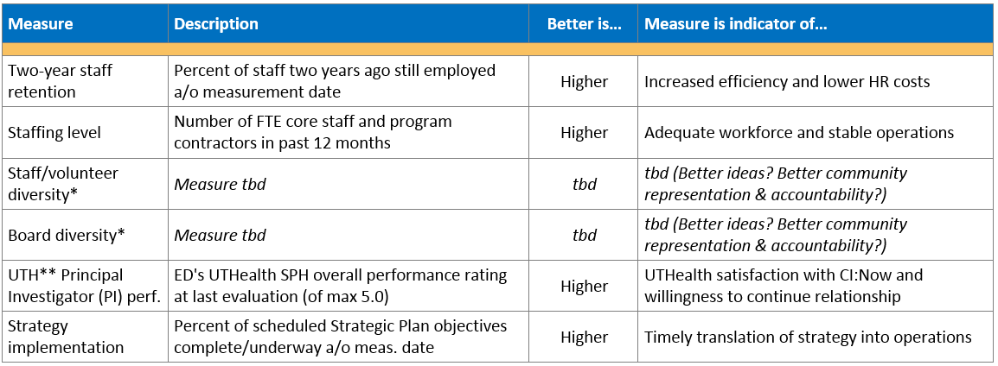
Measures of operational strength & stability
*SA is not a diverse city! **UTH = UTHealth, to which CI:Now’s core staffing is contracted

Slide 5
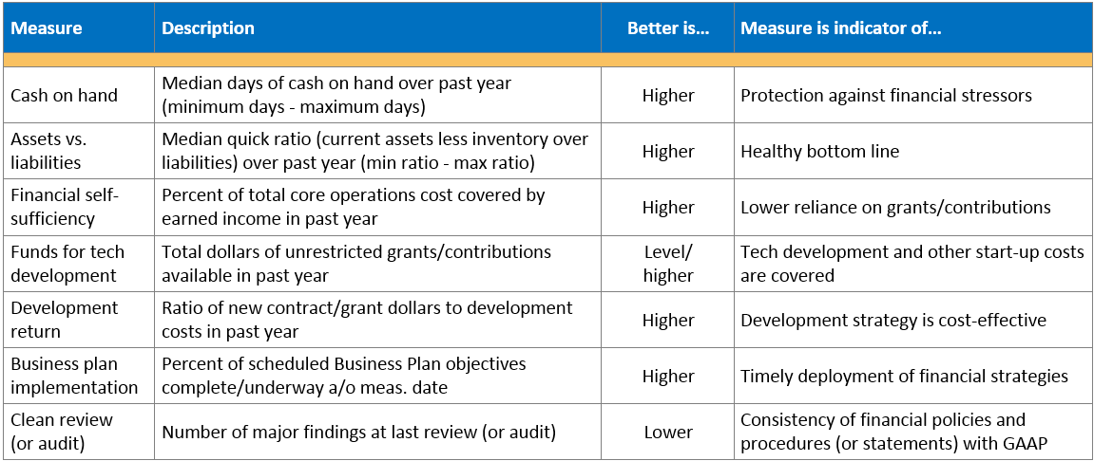
Measures of financial strength & stability

Slide 6
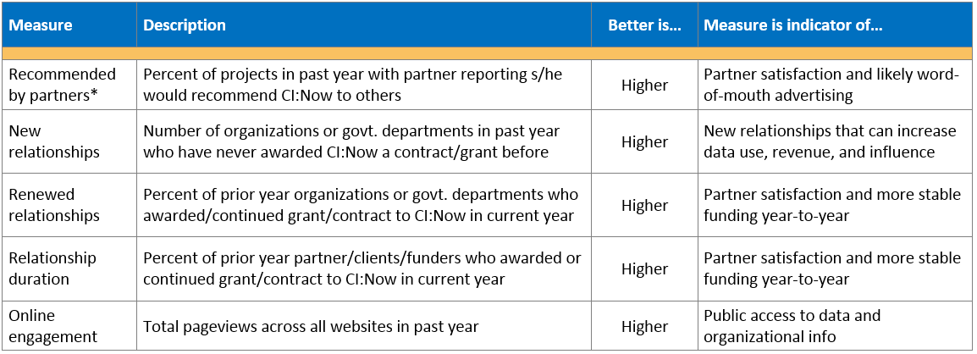
Measures of community engagement
*Developmental

Slide 7
Fidelity to NNIP model and partner responsibility
Core standards to maintain in home area:
Build and operate an information system with recurrently updated data on neighborhood conditions across topics;
Facilitate and promote the direct practical use of data by community and government leaders in community building and local policymaking; and
Emphasize the use of information to build the capacities of institutions and residents in distressed neighborhoods.

Slide 8
Fidelity to NNIP model and partner responsibility
Additional standards:
Positive and collaborative working relationships with a wide range of local institutions
Reputation for neutral information and data
Strong leadership; technical and staff capacity to provide data intermediary services
Stable institutional home with strong mission fit
Covered in Participation Report?
Contribute to the knowledge sharing and supportive network of the partnership
Submit updates on recent partner activities and data inventory at least semi-annually
Regularly attend and participate in partnership meetings
Recognize and promote the network as appropriate to local and national audiences

Slide 9
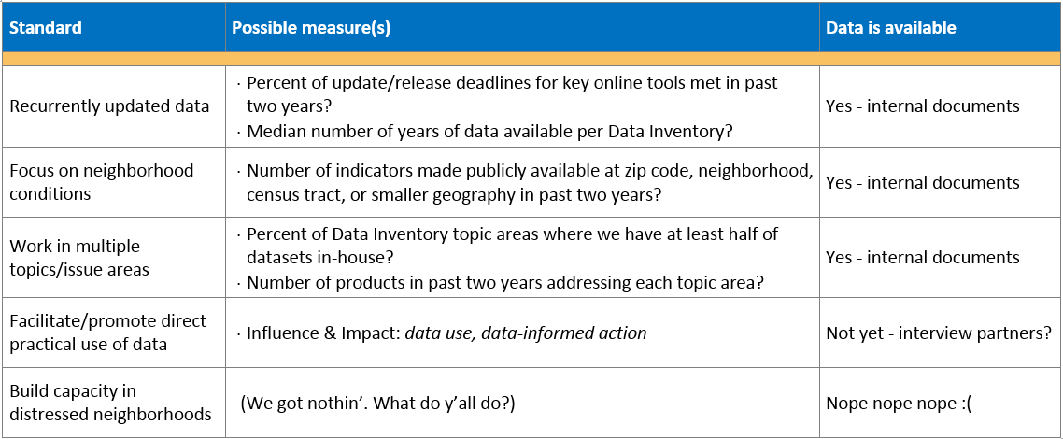
Measures of fidelity to NNIP core standards

Slide 10
Measures of fidelity to NNIP add’l standards

Slide 11
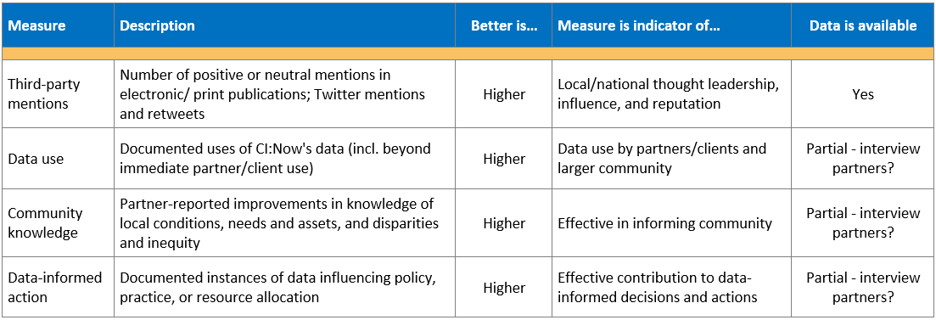
Measures of influence and impact

Slide 12
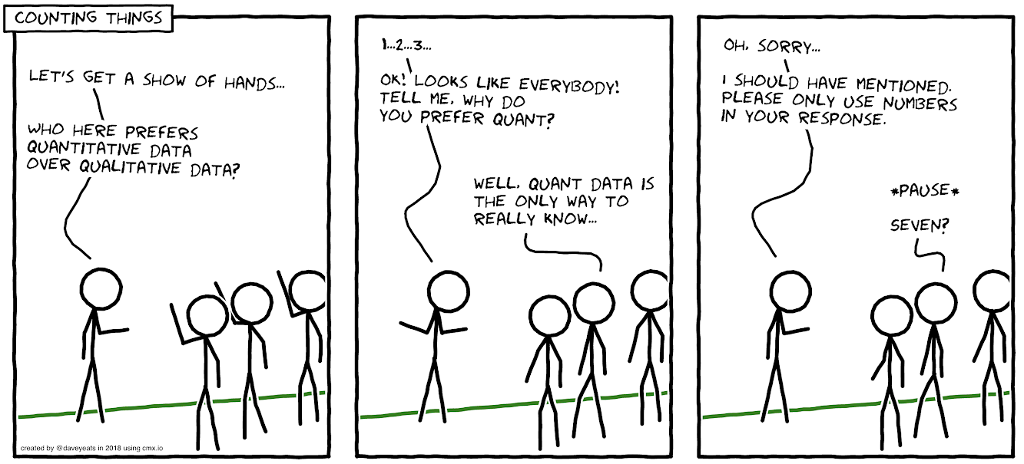
xkcd.com

Slide 13
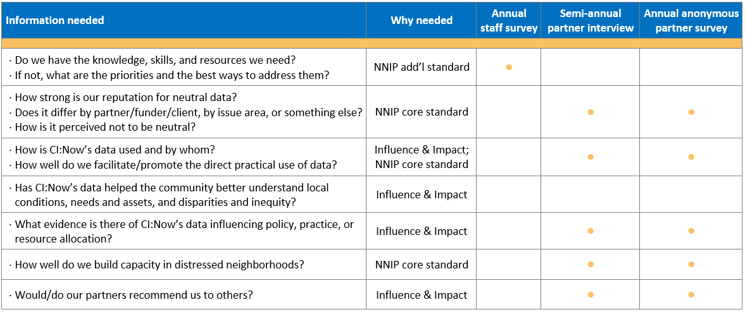
So what do we need to collect sustainably?

Slide 14
You’re doing the hard work of
changing our community for the better.
How can we help you?
Laura.C.McKieran@uth.tmc.edu
210.276.9007
http://cinow.info/newsletter-signup/

