Slide 1
Demonstrating the Need for Implementing Small Area Fair Market Rents (SAFMRs) in the Baltimore Metro Area
Cheryl Knott Assistant Director, Baltimore Neighborhood Indicators Alliance
The Association of Public Data Users (APDU) Conference July 26, 2023

Slide 2
Housing Choice Voucher Program (HCV) in Baltimore City
In Baltimore more than 17,000 households have access to a housing voucher, an additional 23,000 are on a waiting list to receive one
The HCV program has led to artificial inflation of existing rental prices in low to middle income neighborhoods, resulting in market pressure among other renters in the same neighborhood, causing those without any housing assistance to struggle to pay rent
Although the rent burden in Baltimore City has decreased over the last decade overall, there has been a significant increase in a select few neighborhoods in the number of people spending more than 30% of their income on rent.
The neighborhoods with the highest voucher use saw the greatest increases in rent burden, which is exactly what the housing voucher was intended to prevent

Slide 3
Fair Market Rent vs Small Area Fair Market Rent
Housing voucher subsidies are capped based on fair market rents (FMRs) that HUD estimates each year for modest housing units in a geographic area
Historically, HUD established a single set of payment standards (rents) for units of various sizes in each metro area. Typically, these encompass large regions with various neighborhoods characteristics that skew payment ceilings higher in certain low-income neighborhoods
Small Area Fair Market Rents (SAFMR) are based on rents in particular zip codes and therefore reflect neighborhood rents more accurately than metro-level rents

Slide 4
Data Tool – Input Datasets
Interactive map and dashboard (ArcGIS Online) to display data indicators by Census Tract
American Community Survey 5-Year Estimates, 2017-2021
Race/ethnicity
Median household income
Gross rent
Rental affordability (percent spending > 30% of income on housing costs)
HUD
Number of housing choice vouchers divided by total renters (ACS)
Area median income - AMI
MdProperty View (Maryland Department of Planning)
Owner-occupancy
RBIntel
Cash sales of residential properties

Slide 5
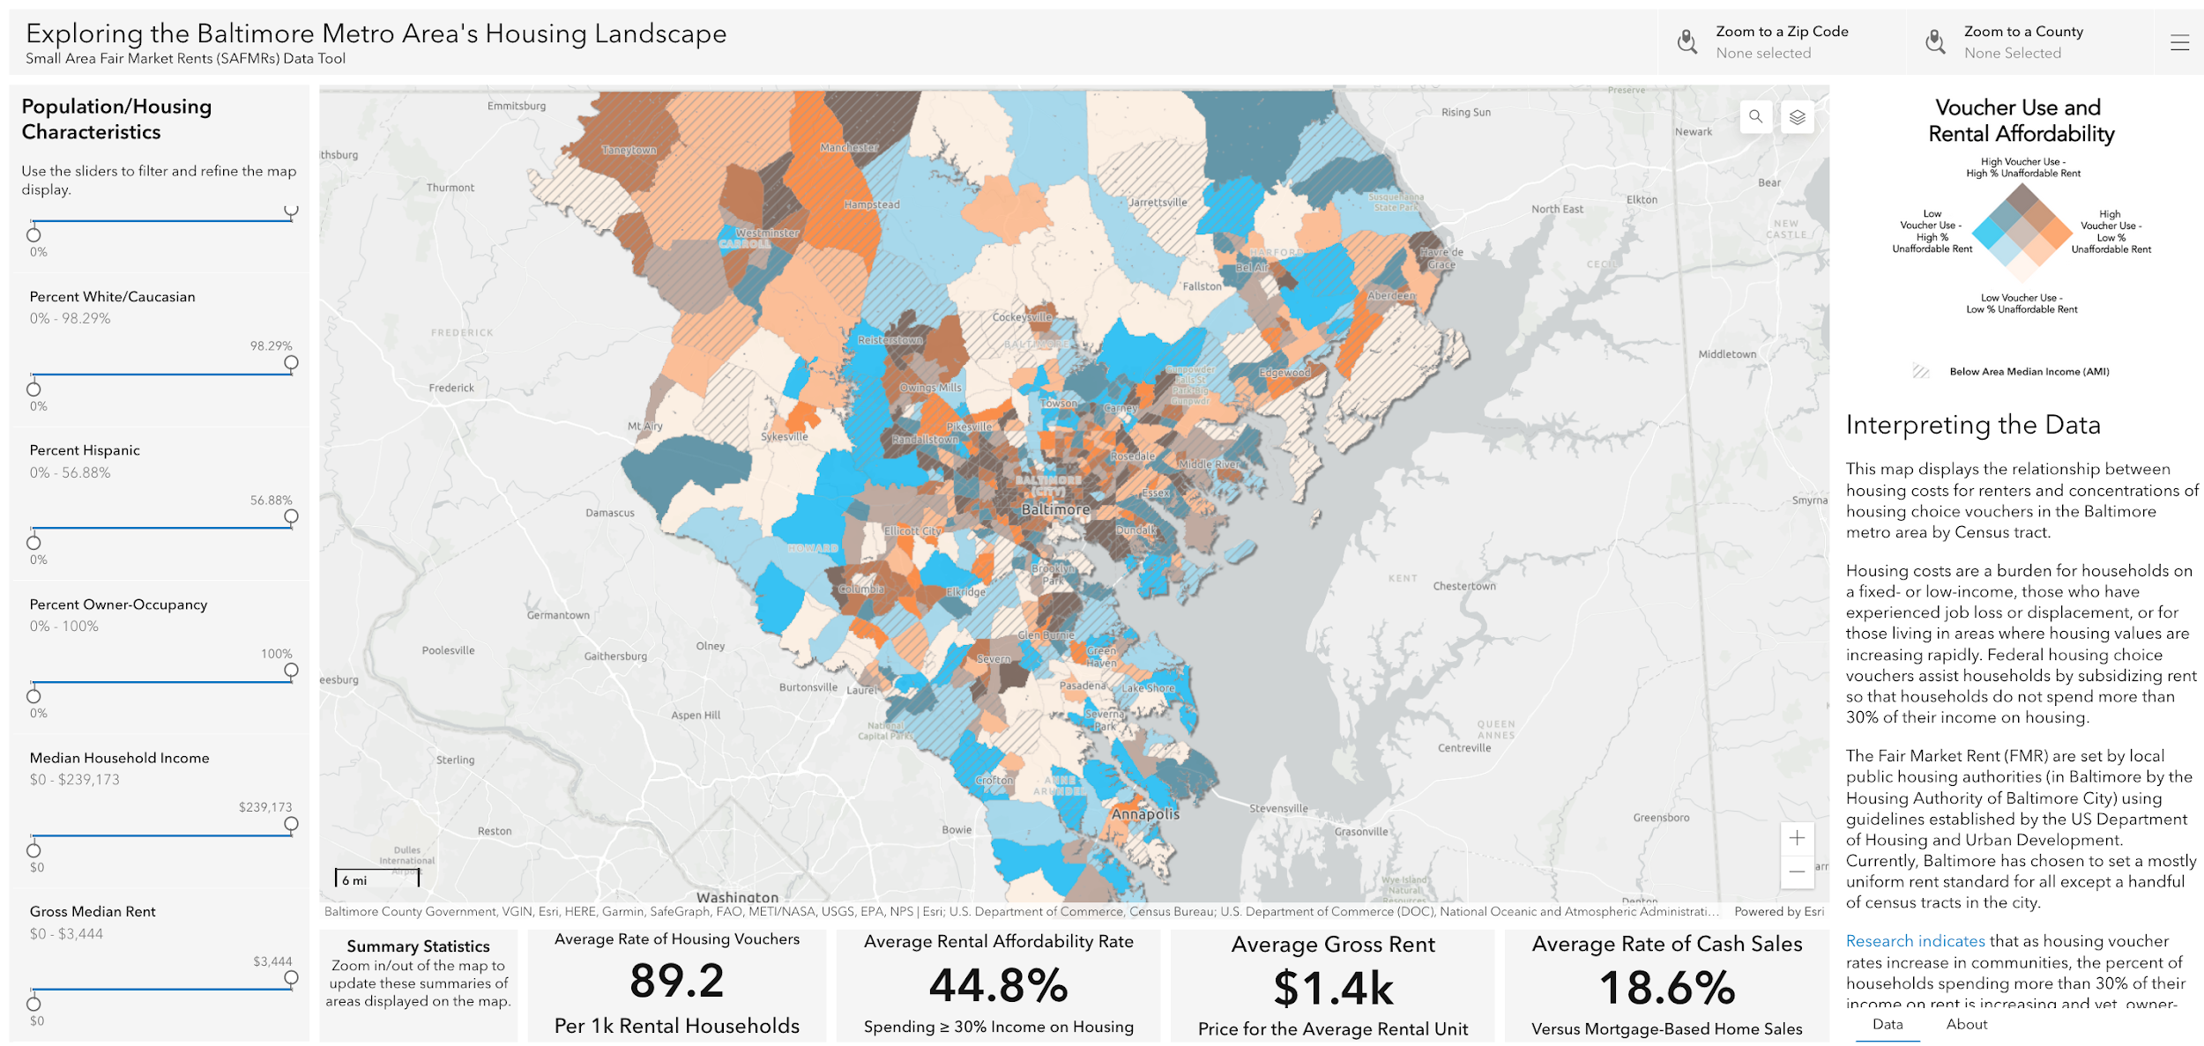

Slide 6
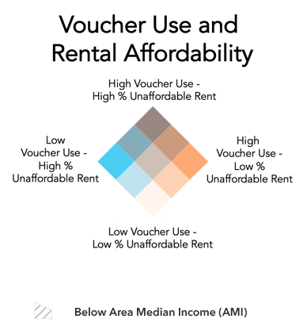
shorturl.at/BFO25
Bivariate choropleth map to show relationship between voucher use and rental affordability
Hatched overlay to show Tracts that are below the AMI

Slide 7
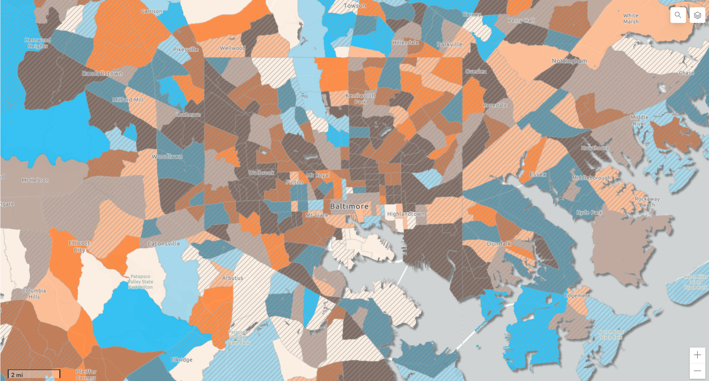
shorturl.at/BFO25
Spatial concentrations of high voucher use and high rental costs apparent in Baltimore

Slide 8
shorturl.at/BFO25
Custom sliders for displaying population and household characteristics
Adjust the sliders and the map and numeric indicators will update its display

Slide 9
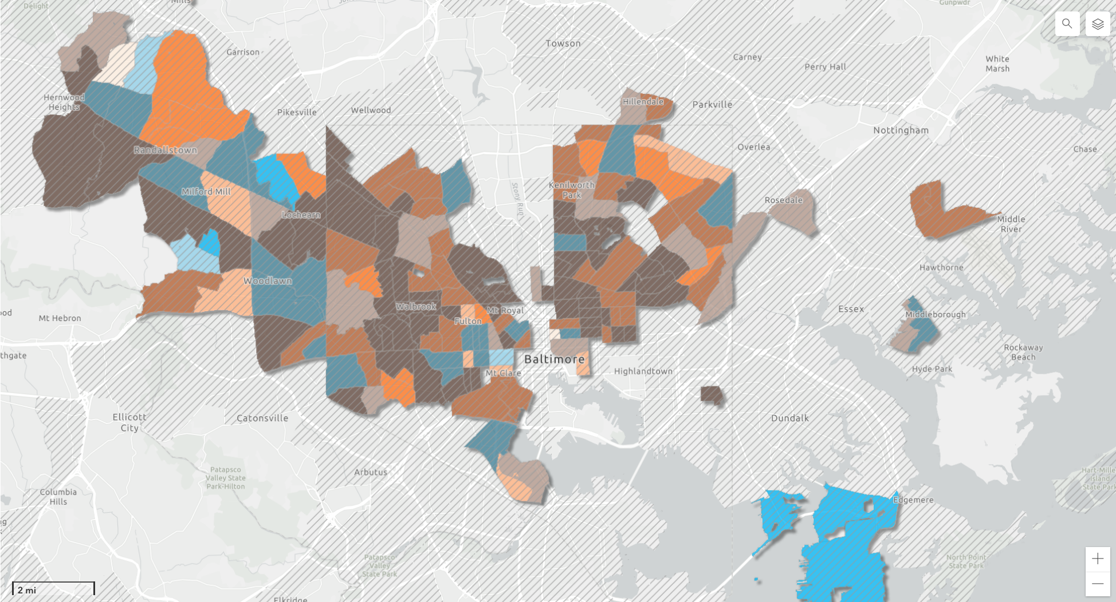
shorturl.at/BFO25
Filter: More than 50% Black/African American

Slide 10
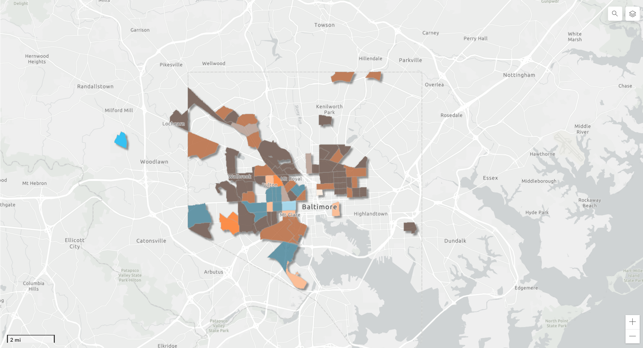
shorturl.at/BFO25
Filter: More than 50% Black/African American AND
Owner-occupancy less than 50%
*de-selected the AMI hatching for visibility

Slide 11
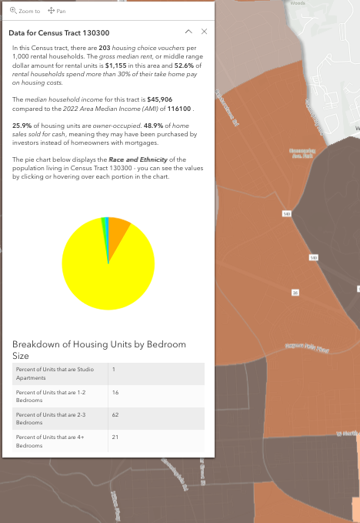
shorturl.at/BFO25
Click on a Tract on the map to get data descriptives of that area:
Voucher utilization
Affordability
Income
Ownership
Cash sales
Race/ethnicity
Housing size

Slide 12
shorturl.at/BFO25

Slide 13
Thank you!
Cheryl Knott, Assistant Director Baltimore Neighborhood Indicators Alliance cknott@ubalt.edu https://www.bniajfi.org
shorturl.at/BFO25

