Slide 1
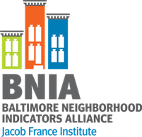
Mapping Baltimore’s Green Pattern Book
Putting Administrative Data to Work to Transform Vacant Lots into an Integrated Network of Green Spaces
Nancy Jones
September 2, 2015

Slide 2
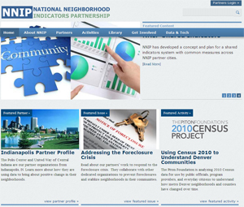
History of BNIA-JFI
Established in 2000 as a project within Association of Baltimore Area Grantmakers (ABAG)
Advanced information systems with integrated and recurrently updated information on neighborhood conditions in their cities
“Democratization of Data” Overcome the resistance of local public agencies to sharing data
Baltimore one of the first partner-cities
Now 36 partners
Moved to the Jacob France Institute in 2007

Slide 3
BNIA Database
postGIS / postgreSQL
Geodatabase
Demographics
Health
Sustainability
Workforce
Crime
Housing
Education
Arts

Slide 4
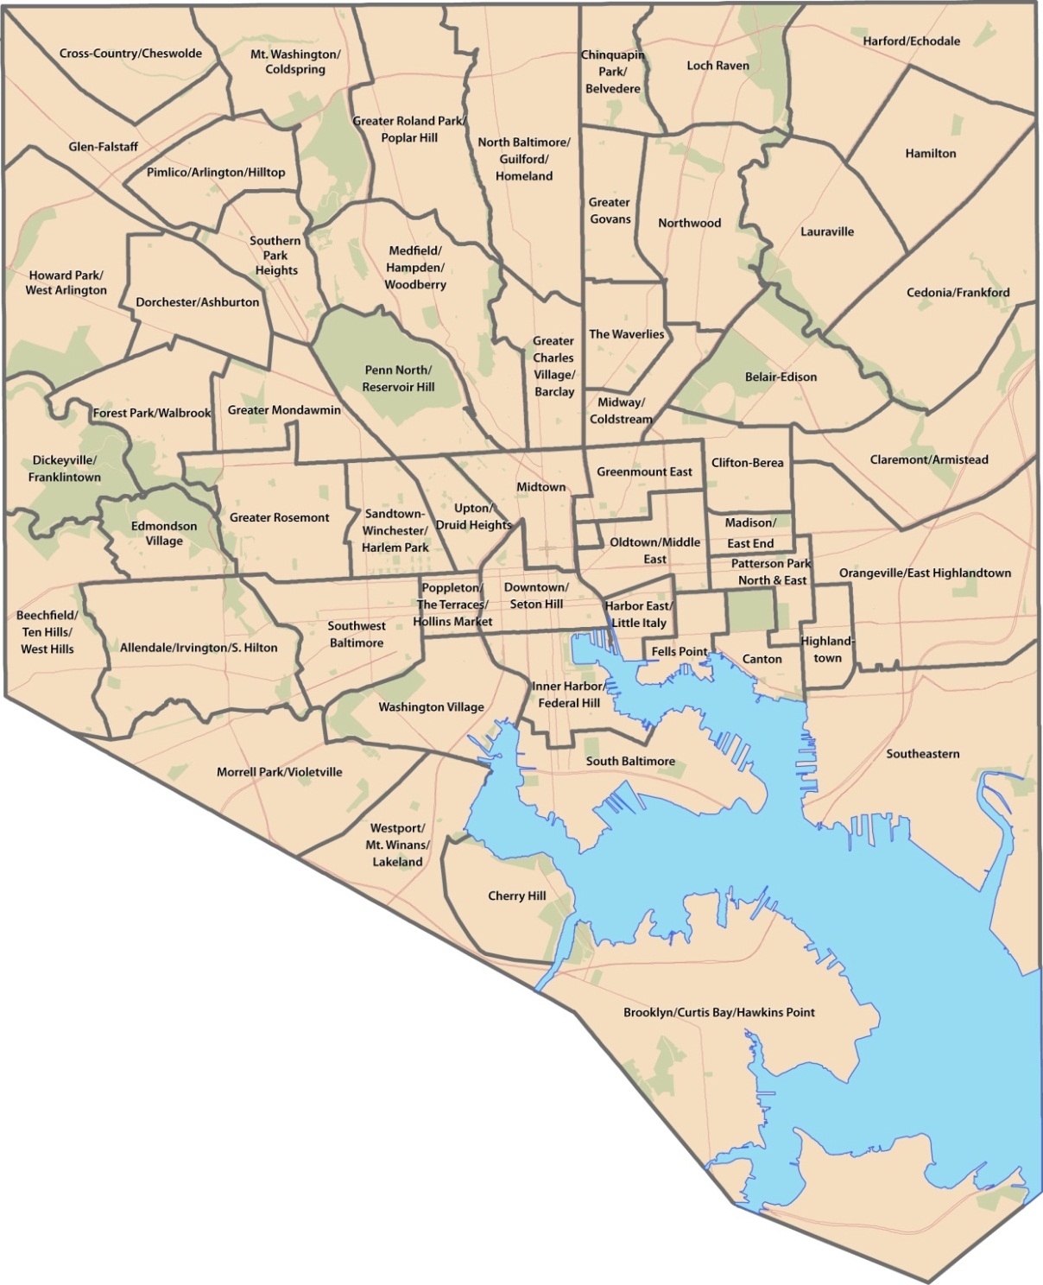
Baltimore City CSAs 2010 - - - Number - 55 Based on 2010 Census boundaries Aggregations of Census tracts (respectful of neighborhoods)
Notes:
Here are the boundaries of the CSAs moving from 2010 forward. While the number remains the same, 5 CSAs have changed due to Census changes – all around the central part of the City. The map you might have seen this morning describes these changes in greater detail. The new map will soon be placed on our website and Facebook page for people to view and we hope to get your comments and feedback.

Slide 5
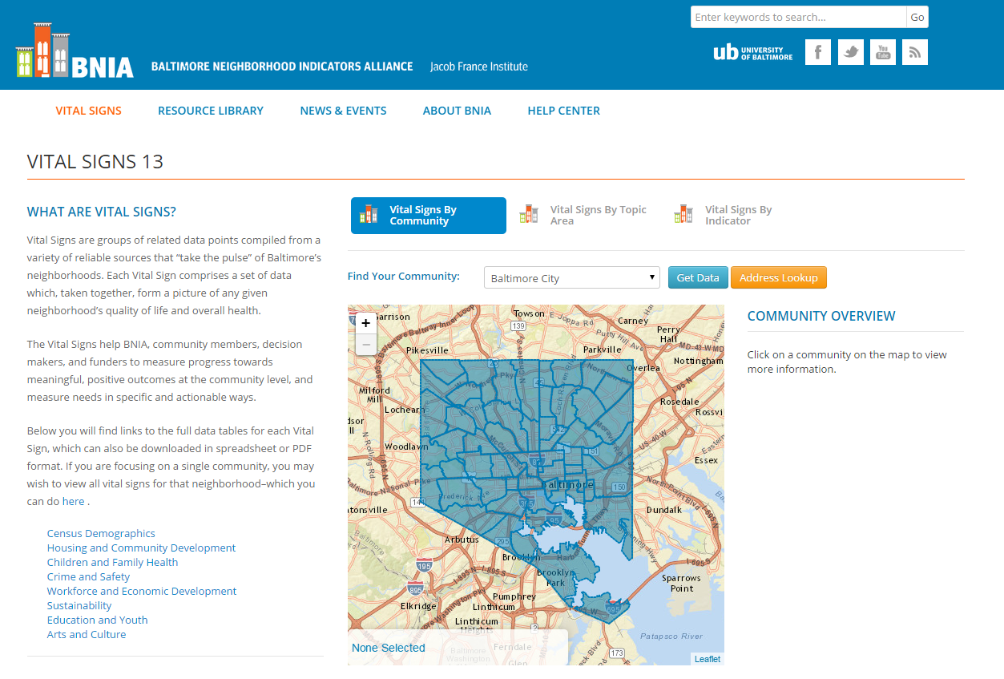
Project funded by the Annie E. Casey Foundation
Many new indicators in Vital Signs 11, continued tracking for Vital Signs 12
Available at the CSA data FREE on BNIA-JFI website
Notes:
Most persons know BNIA for producing Vital Signs. The continued support we have received from the Annie E. Casey Foundation allows for us to provide the Vital Signs data for Baltimore’s neighborhoods. We currently track 129 indicators of neighborhood vitality that we believe are important to understand and plan for the future of the City and its neighborhoods.
These indicators cut across subject areas – ranging from housing, to health, to education, to safety, to sanitation.
While we make these indicators available for free at the Community Statistical Area, most of the indicators are available for customized analyses at other geographies – including neighborhood, census tract, councilmanic district, and zip code.
And as you saw this morning, we are asking for your input and guidance in selecting from our current list of indicators that are most important and looking to add those that you have said are important to track that we currently do not collect. In fact at 1pm, we will be meeting in Room 143 to further discuss the Vital Signs indicators.

Slide 6
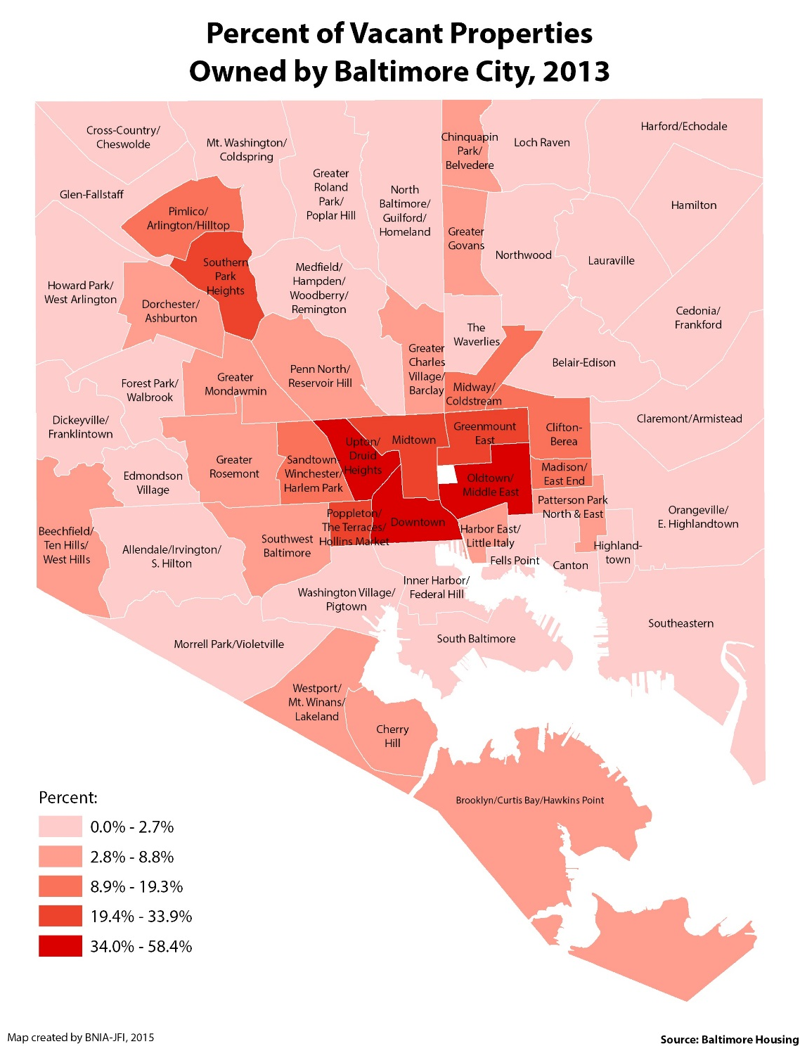

Slide 7
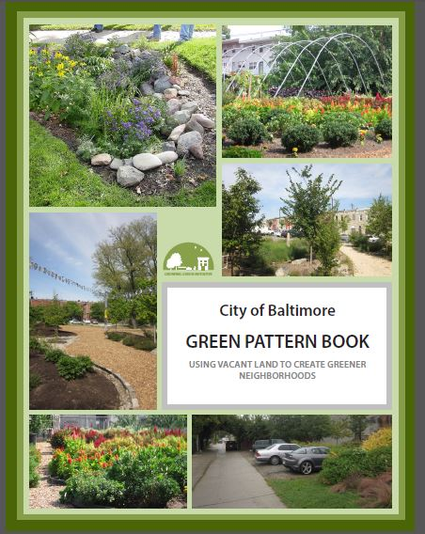
“Green Renaissance”
Strategies for converting vacant and abandoned properties and/or land into green amenities for the City
8 patterns with guidelines for each

Slide 8
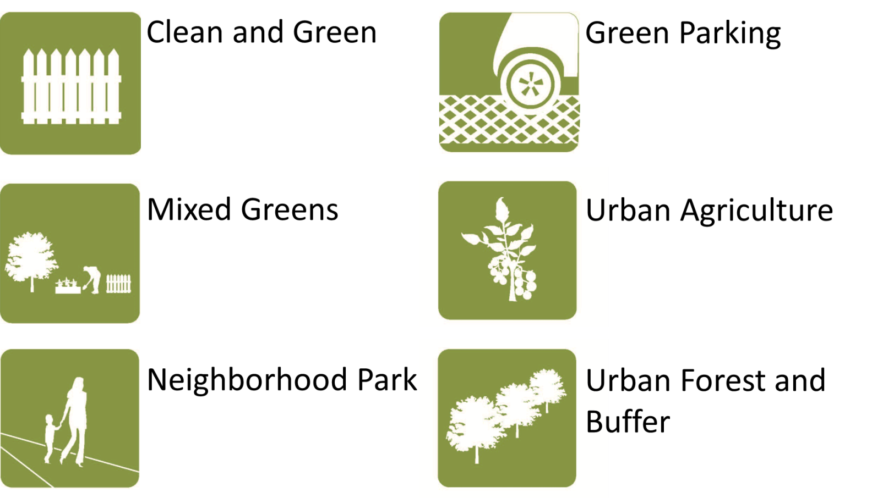
Baltimore’s Green Patterns
Community Managed Open Space
Stormwater Management
Notes:
The City of Baltimore is in the process of identifying vacant land and abandoned buildings that have the potential to be converted into a use that enhances neighborhoods while promoting resiliency and sustainability. An initial step toward this reuse is the Green Pattern Book that provides guidance on identifying green strategies based on potential for redevelopment. Mapping sites that show characteristics of one of the eight patterns can be an essential tool for achieving the vision defined by the City. In 2013, the Baltimore Neighborhood Indicators Alliance (BNIA-JFI) piloted a publicly- accessible, interactive map for this purpose using the pattern community-managed open space.
Now, in 2014, BNIA-JFI is enhancing the map features and adding a second element for stormwater management. Understanding urban waters and the Baltimore communities that surrounds them requires ongoing information about the social, economic, and environmental characteristics of the City and the region. Working with Baltimore’s Department of Public Works, BNIA-JFI is leveraging existing socioeconomic data and integrating it with data related to sites with potential to reduce runoff and nutrient loads to the City’s watersheds. Future iterations of the map will include components of the remaining six green patterns.

Slide 9
Baltimore Green Registry http://water.bniajfi.org/
Collaboration of Baltimore Neighborhood Indicators Alliance (BNIA) and Baltimore Urban Waters Partnership
BNIA: interested in developing indicators of sustainability for Vital Signs community indicator project and policy tracking
Urban Waters: interested in help with assembling primary data and in neighborhood context
Notes:
Thanks to Mike Galvin for suggesting this and to Seema Iyer from BNIA for helping me plan this presentation
Mike can chime in with comments too ….
http://water.bniajfi.org/

Slide 10
Current Data on the Map
Community-managed open space
Where are the locations of CMOS in the City?
Stormwater management sites
Where are stormwater management sites with potential for interventions?
Notes:
Open space – combined data from several community groups into 1 database
Check on website
Clean and Green
Mixed Greens
Neighborhood Park
Green Parking

Slide 11
Data Sources
Multiple agencies and organizations provide data on any single pattern
For instance, the master CMOS database was developed from combining datasets from 5 separate sources (9 total datasets).
Stormwater Management data was derived from multiple datasets from the Department of Public Works

Slide 12
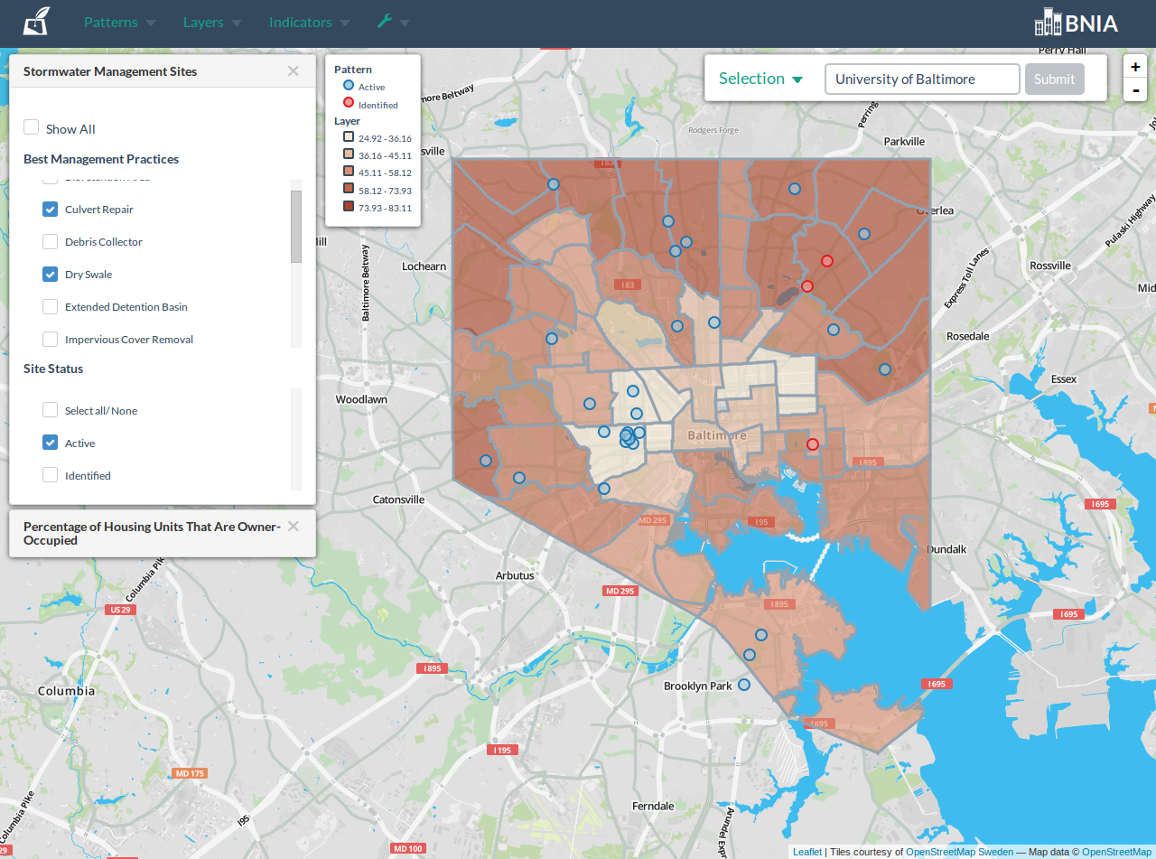
Baltimore Urban Waters
Notes:
Hot off the presses – shows interventions along a thematic map with a variety of ngh characteristics

Slide 13
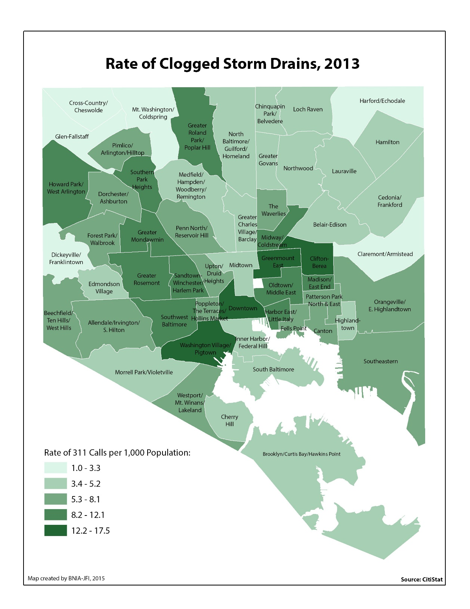
Notes:
From Vital Signs gallery
Vital Signs is a community Frame, Choose, and Track Community Goals
Ensures that environment is viewed as a key component of quality of life

Slide 14
Challenges
Convening multiple agencies together with the intent to collaborate and SHARE data
Converting the addresses provided into geolocatable points. & # () other unique ways to define a place don’t make the cut!
Merging datasets from multiple stakeholders with different objectives into a single database [that makes sense to all]
Choosing mapping technology…

Slide 15
Enjoy our website bniajfi.org

