Slide 1
Intro to NNIP
NNIP Partners’ Meeting - 2022
October 26, 2022
Leah Hendey

Slide 2
Urban Institute
Research nonprofit dedicated to elevating the debate on social and economic policy
Mission: To open minds, shape decisions, and offer solutions through economic and social policy research.
Notes:
LEAH
Mention Some Areas of Research/Substantive Areas of Expertise Urban has

Slide 3
National Neighborhood Indicators Partnership (NNIP)
A peer learning network of community data organizations in more than 30 cities coordinated by the Urban Institute.
Shared Mission: To ensure all communities have access to data and the skills to use information to advance equity and well-being across neighborhoods.
Notes:
LEAH

Slide 4
Our Beliefs
Place matters.
Data and capacity to use data are tools for communities.
Good data doesn’t just happen.
Notes:
Place matters: The places where people live affect their health, security, education, and economic success. We can only make progress toward equity and well-being if we understand how these issues intersect and vary across neighborhoods and among different groups of people.
Data and capacity to use data are tools for communities. With data and the skills to use them, people can identify strengths; uncover problems; and change policies, programs, and investments to better meet the needs of all residents.
Good data doesn’t just happen. Data must be collected, cleaned, analyzed, and shared—all of which takes time, trust, expertise, knowledge of the community, and a diversity of perspectives.

Slide 5
Our Beliefs
Diverse and inclusive organizations produce higher-quality analysis and stronger collaborations
Democratizing data means including people and communities who have been marginalized so they can better advocate for themselves.
Notes:
Organizations that reflect the diversity in their communities and are inclusive of all people produce higher-quality analysis and stronger collaborations.
- note recent guide

Slide 6
Our Work
Strengthen the ability of local organizations to expand the use of data.
Learn about innovative methods and practices from one another and outside experts.
Elevate insights and innovations from our communities to share with local and national audience
Notes:
Using their local expertise and data, our partners connect residents, nonprofits, government, and other
stakeholders to build a shared understanding of community issues and develop solutions together. To better serve our communities, we:
Strengthen the ability of local organizations to expand the use of data. Learn about innovative methods and practices from one another and outside experts. Elevate insights and innovations from our communities to share with local and national audience

Slide 7
Network Roles
Partners: Commit to carrying out the NNIP model at home, share knowledge, and participate in network activities.
Urban: facilitates peer learning, launches cross-site projects, creates products to inform policy and practice, and builds support for community information field.
Executive Committee: Six elected staff members from partner organizations help govern NNIP.
Notes:
[pause – questions for discussion]
Does any one want to share an example of how their organization demonstrates the NNIP model and activities? For those not at partner organizations – how do these activities align with where you see needs in your community related to data and information?
I wanted to just give you a bit more info about how the NNIP network operates, and you’ll here more about some of our work in the opening presentation that Kathy Pettit will do.
Cover network roles.
Strategic Goals
Build and strengthen local capacity
Support current partners
Support potential partners
Inform local and national policy
Build support for community information field
Deleted:
organizes and plans meetings,

Slide 8
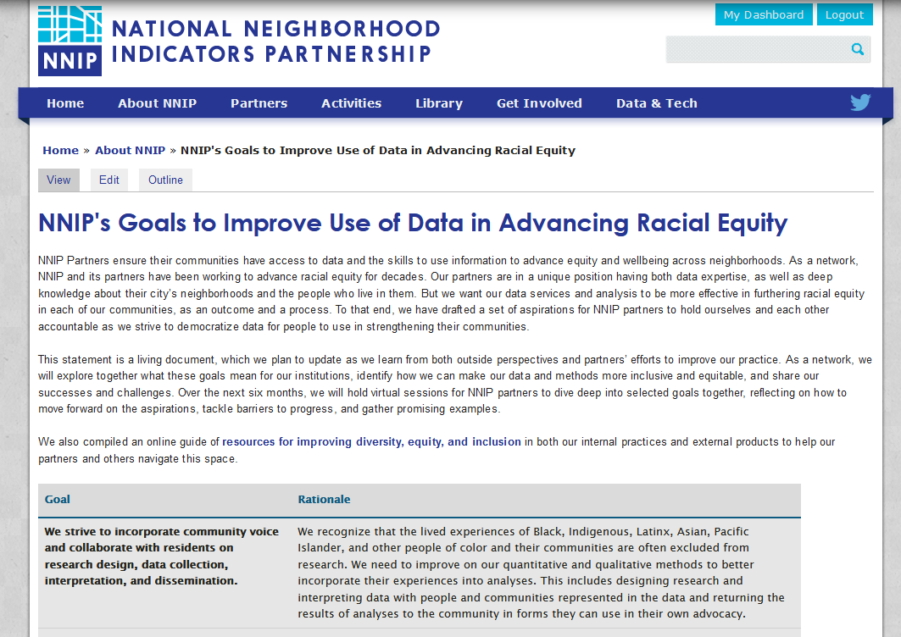
NNIP’s Goals to Improve the Use of Data in Advancing Racial Equity
https://bit.ly/equitydatagoals

Slide 9
Funding for 2022
Current general operations
Annie E. Casey Foundation
NNIP cross-site projects or adjacent grant programs
Black Wealth Data Center
Microsoft Catalyst Grant Program
RWJF – Using Data to Address Structural Racism
Notes:
Casey has been our funder since the beginning. Microsoft also supported this meeting.

Slide 10
Local Partners

Slide 11
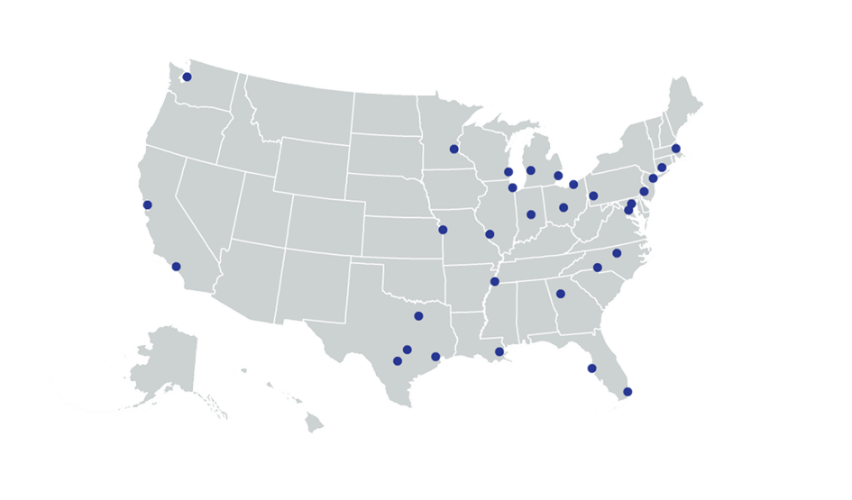
Many different types of organizations, all with long-term stake in the community
Notes:
Grown from 6 founding partners to 30 and more on the way. The partners are housed in various types of institutions–5 of them have more than 1 organization, so there are 36 institutions for our 32 partner cities. (39% universities, 25% nonprofits, remaining split between local funders and regional/local governments). What we found that is more important than the type of institution is that the are respected by all sectors and have a long-term stake in their community.

Slide 12
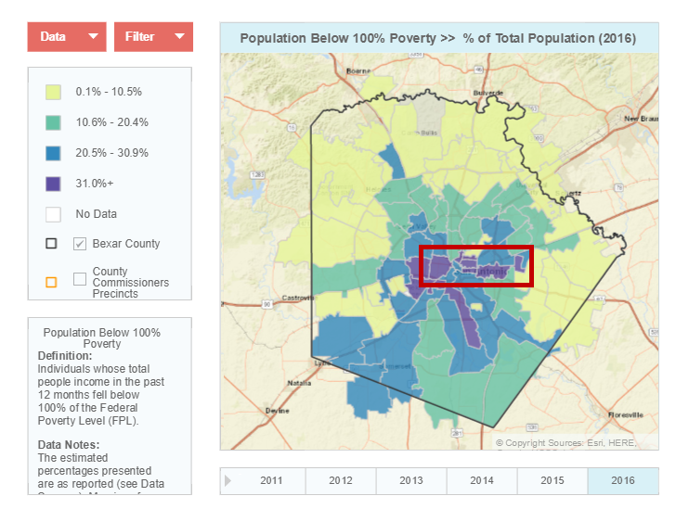
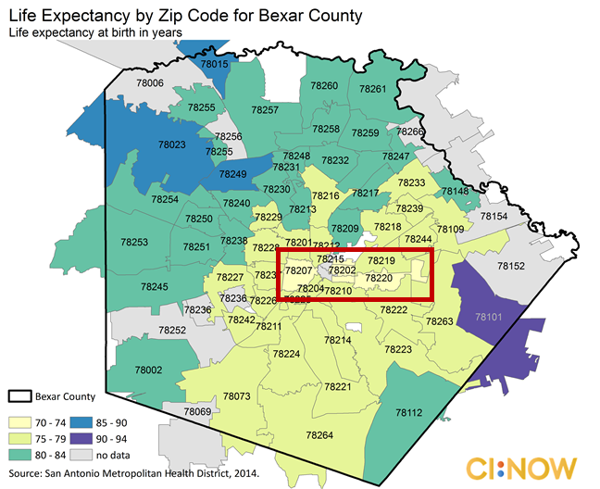
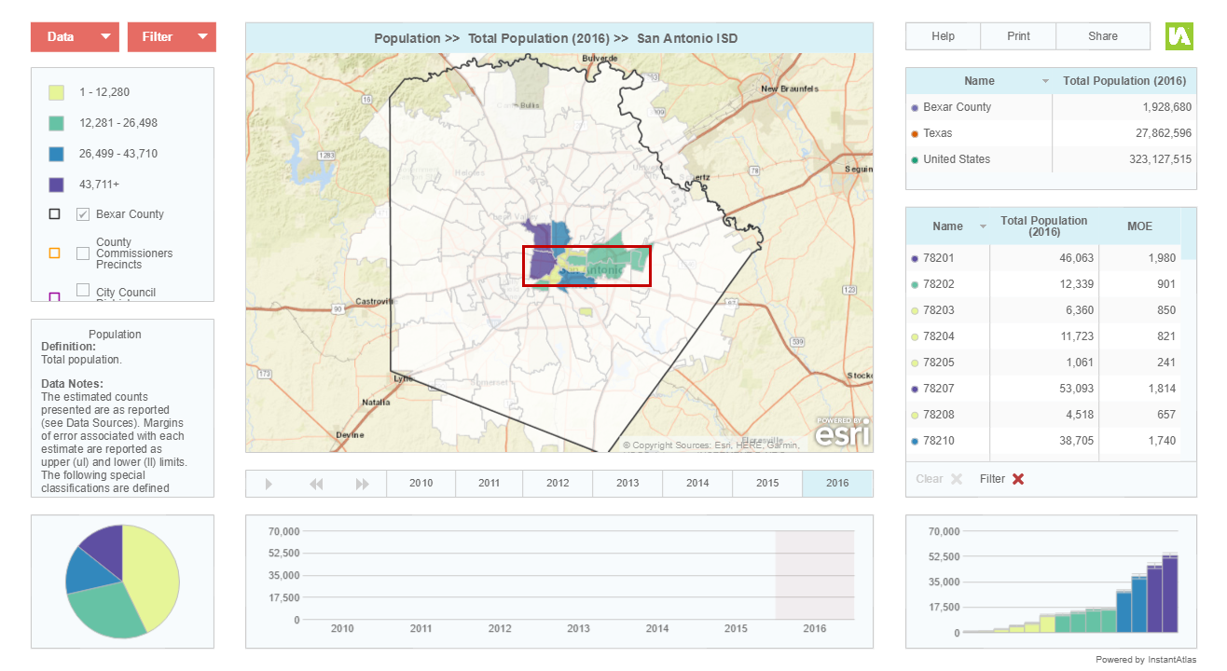
Life expectancy
and poverty
San Antonio ISD
Notes:
[Laura]
Reference if possible:
Democratize Information
Facilitate the direct use of data by stakeholders
Serve multiple audiences and purposes
But a central focus on strengthening and empowering low-income neighborhoods and communities of color
Use information to promote collaboration
Acts as a bridge among public agencies, nonprofits, businesses, resident groups
Success due to: trusted and engaged institutions; relevant high quality data and analysis, mission to support use of data for action

Slide 13
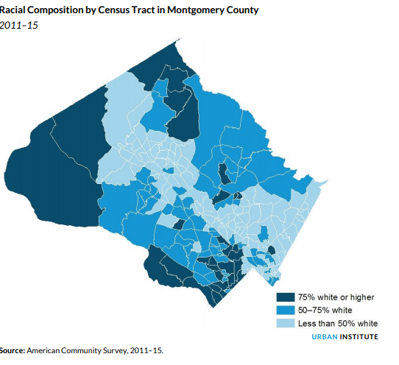
Promote racial equity in
Montgomery County
Notes:
[Leah]
Urban Institute also serves as the NNIP partner for the Washington, DC area, and I play a role in that. Local philanthropies in the area have been really interested in bring the racial inequities that exist in our prosperous region to the forefront.
In addition to the administrative data we organize for DC, we used the ACS data to calculate what equity would look like if you saw no differences by race and ethnicity. This map is of Montgomery County, a suburban jurisdiction northwest of DC that is relatively affluent. You can see those that is still quite segregated – That strip of less than 50% white follows the route of a major freeway.
We found that despite affluence large inequities existed in education, income, and homeownership. For example, in an equitable Montgomery County we’d expect to see 6200 additional black residents and almost 32000 Latino residents with a high school degree.
The local foundations shared this data with the County Council - who in April passed a resolution that referenced the report and will take a look at equity as a step towards requiring a racial equity impact assessment on new legislation. [review smartsheet]

Slide 14
Partners’ Shared Activities
Democratizing data:
Disseminate information &
apply data to achieve impact
Assemble, transform, & maintain
neighborhood data
Build local capacity to
access and use data
Notes:
- assemble and collect ngh data
- work with local groups to USE the data - - make sure everyone has access – esp communities under stress that have traditionally not had access to data.
- build up the culture of valuing using data and the capacity to do so.

Slide 15
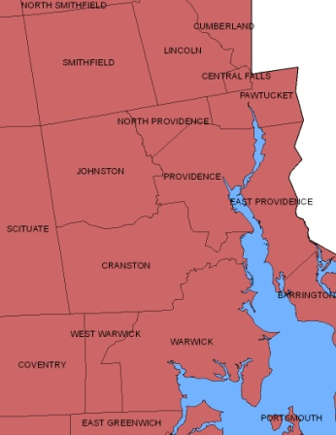
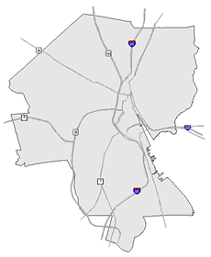
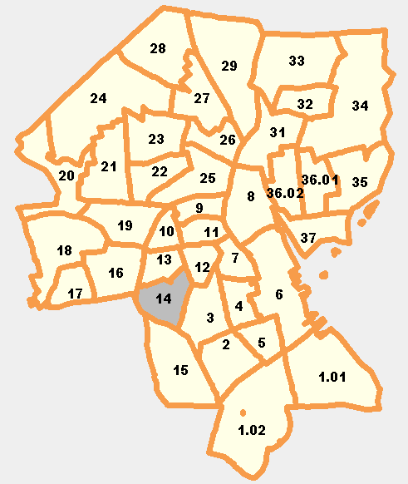
What Activities Do NNIP Partners Perform? Assemble, Transform and Maintain Data
Types of Data
Education
Child care
Births, deaths
TANF, Food Stamps
Health
Crime
Property sales, prices
Foreclosures
REGION
CITY
NEIGHBORHOOD
PARCEL
TRACTS
Notes:
To move from these specific examples to more general activities = One of the major categories of activities that NNIP Partners perform is to - Assemble, transform and maintain data. What is more unique about NNIP partners is that they focus on collecting administrative data.
The partners collect data once from police, schools, health department; and add value by cleaning the data; and develop ngh-level indicators.
The 3 key aspects of the data that partners maintain as we described in the NNIP model earlier – are:
Neighborhood-level is key since problems are not evenly distributed across cities and priority issues vary across neighborhoods.
Multiple topics: the ability to cover many issues is critical: residents don’t experience their community in silos and the solutions aren’t siloed either. I think you’ll see examples of this through out the meeting.
Recurrent: Not just one-time project, but formal agreements to get the data every year or sometimes every day to be ready when need for data arise
Result is a one-stop shop that is a flexible resource for the whole community – much more cost-effective than each nonprofit group trying to do it themselves. There is an economy of scale.
This part is hard work and the systems are built incrementally. Perspective of investment in infrastructure – which requires commitment from partner org and their funders to grow and support the systems over time.
NNIP views data as a tool that can bring stakeholders together to make progress on ambitious community goals. But we recognize that data are shaped by the biases of the people and institutions that create them and have been used to harm people and communities. NNIP partners aim to provide independent analysis driven by the data. To do so we strive to be critical consumers of data, to understand how each data source can be used and how it shouldn’t, and to minimize the risk that the data poses. [link to equitable data practices brief]. We know involving people and communities represented in the data in the collection, interpretation, and dissemination of information will lead to better data, conclusions, and decisionmak

Slide 16
What Activities Do NNIP Partners Perform?
Disseminate information and apply the data to achieve impact
Maintain website (neighborhood profiles, etc.)
Analyze local conditions, programs, and policies
Work 1-on-1 with groups on using data for planning
Build local capacity to access and use data
Provide training on how to use data
Educate on issues related to local capacity to use data in advocacy, planning, policymaking, or program implementation
Notes:
Though the data is necessary and hard work to accomplish, the most important set of activities that partners take on are to disseminate information and apply the data to achieve impact as you heard in the earlier examples. These activities take on a variety of forms – from the more passive dissemination of data in neighborhood profiles on a website to conducting in-depth analyses of local conditions and programs. To truly get the data out there and used NNIP Partners need to be actively engaging will local stakeholders..
The other set of activities is about increasing the capacity of the community to use data through training and education and to advocate for or collaborate in ways the strengthen local data capacity and use of data. You’ll hear from our partners on how they’ve done some of this tomorrow through their involvement with the open data efforts in their cities.
***Reference*****************************
Disseminate information and apply the data to achieve impact.
Maintain a website with static neighborhood data and/or interactive tools
Prepare data products for local clients (maps, fact sheets, data excerpts)
Conduct analyses of local conditions, programs, and policies
Present data and results of local analyses at public forums
Provide ad hoc help and technical assistance to local groups on how to access/use data
Work one-on-one with organizations or foundations on using data for program planning and design
Use data to strengthen civic capacity and governance.
Provide training to local groups on how to access and use data
Conduct public education on issues related to strengthening local data capacity
Collaborate with others to strengthen local data capacity (serving on civic committees, encouraging open data, etc.)

Slide 17
Stay in Touch! http://www.neighborhoodindicators.org/get-involved/listservs or Follow Us @NNIPHQ
Kathy Pettit: kpettit@urban.org; 202-261-5670
Leah Hendey: lhendey@urban.org; 202-261-5856
Notes:
Visit our website to sign up for our NNIPNews – and get updates from NNIP on our quarterly newsletter. There are also Twitter lists to follow our partners and you can follow the Network on Twitter @NNIPHQ
You have your packets which has the agenda for the next three days. Note code of conduct. Working meeting The sessions are a mix of topical and technical. We encourage active participation – that’s what makes it such a great peer learning network.
Explain camp - So don’t be afraid to jump in. Or propose an NNIP Camp session!
Mention buddies / Executive committee- people to go to ask questions.
Feel free to ask any questions.

