Slide 1
Agile Scrum Management

Slide 2
What is Agile Scrum?
Agile/SCRUM is a project execution methodology that principally seeks to promote the early and frequent delivery of value.
Notes:
The value to using Agile is in the:
Rapid delivery of value
Risk limited to two-week sprint
Short delivery cycles tolerate change

Slide 3
How does Agile Scrum work?
In this process, the work to be done is identified in a roadmap, then listed in a backlog consisting of prioritized user stories. User stories have specific acceptance criteria which are used to demonstrate completion. An epic is a super story that is too big to complete at once.
Work is performed in two week time-boxes called sprints. At the beginning of each sprint, the team commits to completing a number of user stories from the top of the backlog. The daily scrum meeting happens each day to account for the work completed to date.
At the end of the sprint, the team gathers to demonstrate that it actually completed all the work it committed to complete. This is the sprint demo.

Slide 4
Who are the players in Agile Scrum?
Product Owner is responsible for ensuring that the work done creates most possible value
Scrum Master is responsible for facilitating progress and ensuring the team doesn’t over-commit to work
Team creates and demonstrates product every two weeks
Stakeholders actively contribute ideas, changes, enhancements and new features

Slide 5
What tools can you use to execute Agile Scrum?
Free
Open source
Simple to use
Taiga
Other platforms include: Scrumwise, Targetprocess, Acunote, Agile Agenda, Agile Buddy, Agile Soup, Banana Scrum, Binfire, etc
Notes:
Taiga is a project management platform for agile developers & designers and project managers who want an easy tool to manage the workload across a team.

Slide 6
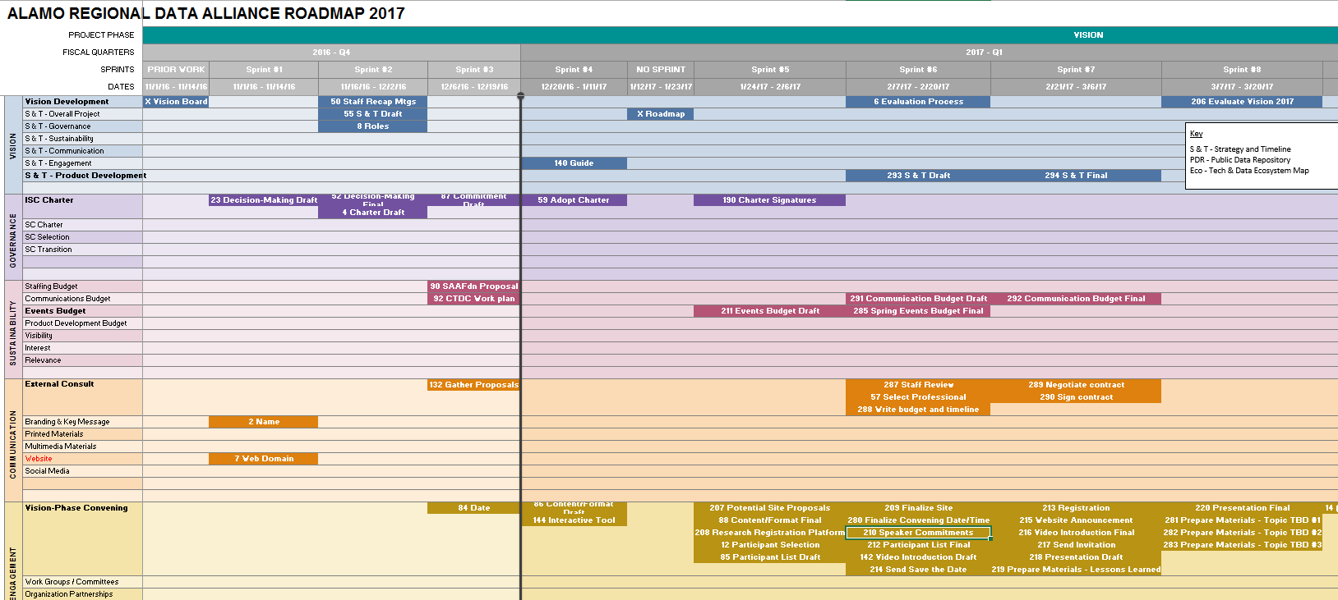
Roadmap
Notes:
A user story road map arranges user stories into a useful model to help understand the functionality of the system, identify holes and omissions in your backlog, and effectively plan holistic releases that deliver value to users with each release
The story map is not static, but very much alive! You can update, prioritize, add, and remove stories every week.

Slide 7
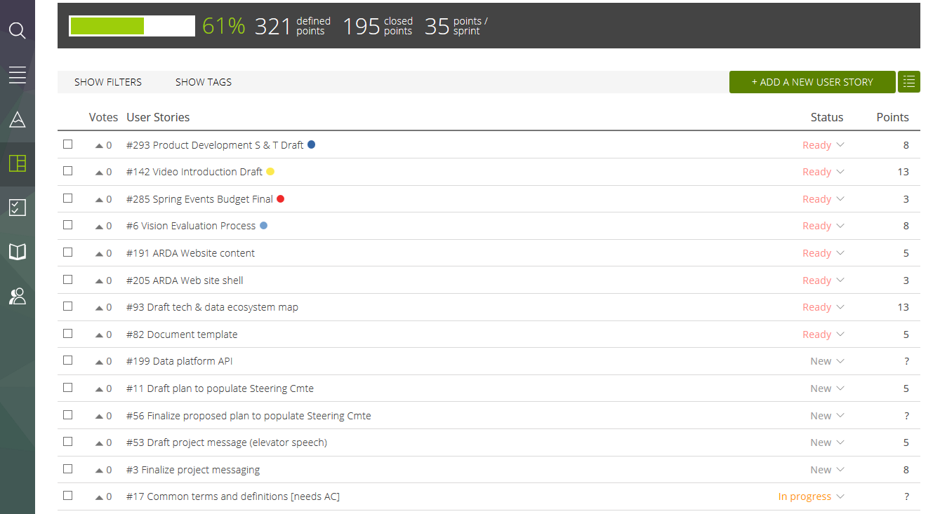
Backlog
Notes:
A product backlog is a prioritized list of work for the development team that is derived from the roadmap and its requirements. The most important items are shown at the top of the product backlog so the team knows what to deliver first.

Slide 8
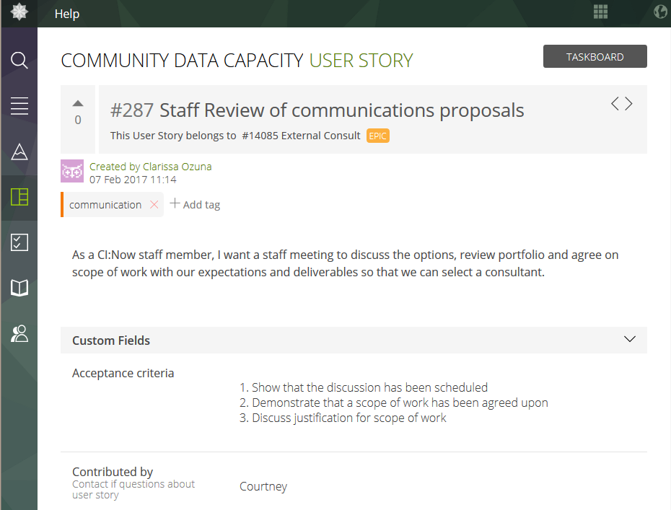
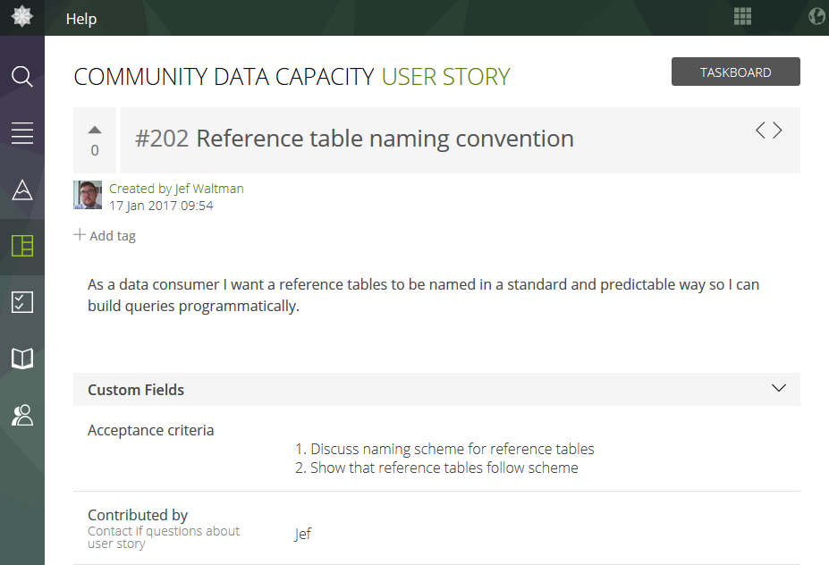
User Stories
Notes:
User stories are short, simple descriptions of a feature told from the perspective of the person who desires the new capability, usually a user or customer of the system.
They typically follow a simple template:
As a <type of user>, I want <some goal> so that <some reason>.

Slide 9
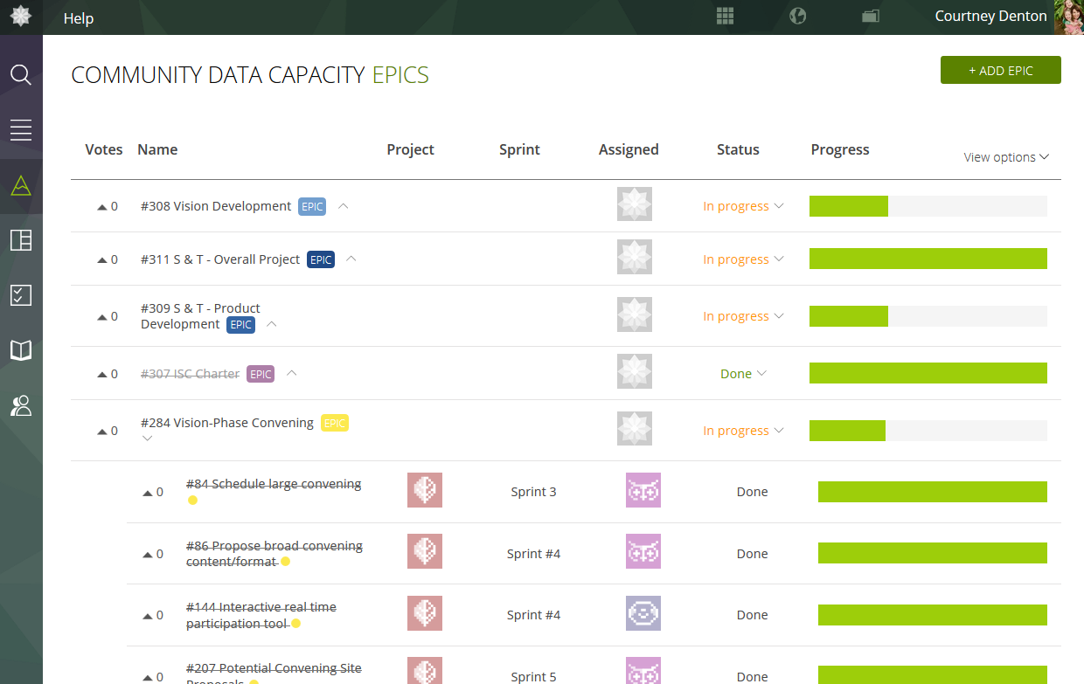
Epics
Notes:
Epic can be defined as a work, which can not be completed in a week time, or any work which will take a full sprint to complete. By observation 5-10 user stories comprise of one Epic
A good example of the difference between an epic and a user story is:
Epic - Create a web site
Story - Create the Home page

Slide 10
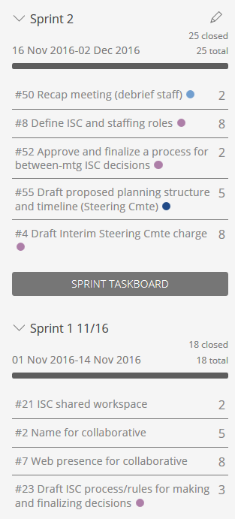
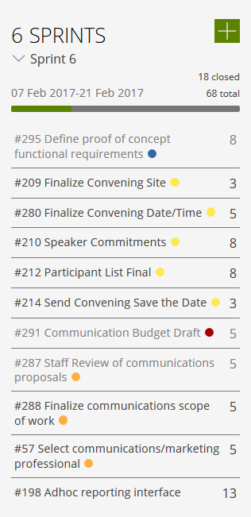
Sprints
Notes:
Work is confined to regular, repeatable work cycle, known as sprints. We have chosen 2-week time-boxes.
At the beginning of each sprint, the team commits to completing a number of user stories from the top of the backlog.

Slide 11
Daily Scrum
What has s/he accomplished since the last daily scrum meeting?
What is s/he going to accomplish until the next scrum meeting?
What are the impediments that prevent s/he from accomplishing tasks?
Notes:
The daily Scrum meeting is a short everyday meeting, ideally during start of the working day. Each team member who works towards the completion of a given sprint needs to participate. During this meeting, each team member should briefly provide the answers to three questions

Slide 12
Sprint Demo
The purpose of the sprint demo is to show that each story user story selected for inclusion in the sprint was successfully completed according to its acceptance criteria.
Notes:
The benefits of the live feedback are: Additional items for backlog; Suggested changes; Something that could be done better; Missing / wrong acceptance criteria; Notice a bug or defect

Slide 13
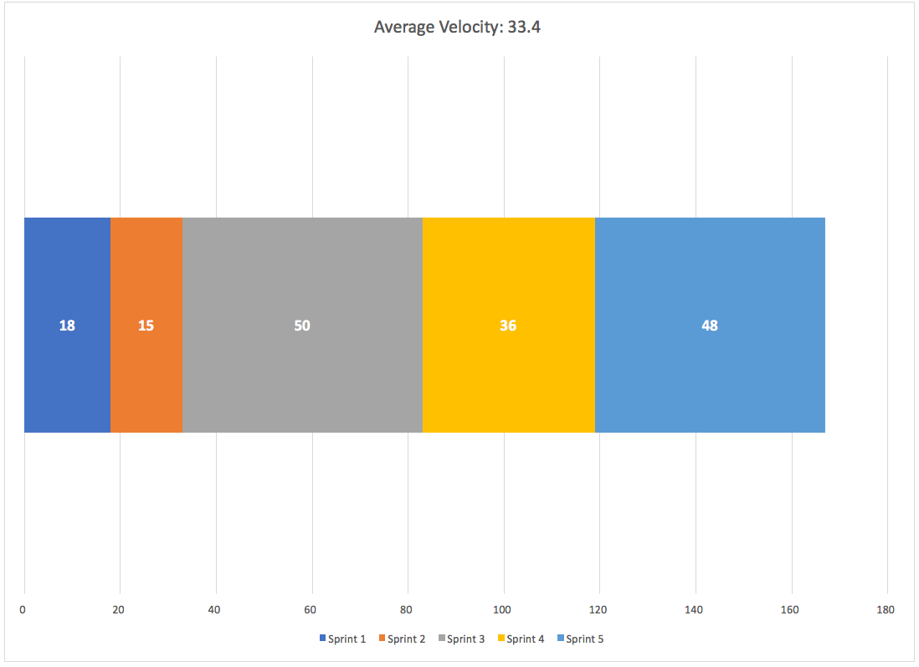
Timeline and Velocity
Notes:
There are 2 ways to manage the workload: velocity and capacity.
Velocity-based planning: Velocity is usually tracked as completed story points in a sprint. You should have a good idea after 11 sprints of your average story point velocity and should be able to forecast how many 'points' your team can accomplish in an upcoming sprint. After doing your story estimation, the number of stories you choose to tackle in the upcoming sprint should be based on this historical sprint velocity.
Capacity (hours) planning: After you have selected your stories, the task planning begins and you start estimating what will be done and how long each task will take. This will let you see how many hours of work you believe you have to do. Based on your average capacity on the team, this will help you validate whether the initial point-based planning is still on track.
My thoughts: I use capacity mostly to make sure I am tracking actual availability within a given sprint. On average, the team might have about 50 hours per person, but what about a sprint starting on December 15th? Suddenly a lot of folks are taking holidays and vacation time and the sprint capacity is affected. For this reason, I don't believe in using historical capacity's to estimate the current capabilities of the team.
My advice would be to use your story-point velocity that you have established to determine which stories to take on, and then build out the true capacity for the upcoming sprint based on resource availability.

