Slide 1
Using the Census API to automate data analysis
Presented by:
Caroline Heffernan
carolineh@datacenterresearch.org
Notes:
Hi my name is Caroline Heffernan, I am a data analyst at The Data Center in New Orleans and today I am going to talk to you about using Census API to automate data analysis.

Slide 2
Agenda
Overview of Neighborhood Profiles
B. What is an API?
C. Using Census API
D. Setting up HTML
Dr. George Dr. Allison Plyer
Ben
Dr. George Dr. Allison Plyer
Ben
Notes:
Specifically, we have used the API to automatically update our Neighborhood Statistical Area Data Profilles.

Slide 3
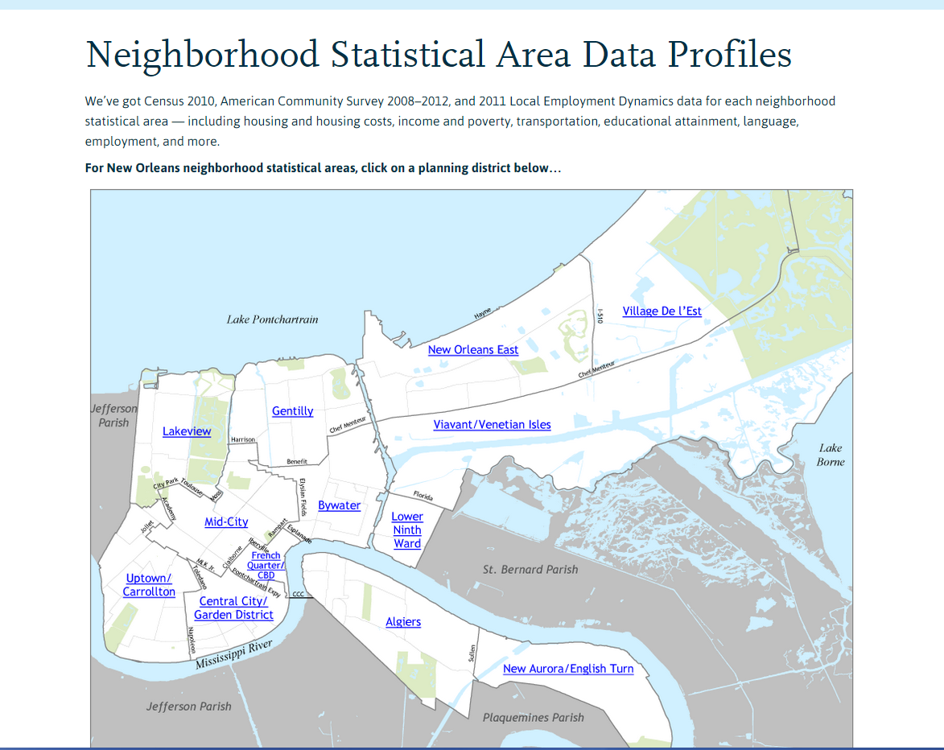
Neighborhood Profiles
Dr. George Dr. Allison Plyer
Ben
Notes:
What are the Neighborhood Profiles?
Our Profiles provide basic demographic and economic data on a neighborhood level using Census, ACS and LED data.
This data is used by many community members, nonprofits, and grant writers and answers many of the basic questions people may have about New Orleans.
When you come to our website, and click on the link, you will be brought to this page. Here the areas of New Orleans are broken down by planning district. If you were to click on a district, it would be broken down by neighborhood, and if you were to select a neighborhood, it would look like this…

Slide 4
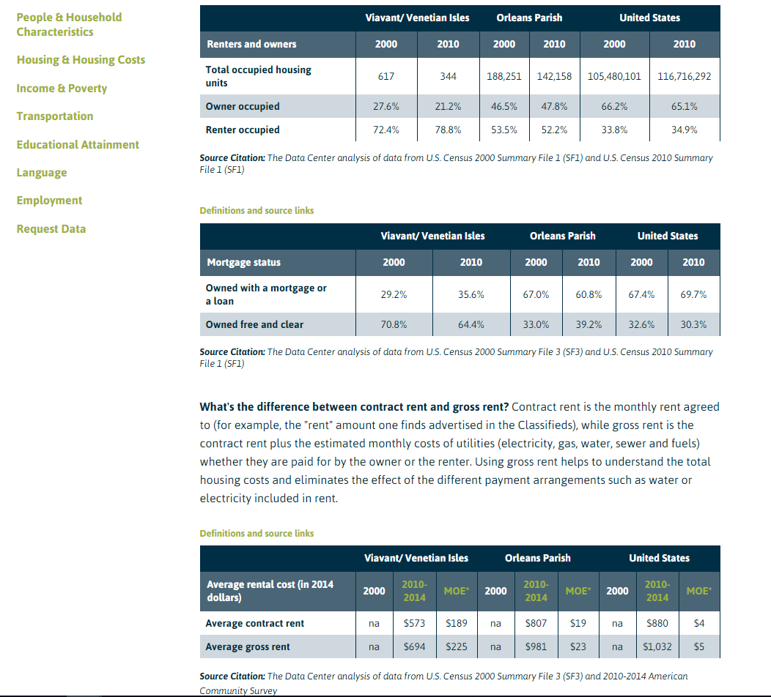
Neighborhood Profiles
Notes:
Each of New Orleans’ 72 neighborhoods has 23 tables of data that falls into 7 different categories.
People & Household Characteristics
Housing & Housing Costs
Income & Poverty
Transportation
Educational Attainment
Language
Employment
There are also explanations as to why we use certain data and links that give helpful tips on how to use this data accurately when writing a grant proposal

Slide 5
Agenda
Overview of Neighborhood Profiles
B. What is an API?
C. Using Census API
D. Setting up HTML
Dr. George Dr. Allison Plyer
Ben
Notes:
So as you can see, updating all of this data is no small task, but it is important. Which means that every year we had to dedicate time and resources to updating all 72 neighborhoods.
This past year, we decided to look into making this process more efficient through the use of APIs.

Slide 6
What is an API?
Application Programming Interface
Fixed code words and variables to create a “call”
When to use APIs?
Notes:
So, what is an API?
An API (Application Programming Interface) is a window into the internal data and offerings of a software or database. It’s manifested in a set of fixed “calls” that allow external applications and users to use that internal data/information. Importantly, API’s promise consistency, meaning that external users can rely on dynamic updating if they’re using APIs. Unlike a website, whose format could change, or whose offerings could run out, API’s are consistent. I’ll explain this further late (explain further later with an example…factfinder vs. API). In the case of the Census, the API contains a set of fixed set of code words that a user can arrange to pull from a database. These code words include variables that determine which data/information is pulled from the database and together these words form a phrase or a “call”
When do you use an API?
APIs are great for dynamically pulling in data that can then be analyzed on the spot
For example, rather than copy and pasting a spreadsheet downloaded online into a worksheet, one could use an API to feed data directly into that worksheet. One could quickly re-analyze that data with a different variable by just changing the call (for example, changing the year), and allowing the analysis to update.
APIs are PARTICULARLY useful when you have an activity that you can repeat/replicate. In this case, changing just one of the variables or code words (for example, year, or geography) will update the data.
Finally, APIs can completely automate data analysis/display in the case of frequently updated data. For example, if you want to analyze the most recent unemployment rate, you can set up a call to call for the employment data of the current month and then set up a worksheet to analyze this data. That way, whenever you look at the worksheet, you will see that month’s unemployment rate. Pretty cool right?

Slide 7
Agenda
Overview of Neighborhood Profiles
B. What is an API?
C. Using Census API
D. Setting up HTML
Dr. George Dr. Allison Plyer
Ben
Dr. George Dr. Allison Plyer
Ben
Notes:
So once we knew we wanted to use an API, specifically the Census API, to automate the data analysis for our Neighborhood Profiles, we spent a LOT of time researching the best way to do that.

Slide 8
Disasters tend to accelerate pre-existing trajectories.
Example call
http://www.census.gov/data/developers/data-sets.html
Notes:
The first thing we had to learn, was how to formulate a call to pull data from the API.
The call is made up of 6 distinct parts, The base of the call, the year of the dataset, the dataset name, the list of variables, the geographic parameters, and the key.
The base is always the same, it directs you to the census website
The year and dataset obviously vary depending on the data you want
The variables are made up of two parts, the beginning which refers to the table, and the number which refers to the specific variable. For each, there is an M for MOE and an E for estimate
The geographic parameters specify the geography you want data for and can be as specific as a census tract
Finally the key is the unique identifier the Census gives you when you request a key so that they can track who is using the API
http://www.census.gov/data/developers/data-sets.html If you go to the link at the bottom of the page, it has a list of all datasets that are available through the API as well as a variable list and example calls for each dataset

Slide 9
Google Sheets importdata()
Dr. George Dr. Allison Plyer
Ben
Notes:
Once we had become familiar with the Census API format of calling data, we had to figure out where we were going to call data TO, in order to actually analyze it.
Those who use API to create apps and programs normally use databases, but this was not familiar to us so we found a solution that was easier, Google Sheets.
Google sheets is great for two reasons, 1. it is dynamic, and 2. it is similar to excel.
Since Google sheets is online, it can be automatically updated. We broke up our call in 3 parts, 1. the base, 2. the year, and 3. the rest. We then used a formula based on TODAY to insure that the year would update at the same time that the new ACS data was released. We then concatenated the three parts together and used the Importdata() formula to pull in our call.
Once we had all of the variables for each datatable we wished to create, it was simply a matter of analysis. Since google sheets is similar to excel and has almost all of the same functions, this part was fairly straightforward.
Explain how you could use this to quickly update/tweak a complex analysis. You could change the year or geography seamlessly and execute complex analysis, rather than having to constantly pull from factfinder. (I.E. if the New Orleans metro was to change again, we could change the counties pulled in)

Slide 10
Agenda
Overview of Neighborhood Profiles
B. What is an API?
C. Using Census API
D. Setting up HTML
Dr. George Dr. Allison Plyer
Ben
Notes:
In order to create a full product, we needed to figure out a way to get the analysis from Google sheets to our website.

Slide 11
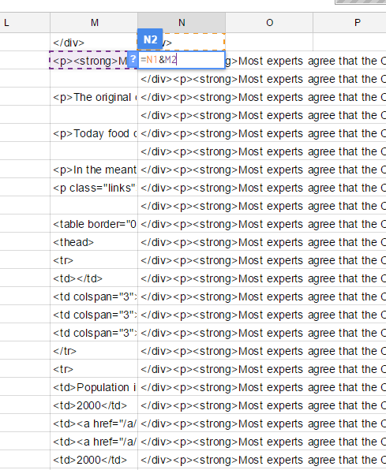
Setting up HTML
Notes:
Once all of the raw data had been pulled into sheets and the analysis had been performed, we had to figure out how to get the data to automatically update on the website. The API was able to automate our analysis, but could not help with automating our display.
We were able to take the html of our current non-dynamic neighborhood profiles and fill it in google sheets with the formulas from our now dynamic analysis. That process is displayed on this slide. Once we concatenated these templates and analyses, we ended up with the html of a full web page. At this stage, we could have copy and pasted that html to our pages and called it a day.

Slide 12
Not Covered
Publishing from Google Docs to a Website (AJAX/Wordpress)
Automating updates (Google Scripts)
Dr. George Dr. Allison Plyer
Ben
Notes:
However, we went for the full technology home run. We consulted with our web developer and figured out how to get wordpress to pull html from a cell in google docs and display it on the web. I don’t have enough time to discuss that process, so that might be for another presentation!
Nevertheless, once that was done, the tables were up on the website

Slide 13
Conclusion
Automatic updating
Reduction of errors
Replicable
Notes:
Using the Census API was a great decision for us because it means that we can continue to produce this valuable dataset with less labor and fewer errors because any error hat comes up will show up in every neighborhood instead of in the past where the large amount of copy and pasting involved could lead to errors only in one or two neighborhoods. We also can apply this approach to other projects. For example, we have already used this template to automate another regularly updated brief, Who Lives in New Orleans and Metro Parishes Now? And this time around it took considerably less time to implement without the months of research and troubleshooting we did with the Neighborhood Profiles. Who Lives includes graphics, and we wanted to automate those too, so we used another robust technology, Plotly, and integrated it into a dynamic solution coupled with the Census API and Google Sheets.
It definitely took us time and lot of trial and error to figure this out and I know that this is a lot of information. So if anyone is interested in replicating this process, feel free to reach out.
Thank you

