Slide 1
Using maps to make funding decisions in 5 easy minutes!
Anthony Galvan

Slide 2
How we got here…

Slide 3
Community Impact Funding Process
Health
Income
Education
Financial Capability
Workforce Development
Clients Served
Percent in Poverty
Unemployment Rate

Slide 4
Basic Task
Build a map containing these components:
All ZIP codes in the UWMD service area
A bubble/dot in each ZIP code representing the number of clients served by UWMD funded agencies
An underlying choropleth showing a relevant indicator
Inform funding decisions
Use map to see where clients are served compared to where the need is

Slide 6
UWMD Staff “Suggested Changes and Additions”
More maps
More data
Different data
Data that doesn’t (don’t) exist
Also, we found this other thing…

Slide 7
New Task: Build a Custom Tool in Two Weeks

Slide 8
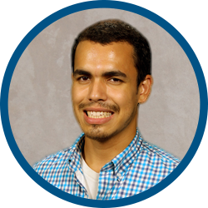
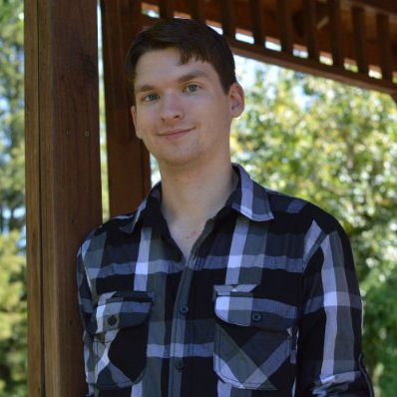
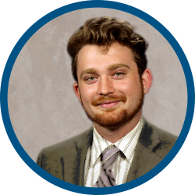
Awesome Staff Works in Overdrive

Slide 9
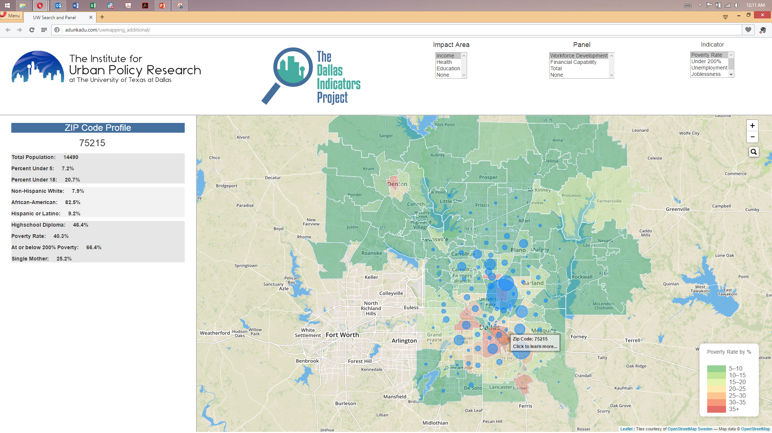
DEMO

Slide 10
For More Information
Anthony Galvan
Institute for Urban Policy Research The University of Texas at Dallas
800 West Campbell Road, WT20 Richardson, Texas 75080
V: 972-883-5438 F: 972-883-5431
anthony.galvan@utdallas.edu http://iupr.utdallas.edu
@galvanthony

