Slide 1
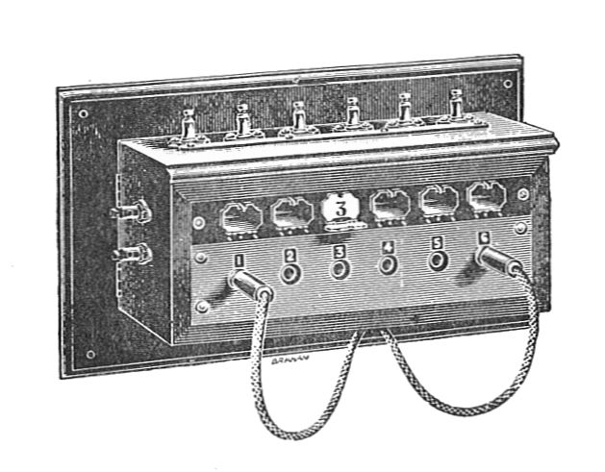
Librarians asCritical
Infrastructure
in Civic Data Ecosystems
November 13th, 2018

Slide 2
About Me

Slide 3
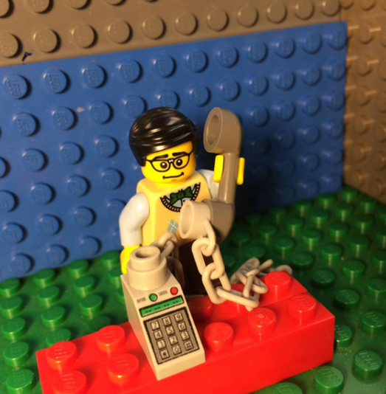

Slide 5
Examples of Data Management Partnerships

Slide 6
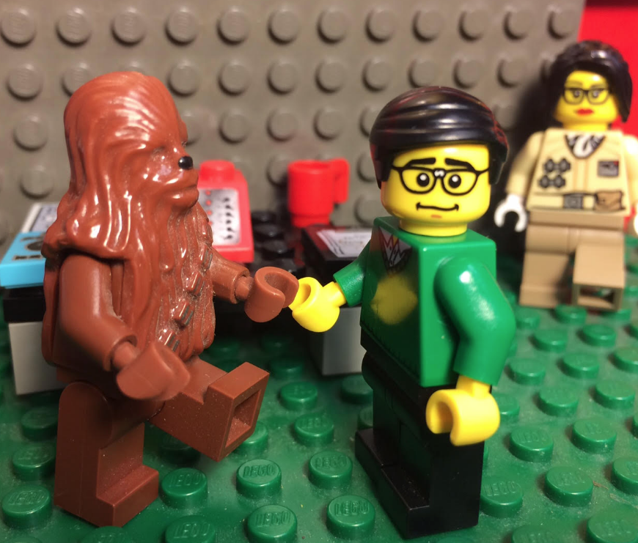
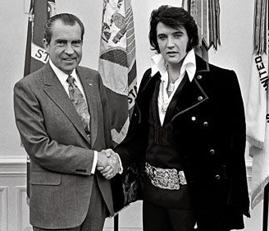
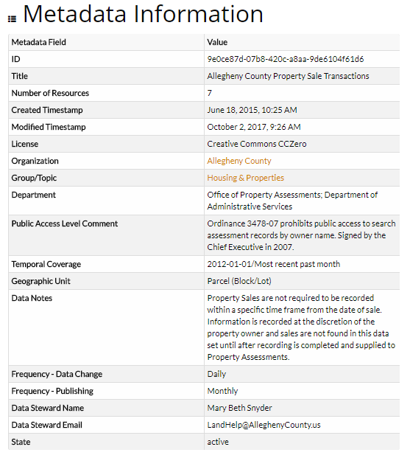
Metadata Consultation
Re-enactment
Notes:
Metadata slide - Mike Bolam metadata librarian at Pitt helped us figure out what we needed in terms of metadata. Nora Mattern photobombed.

Slide 7
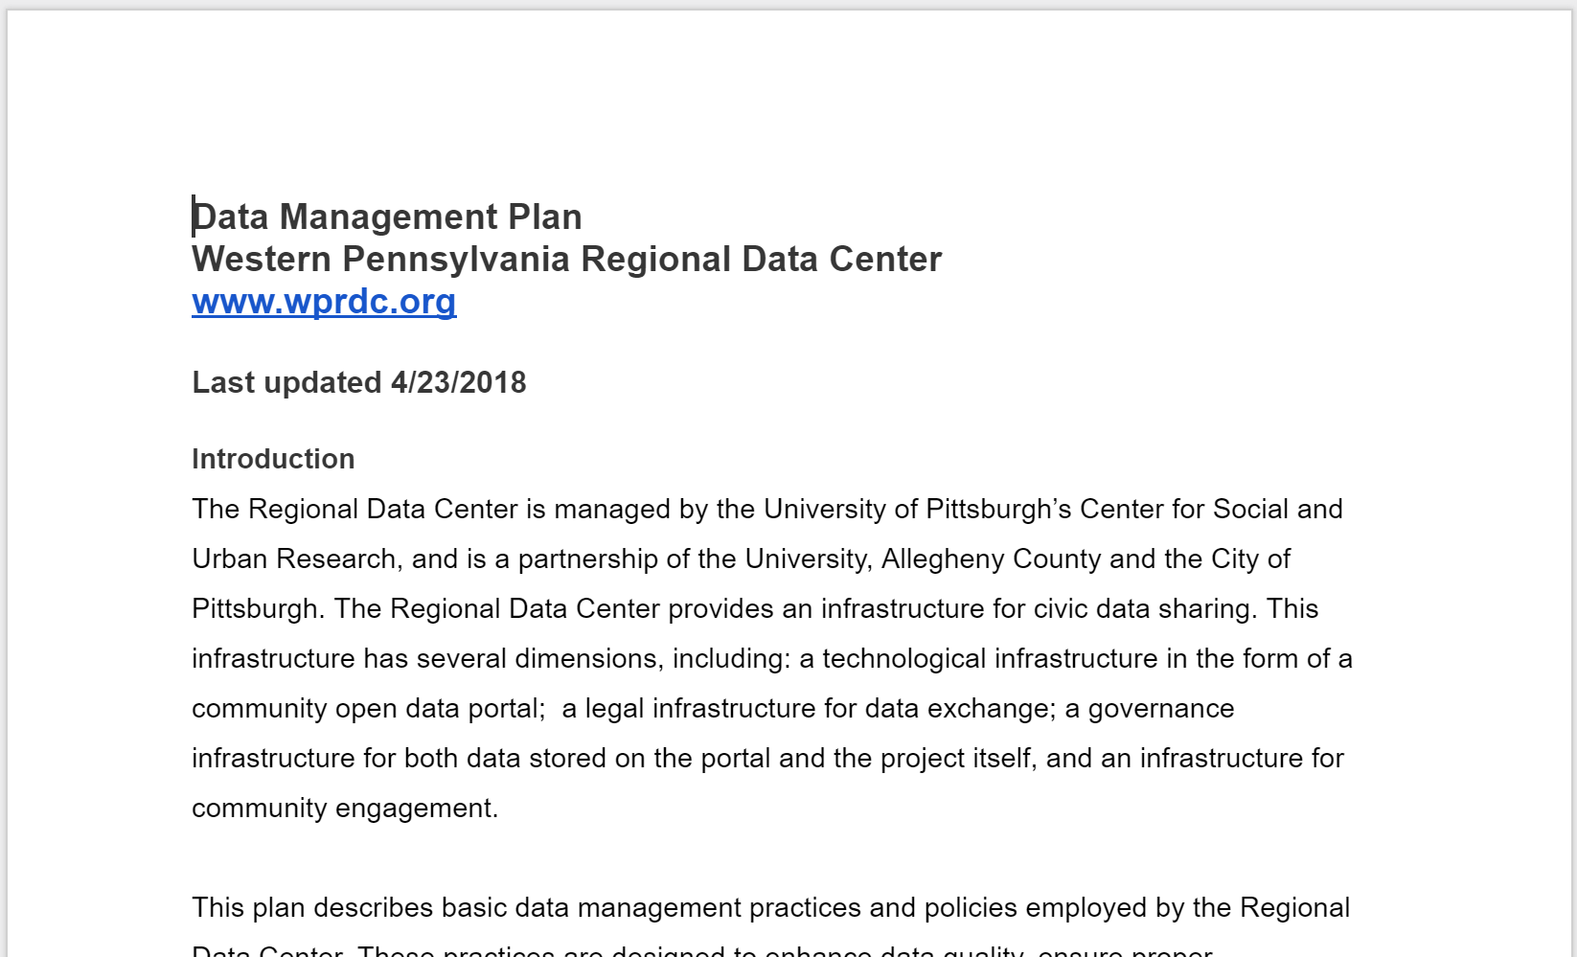
Data Management Plans

Slide 8
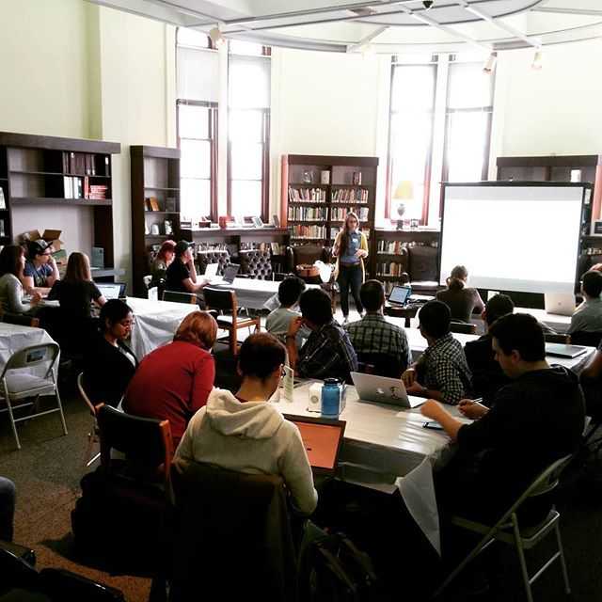
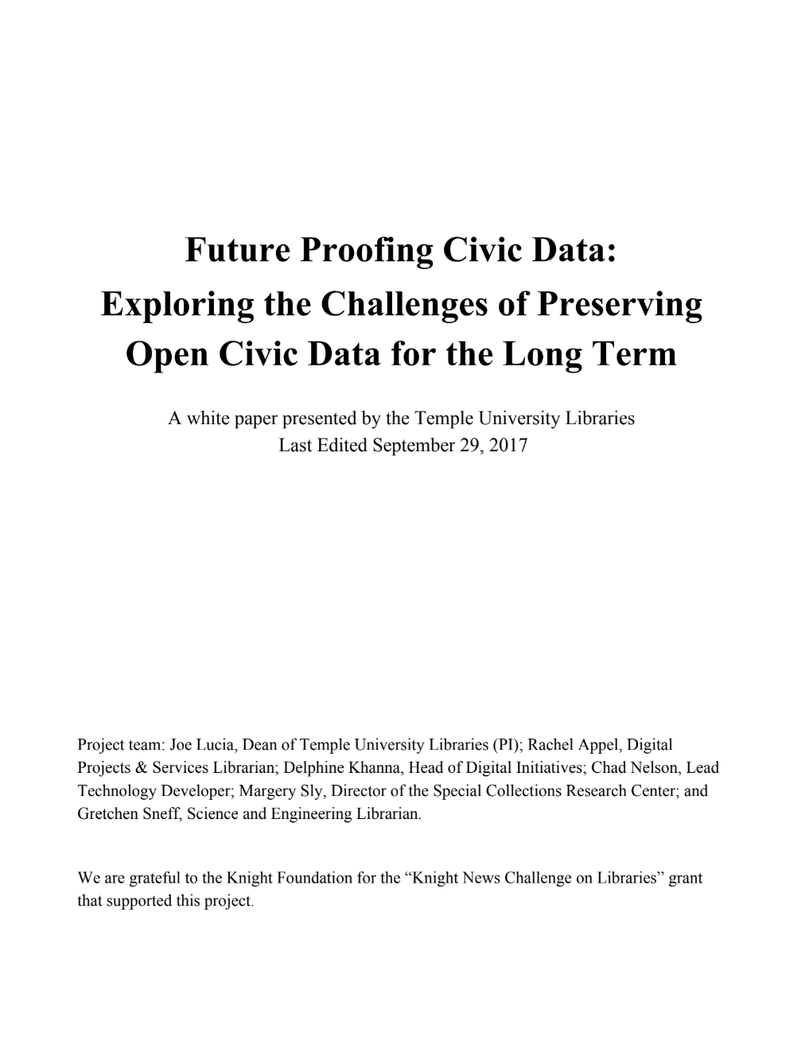
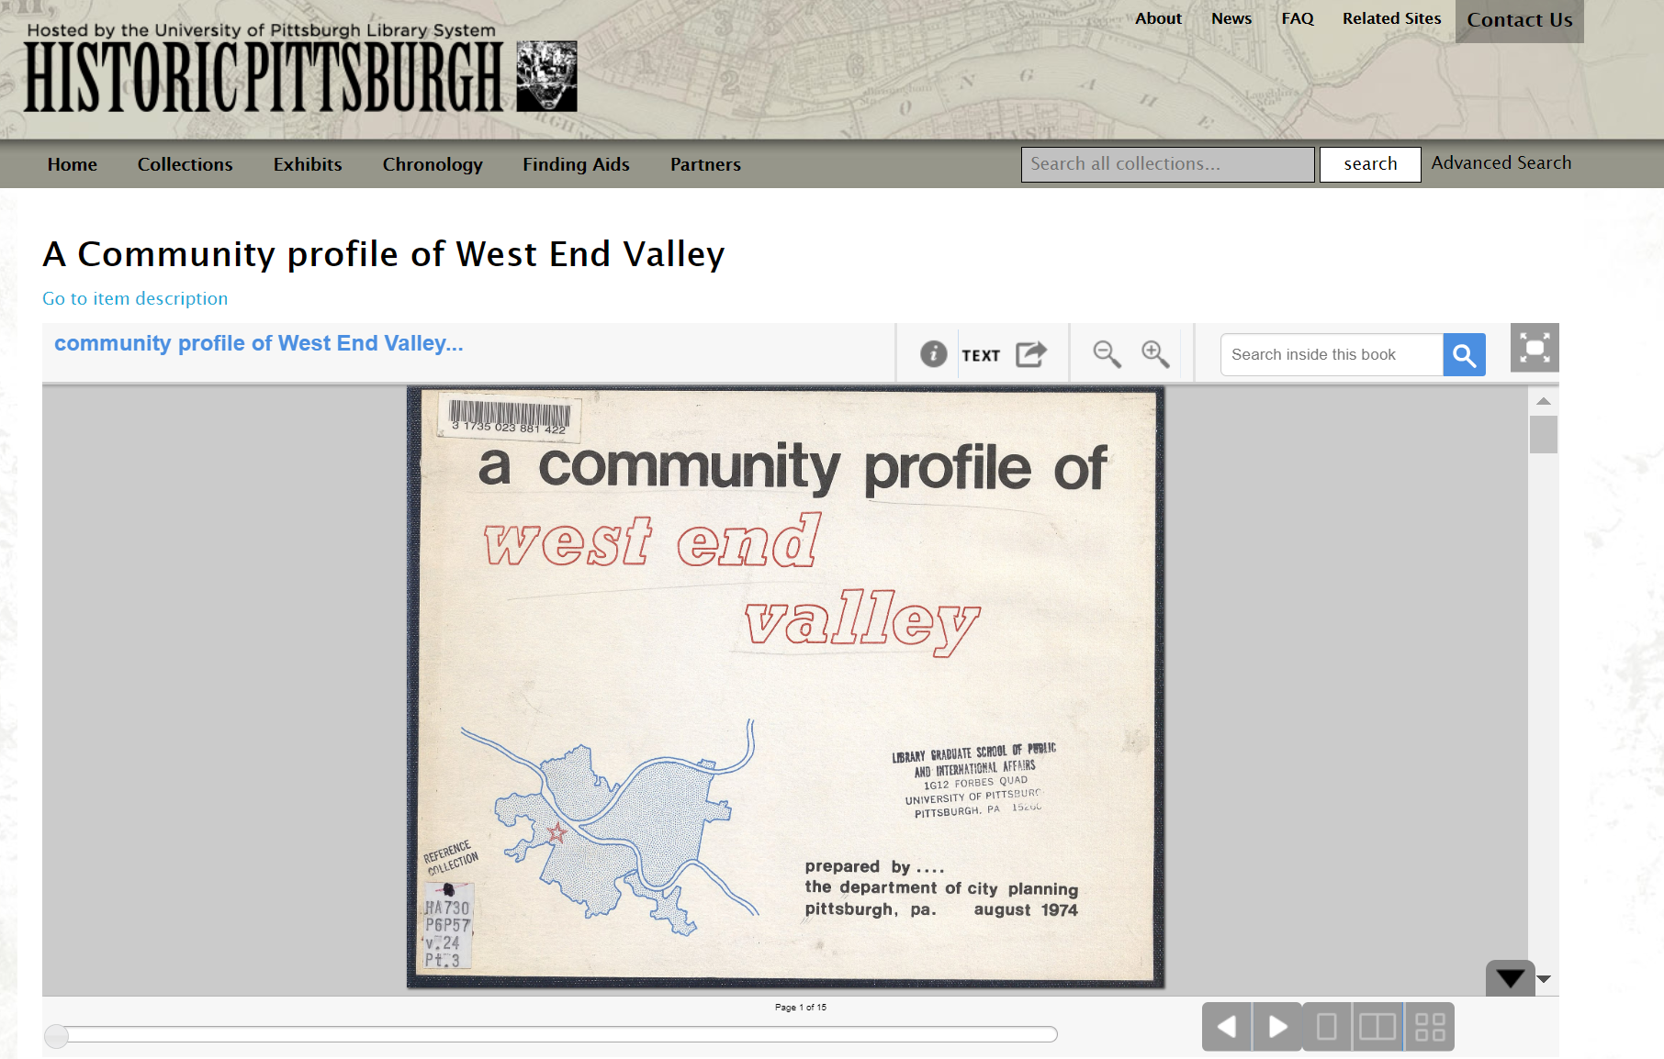
Data Archiving and Preservation
Notes:
Rachel’s stuff from Temple is a great fit here. Also our work with Pitt archives and the stuff Brooke is doing with CLP in addition to data rescue.
https://storify.com/parnopaeus/data-rescue-pittsburgh
http://www.post-gazette.com/local/region/2017/04/03/Donald-Trump-EPA-data-Carnegie-Library-Pittsburgh-Data-Rescue-Pittsburgh/stories/201704030063
Open data portal selection slide

Slide 9
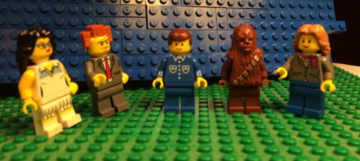
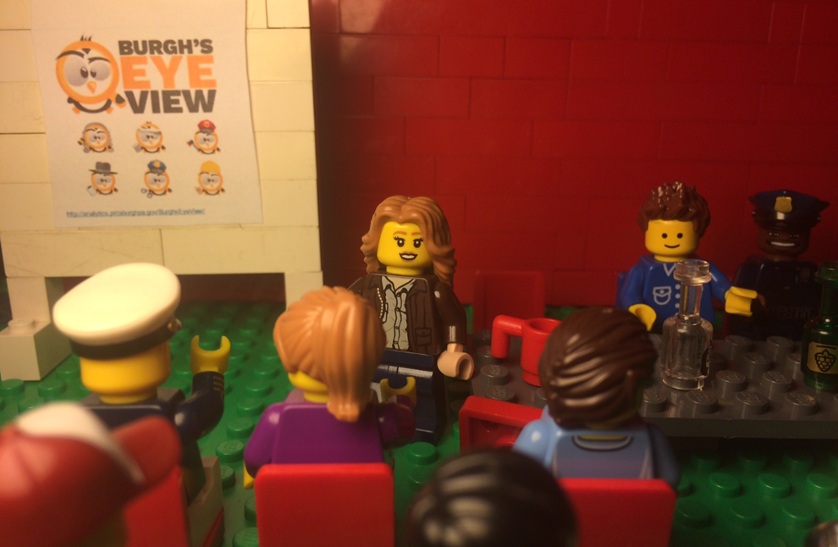
Privacy Advice
Notes:
We pulled together the library team to help the City of Pittsburgh figure out privacy issues with 311 data. Initially published with neighborhood names, no addresses. City wanted to minimize risk of retaliation against people that complain about neighbors. Users wanted coordinate level potholes.

Slide 10
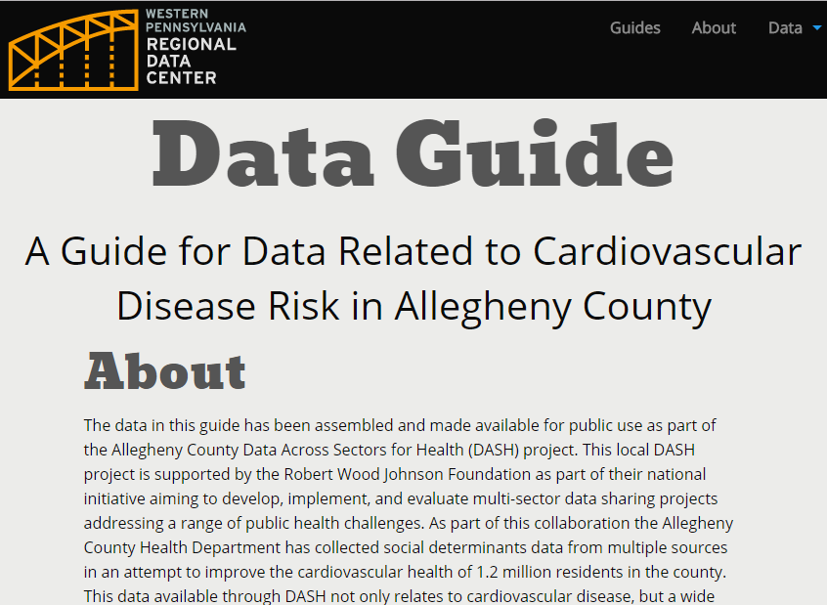
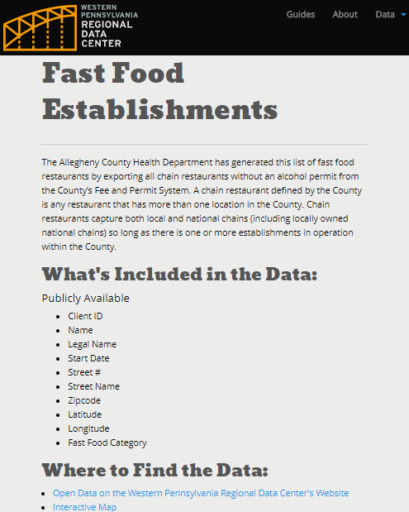
Context for Data with Guides or ReadMe
Notes:
We drafted data guides. Context for data users. Librarians pointed to lib guide format.

Slide 11
Library as Publisher
Notes:
CLP and DLS publish data - possibly list a few other libraries that publish open data (Toronto is one…)

Slide 12
Examples of Community Engagement Partnerships

Slide 13
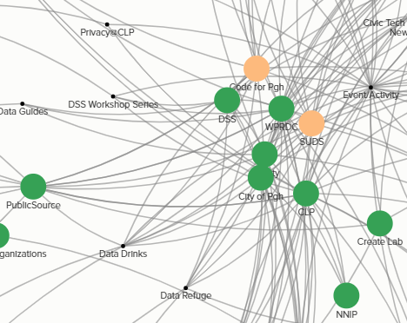
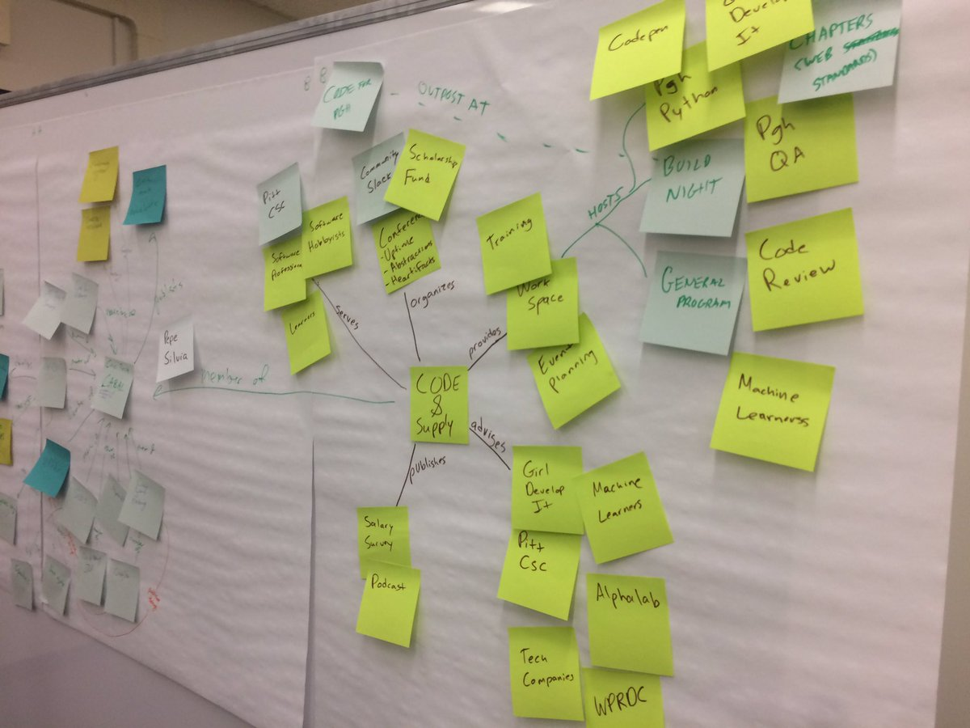
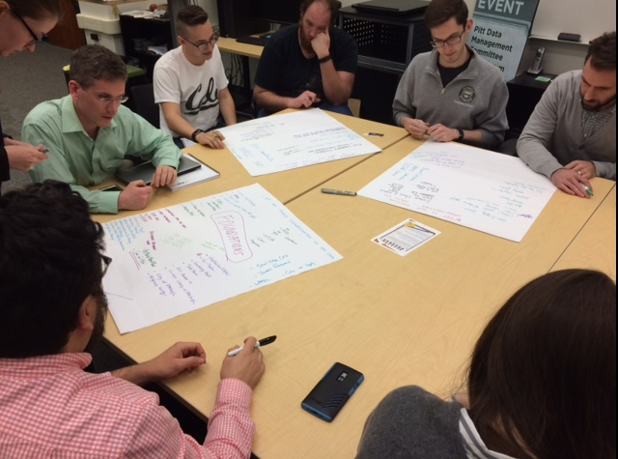
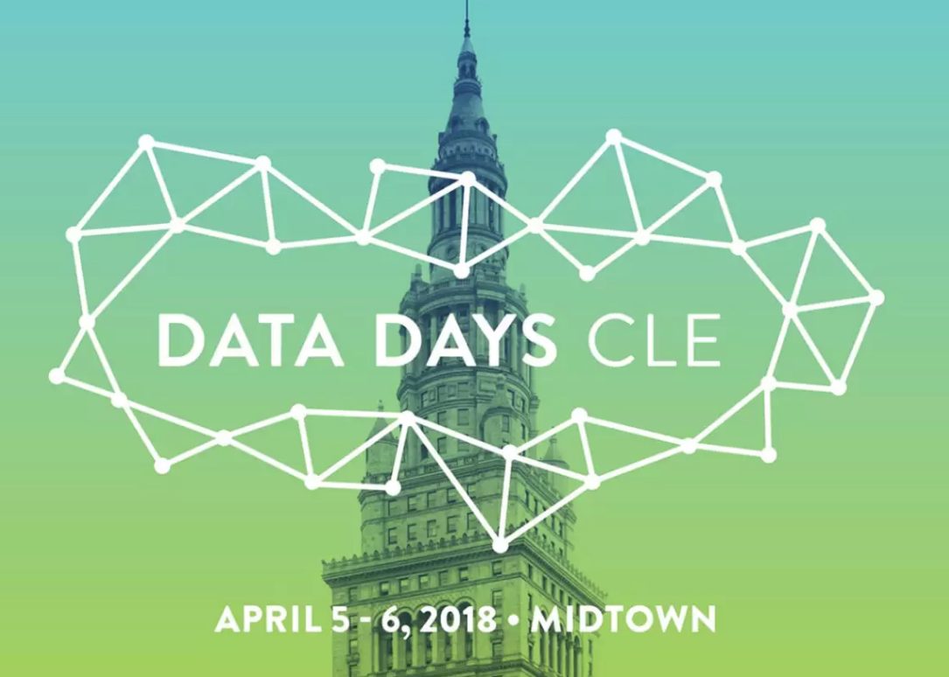
Cultivating an Ecosystem
Notes:
Roundtable + community organizing
Roundtable our effort to build a stronger ecosystem - Monthly meetings Living Cities, NNIP, Code for America on project at national scale. Locally, Regional Data Center, Libraries, City, County, Civic Tech, Student orgs monthly coordination meetings and shared activities. SUDS leadership, ecosystem map

Slide 14
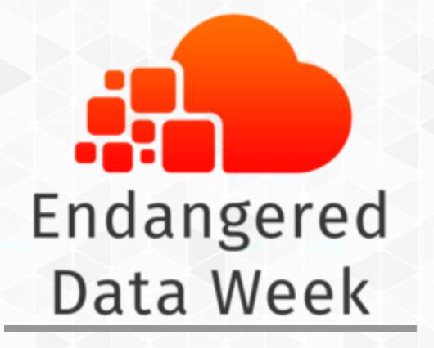
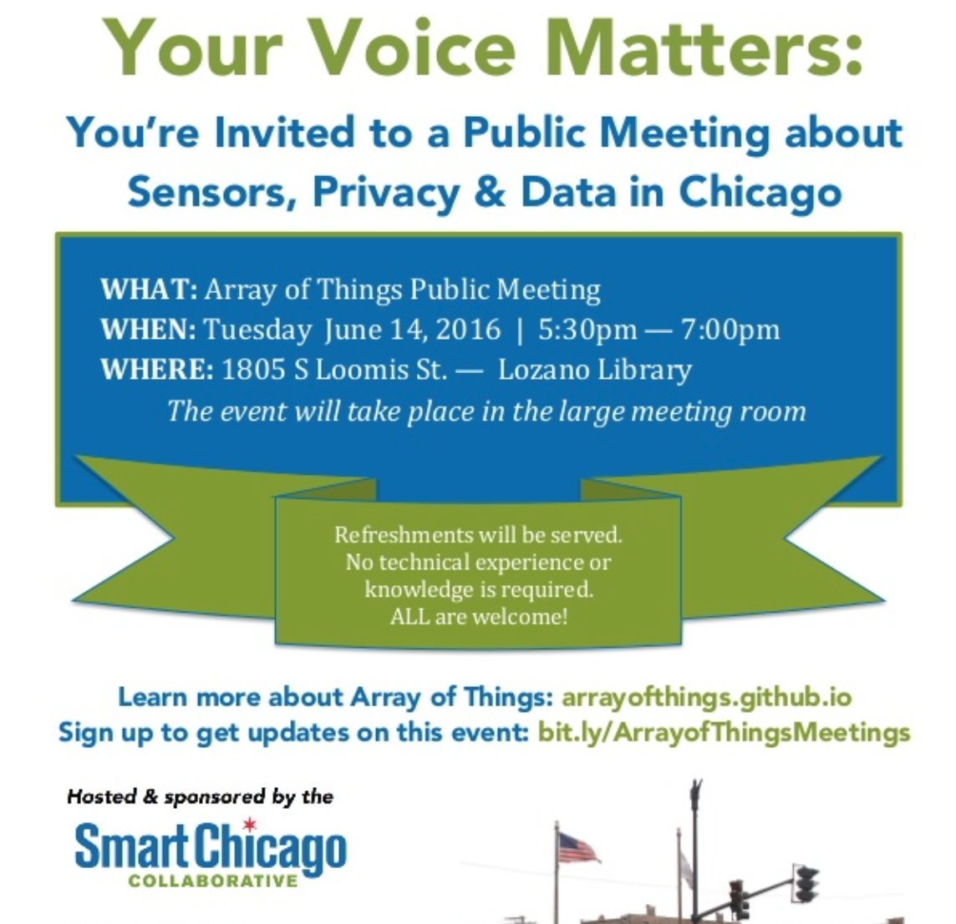
Facilitate Community Conversations
Notes:
ALA Choose Privacy Week Chicago IoT conversations were hosted at the library (Denice) - CLP speaker series

Slide 15
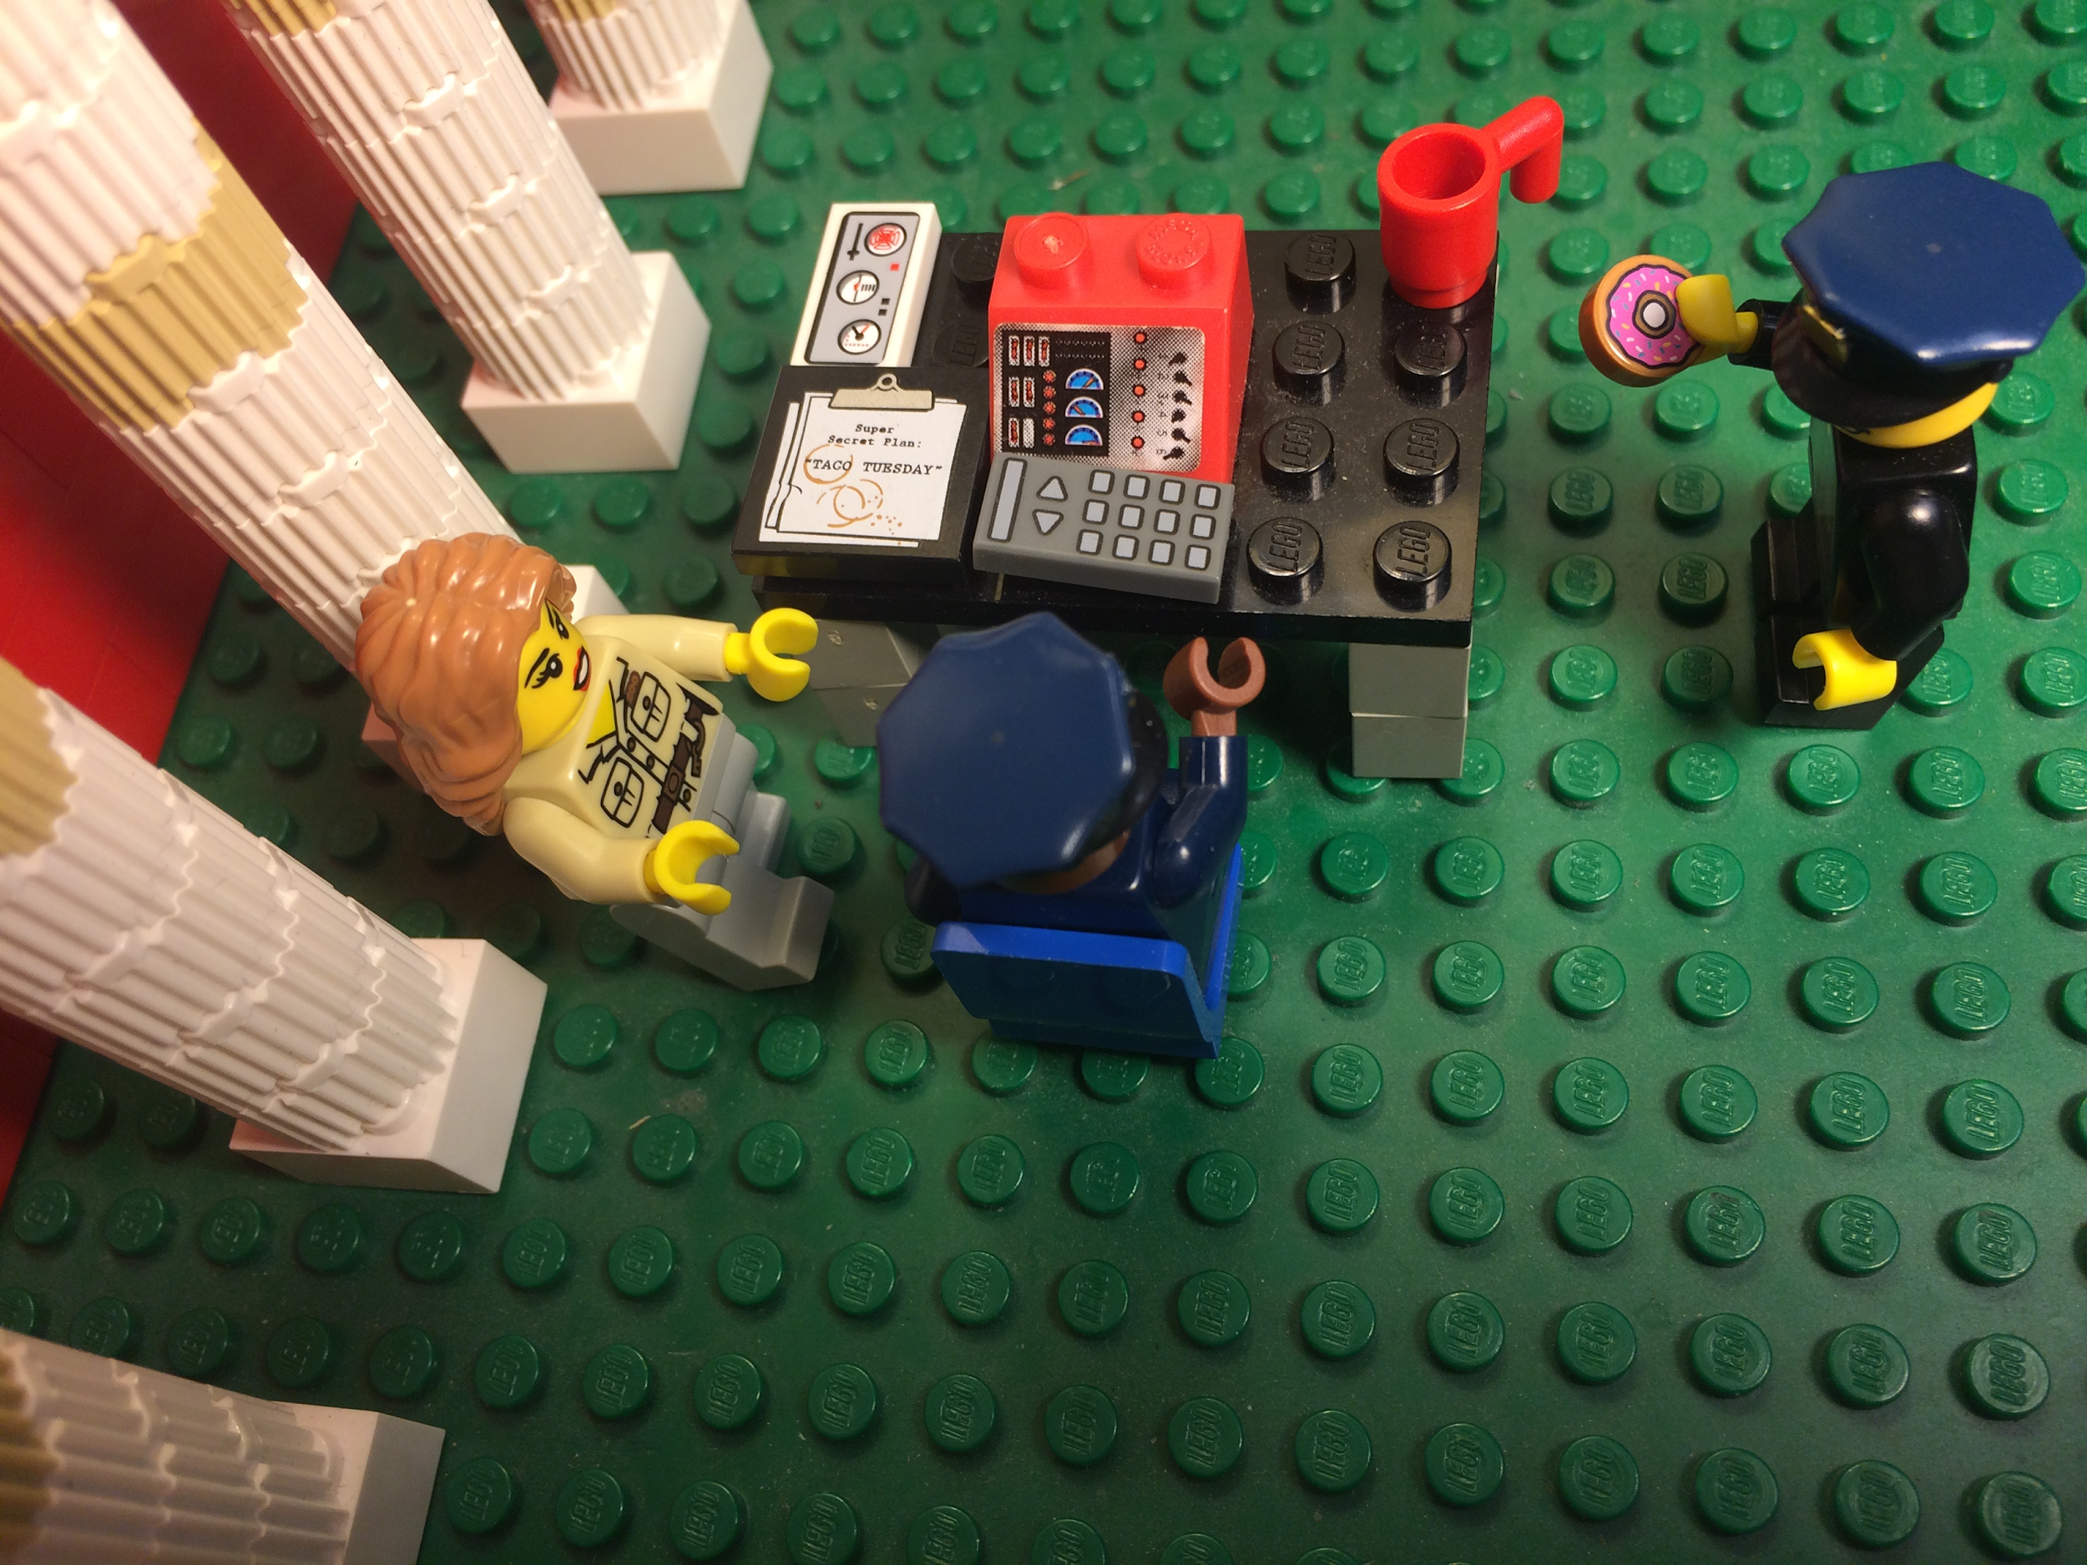
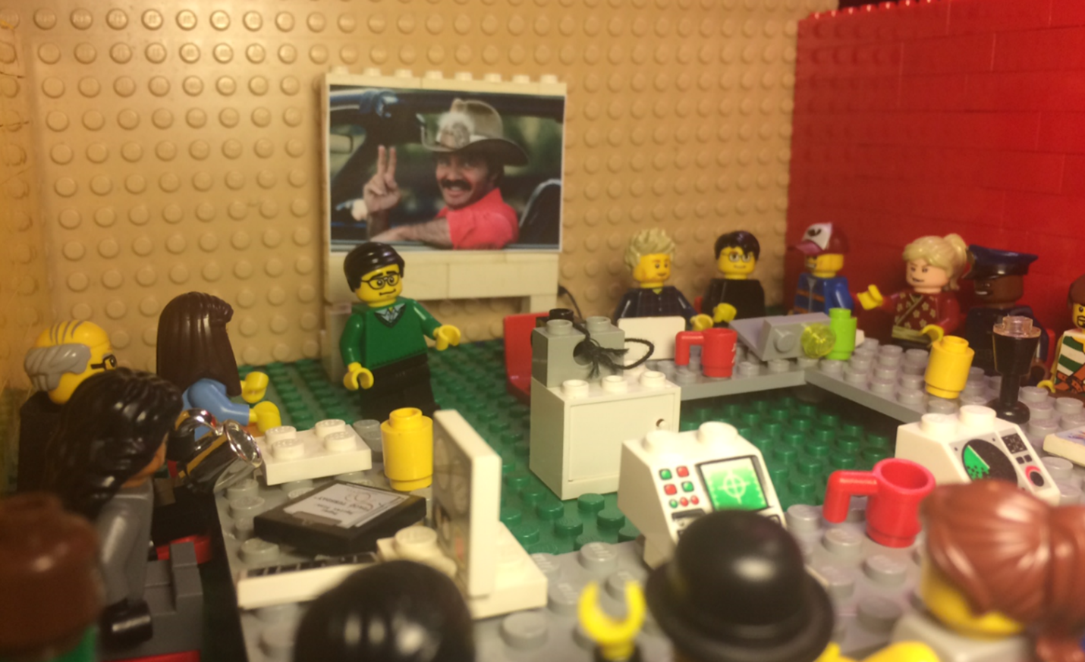
User Engagement and Feedback
Data User Group Meeting
Civic User Testing
Notes:
User Groups, CUT group example from Chicago

Slide 16
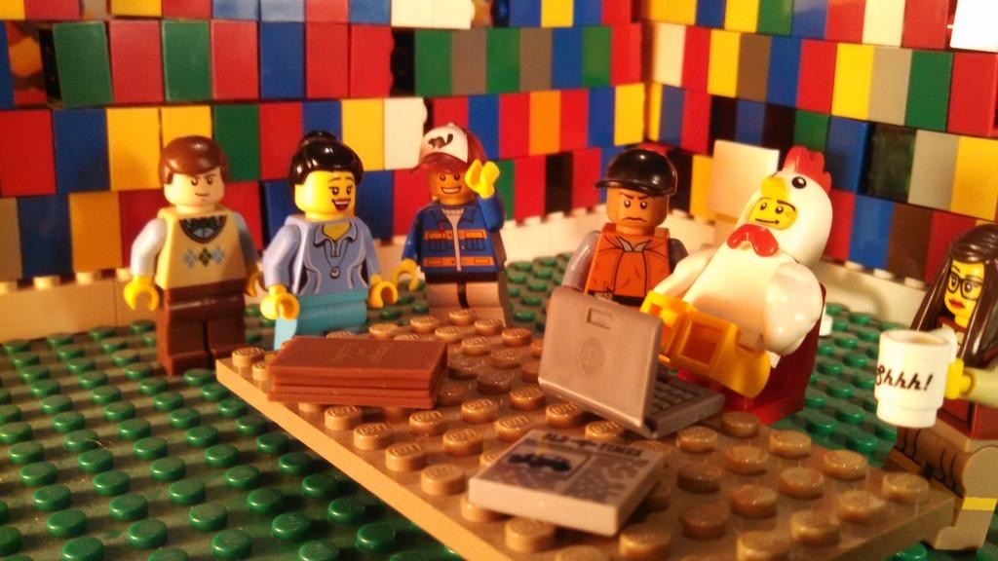
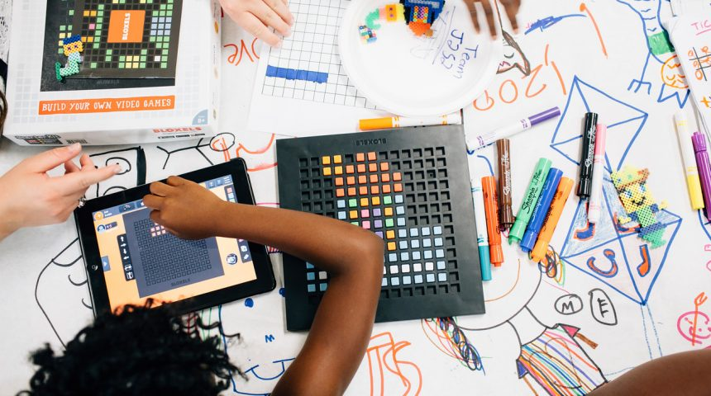
Provide a Home for Community Events
Notes:
Work night + Codefest/Codefest Jr. other examples of library as a host - DSS example too

Slide 17
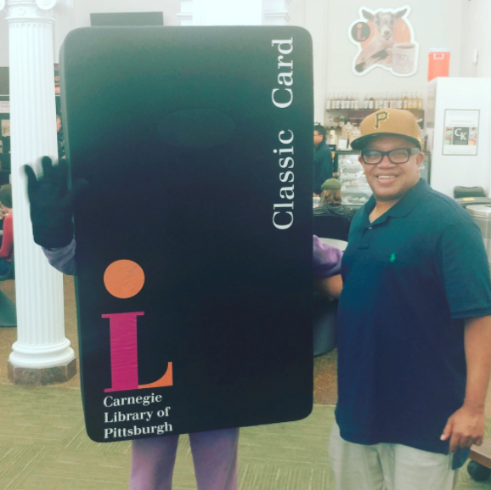
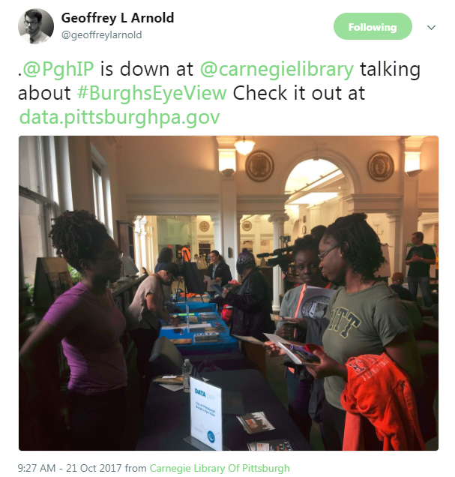
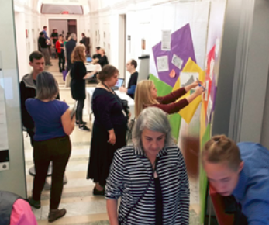
Celebrate Data through a Data Day
Notes:
NNIP Guide: Data Day> Blog about Data day: https://www.livingcities.org/blog/1226-pittsburgh-s-data-day-using-civic-data-to-spark-hands-on-community-engagement

Slide 18
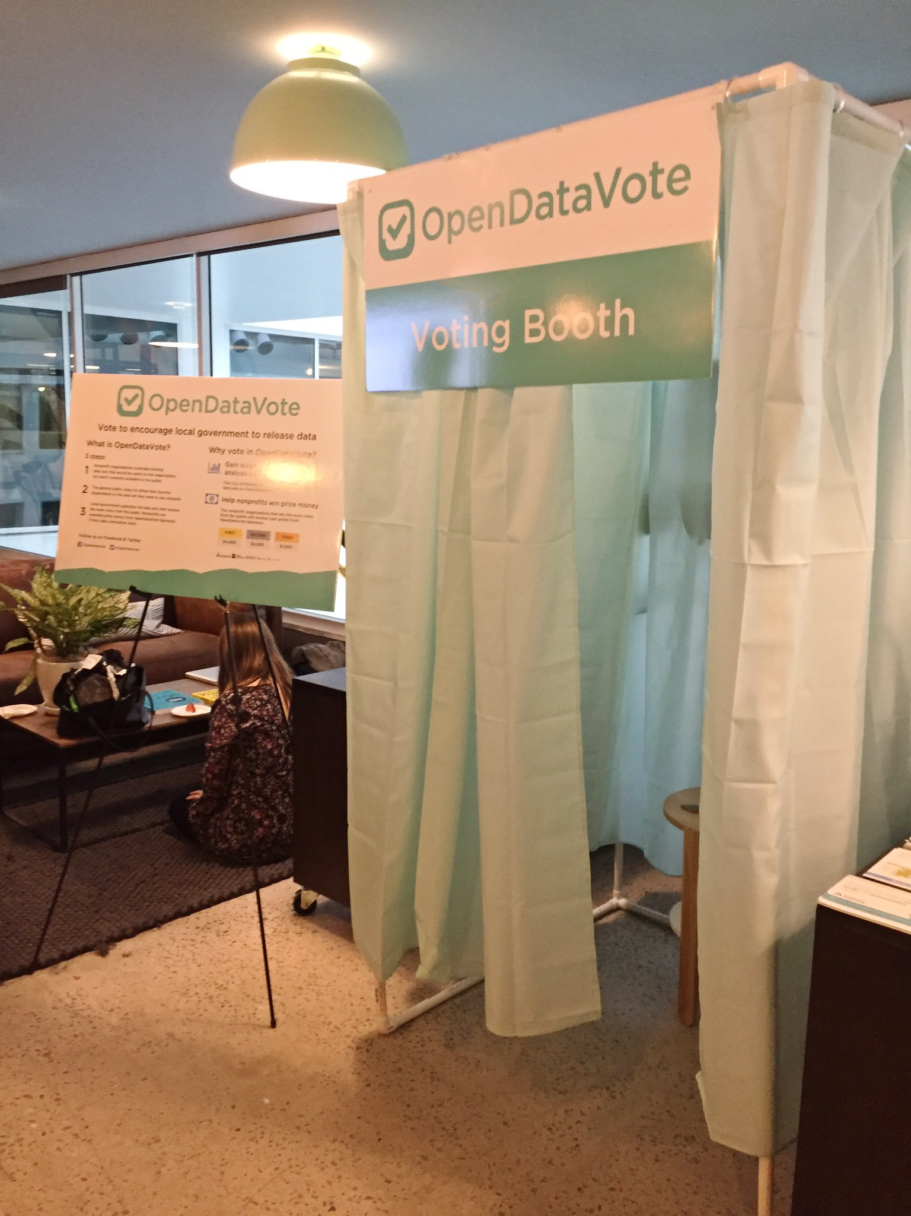
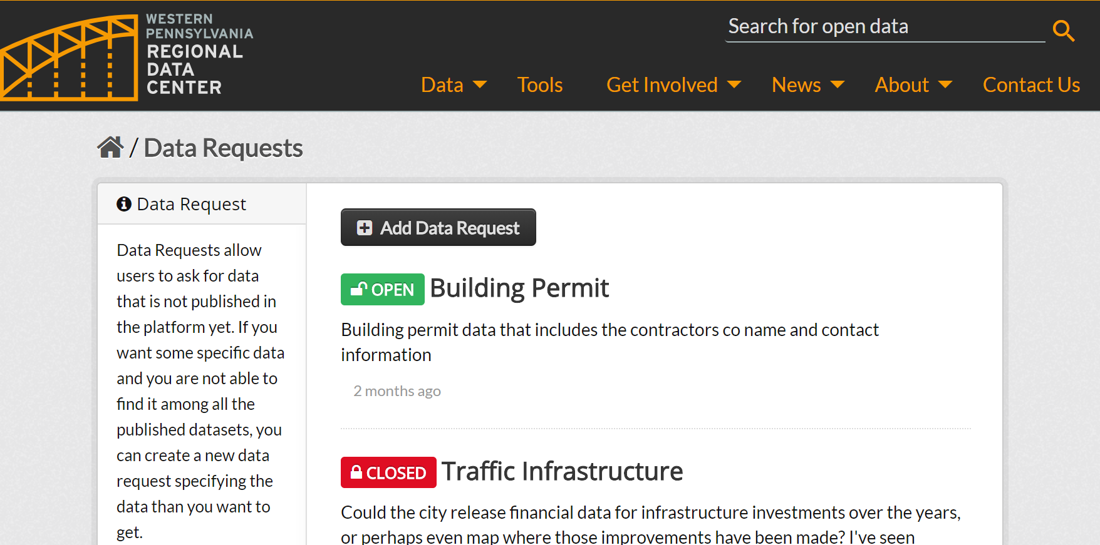
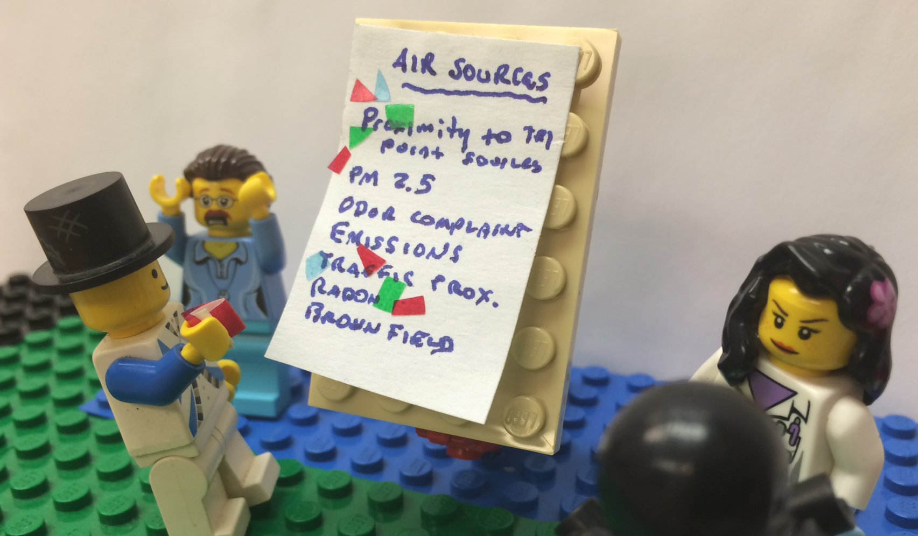
Establish publishing priorities

Slide 19
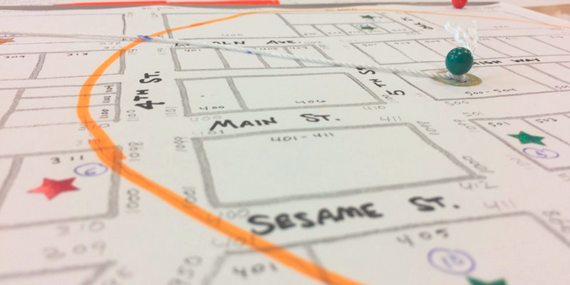
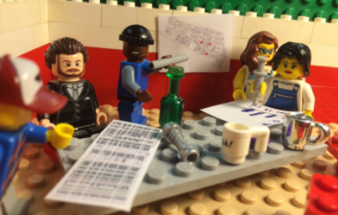
Data Literacy Training
Notes:
EMERSON mention Users at user group meeting suggested a very basic beginner friendly workshop. 311 paper-based data literacy training and curricula with CLP. Initial version adopted MIT Media Lab finding stories workshop. Observation that paper-based learning best

Slide 20
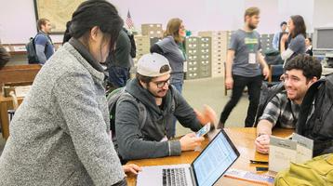
Data Skills Training
NNIP Microsoft Trainings
Data/Library Carpentry
Data SF
Civic Data Ambassadors
Individual workshops

Slide 21
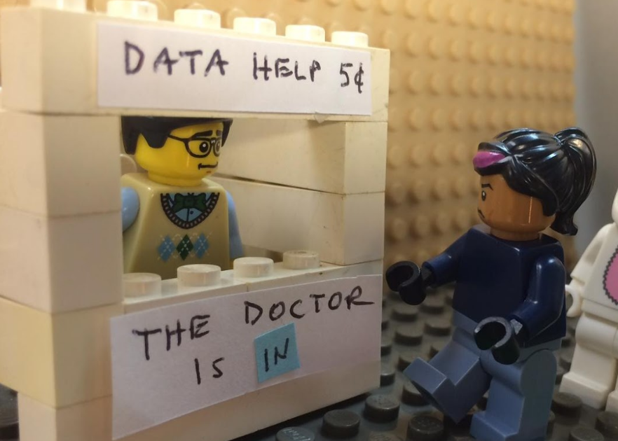
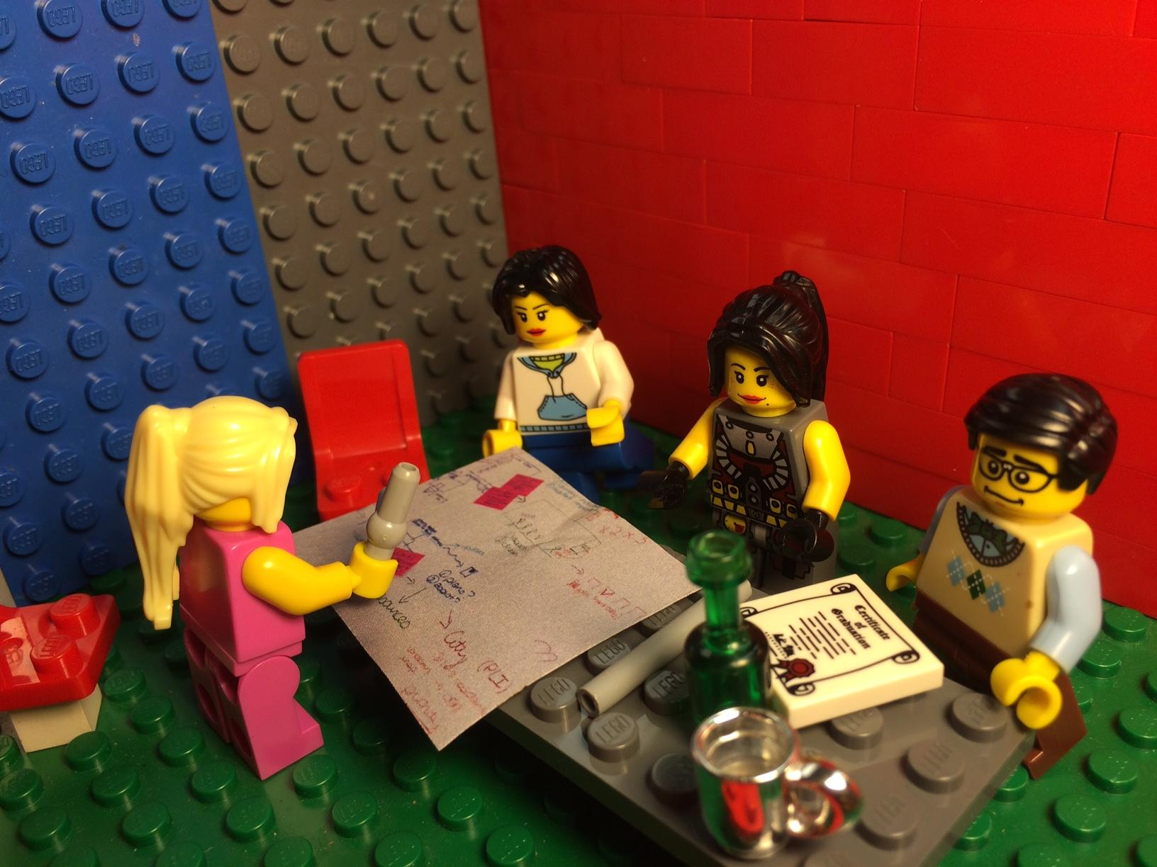
Technical Assistance
Notes:
Technical assistance - small scale help desk or more intensive consultations

Slide 22
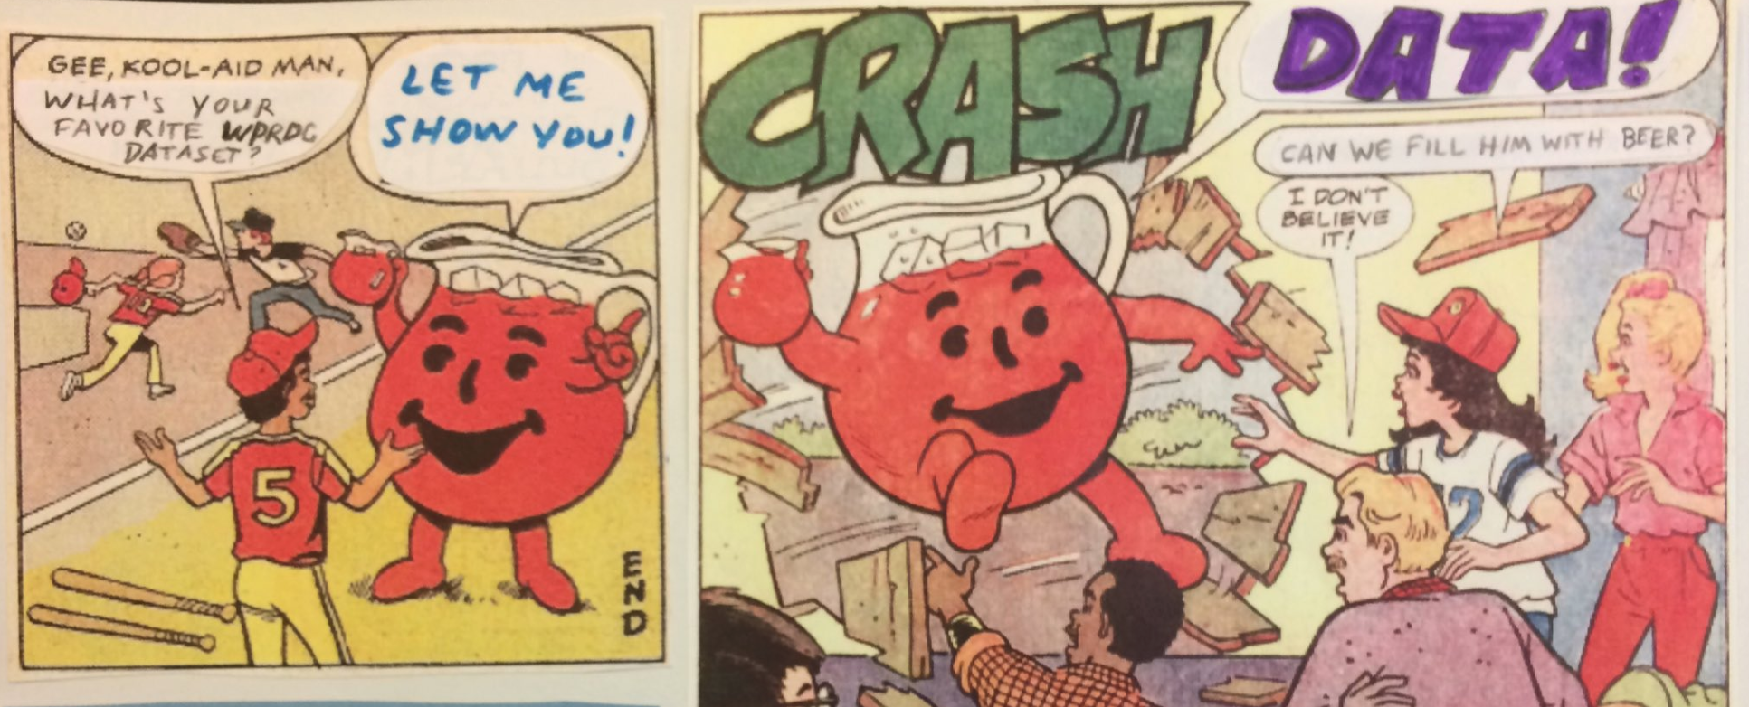
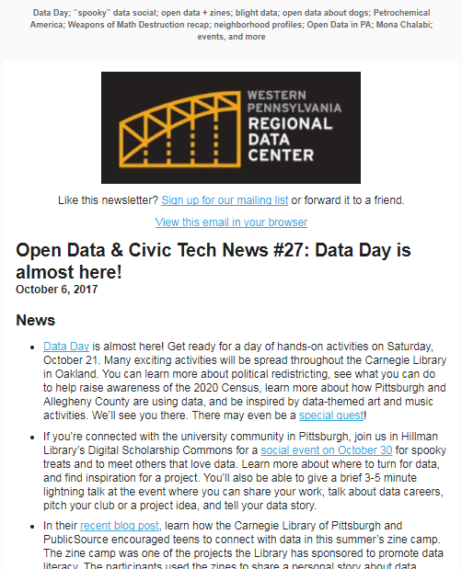
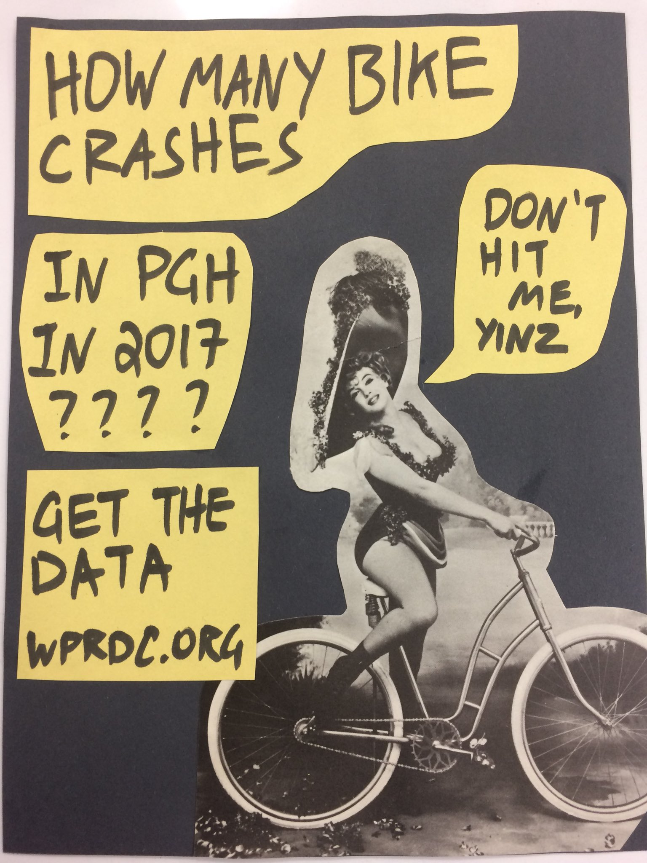
Promotion - Social Media, Newsletter, Events Calendar, Flyers, Etc.
Notes:
Shared newsletter an outgrowth of the roundtable. Amplify each other’s news and activities, show energy in eccosystem

Slide 23
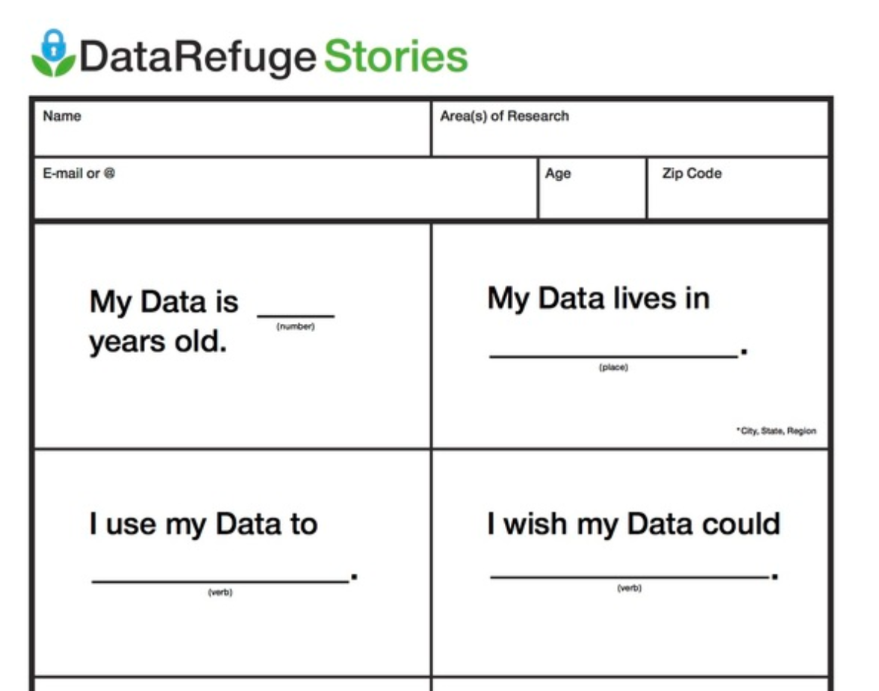
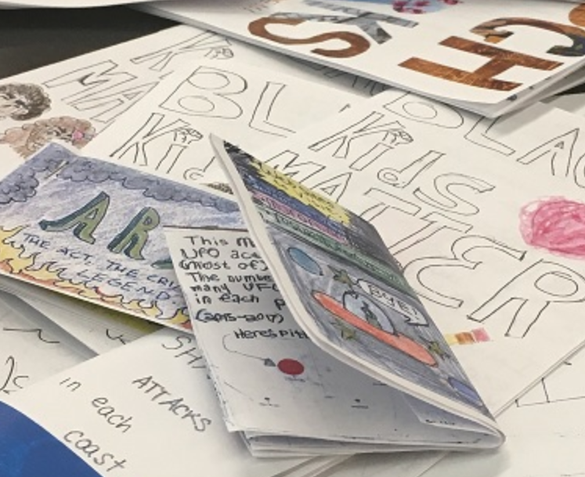
Storytelling

Slide 24
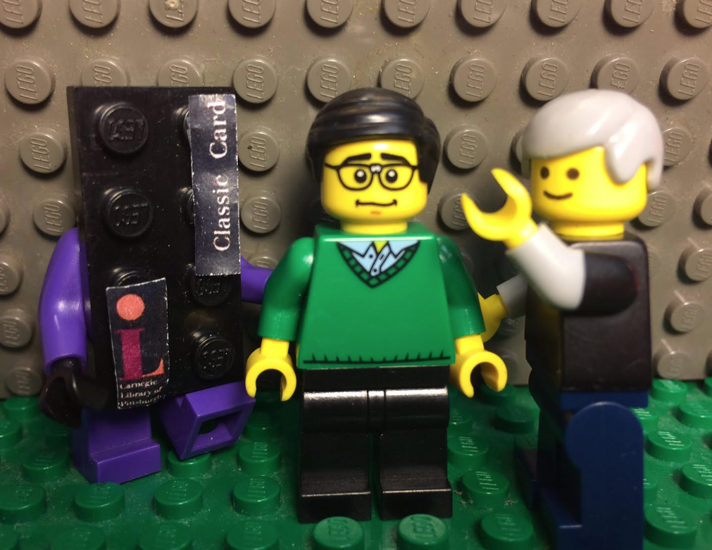
Librarians Give Great Advice
Notes:
Open data portal selection process + advisory board + Data Management Plan are informal and formal ways librarians advise us. Andrew Cardnegie is the personification of shared Eleanor/Toby expertise

Slide 25
Civic Switchboard

Slide 26
(Just enough about)
The Civic Switchboard Project
Our Pittsburgh experience: libraries and library workers should be key actors in civic open data ecosystems and act as core data intermediaries
Conviction 1: Cultivating a healthy local civic data ecosystem depends upon the coordinated efforts of a variety of data intermediaries. Intermediaries need to work together; library involvement can include both academic and public libraries
Conviction 2: No single model can be made to fit every city or region. Modelling at the national level must be done by capturing a wide variety of successful local practices.
Notes:
Our Pittsburgh experience: libraries and librarians should be key actors in civic open data ecosystems and act as core data intermediaries
Conviction 1: Cultivating a healthy local civic data ecosystem depends upon the coordinated efforts of a variety of data intermediaries. In other words, no single entity can effectively cover all of the necessary roles alone. Library involvement can include both academic and public libraries
Conviction 2: no single model can be made to fit every city or region.Because each community’s civic data ecosystem is unique, the structure of local data intermediaries have evolved to take different shapes. Modelling at the national level must be done by capturing a wide variety of successful local practices.

Slide 27
(Just enough about)
The Civic Switchboard Project
Project Website + Blog + Community of Practice
https://civic-switchboard.github.io/
Civic Switchboard Guide and Toolkit
https://civic-switchboard.gitbooks.io/guide/
2018 Workshops: Before NNIP and DLF
2019 Field Awards
Notes:
Our Pittsburgh experience: libraries and librarians should be key actors in civic open data ecosystems and act as core data intermediaries
Conviction 1: Cultivating a healthy local civic data ecosystem depends upon the coordinated efforts of a variety of data intermediaries. In other words, no single entity can effectively cover all of the necessary roles alone. Library involvement can include both academic and public libraries
Conviction 2: no single model can be made to fit every city or region.Because each community’s civic data ecosystem is unique, the structure of local data intermediaries have evolved to take different shapes. Modelling at the national level must be done by capturing a wide variety of successful local practices.

Slide 28
Thank You! Check-out Civic Switchboard, and find a friend at your library.

