Slide 1
How We’re Trying to Do Better at Websites
April Urban
Center on Urban Poverty and Community Development
Case Western Reserve University
Cleveland

Slide 2
Lots of white space that could be better used
?
Most people won’t know what this is
NO STAFF ABLE TO UPDATE SITE
Missing link to most used/loved data portal
Outdated logos, some expired partnerships
Lots of white space that could be better used
Unhelpfully smooshed text
Unhelpful smooshed text
Notes:
Old website = bad

Slide 3
What we do
HOW DO YOU CONVEY ALL OF THIS ON A WEBSITE?
HOW DO YOU CONVEY VALUE OF CORE DATA PROCESSING?
Community focused data stories
Make data accessible
Data stories and work by partners
Clean data
Access data
Link data
Rigorous research and contributions to academic field
Community partnerships for program evaluation

Slide 4
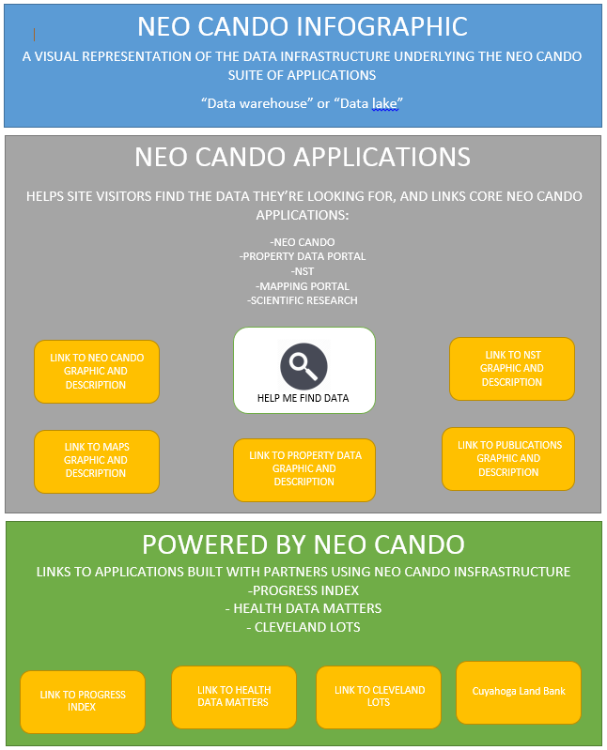

Slide 5
Stuff to figure out
Cross data portal search function
Ways to communicate:
Data portal functions with visuals
Our value to the data ecosystem and partnerships
Emphasize value of core data processing / data warehouse work
Notes:
It’s a damn good thing there’s a network!
Looked for: Ways you communicate the value of core data work (messaging side)
Ways you communicate value of contributing to environment (partnerships)
Ways you visually communicate (graphics side)
Search functions that allow users to find the data they’re looking for

Slide 6
THANK YOU NETWORK!
NOT Poverty
We looked at what you
are doing
So we can copy it
Center’s Strong Suit
Notes:
It’s a damn good thing there’s a network!
Looked for: Ways you communicate the value of core data work (messaging side)
Ways you communicate value of contributing to environment (partnerships)
Ways you visually communicate (graphics side)
Search functions that allow users to find the data they’re looking for

Slide 7
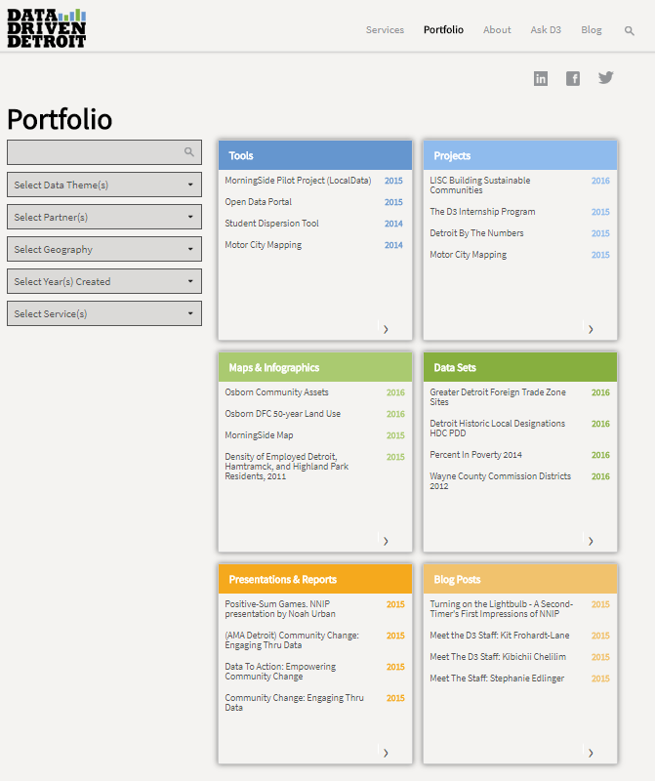
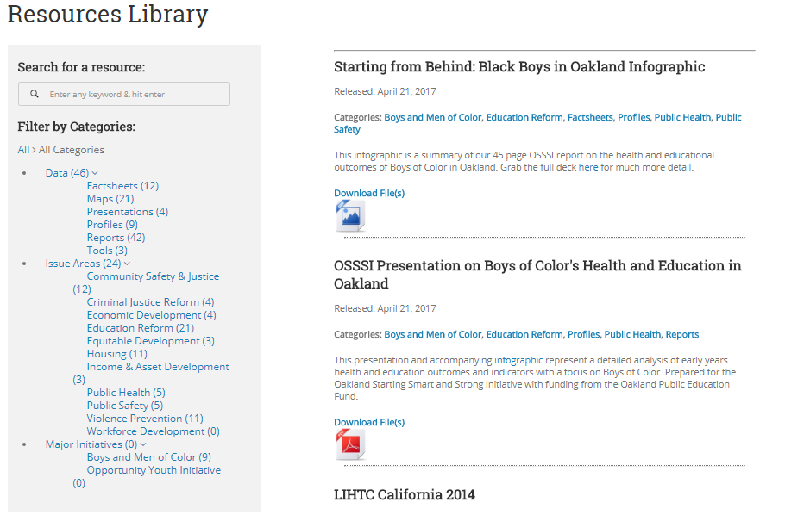
Search functions

Slide 8
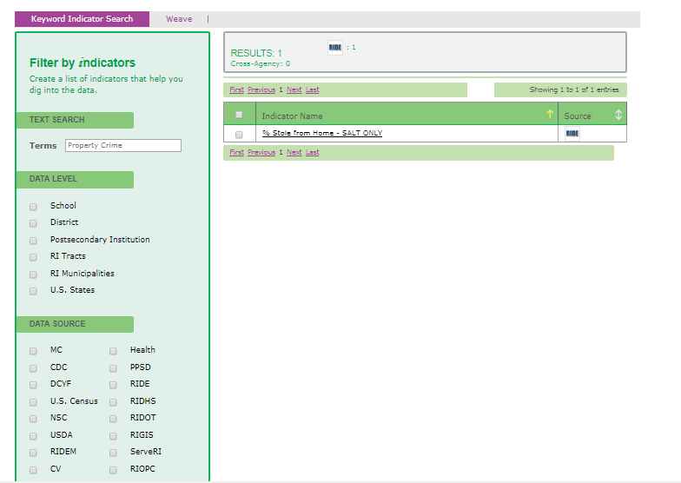
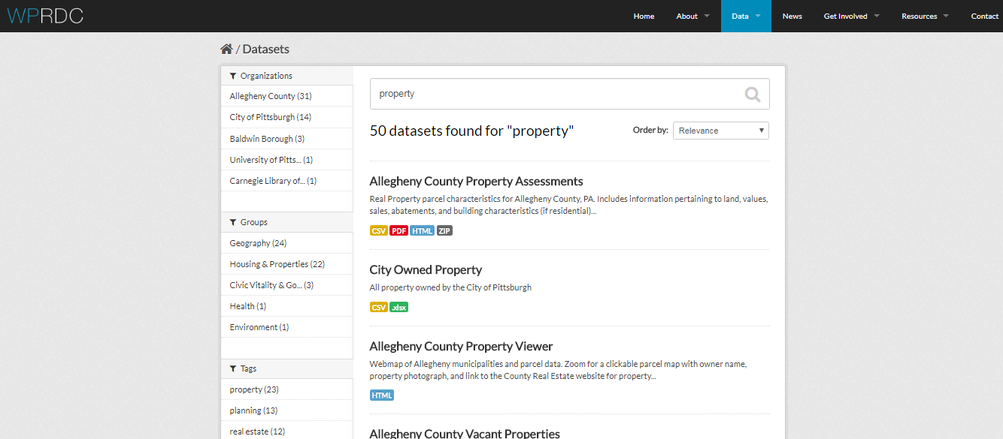
Search functions

Slide 9
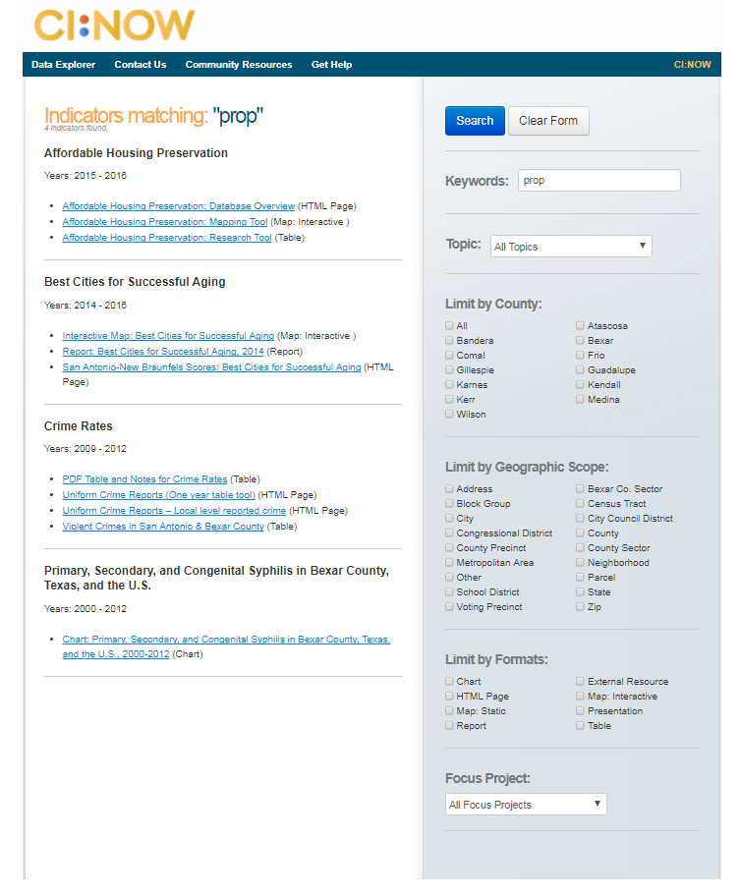
Search functions

Slide 10
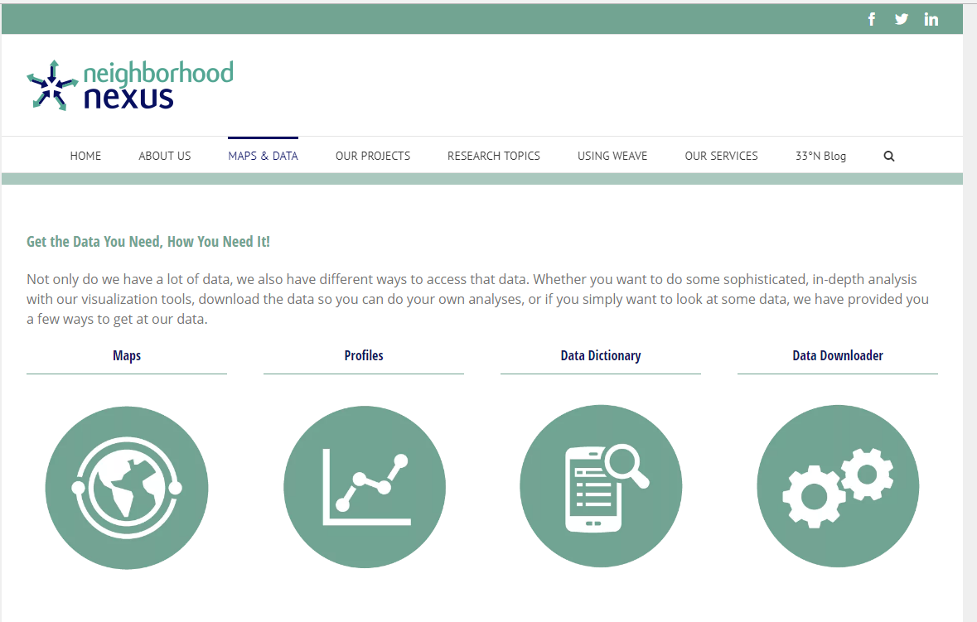
Data portal visuals / graphics

Slide 11
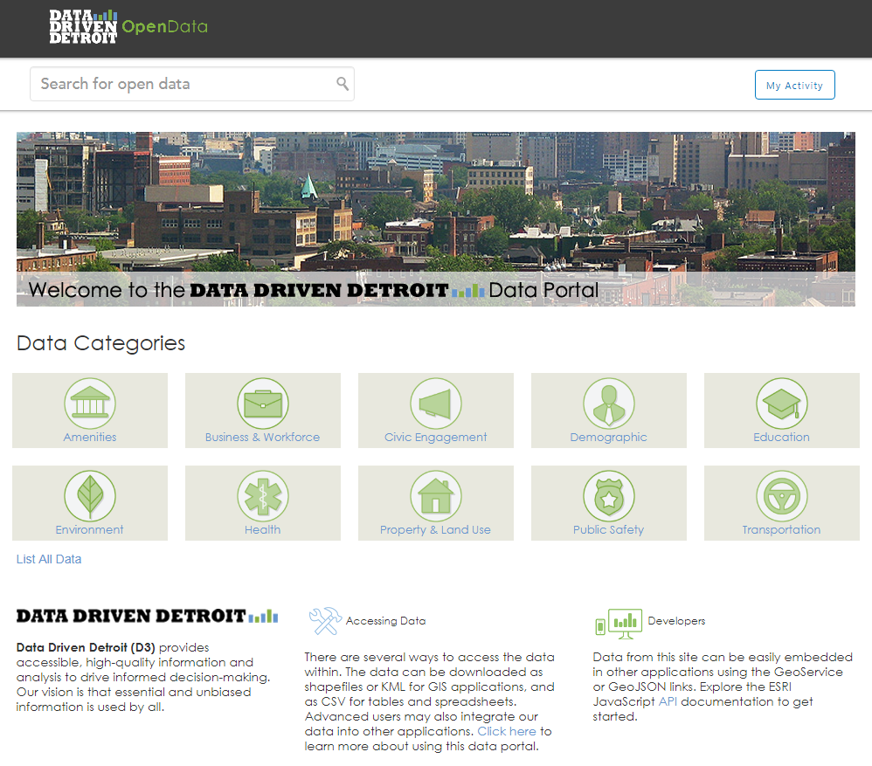
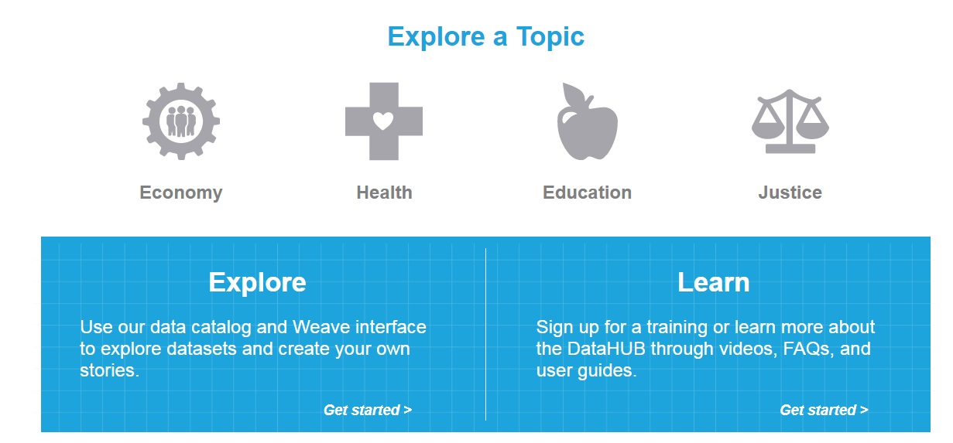
Data portal visuals / graphics

Slide 12
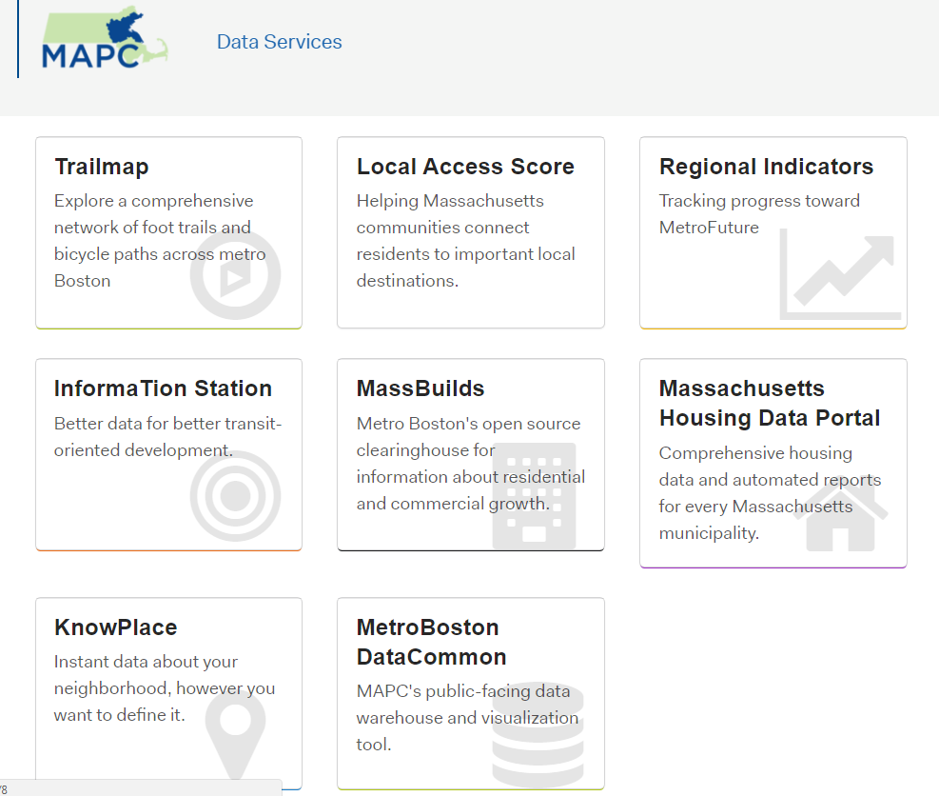
Data portal visuals / graphics

Slide 13
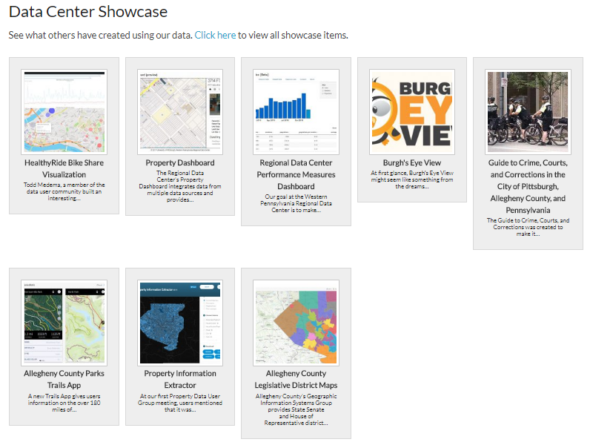
Data ecosystem and partnerships

Slide 14
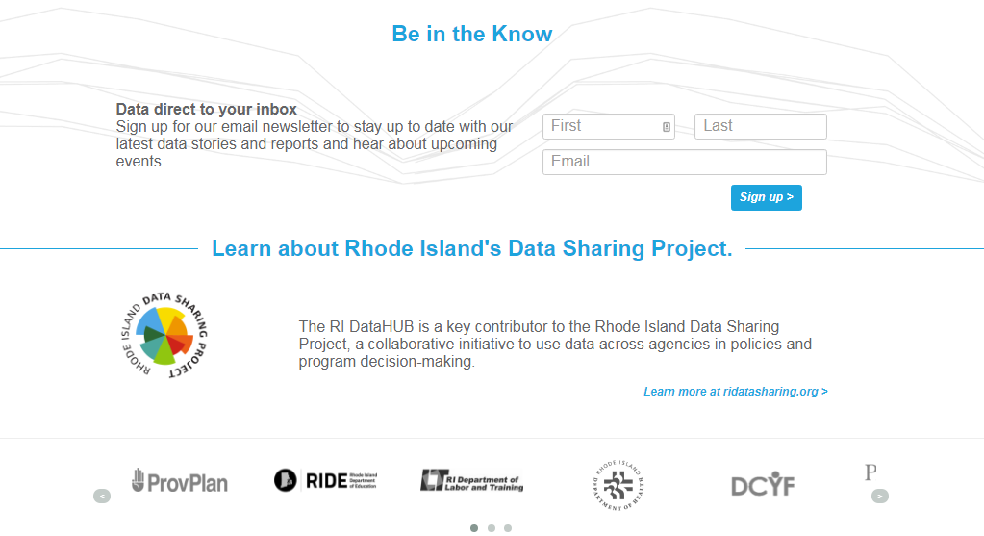
Data ecosystem and partnerships

Slide 15
Data warehouse / core value

Slide 16
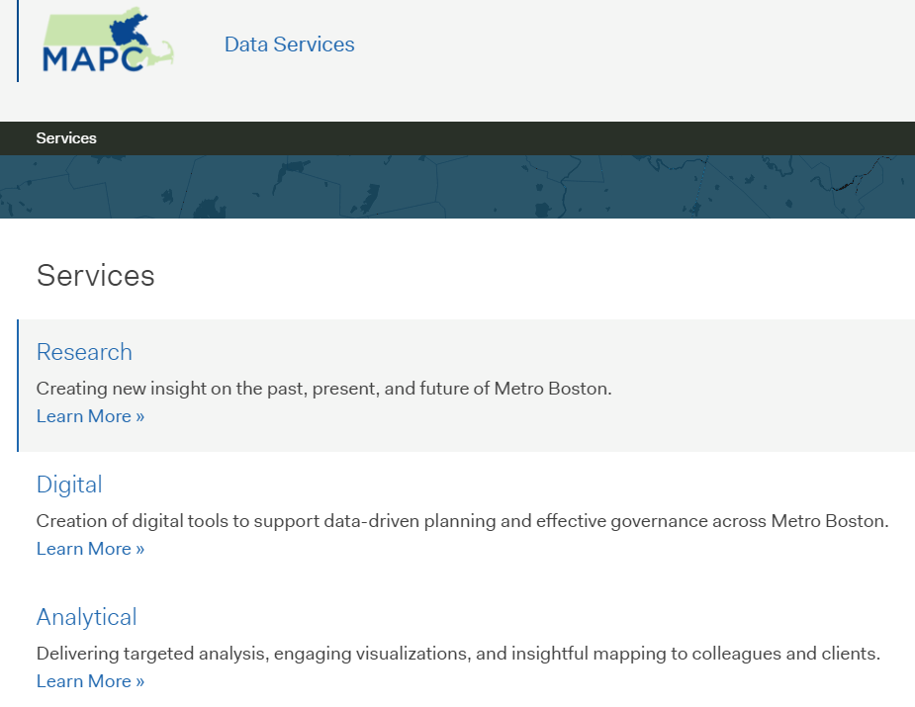
Data warehouse / core value

Slide 17
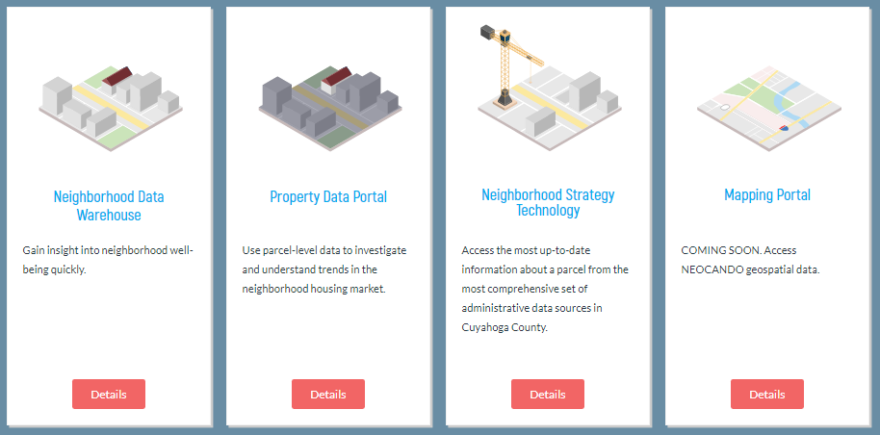
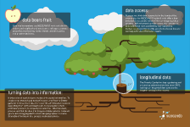

Slide 18
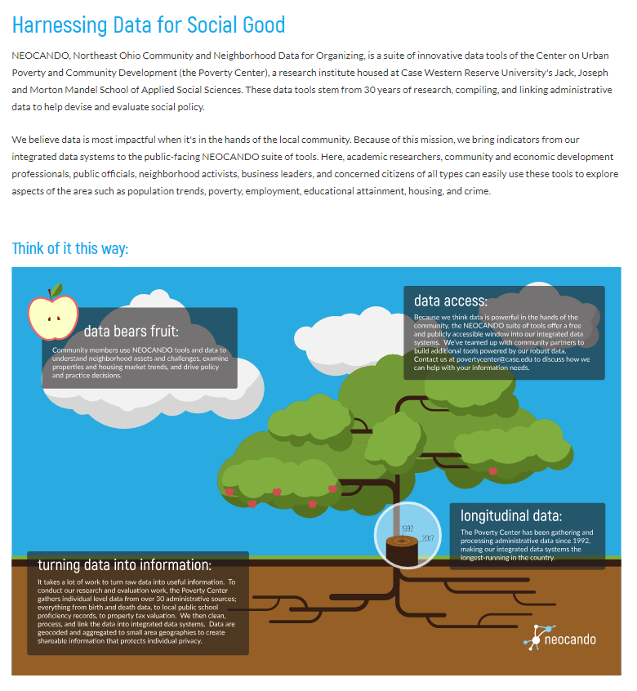

Slide 19
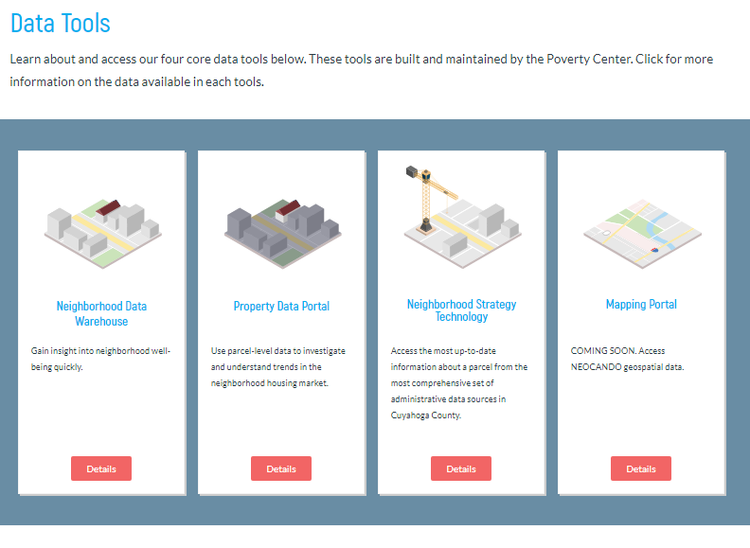

Slide 20
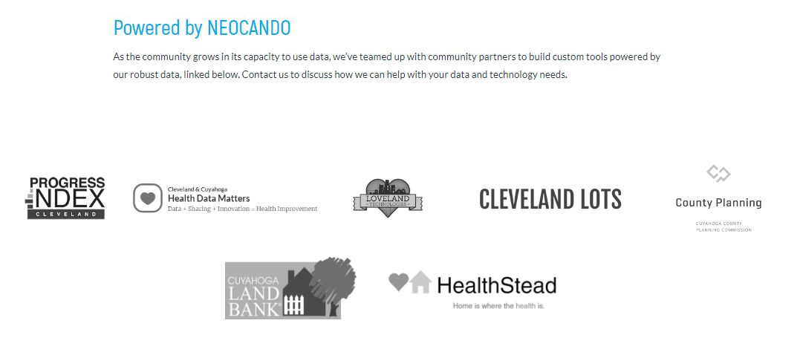

Slide 21
Hindsight
Talk to users (even a little)
Infographic probably doesn’t work
Continue to think about if 2 sites can work
Try even harder to work with the University to make sure branding people are happy

