Slide 1
MORPC Data User Personas
NNIP Partner Meeting – Idea Showcase
May 11, 2018

Slide 2
The Problem
As data becomes more numerous and complex, more open, and easier (through technology advances) to deliver to more people in more formats, how do we deliver tools and resources that are practical, relevant and accessible to the people who need them?
Notes:
MORPC has always provided a wide array of data resources and services to communities and residents throughout Central Ohio
Sought to answer this through User Experience (UX) Research & Design principles

Slide 3
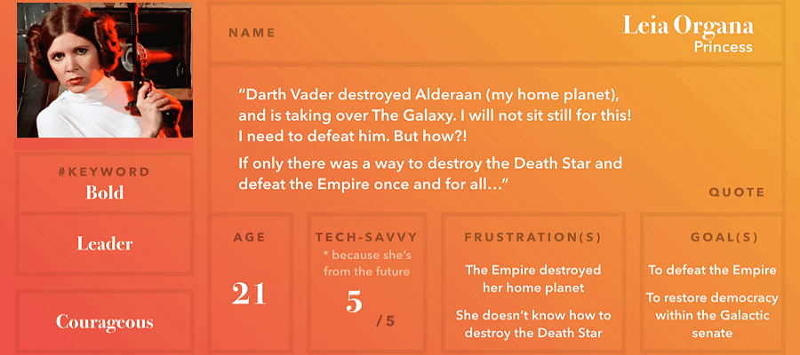
Data User Personas
Notes:
Fictional representations of key user groups
Based on data and research collected about actual users
Focus on the needs and expectations of individual user types – allowing for development of targeted resources
Detailed characteristics, behaviors, needs & challenges provide specificity to guide design

Slide 4
UX Data Collection
Three focus groups
Regional survey of data users (445 responses)
Peer organization interviews
  Atlanta Regional Commission
  University of Pittsburgh Center for Social and Urban Research
  Urban Strategies Council (Oakland)
  Connecticut Data Collaborative
  Data Driven Detroit
  Data LA
Thank You Atlanta & NNIP Friends!

Slide 5
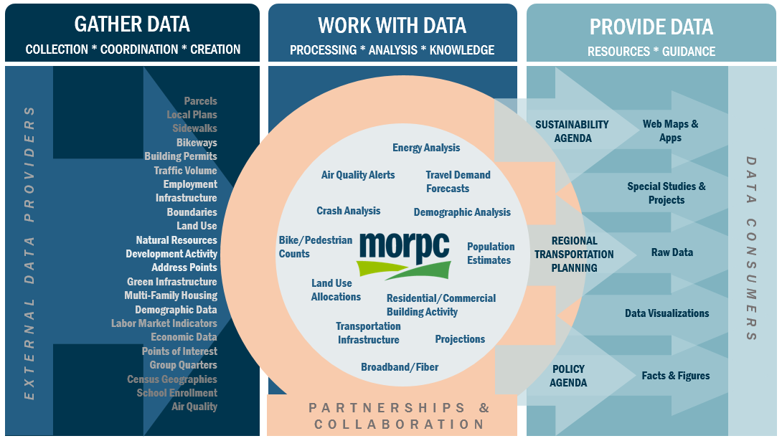
Data Roles, Activities, & Relationships

Slide 6
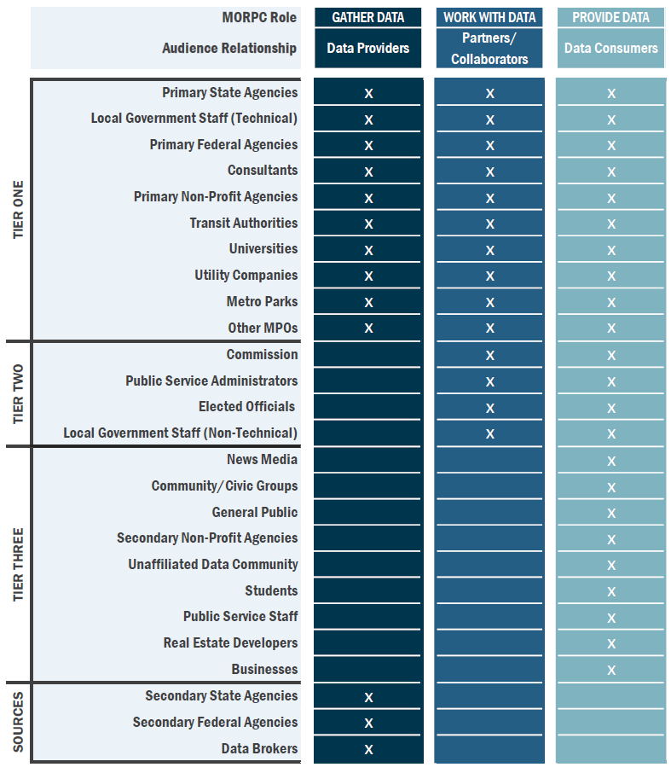
Data Audiences

Slide 7
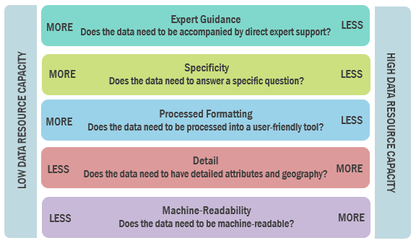
Spectra of Audience Data Resource Capacity

Slide 8
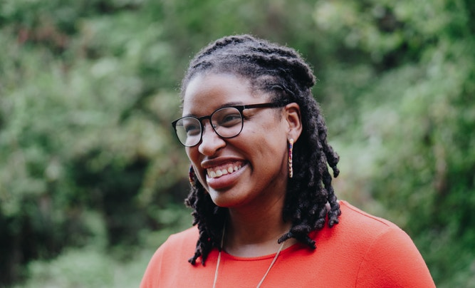

USER DATA NEEDS
Expert Guidance
Specificity (answers a question about a place, exactly)
LOW
User-Ready Formatting (e.g. charts, graphs, reports)
HIGH
Detail (geographic and attributes)
Savvy Sonja Outgoing│Curious│Diligent
Has watched every episode of Parks and Recreation, 3 times.
Machine-Readability
Planner for a mid-sized city government. Analyzes data to find answers to questions and share information with stakeholders.
Behaviors
Uses many local, regional, state and federal open data sources.
Keeps up with issues and skills by attending local conferences and user groups.
Uses intermediate GIS skills regularly.
Creates maps and charts to communicate with internal staff, stakeholders and the public.
Needs & Challenges
When she finds an interesting online map or other resource, wants to have easy access to the underlying data to use in her own work.
A ‘generalist’, she needs data with different subjects.
A local planner, she needs geographic detail.
Even though she tries to stay tuned-in, frequently discovers data sets that have been available, but that she wasn’t aware of before.

Slide 9
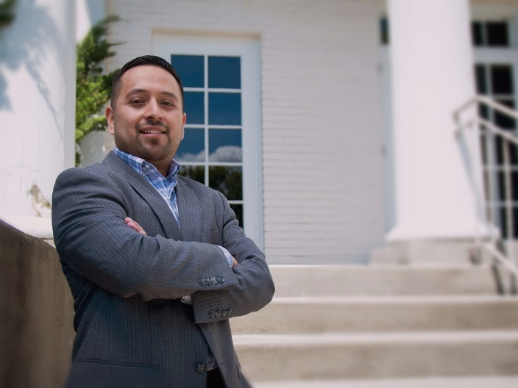
USER DATA NEEDS
Expert Guidance
Specificity (answers a question about a place, exactly)
LOW
User-Ready Formatting (e.g. charts, graphs, reports)
HIGH
Detail (geographic and attributes)
Manager Marco Steady│Resilient│Compassionate
Soccer dad. Spends weekends coaching his kids’ teams.
Machine-Readability
Administrator for a township. Uses data to share information and understand practical issues.
Behaviors
Focused on key functions of the township, such as permit applications, street maintenance and asset management.
Works in a small team in a building with all other township government staff.
Works closely with the adjacent city, and the county to deliver services to residents.
Stays busy just keeping up with the workload.
Needs & Challenges
Comfortable with his ‘go-to’ sources of data needed to keep up with work.
Would like to see some updates in software and workflow, but it’s hard to imagine how a small team like his would implement changes.
Points people to entities with more staff resources when they ask for data or analysis.
Needs assistance and support in pursuing funding for operations and infrastructure projects.

Slide 10
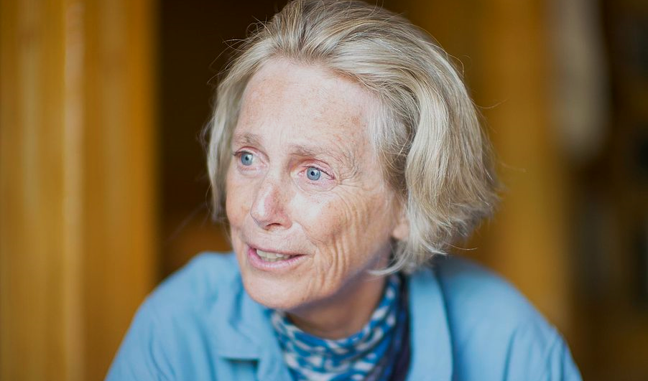
USER DATA NEEDS
Expert Guidance
Specificity (answers a question about a place, exactly)
LOW
User-Ready Formatting (e.g. charts, graphs, reports)
HIGH
Detail (geographic and attributes)
Engaged Elaine Insightful│Determined│Energetic
World Traveler. Can handle much spicier food than you.
Machine-Readability
Retiree, neighborhood advocate, watershed protection group board member. Seeks to engage in participatory analysis about areas of expertise.
Behaviors
Follows local news to keep up with happenings in the community.
Uses apps to navigate when getting around town.
Engaged in neighborhood civic group.
Frequently attends public meetings.
Uses social media to discuss local and national politics.
Needs & Challenges
Looking for new ways to use technology to simplify daily life.
Would like to see data about her community—things like property sales and development plans—in an accessible format.
Likes to share data from the news and reports, but wants to feel confident in her sources.

Slide 11
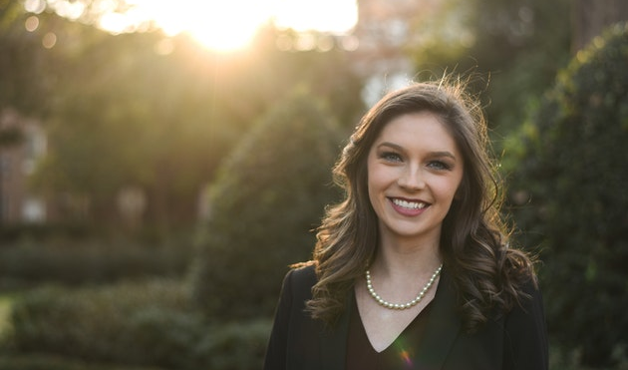
USER DATA NEEDS
Expert Guidance
Specificity (answers a question about a place, exactly)
LOW
User-Ready Formatting (e.g. charts, graphs, reports)
HIGH
Detail (geographic and attributes)
Decisive Delaney Enthusiastic│Organized│Direct
Has two Dachshunds named Oscar Mayer and Nathan.
Machine-Readability
Elected village council member. Looks for accessible data to inform decisions and communicate with residents.
Behaviors
Reaches out to regional data providers to find information that addresses a particular issue in her village.
Talks regularly to constituents and stakeholders with an interest in development in her community.
Reads news about the region regularly.
Attends presentations about regional planning and development issues and reads reports.
Needs & Challenges
Analysis to aid in choosing and communicating the impact of public projects.
Would like an easy way to find stats, charts and graphs specific to her village.
Understanding projects, initiatives and trends in the region and how they impact her community.

Slide 12
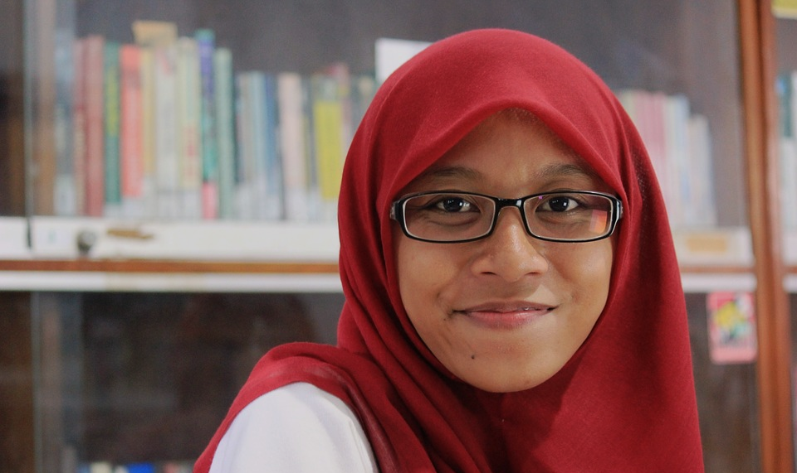
USER DATA NEEDS
Expert Guidance
Specificity (answers a question about a place, exactly)
LOW
User-Ready Formatting (e.g. charts, graphs, reports)
HIGH
Detail (geographic and attributes)
Hopeful Hadiya Sincere│Loyal│Eloquent
Debate champion. Can and will beat your argument.
Machine-Readability
Affordable housing nonprofit employee. Wants to understand and communicate housing needs, and demonstrate program impacts.
Behaviors
Passionate about her work, advocates for affordable housing on and off the clock.
Writes grants to secure funding.
Attends regional events to network and stay current.
Uses government and nonprofit-produced reports and resources in her work.
Needs & Challenges
Needs data about neighborhood housing.
Always seeking better ways to identify and justify areas with funding needs.
Looks for data to help tell stories about health and safety outcomes related to housing
Wishes she had time and resources to do her own neighborhood surveys, instead of always relying on small-sample Federal demographic data.

Slide 13
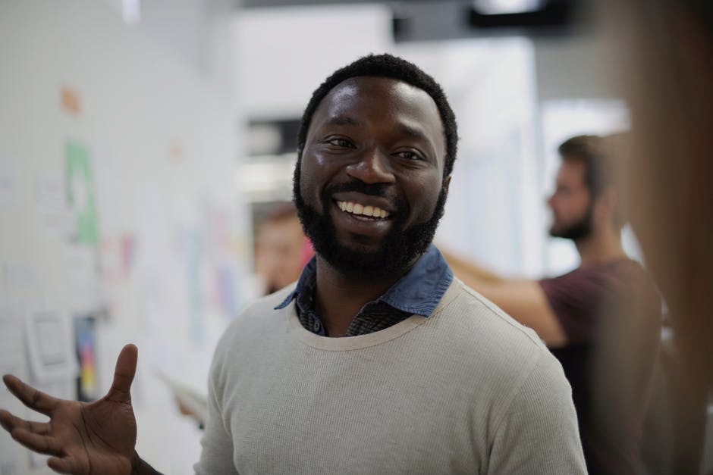
USER DATA NEEDS
Expert Guidance
Specificity (answers a question about a place, exactly)
LOW
User-Ready Formatting (e.g. charts, graphs, reports)
HIGH
Detail (geographic and attributes)
Specialist Samir Ambitious│Systematic│Affable
Biggest. Movie nerd. Ever.
Machine-Readability
Project manager for a planning and engineering consulting firm. Needs project-specific data to meet contracted goals and regulatory requirements.
Behaviors
Attends industry conferences to keep up with best practices in his field.
Travels for work often, sometimes internationally.
Enjoys solving one type of problem really well.
Sometimes works long hours, and just wants to relax whenever he gets a chance.
Creates specific kinds of data, when the project requires.
Needs & Challenges
Knows what he’s looking for, but sometimes needs help from local experts to know where to find it.
When working in a new place, uses reports, graphs and charts to get familiar.
When it’s time to get the work done, needs clean, high-quality, detailed, machine-readable data for the people on his team.

Slide 14

USER DATA NEEDS
Expert Guidance
Specificity (answers a question about a place, exactly)
LOW
User-Ready Formatting (e.g. charts, graphs, reports)
HIGH
Detail (geographic and attributes)
Coding Corey Creative│Socially-Minded│Geek*
*Self-proclaimed and unapologetic
Machine-Readability
Civic tech enthusiast. Wants to make cool solutions to real community problems with any and all data they can get their hands on.
Behaviors
Sometimes stays up all night programming…just for fun.
Engaged in local arts, politics and social-service organizations.
Believes in the power of technology to do good.
Attends tech user groups, meetups and hackathons, whenever possible.
Publishes data visualizations on their blog.
Needs & Challenges
Indiscriminately consumes data.
Frustrated when the data are out there, but aren’t open.
In spite of their ravenous data appetite, they ‘get it’ that data can be misleading, and do their best to use it responsibly.

Slide 15
Aaron Schill
Director, Regional Data & Mapping
aschill@morpc.org
111 Liberty Street, Suite 100
Columbus, Ohio 43215
Phone: 614.233.4154
www.morpc.org

