Slide 1
Leaders
Listen
Transportation
Survey:
Bringing Passenger Rail back to Columbus
Ethan Hug, Data Analyst
Notes:
Hello and Thank you,
I am Ethan Hug, a data analyst at MORPC, Columbus Ohio’s Metropolitan Planning Organization, and a council of over 80 local governments and community partners.
We provide nonpartisan data analysis, community resources, and long-range planning to enhance the future prosperity of Central Ohio.

Slide 2


Background
Leadership, Communication and Engagement
Collaboration
First survey in our series
  Transportation – Spring 2023, complete
  Sustainability – Fall 2023, processing
  Housing –Winter 2023/24, upcoming/ in development
Notes:
As part of this,
MORPC's leadership, with collaborators at The Columbus Dispatch and the Ohio State University secured funding for the initial survey.
Which Evolved into a semi-annual series, enabling residents to share their opinions on MORPC’s key work
with
The first survey focusing on MORPC's core function: transportation planning.

Slide 3
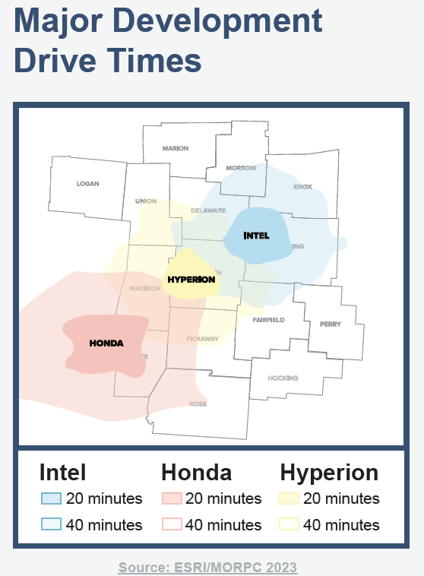
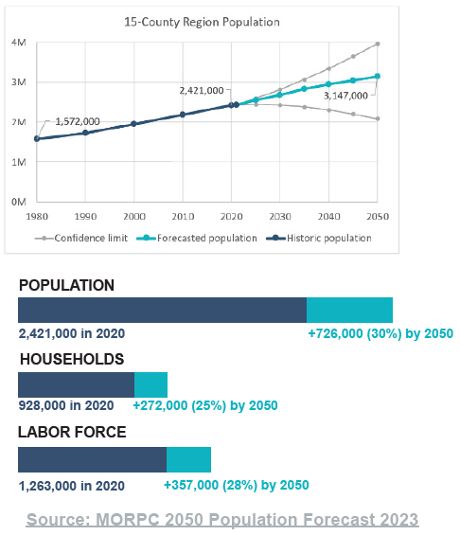
The need
Notes:
The surveys significance goes deeper than just transportation planning,
It was also needed because INTEL, HYPERION, and HONDA are investing billions in the region
And my team projects that the region’s population will grow to over 3 million by 2050:
Adding
726,000 residents
272,000 households
AND
357,000 workers.

Slide 4
Question Development
Cross department involvement
Survey question bank
Address concerns of underrepresented groups
Generate insights to inform decision makers
Notes:
The survey questions were development through cross-departmental collaboration.
MORPC’s staff generated questions that leadership then distilled to 8, not including demographics.
The intent was to understand diverse groups unique and relevant perspectives.

Slide 5
Annual repetition and benchmarking
The questions, combine across Transportation, Sustainability, and Housing, to form a cohesive set to populate “Community Profiles” in the future
Set of demographic questions not in ‘Core 8’
  Race
  Age
  Gender Identity
  ZIP Code
  Political Alignment
  Others
Notes:
The questions had to provide decision-makers with insights to residents' transportation needs,
track changes over time for benchmarking,
and capture the experiences of underrepresented populations across the Region.

Slide 6
Survey Partner
Partnered Center for Human Resource Research (CHRR)
Used MORPC channels and connections
  Used CHRR Survey Panelists
Validating Survey Questions and approach
Notes:
For robustness, MORPC collaborated with researchers at the Ohio State University,
Who helped with question wording, survey distribution, and response validation.
Over 2,000 responses were validated, with about a third from CHRR's American Population Panel and the rest through MORPC channels.

Slide 7
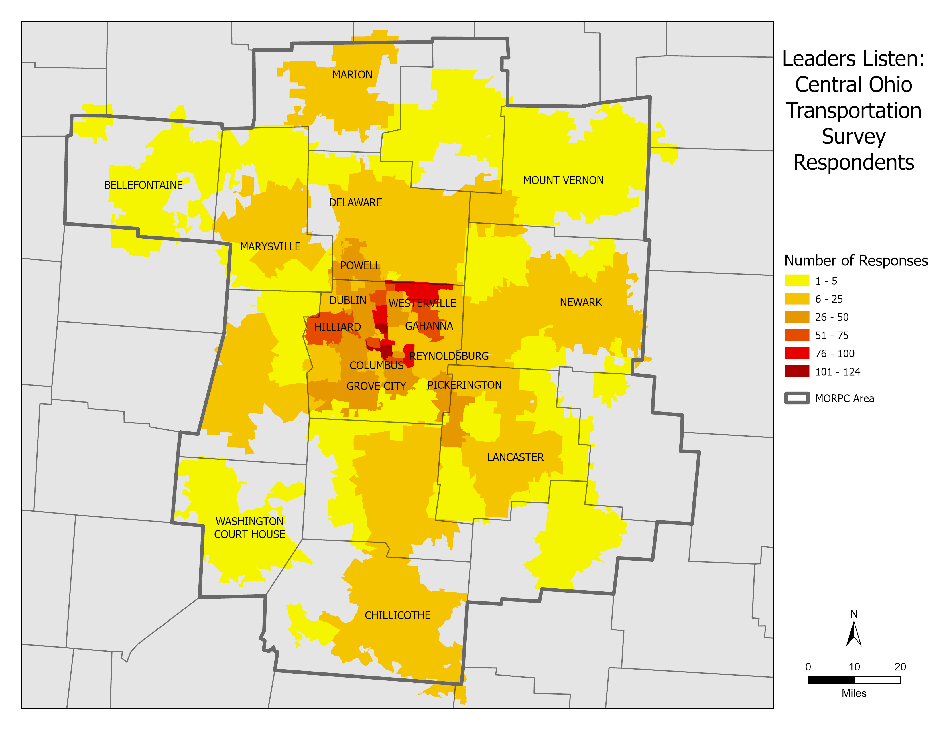
Notes:
Here, we see the distribution of those 2,000 responses across MORPC's 15-county area by ZIP Code.
As anticipated, most respondents were from urbanized areas, especially Columbus.
So what did we actually ask in our survey?

Slide 8
The Questions Stems
Mobility Concerns
Commuting
Transportation investments
Amtrak viability
Notes:
So what did we actually ask in our survey?
Participants were asked their perspective on issues related to their;
mobility concerns,
convenience of commuting types,
and transportation and project investment types

Slide 9
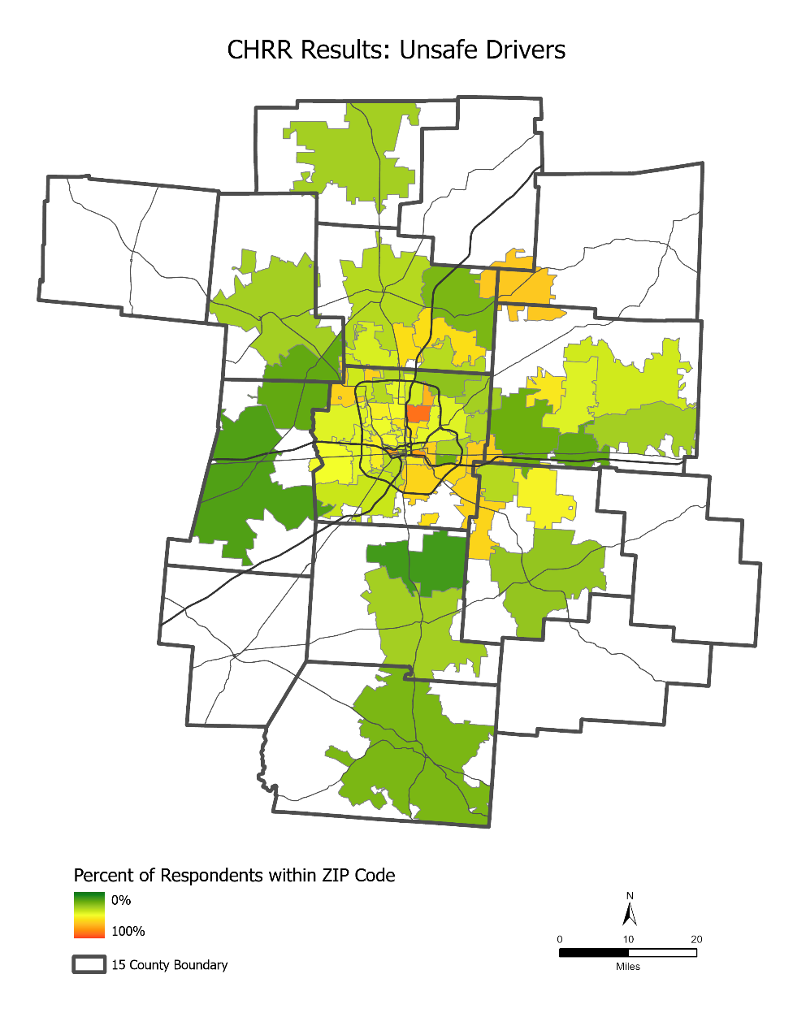
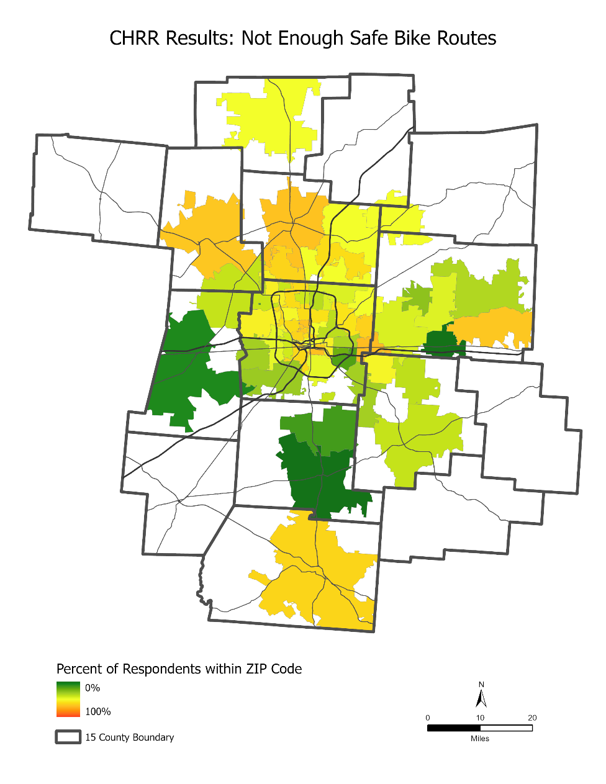
What concerns do you personally have for moving around in your community?
Notes:
These maps show where communities have high rates of concern (in orange).
On the left are rates for Unsafe Drivers
On the right is for Not enough safe bike routes.
Urbanized areas generally experience higher rates of concern
However
Some items are better understood in the context of the transit funded area
Such as…

Slide 10
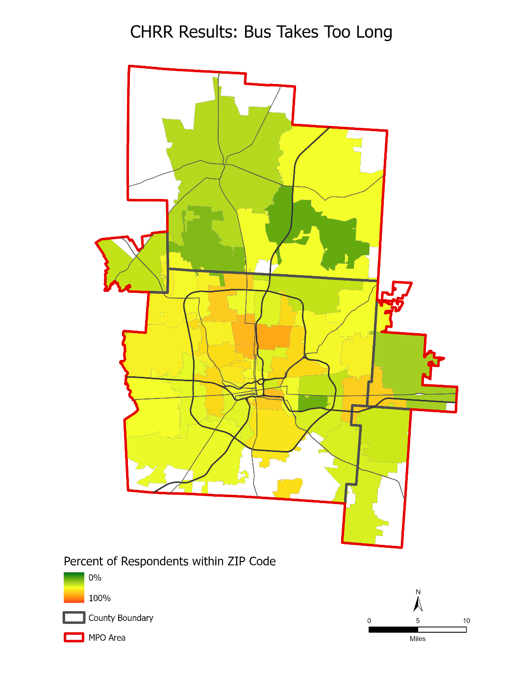
What concerns do you personally have for moving around in your community?
Notes:
With This map displaying participants rate of concern for item “the bus takes too long” for travelling in their community
This focus on the MPO area is because most public bussing occurs here and it’s where MORPC’s transportation funding is allocated.
The more orange areas, aligns with locations that have international and minority populations.

Slide 11
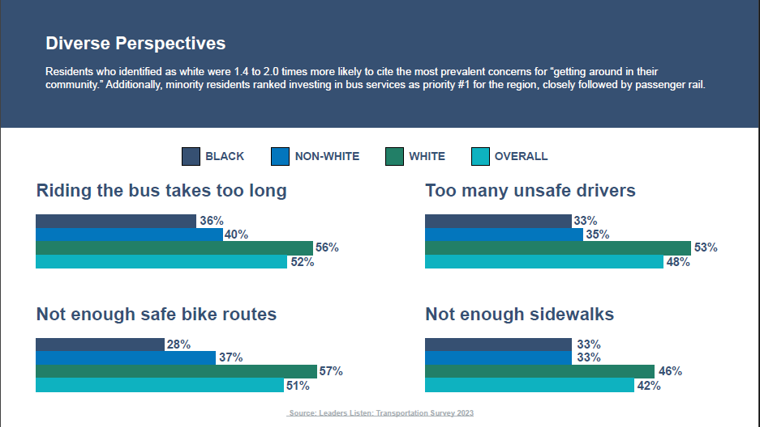
Notes:
Here, we see participants' concerns for "getting around in their community“ by race.
Notably, White respondents express greater concerns about mobility compared to Black or Minority respondents.
--
Not enough safe bike routes, Riding the bus takes too long, Too many unsafe drivers, Not Enough Sidewalks, Lack of accessible ramps and sidewalks, Crosswalks are not safe enough, No bus lines serve my area, Traffic is too congested, Owning a car is too expensive,

Slide 12
Convenient Commuting
Notes:
On the left we see, Black participants were less likely to describe walking, biking, or taking the bus as "not at all" or “slightly" convenient than the White cohort
Suggesting White respondents perceive non-car transportation modes as less convenient and have more transportation concerns than other cohorts,
Possibly illuminating why, they are less likely to use mass transit.
On the right though, 2/3rds consider commute time as important when deciding where to live.

Slide 13
Transportation Investment Priorities
Notes:
Supporting this Black participants ranked investment for Bus Services highest likely because of utilization rates and desire for better service.
However,
Passenger Rail was the top-rated investment for the region overall.
AND
The desire of passenger rail is further highlighted by

Slide 14
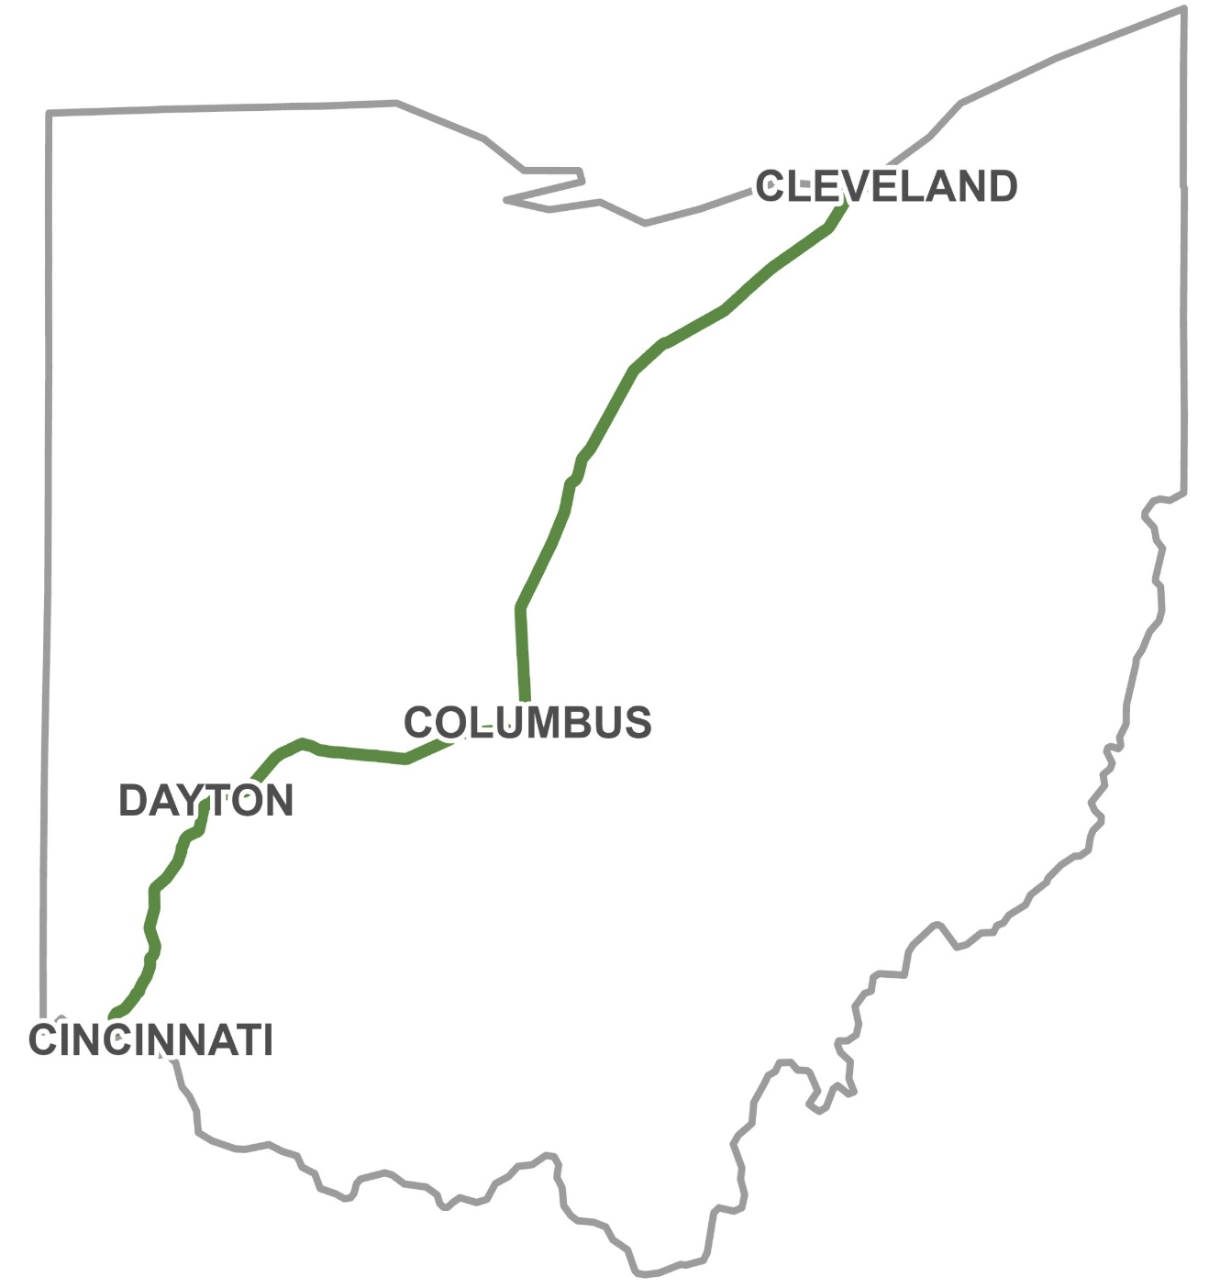
Amtrak Connections
Notes:
The robust results, shown here, supporting Amtrak passenger rail, with 75% expressing that Amtrak would be “very“ to “extremely” helpful to the region.
Our survey data not only strengthened MORPC’s proposal for the 3C&D corridor, shown here, but also prompted a second application to the FTA for a Pittsburgh to Chicago route to bring passenger rail back to Columbus.
This was possible after

Slide 15
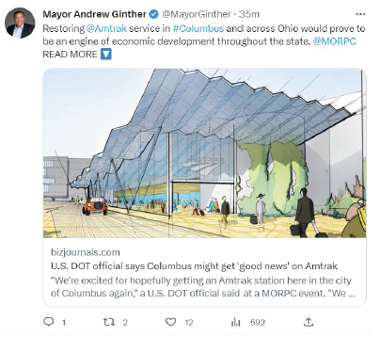
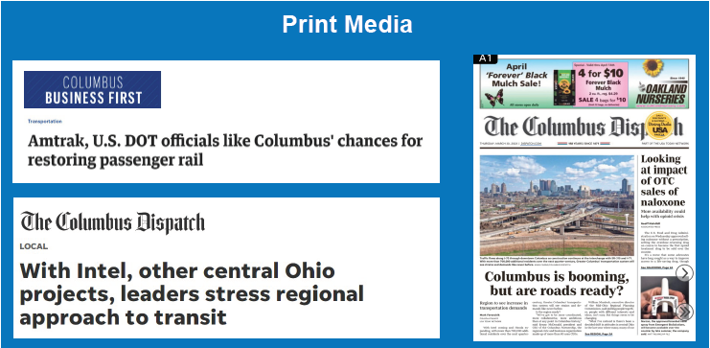
Media Coverage and Uses
Notes:
the
Initial findings were presented at MORPC's State of the Region event in the early spring.
Providing an opportunity to showcase results to local and state decision-makers and media.
Subsequently, the data has been requested across the region to help inform local planning and supporting grant applications.

Slide 16
Thank you

