Slide 1
Cleveland’s Middle Neighborhoods
Michael Henderson, Ph.D.
Senior Research Associate
Center on Poverty & Community Development
michael.j.henderson@case.edu
NNIP Annual Conference
November 10, 2023

Slide 2
Overview
The Cleveland Middle Neighborhoods Initiative
Neighborhood Development Index (NDI) 1.0
Approach
Policy impacts
Looking forward to NDI 2.0
Policy goals
Methodological questions
Ethical questions

Slide 3
What are Middle Neighborhoods?
“Not in deep distress, but not thriving either.”
- Paul Brophy
“Middle neighborhoods are neighborhoods that have
retained a respectable measure of both their physical
and social fabric, are not or not yet areas of highly
concentrated poverty or hyper vacancy, and where
stabilization and gradual improvement remain
realistic strategies.”
-Alan Mallach

Slide 4
Cleveland Middle Neighborhoods Initiative
Established by the City of Cleveland through a grant from the Cleveland Foundation
To identify and develop targeted strategies to support the places stuck in the “gaps between the real values of these strong communities and the perceived value”
Used local administrative and census data to better understand the development patterns and real estate trends in Cleveland
Classify the local housing submarkets and identify Cleveland’s middle neighborhoods

Slide 5
Neighborhood Development Index
Unit of analysis: residential block groups in Cuyahoga County, OH (n=1,134)
Residential: 9+ residential property transfers over the last three years
Primary analysis carried out on aggregated 2017-2019 data
E.g., 2017-2019 median residential sale price
Applied results of 2017-2019 analysis to previous time periods
Back to 2011-2013

Slide 6
Methods
Principal Component Analysis (PCA)
Uncover underlying neighborhood dimensions
Cluster Analysis
Identify distinct types of neighborhoods in Cuyahoga County, defined by similar constellations of neighborhood dimensions
An iterative validation process with local input
Shared preliminary results with local experts (CDCs)
Fit neighborhoods from earlier time periods into 2017-2019 typology

Slide 7
Neighborhood Variables
Residential sales/transfers
% of properties with recent sales (<3yrs)
Median sale price ($/sqft)
Median sale price change (2012-2019)
Residential property characteristics
Size, beds, baths
Age/year built
assessed condition
Additional housing variables
Foreclosure rate
% of rental parcels with recent Housing Choice Voucher use
% owner-occupied
Land use/built environment
Residential parcel density
Commercial parcel density
Residential demolitions

Slide 8
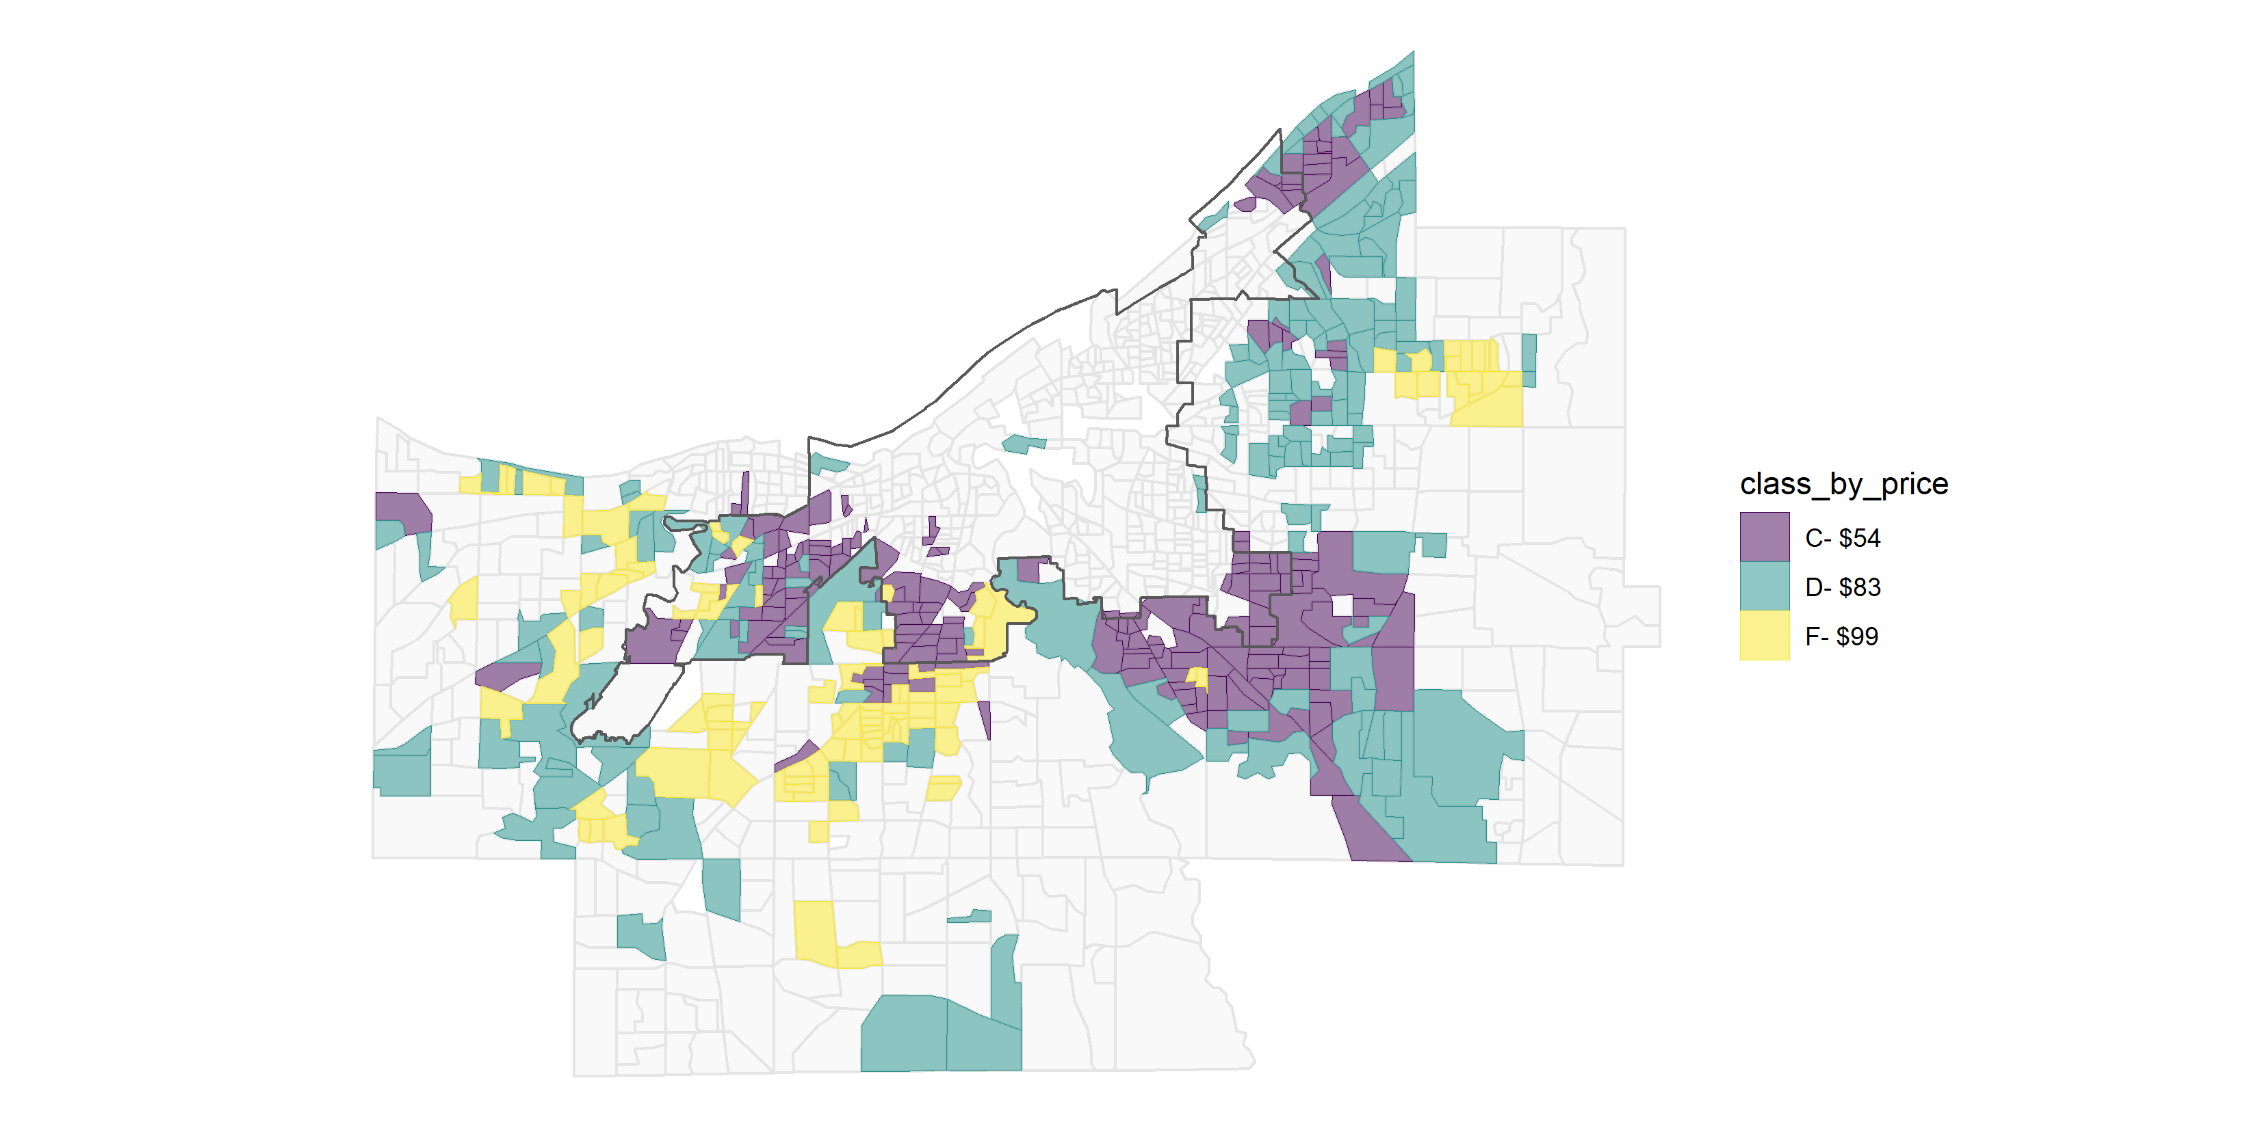
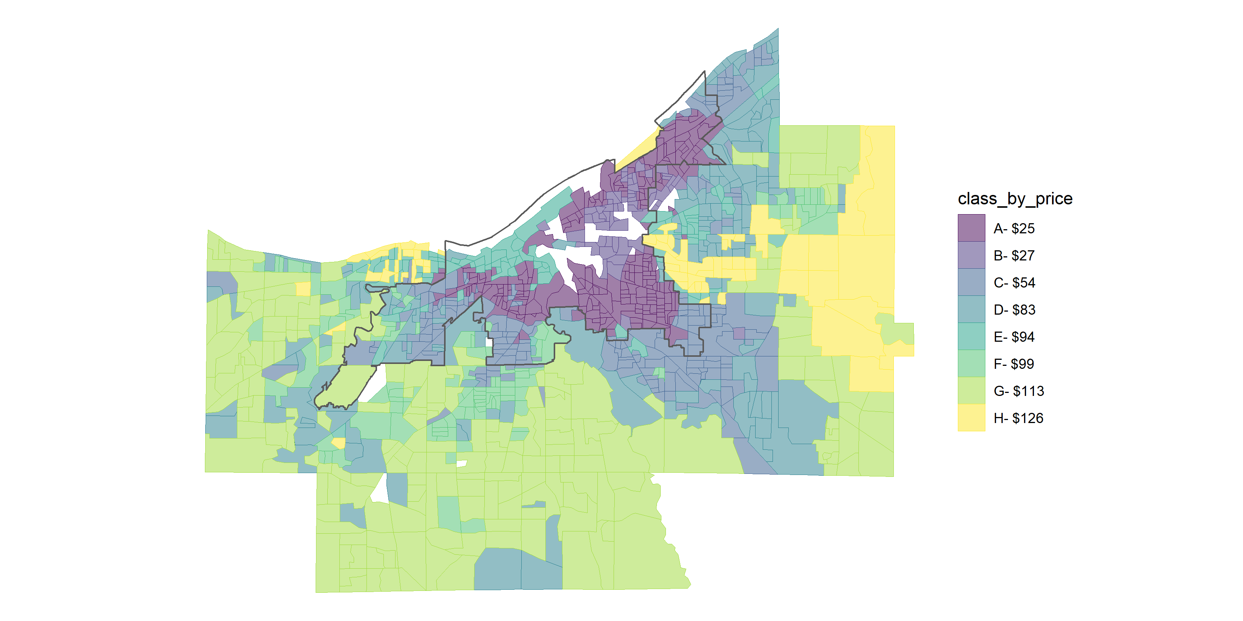
Results
Identified 8 distinct neighborhood types in Cuyahoga County in 2017-2019

Slide 9
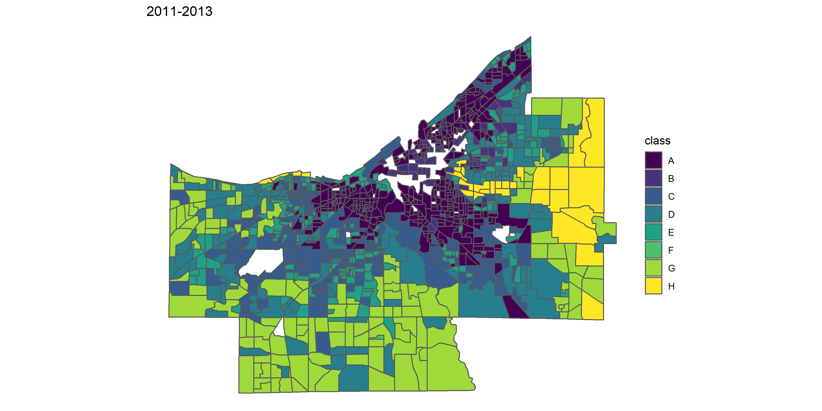
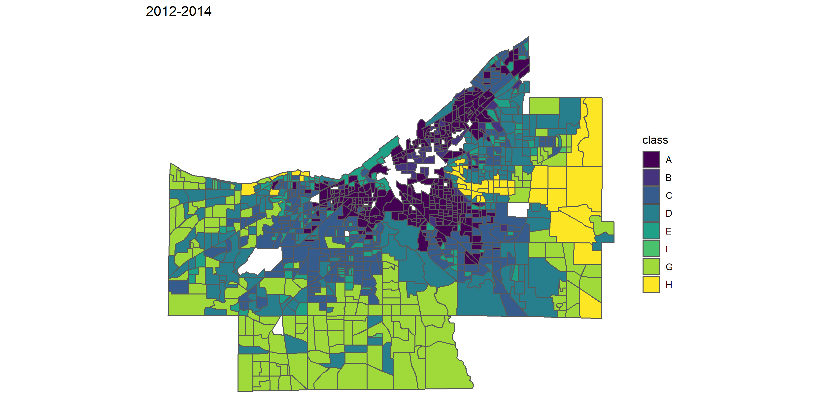
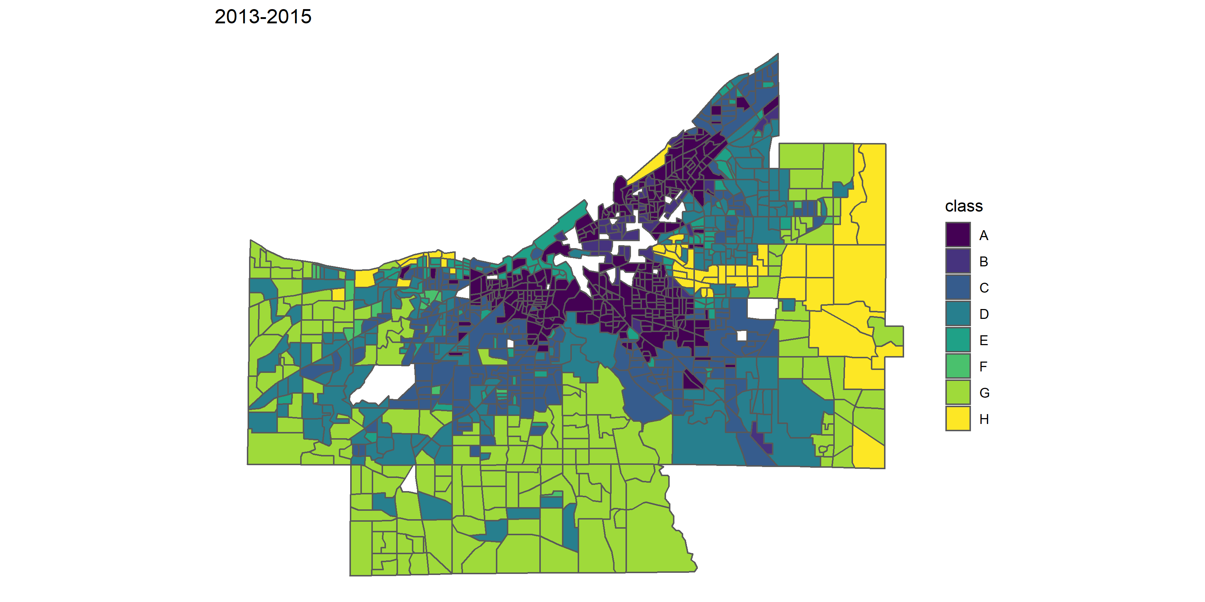
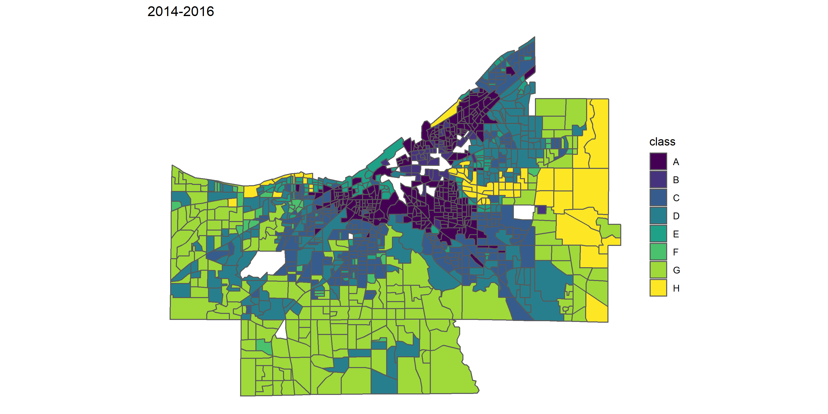
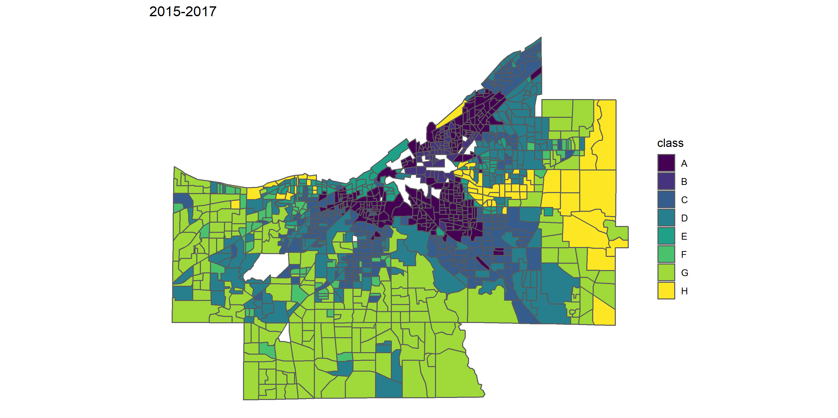
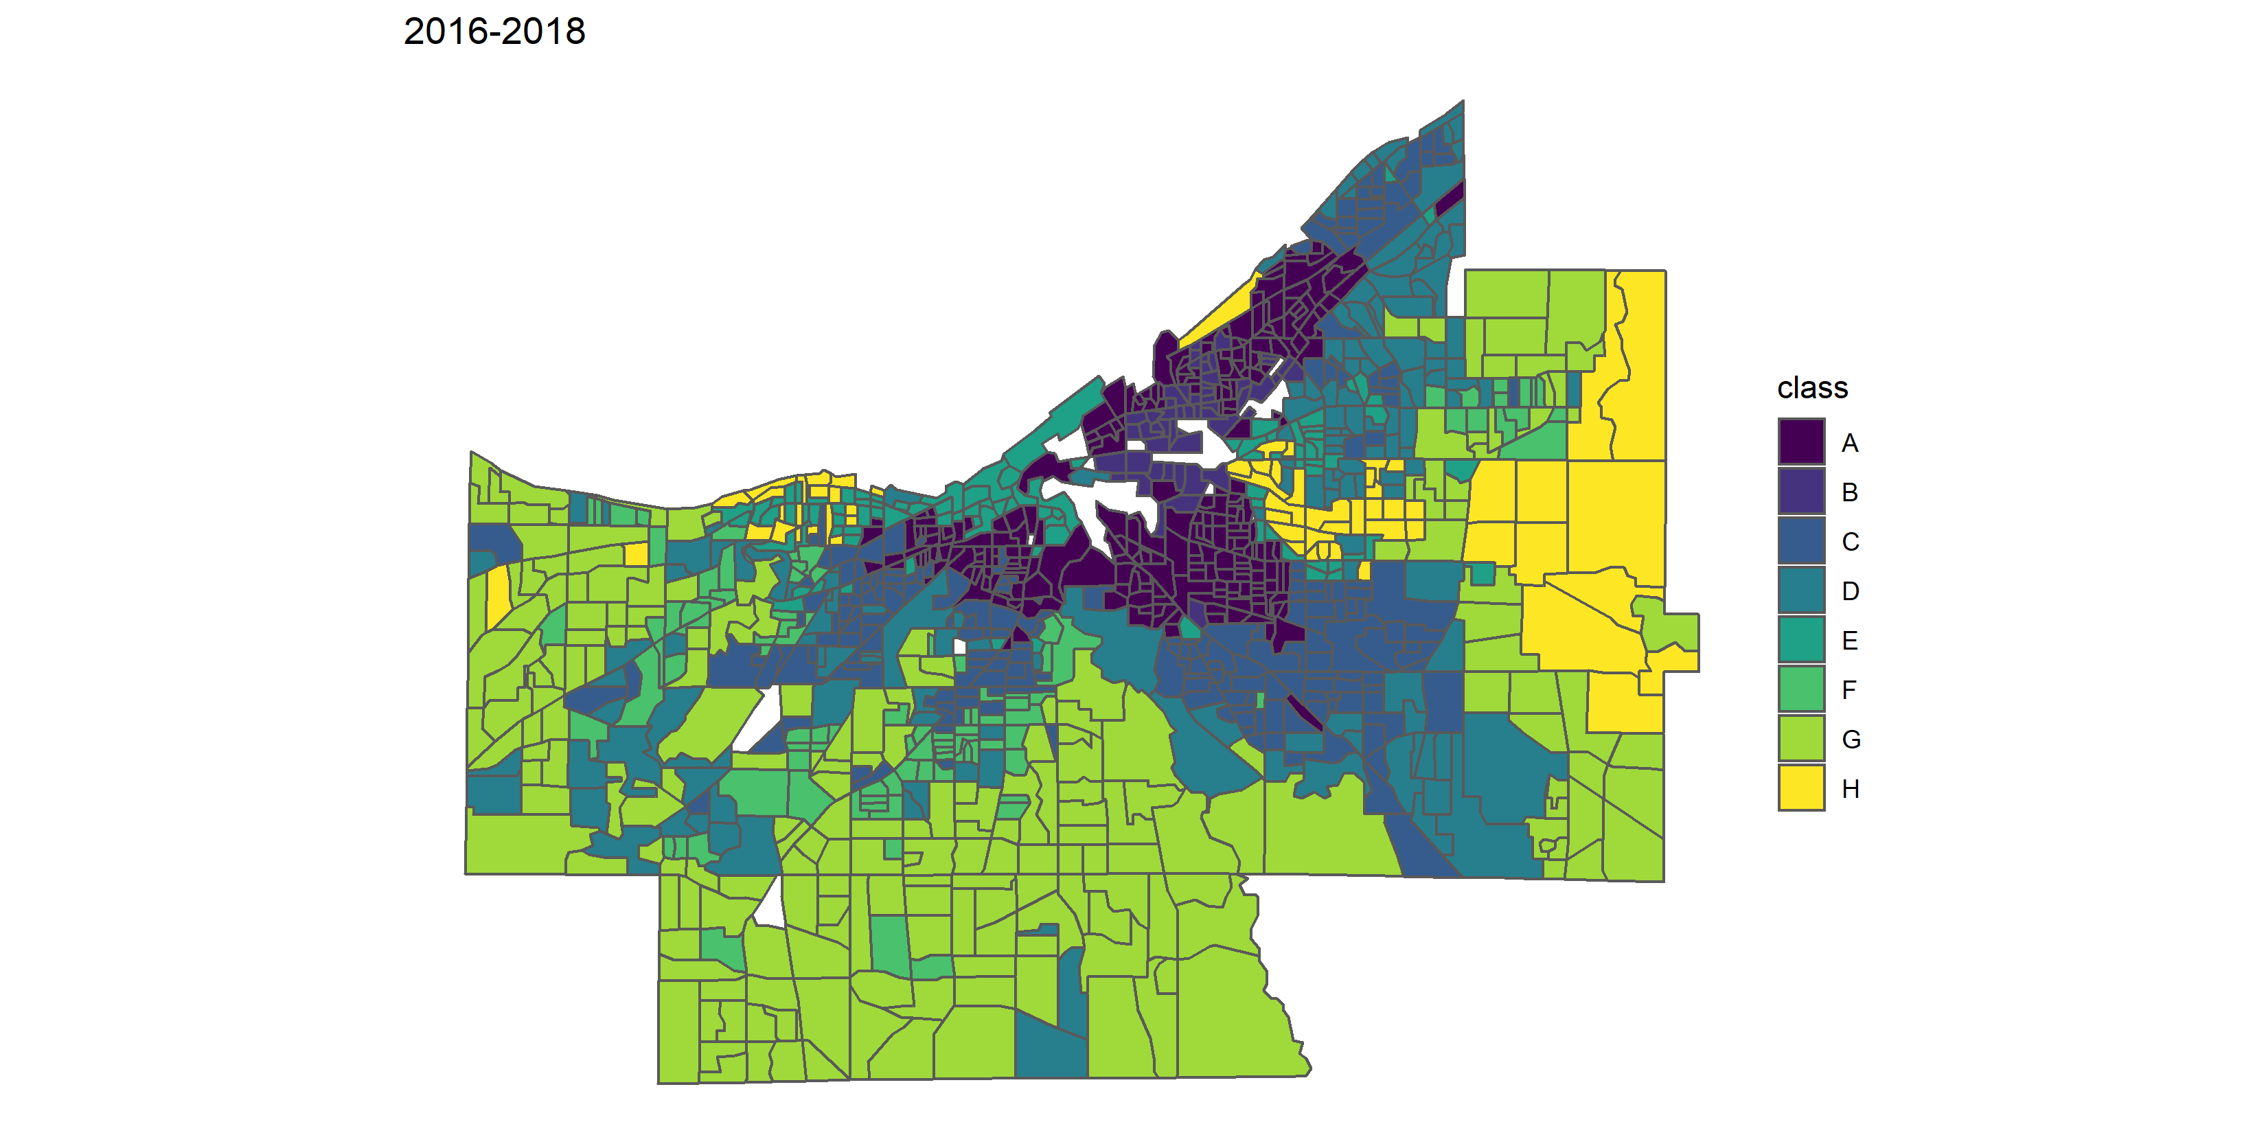

Slide 10
Policy and decision-making impact
Cleveland City Council approved $1 million in funding to establish a loan loss reserve fund
Participating lenders agree to make loans up to 120% LTV
To give local residents the opportunity to buy & rehab homes & stabilize middle neighborhoods
Anticipated to yield $10-13M in additional investment in local housing stock
Informed design of new Cleveland residential tax abatement program

Slide 11
¯
Market Classification
Market Rate Middle Market Opportunity N/A
0
1
2
4
Miles
Neighborhood Development Index
Esri, HERE, Garmin, SafeGraph, GeoTechnologies, Inc, METI/NASA, USGS, EPA,
NPS, USDA
City of Cleveland Department of Community Development
Rev. May 2022

Slide 12
Neighborhood Development Index 2.0
Update typology with current data
Through 2020-2022
Reexamine methodology and input variables
Forecast neighborhood trajectories
Establish fund to support transformational investments in targeted middle neighborhoods
Aligning middle neighborhoods initiative with other local efforts to support local homeownership and investment in housing stock
E.g., City of Cleveland’s Resident’s First proposals
Lead Safe Cleveland initiative

Slide 13
Considerations for Future Work
Making data accessible in a responsible way
Incorporating data on local population into a housing/real estate model
Aligning with other local efforts to invest in local housing quality and homeownership opportunities

Slide 14
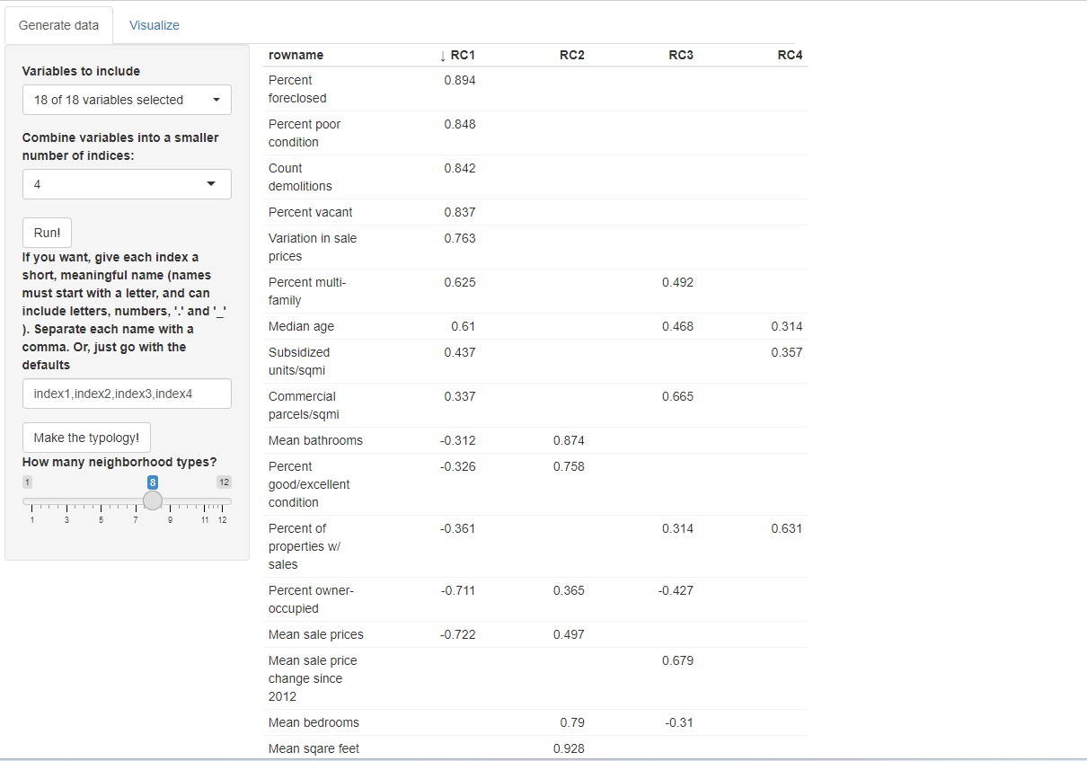
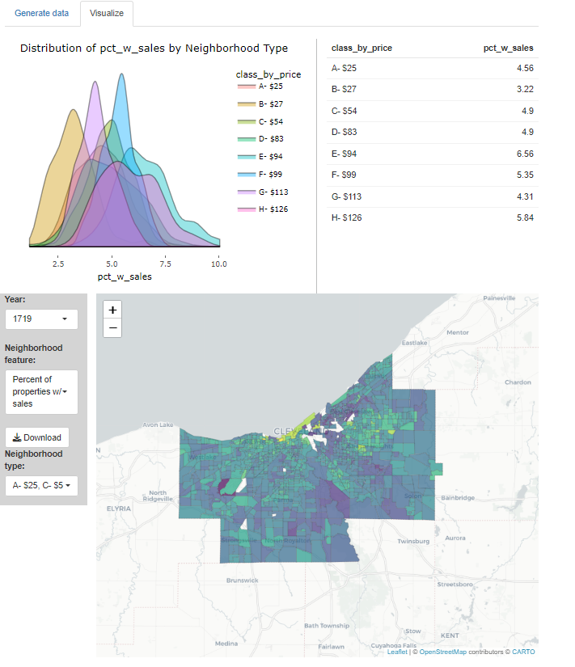

Slide 15
