Slide 1
Adventures in Parcel Surveying!
Lessons learned from data gathering in South saint louis
John cruz, rise
NNIP Spring 2018, AtlantA

Slide 2
background
As part of a community planning effort in South
Saint Louis, a full parcel survey is required.
Notes:
All master plans are required to have a parcel survey by the City

Slide 3
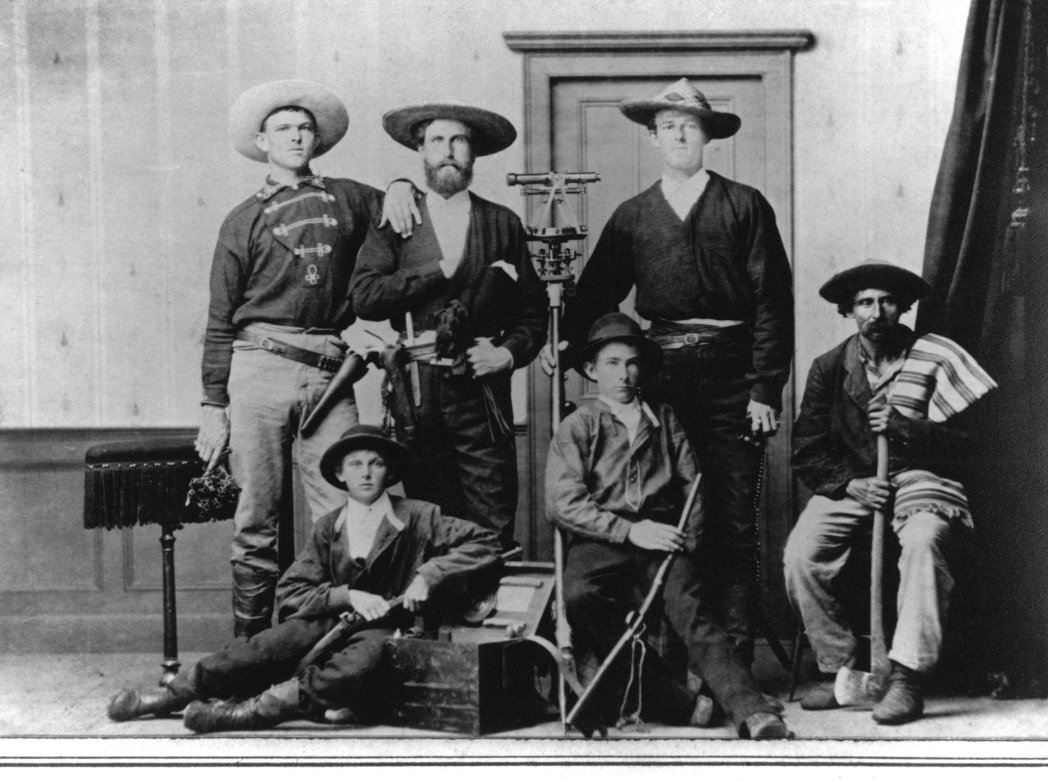
Tasked with surveying over 5,000 parcels.
Thankfully, it’s not 1876 anymore and we have options.
Notes:
So many parcels required staff + volunteers

Slide 4
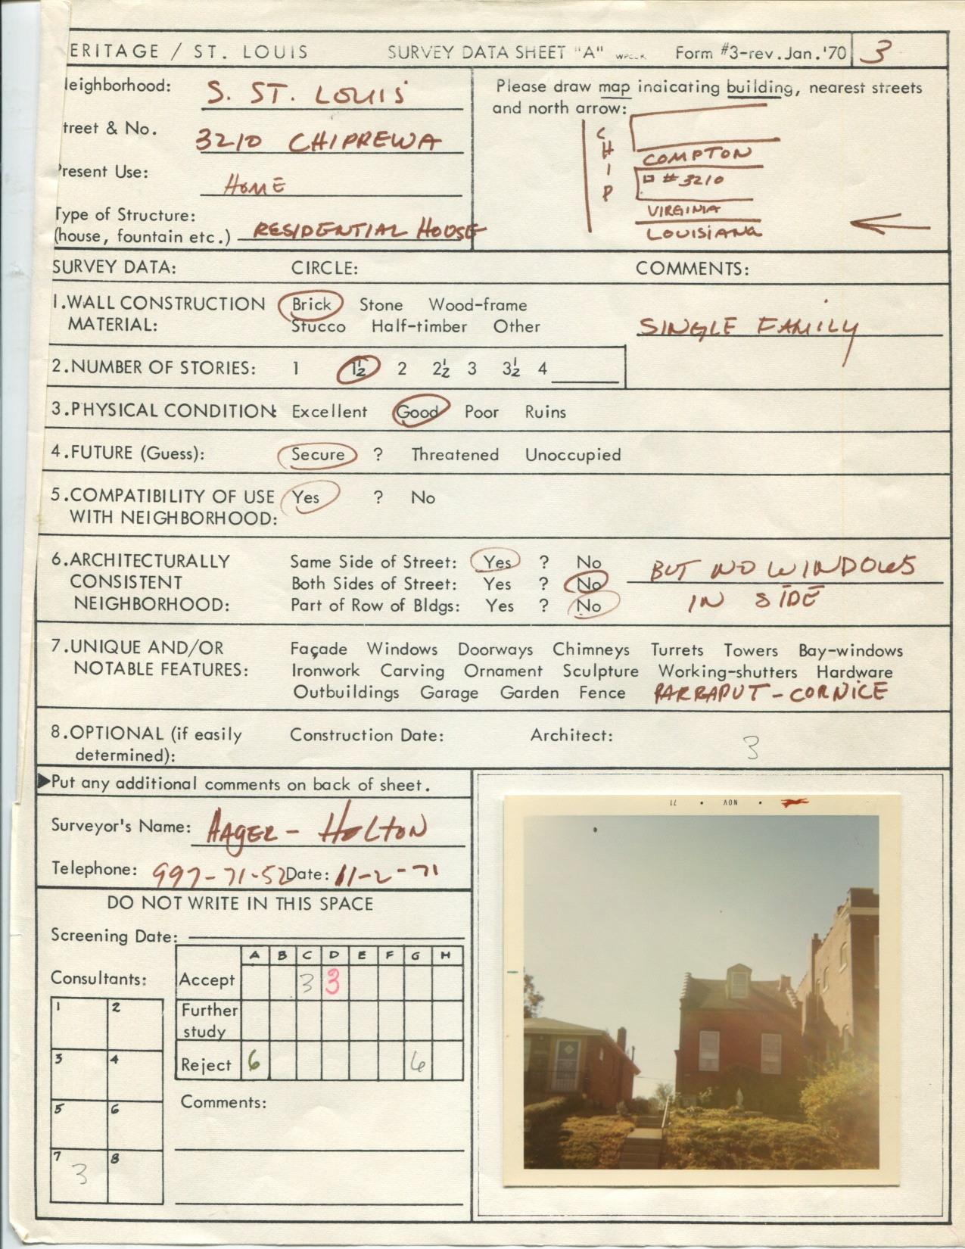
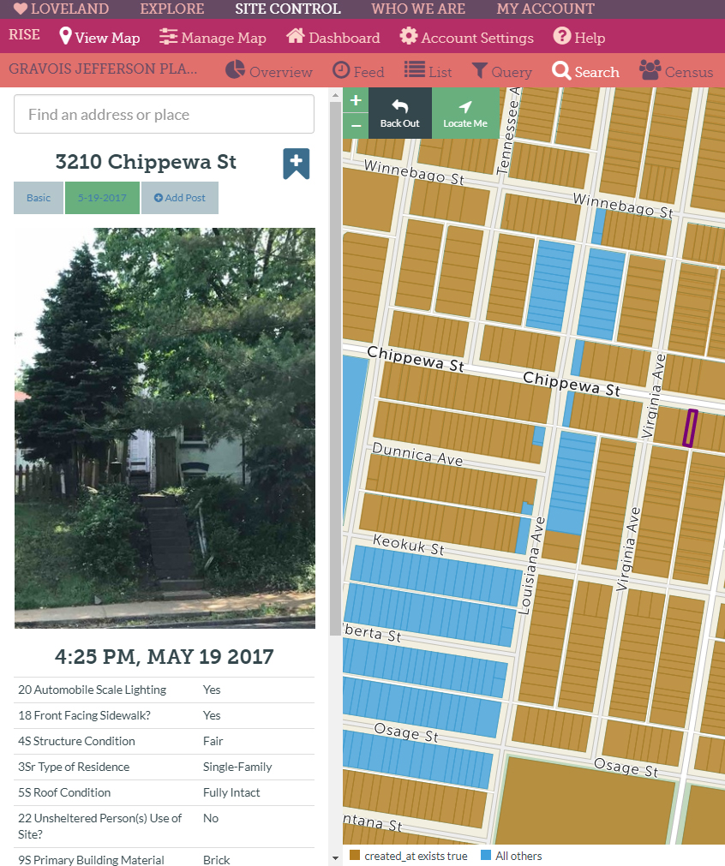
Retching: Pen, Paper, and Clipboard Fetching: Mobile apps w/ web interface
Notes:
Last time the area was surveyed around ~1970, there was pen and paper. Today, we use Sitecontrol from Loveland to do the surveying

Slide 5
So….what did we learn?
Managing our internal team and volunteers?
Notes:
So with our approach figured out, what did we learn from the process?

Slide 6
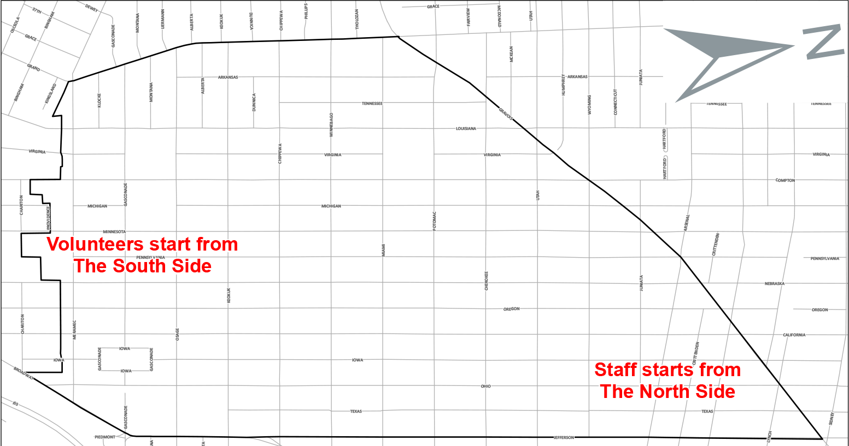
Start different groups at different sides.
You can fill in the gaps later. This helps keep progress organized.
Notes:
Keeping volunteers and staff working on different areas at different times makes the data management easier on staff and helps them fill holes in survey work.

Slide 7
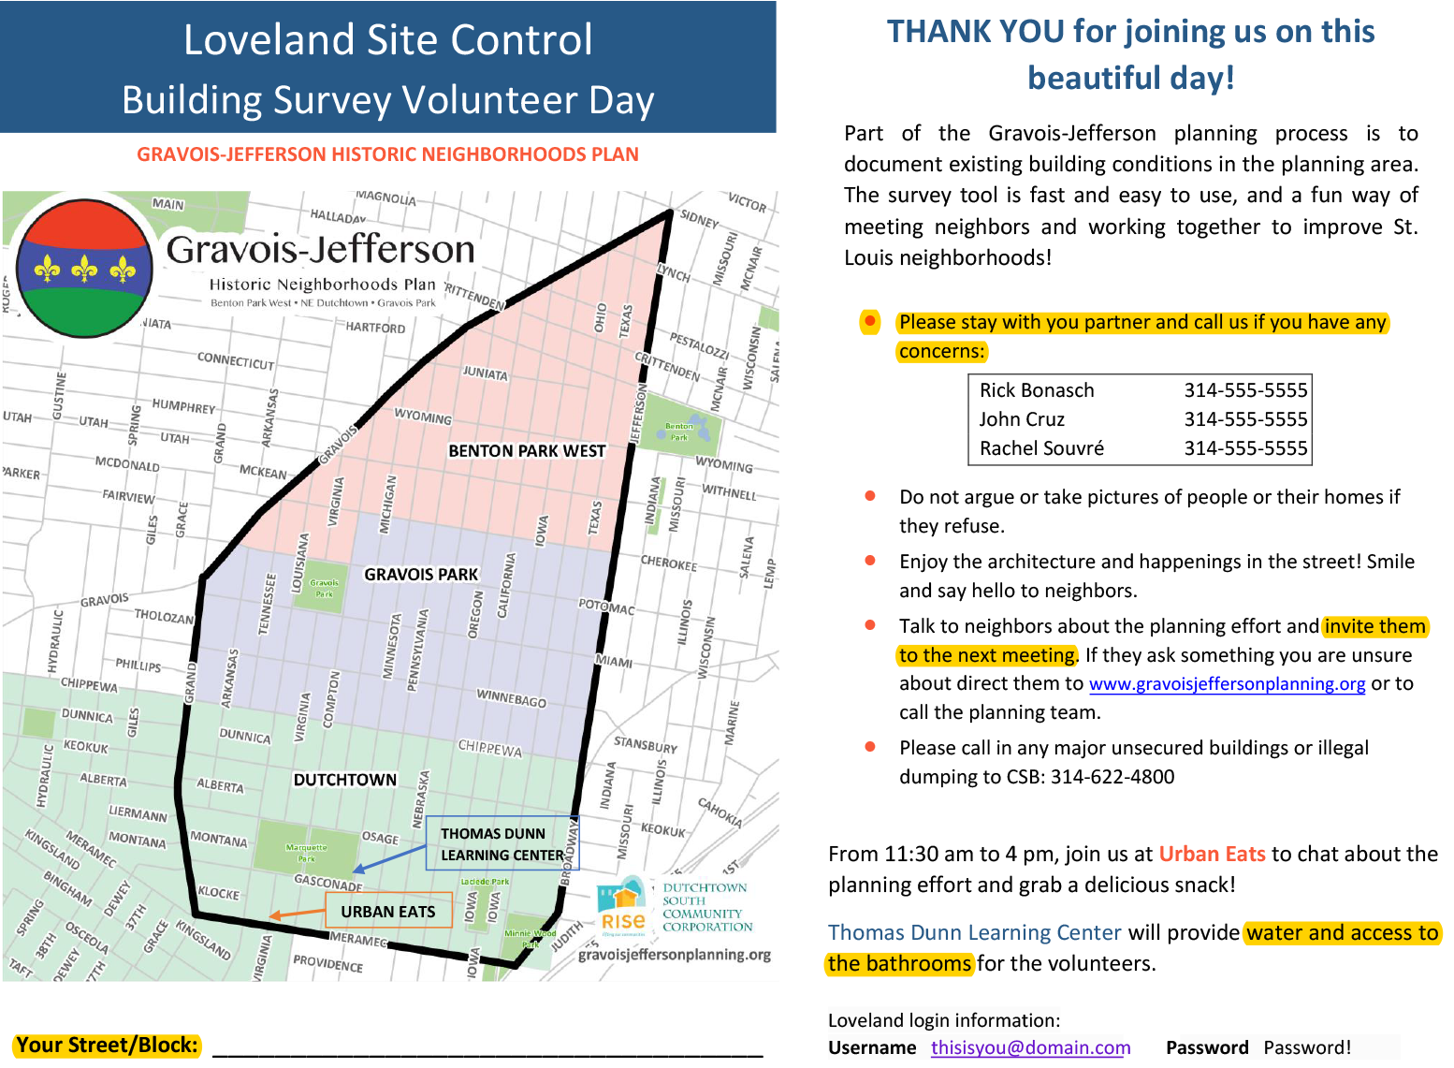
Assign blocks / streets from X to Y to volunteers.
Give them handouts with important information and reminders.
Notes:
Volunteers were given streets and blocks to work on and asked to stay on their street. More information was provided so anything that they would need, in addition to other handouts for residents, was available.

Slide 8
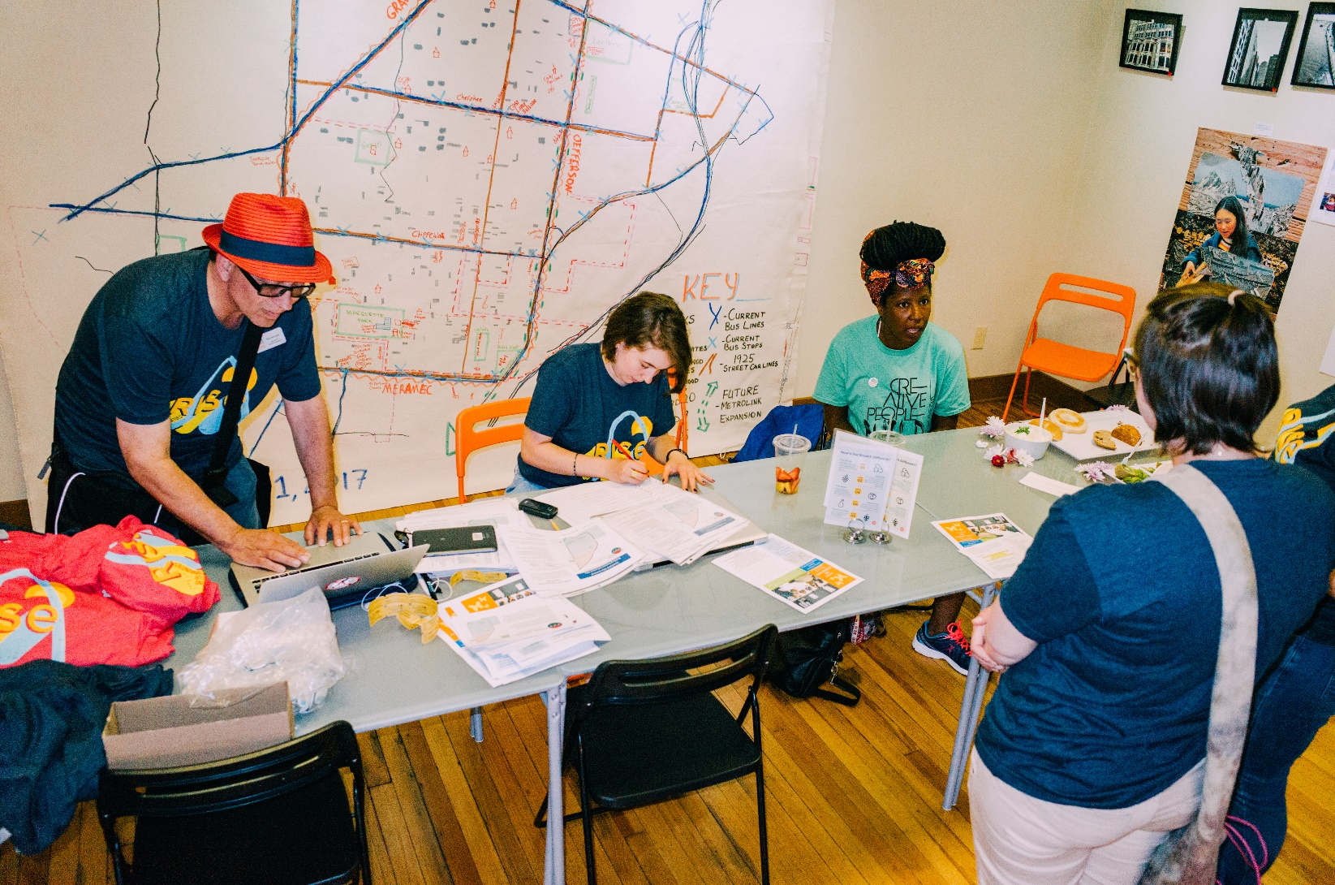
Be well organized with lots of available staff.
Give volunteers food to keep them alive.
Notes:
Stay organized to help people get out and start surveying quickly, any slow-downs will take much more time than anticipated.

Slide 9
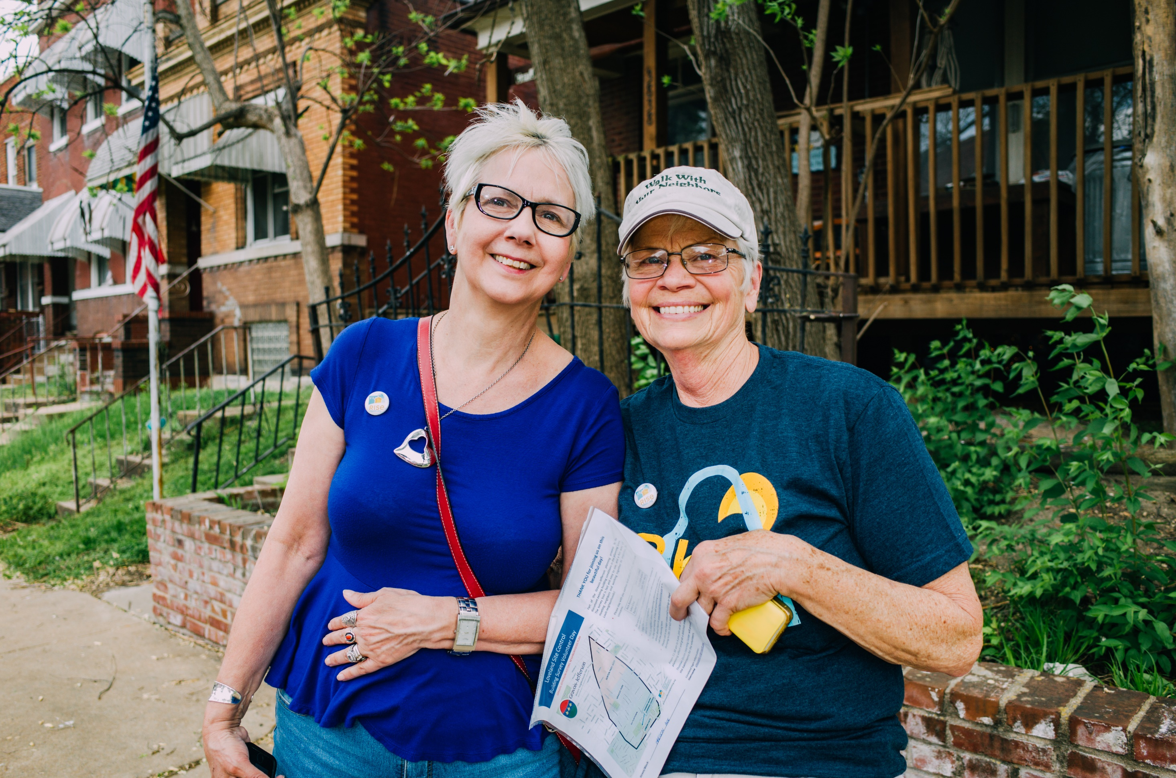
Use the buddy system.
Always send volunteers out in groups of 2 or more, never alone.
Notes:
Even in safe neighborhoods, a buddy helps work through any potential technology issues and helps keep up the energy.

Slide 10
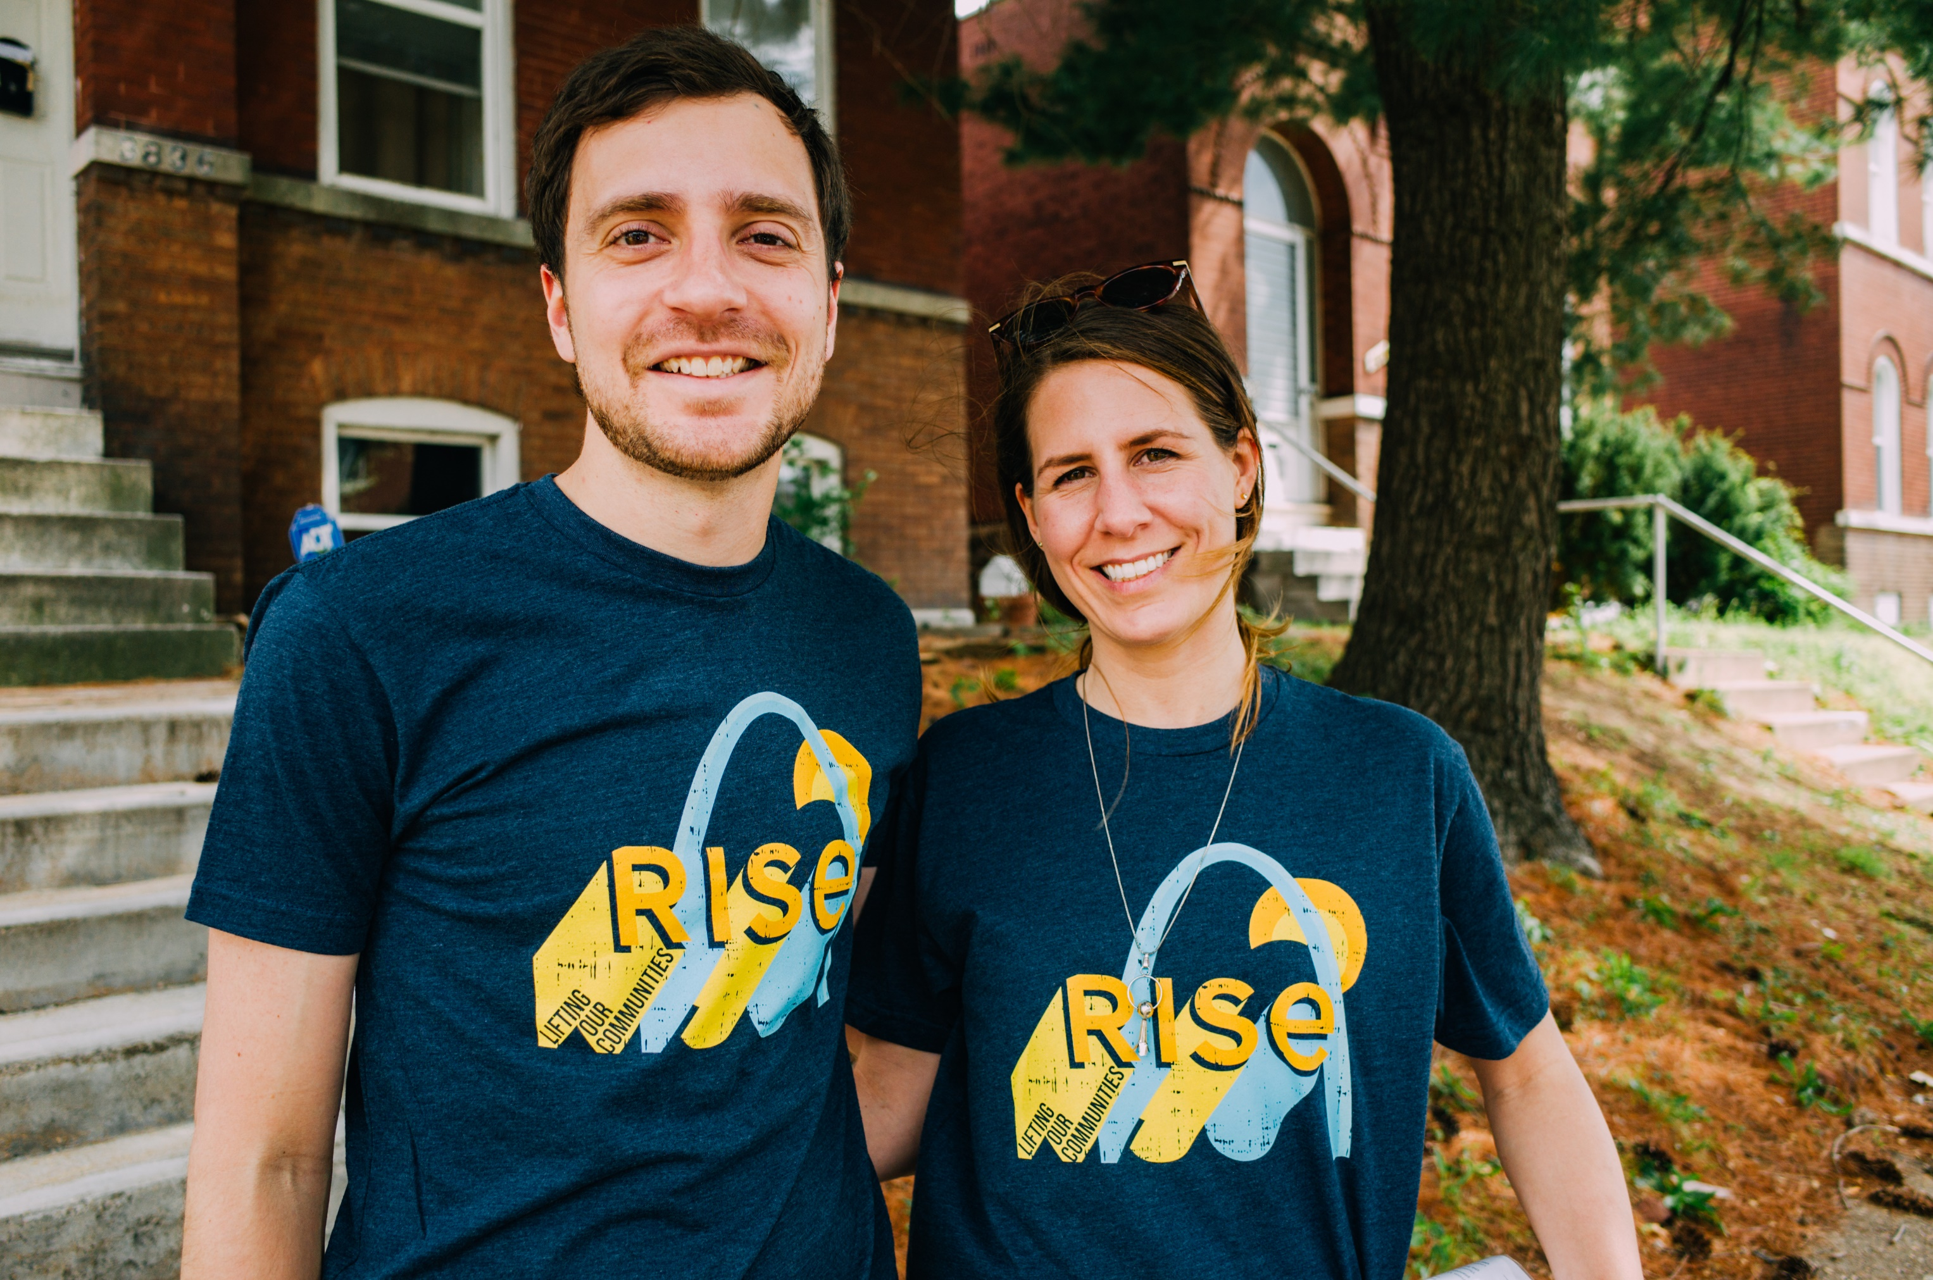
Provide t-shirts, buttons, etc. to wear while surveying.
Raise awareness for your org or effort, let neighbors know who you are.
Notes:
Branding is important. Raise awareness and let people know you’re not a texa$ oil tycoon looking to gentrify someone’s neighborhood.

Slide 11
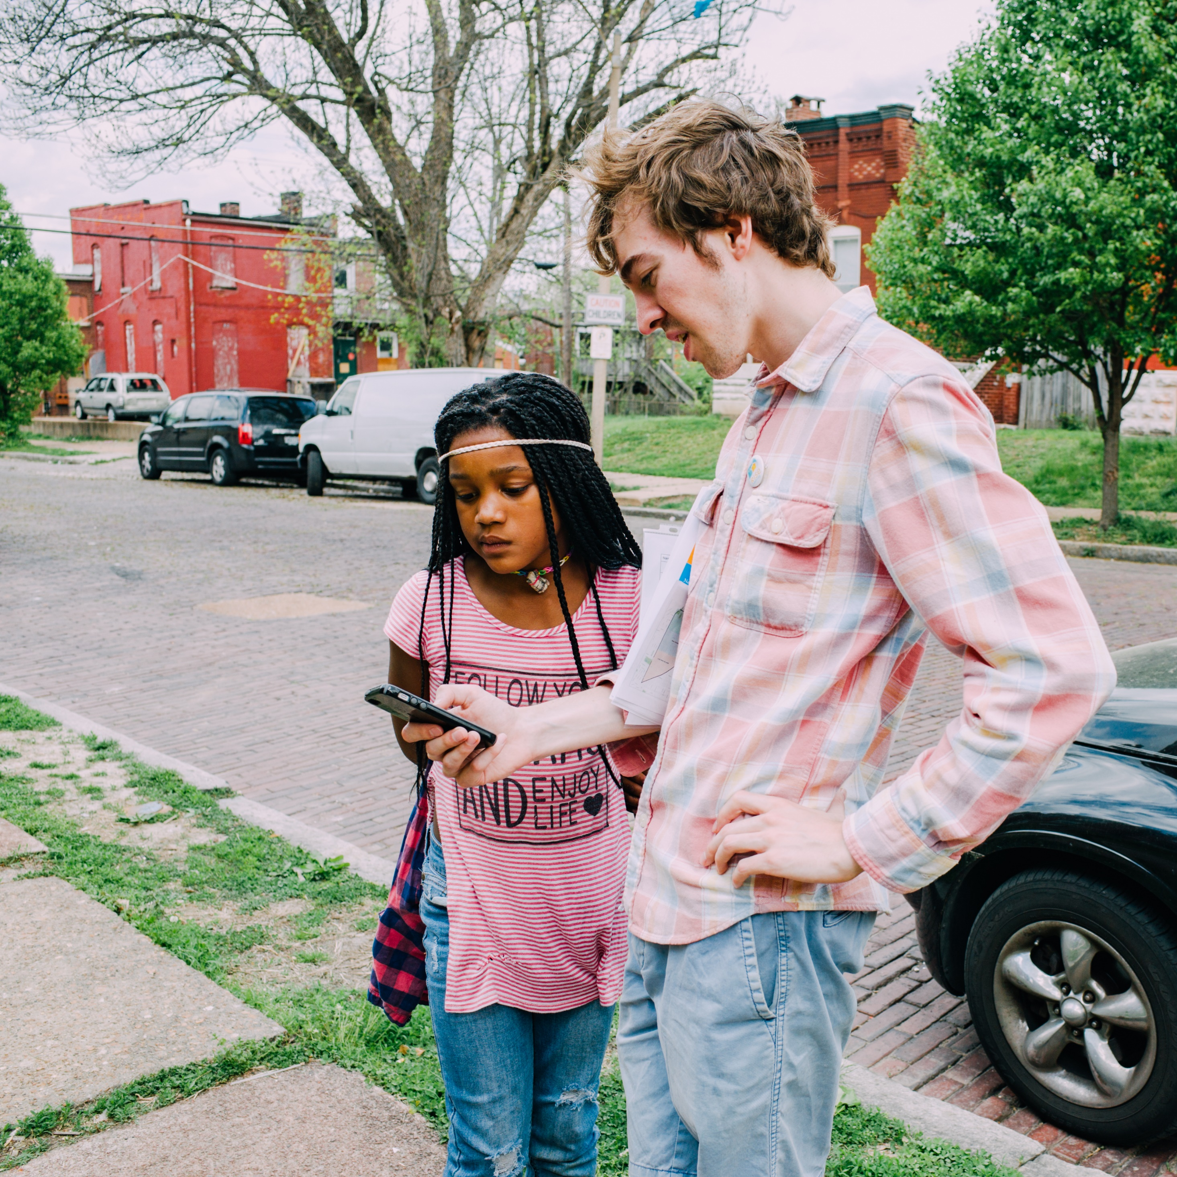
Use surveying as a community engagement tool! Inform residents about your project, your org, or show them how the software works.
Notes:
Let people know about your work and why you’re doing it, show them the software, and have fun doing it.

Slide 12
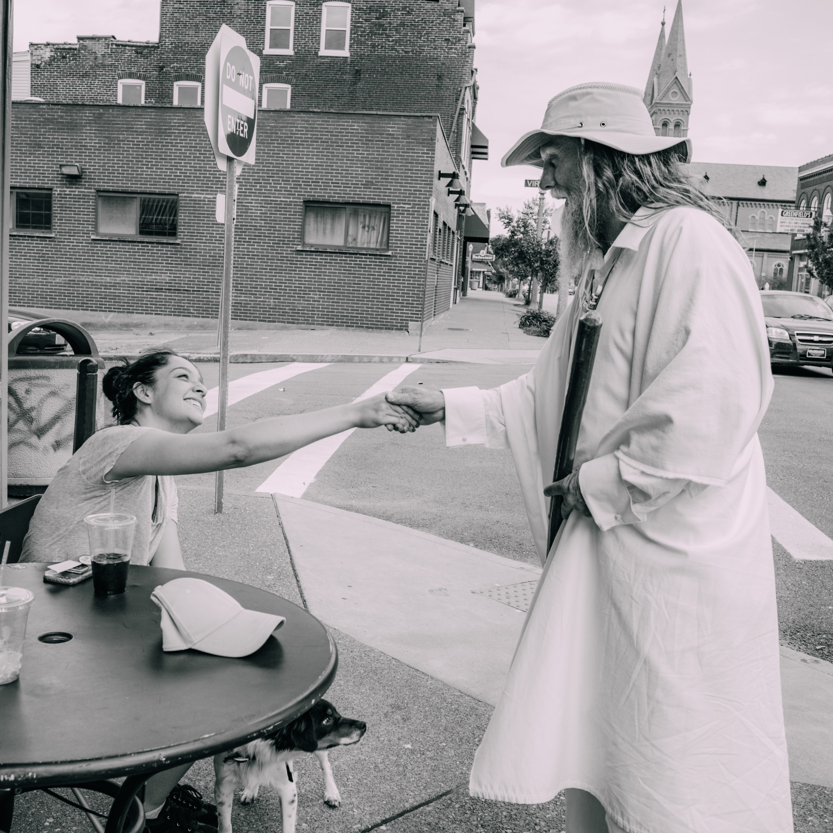
Talk to neighbors that are interested, but practice caution and safety when talking to some of the more interesting ones.
Notes:
Some neighborhood residents you may be unsure of at first, so proceed with caution .

Slide 13
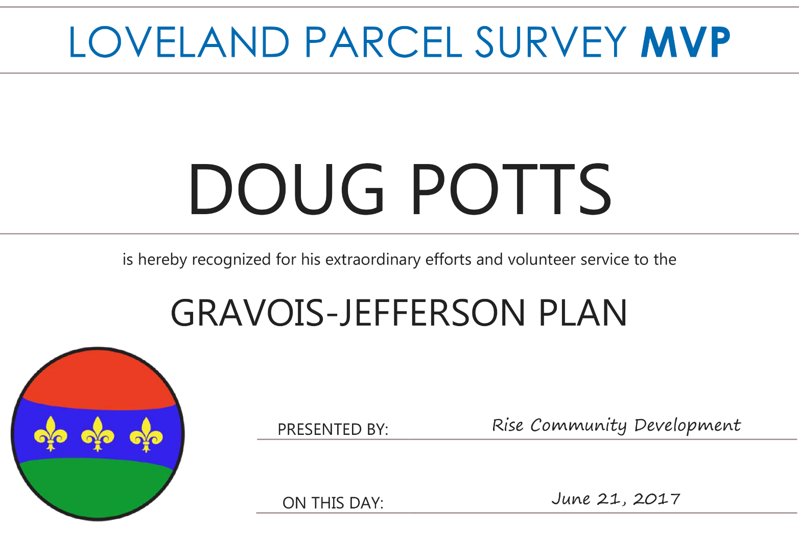
Recognize important volunteer efforts.
People appreciate the little things
Notes:
Doug surveyed hundreds of surveys on his own time! He was a super-volunteer so we made up a certificate for him to show our appreciation.

Slide 14
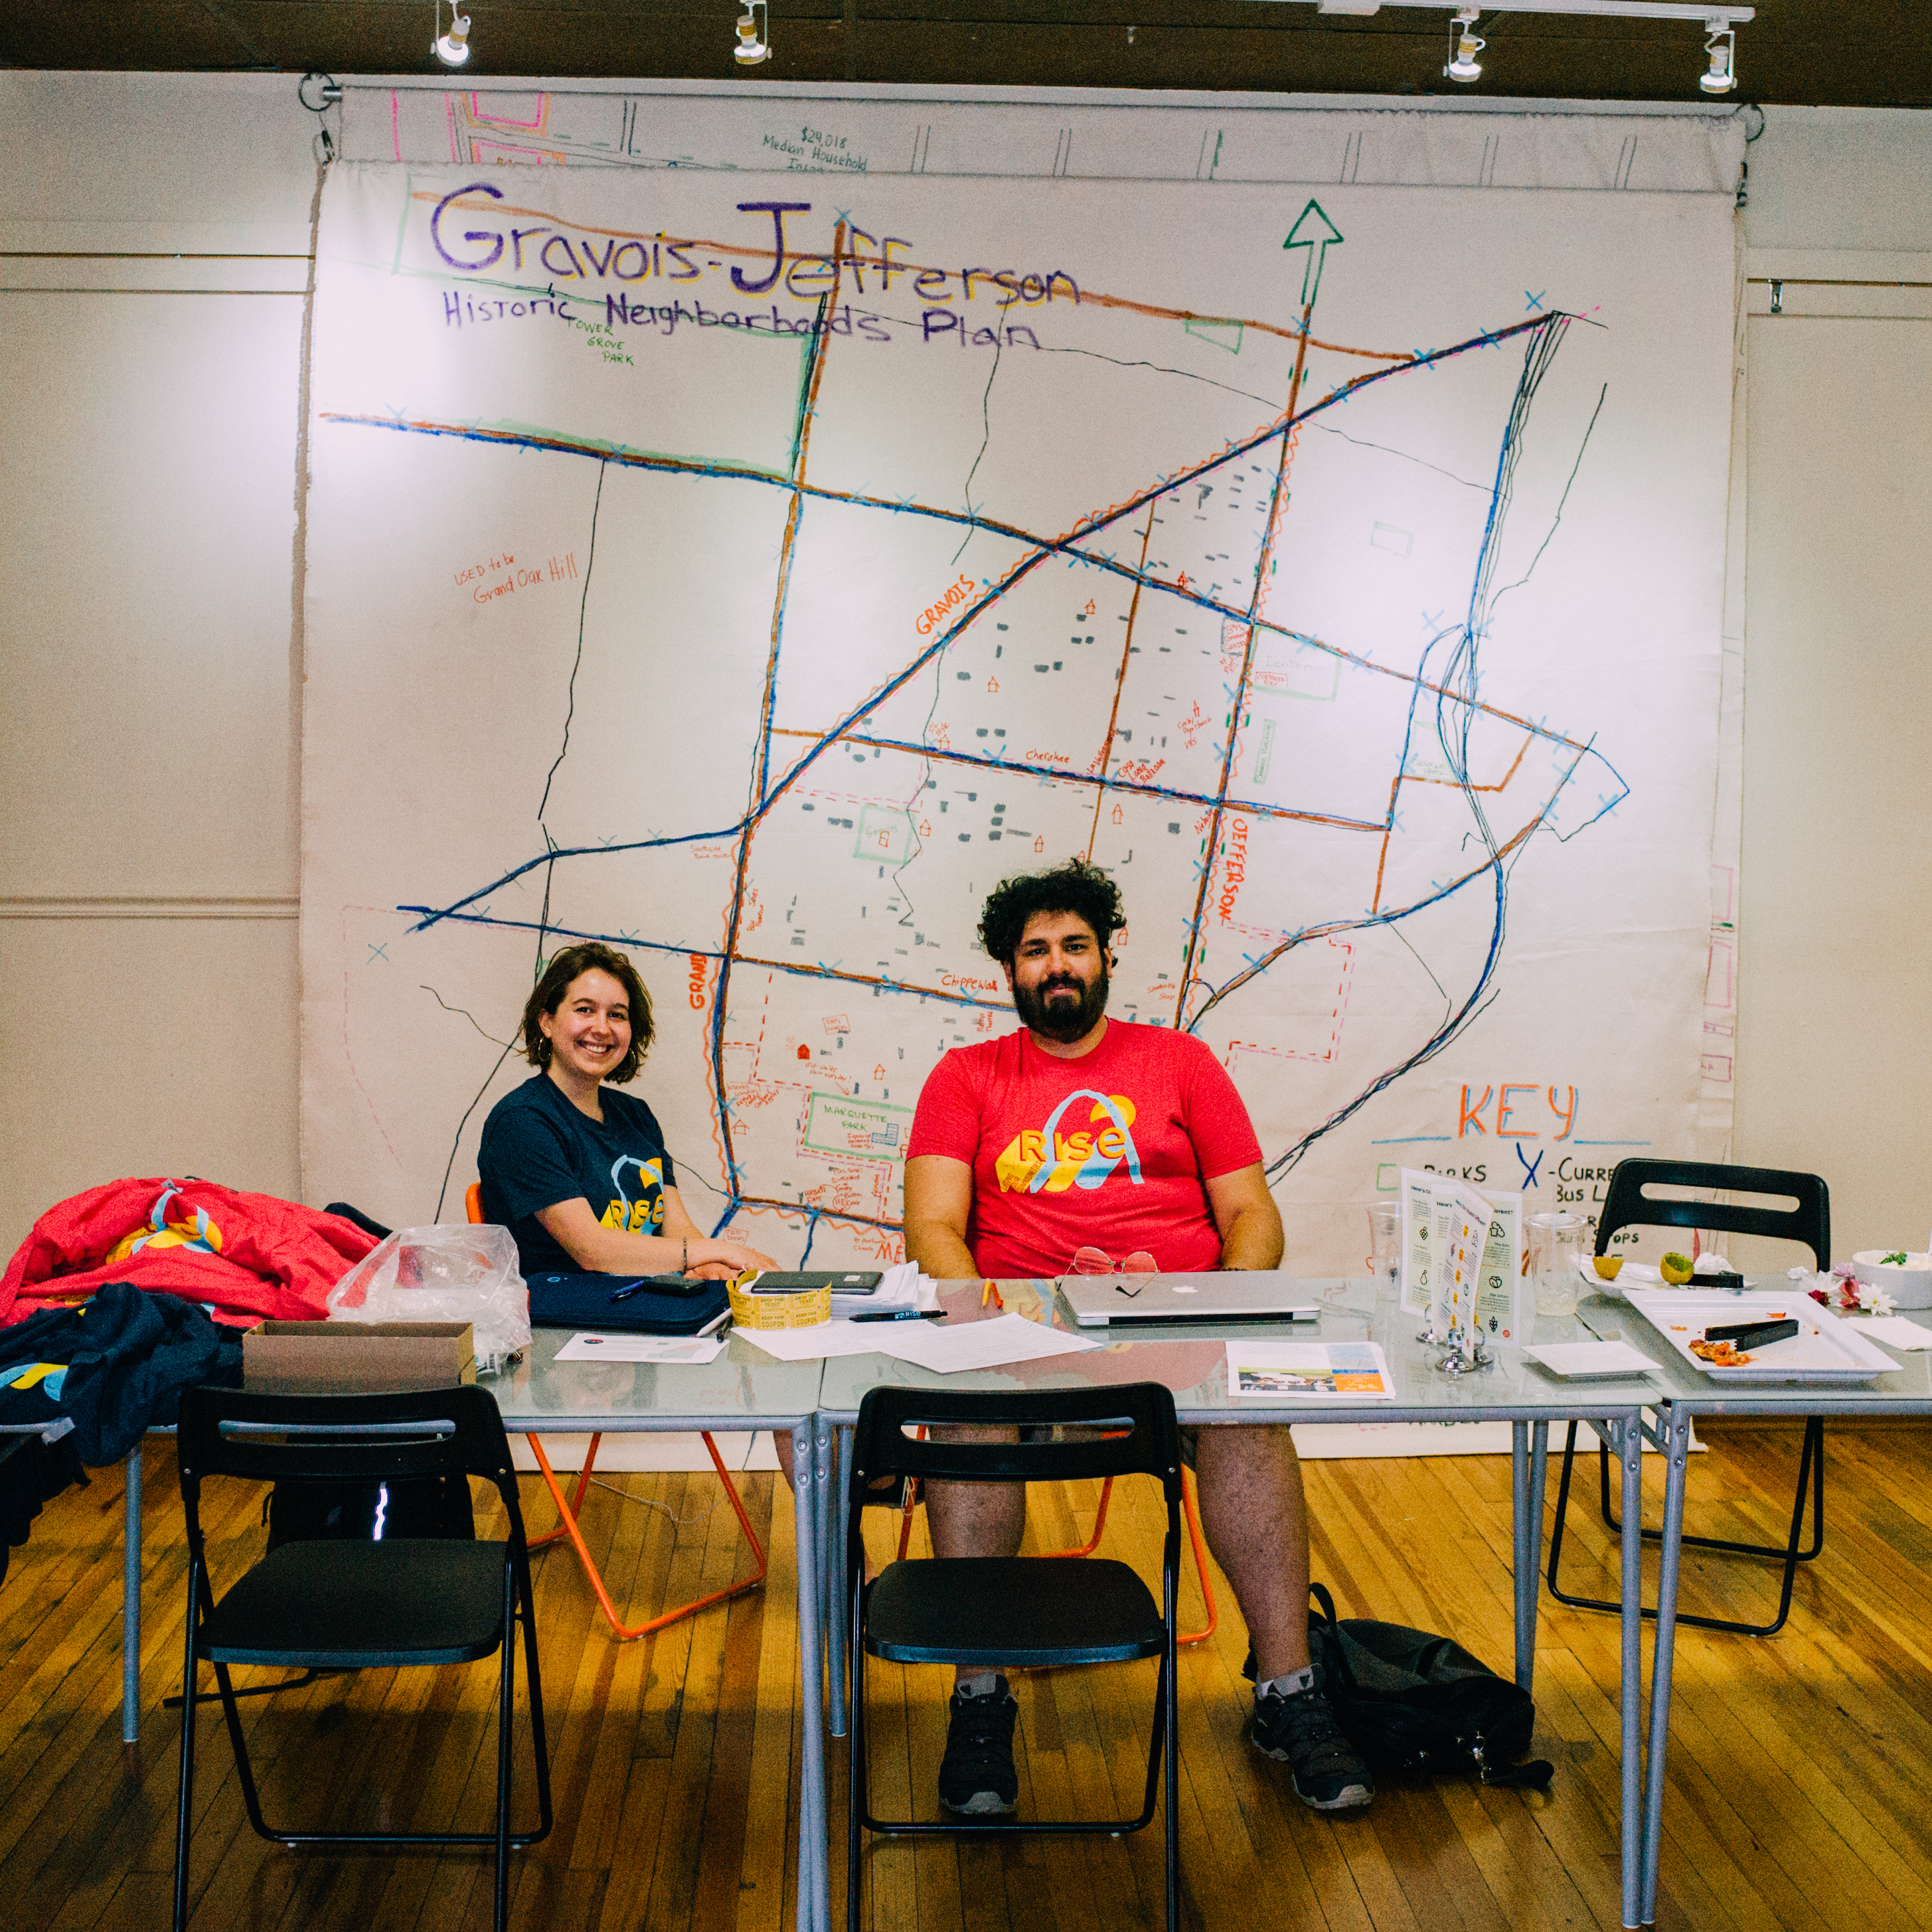
Provide a staffed home base for people to come back to.
Even in the age of communication, physical locations are important.
Notes:
Having a physical location where people can go to and knowing people will answer the phone when called was important. Our base of operations was a restaurant owned by a steering committee member.

Slide 15
Thank you!
Questions, comments, concerns?
johnc@risestl.org
314-333-7017

