Slide 1
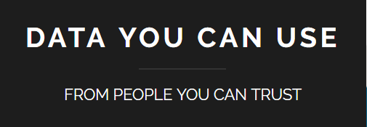
Community Voices in Data Design
Carrie Koss Vallejo
NNIP Spring 2017, Baltimore
Notes:
I’m Carrie Koss Vallejo, I work for the NNIP partner in Milwaukee, Data You Can Use. We recently turned 1 in May, though I’ve been working with some members of this team for several years.
I’m hear to share my experiences with making data profiles for CDBG (Community Development Block Grant Program) neighborhoods in the City of Milwaukee. Our original format has been adopted by additional neighborhoods since their release last September.

Slide 2
Notes:
Data You Can Use has a guiding principal of collecting data that’s relevant to the end users, and reporting findings back to the communities of interest.
We’re a small core team who assist our partners and clients in accessing, analyzing, translating, interpreting and presenting data.

Slide 3
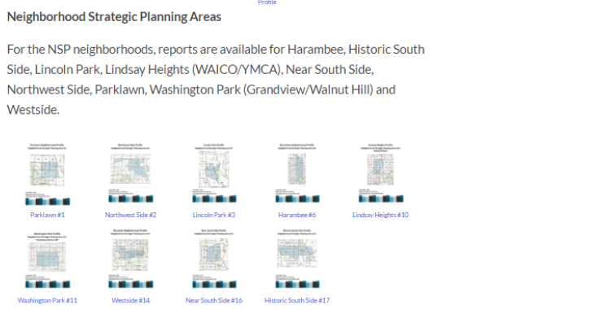
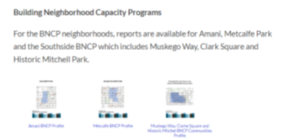
9 original NSP Areas
3 BNCP Profiles
3 upcoming for a local foundation
Notes:
We spent a year working with BNCP neighborhoods to develop profiles that would meet about 80% of their data needs. We have 12 available on our website, with an additional three in progress.
And nine planned, if funding for CDBG areas is included in the next federal budget.

Slide 4
Welcome to Milwaukee
Notes:
Welcome to Milwaukee.
Milwaukee is a city of just under 600,000 people on Lake Michigan, an hour and a half north of Chicago and we have the largest outdoor music festival in the world.
Milwaukee is also known as the most segregated City in the US, based on 2000 Decennial Census data.

Slide 5
Racial Dot Map from the Weldon Cooper Center for Public Service at the University of Virginia.
Notes:
You may be familiar with this racial dot map, which I have zoomed to Milwaukee.
The issue of segregation is so profound that children grow up knowing that different parts of the city look different.

Slide 6
Parklawn:
88.6% Black, 1.0% Latino
Near South Side:
11.1% Black, 71.2% Latino
Notes:
From our reports, here are data points that show the racial differences between two neighborhoods 10 miles apart from one another.
This is a of concern because strong neighborhood demographics are critical for culturally responsive strategic planning and programs.

Slide 7
Nonprofit staff and residents know their neighborhood assets and areas of concern, but may not know how to measure them.
Asset map made with the Nonprofit Center of Milwaukee
Notes:
Staff and residents of the neighborhoods we worked with, which focus on small geographies have in-depth knowledge of their neighborhoods, and strong organizing skills, but lack the skill set to manipulate data to match their custom geographies.
With data assistance, these organizations could use American Community survey data to help in planning, and quantify their observations and neighborhood knowledge.

Slide 8
20,873 vs 598,078
Notes:
This is the population of Harambee, one of the BNCP neighborhoods, compared to the City of Milwaukee.
For CDBGs unable to tailor Census area to their neighborhood, using the city population would set up unrealistic expectations for program effects.

Slide 9
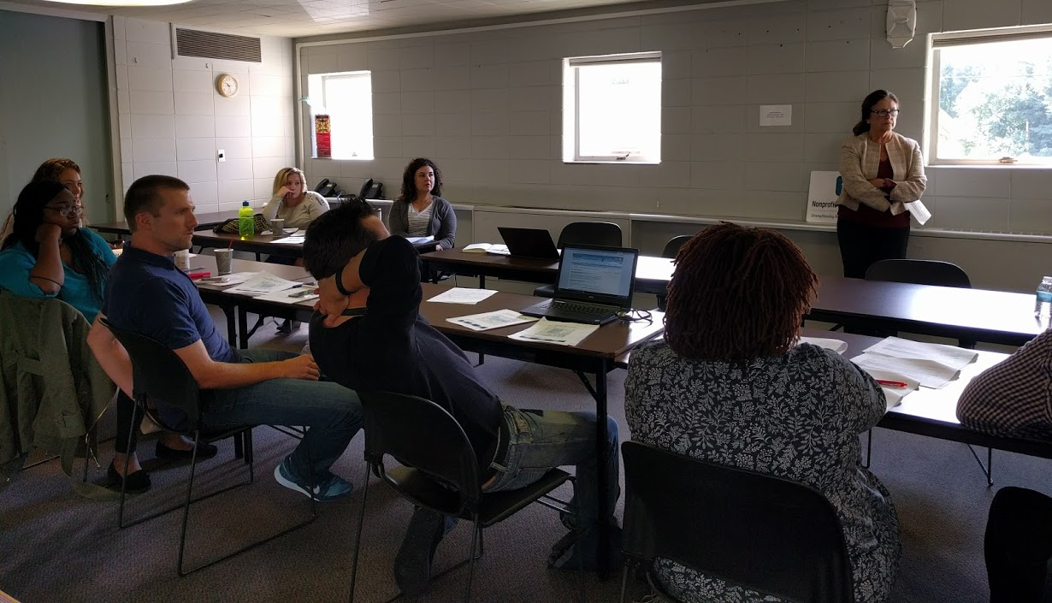
Notes:
The biggest part of my role was to listen to how community organizers wanted to use the data, and make recommendations of what data could fill that need.
Lead pipes were a concern, so we included when housing stock was built, because lead pipe interventions should be targeted at housing built before 1950.

Slide 10
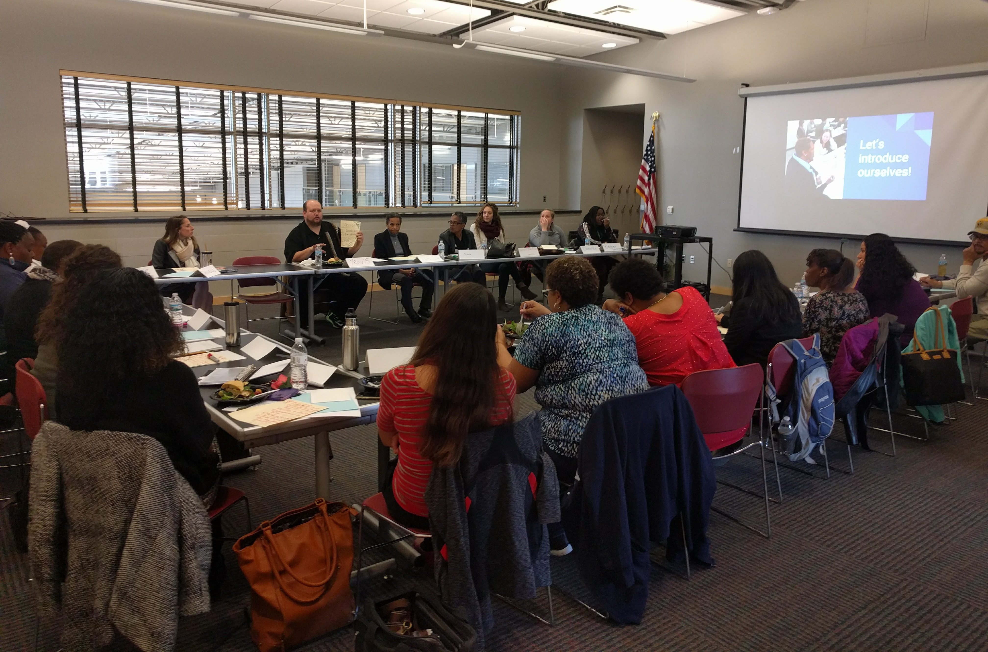
Notes:
Another role as the data advocate was to keep expectations in line for data available at neighborhood level.
A request we couldn’t fulfill, but can advocate in the future, for was # of residents per neighborhood incarcerated.

Slide 11
Suggested data by data team:
Population Sex by Age
Household Characteristics
Educational attainment
Suggested data by community organizers:
Mortgage costs (Mortgage costs for Owner Occupied Housing)
Rental costs (Rent paid by renters)
Notes:
The template began with basic data points recommended by the data team, including population by race and poverty status.
Community organizers gave us additional requests that we were able to accommodate, including mortgage and rental costs.

Slide 12
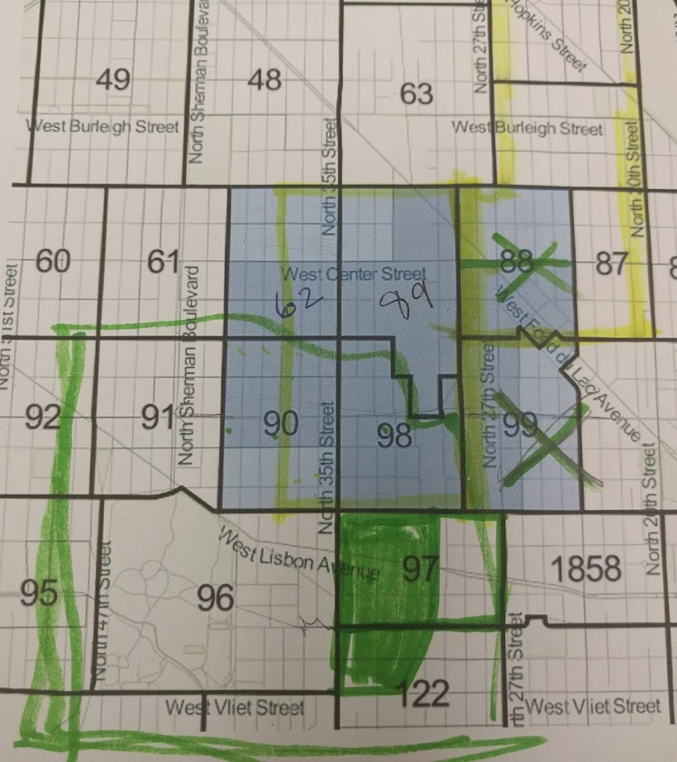
Defining neighborhood areas was sometimes tricky.
Notes:
Our community partners also led in defining the geography to include in their neighborhoods.
These are my notes from a discussion on which Census Tracts to include in a neighborhood report.
The shaded blue area was my recommendation based on rough discussion of streets. Yellow is what we ended up with, and green was a discussion on a neighboring area.

Slide 13
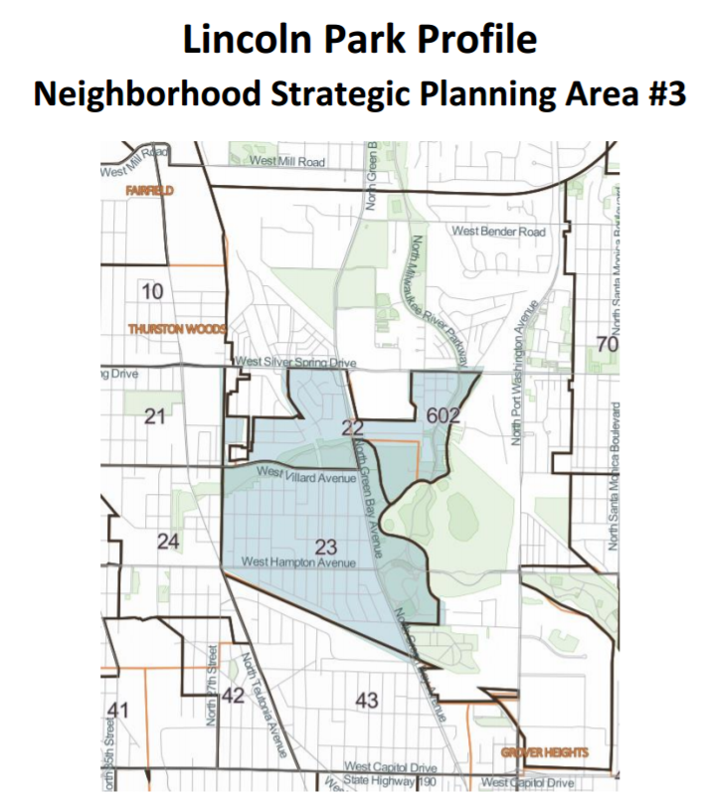
Notes:
This is an example of a rare map where the area of interest, and census tracts aligned perfectly.
In most cases where geography didn’t line up, we gave community partners final say over what to include. This was one method we used to ensure BNCP ownership of data decisions, while helping them to make informed decisions.

Slide 14
Suggestions from the community organizers were very valued by other organizations that opted to create data portraits.
Notes:
Data points like mortgage and rent costs suggested by our community experts were frequently cited as the most interesting by other community members looking at the reports.

Slide 15
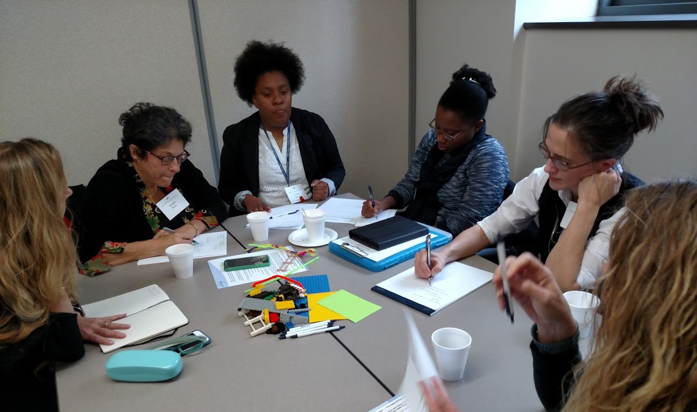
Notes:
In most cases, the data in the completed reports validated CDBG staff and resident experiences, or was within their expectations for the neighborhood. But having actual statistics was helpful to the neighborhood organizers.
In some cases, the context that neighborhood organizers were able to provide to the neighborhood statistics was stunning to our data team.

Slide 16
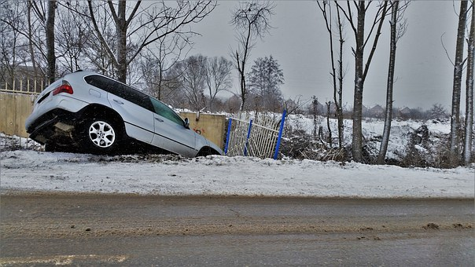
Notes:
Ex: one organizer shared that the data on vehicles looked correct for her neighborhood but it didn’t share the entire story.
Her own household technically had two cars, but one was uninsured (making it illegal to drive in Milwaukee), and the other was on blocks.

Slide 17
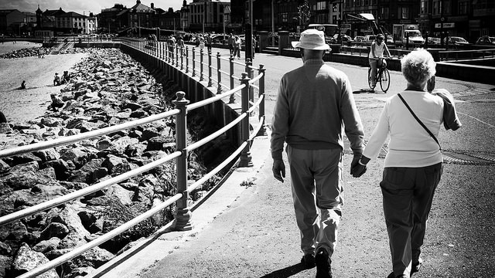
Notes:
There was another insight that directly effected an agency that had been discussing hosting a GED program in house. The data showed that the highest segment of their population with less than a high school diploma was over 65.
Educational attainment for younger groups, at whom GED programs are usually targeted was notably higher.

Slide 18
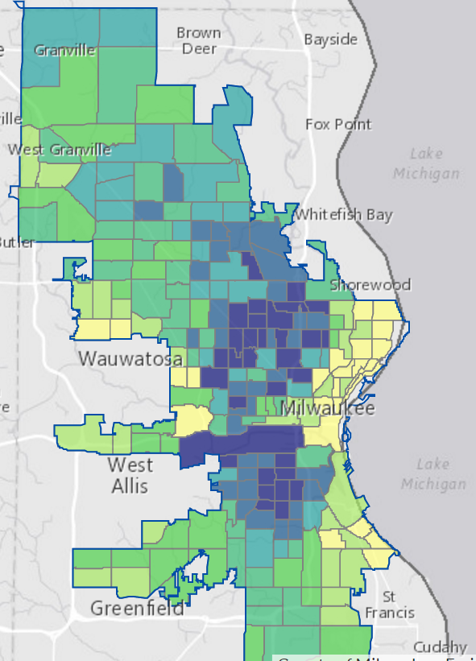
Improving the
data portraits
Notes:
Another expansion we are planning to include is newly available health data at the census tract level from 500 Cities.
For example, this map of model-based estimates for no leisure-time physical activity among adults aged >=18 years.

Slide 19
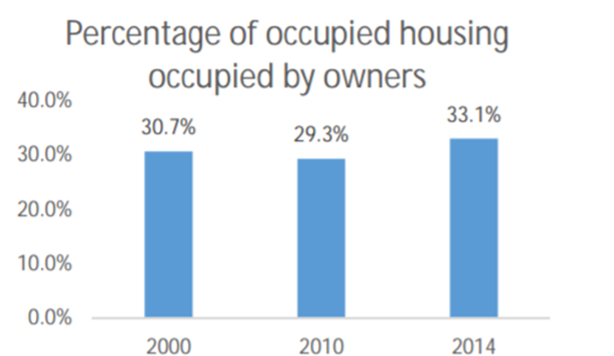
Metcalfe BNCP Profile
Notes:
Other improvements we’re included are adding tailored data appendices that match the goals of the agency.
For instance, the agency that works in this BNCP (Building Neighborhood Capacity Programs) is doing work to support owner occupancy in the area, and wanted to look for more historical data than was included in the format of the original reports.

Slide 20
Thank you to the supporter of the original profiles:
Staff of NSP organizations who attended planning meetings:
Members of the data team;
Dr. Virginia Carlson and Dr. Kathleen Pritchard

