Slide 1
Community Informed Development
Steven Saylor

Slide 2

Western Pennsylvania Regional Data Center
www.wprdc.org

Slide 3

Western Pennsylvania Regional Data Center
We have plenty of data from various publishers….
Notes:
220+ datasets

Slide 4
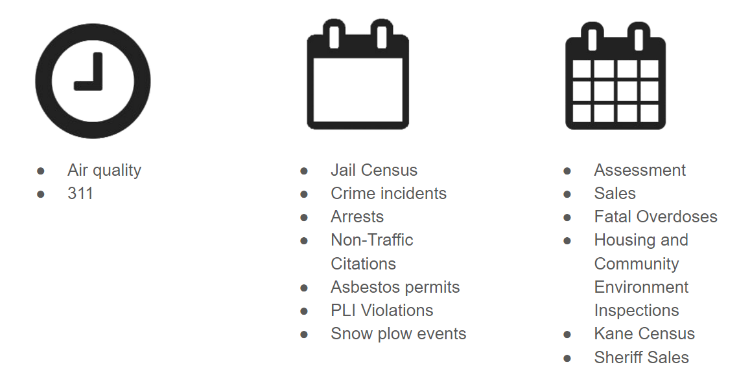
Western Pennsylvania Regional Data Center
…that we collect at varying frequencies.
Notes:
Talk about our ETL

Slide 5
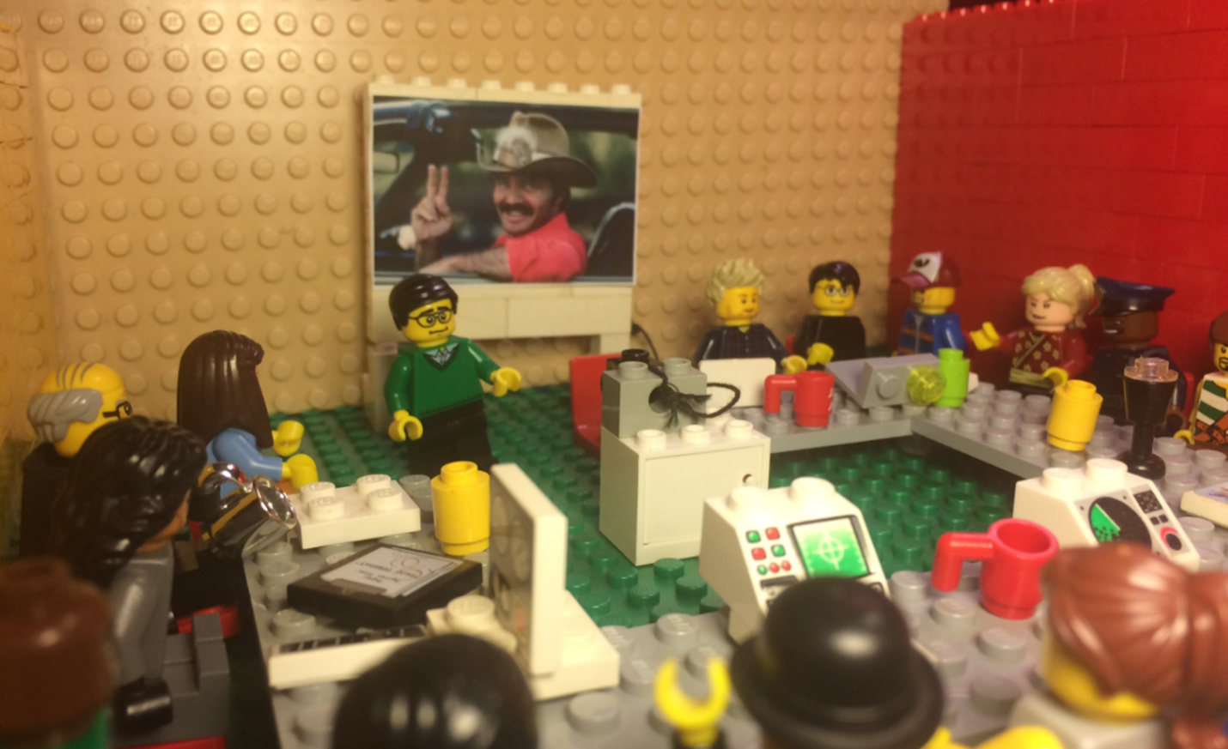
Property Data User Group

Slide 6
Property Data User Group
What problems do users have with accessing the data?
What do our users currently do to solve these problems?
Do current tools seem like they’d be useful?
Notes:
Property data tends to be in large datasets and different data is in different datsets - not easy to quickly pull what you need

Slide 7
Property Data User Group
What problems do users have with accessing the data?
What do they currently do to solve these problems?
Do current tools seem like they’d be useful?
Notes:
A whole bunch of manual data processing - isn't’ great when data changes often.

Slide 8
Property Data User Group
What problems do users have with accessing the data?
What do they currently do to solve these problems?
Do current tools seem like they’d be useful?
Notes:
NYC PlutoPlus, Philly Property Dashboard

Slide 9
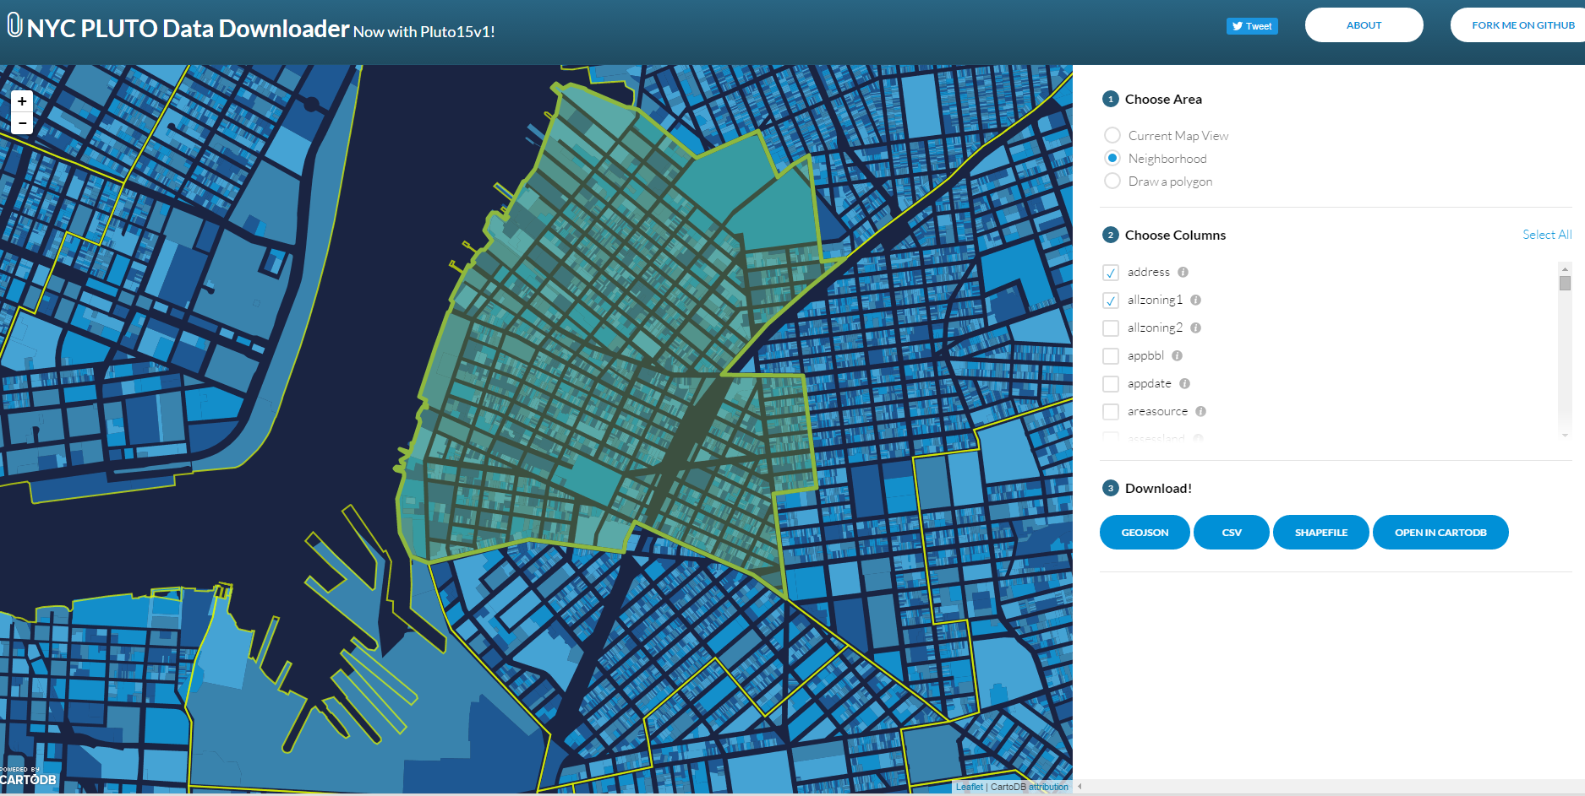
Pluto Plus
http://chriswhong.github.io/plutoplus/

Slide 10
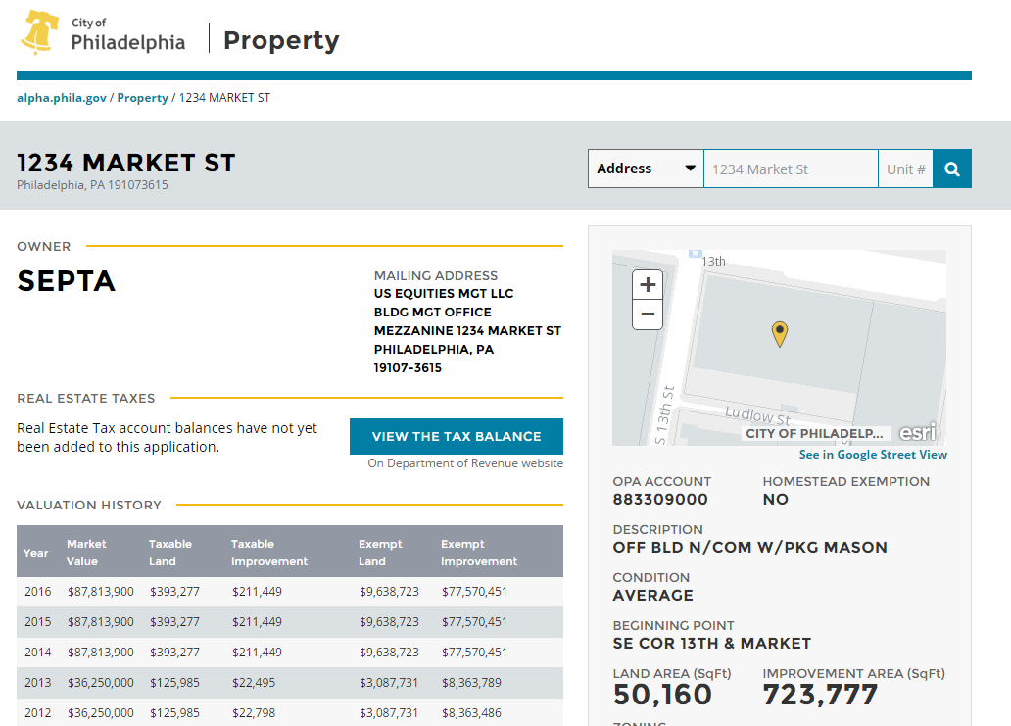
Philadelphia’s Property Dashboard
https://alpha.phila.gov/property/

Slide 11
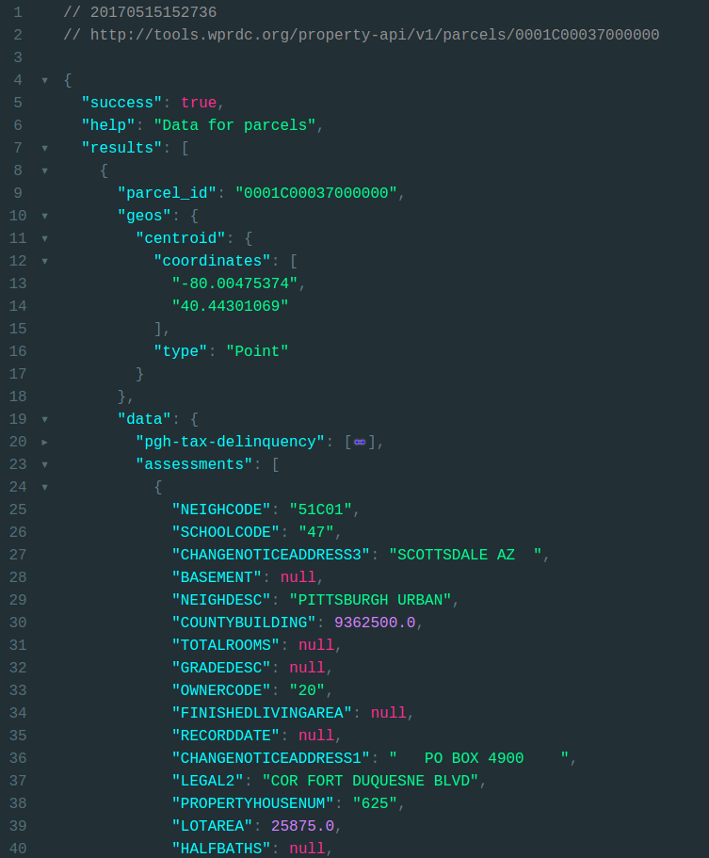
Property Data API
Join all property data.
Make all data that for one property available at one place.
Pulled directly from Data Center.
Notes:
All in one place, up to date
Standardize dataformats (headings, types) for similar data across administrative organizations (different cities, boroughs, townships)

Slide 12
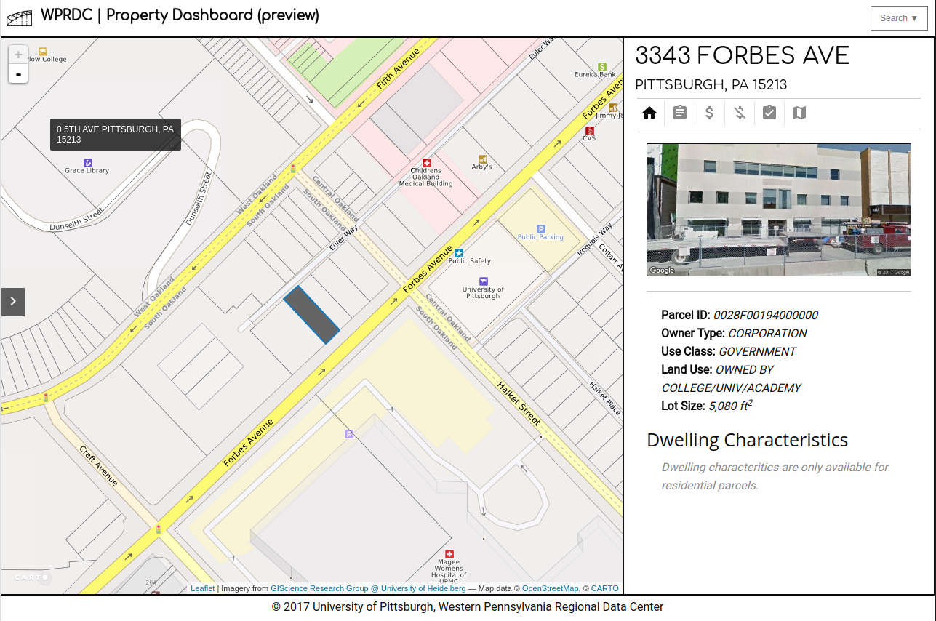
Property Dashboard
All available data for a property.
Select property on a map or...
Search by address or parcel ID
https://tools.wprdc.org/property-dashboard
Notes:
Pretty version of Property API data
It’s up to date!
…

Slide 13
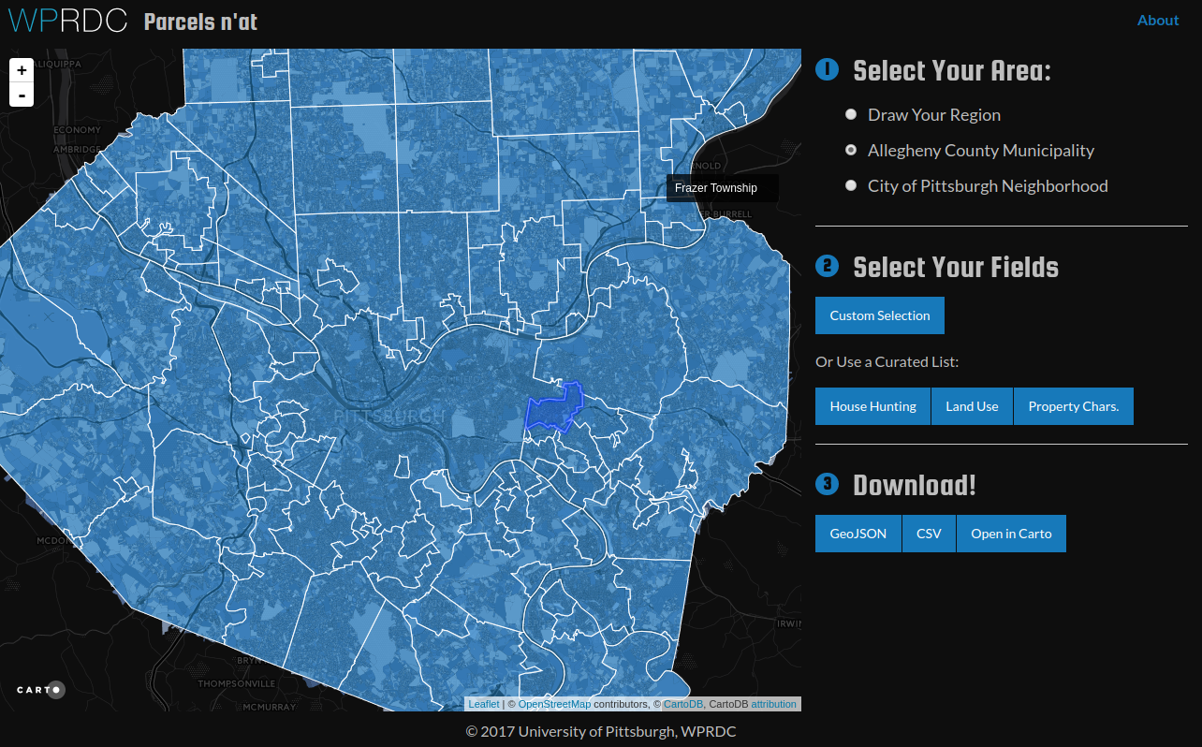
Parcels n’at
Select a region
Select fields
Get data!
https://tools.wprdc.org/parcels-n-at
Notes:
Collect aggregate data from property api

Slide 14
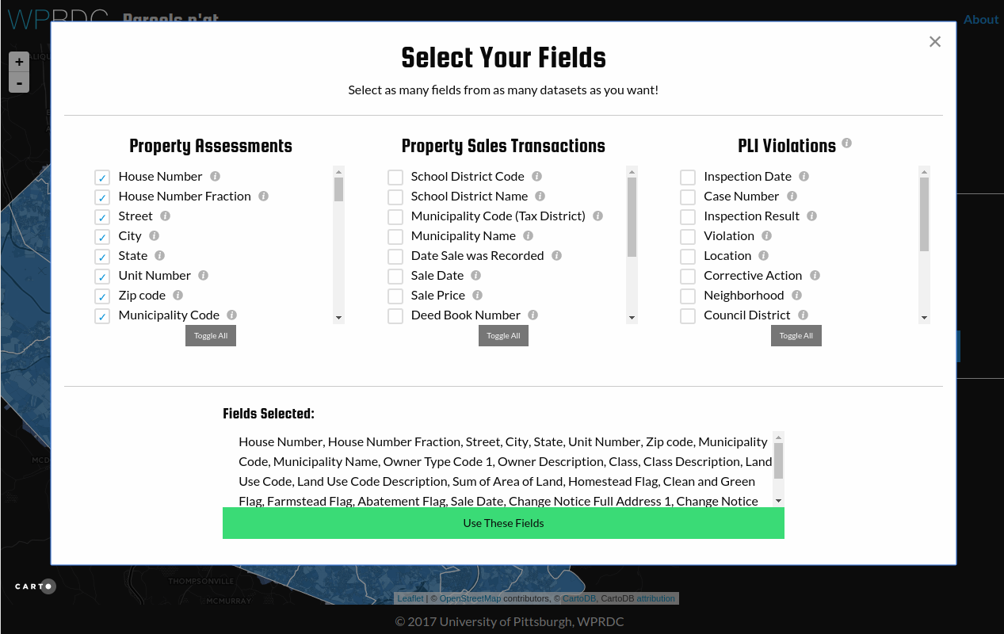
Parcels n’at
Select a region
Select fields
Get data!
https://tools.wprdc.org/parcels-n-at

Slide 15
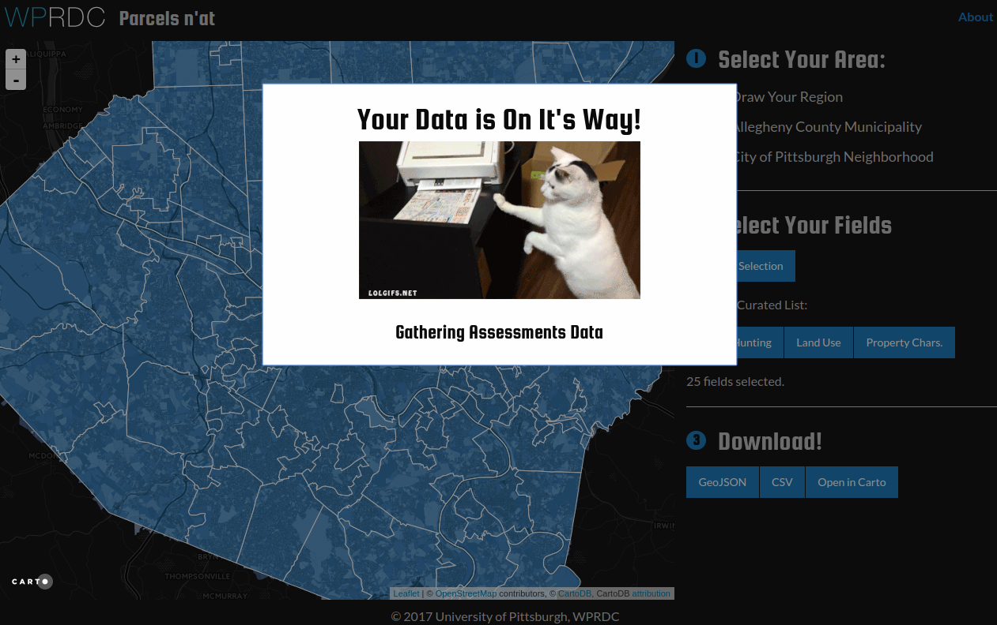
Parcels n’at
Select a region
Select fields
Get Data!
https://tools.wprdc.org/parcels-n-at

Slide 16
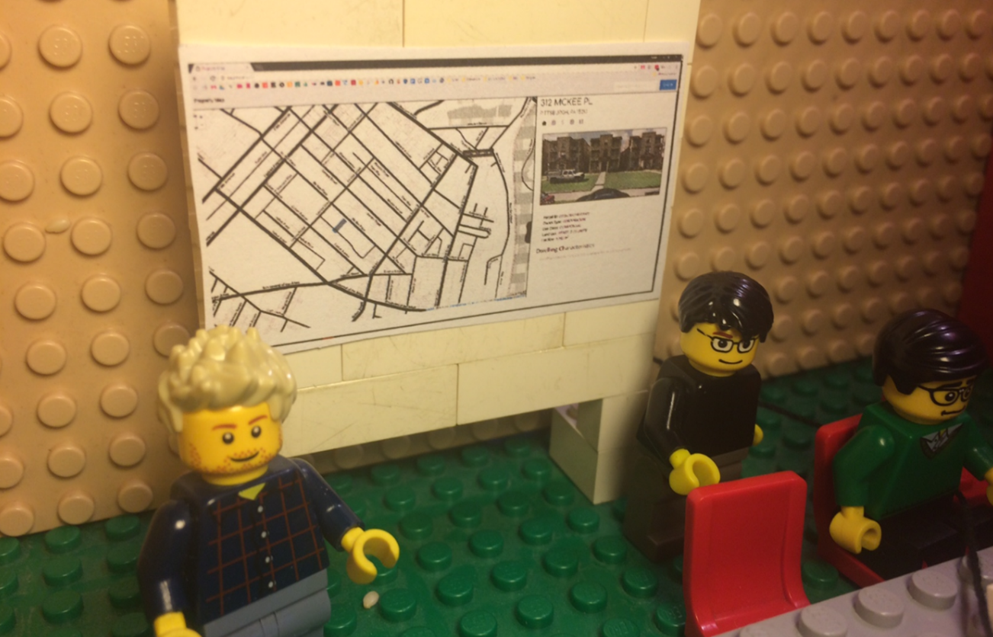
Property Data User Group pt 2, The Regroupening
Preview of new tools.
Group discussion and feedback.
Feature prioritization exercise.
Notes:
Showed of both of the tools and explained the API.

Slide 17
Data User Group pt 2, The Regroupening
Demonstrate preview of new tools.
Group discussion and feedback.
Feature prioritization exercise.
Notes:
Left room for questions.

Slide 18
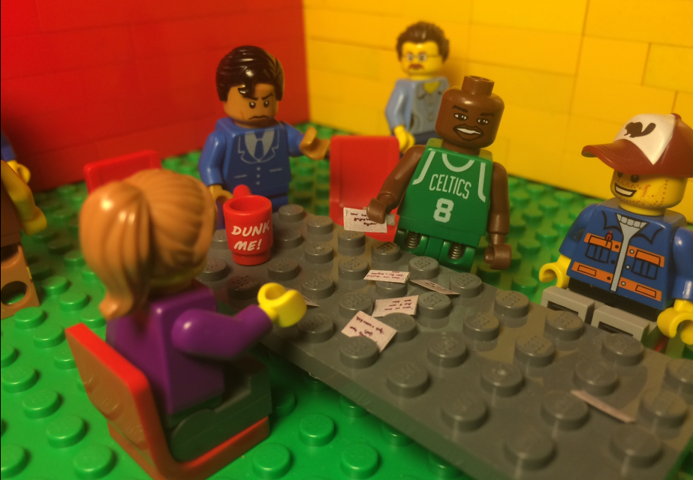
Data User Group pt 2, The Regroupening
Give preview of new tools.
Group discussion and feedback.
Feature prioritization exercise.
Notes:
Card sorting exercise.
We provided potential features and had them rank them into 3 groups. - could write own. “Cats at FAX machines” was sadly generally put in ‘C’.

Slide 19
Going Forward
Continue to develop features based on community’s priorities.
Iterate on these products again at the next property data user group meeting.
Use this process for other tools and datasets.
Notes:
Primarily as we bring in data from administrative bodies outside the city and county
Traffic, crime, you name it!

Slide 20
Contact Me
Steve Saylor
steven.saylor@pitt.edu
412-383-9048
www.wprdc.org

