Slide 1
NNIP Participation Scorecard & Partners Guide to the Network
ROB PITINGOLO
May, 2017
Notes:
Good morning.
I’m going to talk briefly about participation in the NNIP network and introduce a new report that we’ve created to track metrics of participation for each partner organization in NNIP.

Slide 2
There are Many Ways to be Participate in the Network
Source: Martin & Gradeck, 2015
Notes:
Here is the Venn diagram that Shiela and Bob developed to show the different ways that to participate in NNIP.
Some of these are easy for us to track at HQ, but many are things that we don’t always know are happening.
We are developing a system for self-reporting, but please let me know if you have any ideas or feedback.

Slide 3
The NNIP Outstanding Network Steward Award
Introduced in Cleveland last year
Awarded for the first time yesterday
Congratulations to our first winner Erica Raleigh!
Health
Vital Stats
Crime
Housing
Notes:
Yesterday we had our first award session and awarded Erica Raleigh with the first Outstanding Network Steward Award.
We want to make sure that partners are being recognized when they go above and beyond the expectations that are set out for every NNIP partner.

Slide 4
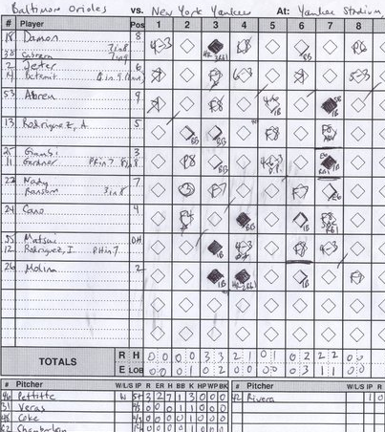
NNIP Participation Scorecard Started After 2012-13 Assessment
“Keep a scorecard on how partners participate, and remind them of their obligation. Point out the opportunity cost to the network of having members who don’t participate in meetings, webinars, and website updates.”
-Auspos 2014
4
Notes:
One of the recommendations from the assessment was to create a ‘scorecard’ to keep track of how partners participate.
This could also be used to measure the opportunity cost to the network when they don’t attend meetings or update the website.

Slide 5
Scorecards Help Hold Partners & NNIP HQ Accountable
Scorecards are distributed privately, no information is shared
Partners can see where they are best fulfilling the expectations of NNIP partnership
NNIP HQ can evaluate how well the network is doing as a whole
5
Notes:
The information on the scorecards isn’t shared with other NNIP partners. It serves the purpose of helping both the partner organization and us.
Partners can see how well they are doing as far as their expectations for NNIP membership and where they can improve.
At HQ we can see how the network is doing as a whole, and help step in if there are areas where we can help improve things.

Slide 6
Reviewing Your Scorecard
Emailed to partner staff earlier this week
Tracking on five primary metrics
Please ask questions if you have any
Feedback is always accepted and appreciated
Health
Vital Stats
Crime
Housing
Notes:
Like I mentioned before, the scorecards were sent to you earlier this week. Please let me know if you think you should have gotten one and didn’t.
We introduced this for the first time last year, but as always, feedback is welcome so that we can improve it for the future.

Slide 7
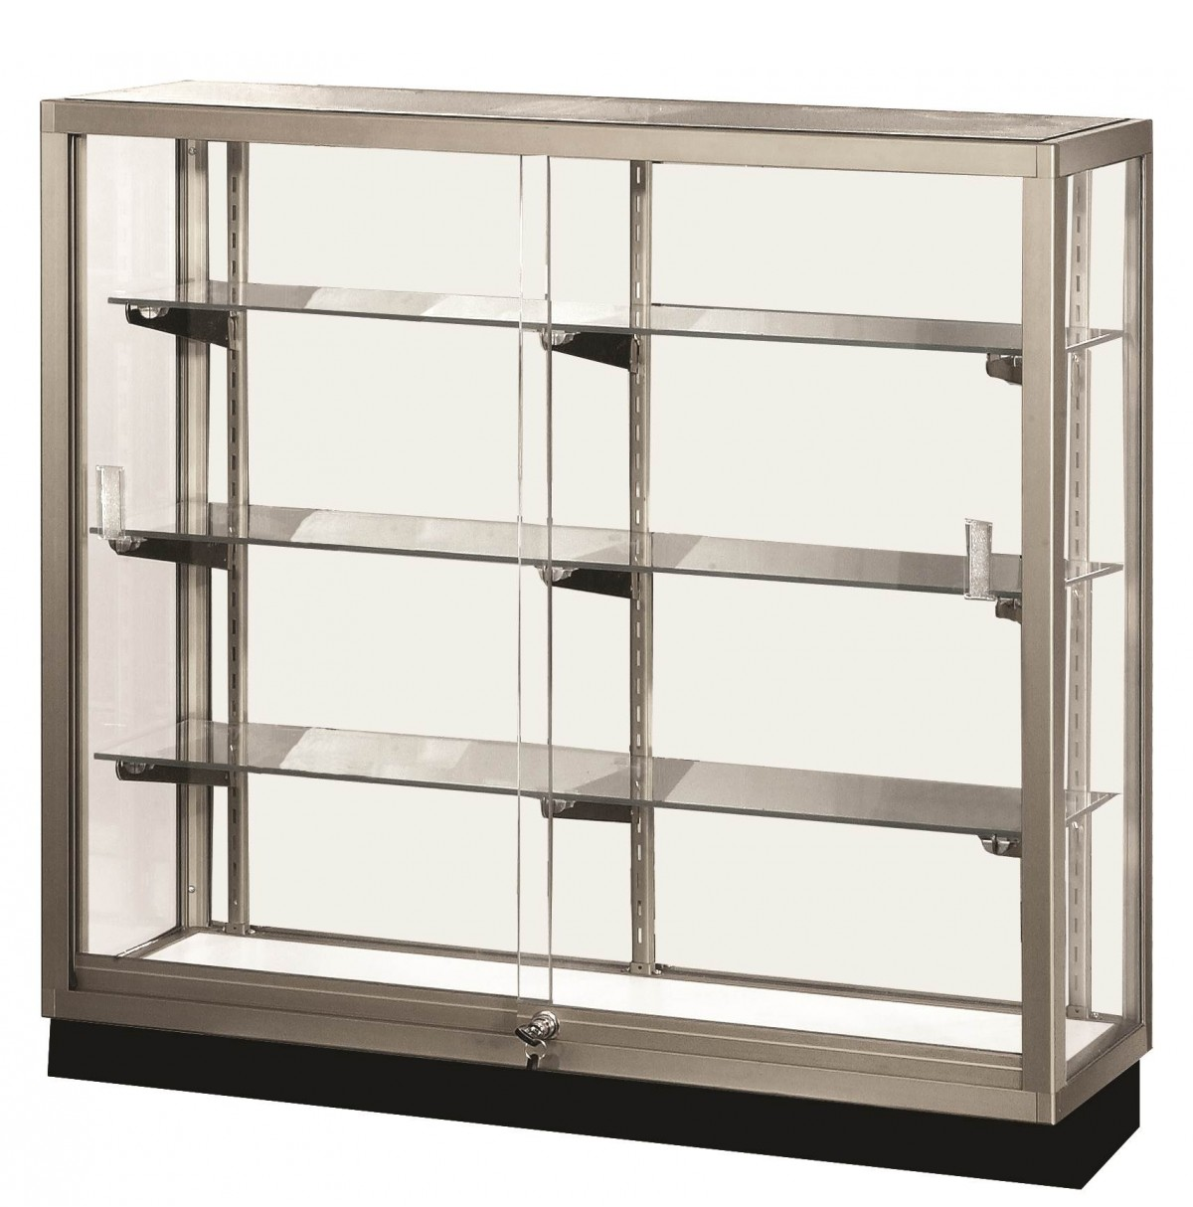
Participation Report Components
Meeting Attendance
Data Inventory
Website Updates
NNIP Logo Badge on Website
Idea Showcase Attendance
Notes:
Here are the components of this version of the report.
Do you attend these meetings?
Do you update the NNIP website on a regular and timely manner?
Do you keep your data inventory up-to-date?
Is the NNIP logo badge on your website?
Have you attended an Idea Showcase webinar?

Slide 8
Partner Meeting Attendance
Notes:
Meeting attendance is one of our strongest participation metrics.
We have 29 partners here in San Antonio. We’ve average around 27 partners at each meeting.

Slide 9
Display NNIP partner badge on your own website!
Notes:
Great example from Rise.
This is such low hanging fruit. Logos are available on the NNIP website. You just need to make sure it’s posted on your own website.

Slide 10
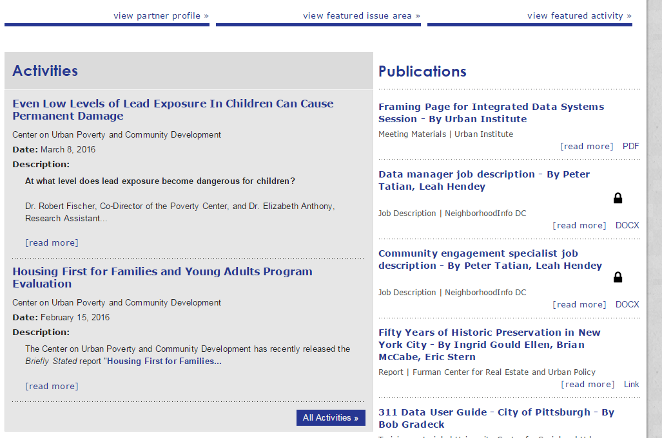
Update the NNIP website
Notes:
Partners are expected to update the NNIP website every quarter.
It’s a great way to show off the work you’re doing and help other partners keep up.

Slide 11
Maintain data inventory
SNIP Stats:
Range: 0-10
Mean: 4.2
Median: 5
Overdue (4)
Up-to-date (28)
11
Notes:
Partners are expected to update their data inventories once per year. The most recent happened last fall before the Cleveland meeting.
Here are the SNIP numbers, they will be even better once all partners are up-to-date on their inventories.

Slide 12
Coming Soon: Quarterly Stewardship Surveys
Based on feedback from our first stewardship award
Every quarter we will ask you to submit examples of outstanding stewards
Health
Vital Stats
Crime
Housing
Notes:
We hope that you’ll consider nominating a partner for this award next year.
We are happy to accept nominations at any time, but there is a cut-off. Please keep an eye on the listserve for that.
You can nominate multiple people if you believe they are deserving of the award.

Slide 13
Introducing the NNIP Partners Guide to the Network
Designed to help new partner organizations & new staff at partners
New staff can learn about the network and how to get involved
NNIP Guide
Health
Crime
Housing
http://www.neighborhoodindicators.org/partnersguide
Notes:
We’re very excited to announce that we just published our NNIP Partners Guide to the Network on the NNIP website.
This was a long time in the making, we now have a comprehensive set of information for new partner staff and organizations.

Slide 14
What You Will Find in the Guide
Who is NNIP?
Expectations of NNIP Partners
How to Participate in the Network
NNIP HQ Staff Contact Information
Communications Channels
NNIP Branding
Procedures for New Partner Staff
Procedures for New Organizations
Health
Crime
Housing
Notes:
Here’s what you’re expect in the guide.

Slide 15
Thank You!
Rob Pitingolo
rpitingolo@urban.org

