Slide 1
“Beyond the Hedges”
Notes:
How can a great city and a great university inspire and support each other?
Rice V2C2: Extend Rice’s Reach and Impact; Engage Houston and Empower Its Success

Slide 2
Beyond the Hedges
Dissemination Plan and Community Methods
Why Esri Story Maps
Pros and Cons
Best practices
Examples
How you can make one yourself
Q & A

Slide 3
Dissemination Plan
Goal: Sharing the results with the appropriate audience in the right way.
Identify the appropriate audience for a particular study
What’s the most appropriate methods of dissemination
Identify potential barriers
Notes:
Researchers are asked to consider how the results will be disseminated and used from the beginning of the project.
A dissemination plan will help guide the research process and keep the researchers focused on the project goal.

Slide 4
Communication Methods
Within the hedges (academic community)
Publication in journals
Poster presentation
Presentation at professional conferences
Book chapters
Printed reports
Beyond the hedges (community-based research)
Research briefs; Policy briefs
Rollout event; Presentation at community meetings and meetings with stakeholders
Websites with maps and other data visualization products
Blog post, Newsletters
Media coverage, press release, updates on social media
Videos, Podcasts, Webinars
Notes:
As a local data intermediary, if we don’t know the best way to share the results and spread the information, we might not be able to achieve our mission.

Slide 5
Primary benefits | Create Awareness & Gain Exposure | Build networks and seek collaboration | Increase readership | Facilitate data use
Research briefs | x
Press releases, media coverage | x | x | x
Institutional newsletters | x | x | x
Rollout event, Webinar | x | x | x
Social media | x | x | x
Blogging | x | x | x
Videos, Podcasts | x |  | x | x
Maps, storyboard | x |  |  | x
Data dashboard | x |  |  | x
Data portal | x |  |  | x
Notes:
Resource Links
https://depts.washington.edu/ccph/pdf_files/CARE_Dissemination_Strategies_FINAL_eversion.pdf

Slide 6
Esri Story Maps:
Why storytelling is important and powerful
Goal:
Distributing urban data to wider audiences;
Expanding the language of urban discourse
The tool enables GIS professionals to interpret data for lay person and empowers the public to use maps to tell place-based stories.
Notes:
https://storymaps.arcgis.com/en/

Slide 7
Process
Research topic areas
Analyze data
Select results to present
Create story map
Conduct user tests
Finalize product
Notes:
http://proceedings.esri.com/library/userconf/proc17/papers/315_331.pdf

Slide 8
Pros and Cons
Pros
Combining interactive maps, multimedia content and narratives
Great aesthetics
Easy to use
Intended for public
Cons
Frame size and styling
Limited design template
Some restrictions embedding into website
Notes:
Story Map apps are open source, so styling changes could be made beyond what the tool currently offers.
Train students to do it

Slide 9
Apps
Story Map Tour: photos or videos linked to a map.
Story Map Journal/Cascade: an in-depth narrative organized into sections in a scrolling side panel or full-screen scroll
Story Map Series: tabbed layout; side accordion layout; bulleted layout
Story Map Crowdsource: publish a story to which anyone can contribute photos with captions.
Story Map Swipe: compare two maps and see data patterns or change over time.
Story Map Spyglass: et your users peer through one map with our spyglass tool to see another map. Great for before and after maps.
Notes:
http://proceedings.esri.com/library/userconf/proc17/papers/315_331.pdf

Slide 10
Best practices
Connect with audience
An engaging title
Visual appeal
User experience
Choose basemap wisely
Less is more
Adding Google Analytics to your Story Maps
Notes:
Give Credits
Resource link: https://developerscorner.storymaps.arcgis.com/tagged/best-practices

Slide 11
How you can make one
Low cost: online resources and training materials
Online tutorial: https://storymaps.arcgis.com/en/app-list/map-tour/tutorial/
Online lesson: https://learn.arcgis.com/en/projects/get-started-with-story-maps/lessons/create-a-photo-map-tour.htm
Low effort: no coding required
Open source
Resource code at GitHub: https://github.com/Esri/storymap-tour/
Developers’ Corner: https://developerscorner.storymaps.arcgis.com/
Notes:
Story Map apps are open source, so styling changes could be made beyond what the tool currently offers.
Train students to do it

Slide 12
HCDC Gallery & Featured Products
Cascade: Mapping Houston Development; Kinder Houston Area Survey; Hurricane Harvey; Community Bridges Program
Story Map Series: Disparate City; Community Tabulation Area
Swipe: Taking Stock
Notes:
http://www.datahouston.org/gallery.html

Slide 13
Kinder Houston Area Survey
 | Create Awareness & Gain Exposure | Community Engagement | Facilitate data use
Reports
Presentation
Topline survey results
Press release
Media coverage
Google spreadsheet
Storyboard
Data portal
Notes:
History: Reports
Reports, data, presentation
Report + Presentation + Data + Story map

Slide 14
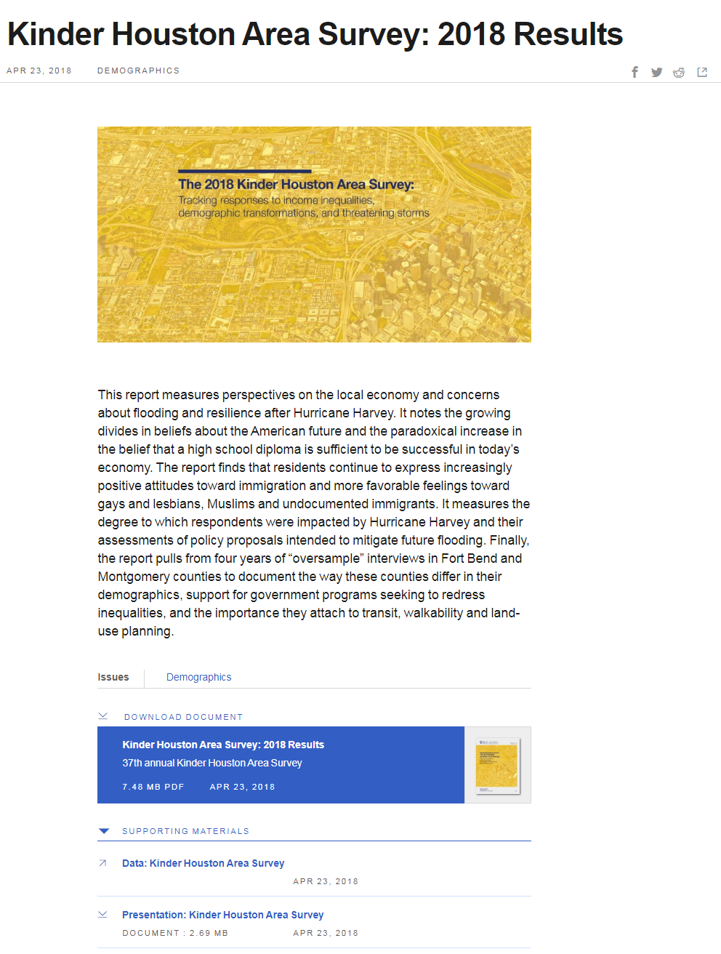
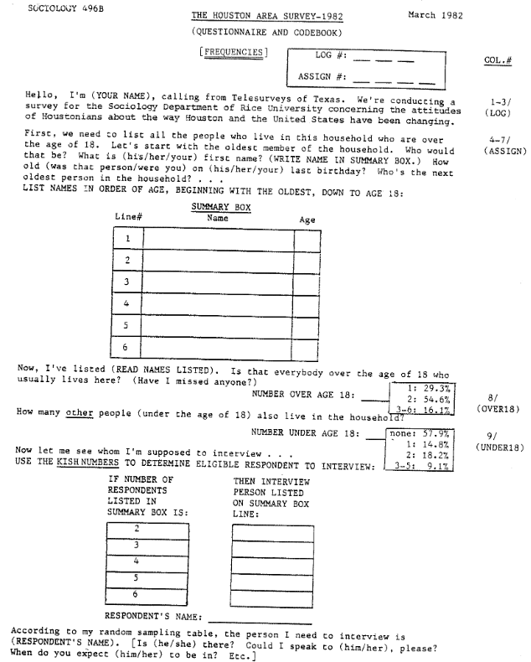
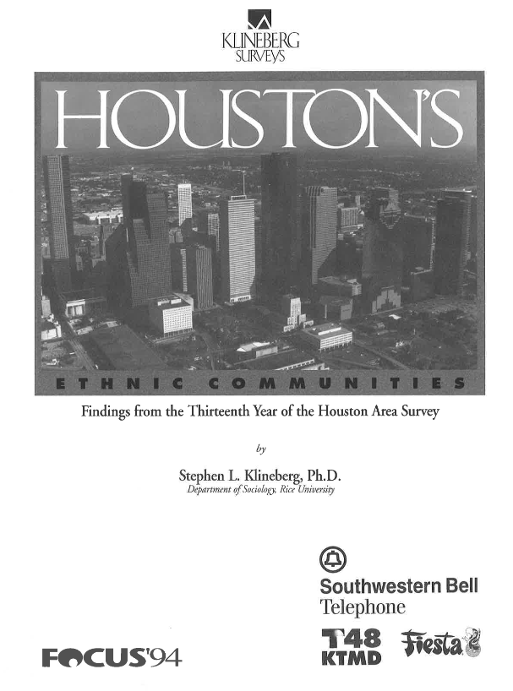
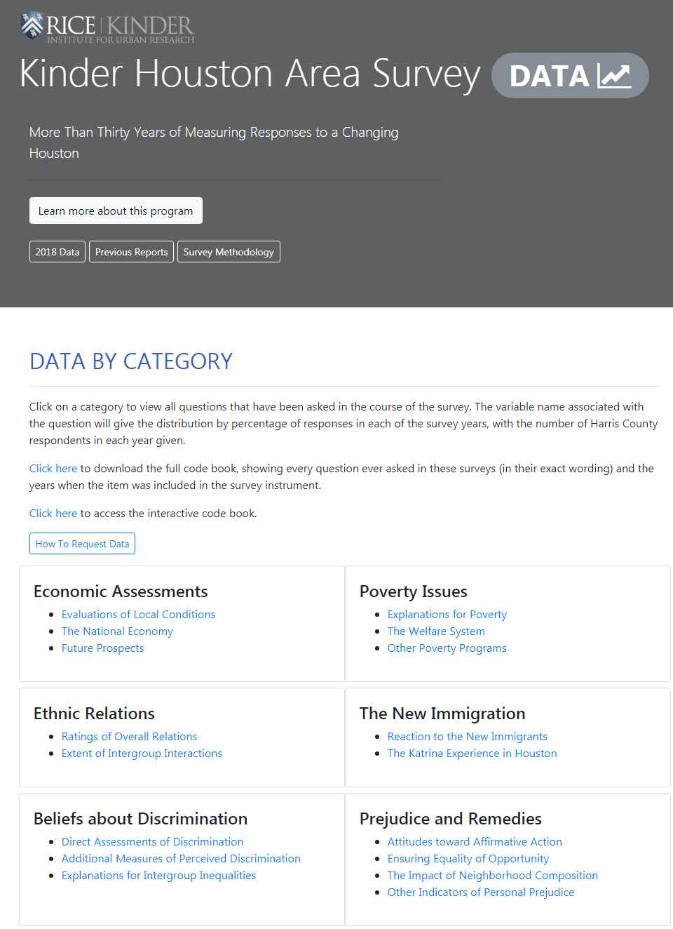
1982
1994
2018
Printed Report: Download (PDF)
Presentation: Download (PDF)
Press Release
Data: datahouston.org/khas
Story Map

Slide 15
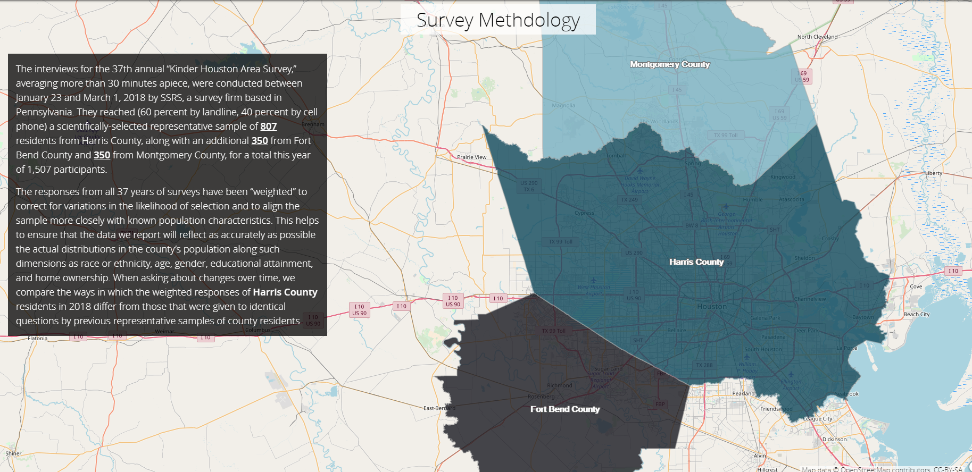
Kinder Houston Area Survey

Slide 16
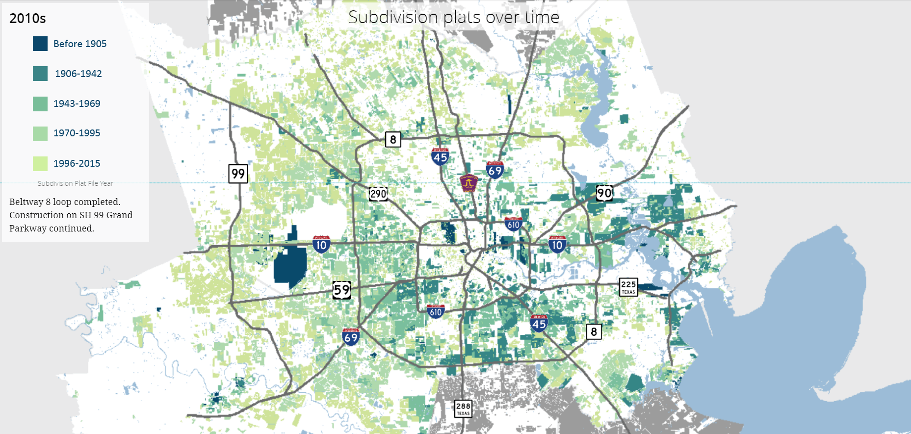
Mapping Houston Development

