Slide 1
DIY Data Viz
Laura Simmons
UNC Charlotte Urban Institute
May 11, 2018

Slide 2
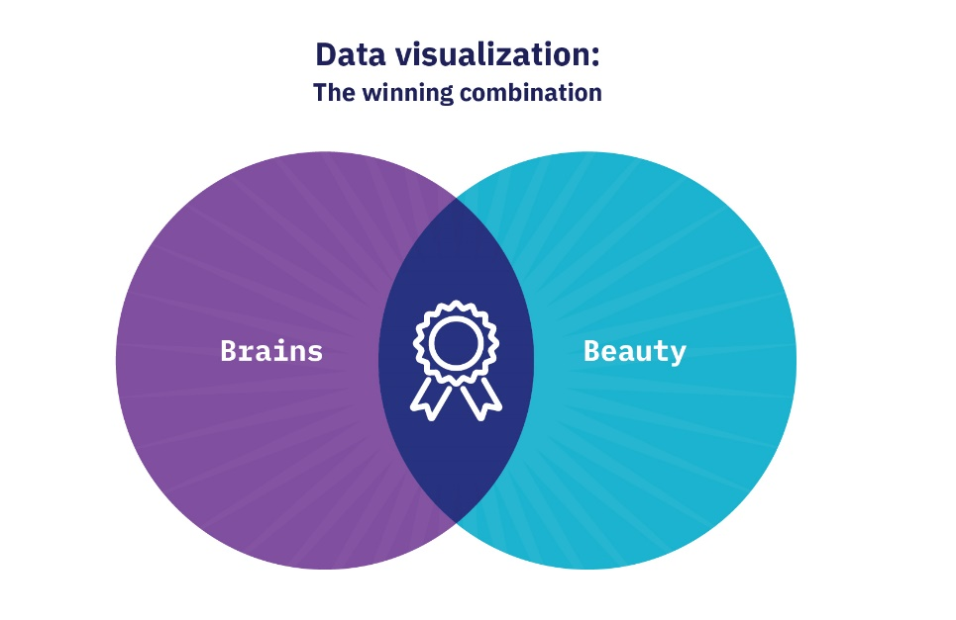
Notes:
Why I’m talking to you about this:
I do a fair amount of data viz in my job
Embeded in reports, presentations, or web articles
Or standalone like what I’m going to talk about today
It’s one of my favorite aspects of my job- love the challenge of looking at a dataset and figuring out the best way to visualize it
Do a good deal of reading on the subject
I’m a geographer and have no training in design.

Slide 3
Notes:
What I’m going to talk about:
Like many of you, we also use an array of different tools to create our visualizations.
I’m going to focus on two examples that were made using three of the tools we use the most- Tableau, Excel, and Powerpoint
ArcMap is the other but Jie already talked about that

Slide 4
Data exploration
Tableau dashboard
Notes:
Tableau is great for telling stories. It has lots of features that facilitate walking an audience/reader through a dataset and pointing things out. But it’s also a really good tool to use to explore a dataset, and that’s what I’m going to focus on here.
Data visualization is not only a good way to communicate a data-filled message to others, but it’s also a great way to quickly understand / explore a dataset to figure out what’s interesting and what you might want to communicate.

Slide 5
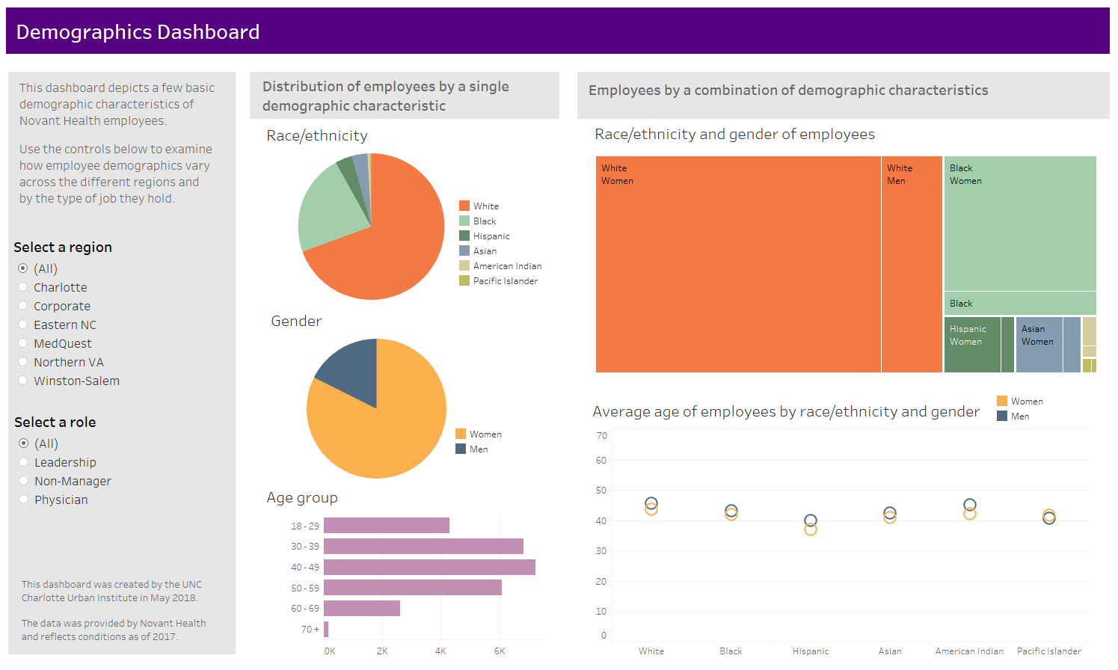

Slide 6
Tools we used

Slide 7
Format data in Excel

Slide 8
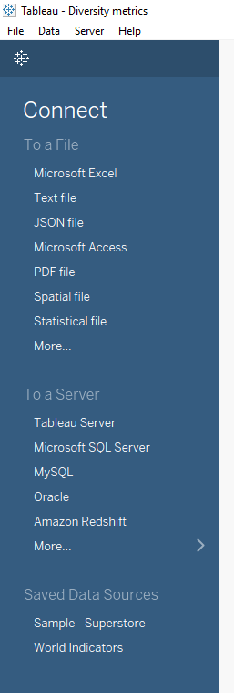
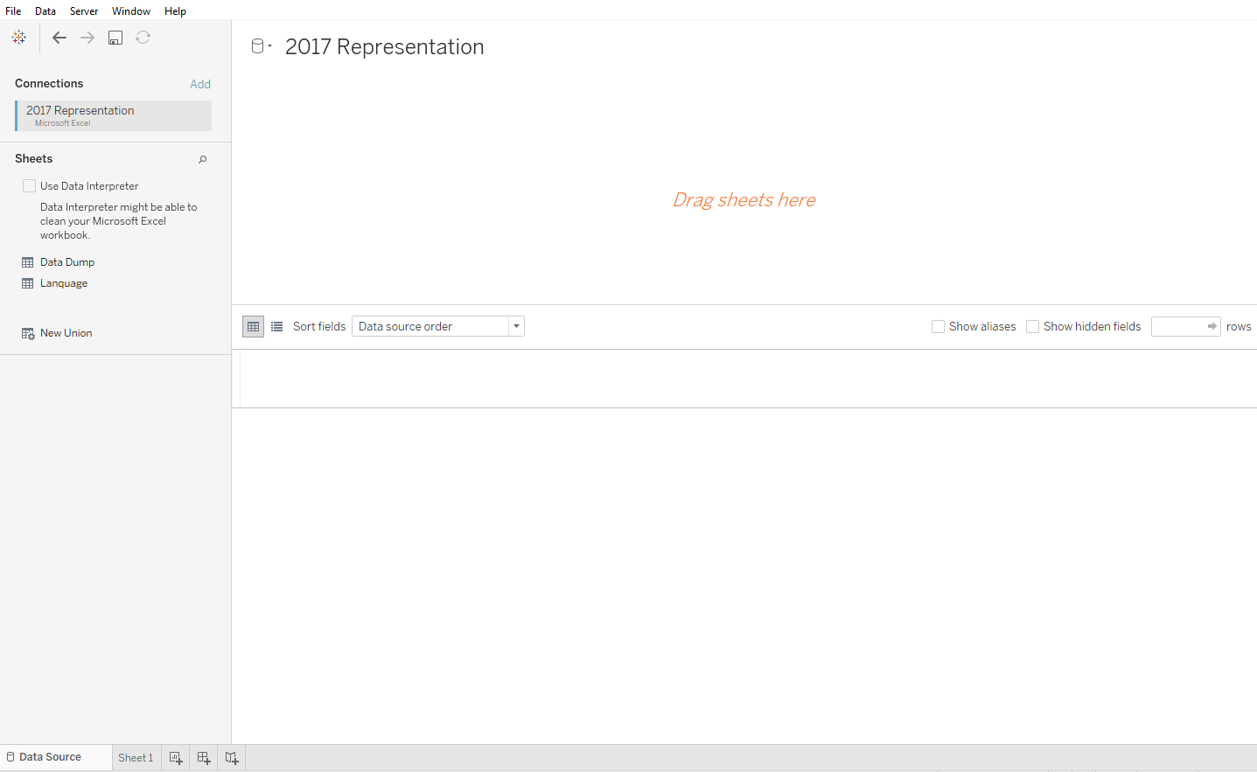
Connect to data in Tableau

Slide 9
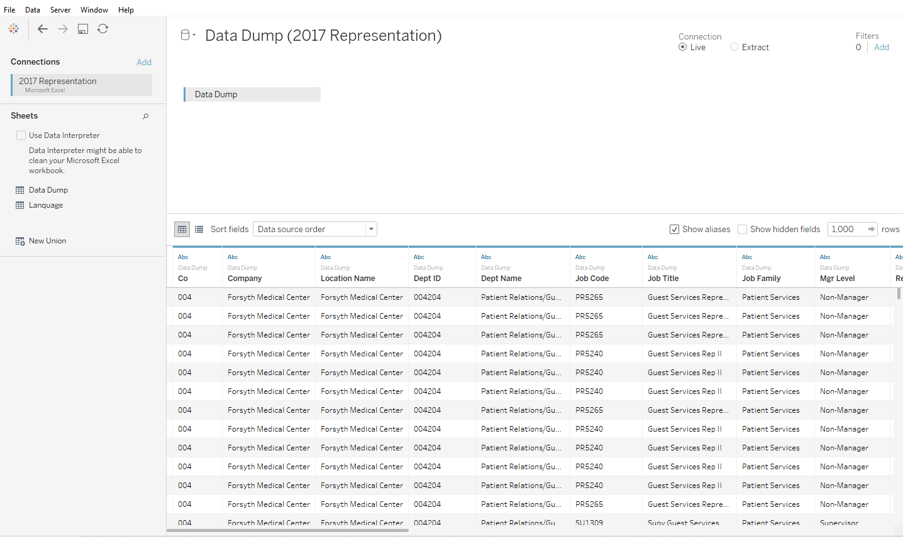
Drag and drop sheet

Slide 10
Make a chart

Slide 11
Add another level

Slide 12
Change chart type

Slide 13
Add a filter

Slide 14
Change chart colors

Slide 15
Make another chart in a new sheet

Slide 16
Make a dashboard of multiple charts

Slide 17
Finishing touches

Slide 18
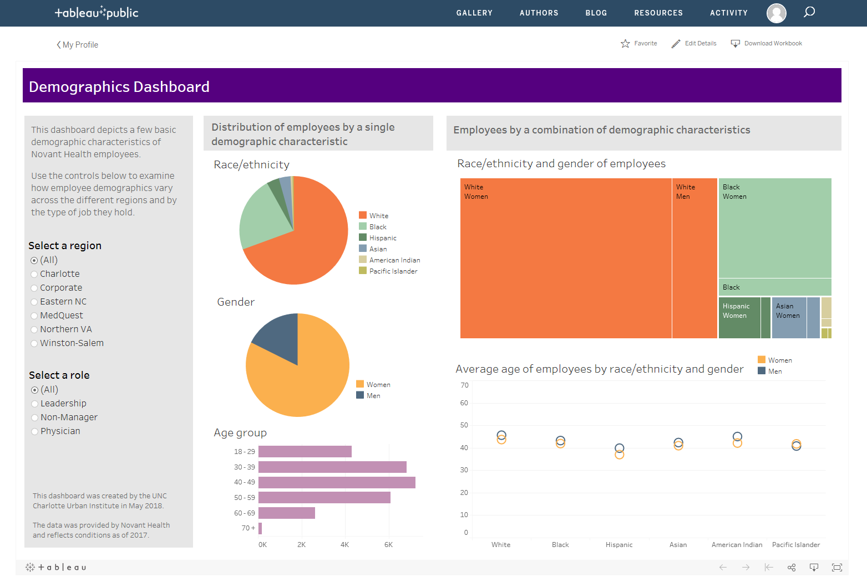
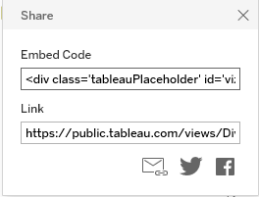
Publish and share

Slide 19
Data snapshot
Infographic handout

Slide 20
Notes:
The Charlotte Post Foundation is hosting a forum to discuss the school district as part of its Black Lives Matter Charlotte initiative March 24 at Mt. Moriah Primitive Baptist Church, 727 West Trade St. The forum starts at 6 p.m. It is free but space is limited. RSVP by calling (704) 376-0496.
“Our previous gatherings have focused on health disparities,” said Gerald Johnson, publisher of The Charlotte Post and president of the Post Foundation board. “We are looking forward to having a candid conversation with the community as it relates to education. Too often meetings are being held about our community without our community being at the table. ”
Black Lives Matter Charlotte is an effort to highlight needs of the African American community in health, education, crime and upward mobility. In addition to discussion and dialogue, the foundation has been working to identify a collective set of actions to pursue to address these concerns.
The forum will focus on education disparities impacting Charlotte’s black community and will feature an interactive presentation from Amy Hawn Nelson, director of Social Research at the UNC Charlotte Urban Institute and director of the Institute for Social Capital.
On the Net:
www.blacklivesmattercharlotte.org

Slide 21
Tools we used

Slide 22
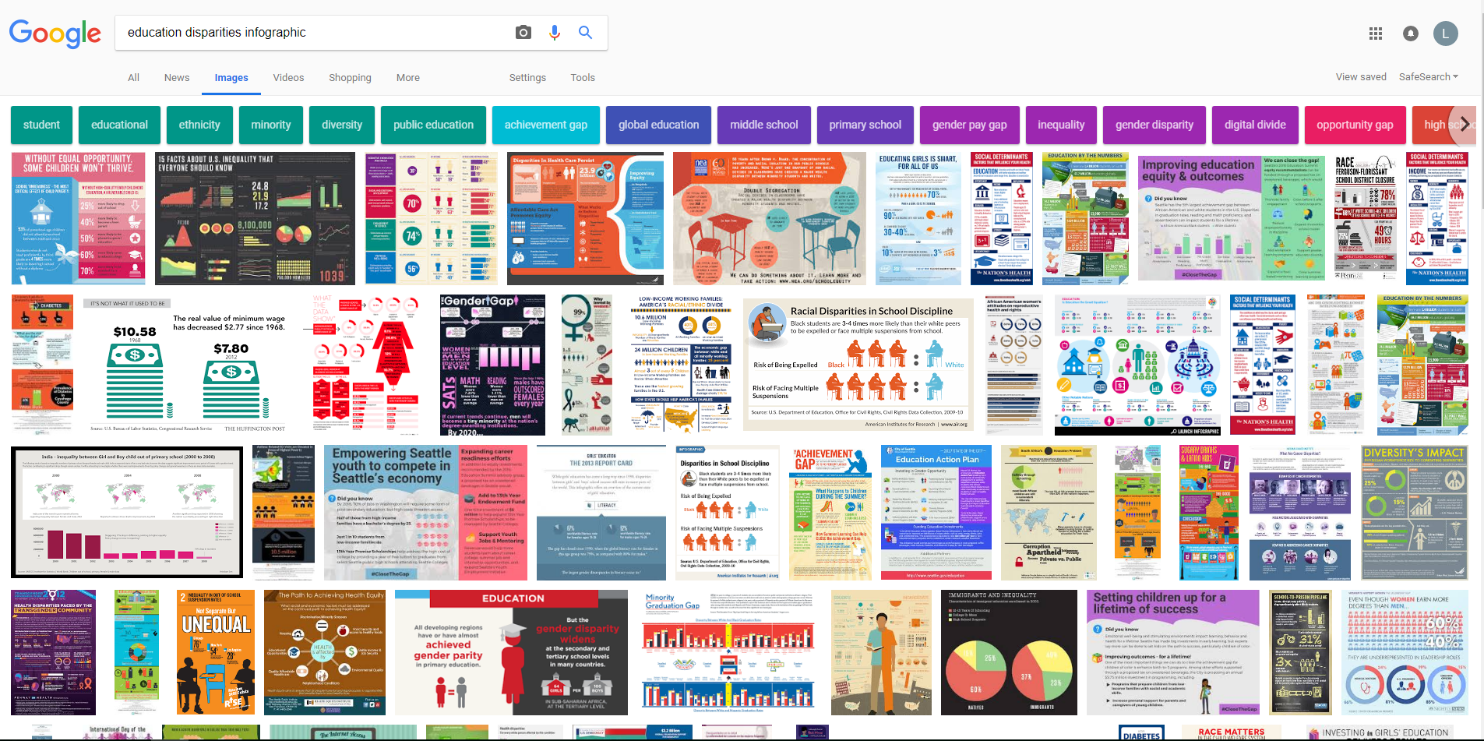
Get ideas

Slide 23
Sketch out a rough plan
Notes:
Important to think about what you want to communicate with your data before jumping in and making stuff
You probably won’t stick to it completely, but it does force you to be a little more thoughtful about what elements to include and where to put them

Slide 24
Start graphs in Excel
Notes:
Choose the right chart
Donut charts to show parts of a whole because 3 or fewer categories, easy to compare a few at a time
Dot plots for proficiency and graduation rates because easy to compare multiple groups and compact size
Start with a scatter plot

Slide 25
Switch Row/Column

Slide 26
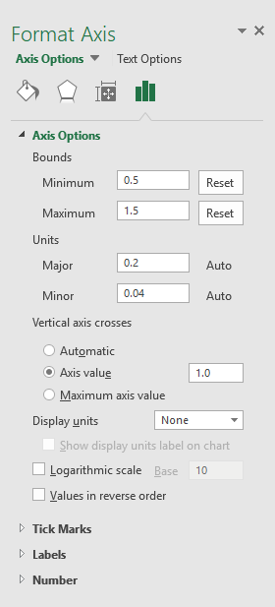
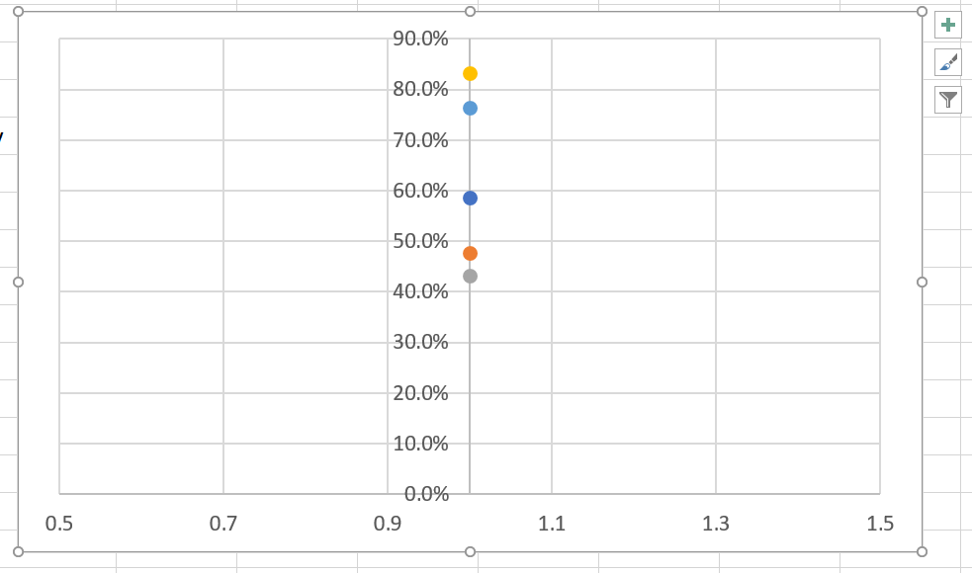
Adjust x axis

Slide 27
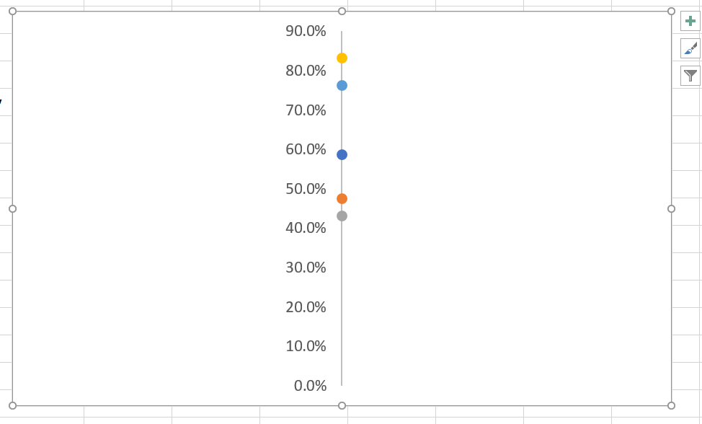
Remove x axis and gridlines

Slide 28
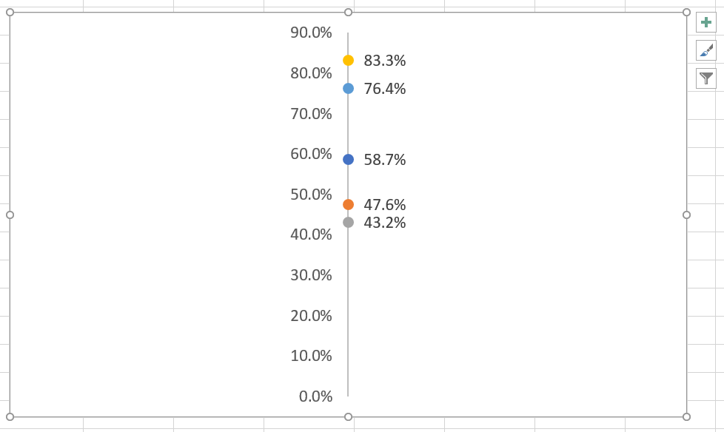
Add data labels

Slide 29
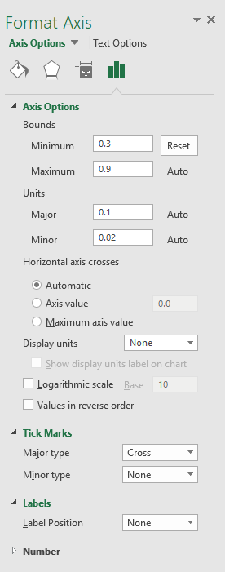
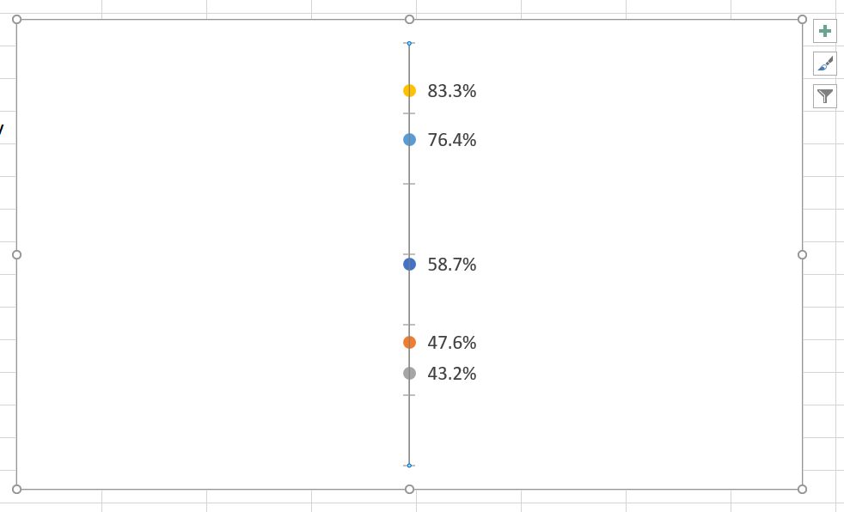
Adjust y axis

Slide 30
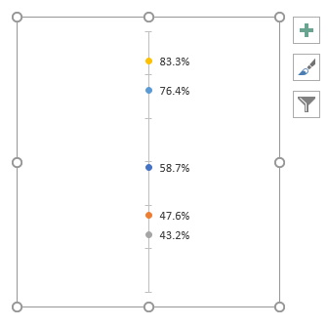
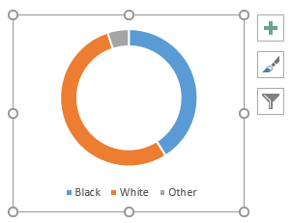
Polish in PowerPoint
Notes:
Color, title wording, fonts, overall size
For multiples of similar formats, usually get one exactly how I want it (or very close), then copy and paste it and just change the data source and title to save time on doing all the same formatting changes again.
Notice that I used the same colors for each racial group across the various charts.

Slide 31
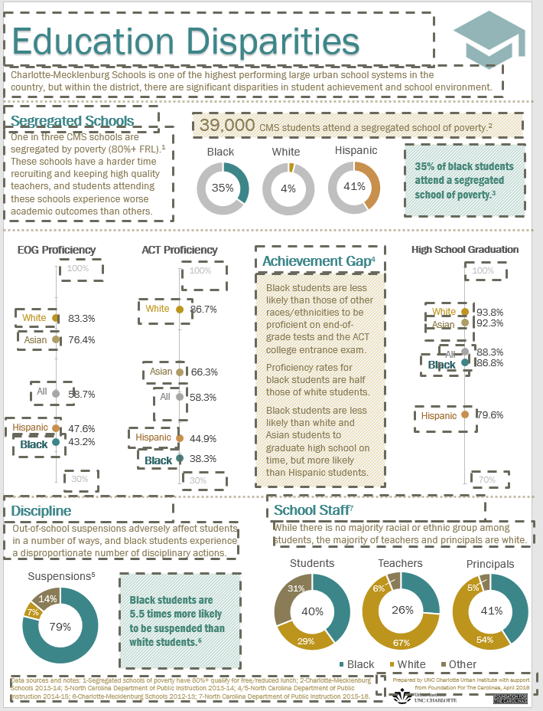
Text boxes a plenty
Notes:
Section titles
Blurbs
Factoids
Footnotes and acknowledgement
Labels for graphs
Tips:
Use lots of separate ones, which makes it more flexible to format
When adding a new one, copy and paste a similarly formatted one and edit the text to save time on formatting
Group and Align are very helpful features
Used different font sizes and boldness
Added a background shade to a few to make them stand out more

Slide 32
Finishing touches

Slide 34
Try it!

