Slide 1
Beyond PDFs: Visualizing your Data
NNIP Spring 2018 Atlanta
May 2018
Rob Pitingolo

Slide 2
Communicating data in 2018
Even in 2018, this is still one of the most common ways that NNIP partners disseminate their research

Slide 3
Visualization can seem intimidating!
Visualisingdata.com has a list of over 250 data visualization tools and software.

Slide 4
NNIP survey of partners
Sent to partners in April 2018
Inventoried which tools partners use regularly
Asked which tools partners want to learn more about
Thank you for participating!

Slide 5
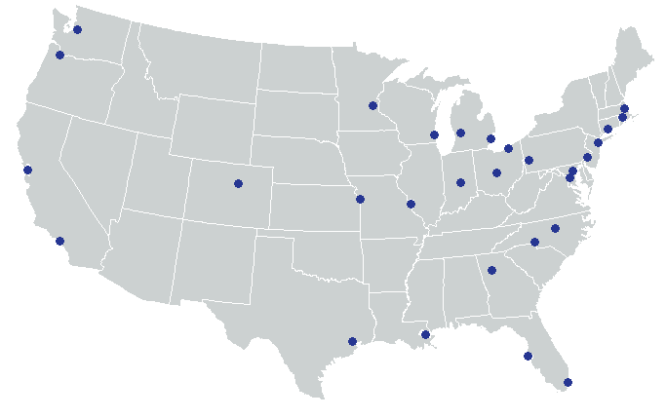
Almost 100% response!

Slide 6
Most popular visualization tools

Slide 7
Most popular visualization tools

Slide 8
Tools people want to learn about
Notes:
We're trying to figure out how to faciliate tech knowledge exchange across the network , so if you

Slide 9
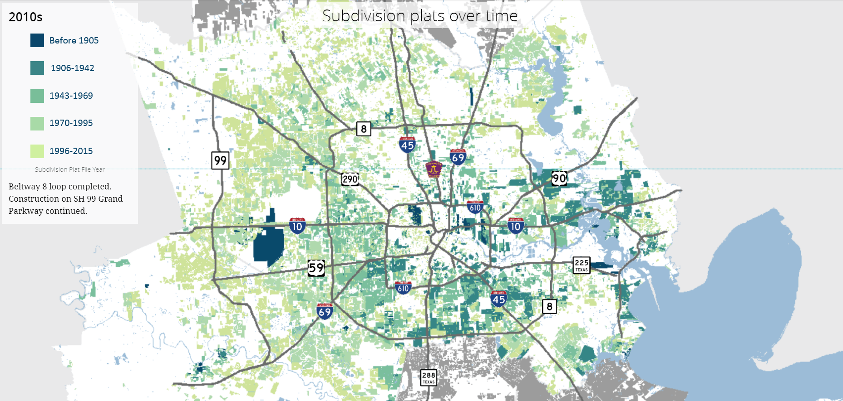
Today’s presenters
Jie Wu
Kinder Institute for Urban Research
Laura Simmons
UNC Charlotte Urban Institute

