Slide 1
The Undercount of Young Children in the U.S. Census
National Neighborhood Indicator Partnership
May 19, 2017
William. P. O’Hare
O’Hare Data and Demographic Services LLC

Slide 2
Methods Used by the Census Bureau to Assess Census Coverage
Demographic Analysis (DA)
  Independent population estimates are made based on birth and death certificate data and estimates of net international migration. The independent estimates are compared to the Census counts to measure net coverage.
Dual-Systems Estimates (called Census Coverage Measurement in 2010)
  A post-enumeration survey (PES) is conducted and the results of the PES are compared to the Census to determine undercounts and overcounts.

Slide 5
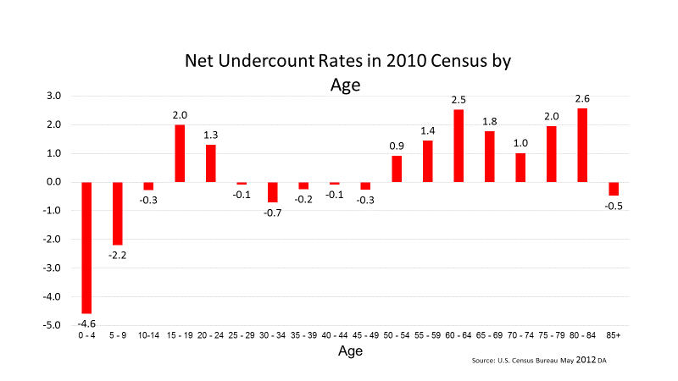

Slide 12
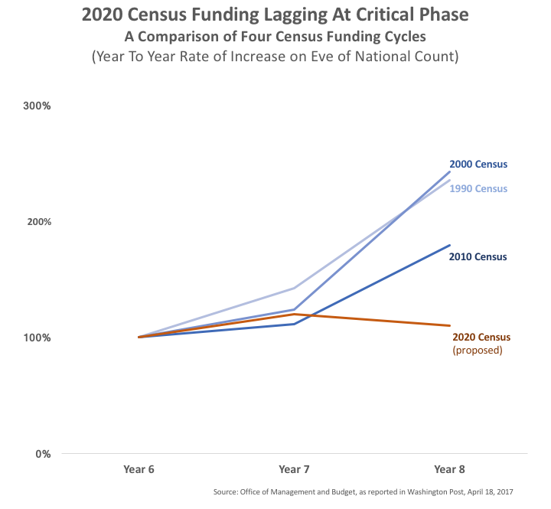

Slide 13
How to Get Involved
Interactive Mapping Application – Coming Soon
Census Complete Count Committees
Census Partnership Program
Census Project website (https://thecensusproject.org/)
Census 2020 Website (https://www.census.gov/2020census)
LCCR website (Coming Soon)

Slide 14
Key Points
Young children have a higher net undercount rate than any other age group.
Undercount rates for young children are higher in large counties.
There are many ways for NNIP groups to get involved in this issue.

Slide 15
THANKS
Contact Information
Bill O’Hare
billohare1@gmail.com

