Slide 1
Tracking Business & Employment for Economic Development
Merissa C. Piazza
Program Manager
Center for Economic Development
Cleveland State University
m.c.piazza83@csuohio.edu
NNIP Conference
September 16, 2016

Slide 2
About the Center for Economic Development
Applied Research Center in the Maxine Goodman Levin College of Urban Affairs
Economic Development Administration University Center
Expertise in economic & business databases
Indicator projects:
Fund for Our Economic Future “What Matters to Metros”
Dashboard of University as Anchor Institutions
Notes:
Applied Research Center with a focus on:
Economic Development
Entrepreneurship
Industry Analysis
Performance of Economic Clusters
Workforce Development

Slide 3
Business Data Out There
Individual Businesses
Aggregate
Hoover’s (Dun & Bradstreet)*
LexisNexis*
NETS*
Reference USA/Info USA*
Quarterly Census of Employment & Wages (special permission)
Innovation Data: SBIR/STTR; Patents
Licenses
Tax Records
Occupancy Permits
Building Permits
Zip Code Business Patterns
* Denotes data for purchase from private company
Notes:
There are many different business level databases out there, some are public and some are private.
Many of the private databases can be restrictive due to their licenses and cost prohibitive. This presentation is to give you a flavor of the data, so that you can have informed discussion when you need to use them.
There are aggregate business data available from:
Licenses
Tax Records
Occupancy Permits
Building Permits
Zip Code Business Patterns
The individual business databases out there I am familiar with are:
Hoover’s (Dun & Bradstreet)*
LexisNexis*
NETS*
Reference USA/Info USA*
Quarterly Census of Employment & Wages (special permission)
Innovation Data: SBIR/STTR; Patents
There are pros and cons from working with each of these databases

Slide 4
Private Database Content & Usability
 | Name of Business | Address | CEO Information | Email Addresses | MBE/WBE Info
Hoover's (D&B) | √ | √ | √ |  | √
LexisNexis | √ | √ | √ | √
Reference USA | √ | √ | √ | $ | $
Information on Licensing Agreements:
Each company has their own licensing agreement and payment for the database is determined based upon the use of the data
Notes:
Of the three private databases it is important to understand the components of these data.
For example: If you were going to produce counts of businesses it would be one cost, as compared to distributing a listing of companies

Slide 5
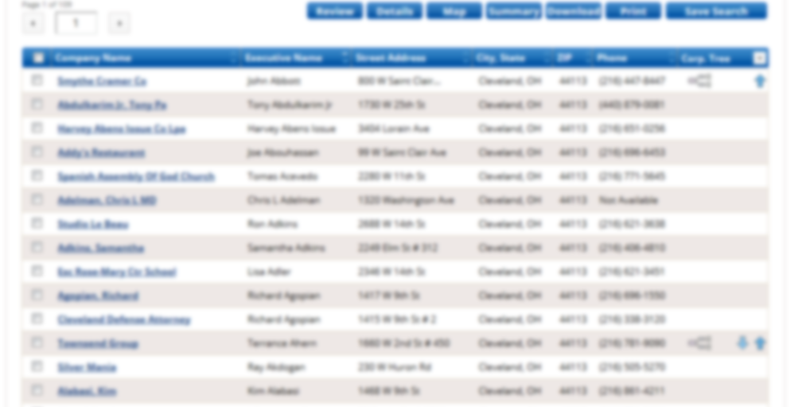
Reference USA
Data collected by calling establishments
Establishments maybe double counted (i.e. multiple departments in one organization)
Opening & Closings aren’t very timely
Depending on license – may charge by record
Charge additional $ for MBE/WBE and emails

Slide 6
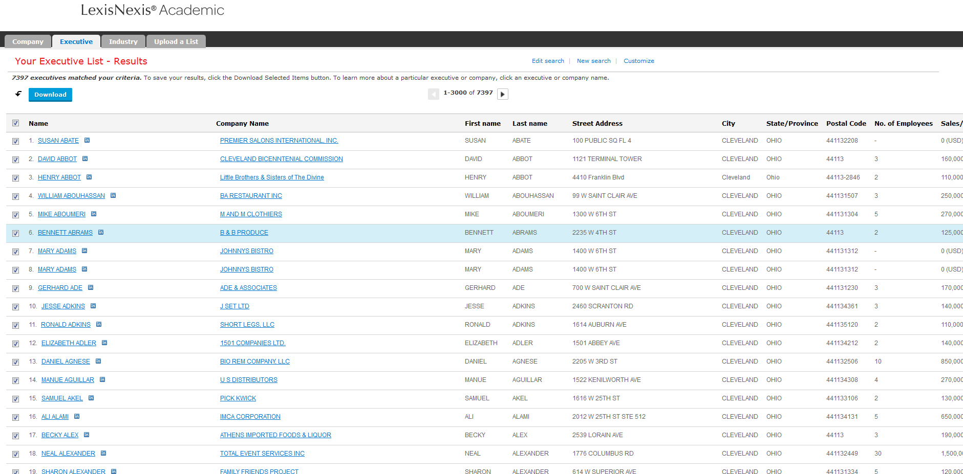
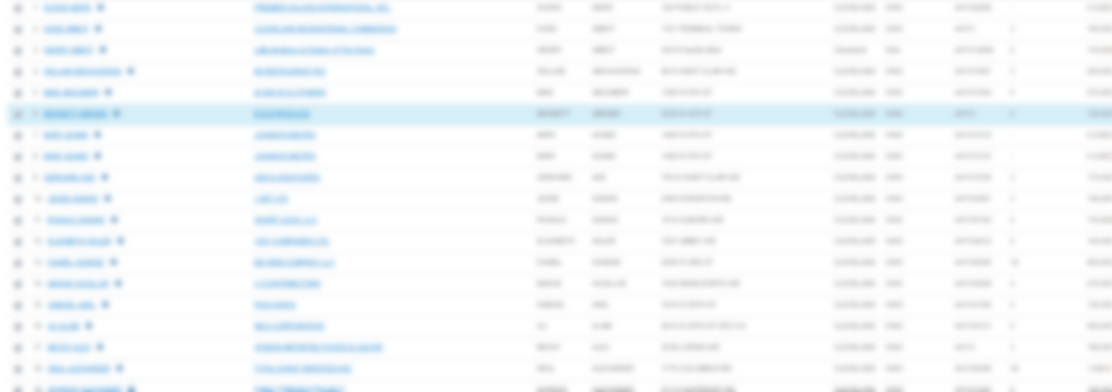
Lexis Nexis
Based on DUNS number from D&B
Tends to have more firm level data than establishment details
Emails are apart of base license
NO MBE & WBE

Slide 7
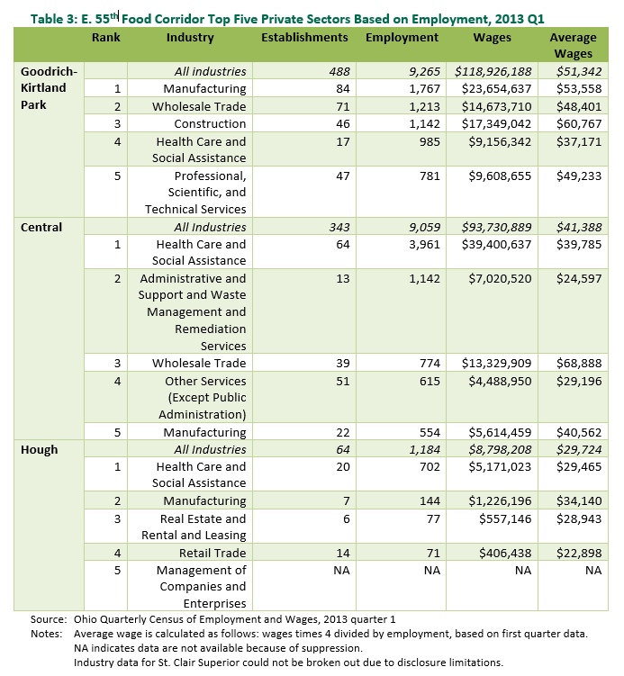
Quarterly Census of Employment and Wages (QCEW)
Based on administrative records of Unemployment Insurance tax data
Establishment level data contains:
Trade & Legal Name
Address
NAICS
Ownership (private, government)
Ohio allows for data to be used for statistical purposes
Must sign a contract with them
Data subject to confidentiality review
Check with your state LMI office
http://engagedscholarship.csuohio.edu/cgi/viewcontent.cgi?article=2348&context=urban_facpub1444
Notes:
Quarterly Census of Employment and Wages – is known as the QCEW or formerly ES202
QCEW data is based on Unemployment Insurance (UI) tax data collected by each state
Through an agreement with the state tax offices, UI tax data can be used for statistical purposes – becoming the QCEW
QCEW collected data from 98% of employment and wages on a quarterly basis from all establishments in the nation. Each state is responsible for its own data collection.

Slide 8
Pros & Cons of these databases
- Serve as an estimate of businesses in an area
- Aggregate counts of establishments, employment & wages
- No information on self-employed
- Not timely for openings/closings
- Inflate small business counts
Pros
Cons

