Slide 1
Local Administrative Sources for Business Data NNIP September 2016
john.killeen@durhamnc.gov
city of durham/neighborhood dataworks

Slide 2
About DataWorks
Neighborhood DataWorks - not-for-profit data intermediary, maintaining official indicators portal (Neighborhood Compass) and engaging communities with data.
Mission: Democratizing data to facilitate an empowered, productive, and equitable community.
Supported by Durham City and County, Social Science Research Institute (SSRI) at Duke University.

Slide 3
local business data | sources
NAME | COVERAGE | SOURCE
Privilege License Database | Citywide | City Finance Department
Minority and Women Owned Businesses (SDBE) | Citywide | City Dept. Equal Opportunity Equity Assurance
Historically Underutilized Businesses (HUB) | Statewide | NC Department of Administration
Registered Corporations | Statewide | NC Secretary of State Corporations Division

Slide 4
local business data | basic content
 | Name of Business | Address | Home-Based | Registered Agent | Active Status | Email Address | MBE/WBE/
Privilege licensing | √ | √ | √ | √ | √ | √
HUB | √ | √ |  | √ |  | √ | √
SDBE | √ | √ |  | √ |  | √ | √
Corporations | √ | √ |  | √ | √ | √

Slide 5
privilege license database
All legally-operating businesses within the city
In NC defunct as of June 30, 2015 by act of legislature
Also includes beer & wine licenses, causing some duplication that can be filtered easily
Includes ~8,500 licenses, 559 beer & wine
~7,918 businesses in QCEW (Durham County, 2015)
Notes:
Any person who conducts business within the City of Durham, either by maintaining a business location within the City or, either personally or through agents, solicits business within the City, or picks up and/or delivers goods or services within the City, is liable for the City’s Privilege License Tax unless specifically exempted by federal, state law, or local ordinance. If a company or individual is engaged in more than one type of business activity within the City of Durham, a separate business tax receipt may be required for each type of business activity. A separate business tax receipt is required for each business location in the City of Durham. (Sec.4)

Slide 6
historically underutilized businesses (HUB)
Opt-in, network for government contract bids.
Separate fields for gender and race/ethnicity
Also includes owners w/disability
Ethnic categories: Asian-American (AA); American Indian (AI); Black (B); Hispanic (HA)
186 businesses (based in Durham)
Notes:
Thank you for your interest in becoming certified as a HUB firm with the State of North Carolina under the Statewide Uniform Certification Program (SWUC). Per N.C. General Statute 143-128.4, to qualify as a historically underutilized business, a business must be at least 51% owned, controlled and managed by one or more citizens or lawful permanent residence of the United States who are members of one or more of the following groups: (1) Black, (2) Hispanic, (3) Asian American, (4) American Indian, (5) Female, (6) Disabled and (7) Disadvantaged.

Slide 7
minority and women-owned businesses (SDBE)
Fields also include:
service type (not standardized)
business class: construction, professional services, non-professional services, supplier/vendor
Combined categories (one field) : Asian-American (AS); Minority (M); Hispanic (H); Women-owned (W)
273 businesses (based in Durham)

Slide 8
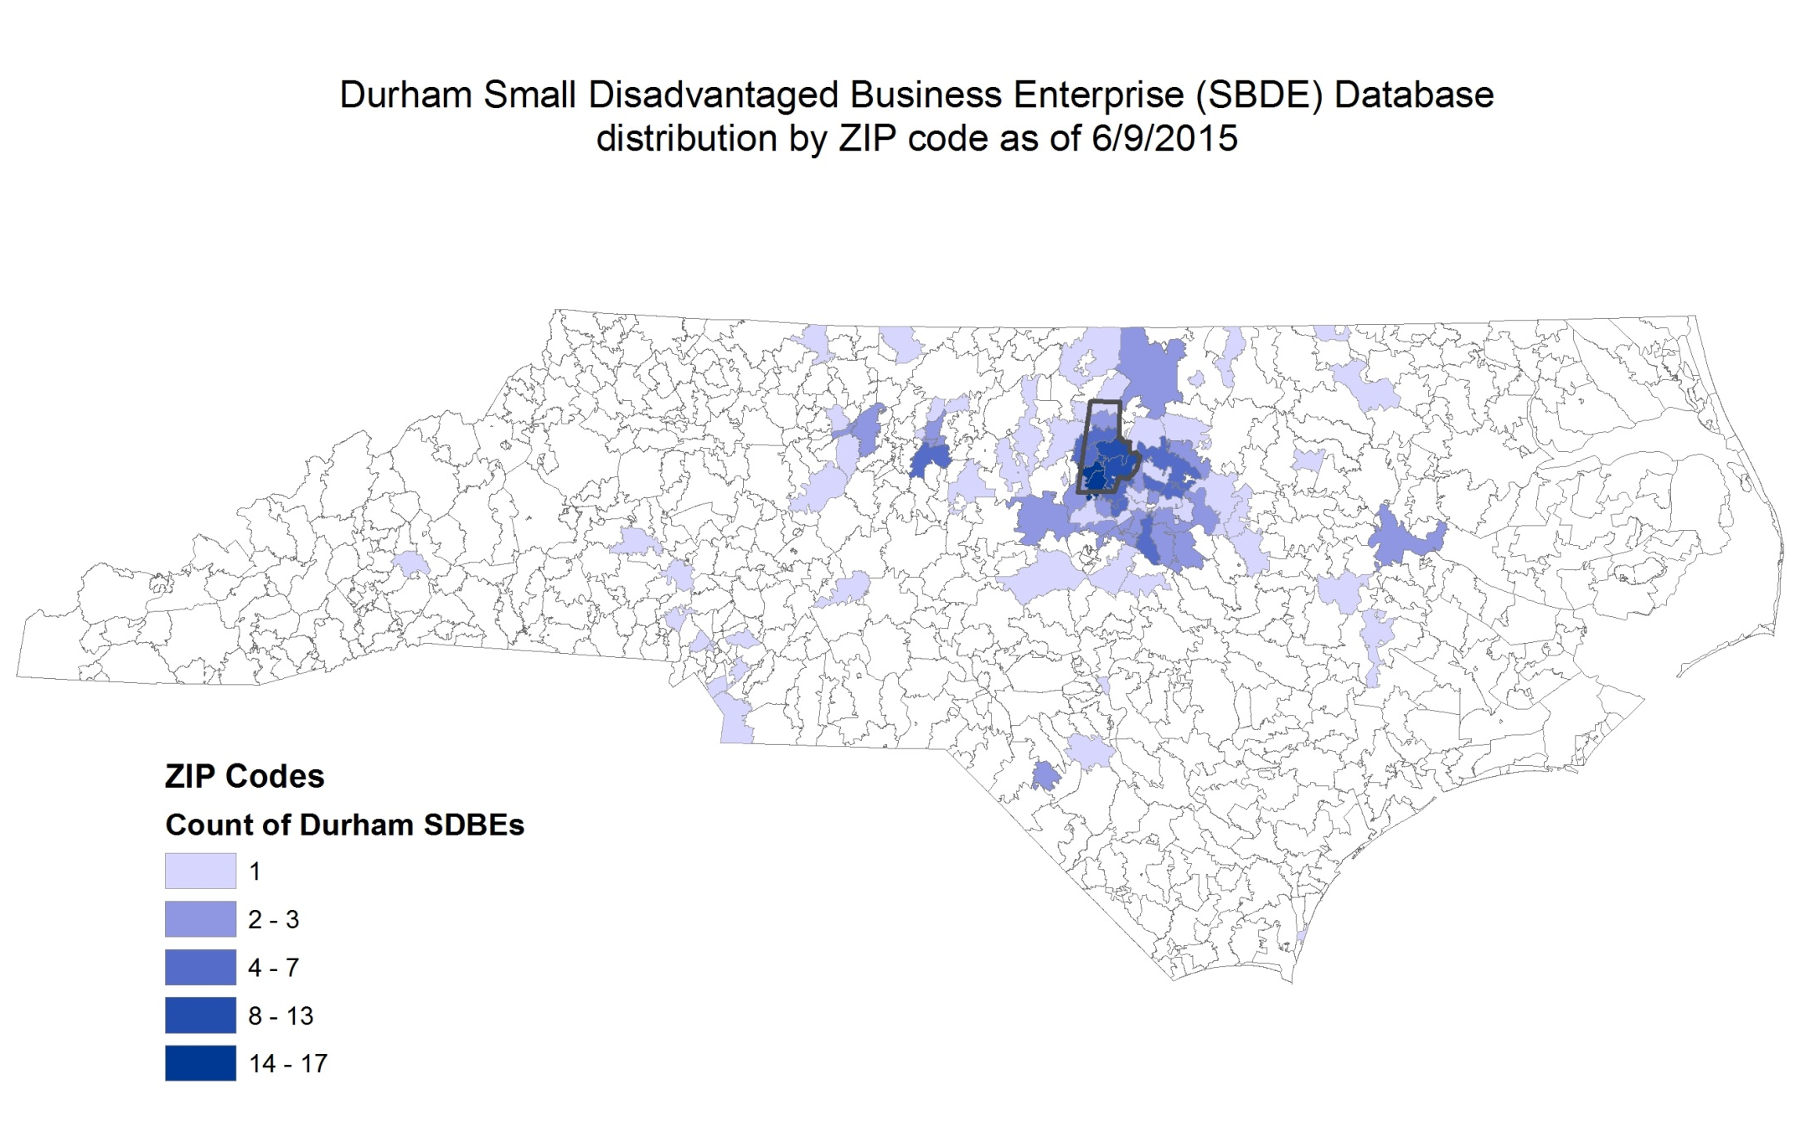
SDBE includes any contractor seeking to do business in the city (30% based in Durham)

Slide 9
registered state corporations
Secretary of State/Corporations
Complete reference to licensing activity
Licensed LLCs, PLLCs, non-profits, etc.
Dissolutions, withdrawals, conversions, mergers…
Registered address + street address
Updated in ~real time
Public portal* and subscription service (access to SQL db)
Notes:
The Corporations Division is responsible for the examination, custody and maintenance of the legal documents filed by more than 400,000 corporations, limited partnerships and limited liability companies. The duty of the Secretary of State is to ensure uniform compliance with the statutes governing the creation of these entities, record the information required to be kept as a public record, and provide that information to the public. The Corporations Division acts in an administrative capacity only and cannot give legal advice.
Closely linked with tax status

Slide 10
what’s missing from these sources?
The informal sector, whether home-based, at flea markets, side hustles…
Demographic info (for licensing and corporations)
Salaries, wages, benefits
Industry classifications (NAICS)

Slide 11
purposes
Illustrating business activity
Identify clustering of types (non-profit, etc.)
Potential links between real estate and existing business demand
Identify abnormal rates of dissolution by neighborhood
Great starting point for business surveying

Slide 12
"Durham is way too culturally and historically significant for us to neglect our other communities. Every time I'm in the Angier Avenue/Driver Street area, it looks like a little ghost town.”
Quote: Tobias Rose (bold type in original), http://www.indyweek.com/indyweek/does-black-wall-street-need-to-be-blacker
Notes:
Rose was probably referring to the built environment here compared to downtown where investments have been concentrated [although commercial parcels in the Angier/Driver district are 52% vacant] – but the imagery of the ghost town reinforces a false notion of a dead economy where a handful of frontier folk are the only ones around. That image can get carried away and cause tension when newcomers want to establish businesses and with perfectly good intentions believe they are jump-starting the joint.
So people who don’t know the neighborhood intimately can misunderstand things like the economy of a neighborhood.

Slide 13
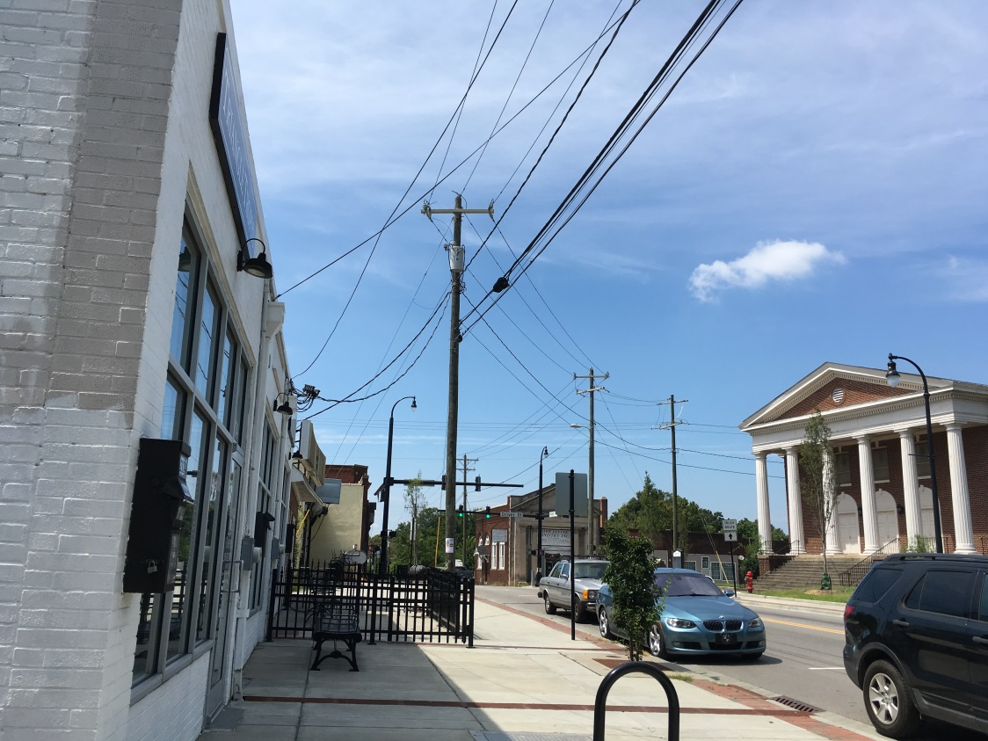
Privilege license database 2015
Notes:
And while Angier and Driver may feel to a comparative stranger like there ain’t much happening, there is more than meets the eye. (And the district is rapidly changing…) The image on the right illustrates the number of licensed home-based businesses within a quarter-mile of Angier and Driver.

Slide 14
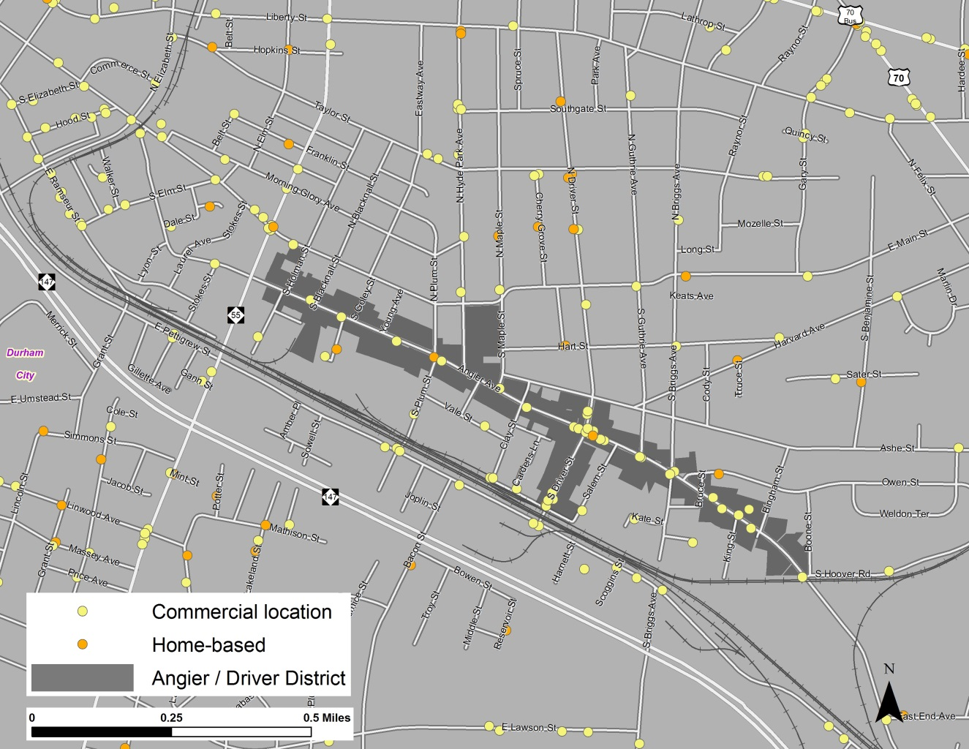
Privilege license database 2015
Notes:
And while Angier and Driver may feel to a comparative stranger like there ain’t much happening, there is more than meets the eye. (And the district is rapidly changing…) The image on the right illustrates the number of licensed home-based businesses within a quarter-mile of Angier and Driver.

Slide 15
purposes
Illustrating business activity
Identify clustering of types (non-profit, LLC, home-based, etc.)
Potential links between real estate and existing business demand
Identify abnormal rates of dissolution by neighborhood
Great starting point for business surveying

Slide 16
Summary of home-based /commercial locations by neighborhood areas, including blockgroups: http://arcg.is/2bAb6q7
Privilege license database 2015

Slide 17
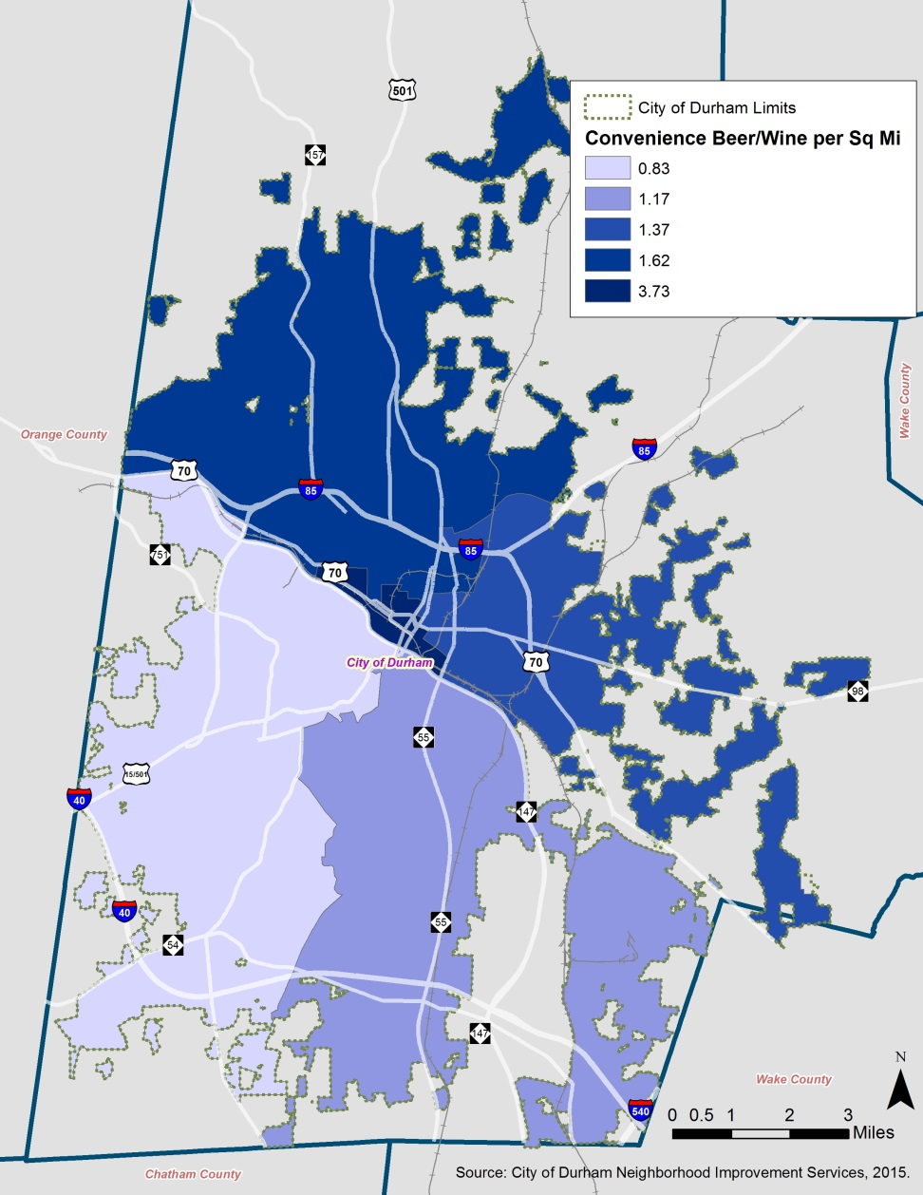
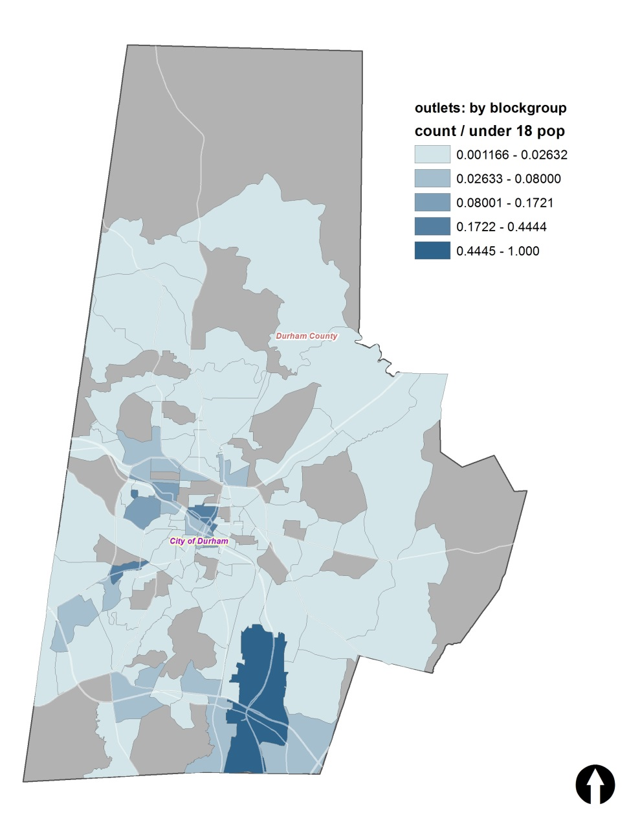
Together for Resilient Youth (TRY) – privilege licenses 2014
Density of convenience beer & wine outlets by police district;
Density of all beer & wine outlets by youth population (under 18)
Notes:
Exposure, but also the Good Neighbor program…

Slide 18
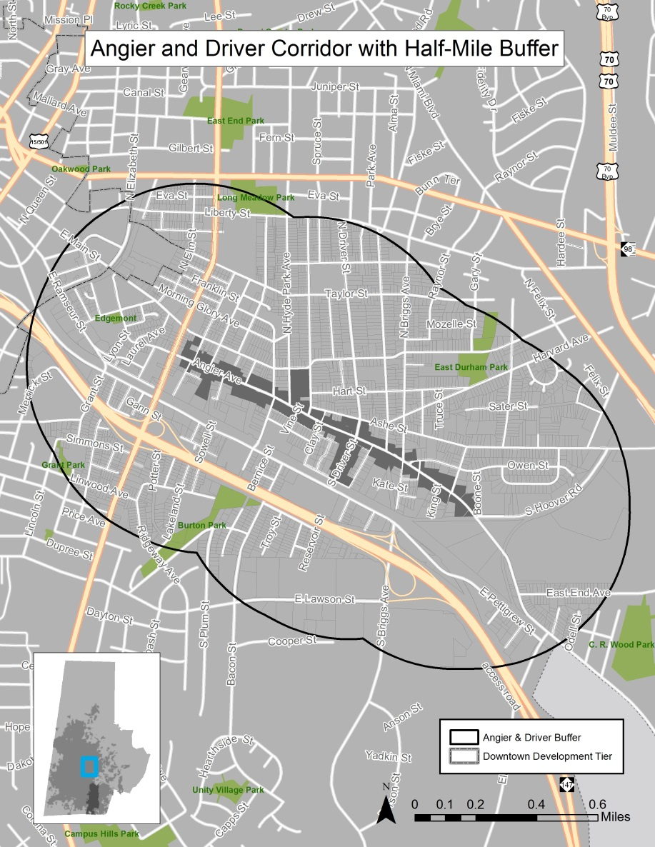
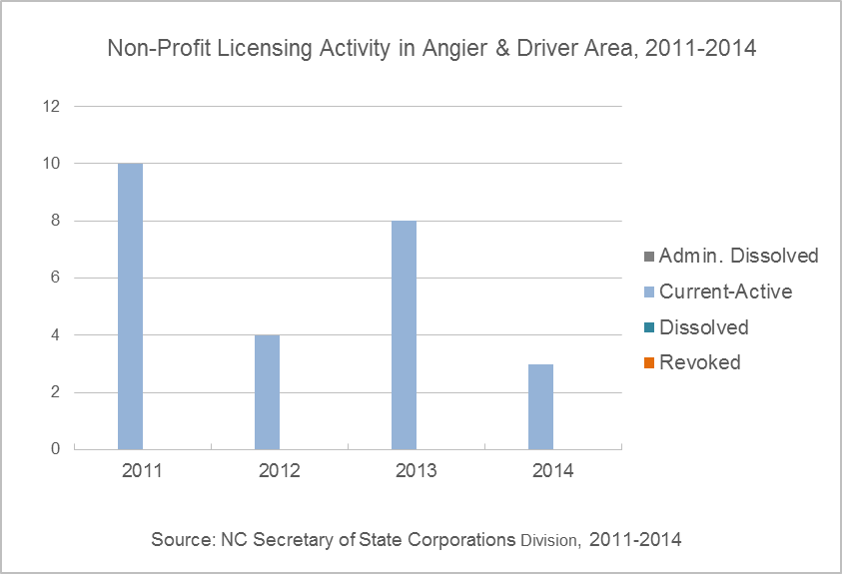
Summary by any custom area, like a local Economic Development District
NC Corporations 2015

Slide 19
purposes
Illustrating business activity
Identify clustering of types (non-profit, LLC, home-based, etc.)
Potential links between real estate and existing business demand
Identify abnormal rates of dissolution by neighborhood
Great starting point for business surveying

Slide 20
John Killeen
Neighborhood Compass Project Manager
City of Durham
919.475.3054
john.killeen@durhamnc.gov

