Slide 1
The 2020 Census: A New Design for the 21st Century
National Neighborhood Indicators Partnership Meeting
May 19, 2017
Jennifer Kim U.S. Census Bureau

Slide 2
The 2020 Census
The Decennial Census
Purpose:
To conduct a census of population and housing and disseminate the results to the President, the States, and the American People
Primary Uses of Decennial Census Data:
Apportion representation among states as mandated by Article 1, Section 2 of the United States Constitution:
Draw congressional and state legislative districts, school districts and voting precincts
Enforce voting rights and civil rights legislation
Distribute federal dollars to states
Inform federal, tribal, state, and local government planning decisions
Inform business and nonprofit organization decisions (e.g., where to locate, size of the market)
Provide population benchmark for nearly every other United States survey
Representatives and direct Taxes shall be apportioned among the several States which may be included within this union, according to their respective Numbers … The actual Enumeration shall be made within three Years after the first Meeting of the Congress of the United States, and within every subsequent Term of ten years, in such Manner as they shall by Law direct.

Slide 3
The 2020 Census
Operational Overview
COUNT THE POPULATION
Make it easy for people to respond anytime, anywhere— via internet, phone or mail
Encourage people to use the new online response option
Use the most cost-effective strategy to contact and count nonrespondents
Knock on doors only when necessary
Streamline in-field census-taking
ESTABLISH WHERE TO COUNT
Minimize field work, verify 75% of addresses using data sources in-office
Conduct a 100% review and update of the nation’s address list
Use multiple data sources to identify areas with address changes
Get local government input
m
MOTIVATE
PEOPLE TO RESPOND
Conduct a nation-wide communications and partnership program
Maximize outreach using traditional and new media
Target ads to specific audiences
Work with trusted sources to inspire participation
RELEASE CENSUS RESULTS
Deliver apportionment counts to the President by December 31, 2020
Release counts for redistricting by April 1, 2021
Make it easier for the public to get data

Slide 4
The 2020 Census
The 2020 Census Environment
2020 Census
Constrained fiscal environment
Rapidly changing use of technology
Information explosion
Distrust in government
Informal, complex living arrange-ments
A mobile population
Declining response rates
Increasingly diverse population
The 2020 Census is being conducted in a rapidly changing environment, requiring a flexible design that takes advantages of new technologies and data sources while minimizing risk to ensure a high quality population count.

Slide 5
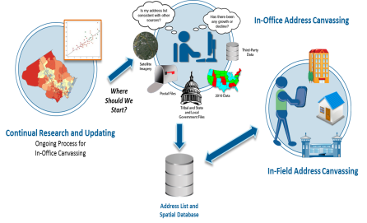
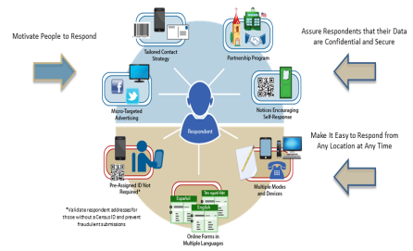
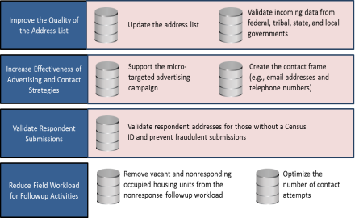
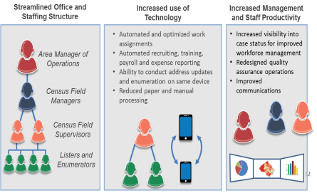
The 2020 Census
Key Innovation Areas
Reengineering Address Canvassing
Optimizing Self-Response
Utilizing Administrative Records and Third-Party Data
Reengineering Field Operations

Slide 6
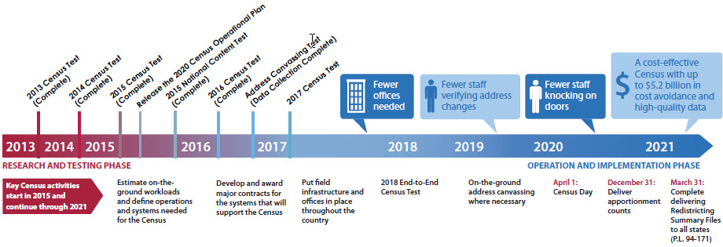
The 2020 Census
Timeline

Slide 7
Content Testing on Race/Ethnicity
2015 National Content Test (NCT)
Question Format
Separate origin and race questions vs. combined origin and race questions
Middle Eastern or North African (MENA) Category
MENA is placed among response options for selecting a major race or ethnic category
Instruction Wording
Old and new instruction wording tested to help improve clarity of question
Terminology
Alternative terms used to describe the concepts and groups in the question stem, instructions, and examples

Slide 8
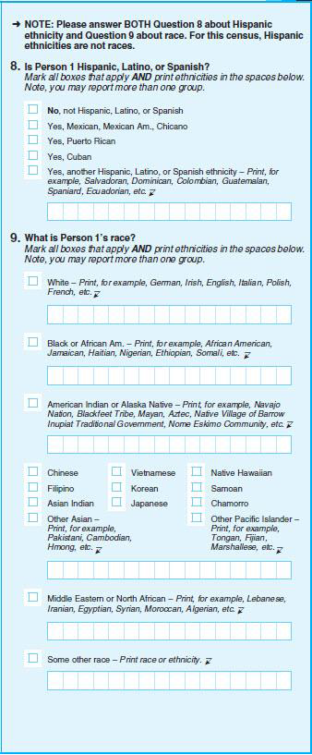
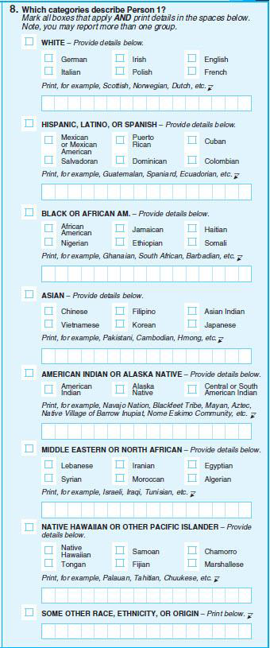
NCT Example of a Separate Question
NCT Example of a Combined Question
Notes:
8

Slide 9
Content Testing on Race/Ethnicity
NCT Findings
The combined question format appears to elicit higher quality data on race and ethnicity
No changes to distribution for major groups
Decreased Some Other Race reporting
Lower item nonresponse for the combined race/ethnicity question than for the separate race question
Same or higher level of detailed reporting
Higher overall consistency for Hispanics
The use of a distinct MENA category appears to elicit higher quality data for people who would identify with MENA
People who identify as MENA use the MENA category when it is available
People who are MENA have trouble identifying as only MENA when no category is available

Slide 10
Non-English Content
2020 Language Support
2010
Telephone Questionnaire Assistance
(Limited Language Options)
2020
Paper Questionnaires
Field Materials
Language Assistance Guides (Paper)
“It’s Easy” Videos (via Comcast)
Paper Questionnaires
Language Assistance Guides
(Paper and Internet)
Census Questionnaire Assistance
(Expanded Language Options)
Internet Instrument
Field Materials
Field Enumeration Instrument
Language Identification Flashcard
Language Identification Flashcard

Slide 11
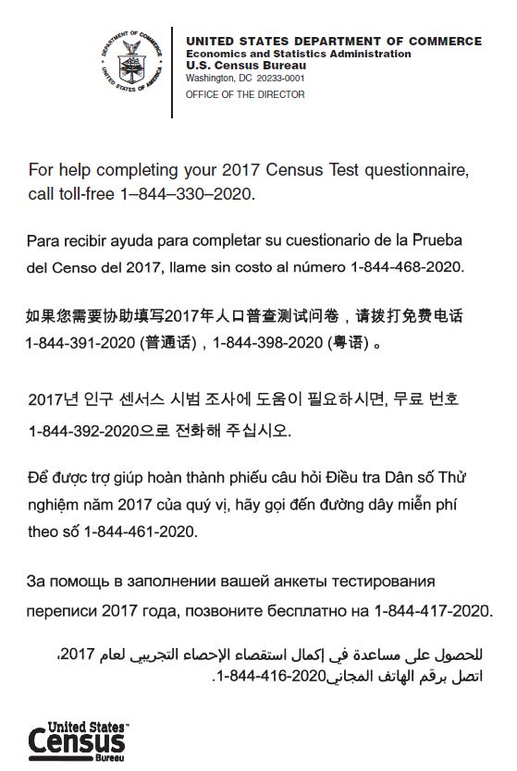
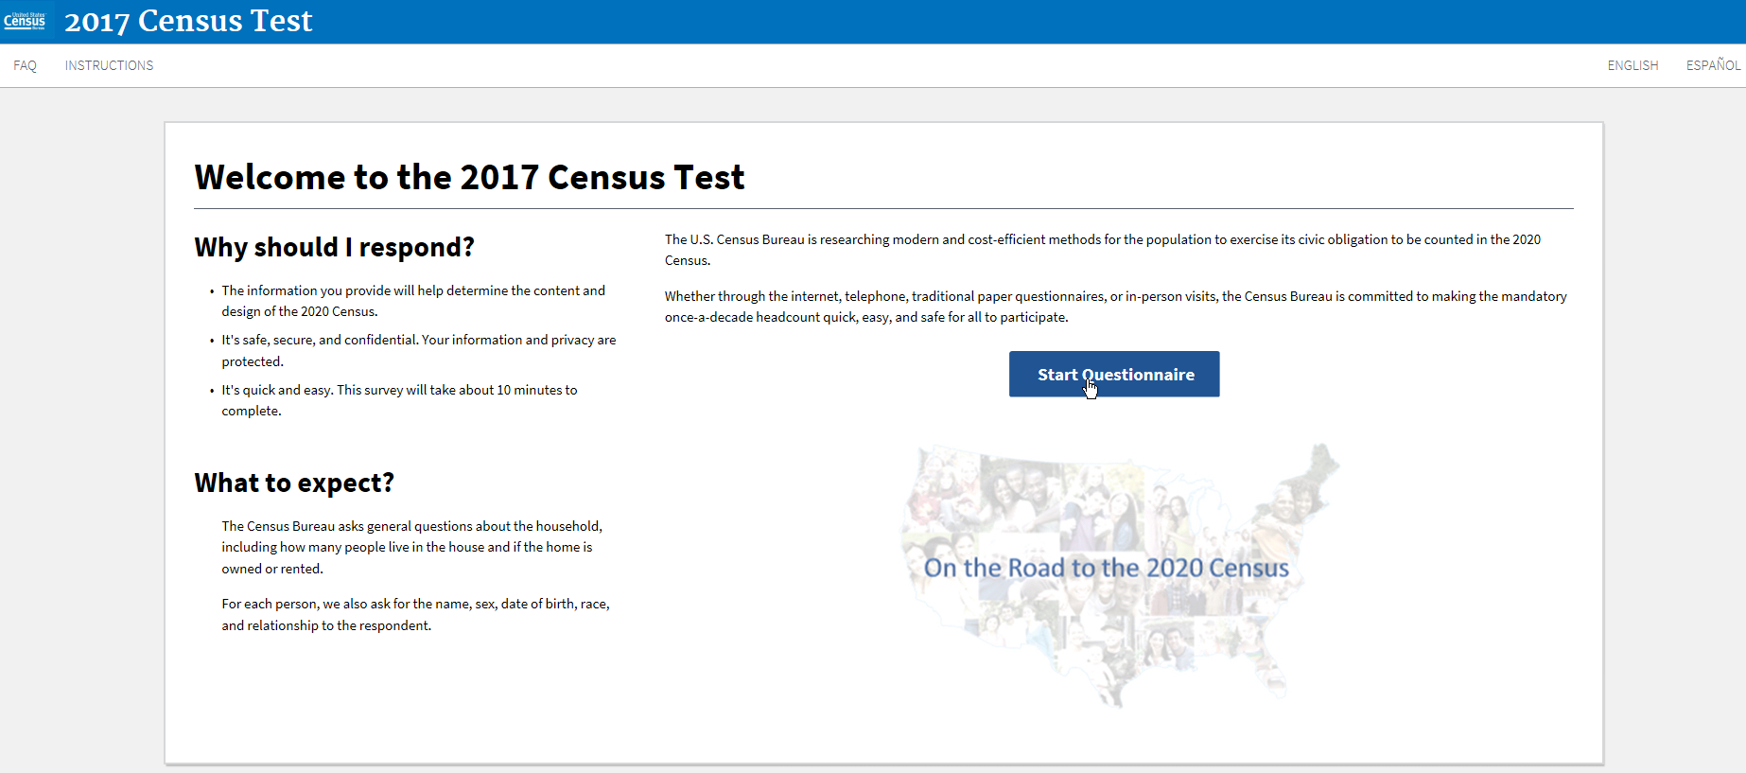
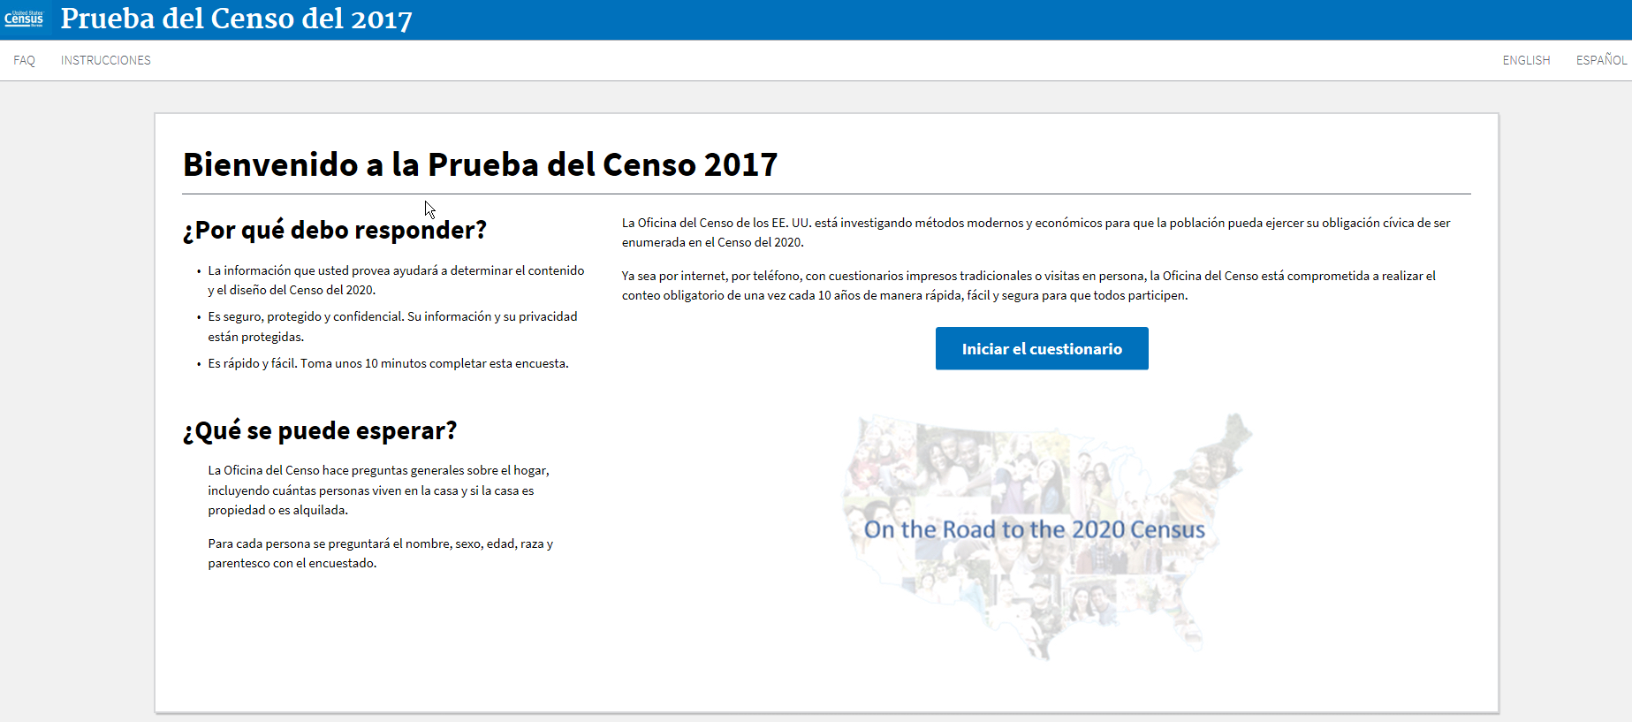
Examples of Non-English Response Options
Internet Self-Response / Census Questionnaire Assistance

Slide 12
The 2020 Census A New Design for the 21st Century

Slide 13
Connect with Us
facebook.com/uscensusbureau
twitter.com/uscensusbureau
youtube.com/user/uscensusbureau
instagram.com/uscensusbureau
pinterest.com/uscensusbureau
Sign up for and manage alerts at https://public.govdelivery.com/accounts/USCENSUS/subscriber/new
More information on the 2020 Census Memorandum Series:
http://www.census.gov/programs-surveys/decennial-census/2020-census/planning-management/memo-series.html
More information on the 2020 Census:
http://www.census.gov/2020Census
More information on the American Community Survey:
http://www.census.gov/programs-surveys/acs/
American Community Survey

