Slide 1
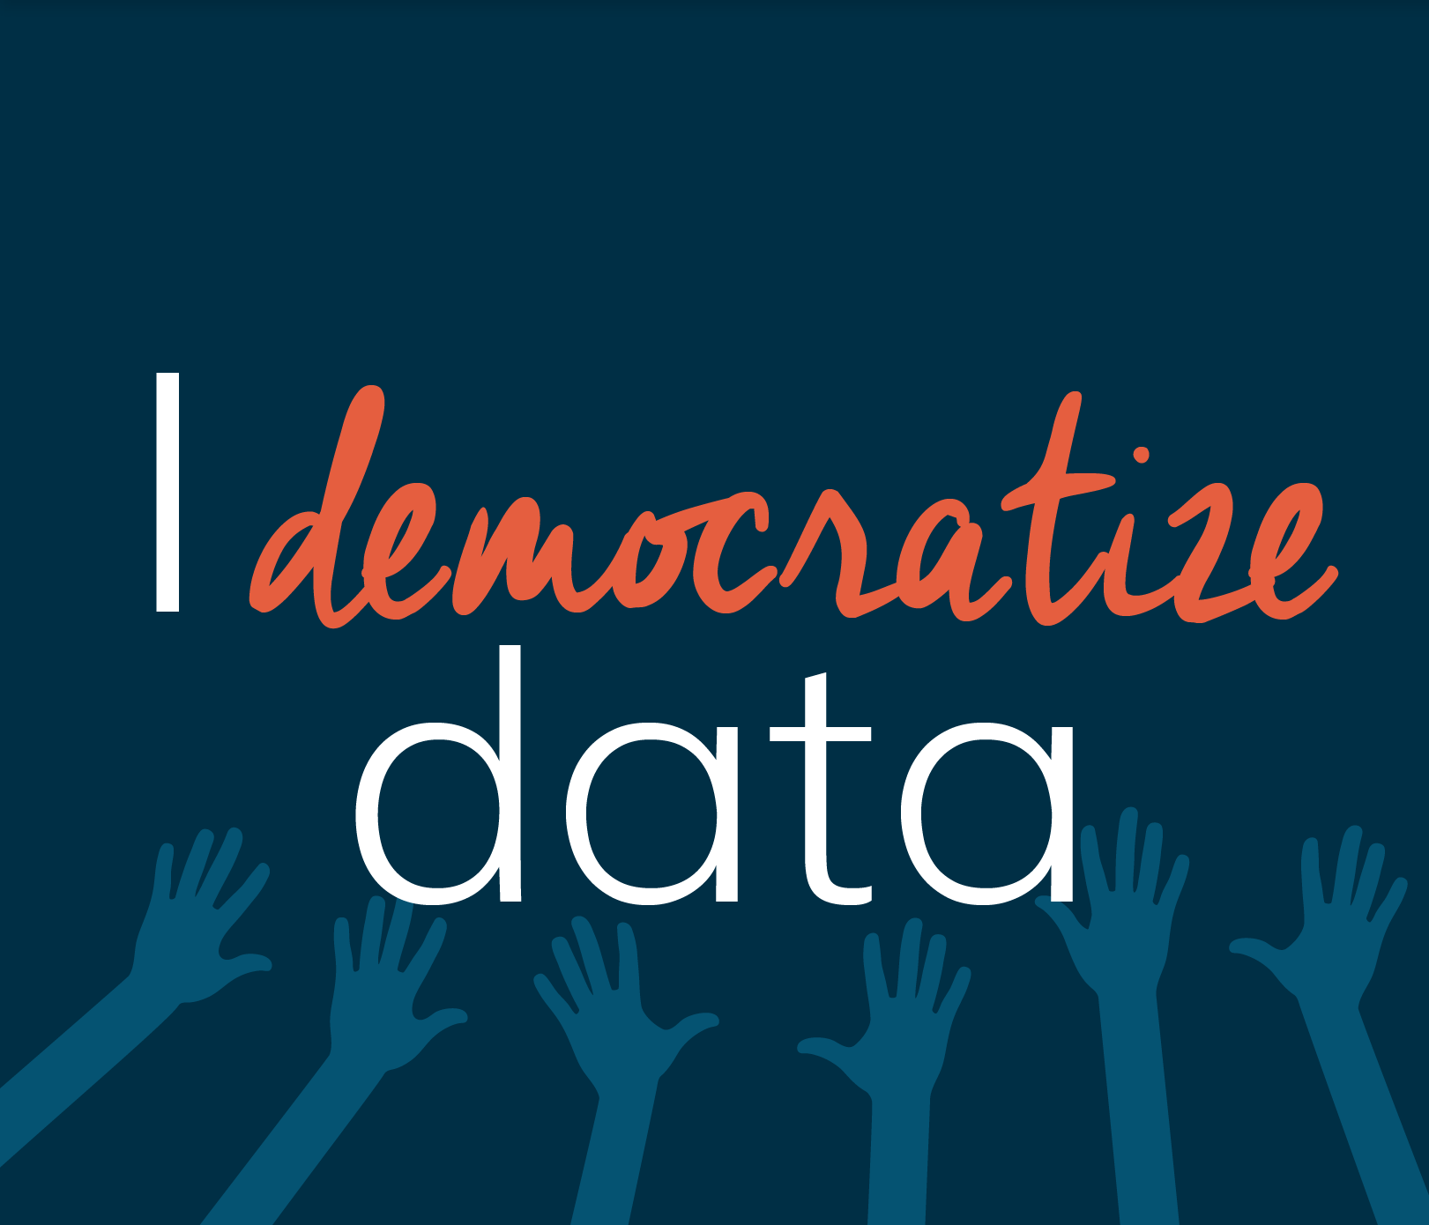
Expanding your impact with media

Slide 2
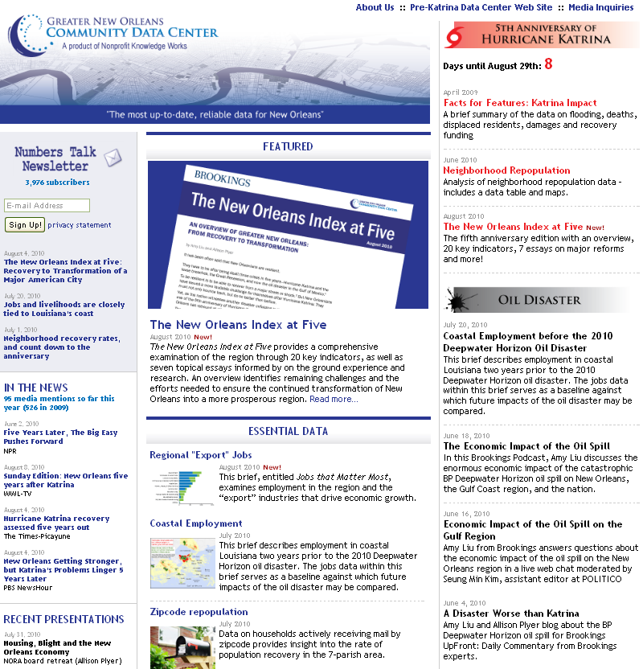
Unique visits
Approx 5,000 visits/month, 60,000 visits/year
Notes:
For many years our web site has been used extensively for grant writing, planning and advocacy. But after Katrina we wanted to extend our reach even further, to create a common understanding of trends to help inform the actions of key decisionmakers as well as the general public. And we realized that if we really wanted to democratize data, the internet wouldn’t cut it.

Slide 3
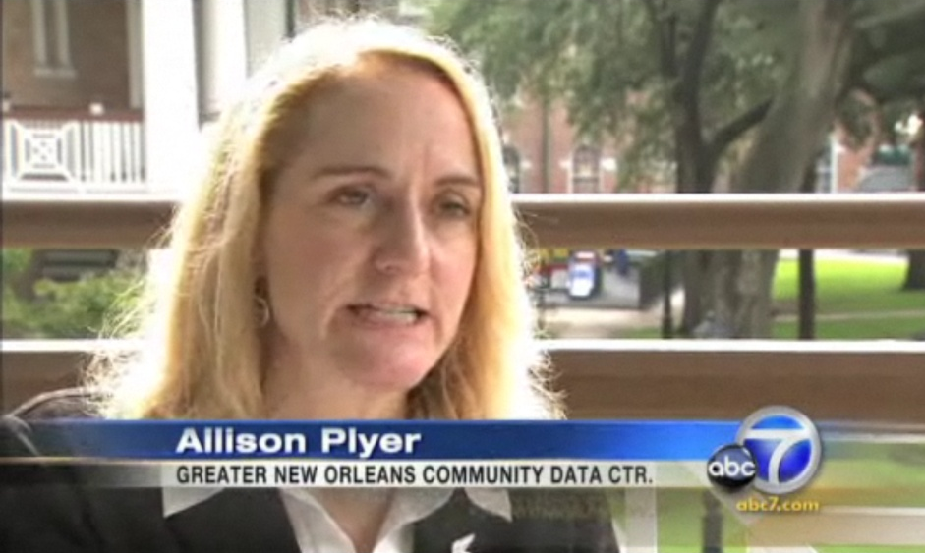
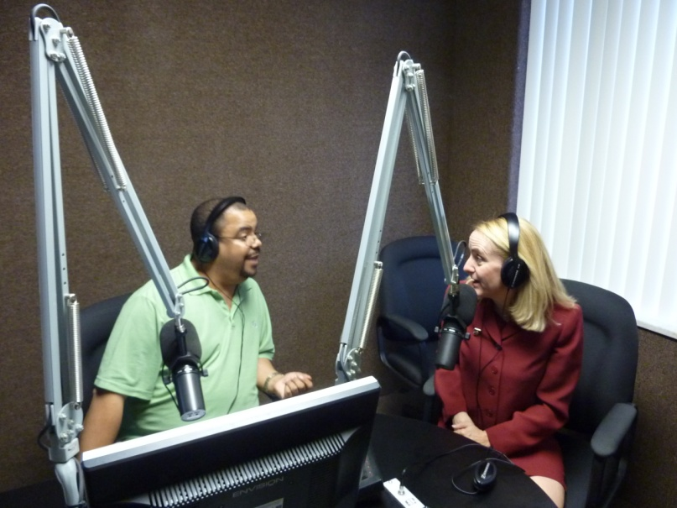
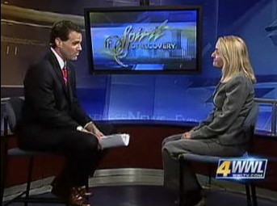
Form a common understanding…
Unique visits
Approx 5,000 visits/month, 60,000 visits/year
Notes:
We had to get on TV and Radio. Not everyone uses the internet as much as many of the folks in this room. We found that by getting on TV and radio we greatly expanded our reach to grassroots folks as well as decisionmakers.
Why was it important to reach a broader audience? Because our goal is {click} to form a common understanding from which all stakeholders can move forward in a common direction.

Slide 4
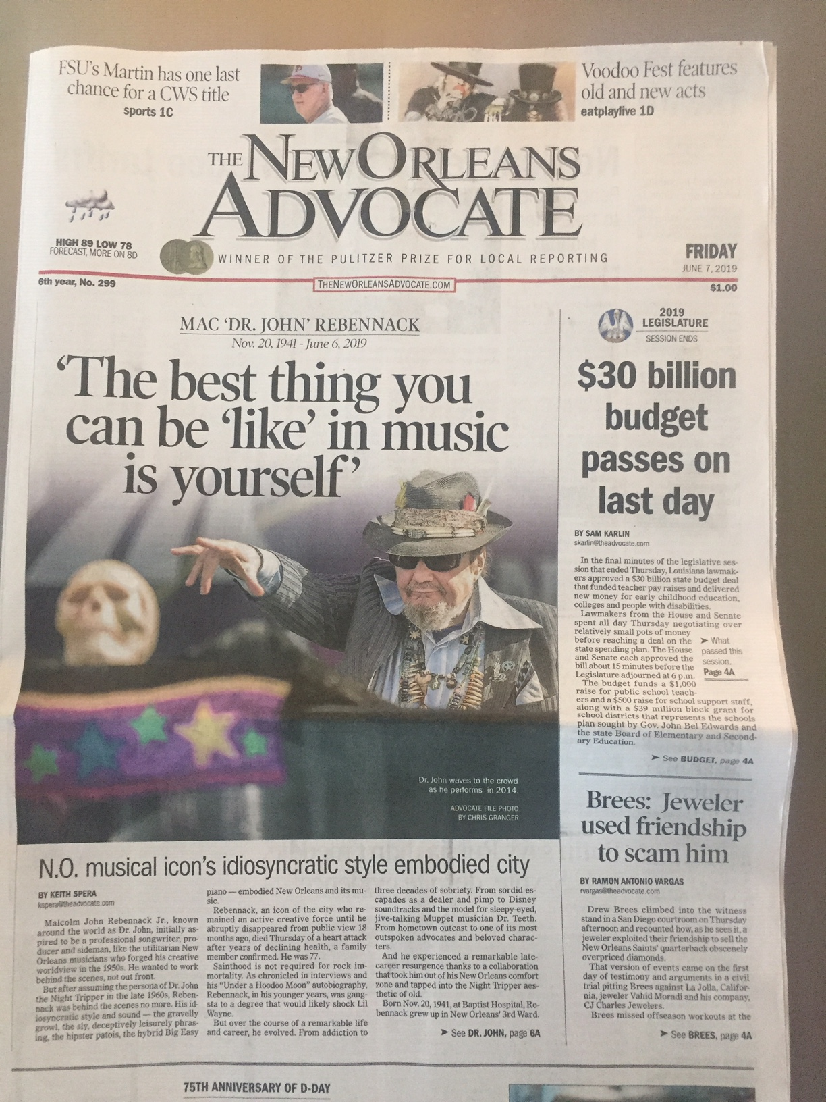
Why does media need data intermediaries?
Fact checking
Quality content and analysis

Slide 5
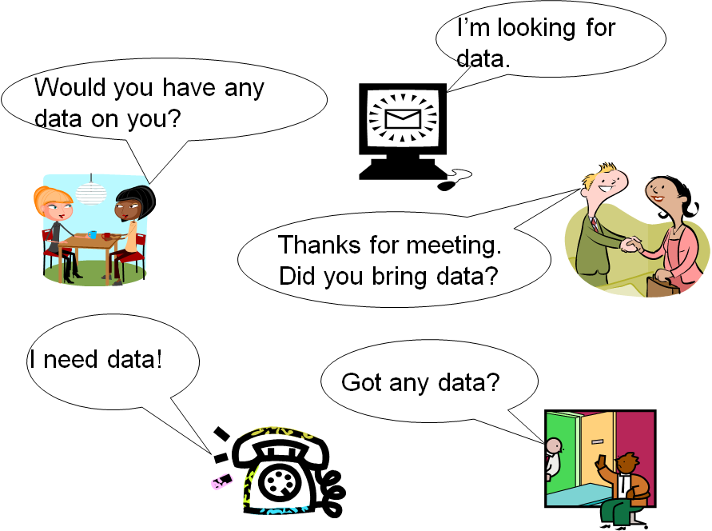
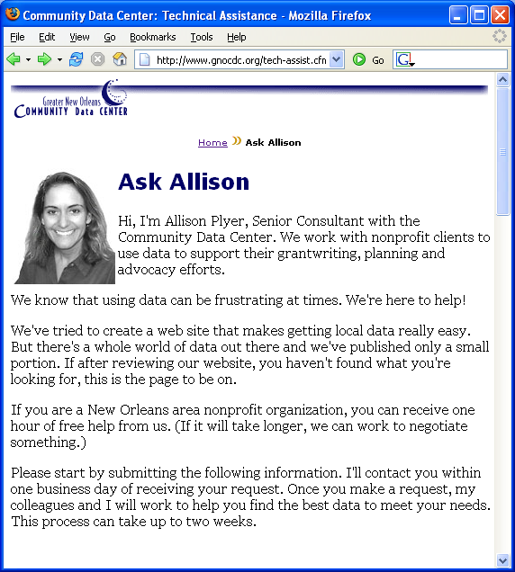
Ask an Expert

Slide 6
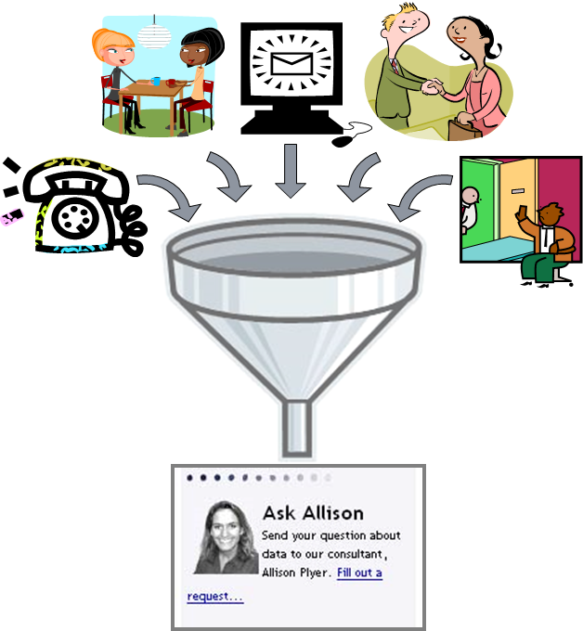
Ask an Expert
Protocol: Answer on same day

Slide 7
Ask an Expert
Protocol: Answer on same day

Slide 8
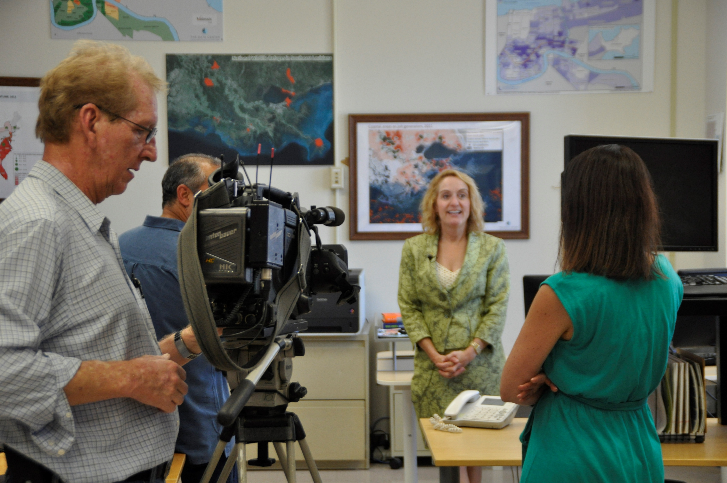
Hone your message
Notes:
Of course, you have a lot of data, and you know all the nuances in the data. But you have to find the key message or messages and make sure you articulate those.

Slide 9
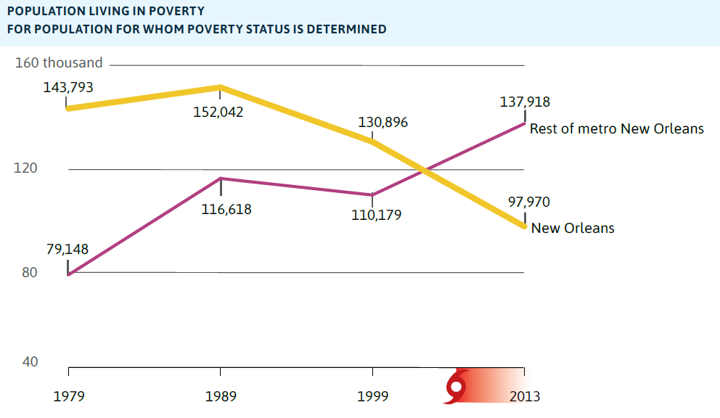
Hone your message:
Address common misconceptions
“The poor live in the city.”
Notes:
Address common misconceptions. A great way to get media attention.
For example, {click}
When in fact, {click} poverty is growing most quickly in the suburbs.
We are constantly scanning the media to identify common misconceptions or preconceptions that can be addressed with a data. We also attend all kinds of meetings to scan for possible preconceptions that can be addressed with data.
And then, of course, focus your message on that misconception

Slide 10
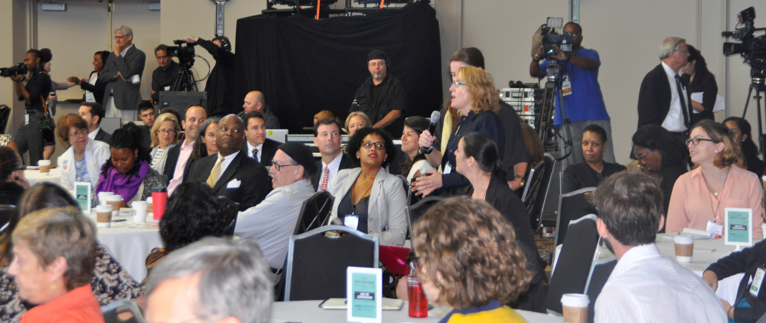
Hone your message:
Remember you are talking to your audience, not the interviewer.

Slide 11
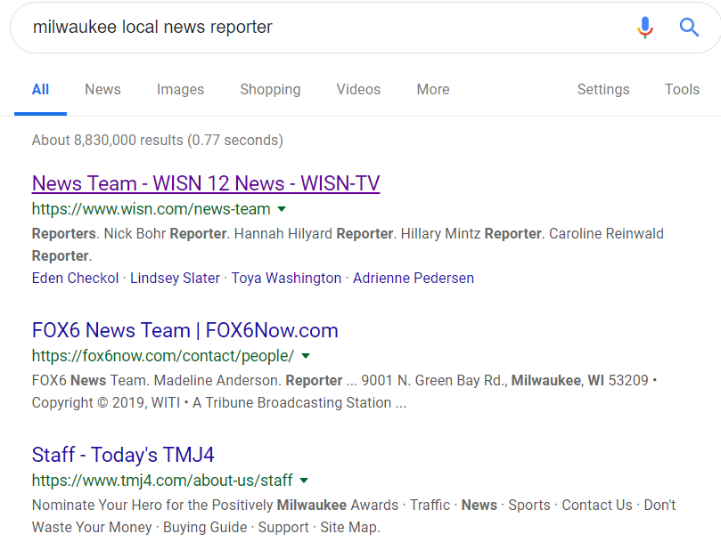
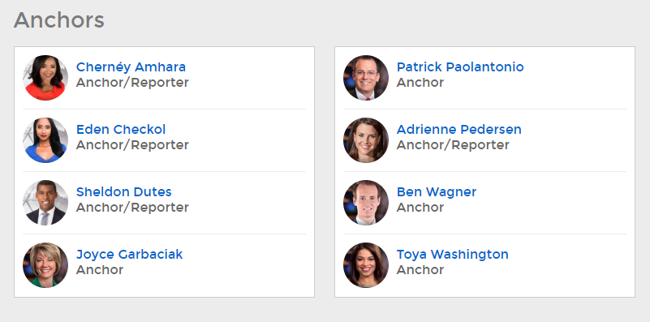
Assemble a list by googling

Slide 12
Yes, anytime, anywhere
Notes:
We had to get on TV and Radio. Not everyone uses the internet as much as many of the folks in this room. We found that by getting on TV and radio we greatly expanded our reach to grassroots folks as well as decisionmakers.
Why was it important to reach a broader audience? Because our goal is {click} to form a common understanding from which all stakeholders can move forward in a common direction.

Slide 13
How to:
Assemble a list by googling.
Hone your message.
Address common misconceptions.
Talk to the listener, not the interviewer.
Respond to requests on the same day.
Be willing to do media interviews anytime, anywhere.
Press releases….

