Slide 1
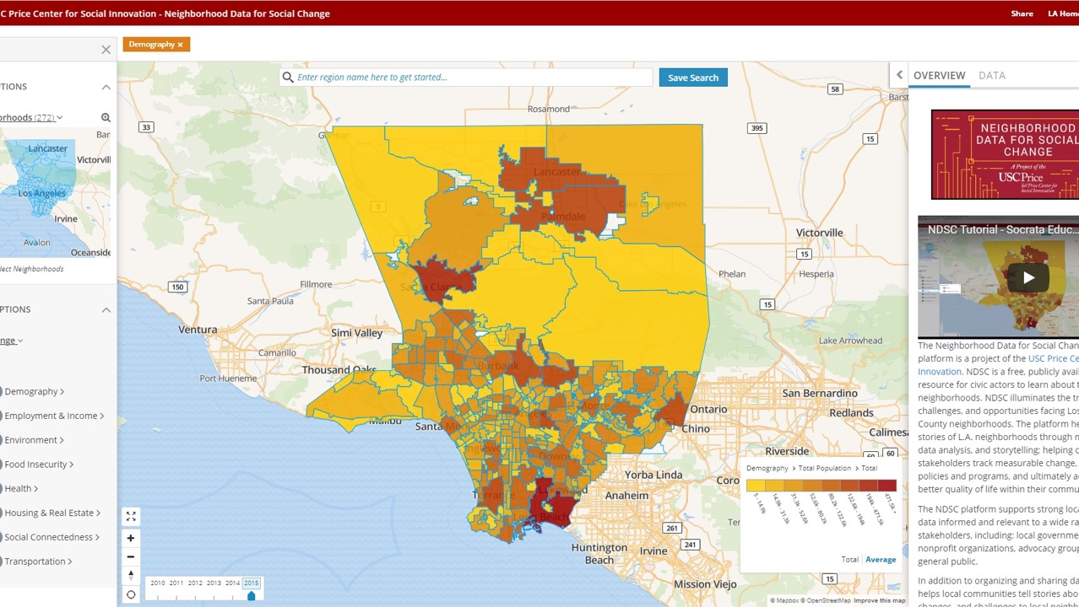
Neighborhood Data for Social Change
Caroline Bhalla, Managing Director

Slide 2
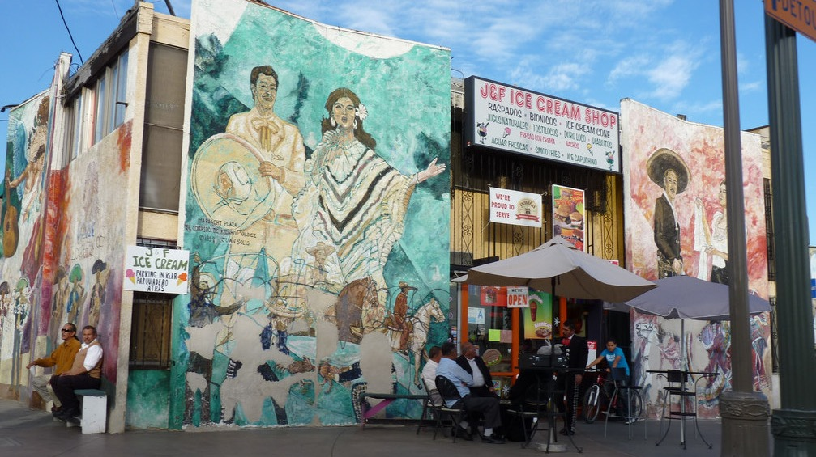
BOYLE HEIGHTS RESIDENTS FACE SIGNIFICANT OBSTACLES TO HOMEOWNERSHIP

Slide 3
OPPORTUNITY YOUTH IN LOS ANGELES

Slide 4
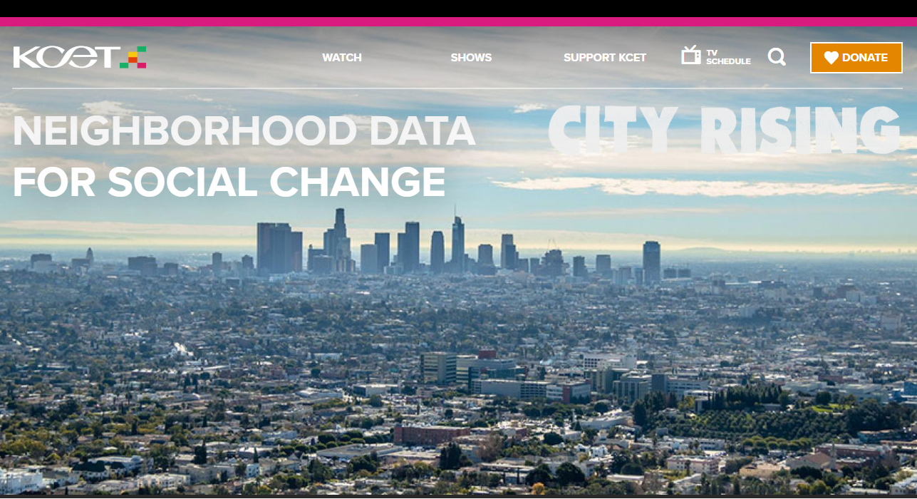

Slide 5
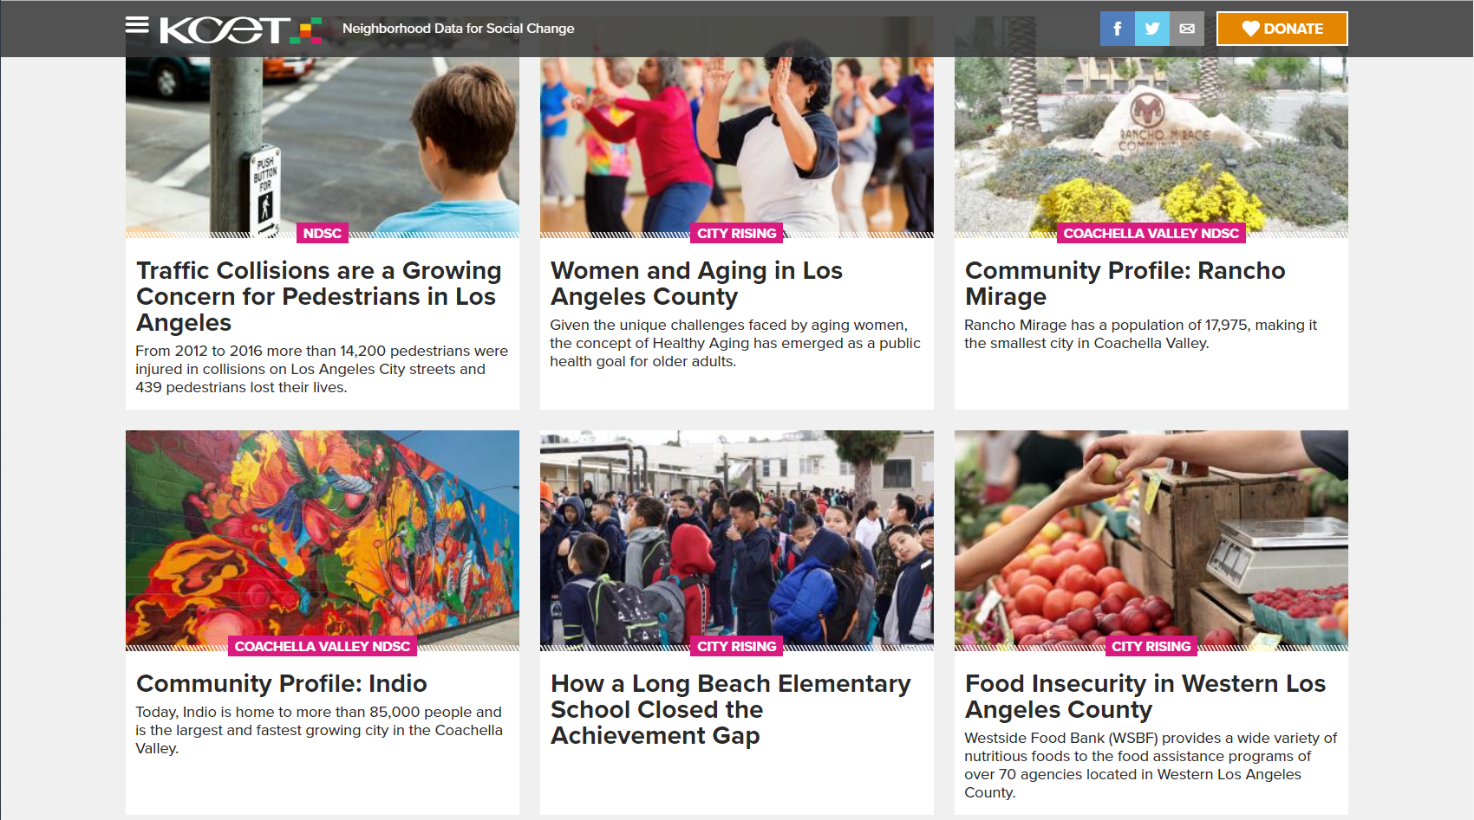

Slide 6
Stay Connected
@NDSC_LA
@PriceSocialInnovation
www.la.myneighborhooddata.org

