Slide 1
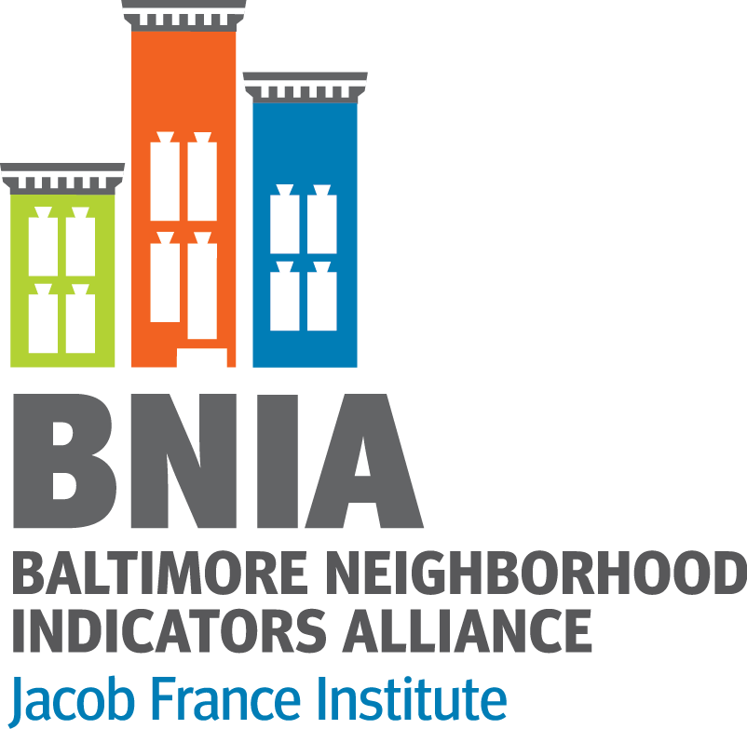
Working with Students: Baltimore Neighborhood Indicators Alliance
@bniajfi
Cheryl Knott Friday, October 13, 2017
cknott@ubalt.edu (410) 837-4377

Slide 2
Baltimore Neighborhood Indicators Alliance
Initially a stand-alone non-profit, moved to the University of Baltimore in early 2007
Housed within The Jacob France Institute in the Merrick School of Business
University of Baltimore is a non-traditional university
Students of all ages, all backgrounds
Majority commuter school
Urban campus
Business, law, public administration degree programs

Slide 3
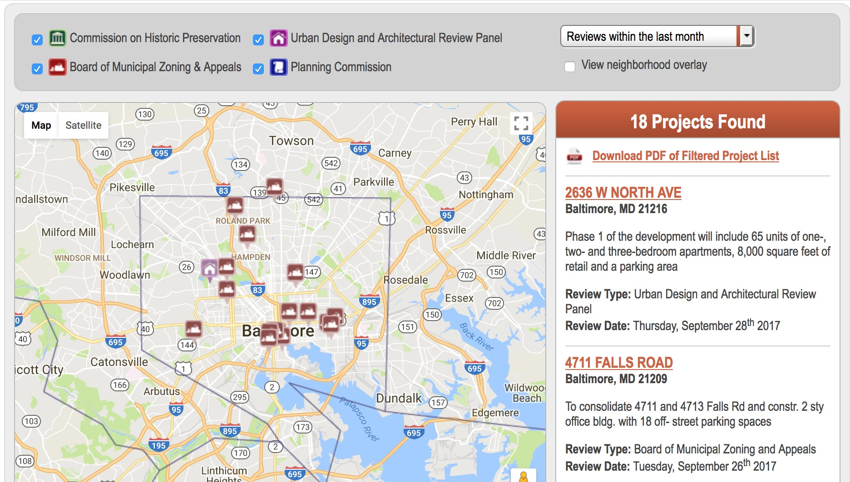
Real Estate Pipeline
Seema Iyer – Real Estate and Economic Development (REED) program:
realestate.bniajfi.org

Slide 4
Other Student Opportunities
Social media/publications design student from the undergraduate program in Digital Communications
Other University System of Maryland (USM) Students:
Mapping/GIS Assistants to assist with geocoding and mapping
Computer Science interns creating web scraping and data cleaning tools
Sondheim Nonprofit Leadership program at University of Maryland, Baltimore County (UMBC) – fellow assisting event coordination for Baltimore Data Day
shrivercenter.umbc.edu/nonprofitleadership/

