Slide 1
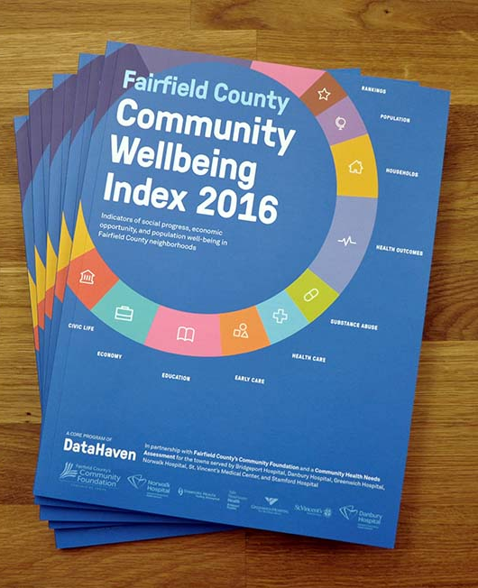

Working with University Students
Benefits to DataHaven as a placement or partner site
  Students can serve as flexible part-time or full-time (summer) paid staff to help complete projects
  More robust analysis of neighborhood data that we otherwise wouldn’t have time or resources to do (with co-preceptors)
              Students with journalism background can bring exceptional communications expertise
              Staff development – mentoring, research
              Build relationships with potential funders and diversify funding streams (federal revenue): universities and groups they work with like city government, hospitals, neighborhoods

Slide 2
Working with University Students
Placements/Partnerships at DataHaven
  Work-study placements and fellowships for undergraduate & professional students at Yale University, Southern Connecticut State Univ., University of Connecticut
  Graduate work (Doctoral students at Yale, Harvard, McGill, etc.)
  Serve on steering committees on community –university projects that focus on postdoctoral fellows’ work (Yale)
  Student newspapers and broader advising/guest lectures

Slide 3
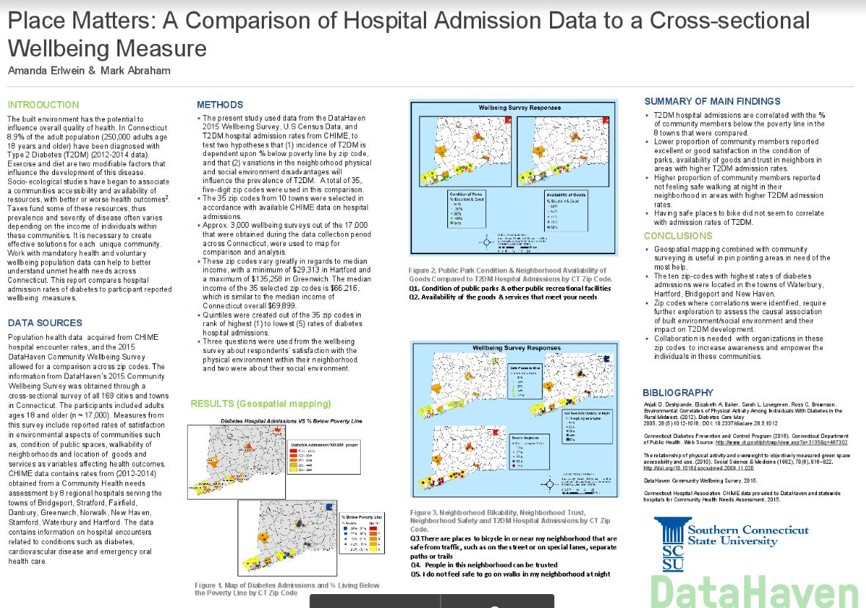
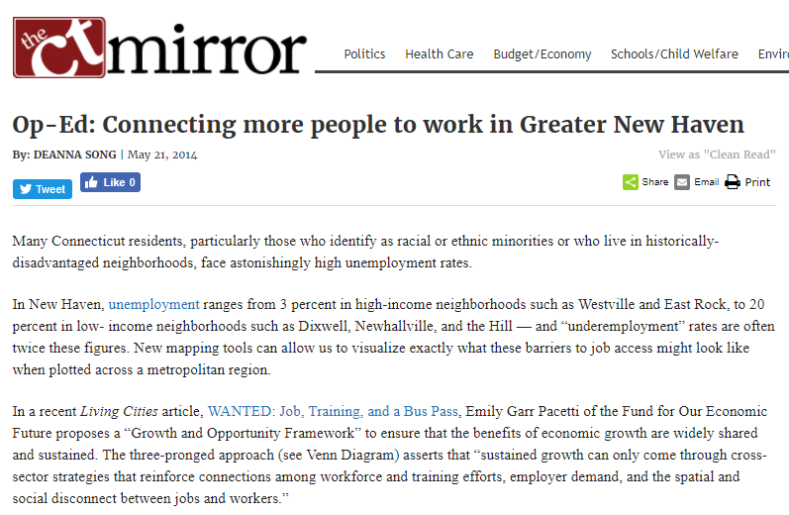
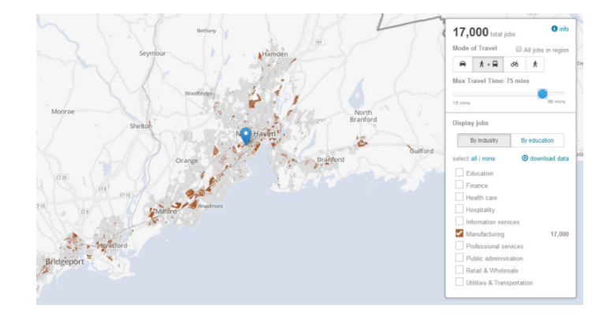
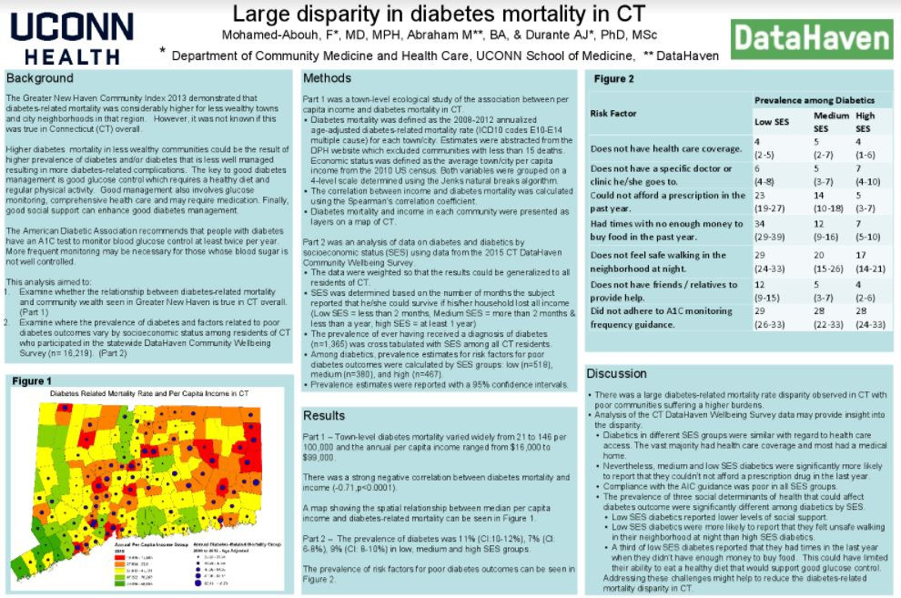
Working with University Students

Slide 4
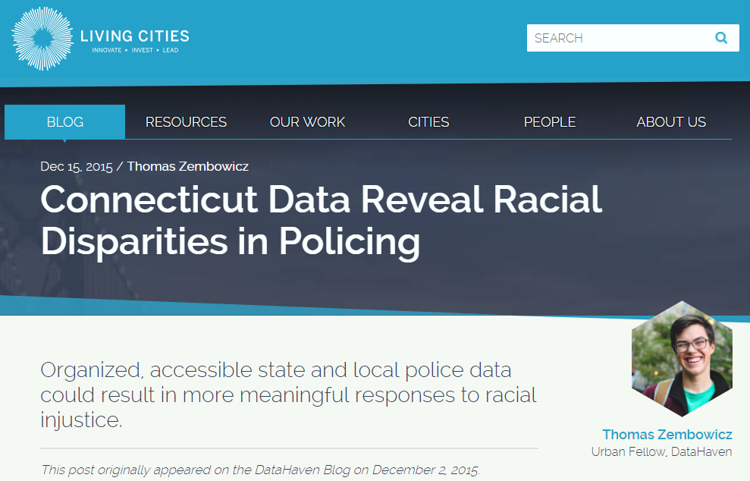
Working with University Students

Slide 5
Working with University Students
Student preferences
  Being matched with an appropriate project/site requiring a sufficient level of independent work (or guidance)
  “Hands-on” experiences, like survey collection & field work
  Combining field work with classroom experiences and theory
  Responsible and responsive mentors/faculty/staff who can help navigate diverse neighborhoods and situations
  Publications or portfolio pieces

Slide 6
Working with University Students
Community partner preferences
  Being involved at outset of projects and seen as collaborators and equals in thinking about what kinds of studies to design and how communities can help (e.g., community-engaged research)
      “Unless you include community members from beginning to end and honor their skills and expertise, you won’t get to the right questions.”
      -Dr. Emily Wang, Yale University / DataHaven Board
  Longer placements (e.g. 1 year vs 1 month), and long-term relationships with organizations providing students/fellows
  Receiving data or final products that are useful and timely
  Compensation if they are serving as a mentor or placement “site,” including funding to pay staff and students
  Easy and effective application/matching process

