Slide 1
Social Media Strategy
Using social media as a micro-publication and advertising strategy to reach current and new users
Dabne Whitemore, Director of Finance and Development
dabnew@datacenterresearch.org

Slide 2
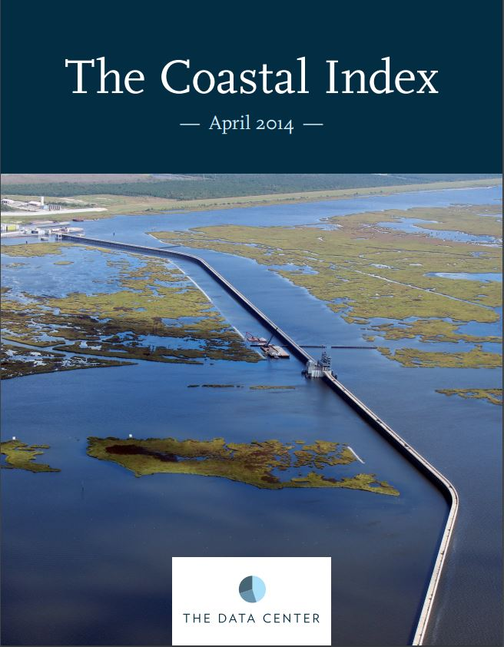
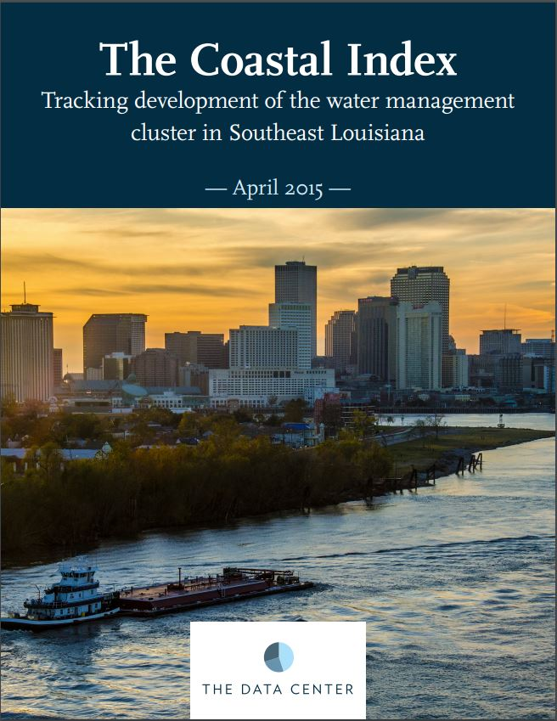
Background
Started in April 2016
Grant-funded by Walton Family Foundation
  Republish through data visualization
  Increase awareness of coastal issues following BP oil spill in 2010
Twitter: 490 Followers
Facebook: 154 Page Likes
LinkedIn: 91 Followers

Slide 3
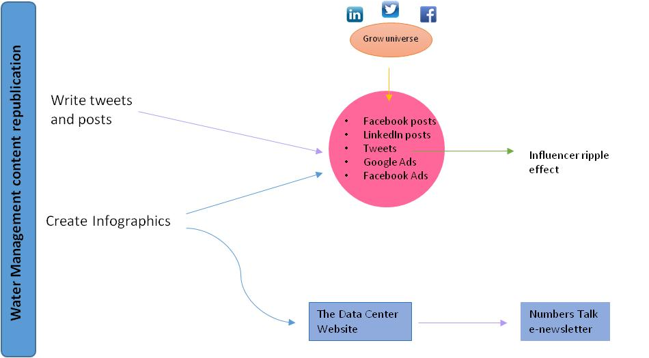
Social Media Strategy Development

Slide 4
Operational Process
Hired outside vendor to oversee content and posting
Review and approve weekly calendar
Same content in posts across all platforms (FB & LinkedIn, Twitter, Instagram)
Check data, links, and approve graphic
Schedule posts for week through Spout Social; recycle posts
Monthly analytic reports

Slide 5
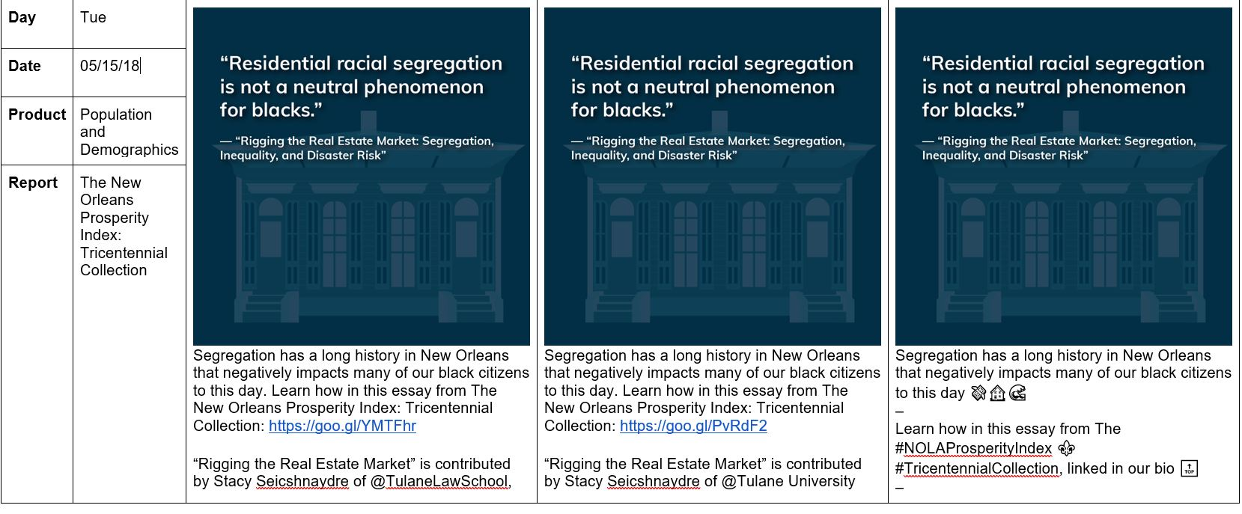
Social Media Calendar Example
Facebook / LinkedIn = 1 post daily
Instagram = 3/week

Slide 6
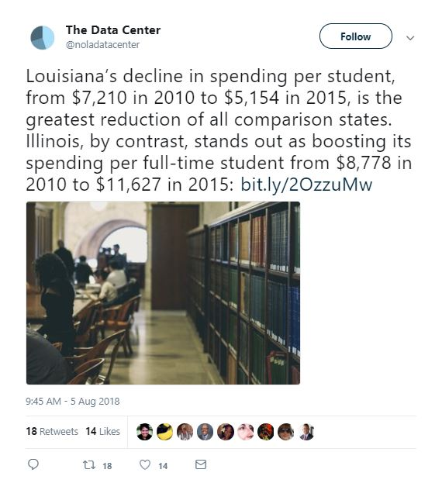
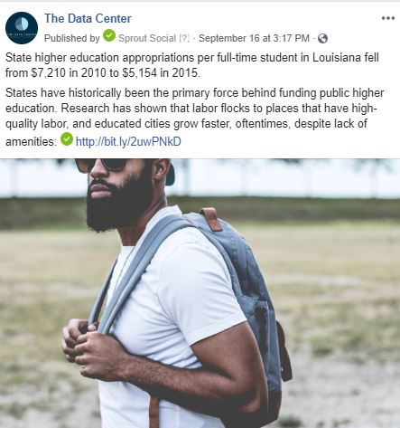
Content

Slide 7
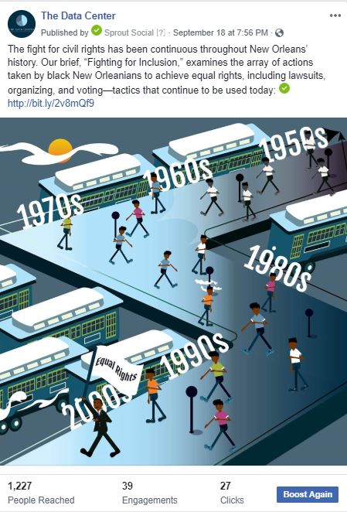
Infographics

Slide 8
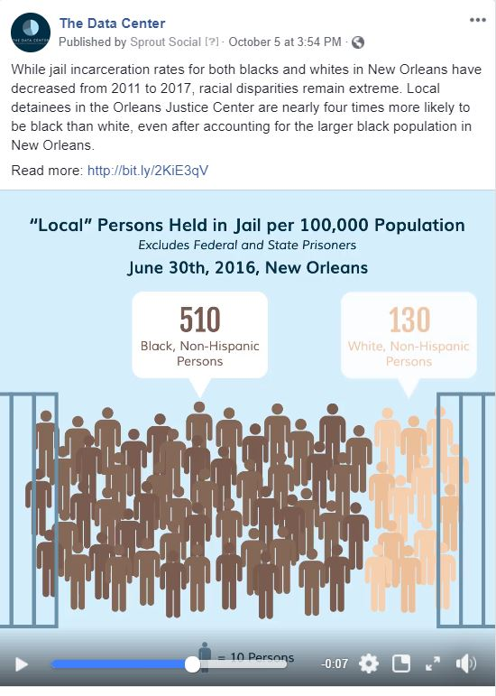
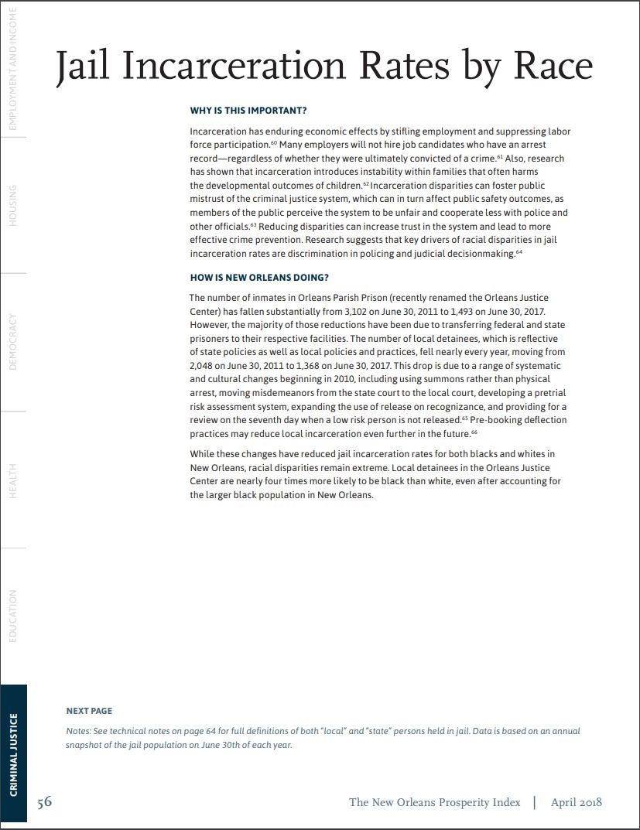
Infographics

Slide 9
Infographics

Slide 10
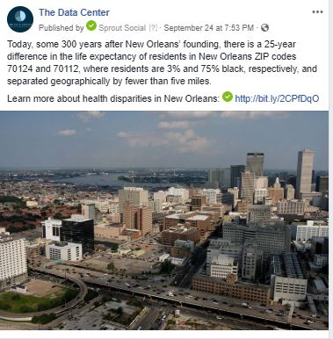
Engagements: Comments

Slide 11
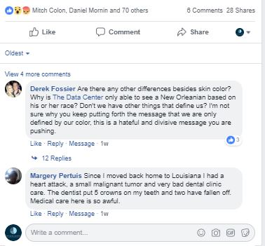
Engagements: Comments

Slide 12
Engagements: Comments

Slide 13

Engagements: Comments

Slide 14
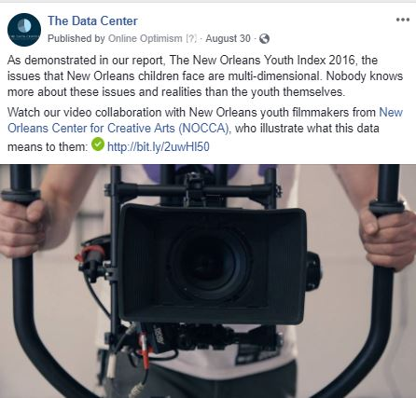
Facebook Advertising

Slide 15
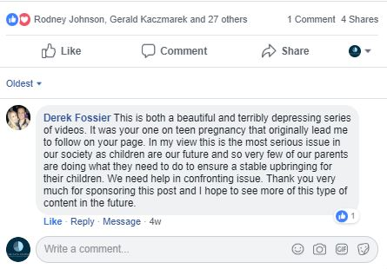
Facebook Advertising

Slide 16
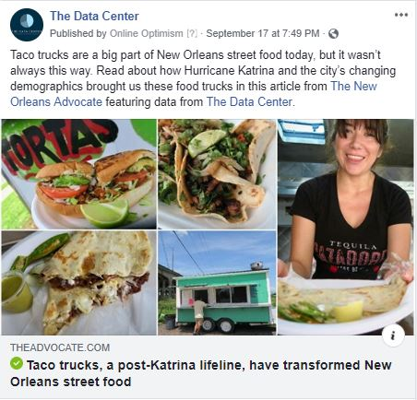
Traditional Media

Slide 17




Measuring Impact for Social Media
4 Sequential Stages
  Vanity Metrics
  Engagement Metrics
  Narrative impact
  Anecdotal outcomes

Slide 18
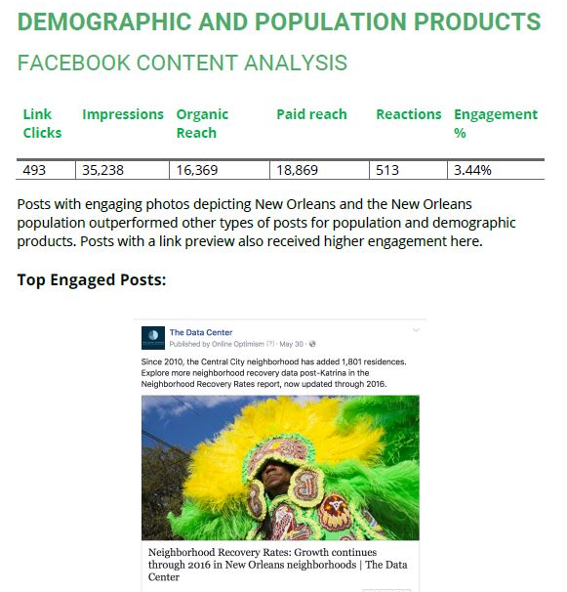
Challenge: Reporting
Reports are over 100+ pages in a PDF!

Slide 19
Challenge: Reporting
“A top Facebook post from this month received
85 reactions and 21 comments.”

Slide 20
Challenge: Reporting
“A top Facebook post from this month received
85 reactions and 21 comments.”

Slide 21
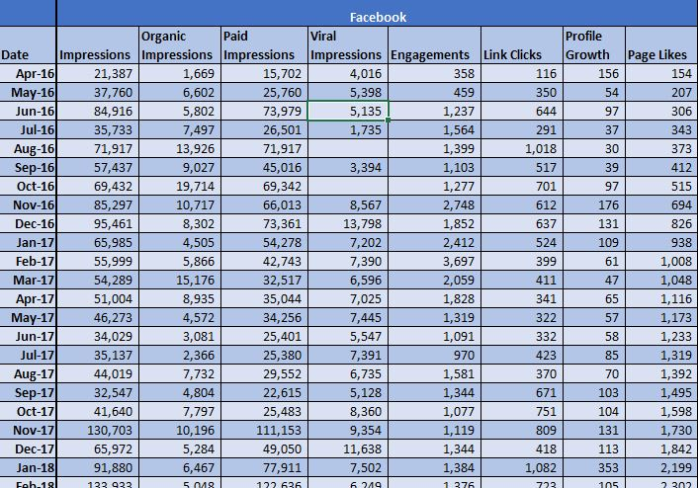
Solution!

Slide 22
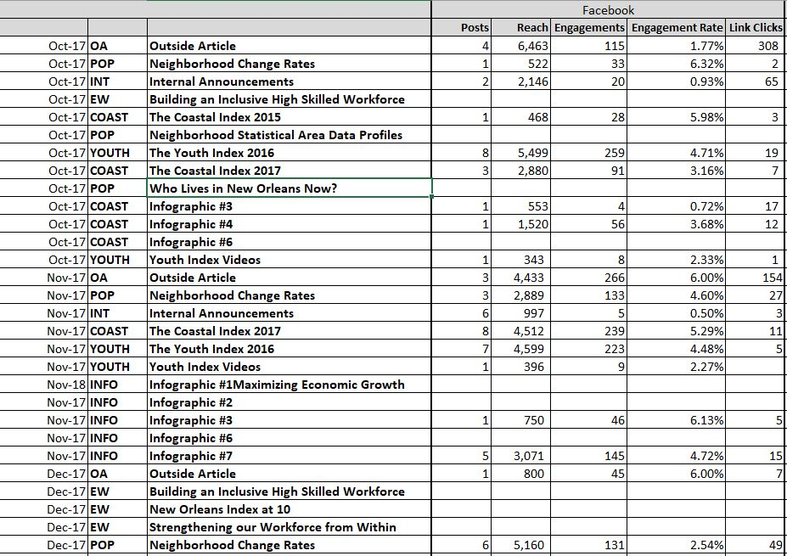

Slide 23
By the Numbers!

Slide 24
By the Numbers!

Slide 25
By the Numbers!

Slide 26
Where are we now?
We have a data set!
Do some data wrangling that can be integrated monthly in an internal KPI dashboard
Hiring a market analytics firm to help us establish a framework to answer the more in-depth metrics around anecdotal outcomes, user demographics, and content analysis.
  “Changes in laws and policies, causing shifts in public debate, alterations in individuals’ knowledge, beliefs, and behavior.”

