Slide 1
Social Media: A Detroit perspective
Stephanie Quesnelle, Research Analyst
October 1, 2018

Slide 2
Outline
Overview of social media platforms
D3’s communication strategy
Our new social media strategy

Slide 3
Social Media Platforms

Slide 4
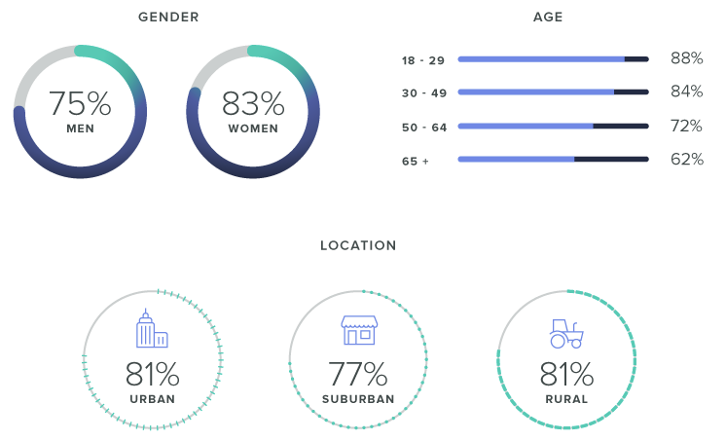
Facebook
Purpose: Build an organization’s reputation
Easily communicates ideas, insights, and events to the broader community
2.3 Billion Users
Facebook Demographics
Notes:
Setback: Changes to policies decreased organic engagement recently. Small advertising budget is very helpful
Pro tip: Business manager gives multiple users ability to post and maintain the site

Slide 5
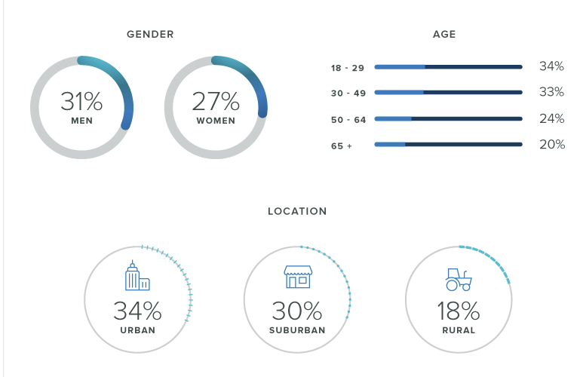
LinkedIn
Purpose: Foster professional networks and stay engaged with key community actors
562 million users (24.4% of Facebook Users)
LinkedIn Demographics
Notes:
Setback: Significantly smaller active userbase than Facebook
Protip: Content can be very similar to Facebook, but edit the posts slightly to keep people on both platforms engaged.

Slide 6
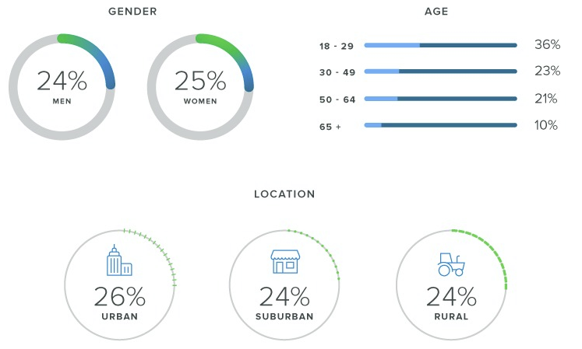
Twitter
Purpose: Breaking news, conversations, and instant feedback
310 Million Users (13.5% of Facebook)
Twitter Demographics
Notes:
Setback: Rapidly changing conversations and content can be quickly buried…1.75 million tweets a day. Easy to get lost.
Protip: Interactions with followers and responses are really important as it builds relationships. Don’t use too many hashtags.

Slide 7
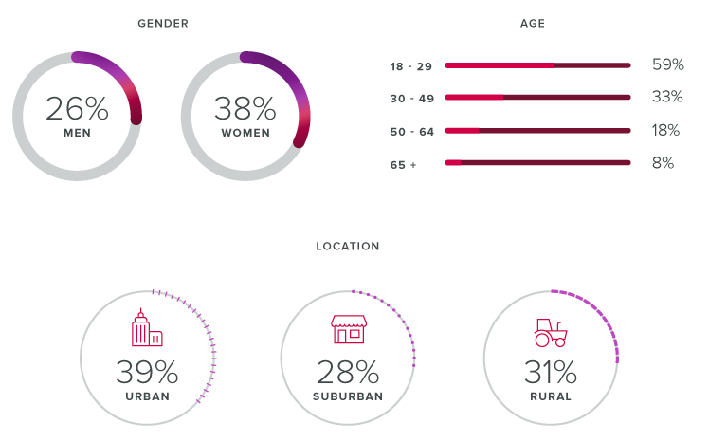
Instagram
Purpose: Sharing aesthetically pleasing or very interesting videos and images
1 Billion Users (43% of Facebook Users)
Instagram Demographics
Notes:
Setback: Requires interesting events and content to display in photo format and intensive graphic design experience for graphics
Protip: hashtags. Recent study found 9-12 hashtags get the most engagement and longer hashtags (21-24) perform best

Slide 8
D3’s Communication Strategy

Slide 9
Our Social Media Goals
Promote good research about issues we care deeply about
Highlight our own work in the Detroit area
Spark curiosity and encourage people to dig deeper

Slide 10
Challenges D3 faces with social media
Out-source social media management
Limited understanding of D3’s expertise when commenting
Time consuming and difficult to manage engagement processes
Privacy considerations for staff

Slide 11
D3’s Social Media Platforms
Facebook
LinkedIn
Twitter
Instagram

Slide 12
Why not Twitter and Instagram?
Twitter requires time devoted to engagement and conversations
Budget limitations
Expertise limitations
Time limitations
Instagram requires engaging photos and graphics
Limited material
Privacy implications for staff
Graphic design requirements

Slide 13
Our New Strategy

Slide 14
The Problem
Over 10 years, a lot of accumulated knowledge
Not always easily accessible
Difficult to digest and understand
Many other actors also provide valuable resources

Slide 15
The Solution
Data Vignettes
Online subject-based portals to a variety of information
Key indicators
Local data
Interesting maps, news, research papers, and blog posts
Online tools
Other resources
Provide resource to the community AND around 3 months of useful, impactful data points for social media posts

Slide 16
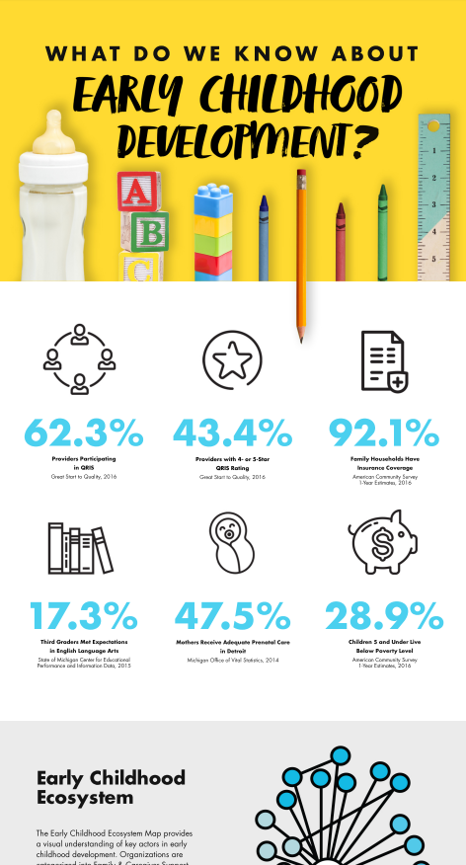

Slide 17
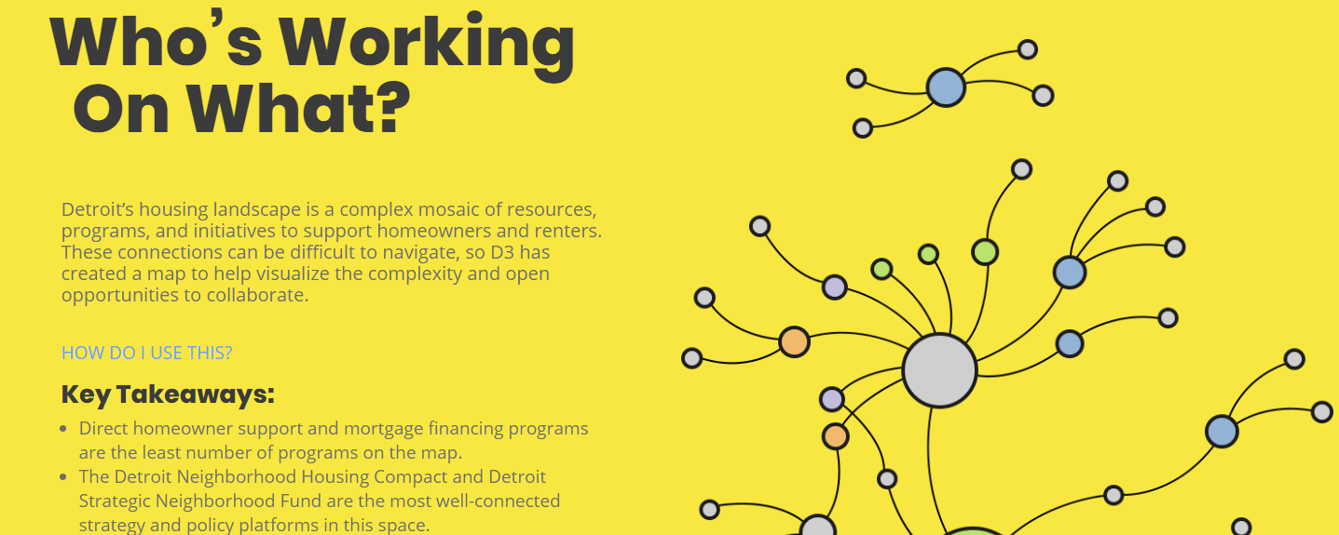

Slide 18
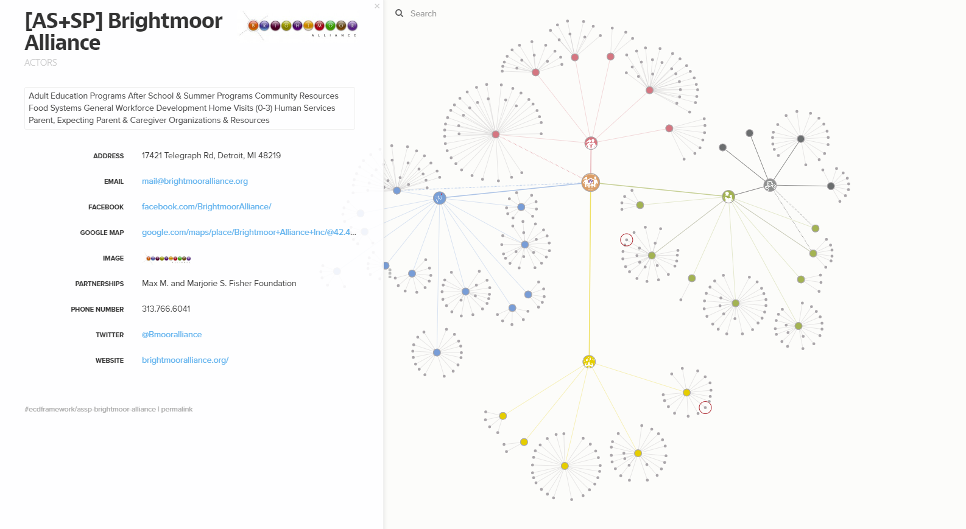

Slide 19
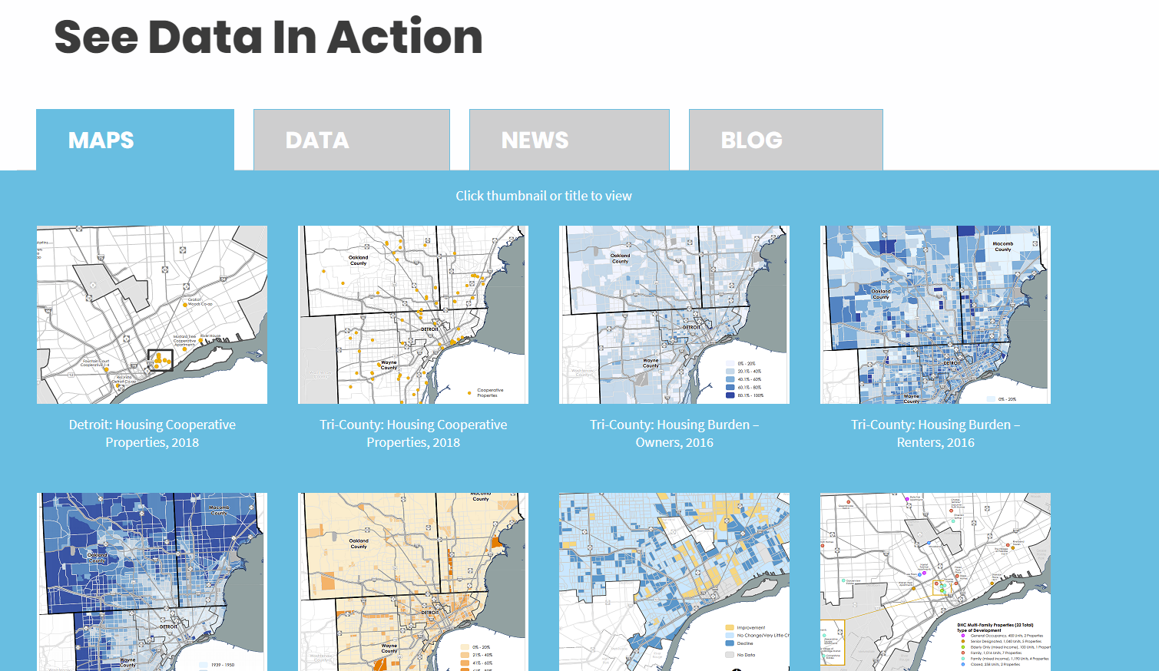

Slide 20
www.DataDrivenDetroit.org
Stephanie Quesnelle
squesnelle@DataDrivenDetroit.org
Looking for data?
AskD3@DataDrivenDetroit.org

