Slide 1

Urban Data Platform
https://www.kinderudp.org
October 19th, 2018
Notes:
The Kinder Institute Urban Data Platform is created to facilitate cross-disciplinary research to advance knowledge about Houston's people, government, and built environment.

Slide 2
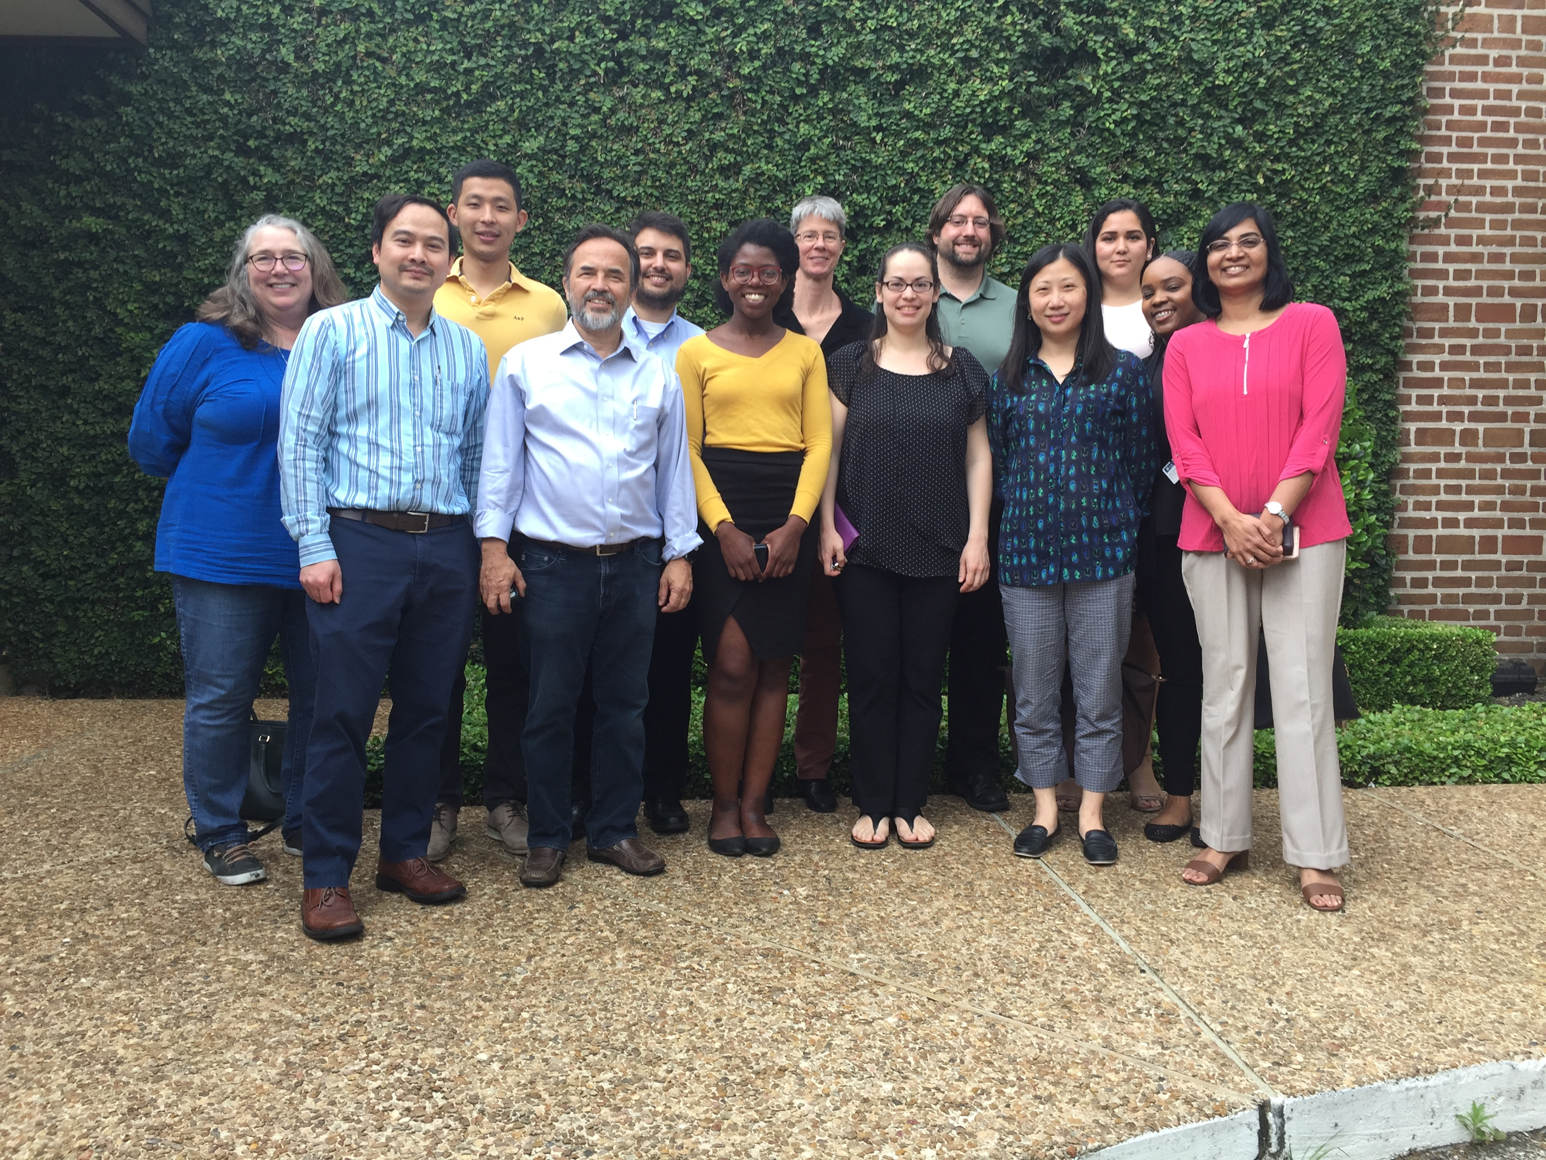
Our Team
Notes:
This data initiative is led by Dr. Kathy Ensor, a Statistics professor at Rice University and supported by a team with experience in GIS, statistics, data management, and IT.

Slide 3
Data are Secure
Rice Network
UDP Data
VRDE Virtual Machines
VPN
Notes:
The Urban Data Platform has two primary components. The first is a secure computing environment and data library of research-ready geocoded data for Houston.

Slide 4
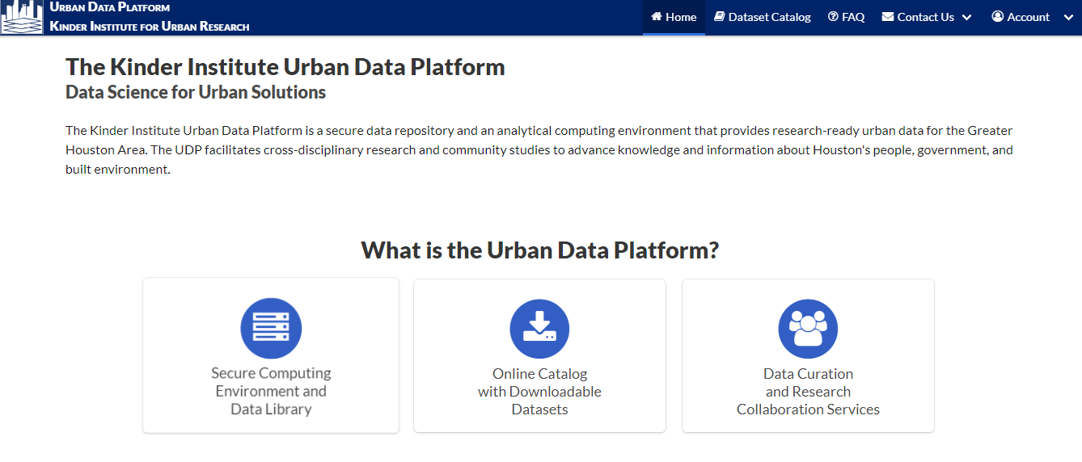
kinderudp.org
Notes:
The second component is a public online dataset catalog that allows users to search the metadata and download unrestricted and shareable datasets.

Slide 5
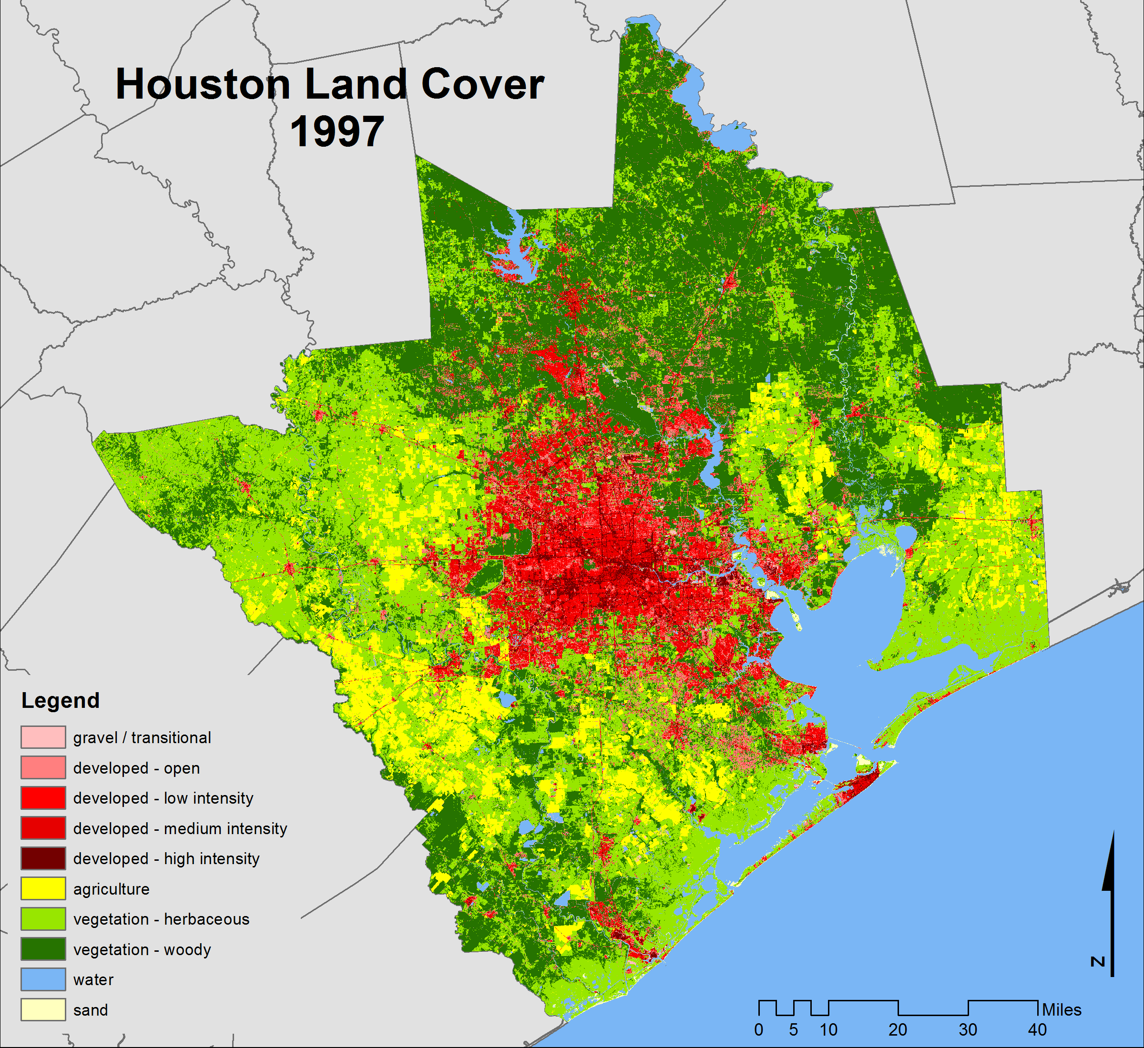
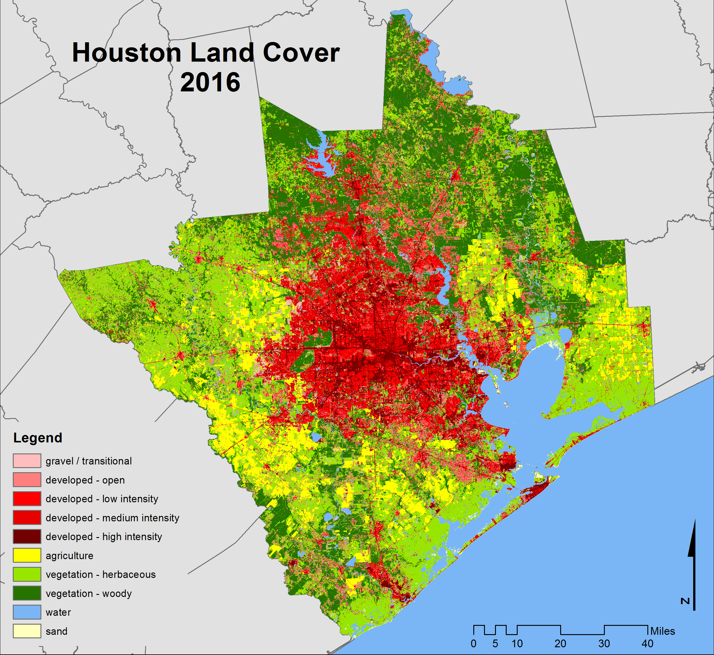
Houston Specific
https://doi.org/10.25612/837.zky64nnmo9y3
Notes:
The majority of the data is local and covers a maximum of a 15-county region. The geographic units of the data vary from address-level to county-level. Unlike pulling data from federal websites, all data has already been processed specifically for our region. Some are collaborative data, which was collected by a variety of agencies and aggregated by the UDP team, some are original data created by the Kinder researchers.

Slide 6
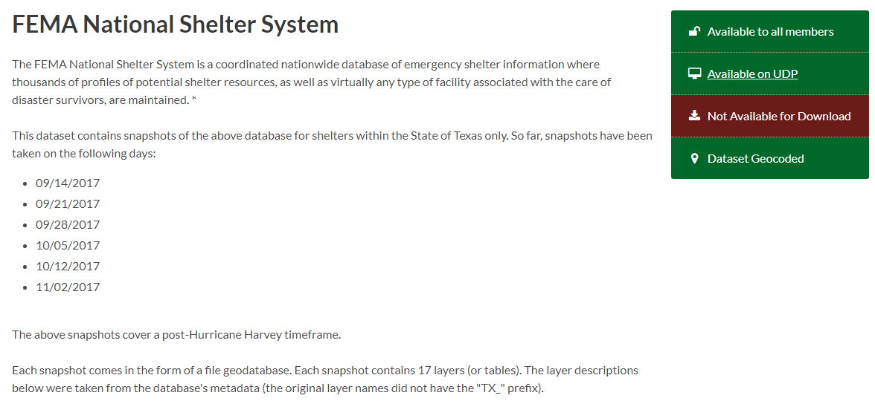
Time-Sensitive Data Snapshots
Notes:
In special instances, like Harvey, a lot of data is generated rapidly, and much of it may be freely available but hard to find, or could be a live snapshot. So we download and provide those time-sensitive data snapshots.

Slide 7
Researcher-Ready
Notes:
So what’s the strength of the datasets available at UDP? They are research-ready!!
What does that mean?

Slide 8
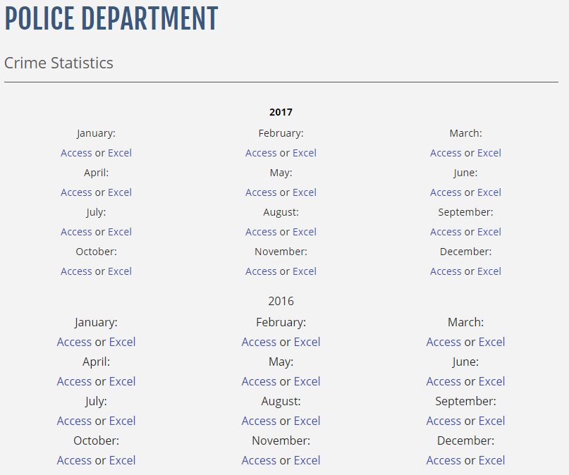
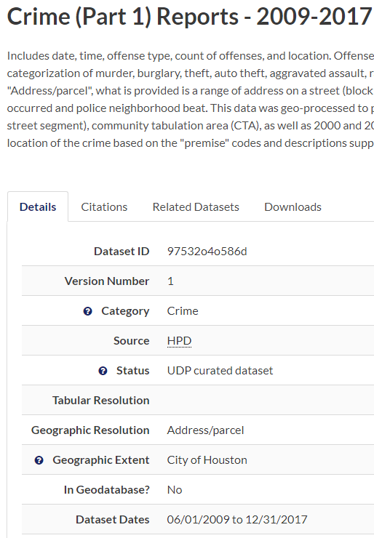
Unified, Cleaned and Standardized
Notes:
Data are unified, cleaned and standardized. For example, we may remove invalid values, rename and format fields, create variable that indicates whether the original record has a code, a description, or is missing.

Slide 9
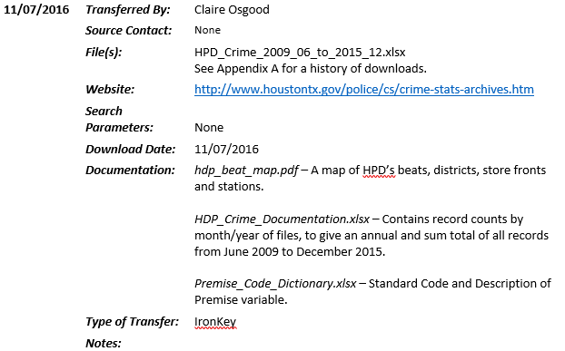
Researched, Enhanced and Documented
Notes:
Data are researched and enhanced. The data curation steps are documented. This is a small snapshot of a 3-page document describing every time the data was downloaded, uploaded, or transferred.

Slide 10
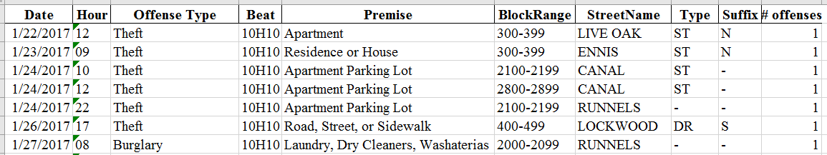
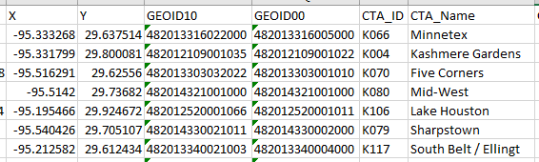
Geocoded
Notes:
Data are geo-referenced, allowing linking across multiple data sets by shared geography. Geocoding results are also documented.

Slide 11
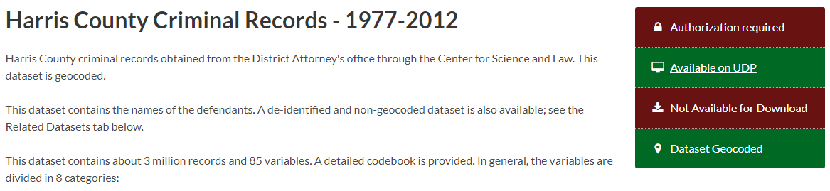
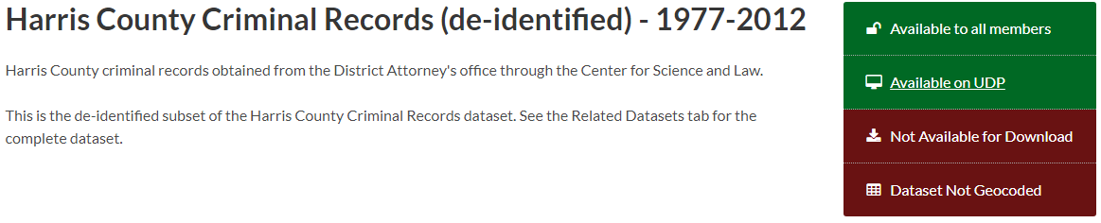
Aggregated
Notes:
In addition, when it is possible to take restricted data and remove variables or aggregate data to a larger geographic unit, so that the data can be shared, we will do so and provide as a secondary dataset.

Slide 12
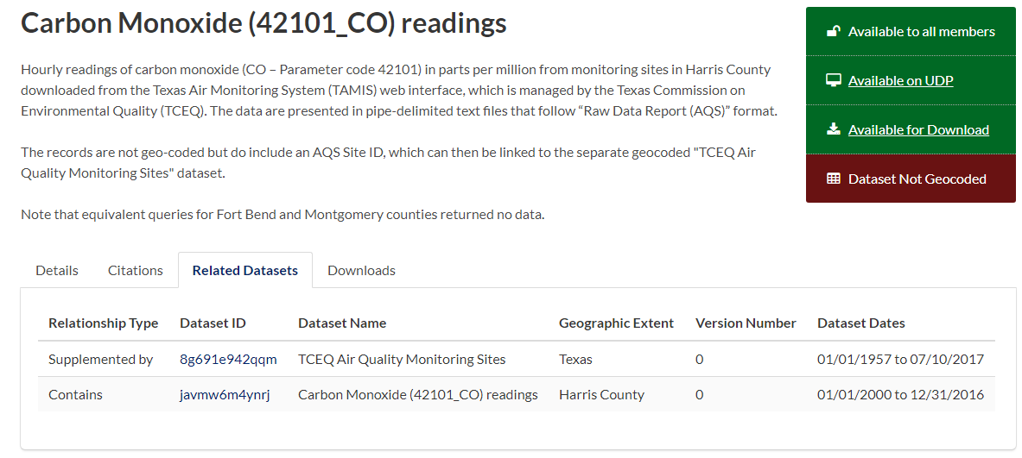
Cross-Referenced
Notes:
In cases where tabular datasets can be easily joined to spatial datasets, clear instructions are provided, indicating the name of the spatial data available on the UDP, along with the particular variable to be used in the join. Under the “Related Datasets” tab, the necessary spatial data is listed. Clicking on the Dataset ID will take you straight to that data.

Slide 13
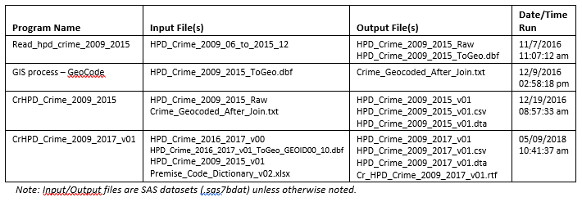

Audited and Archived
Notes:
Data are audited and archived. Datasets are published and meet public data access requirements for federally funded research.

Slide 14
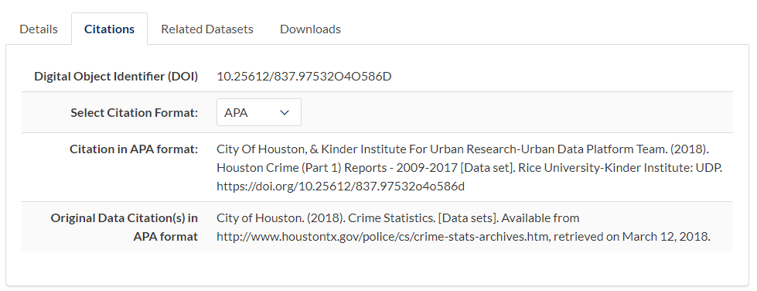
Licensed and Citable
Notes:
A Digital Object Identifier is a unique, registered string for persistent identification of digital content and associated metadata. Dataset history is also available. Any updates receive a new DOI.

Slide 15
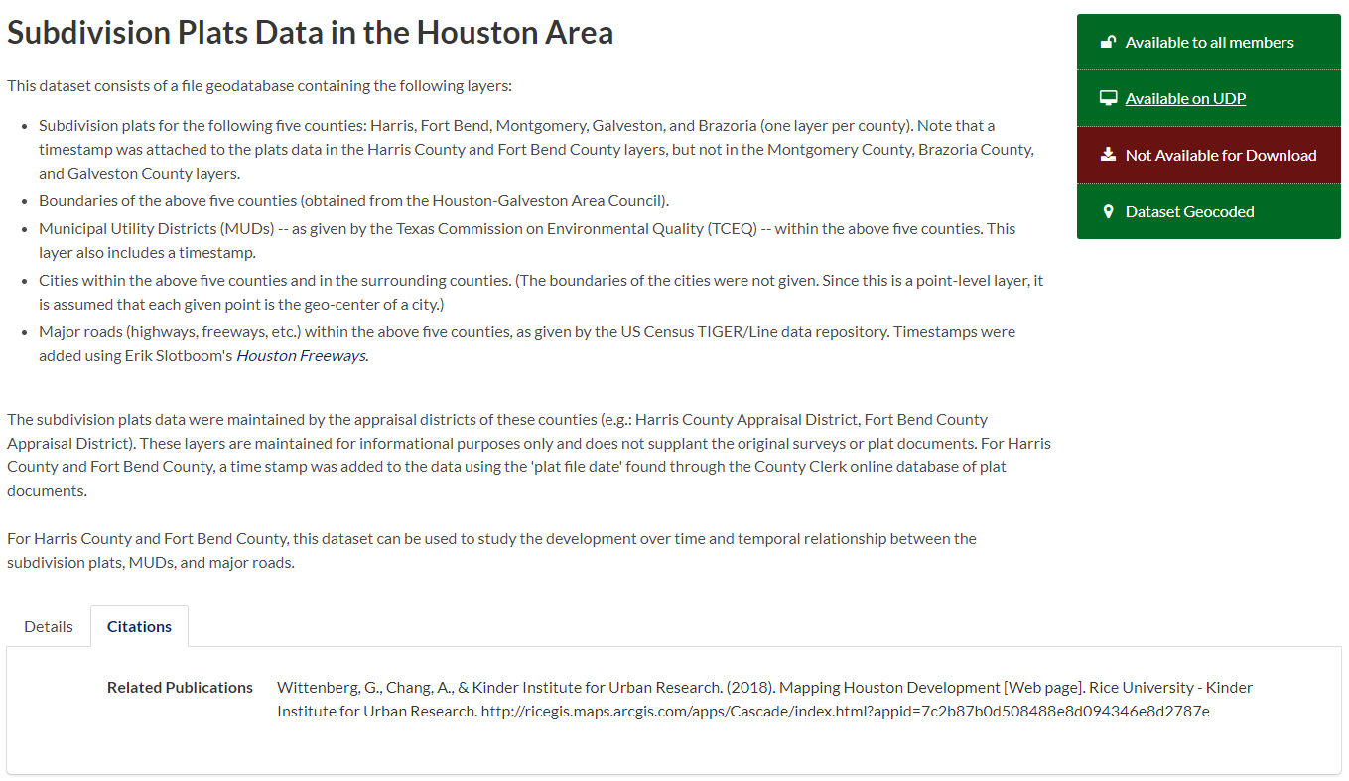
Cited Data are Accessible
Notes:
UDP will mint DOIs for each published dataset through DataCite in collaboration with Rice University’s library. And in turn, with a DOI, citations are picked up by various systems.

Slide 16
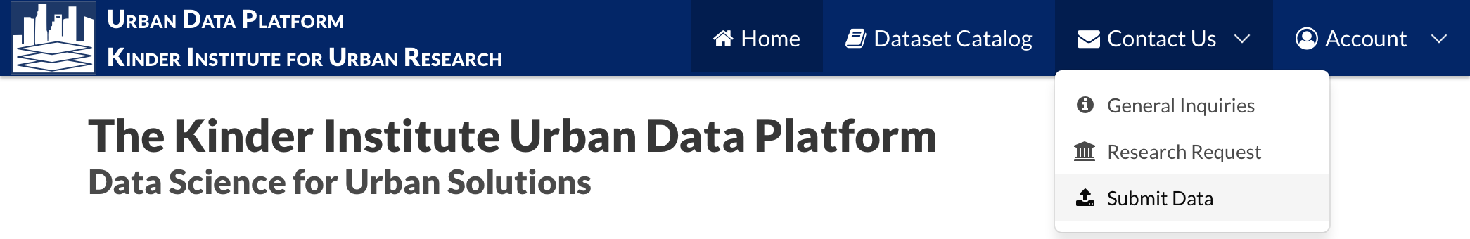
Data Submission
Notes:
We also welcome researchers and organizations to share data with us. Users could make a request online to submit data, but they will not be uploading data through the public site. After they complete the form, a UDP staff will contact the user and provide a link to a secure File Transfer Portal that allows for secure transmission of sensitive data directly to the UDP.

Slide 17
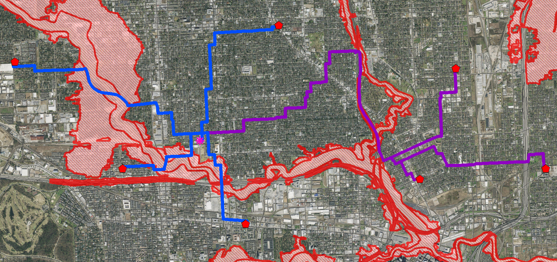

ArcGIS network modeling to reroute fire trucks during Houston floods
Collaboration Opportunities
J. Arroon and J.D. Nellis
Notes:
This data initiative creates many collaboration opportunities, such as data service, research support and collaboration between the university, government agencies and nonprofits.
Results of research, if unrestricted, can be shared as additional datasets and data provider gets cited. Here’s one example.
FEMA 100-year floodplain is used as a barrier to simulate flooding that might occur in Houston from a Hurricane. Blue is the shortest route during regular conditions and purple is the shortest route avoiding the floodplain.

Slide 18

Kinder Institute for Urban Research
Urban Data Platform
https://www.kinderudp.org
Notes:
Currently, there are almost 150 datasets on the UDP, two-thirds are geocoded. This effort is made possible by Houston Endowment, and supported by Rice University administration.

