Slide 1
No Data about Us without Us: Collaborative Interpretation of the Best Starts for Kids Health Survey
October 19, 2018
Sara Jaye Sanford, MPH
Public Health – Seattle & King County
Assessment, Policy Development & Evaluation Unit
Notes:
Hello, my name is Sara Jaye and I’m here to share collaborative interpretation project we recently did.
What is participatory interpretation and why do it? Community co-creates data and it comes from them; part of our job is to give that data back to them in a usable way. When we talk about health inequities, it can be done in a way that is stigmatizing or disempowering of communities; or it may simply reflect our theories rather than their experiences. That’s why it’s so important to give communities the power to shape that narrative. Who uses data for what, and why → no data about us without us.
Best Starts for Kids (BSK) is a voter-approved initiative to improve the health and well-being of King County, Washington by investing in promotion, prevention and early intervention for children, youth, families, and communities.
Building strength and resilience
Most comprehensive approach to child development in the nation.
Vision: We want to see more babies born healthy, more kids thrive, and more young people happy, healthy, successful
In the absence of robust population-based local area data necessary to assess needs or evaluate impacts on young children, the Best Starts for Kids Health Survey (BSKHS) of families and children 5th grade and younger in King County was developed. Equity-based approaches were used to achieve a highly diverse, representative sample. We turned to community partners to drive interpretation of BSKHS results through participatory “data dives.”
King County context: thriving economically but inequities remain and in some cases are growing; diverse with large and growing immigrant and refugee communities, many languages; urban, suburban and rural communities; rapid population growth.

Slide 2
“
Equity is an ardent journey toward well-being as defined by the affected.
-BSK Children & Youth Advisory Board Equity Statement
”
Notes:
Our Children & Youth Advisory Board developed an equity statement that guides our work:
Equity is an ardent journey toward well-being as defined by the affected
· Equity demands sacrifice and redistribution of power and resources in order to break systems of oppression, heal continuing wounds, and realize justice
· To achieve equity and social justice, we must first root out deeply entrenched systems of racism
· Equity proactively builds strong foundations of agency, is vigilant for unintended consequences, and boldly aspires to be restorative
· Equity is disruptive and uncomfortable and not voluntary
· Equity is fundamental to the community we want to build

Slide 3
What is the BSK Health Survey?
First-ever data about the health and well-being of King County children 5th grade and younger
Questions on strengths, behaviors, and supports of children and families
Conducted by the University of Washington Social Development Research Group
Data collection September ’16 to January ‘17
Web-based, phone, and mail surveys
In English, Spanish, Vietnamese, Chinese, Somali, and Russian
Oversampling by age, race/ethnicity, geographic region
Convenience sample add-on to increase size of specific demographic groups: People of color, children with disabilities, with welfare involvement, LGBTQ+ families
5,947 families participated in Fall 2016-Winter 2017
Findings used for program development and evaluation
Equity-based approaches embedded throughout design,
conduct, OUTREACH, INTERPRETATION
Notes:
Given that we have an equity-based approach, how does that translate to our work with population-based data?
Questions that focus on strengths not just needs
Three different response options: web, phone, paper
Six languages; interviewers bicultural as well as bilingual
Oversampling and convenience sampling to reach certain groups
Overall success: 54% of children represented in BSKHS were children of color, vs. 52% of children in King County
While we had our own data we were focused on understanding, you can do community-based interpretation of any data that is important to your work!

Slide 4
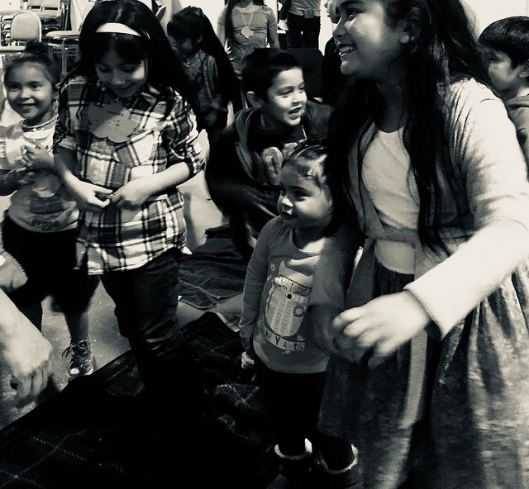
Why turn to the community to help interpret data?
Build trust in Best Starts for Kids
Build relationships & two-way dialogue
Build community awareness of and ownership of data
Build community data literacy
Better understand culturally specific responses to survey questions
Better understand results for communities with small sample sizes
Learn how to appropriately frame data in our dissemination & communication
Who has the expertise to contextualize and understand data?
Notes:
Now that we have conducted and analyzed survey data, the commitment to equity is not over. We work with the community to understand the data, respecting the expertise that community members have about their own lives, and offering transparency and accessibility about the survey methods and results.
There are many benefits to interpreting data collaboratively with community members. But fundamental is the belief that community members hold knowledge and experience key to understanding data about their communities. We are not the experts.
Part of the purpose is to build a TWO-WAY dialogue about BSKHS data.

Slide 5
Community Engagement
Select topics and communities of interest; secure resources
Build & formalize partnerships
Plan gatherings and develop data placemats
Share and act on findings
Hold data dives!
Notes:
Community engagement and partnerships are key to holding a successful data dive. It should be part of every step of process. We heard early on that it was essential for communities to interpret their own data, so we selected eight different communities to hold data dives with, and developed partnerships with community organizations that had knowledge, trust, and relationships with those communities.
We could not have done this work without the Community Café Collaborative; Open Doors for Multicultural Families; and United Indians of All Tribes Foundation.
Community-based work, especially if you don’t already have strong relationships with your partners, takes TIME. Challenges can come up with each of these steps. You will do yourself and your partners a favor if you build a flexible timeline that will give you enough room to truly engage the community and troubleshoot where needed!
Building partnerships: Plan to allow time and resources to contract with qualified community partners. Depending on your agency, this may take some time. It’s important to clarify each partner’s roles through the scope of work and to compensate partners fairly for their time and expertise. Sometimes it’s easier to fund partners to take care of things such as providing participants food and gift cards.
Be prepared to build internal partnerships as well. Community members want to see how your agency is taking action, not just analyzing data. (We didn’t do this, but if your agency has navigators or community health workers, you may consider inviting them to attend so that they can assist participants with any immediate needs that come up.) Internal partnerships can also help set the stage to share what you learn at data dives with those who can act on it or integrate that feedback into their work. For example, BSK is granting funding for home visiting and parenting support programs, and we were able to continue the conversation with three communities to give their input into how that funding should be spent.
Note that your agency doesn’t have to be responsible for every step. Our community partners did most of the event planning as they knew the times, places, food, format, and outreach methods that worked best in their communities. We developed the data placemats, but got their feedback before printing them. At the events, KC staff presented information and answered questions about the survey and results, but a community facilitator led the events.

Slide 6
Four Topics
Flourishing & Resilient Children
Four Questions
What is your initial reaction?
Adverse Childhood Experiences
Reading, Singing, & Telling Stories
Family Resiliency & Parent Support
Do these results reflect your experiences?
What additional questions does this raise for you?
If we spoke with one voice, what would we be saying?
Eight Data Dives!
American Indian/ Alaska Native
Chinese American*
Vietnamese American*
Latinx*
LGBTQ2S
Black/African American
Samoan American
Somali American
*held in a language other than English
Notes:
We selected topics based on what was new to us, what was complex, what we thought might be culturally loaded. This is one of the hardest steps because you have great power in creating the space when you select what data to focus on! After this experience I would consider 4 a max for this type of event. 2-3 would be enough for a robust discussion, especially if you have multiple data points within a topic.
We developed 4 open-ended questions to generate discussion. What we really wanted to understand was whether our data reflected their lived experiences, and what their insight into the “whys” of the data are. This is what helps us actually APPLY the findings from our survey to our programmatic work with families.
We ultimately ended up holding 7 data dives across King County with different communities. Those marked with an asterisk were held in languages other than English.
Questions:
Toddlers and Infants: How well do each of the following phrases describe this child?
This child is affectionate and tender with you
This child bounces back quickly when things do not go their way
This child shows interest and curiosity in learning new things
This child smiles and laughs a lot in org
(Definitely true Somewhat true Not true)
Elementary Age Children: How well do each of the following phrases describe this child?
This child shows interest and curiosity in learning new things.
This child works to finish tasks they start.
This child stays calm and in control when faced with a challenge.
(Definitely true Somewhat true Not true)
The next questions ask about events that may or may not have happened during this child’s life. These events can happen in
any family, but some people may feel uncomfortable with these questions. You may skip any questions you do not want to
answer.
To the best of your knowledge, has this child EVER experienced any of the following?
Parent or guardian divorced or separated
Parent or guardian died
Parent or guardian served time in jail
Saw or heard parents or adults slap, hit, kick, punch one another in the home
Was a victim of violence or witnessed violence in the neighborhood
Lived with anyone who was mentally ill, suicidal, or severely depressed
Lived with anyone who had a problem with alcohol or drugs
Was treated or judged unfairly because of their race or ethnic group
(Yes/No)
DURING THE PAST WEEK…
On how many days did you or other family members read to or with this child?
On how many days did you or other family members tell stories or sing songs to this child?
(0 days 1-3 days 4-6 days Every day )
When your family faces problems, how often are you likely to do each of the following?
Talk together about what to do
Work together to solve our problems
Know we have strengths to draw on
Stay hopeful even in difficult times
(All of the time Most of the time Some of the time None of the time)
DURING THE PAST 12 MONTHS, was there someone that you could turn to for day-to-day emotional support with parenting or raising children?
(Yes/No)

Slide 7
Parent/Caregiver Reports of Flourishing Children in King County
Toddlers and infants
Elementary-aged children
2 in 3 are flourishing, as measured by the 4 things below
1 in 3 are flourishing, as measured by the 3 things below
2 in 3 children bounce back quickly when things don’t go their way
1 in 3 children stay calm and in control when faced with a challenge
BSK Health Survey, 2017
Notes:
This is one example of a data placemat. It shows results “flourishing and resilient children.” Each placemat showed findings on one or two survey topics specific to the community, ideally in a simple form. For Latinx, Chinese, and Vietnamese data dives, they were translated.
The questions (including demographic questions) were included on the back.
In some placemats, data was shown infographic-style, with people icons. This example shows a simple bar chart. Note that this is one of the more complicated placemats, with lots of data points. I actually recommend simplifying them more than this. One half would be a better amount of info to include. We developed four of these for each data dive, so you can imagine that that can be a lot to digest.
For data dives held in different languages, placemats were translated.

Slide 8
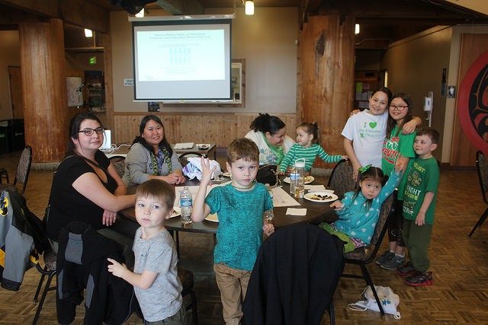
“It’s definitely upsetting for me because my culture is very important for me. There’s been that disconnect for me. I don’t want my children to grow up in a world where they are seen as a number and a statistic. I’ve fought hard to…show them that they aren’t just a number. You need to build that personal relationship to learn about someone. We’re not just a number.”
-American Indian/Alaska Native parent responding to survey methodology
Notes:
Participants had responses to the survey methods as well as to the results. They wanted to understand how communities were sampled to judge for themselves whether they felt it was a representative group; who came up with the questions; and how data were analyzed.
To me, this quote speaks to the importance of the relationship-building work that the data dives are part of. One thing that this parent is expressing to us is that we cannot understand her family or community based on our quantitative data alone; the relationship-building

Slide 9
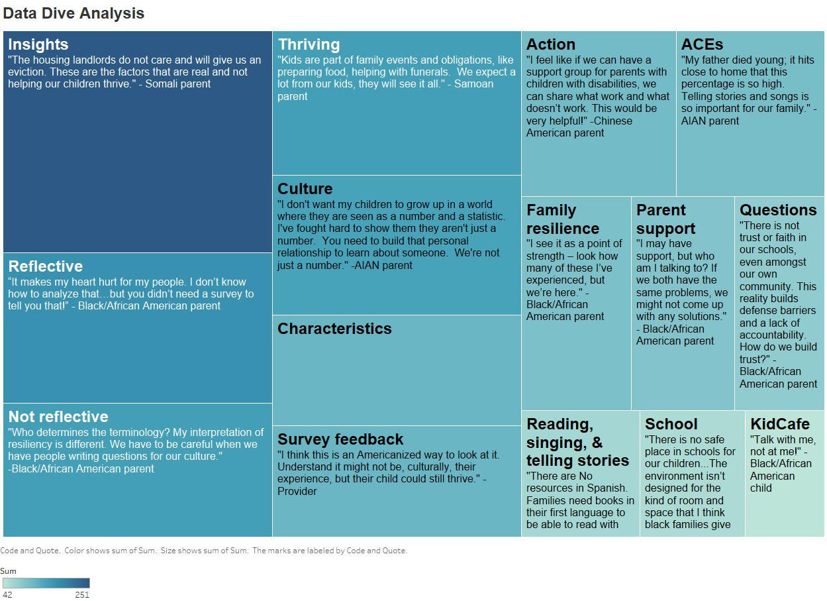
Results
Notes:
We considered the data dive discussions to be rich sources of qualitative data. We did a qualitative analysis of data dive notes to document themes:
3 people participated in two rounds of coding
Combination of inductive and deductive: Went in with some key themes based on our four topics (deductive); also looked for emergent themes (inductive)
This is a screenshot of an interactive Tableau viz that we built. Online you can explore the results by theme and by group, with illuminating quotes in tooltips.
We’ve also shared community feedback through a great series of blog posts, and heavily relied on them in writing data briefs on these four topics.

Slide 10
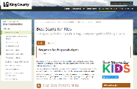
Thank You to the Participants & Partners
Many thanks to the families, community organizations, and team members that contributed!
VISIT US AT www.kingcounty.gov/BSKIndicators
OUR WEBSITE
OUR BLOG
TWEET US!
FIND DATA!
FIND DATA!
kingcounty.gov/beststarts
beststartsblog.com
@BestStartsKC
#BestStarts
17
Notes:
Lessons learned:
-Relationships are key and if you yourself don’t identify as part of a community, find an ally.
-We can better integrate our community engagement with programs
-Cultural humility
-Make it part of an ongoing dialogue, not a one-off:
Many communities may have “research fatigue.” They have been asked by gov’t and researchers for info many times, and having seen little resulting action.
Communities are interested in and care about data!
In our experience, however, they are less interested in data for its own sake, and more interested in it as a catalyst for action to improve community health and conditions.
Continue partnerships: Show how you are acting on their feedback; connect to resources when appropriate; outreach for data collection…You may need to work across your agency, not just within your team or department!
Overall we felt this project was well worth the time and energy that went into it and I hope you will consider how you can partner with community members in interpreting data.
We have a series of blogs posted! Please check out our blogs to see more. You can also explore the interactive Tableau viz to hear more.

